Slide 1
EE 261, Spring 2025, Lecture 11
Goal/Topic:
A bit more circuit fundamentals
Introduce node-voltage analysis
Announcements: HW 4 posted soon (due Sunday, Feb. 9).
Notes regarding MATLAB and node-voltage analysis posted.
Planning to return graded test on Wednesday.
And…

Slide 3
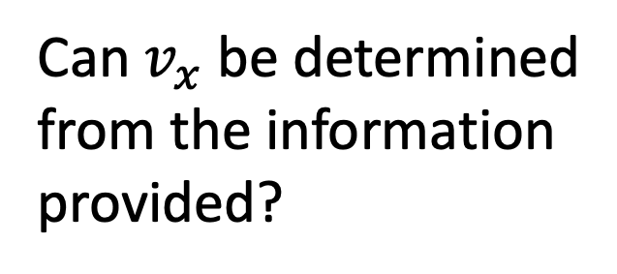
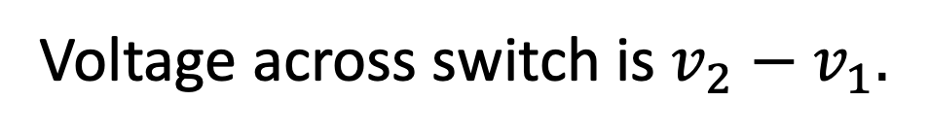

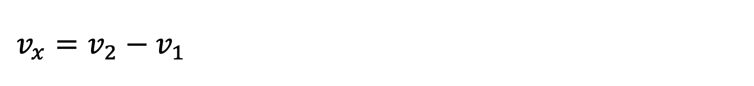



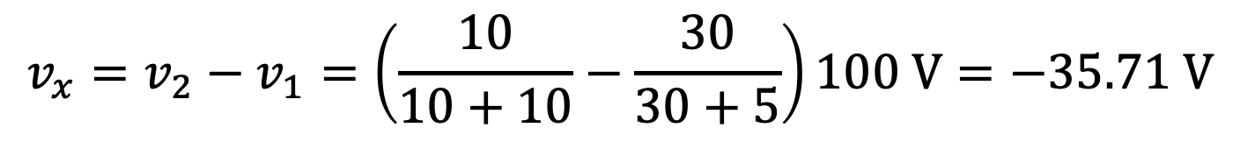
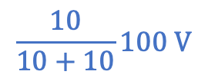


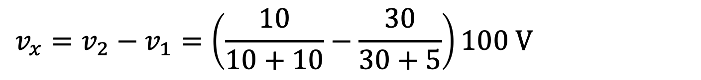
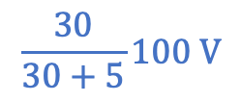
From previous lecture:
$$i_{a}$$
open switch
(open circuit)
$$i_{b}$$
$R$ is unknown.
Can $v_{x}$ be determined
from the information
provided?
$$\frac{30}{30+5}100 V$$
$$\frac{10}{10+10}100 V$$
Yes
No
$$i_{a}$$
$$i_{b}$$
No path for current to flow through mystery resistor $R$.
Voltages at both ends of $R$ must be the same ($v_{1}$).
Voltage across switch is $v_{2}−v_{1}.$
Find $v_{1}$ and $v_{2}$using voltage division.
$$v_{x}=v_{2}−v_{1}=\left(\frac{10}{10+10}−\frac{30}{30+5}\right)100 V=−35.71 V$$
$$v_{x}=v_{2}−v_{1}=\left(\frac{10}{10+10}−\frac{30}{30+5}\right)100 V=−35.71 V$$
$$v_{x}=v_{2}−v_{1}=\left(\frac{10}{10+10}−\frac{30}{30+5}\right)100 V=−35.71 V$$

Slide 4
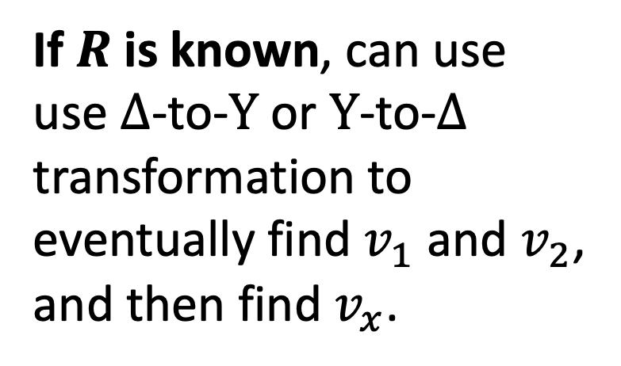



Consider with switch closed:
$R$ is unknown.
$$i_{a}$$
$$i_{b}$$
If $R$is known, can use
use $Δ$-to-$Y$ or $Y$-to-$Δ$
transformation to
eventually find $v_{1}$ and $v_{2}$,
and then find $v_{x}$.
$$i_{a}+i_{x}$$
$$i_{b}−i_{x}$$
But, there is a better way!
Can $v_{x}$ be determined from the information provided?
(Arguably.)
Yes
No
Current can flow through $R$ (but don’t know amount).
$v_{x}$ still $v_{2}−v_{1}$, but cannot use voltage division to find $v_{1}$ or $v_{2}$.
$v_{x}$ still $v_{2}−v_{1}$, but cannot use voltage division to find $v_{1}$ or $v_{2}$.
No resistors are in series (nor in parallel).

Slide 5
Node-Voltage Analysis
Allows us to solve for voltages throughout any circuit.
Yields a set of equations for circuit voltages (at nodes).
From these voltages, can obtain any other circuit quantity of
interest (e.g., currents or powers).
“Recipe:”
Identify nodes that join three or more elements (essential nodes).
Pick reference node (ground);
label voltages at remaining nodes (i.e., the “node voltages”).
Write KCL for (unknown) non-reference nodes→node-voltage eqs.
Solve equations for voltages.
Find any desired remaining circuit parameters from node voltages
(may entail voltage division, current division, etc.).
(Can label all nodes, but typically analysis
only concerned with the essential nodes.)
That’s all there is to it!
(but if you want more…)

Slide 6
Example: Find node voltages
Not
essential.
“Nodes” are synonymous
with (connected) wires.
Step 1: How many essential nodes ($≥$3 elements coming together)?
3

Slide 7
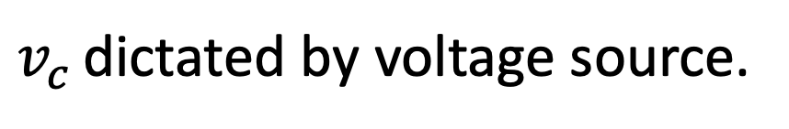


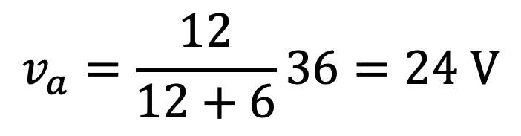
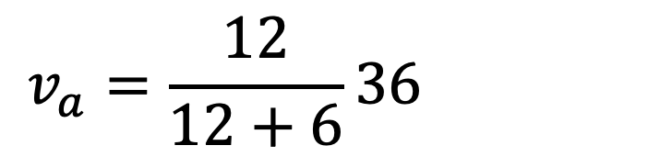

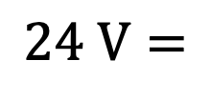
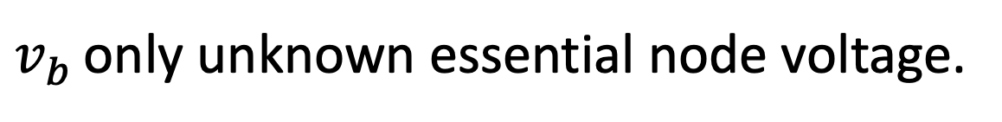
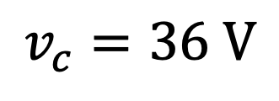
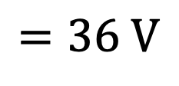
Step 2:
$$=36 V$$
Didn’t have
to label.
$$24 V=$$
Choose reference node (ground).
Label remaining nodes. ($v_{a}$ not essential.)
Label remaining nodes. ($v_{a}$ not essential.)
$v_{c}$ dictated by voltage source.
$$v_{c}=36 V$$
$$v_{a}=\frac{12}{12+6}36=24 V$$
$$v_{a}=\frac{12}{12+6}36=24 V$$
Obtain $v_{a}$ via voltage division (if needed).
$v_{b}$ only unknown essential node voltage.

Slide 8
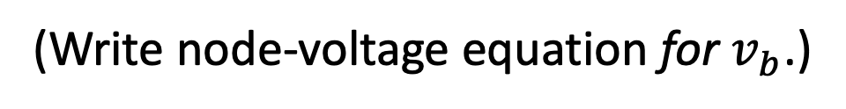

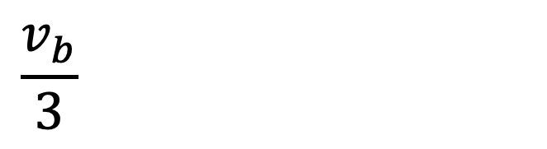
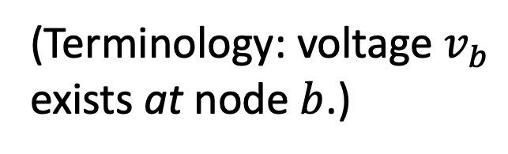
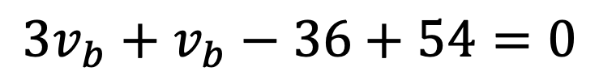



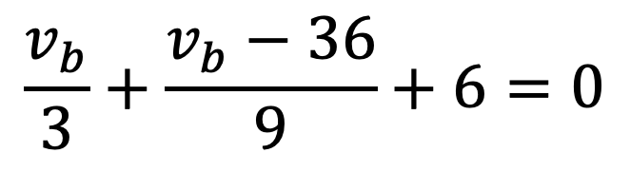

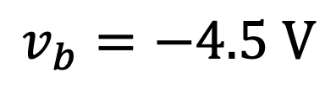
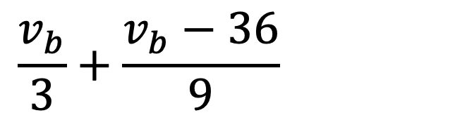
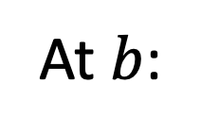
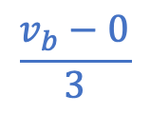
Step 3:
$$=36 V$$
$$−$$
$$+$$
b
(Terminology: voltage $v_{b}$
exists at node $b$.)
$$+$$
$$−$$
Write node-voltage equation
(KCL) at node $b$.
$$0 V$$
(Write node-voltage equation for $v_{b}$.)
$$\frac{v_{b}−0}{3}$$
Take out-going currents as positive.
And, assume all
currents out-going.
$$\frac{v_{b}}{3}+\frac{v_{b}−36}{9}+6=0$$
$$\frac{v_{b}}{3}+\frac{v_{b}−36}{9}+6=0$$
$$\frac{v_{b}}{3}+\frac{v_{b}−36}{9}+6=0$$
At $b$:
One equation, one unknown.
Multiply by $9$:
$${3v}_{b}+v_{b}−36+54=0$$
$$v_{b}=−4.5 V$$

Slide 9
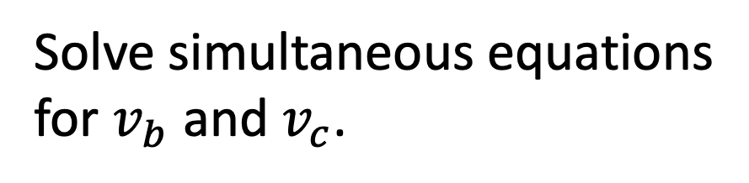
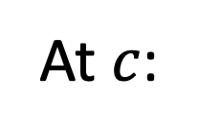
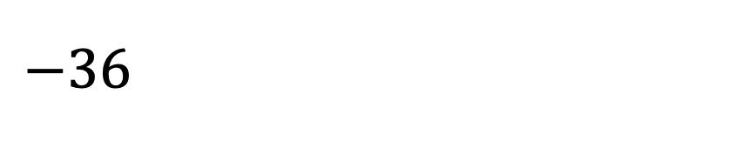


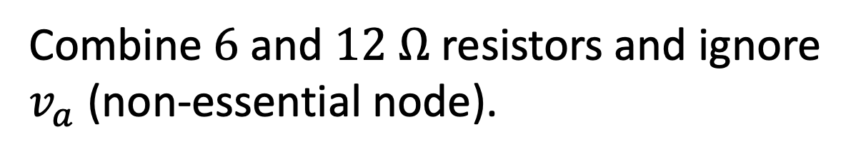
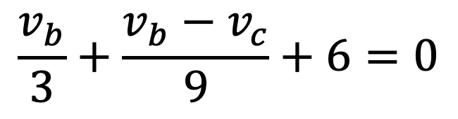
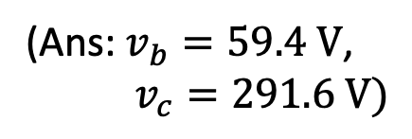
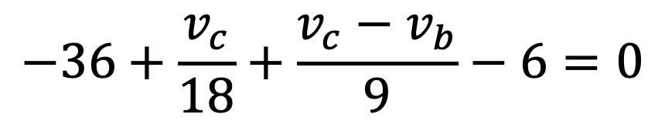

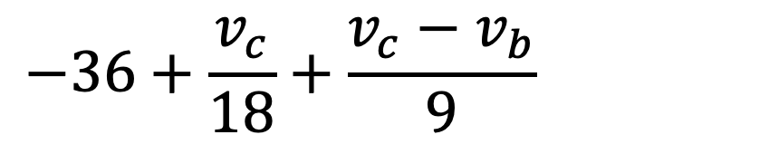
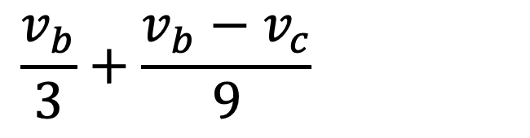


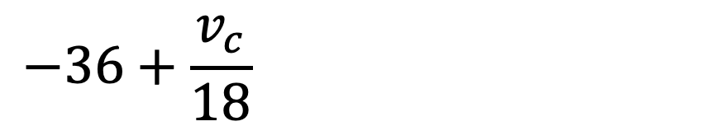
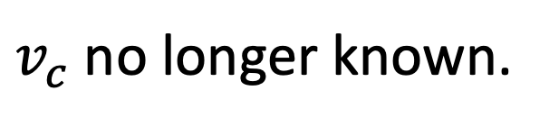
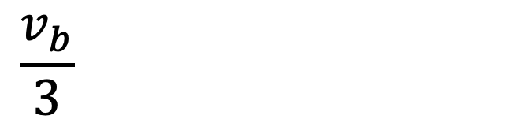
Change $36 V$ source
to $36 A$ source.
$$+$$
$$−$$
$v_{c}$ no longer known.
KCL for $v_{b}$ nearly
unchanged.
Now
unknown.
$$\frac{v_{b}}{3}+\frac{v_{b}−v_{c}}{9}+6=0$$
Write nodal eq. for each
unknown essential node.
$$\frac{v_{b}}{3}+\frac{v_{b}−v_{c}}{9}+6=0$$
$$\frac{v_{b}}{3}+\frac{v_{b}−v_{c}}{9}+6=0$$
At $b$:
1 eq., 2 unknowns.
Combine $6$ and $12$ $Ω$ resistors and ignore
$v_{a}$ (non-essential node).
Need KCL for $v_{c}$ too.
$18$ $Ω$
$$−36+\frac{v_{c}}{18}+\frac{v_{c}−v_{b}}{9}−6=0$$
Solve simultaneous equations
for $v_{b}$ and $v_{c}$.
$$−36+\frac{v_{c}}{18}+\frac{v_{c}−v_{b}}{9}−6=0$$
$$−36+\frac{v_{c}}{18}+\frac{v_{c}−v_{b}}{9}−6=0$$
$$−36+\frac{v_{c}}{18}+\frac{v_{c}−v_{b}}{9}−6=0$$
At $c$:
(Ans: $v_{b}=59.4 V$,
$v_{c}=291.6 V)$

Slide 10
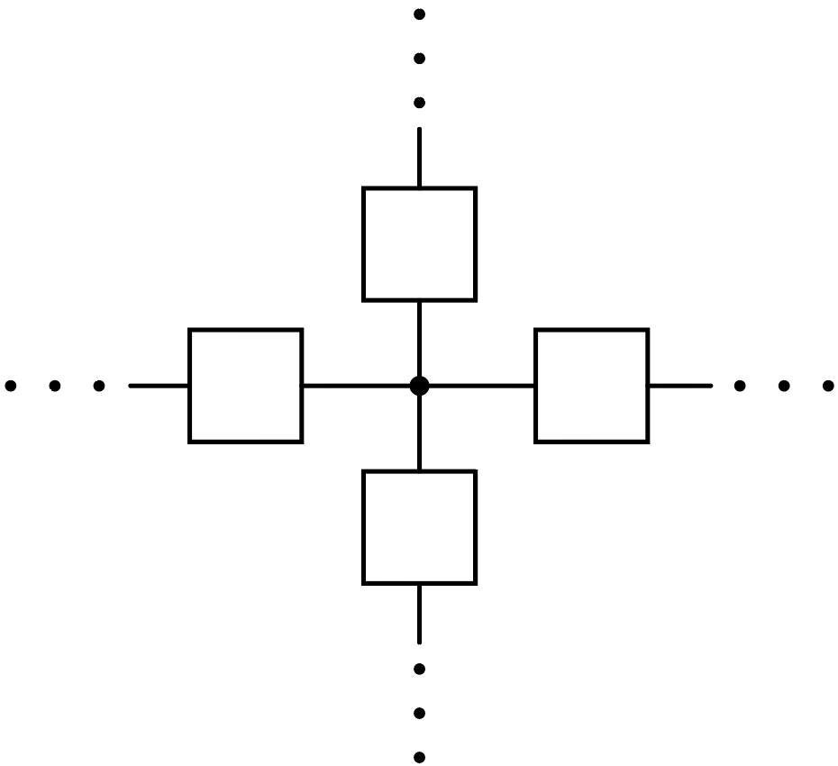
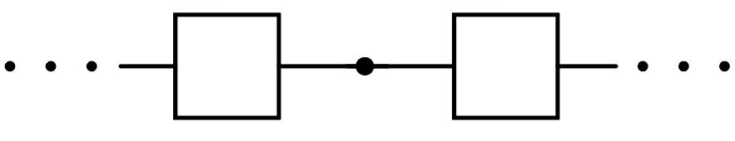
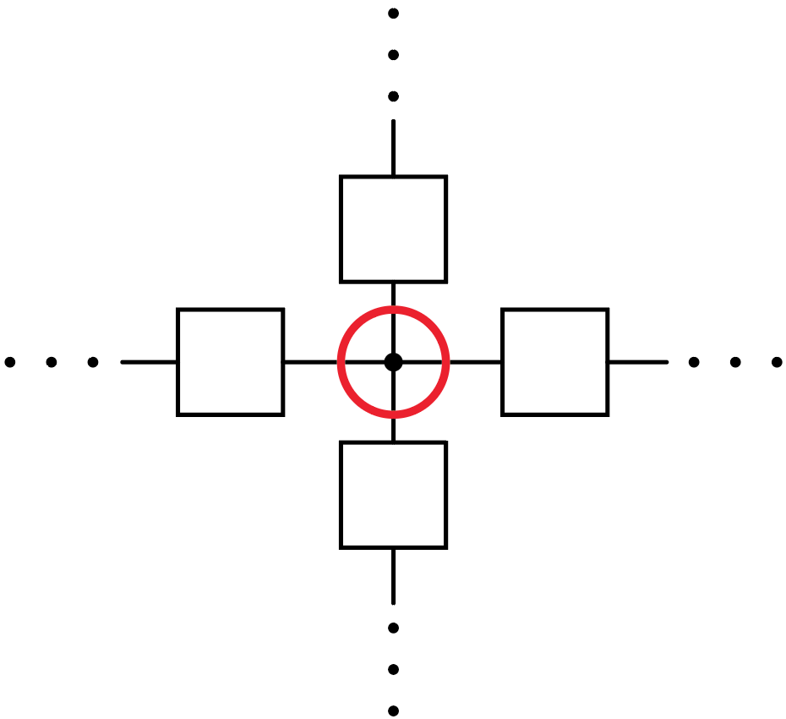
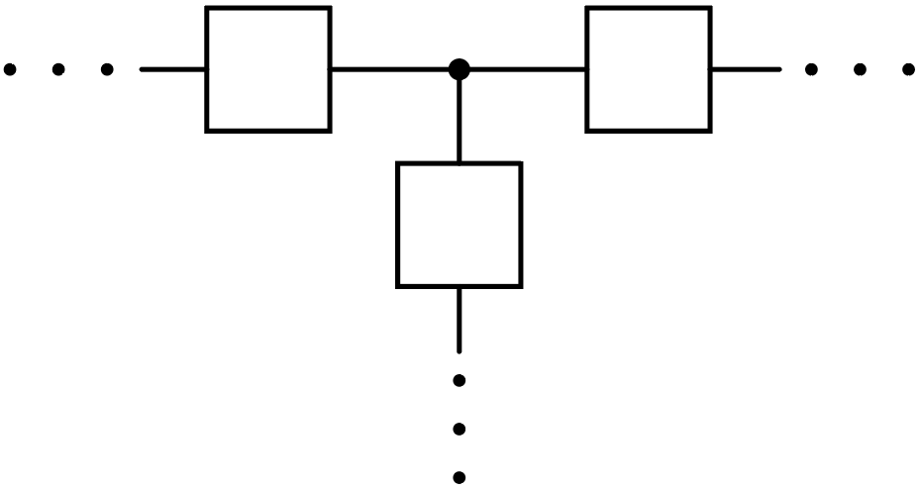
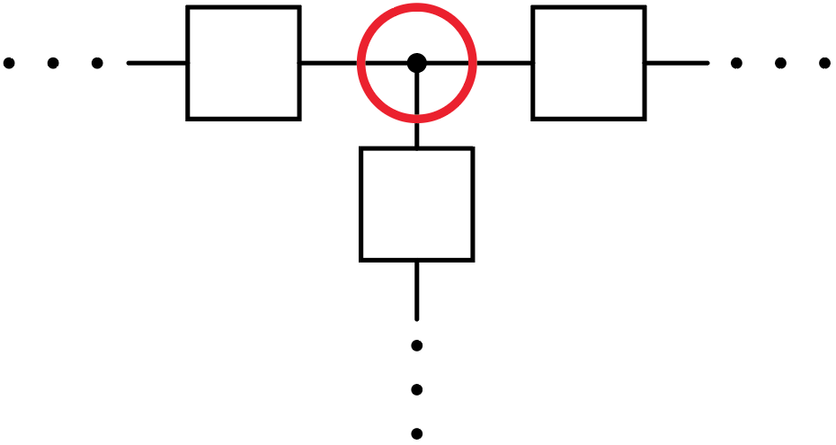
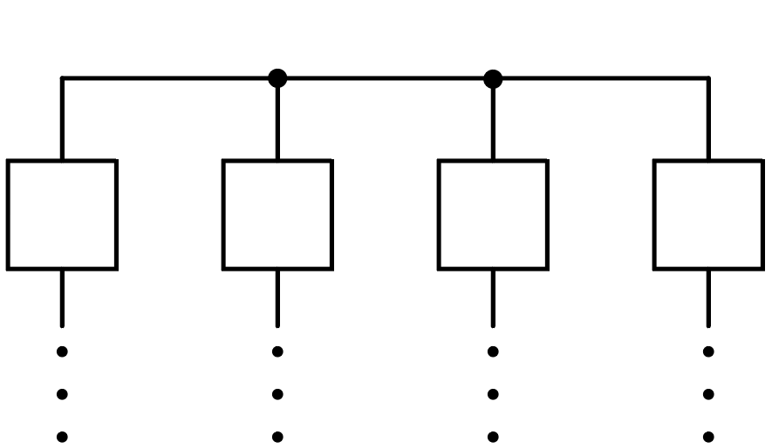
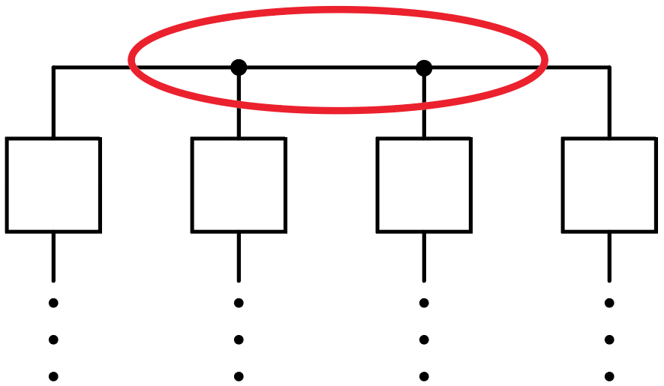
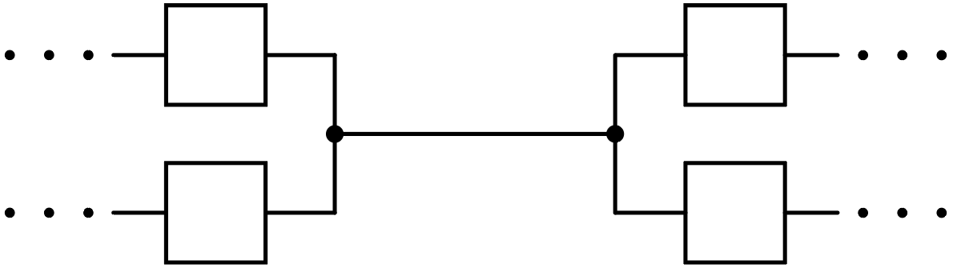
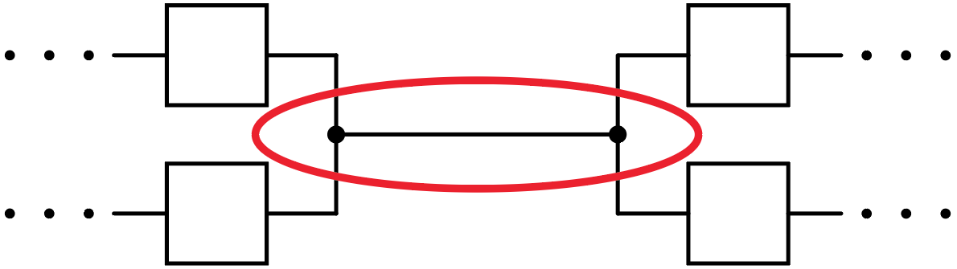
Essential Nodes
Not an essential node.
One essential node.
One essential node.
Dots don’t make the node: Connected wires/elements do.
One essential node.
One essential node.

Slide 11
Consider:
Three voltages are unknown.
Need three node-voltage
equations to determine.
How many essential nodes? (numeric poll)
4
Add ground and label remaining essential nodes ($≥$3 elements coming together).

Slide 12
Consider:
A) Yes
B) No
Are any resistors in parallel?

Slide 13
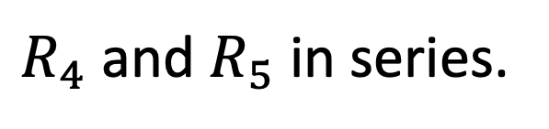
Consider:
$R_{4}$ and $R_{5}$ in series.
Can/should combine series and
parallel resistors, as appropriate,
then perform analysis.
A) Yes
B) No
Are any resistors in series?

Slide 14
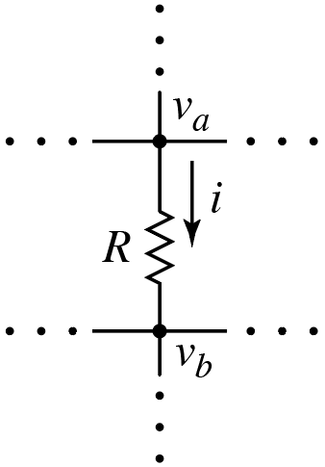
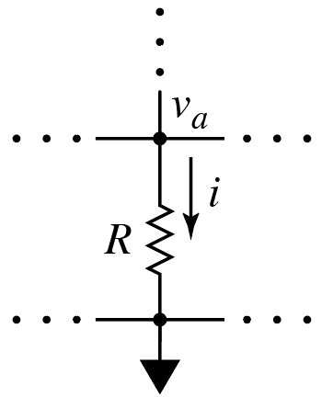
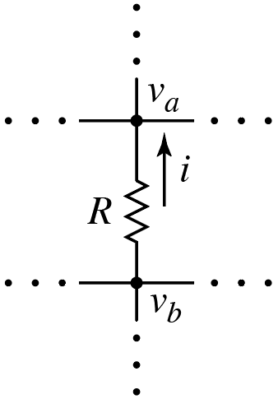


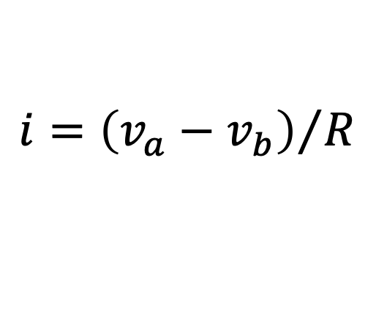









Consider:
What is the
current $i$?
What is the
current $i$?
$$+$$
$$v$$
$$−$$
$$+$$
$$v$$
$$−$$
$$i={\left(v_{a}−0\right)}/R$$
$$i={\left(v_{a}−v_{b}\right)}/R$$
$$={v_{a}}/R$$
“$v_{a}$-centric”
equation
Expressions for currents in node-
voltage equations change sign
depending on the node being
considered. We never write node-
voltage equation for ground as it
is not independent of other
equations.
Expressions for currents in node-
voltage equations change sign
depending on the node being
considered. We never write node-
voltage equation for ground as it
is not independent of other
equations.
What is the
current $i$?
$$−$$
$$v$$
$$+$$
$$i={\left(v_{b}−v_{a}\right)}/R$$
“$v_{b}$-centric”
equation

Slide 15




$$+ v −$$
What is the current $i$?
$$i={\left(v_{a}−v_{b}\right)}/R$$

Slide 16





$$+ v −$$
$$v_{b}+v_{1}$$
A) $i={\left(v_{a}−v_{b}\right)}/R$
B) $i={\left(v_{a}−v_{1}\right)}/R$
C) $i={\left(v_{a}−v_{1}−v_{b}\right)}/R$
D) $i={\left(v_{a}+v_{1}−v_{b}\right)}/R$
E) None of the above
What is the current $i$?

Slide 17



$$+ v −$$
$$v_{a}−v_{1}$$
A) $i={\left(v_{a}−v_{b}\right)}/R$
B) $i={\left(v_{a}−v_{1}\right)}/R$
C) $i={\left(v_{a}−v_{1}−v_{b}\right)}/R$
D) $i={\left(v_{a}+v_{1}−v_{b}\right)}/R$
E) None of the above
What is the current $i$?
Same as before!
Order of series elements does not matter.
Must have same result.

