Slide 1
EE 261, Spring 2025, Lecture 13
Goals/Topics:
More on supernodes and node-voltage analysis
Introduce mesh-current analysis
Comments on signs
Announcement: HW 4 due Sunday by midnight.

Slide 2
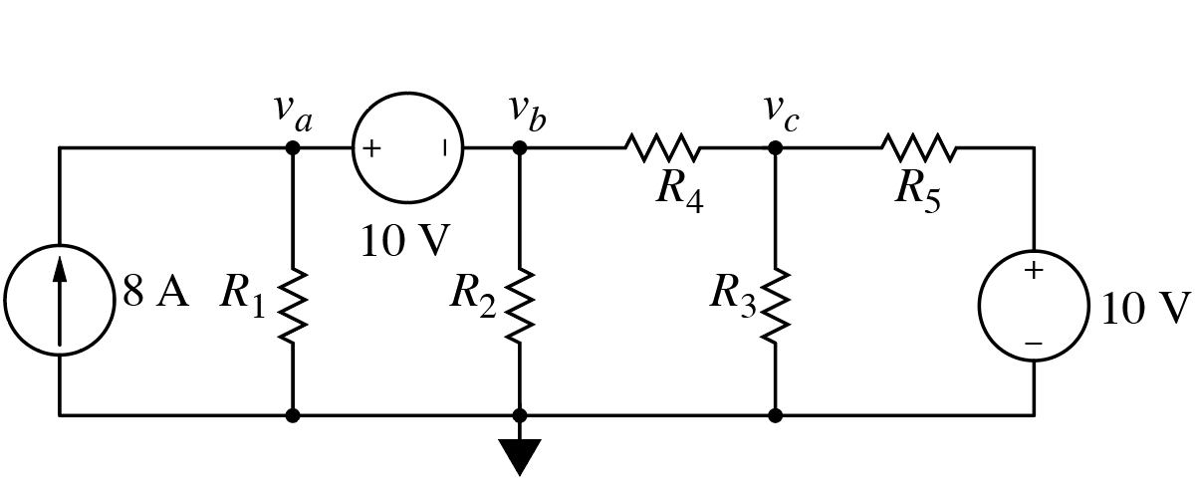
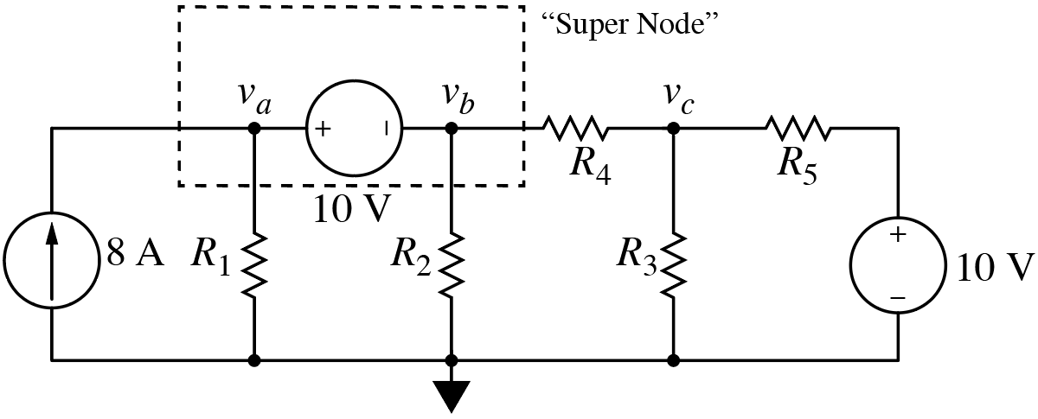
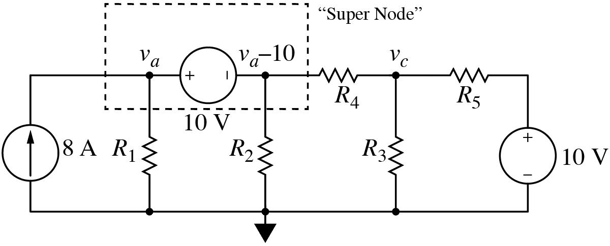
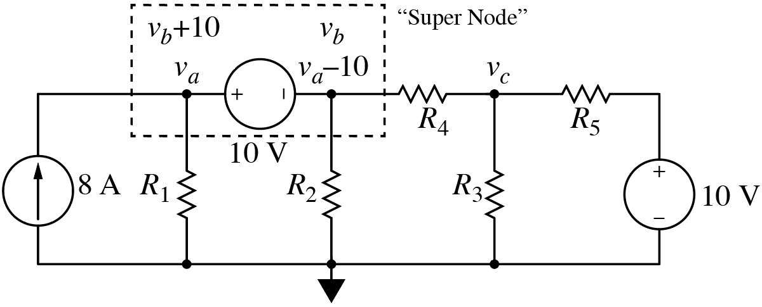
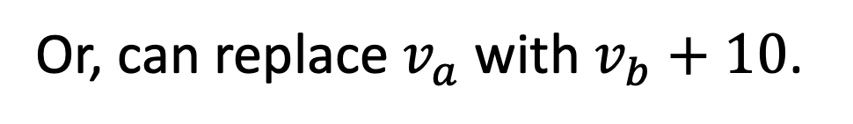
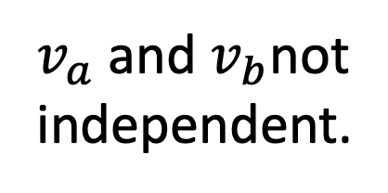
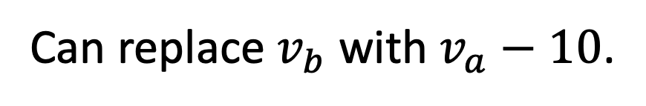
Consider:
i = ?
Obtain one KCL equation
from this supernode.
$v_{a}$ and $v_{b}$not
independent.
Can replace $v_{b}$ with $v_{a}−10$.
Or, can replace $v_{a}$ with $v_{b}+10$.
Only have two unknown voltages ($v_{a}$ and $v_{c}$, or $v_{b}$ and $v_{c}$).
Or, can leave all three node voltages as unknows.
Need to add constraint equation to system of equations.

Slide 3
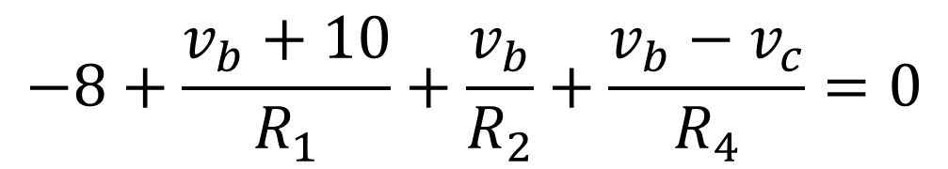
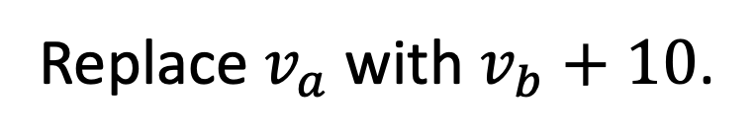
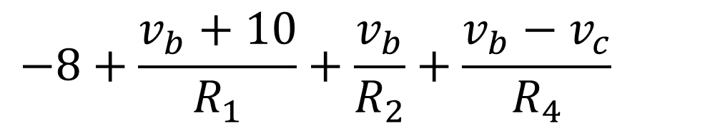
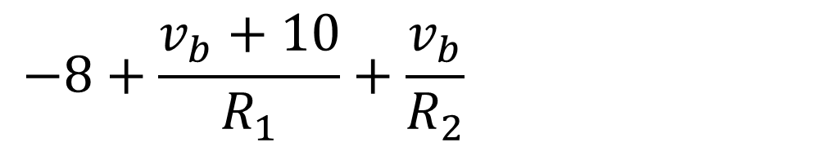
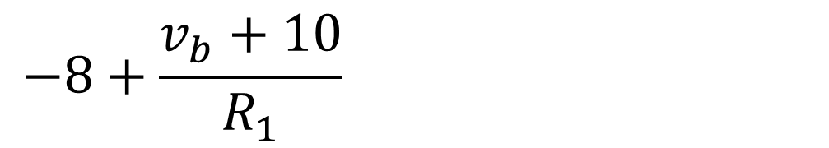
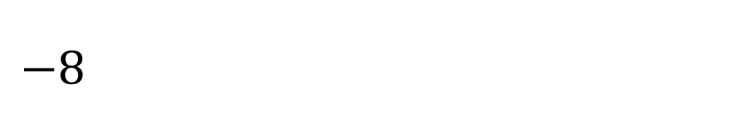
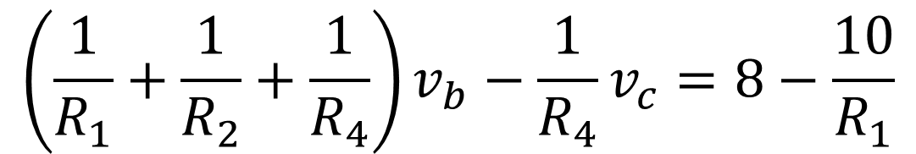
First approach:
Aside: Could write KCL for
ground, but that doesn’t
yield independent equation.
Write KCL for super node and node c.
$$−8+\frac{v_{b}+10}{R_{1}}+\frac{v_{b}}{R_{2}}+\frac{v_{b}−v_{c}}{R_{4}}=0$$
Replace $v_{a}$ with $v_{b}+10$.
$$−8+\frac{v_{b}+10}{R_{1}}+\frac{v_{b}}{R_{2}}+\frac{v_{b}−v_{c}}{R_{4}}=0$$
$$−8+\frac{v_{b}+10}{R_{1}}+\frac{v_{b}}{R_{2}}+\frac{v_{b}−v_{c}}{R_{4}}=0$$
$$−8+\frac{v_{b}+10}{R_{1}}+\frac{v_{b}}{R_{2}}+\frac{v_{b}−v_{c}}{R_{4}}=0$$
$$−8+\frac{v_{b}+10}{R_{1}}+\frac{v_{b}}{R_{2}}+\frac{v_{b}−v_{c}}{R_{4}}=0$$
At SN:
Group and arrange terms.
One equation;
two unknowns.
$$\left(\frac{1}{R_{1}}+\frac{1}{R_{2}}+\frac{1}{R_{4}}\right)v_{b}−\frac{1}{R_{4}}v_{c}=8−\frac{10}{R_{1}}$$

Slide 4
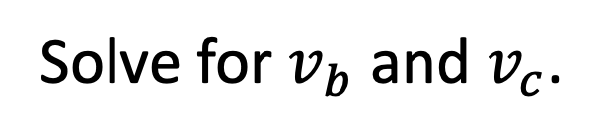
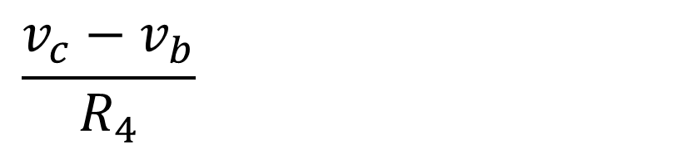
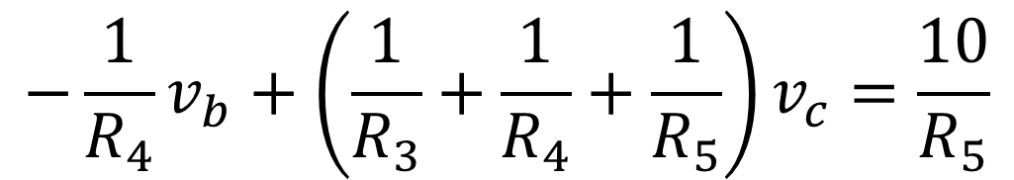
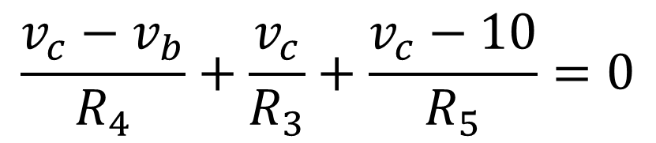
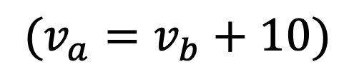
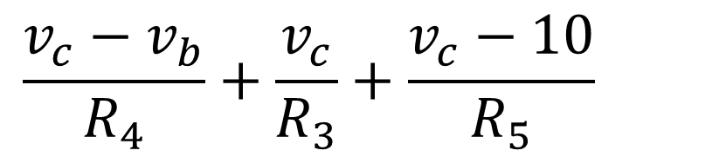

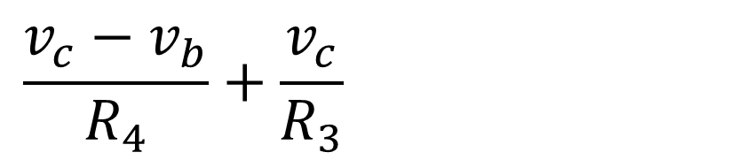
First approach:
$$10 V$$
Write KCL for super node and node c.
$$\frac{v_{c}−v_{b}}{R_{4}}+\frac{v_{c}}{R_{3}}+\frac{v_{c}−10}{R_{5}}=0$$
Replace $v_{a}$ with $v_{b}+10$.
$$\frac{v_{c}−v_{b}}{R_{4}}+\frac{v_{c}}{R_{3}}+\frac{v_{c}−10}{R_{5}}=0$$
$$\frac{v_{c}−v_{b}}{R_{4}}+\frac{v_{c}}{R_{3}}+\frac{v_{c}−10}{R_{5}}=0$$
$$\frac{v_{c}−v_{b}}{R_{4}}+\frac{v_{c}}{R_{3}}+\frac{v_{c}−10}{R_{5}}=0$$
At c:
Two equations;
two unknowns.
$$−\frac{1}{R_{4}}v_{b}+\left(\frac{1}{R_{3}}+\frac{1}{R_{4}}+\frac{1}{R_{5}}\right)v_{c}=\frac{10}{R_{5}}$$
Solve for $v_{b}$ and $v_{c}$.
$$(v_{a}=v_{b}+10)$$

Slide 5

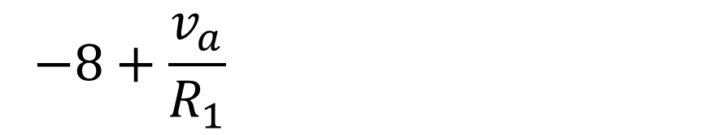
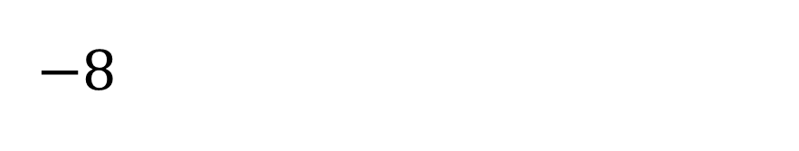
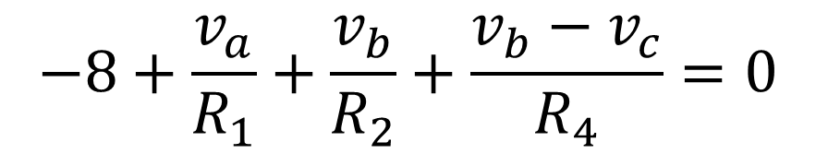
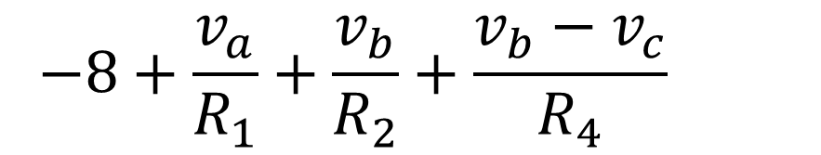
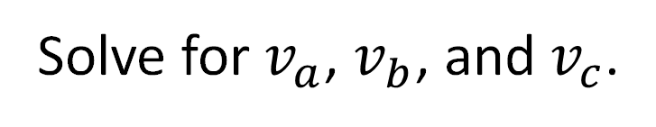
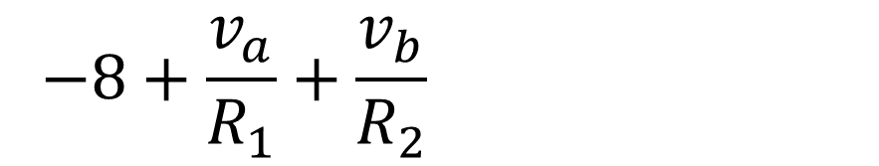

N&R approach:
Leave $v_{a}$ and $v_{b}$ as shown.
Write KCL for super node and node c.
$$−8+\frac{v_{a}}{R_{1}}+\frac{v_{b}}{R_{2}}+\frac{v_{b}−v_{c}}{R_{4}}=0$$
$$−8+\frac{v_{a}}{R_{1}}+\frac{v_{b}}{R_{2}}+\frac{v_{b}−v_{c}}{R_{4}}=0$$
$$−8+\frac{v_{a}}{R_{1}}+\frac{v_{b}}{R_{2}}+\frac{v_{b}−v_{c}}{R_{4}}=0$$
$$−8+\frac{v_{a}}{R_{1}}+\frac{v_{b}}{R_{2}}+\frac{v_{b}−v_{c}}{R_{4}}=0$$
$$−8+\frac{v_{a}}{R_{1}}+\frac{v_{b}}{R_{2}}+\frac{v_{b}−v_{c}}{R_{4}}=0$$
At SN:
One equation; three unknowns.
KCL at node c unchanged from before.
Two equations; three unknowns.
Constraint equation:
$$v_{a}−v_{b}=10$$
Three equations; three unknowns.
Source provides additional equation.
Solve for $v_{a}$, $v_{b}$, and $v_{c}$.

Slide 6
Mesh-Current Analysis
(Dual of Node-Voltage Analysis)
Allows us to solve for currents throughout any circuit.
Yields a set of equations for circuit (mesh) currents.
From these currents, can obtain any other circuit quantity of
interest (e.g., voltages or powers).
Recipe:
Identify meshes (loops that don’t enclose another loop).
Label mesh currents (assume flow in clockwise direction).
Write KVL for each mesh (in terms of currents) → mesh eqs.
Solve equations for currents.
Find any desired remaining circuit parameters from currents
(may entail voltage division, current division, etc.).
That’s all there is to it!
(but if you want more…)

Slide 7
Quick aside: Node voltage vs. mesh current.
Node voltage analysis works for any circuit.
Mesh current analysis only works for planar circuits, i.e., circuits
that can be drawn in a plane with no wires crossing each other.
Cube of resistors.
Planar? Yes.
Planar? Yes.
Cube of resistors
with diagonal.
Wires
cross.
Planar? No.
Planar? No.

Slide 8
Consider this circuit:
There are several
closed loops.
Could write KVL for
any of these.
But we are only concerned with meshes, i.e., loops that don’t
enclose other loops (the smallest possible loops).
But we are only concerned with meshes, i.e., loops that don’t
enclose other loops (the smallest possible loops).

Slide 9
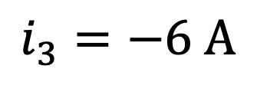
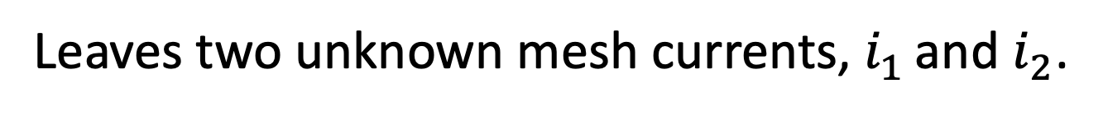
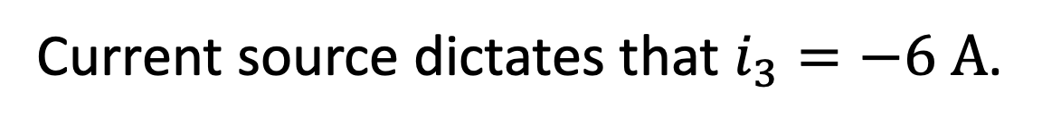
Steps 1 & 2:
$$i_{3}=−6 A$$
Steps 1 & 2: Identify meshes and label currents
(always assume clockwise flow).
Current source dictates that $i_{3}=−6 A$.
Leaves two unknown mesh currents, $i_{1}$ and $i_{2}$.

Slide 10

Consider:
$$i=i_{2}$$
Elements may be part of single mesh (if on edge).
Or, elements may be common to two meshes (if in interior).
For an interior element, element’s actual current is a combination
of two mesh currents.

Slide 11


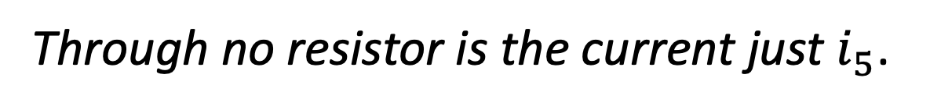

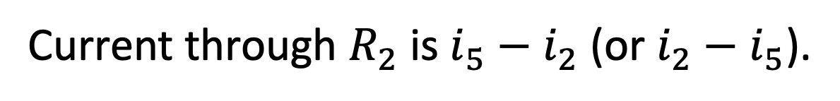

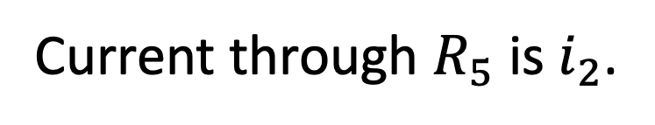


Node voltage analysis yields the voltages at the essential nodes in
the circuit.
Mesh analysis yields the mesh currents, some of which may not be
the (full) current through any circuit element.
Can solve for $i_{1}$, $i_{2}$, $i_{3}$, $i_{4}$, and $i_{5}$.
$$i_{2}$$
Current through $R_{5}$ is $i_{2}$.
$$i_{1}$$
Current through $R_{2}$ is $i_{5}−i_{2}$ (or $i_{2}−i_{5}$).
$$i_{5}$$
Through no resistor is the current just $i_{5}$.
$$i_{3}$$
$$i_{4}$$

Slide 12
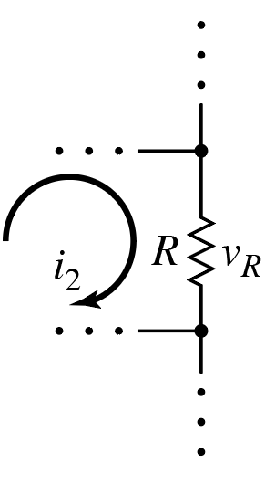
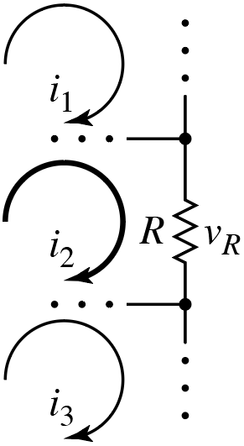
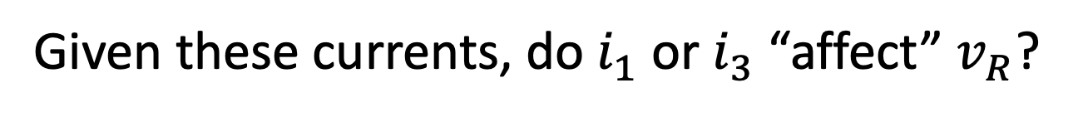
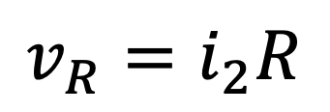

Given these currents, do $i_{1}$ or $i_{3}$ “affect” $v_{R}$?
No.
What is $v_{R}$ when writing KVL for mesh “2”?
$$v_{R}=i_{2}R$$
For the mesh current of interest, will orient
voltage polarity so that Ohm’s Law is used
with a positive sign (and KVL loop “encounters”
higher polarity first, i.e., “sees” a voltage drop).
+
–
In KVL, we always consider (i.e., sum) voltage
drops in the direction of mesh current.
Indicated (or actual) drops are positive.
(Indicated [or actual] increases are negative.)

Slide 13
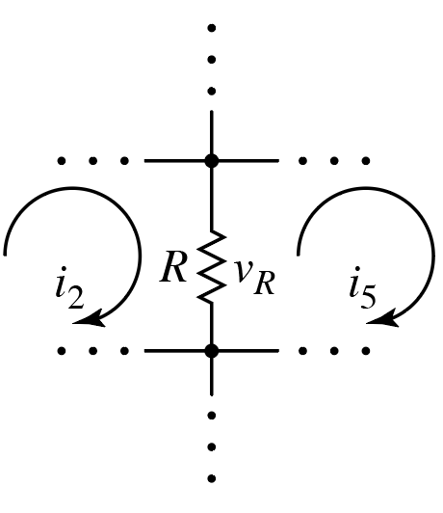
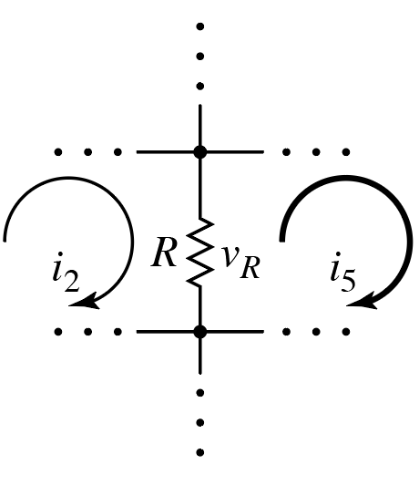
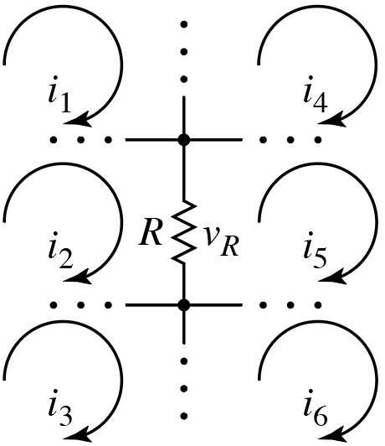
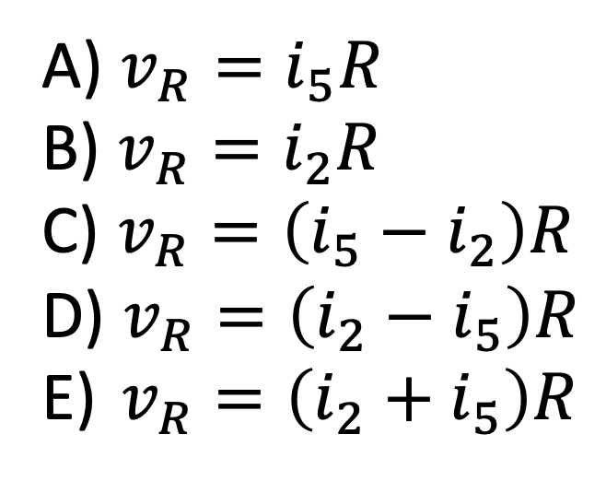


Given these currents, do $i_{1}$, $i_{3}$, $i_{4}$ or $i_{6}$ “affect” $v_{R}$?
No.
What is $v_{R}$ when writing KVL for mesh “5”?
A) $v_{R}=i_{5}R$
B) $v_{R}=i_{2}R$
C) $v_{R}=\left(i_{5}−i_{2}\right)R$
D) $v_{R}=\left(i_{2}−i_{5}\right)R$
E) $v_{R}=\left(i_{2}+i_{5}\right)R$
$$−$$
$$+$$
Want voltage drop in direction of mesh current.

Slide 14
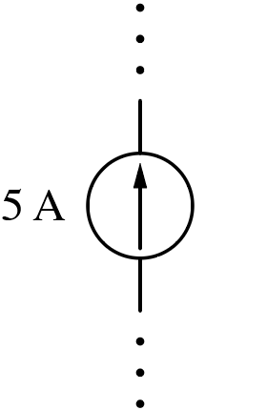
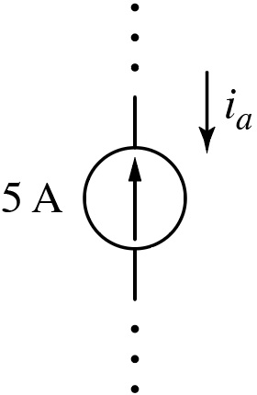
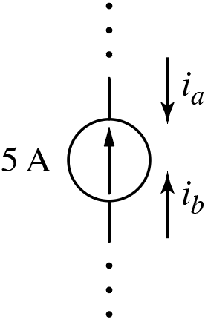
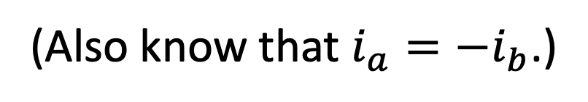
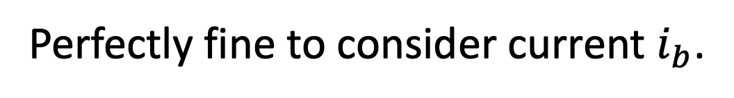
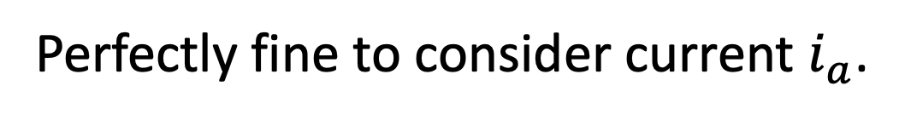
Labeling direction of current flow?
Your choice!
Perfectly fine to consider current $i_{a}$.
Perfectly fine to consider current $i_{b}$.
Actual current flow dictated by circuit
(independent of labels).
Here, source dictates that $i_{b}=5 A$ and $i_{a}=−5 A$.
(Also know that $i_{a}=−i_{b}$.)

Slide 15
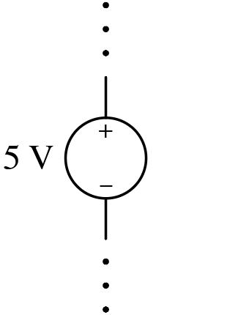
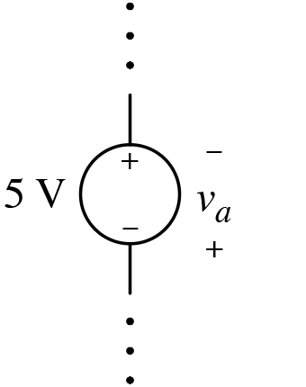
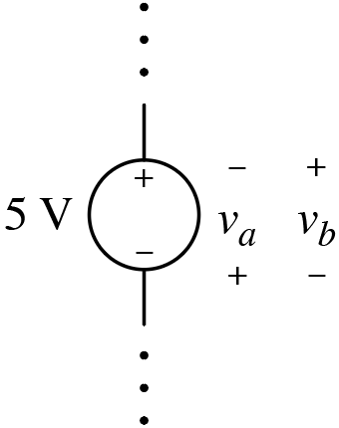



Labeling polarity of voltage?
Your choice!
Perfectly fine to consider voltage $v_{a}$.
Perfectly fine to consider voltage $v_{b}$.
Actual voltage dictated by circuit
(independent of labels).
Here, source dictates that $v_{b}=5 V$and $v_{a}=−5 V$.
(Also know that $v_{a}= {−v}_{b}$.)

Slide 16


Application of passive sign convention?
You have no choices!
If (labeled) current flows into (labeled) high polarity ($+$) terminal,
$v$ and $i$ related with positive sign.
If you use “$v=iR$,” which is what we like to do, (labeled) current
must flow into (labeled) high polarity ($+$) terminal.

Slide 17








Consider:
Pick a direction of current flow, e.g., “down.”
$i_{down}=i_{1}−i_{2}$.
To use Ohm’s law in “standard form” ($v=iR$),
must assign higher polarity ($+$) to top of
resistor.
$v_{R}=i_{down}R=\left(i_{1}−i_{2}\right)R$.
$v_{R}=i_{down}R=\left(i_{1}−i_{2}\right)R$.
This is what is used for mesh “$1$” in
mesh-current analysis.

Slide 18







Consider:
Pick a direction of current flow, e.g., “up.”
$i_{up}=i_{2}−i_{1}$.
To use Ohm’s law in “standard form” ($v=iR$),
must assign higher polarity ($+$) to bottom of
resistor.
$v_{R}=i_{up}R=\left(i_{2}−i_{1}\right)R$.
$v_{R}=i_{up}R=\left(i_{2}−i_{1}\right)R$.
This is what is used for mesh “$2$” in
mesh-current analysis.

Slide 19





What is voltage for these elements
when writing KVL for mesh “a”?
$$− \left(i_{a}−i_{b}\right)R_{1}+$$
$$− \left(i_{a}−i_{b}\right)R_{2}+$$
A) $\left(i_{a}−i_{b}\right)\left(R_{1}+R_{2}\right)−v_{1}$
B) $\left(i_{b}−i_{a}\right)\left(R_{1}+R_{2}\right)−v_{1}$
C) $\left(i_{a}−i_{b}\right)\left(R_{1}+R_{2}\right)+v_{1}$
D) $\left(i_{b}−i_{a}\right)\left(R_{1}+R_{2}\right)+v_{1}$
E) $\left(i_{a}+i_{b}\right)\left(R_{1}+R_{2}\right)+v_{1}$
For mesh b, change the signs:
$$\left(i_{b}−i_{a}\right)\left(R_{1}+R_{2}\right)+v_{1}$$

Slide 20
Recall Mesh-Current “Recipe:”
Identify meshes (loops that don’t enclose another loop).
Label mesh currents.
Write KVL for each mesh (in terms of currents).
Solve equations for currents.
Find any desired remaining circuit parameters from currents.

Slide 21







Step 3:
$$i_{3}=−6 A$$
$$+$$
$$v$$
$$−$$
KVL for mesh 1.
Can combine 6 Ω and
12 Ω resistors: 18 Ω.
Can combine 6 Ω and
12 Ω resistors
Start here.
(In series.)
Mesh 1: $−36+18\left(i_{1}−i_{2}\right)=0$
Mesh 1: $−36+18\left(i_{1}−i_{2}\right)=0$
Mesh 1: $−36+18\left(i_{1}−i_{2}\right)=0$
Mesh 1: $−36+18\left(i_{1}−i_{2}\right)=0$
$$i_{1}−i_{2}=2$$
One equation; two unknowns.

Slide 22













Step 3:
$$i_{3}=−6 A$$
$$+$$
$$v$$
$$−$$
$$−$$
$$v$$
$$+$$
$$+$$
$$v$$
$$−$$
KVL for mesh 2.
Cannot combine $3$ Ω
and $9$ Ω resistors!
(Not in
series.)
Start here.
$$−6 A$$
Mesh 2: $18\left(i_{2}−i_{1}\right)+9\left(i_{2}−i_{3}\right)+3i_{2}=0$
Mesh 2: $18\left(i_{2}−i_{1}\right)+9\left(i_{2}−i_{3}\right)+3i_{2}=0$
Mesh 2: $18\left(i_{2}−i_{1}\right)+9\left(i_{2}−i_{3}\right)+3i_{2}=0$
Mesh 2: $18\left(i_{2}−i_{1}\right)+9\left(i_{2}−i_{3}\right)+3i_{2}=0$
Mesh 2: $18\left(i_{2}−i_{1}\right)+9\left(i_{2}−i_{3}\right)+3i_{2}=0$
Two equations;
two unknowns.
$$\left(30\right)$$
$$−6 A$$
$−18i_{1}+\left(18+9+3\right)i_{2}=9i_{3}=−18$
$$−{3i}_{1}+5i_{2}=−9$$
$−18i_{1}+\left(18+9+3\right)i_{2}=9i_{3}=−54$

Slide 23














Step 4:
$$\frac{1}{2} A$$
$$−\frac{3}{2} A$$
$$6 A$$
$$\frac{9}{2} A$$
$$2 A$$
$$6 A$$
Solve equations.
$$2 A$$
$$−\frac{3}{2} A$$
$$\frac{1}{2} A$$
$$−\frac{3}{2} A$$
}
3$\left(i_{1}−i_{2}\right)=3⋅2$
3$\left(i_{1}−i_{2}\right)=3∙2$
$$i_{2}=−\frac{3}{2} A$$
$$i_{1}=\frac{1}{2} A$$
and
$$−3i_{1}+5i_{2}=−9$$

