Slide 1
EE 261, Spring 2025, Lecture 14
Goals/Topics:
More on mesh-current analysis
Supermeshes
Circuit equivalents
(Thévenin and Norton equivalent circuits)
Best viewed in
presentation mode
in PowerPoint.
Announcement: HW 5 posted (due Monday, Feb. 17).

Slide 2
Recall Mesh-Current “Recipe:”
Identify meshes (loops that don’t enclose another loop).
Label mesh currents.
Write KVL for each mesh (in terms of currents).
Solve equations for currents.
Find any desired remaining circuit parameters from currents.

Slide 3

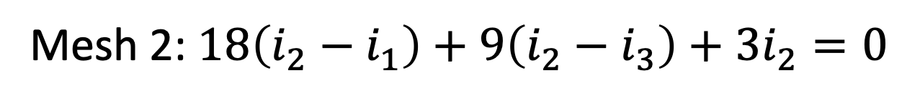



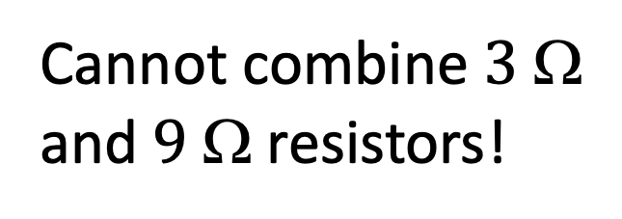

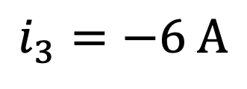

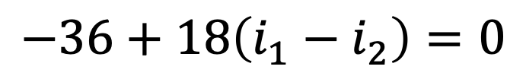

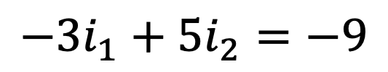
Recall Step 3 (previously wrote KVL for mesh 1):
$$−36+18\left(i_{1}−i_{2}\right)=0$$
$$i_{3}=−6 A$$
$$+$$
$$v$$
$$−$$
$$−$$
$$v$$
$$+$$
$$+$$
$$v$$
$$−$$
KVL for mesh 2.
Cannot combine $3$ Ω
and $9$ Ω resistors!
(Not in
series.)
($i_{2}$ flows through both resistors, but $i_{3}$ does not.)
Mesh 2: $18\left(i_{2}−i_{1}\right)+9\left(i_{2}−i_{3}\right)+3i_{2}=0$
Mesh 2: $18\left(i_{2}−i_{1}\right)+9\left(i_{2}−i_{3}\right)+3i_{2}=0$
Two equations;
two unknowns.
$$−6 A$$
$−18i_{1}+\left(18+9+3\right)i_{2}=9i_{3}=−18$
$$−{3i}_{1}+5i_{2}=−9$$
$−18i_{1}+\left(18+9+3\right)i_{2}=9i_{3}=−54$
$$\left(3+30+3\right)$$
(note this equation)

Slide 4
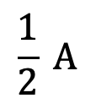

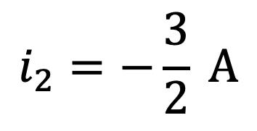
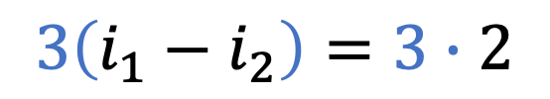
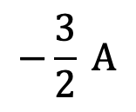
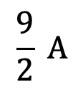
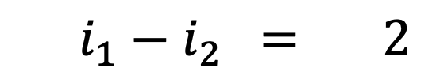

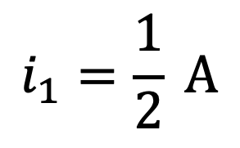
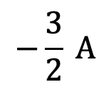
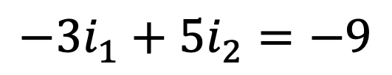

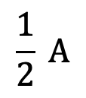

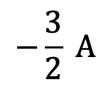
Step 4:
$$\frac{1}{2} A$$
$$−\frac{3}{2} A$$
$$6 A$$
$$\frac{9}{2} A$$
$$2 A$$
$$6 A$$
Solve equations.
$$2 A$$
$$−\frac{3}{2} A$$
$$\frac{1}{2} A$$
$$−\frac{3}{2} A$$
KCL satisfied at every
intersection.
}
$$3\left(i_{1}−i_{2}\right)=3∙2$$
Mesh 1:
$$3\left(i_{1}−i_{2}\right)=3∙2$$
$$i_{2}=−\frac{3}{2} A$$
$$i_{1}=\frac{1}{2} A$$
and
Mesh 2:
$$−3i_{1}+5i_{2}=−9$$

Slide 5
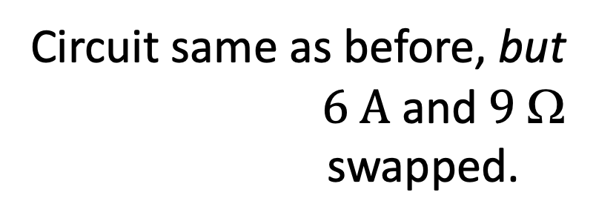
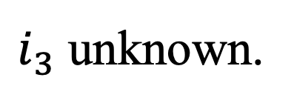
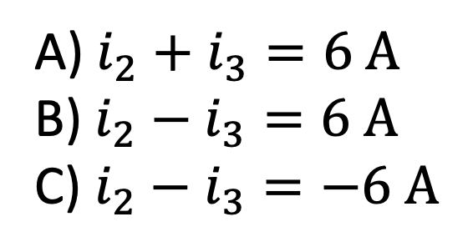

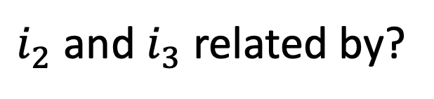

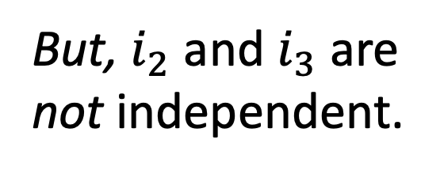
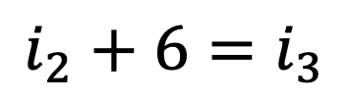
Current source common to two meshes:
Circuit same as before, but
$6 A$ and $9$ Ω
swapped.
$$+$$
$$v= ?$$
$$−$$
$i_{3}$ unknown.
But, $i_{2}$ and $i_{3}$ are
not independent.
If you know one current,
you know the other.
Use KCL.
$i_{2}$ and $i_{3}$ related by?
A) $i_{2}+i_{3}=6 A$
B) $i_{2}−i_{3}=6 A$
C) $i_{2}−i_{3}=−6 A$
(But, you don’t know
voltage across current
source. “Breaks” KVL eqs.)
in
$$=$$
out
$$i_{2}+6=i_{3}$$

Slide 6
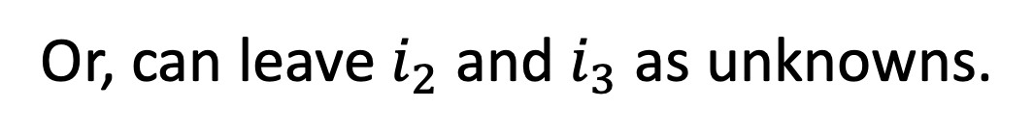

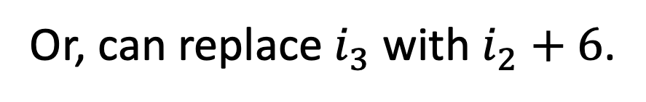

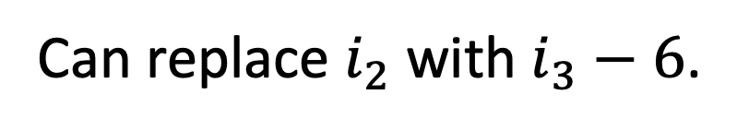
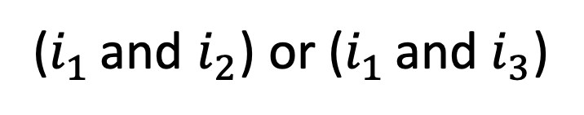
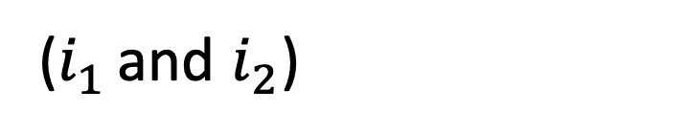
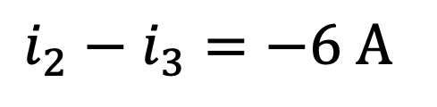

Current source common to two meshes:
Skip over.
Current
source
voltage
unknown.
$$+$$
$$v= ?$$
$$−$$
$$i_{2}+6$$
$$i_{3}−6$$
Combine dependent meshes
to create a supermesh.
KVL holds for any closed path.
Write KVL for supermesh.
Can replace $i_{2}$ with $i_{3}−6$.
Or, can leave $i_{2}$ and $i_{3}$ as unknowns.
Or, can replace $i_{3}$ with $i_{2}+6$.
Supermesh provides one equation.
Two eqs., two unknowns.
Current source provides another eq.
($i_{1}$ and $i_{2}$) or ($i_{1}$ and $i_{3}$)
($i_{1}$ and $i_{2}$) or ($i_{1}$ and $i_{3}$)
$$i_{2}−i_{3}=−6 A$$
Constraint equation.

Slide 7




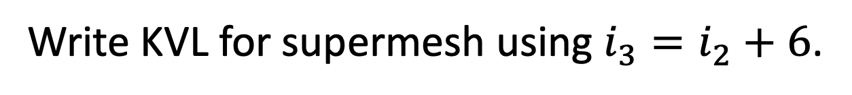
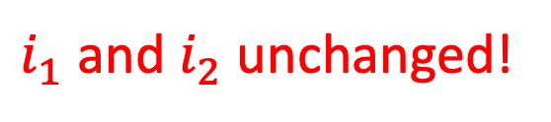


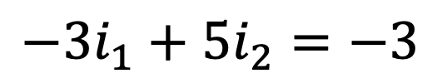

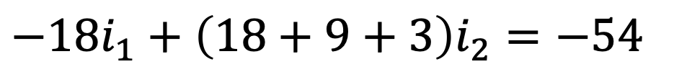

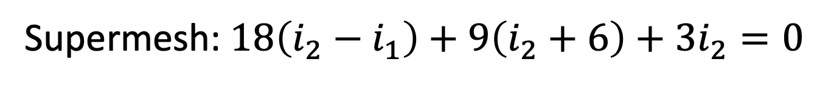

Current source common to two meshes:
$$+$$
$$v$$
$$−$$
$$i_{2}+6$$
$$−$$
$$v$$
$$+$$
$$−36+18\left(i_{1}−i_{2}\right)=0$$
$$+$$
$$v$$
$$−$$
KVL for mesh 1 unchanged.
Combine two dependent
meshes to create a
supermesh.
Write KVL for supermesh using $i_{3}=i_{2}+6$.
Same eqn. as
before swap??
Supermesh: $18\left(i_{2}−i_{1}\right)+9\left(i_{2}+6\right)+3i_{2}=0$
Supermesh: $18\left(i_{2}−i_{1}\right)+9\left(i_{2}+6\right)+3i_{2}=0$
Supermesh: $18\left(i_{2}−i_{1}\right)+9\left(i_{2}+6\right)+3i_{2}=0$
Supermesh: $18\left(i_{2}−i_{1}\right)+9\left(i_{2}+6\right)+3i_{2}=0$
Supermesh: $18\left(i_{2}−i_{1}\right)+9\left(i_{2}+6\right)+3i_{2}=0$
$−18i_{1}+\left(18+9+3\right)i_{2}=−54$
$$−{3i}_{1}+5i_{2}=−3$$
$$\left(3+30+3\right)$$
$i_{1}$ and $i_{2}$ unchanged!

Slide 8
Important Facts:
Can arrange parallel elements in any order provided
we preserve nodes to which elements connected (and
orientation of sources).
Can arrange series elements in any order provided
we preserve same overall series path (and orientation
of sources).
Voltages across and currents through all elements will be unchanged.
All powers will be unchanged.
Circuits we considered with and without supermesh are
actually the same! (Merely swapped two parallel elements.)

Slide 9
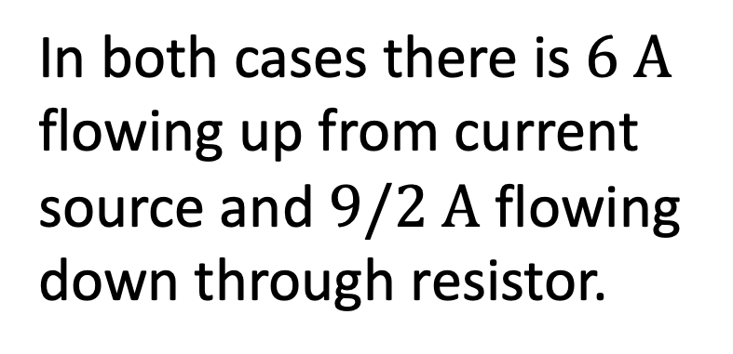
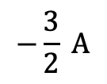
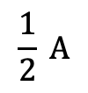
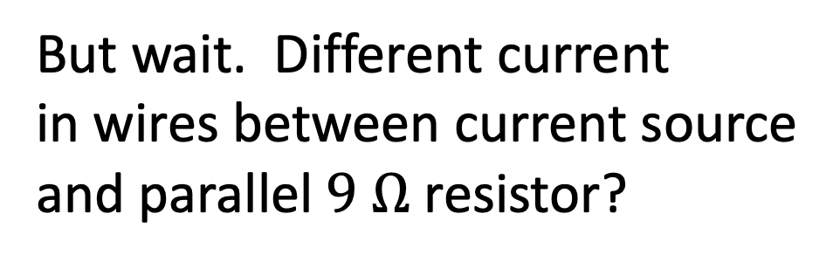
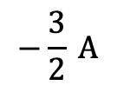
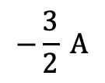
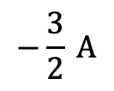
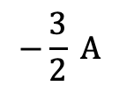

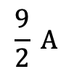
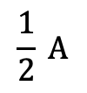

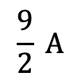
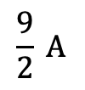



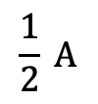

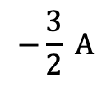
$$\frac{1}{2} A$$
$$−\frac{3}{2} A$$
In both cases there is $6 A$
flowing up from current
source and $9/2 A$ flowing
down through resistor.
$$6 A$$
$$\frac{9}{2} A$$
$$2 A$$
If wires lossless, truly the same.
$$6 A$$
$$2 A$$
$$−\frac{3}{2} A$$
$$\frac{1}{2} A$$
$$−\frac{3}{2} A$$
$$\frac{9}{2} A$$
$$\frac{1}{2} A$$
$$−\frac{3}{2} A$$
$$2 A$$
These are the same!
But wait. Different current
in wires between current source
and parallel $9 Ω$ resistor?
But wait. Different current
in wires between current source
and parallel $9 Ω$ resistor?
$$\frac{9}{2} A$$
$$2 A$$
$$−\frac{3}{2} A$$
$$\frac{1}{2} A$$
$$−\frac{3}{2} A$$

Slide 10
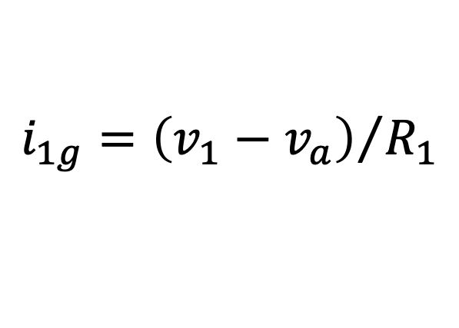




Circuit may already be in simplest form (no elements to combine).
Circuit may already be in simplest form
$$i_{1g}$$
$$i_{1g}$$
$$v_{1}−v_{a}$$
$$v_{a}$$
Three node-voltage equations.
Can swap resistors and voltage sources since they are in series.
That doesn’t affect analysis, but may make it easier to correctly write KCL equations.
$$i_{1g}={\left(v_{1}−v_{a}\right)}/{R_{1}}$$

Slide 11

Circuit may already be in simplest form (no elements to combine).
Can current source be moved
to edge (eliminating need for
supermesh)?
A) Yes B) No
Parallel elements can be swapped.
But, current source not in parallel
with anything.
Three mesh-currents.
If $R_{3}$ or $R_{4}$ replaced with a wire,
a swap would be possible.
Need supermesh.
Yields two KVL equations and constraint equation.
For a given circuit, nodal analysis and mesh analysis may differ in difficulty
and number of variables.

Slide 12





Any circuit of sources and resistors,
when “viewed” between two terminals,
can be reduced to a single resistor and
a single independent source.
(True for linear circuits.)
Thévenin equivalent.
With correct choice of $V_{th}$, $R_{th}$, $I_{N}$, and
$R_{N}$, all these circuits will behave identically
as “viewed” from terminals a and b.
With correct choice of $V_{th}$, $R_{th}$, $I_{N}$, and
$R_{N}$, all these circuits will behave identically
as “viewed” from terminals a and b.
Norton equivalent.
(Internal behavior can be very different.)

Slide 13














Assume $R_{N}=R_{th}=R$.
Must have same load current for any load $R_{L}$.
(which is true)
How are $V_{th}$ and $I_{N}$ related?
(current div.)
$$i_{L}=\frac{R_{eq}}{R_{L}}I_{N}=\frac{1}{R_{L}}\left(\frac{RR_{L}}{R+R_{L}}\right)I_{N}$$
$$i_{L}=\frac{R_{eq}}{R_{L}}I_{N}=\frac{1}{R_{L}}\left(\frac{RR_{L}}{R+R_{L}}\right)I_{N}$$
$$i_{L}=\frac{1}{R_{eq}}V_{th}=\frac{1}{R+R_{L}}V_{th}$$
$$=\frac{R}{{R+R}_{L}}I_{N}$$
$$i_{L}=\frac{1}{R_{eq}}V_{th}=\frac{1}{R+R_{L}}V_{th}$$
Equate expressions
for $i_{L}$.
Cancel denominators.
$$V_{th}=RI_{N}$$
or
$$I_{N}={V_{th}}/R$$
or
$$R={V_{th}}/{I_{N}}$$

Slide 14















These circuits are identical (as viewed from a and b).
$$+ v_{R}−$$
$$i=0$$
$$0$$
Something less than $V_{th}$
$V_{th}$
Something greater than $V_{th}$
KVL: $−V_{th}+v_{R}+V_{oc}=0$
What is open-circuit voltage $V_{oc}$?
No voltage drop across $R_{th}$ when
open circuit between a and b.
$$V_{oc}=V_{th}$$
(It’s simply the voltage
between points a and b
in circuit.)
Given layout of “arbitrary circuit,” can find $V_{oc}$, i.e., $V_{th}$.
$$I_{N}$$
$$R_{N}={V_{oc}}/{I_{N}}={V_{th}}/{I_{N}}.$$
Also, $V_{oc}=I_{N}R_{N}$.
$$R_{N}={V_{oc}}/{I_{N}}={V_{th}}/{I_{N}}.$$

Slide 15







These circuits are identical (as viewed from a and b).
These circuits are identical (as viewed from a and b).
$$I_{N}$$
$$i=0$$
$$+$$
$$v_{R}=0$$
$$−$$
What is short-circuit current $I_{sc}$?
A)$0$
B) ${I_{N}}/R$
C) $I_{N}$
D) $I_{N}R$
E) Something else.

Slide 16










These circuits are identical (as viewed from a and b).
$$I_{N}$$
$$i=0$$
$$+$$
$$v_{R}=0$$
$$−$$
Same!
What is short-circuit current $I_{sc}$?
I_{N}
$$I_{sc}=I_{N}$$
Given layout of “arbitrary circuit” with short, can find $I_{sc}$, i.e., $I_{N}$.
(using info from previous slide)
Having found $V_{oc}$ ($V_{th}$) and $I_{sc}$ ($I_{N}$), $R_{N}={V_{oc}}/{I_{sc}}={V_{th}}/{I_{N}}$.
Having found $V_{oc}$ ($V_{th}$) and $I_{sc}$ ($I_{N}$), $R_{N}={V_{oc}}/{I_{sc}}={V_{th}}/{I_{N}}$.
$$R_{th}=R_{N}$$
Same!
Also, $I_{sc}={V_{th}}/{R_{th}}$.
$$R_{th}={V_{th}}/{I_{sc}}={V_{th}}/{I_{N}}.$$
$$R_{th}={V_{th}}/{I_{sc}}={V_{th}}/{I_{N}}.$$

