Slide 1
EE 261, Spring 2025, Lecture 16
Goals/Topics:
More on source deactivation/superposition
Thévenin and Norton equivalent when original
circuit has only independent sources (shortcut)
Equivalent circuits with only dependent sources
Best viewed in
presentation mode
in PowerPoint.
Announcement: HW 5 due Monday, Feb. 17.

Slide 2


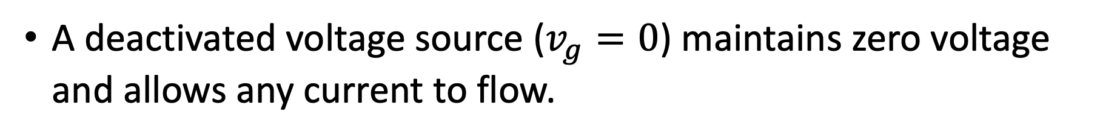

Recall: Deactivating sources
A deactivated voltage source ($v_{g}=0$) maintains zero voltage
and allows any current to flow.
A deactivated voltage source ($v_{g}=0$) maintains zero voltage
and allows any current to flow.
A short circuit.
A deactivated current source ($i_{g}=0$) maintains zero current
and allows any voltage to exist.
A deactivated current source ($i_{g}=0$) maintains zero current
and allows any voltage to exist.
An open circuit.
Recall: Source Superposition
For circuits with multiple independent sources (and any number
of dependent sources), can analyze by summing contributions
from individual independent sources.
For circuits with multiple independent sources (and any number
of dependent sources), can analyze by summing contributions
from individual independent sources.
Turn on one independent source at a time, turning off all others
but must leave on dependent sources throughout analysis.

Slide 3
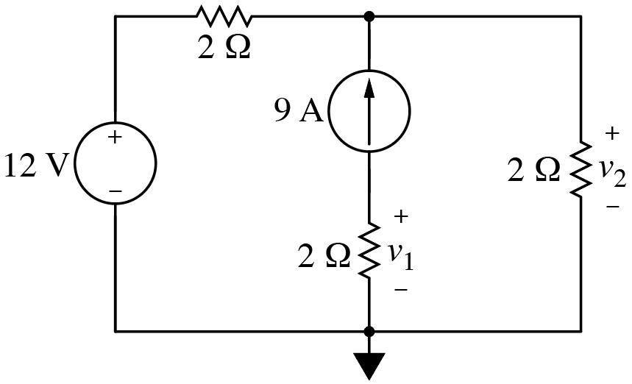
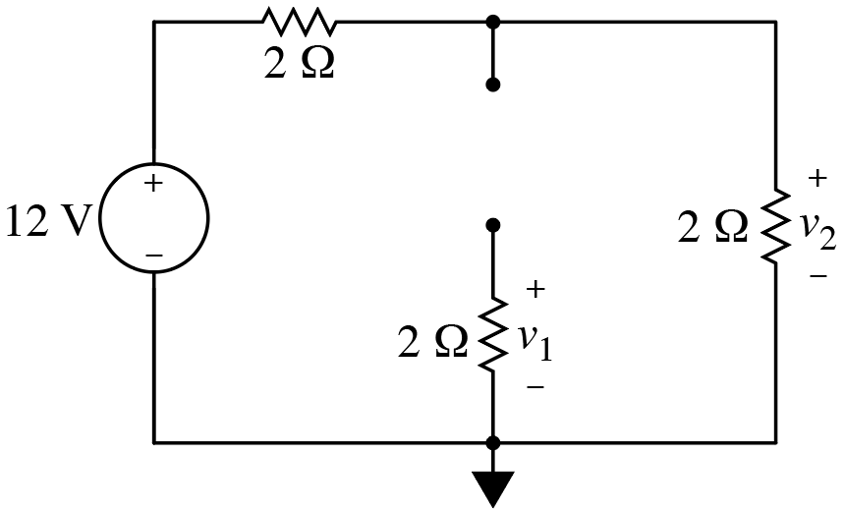
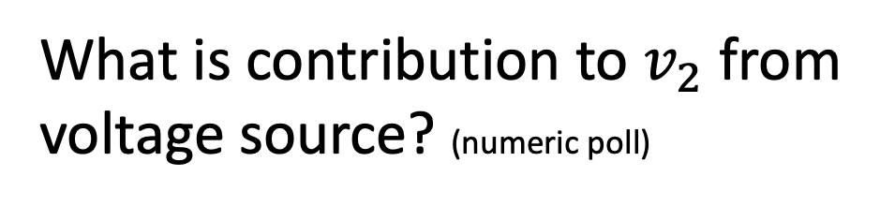
Consider:
What is contribution to $v_{2}$ from
voltage source? (numeric poll)
What is contribution to $v_{1}$ from voltage source? (numeric poll)

Slide 4
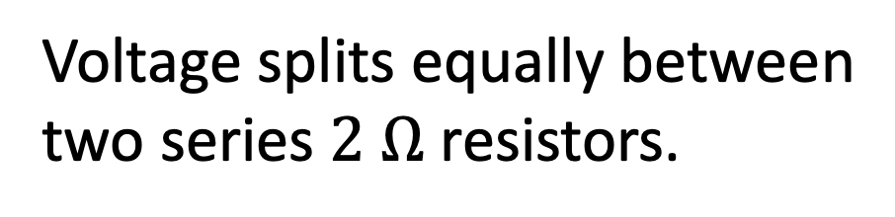
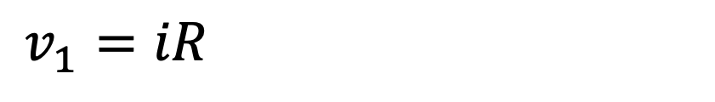
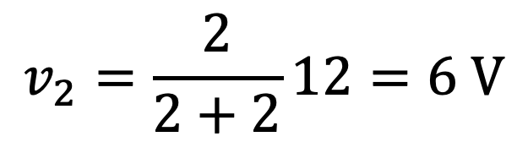
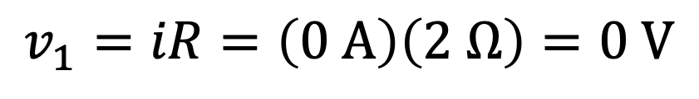

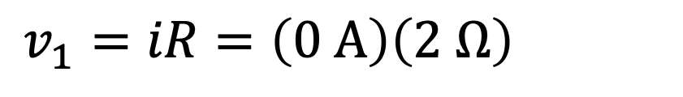
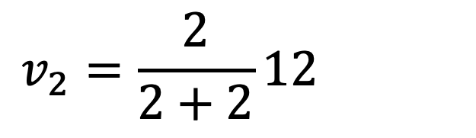
Consider:
What is contribution to $v_{2}$ from
voltage source? (numeric poll)
Voltage splits equally between
two series $2 Ω$ resistors.
$$i=0$$
$$v_{2}=\frac{2}{2+2}12=6 V$$
$$v_{2}=\frac{2}{2+2}12=6 V$$
What is contribution to $v_{1}$ from voltage source? (numeric poll)
No current through resistor.
$$v_{1}=iR=\left(0 A\right)\left(2 Ω\right)=0 V$$
$$v_{1}=iR=\left(0 A\right)\left(2 Ω\right)=0 V$$
$$v_{1}=iR=\left(0 A\right)\left(2 Ω\right)=0 V$$

Slide 5
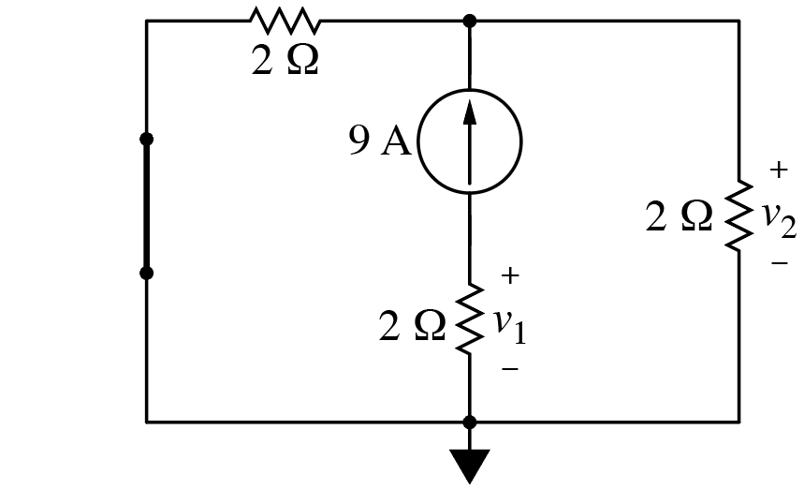
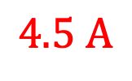

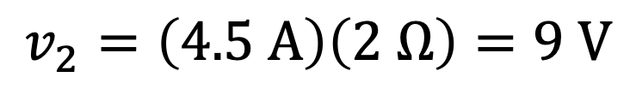

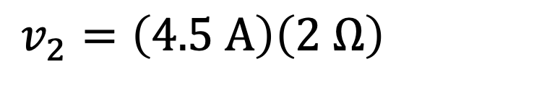


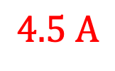
Consider:
$$4.5 A$$
$$4.5 A$$
What is contribution to $v_{2}$ from
current source? (numeric poll)
Current splits equally between
two parallel $2 Ω$ resistors.
$$v_{2}=\left(4.5 A\right)\left(2 Ω\right)=9 V$$
$$v_{2}=\left(4.5 A\right)\left(2 Ω\right)=9 V$$
Another way to
visualize circuit:
$$4.5 A$$
$$4.5 A$$

Slide 6
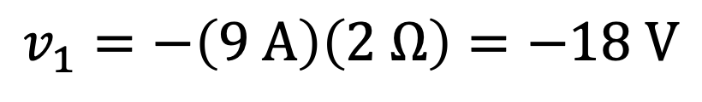
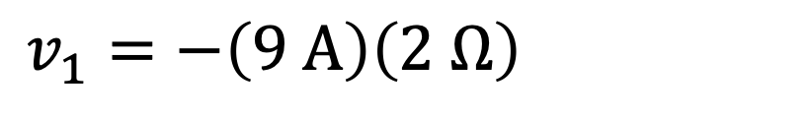


Consider:
What is contribution to $v_{2}$ from
current source? (numeric poll)
Current splits equally between
two parallel $2 Ω$ resistors.
$$v_{2}=\left(4.5 A\right)\left(2 Ω\right)=9 V$$
$$v_{2}=\left(4.5 A\right)\left(2 Ω\right)=9 V$$
$$9 A$$
What is contribution to $v_{1}$ from current source? (numeric poll)
$9 A$ must go through resistor.
$$v_{1}=−\left(9 A\right)\left(2 Ω\right)=−18 V$$
$$v_{1}=−\left(9 A\right)\left(2 Ω\right)=−18 V$$
Don’t forget passive sign convention!
$v_{1}=−18 V$ regardless of whether voltage source is on or off.

Slide 7

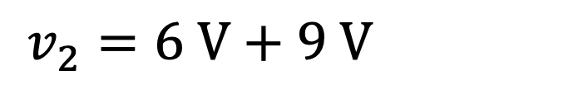
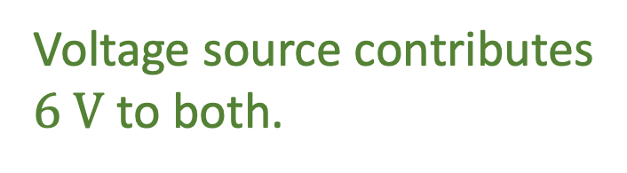
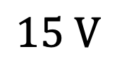
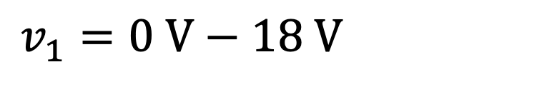
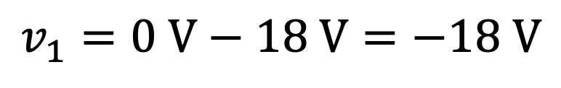

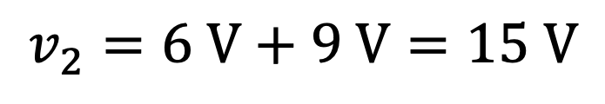

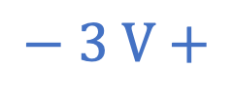
Consider:
$$− 3 V+$$
$$15 V$$
Same voltage across these
two resistors?
$$+ 6 V−$$
$$− 9 V+$$
Voltage source contributes
$6 V$ to both.
Current source contributes
$9 V$ to both.
But, no. Contributions have
opposite polarities.
But, no. Contributions have
opposite polarities.
With both sources on:
$$v_{2}=6 V+9 V=15 V$$
$$v_{2}=6 V+9 V=15 V$$
$$v_{1}=0 V−18 V=−18 V$$
$$v_{1}=0 V−18 V=−18 V$$
voltage source
contribution
current source
contribution

Slide 8
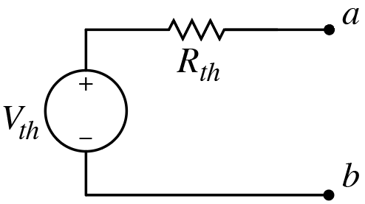
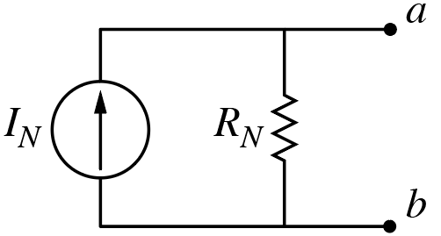
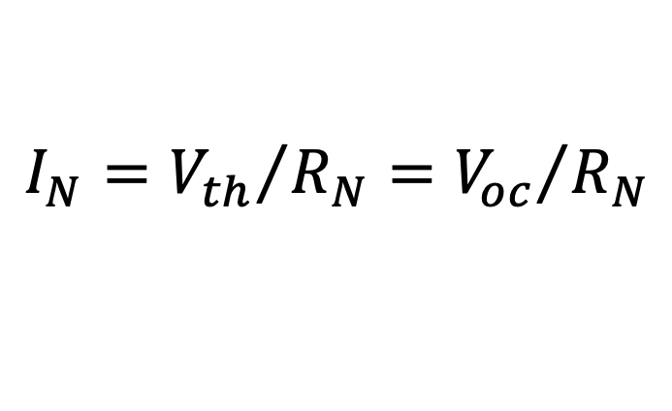
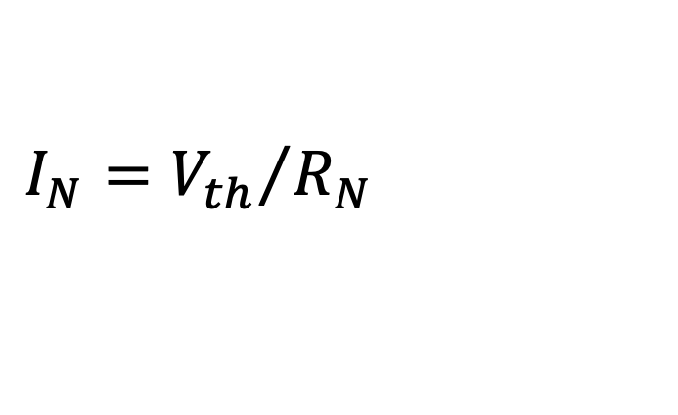
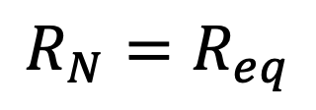
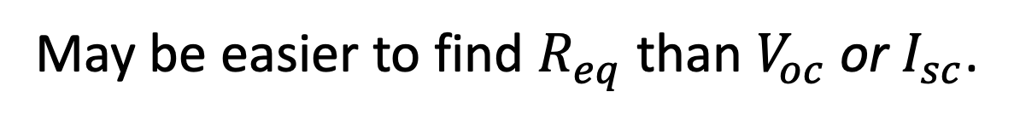


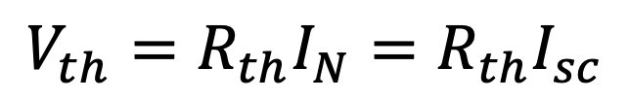
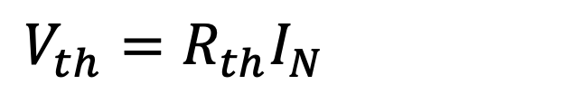
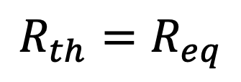
For circuit with only independent sources, can obtain
Thévenin/Norton equivalent resistance by deactivating
all sources and then finding equivalent resistance.
For circuit with only independent sources,
To determine complete Thévenin/Norton equivalent circuit,
need to find either $V_{oc}$ or $I_{sc}$, but would not need to find both.
May be easier to find $R_{eq}$ than $V_{oc}$ or $I_{sc}$.
Handy for HW 5.
Thus, find $R_{eq}$. Then find whichever is easier of $V_{oc}$ or $I_{sc}$.
Found $R_{eq}$ and $I_{sc}$, but want Thévenin equivalent?
$$R_{th}=R_{eq}$$
and
$$V_{th}=R_{th}I_{N}=R_{th}I_{sc}$$
$$V_{th}=R_{th}I_{N}=R_{th}I_{sc}$$
Found $R_{eq}$ and $V_{oc}$, but want Norton equivalent?
$$R_{N}=R_{eq}$$
and
$$I_{N}={V_{th}}/{R_{N}}={V_{oc}}/{R_{N}}$$
$$I_{N}={V_{th}}/{R_{N}}={V_{oc}}/{R_{N}}$$
This is essentially Source Transformation. See Sec. 4.9 of textbook.

Slide 9
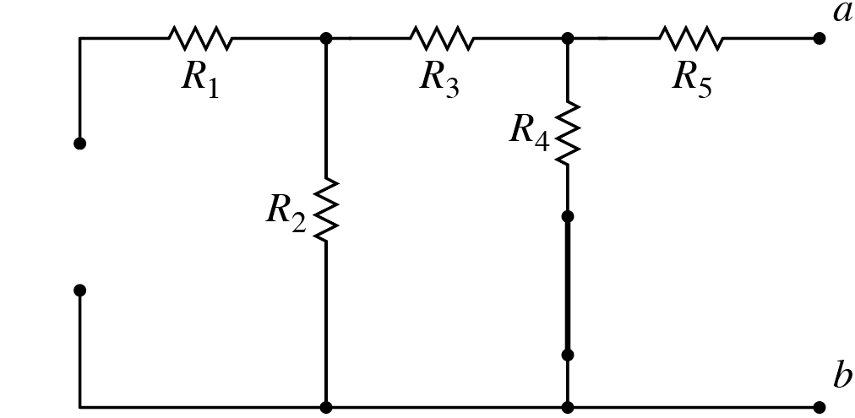
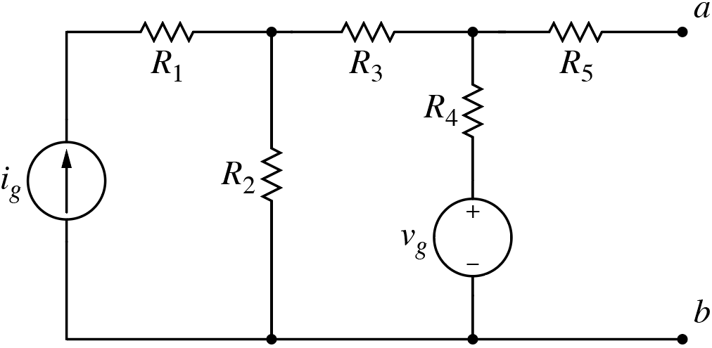
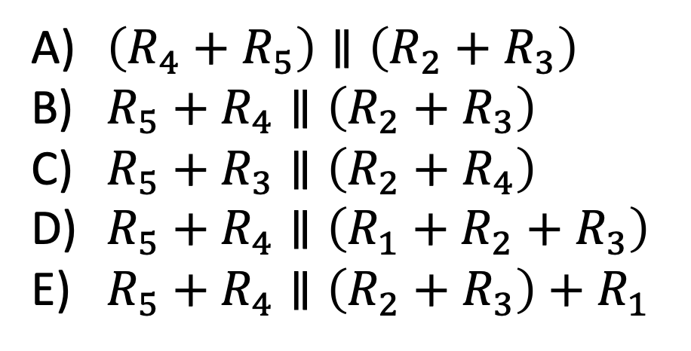
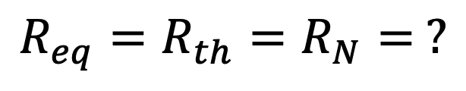

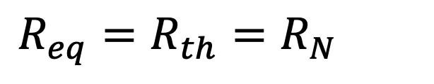
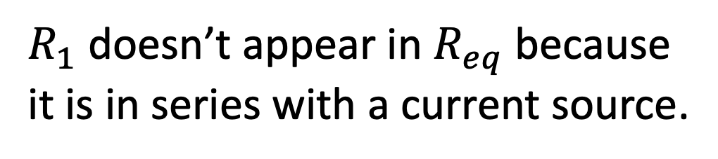
Consider:
No dependent sources.
Find $R_{eq}$ by deactivating sources.
$$R_{eq}=R_{th}=R_{N}= ?$$
$$R_{eq}=R_{th}=R_{N}= ?$$
$R_{1}$ doesn’t appear in $R_{eq}$ because
it is in series with a current source.
$\left(R_{4}+R_{5}\right)∥\left(R_{2}+R_{3}\right)$
$R_{5}+R_{4}∥\left(R_{2}+R_{3}\right)$
$R_{5}+R_{3}∥\left(R_{2}+R_{4}\right)$
$R_{5}+R_{4}∥\left(R_{1}+R_{2}+R_{3}\right)$
$R_{5}+R_{4}∥\left(R_{2}+R_{3}\right)+R_{1}$
A deactivated current source has
infinite resistance, so we don’t care
what resistance is added to it.

Slide 10
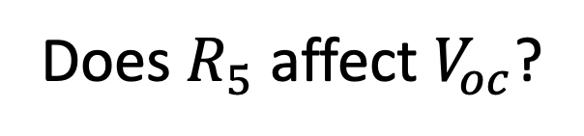
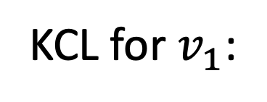


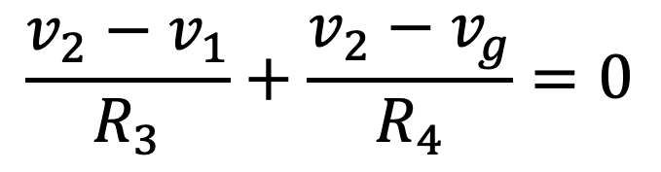

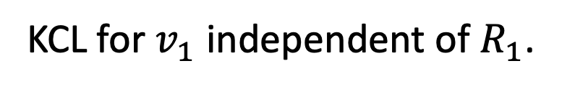
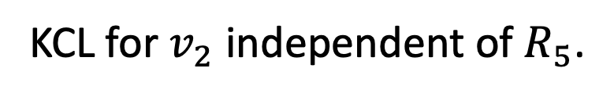
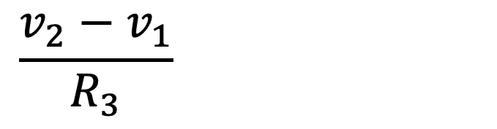
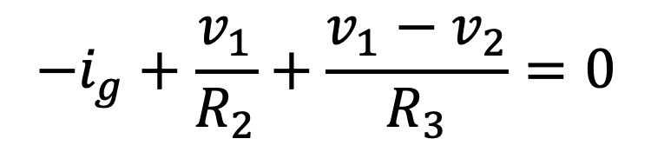
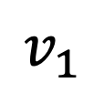
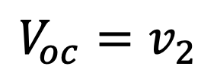
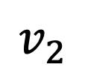







Consider:
Find $V_{oc}$ via node-voltage analysis.
$$v_{1}$$
$$v_{2}$$
$$i=0$$
Does $R_{5}$affect $V_{oc}$?
A) Yes B) No
$$+$$
$$V_{oc}$$
$$−$$
$$V_{oc}=v_{2}$$
KCL for $v_{2}$ independent of $R_{5}$.
Does $R_{1}$affect $v_{1}$?
A) Yes B) No
KCL for $v_{1}$ independent of $R_{1}$.
$$−i_{g}+\frac{v_{1}}{R_{2}}+\frac{v_{1}−v_{2}}{R_{3}}=0$$
$$−i_{g}+\frac{v_{1}}{R_{2}}+\frac{v_{1}−v_{2}}{R_{3}}=0$$
$$−i_{g}+\frac{v_{1}}{R_{2}}+\frac{v_{1}−v_{2}}{R_{3}}=0$$
Does $R_{4}$affect $v_{2}$?
KCL for $v_{1}$:
A) Yes B) No
No $R_{1}$ or $R_{5}$!
But, $R_{5}$ in $R_{eq}.$
$$\frac{v_{2}−v_{1}}{R_{3}}+\frac{v_{2}−v_{g}}{R_{4}}=0$$
$$\frac{v_{2}−v_{1}}{R_{3}}+\frac{v_{2}−v_{g}}{R_{4}}=0$$
KCL for $v_{2}$:

Slide 11











Consider:
Find $V_{oc}$ via node-voltage analysis.
$$v_{1}$$
$$v_{2}$$
Previous slide is fine,
but isn’t how we typically
use node-voltage analysis.
$$+$$
$$v_{4} \\ −$$
$$+$$
$$V_{oc}$$
$$−$$
With an open circuit,
$v_{2}$ is not an essential
node. Only $v_{1}$ is.
With an open circuit,
$v_{2}$ is not an essential
node. Only $v_{1}$ is.
$$−i_{g}+\frac{v_{1}}{R_{2}}+\frac{v_{1}−v_{g}}{R_{3}+R_{4}}=0$$
$$−i_{g}+\frac{v_{1}}{R_{2}}+\frac{v_{1}−v_{g}}{R_{3}+R_{4}}=0$$
$$−i_{g}+\frac{v_{1}}{R_{2}}+\frac{v_{1}−v_{g}}{R_{3}+R_{4}}=0$$
$$−i_{g}+\frac{v_{1}}{R_{2}}+\frac{v_{1}−v_{g}}{R_{3}+R_{4}}=0$$
KCL for $v_{1}$:
One equation; one unknown.
$$v_{2}=v_{g}+v_{4}=v_{g}+\frac{R_{4}}{R_{3}+R_{4}}\left(v_{1}−v_{g}\right)$$
$$v_{2}=v_{g}+v_{4}=v_{g}+\frac{R_{4}}{R_{3}+R_{4}}\left(v_{1}−v_{g}\right)$$
Knowing $v_{1}$, can find $v_{2}:$

Slide 12
For circuits with only dependent sources, Thévenin/Norton
equivalent consists of only a single resistor.
For circuits with only dependent sources,
Must determine this resistance by attaching a “test source”
to terminals and finding the resultant current or voltage.
Ratio of voltage to current gives equivalent resistance.

Slide 13




Consider:
What is $R_{th}$ ($R_{N}$)?
Must “probe” circuit with a source.
Use voltage $V_{T}$.
Can use a current or voltage source.
Then find
voltage created.
Then find
current that flows.

Slide 14



















Consider:
What is $R_{th}$ ($R_{N}$)?
Must “probe” circuit with a source.
Use voltage $V_{T}$.
$R_{th}={V_{T}}/{I_{T}}$.
Let $V_{T}=750 V$.
What is $i_{x}$? (numeric poll)
$$i_{x}={750 V}/{750 Ω}=1 A$$
$$i_{x}={750 V}/{750 Ω}=1 A$$
$$1$$
$$1$$
$$1$$
KCL: $I_{T}=i_{x}−1.5i_{x}+{\left(750−250i_{x}\right)}/{500}=0.5 A$
KCL: $I_{T}=i_{x}−1.5i_{x}+{\left(750−250i_{x}\right)}/{500}=0.5 A$
KCL: $I_{T}=i_{x}−1.5i_{x}+{\left(750−250i_{x}\right)}/{500}=0.5 A$
KCL: $I_{T}=i_{x}−1.5i_{x}+{\left(750−250i_{x}\right)}/{500}=0.5 A$
KCL: $I_{T}=i_{x}−1.5i_{x}+{\left(750−250i_{x}\right)}/{500}=0.5 A$
KCL: $I_{T}=i_{x}−1.5i_{x}+{\left(750−250i_{x}\right)}/{500}=0.5 A$
$$R_{th}={V_{T}}/{I_{T}}={750 V}/{0.5 A}=1500 Ω$$
$$R_{th}={V_{T}}/{I_{T}}={750 V}/{0.5 A}=1500 Ω$$
$$R_{th}={V_{T}}/{I_{T}}={750 V}/{0.5 A}=1500 Ω$$

Slide 15

Solution Summary:
$$1500 Ω$$

