Slide 1
EE 261, Spring 2025, Lecture 17
Goals/Topics:
Maximum power transfer
Operational amplifier basics
Difference amplifier circuit
Announcements: Homework 6 posted. Due Monday, Feb. 24th.
Test #2 Wednesday, Feb. 26th at 8:00 p.m. in Spark G45.

Slide 2
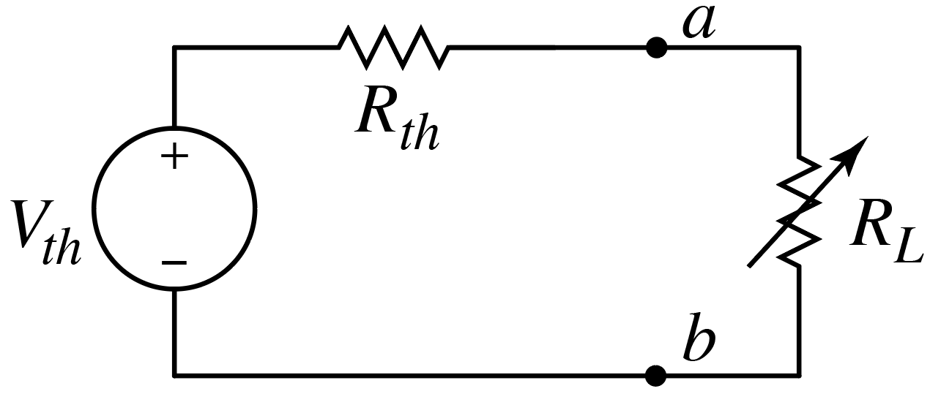


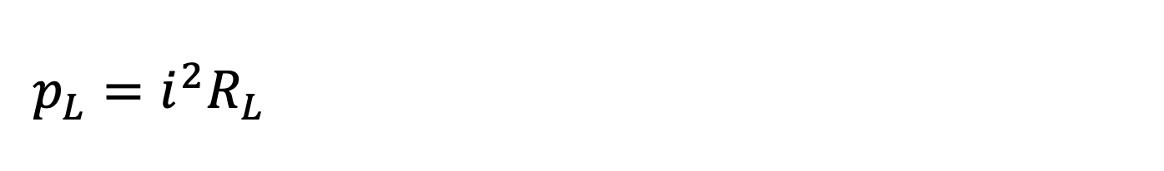

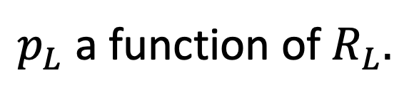
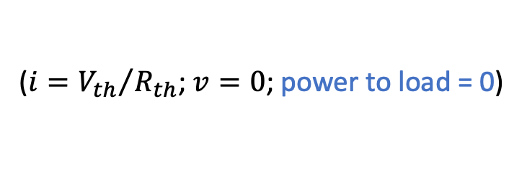

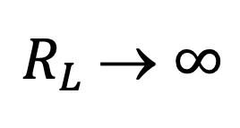

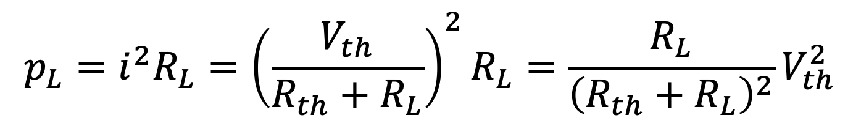
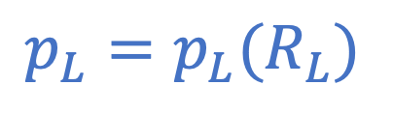

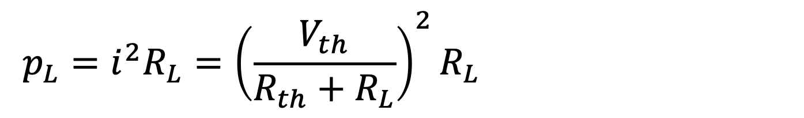
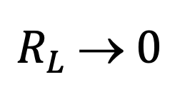
Maximum Power Transfer
: Consider Thévenin circuit with a load.
What $R_{L}$ maximizes load current?
$R_{L}$→ $0$
$$i$$
$$+$$
$$v$$
$$−$$
($i={V_{th}}/{R_{th}}$; $v=0$; power to load = 0)
What $R_{L}$maximizes load voltage?
$R_{L}$→ $∞$
($i=0$; $v=V_{th}$; power to load = 0)
What $R_{L}$ maximizes load power?
Hmm…
Must be between these limits ($0<R_{L}<∞$), but what is it?
What is that load power?
$p_{L}$ a function of $R_{L}.$
$$p_{L}=i^{2}R_{L}={\left(\frac{V_{th}}{R_{th}+R_{L}}\right)}^{2}R_{L}=\frac{R_{L}}{{\left(R_{th}+R_{L}\right)}^{2}}V_{th}^{2}$$
$$p_{L}=i^{2}R_{L}={\left(\frac{V_{th}}{R_{th}+R_{L}}\right)}^{2}R_{L}=\frac{R_{L}}{{\left(R_{th}+R_{L}\right)}^{2}}V_{th}^{2}$$
$$p_{L}=i^{2}R_{L}={\left(\frac{V_{th}}{R_{th}+R_{L}}\right)}^{2}R_{L}=\frac{R_{L}}{{\left(R_{th}+R_{L}\right)}^{2}}V_{th}^{2}$$
$$p_{L}=p_{L}(R_{L})$$
Hold that thought.

Slide 3
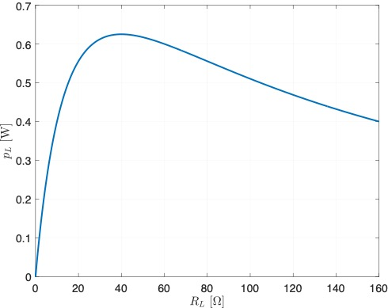
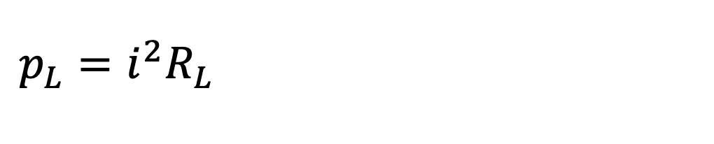

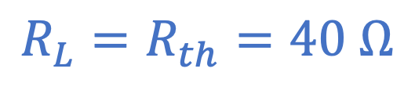
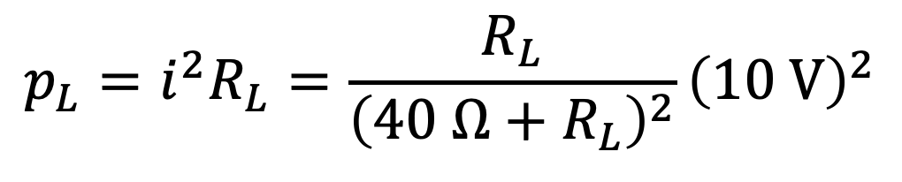
Example:
$$p_{L}=i^{2}R_{L}=\frac{R_{L}}{{\left(40 Ω+R_{L}\right)}^{2}}{\left(10 V\right)}^{2}$$
$$p_{L}=i^{2}R_{L}=\frac{R_{L}}{{\left(40 Ω+R_{L}\right)}^{2}}{\left(10 V\right)}^{2}$$
$$i$$
Peak
$$R_{L}=R_{th}=40 Ω$$

Slide 4
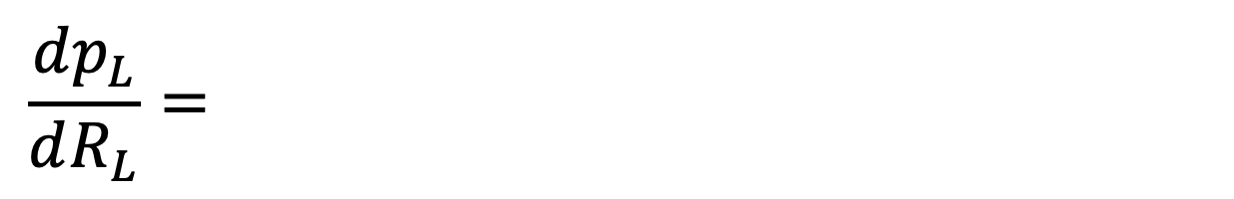
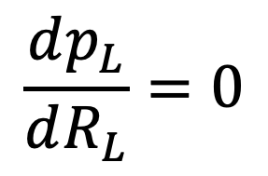

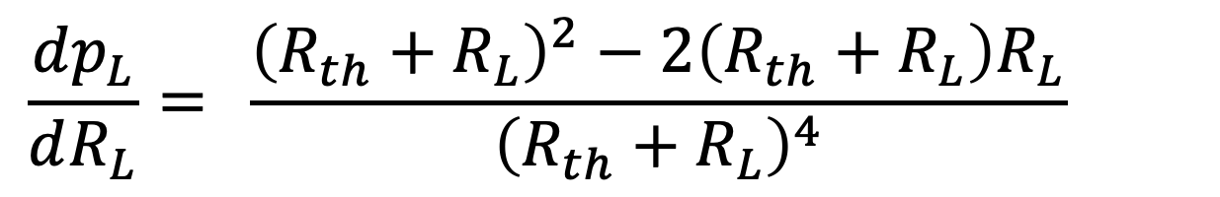
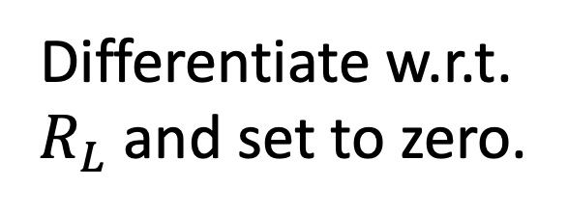
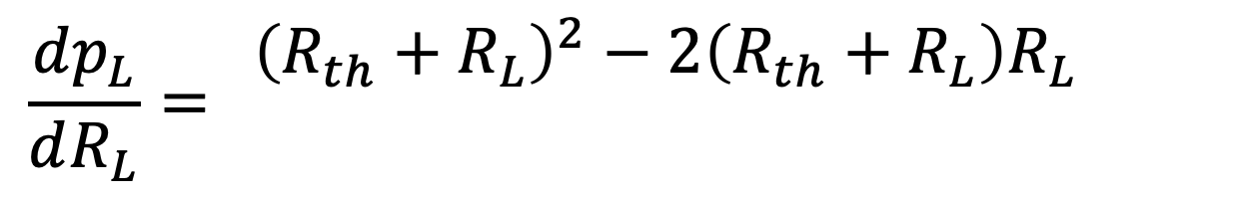
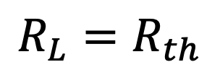
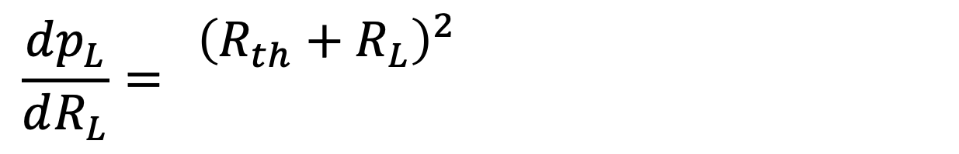
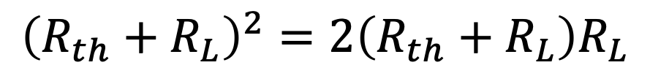
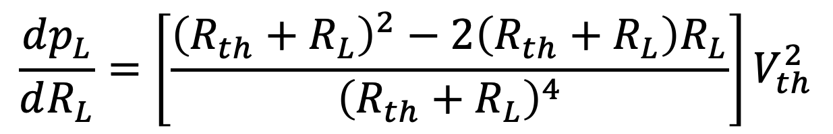

Maximum Power Transfer
: Consider Thévenin circuit with a load.
What $R_{L}$ maximizes load current?
$R_{L}$→ $0$
$$i$$
$$+$$
$$v$$
$$−$$
($i={V_{th}}/{R_{th}}$; $v=0$; power to load = 0)
What $R_{L}$maximizes load voltage?
$R_{L}$→ $∞$
($i=0$; $v=V_{th}$; power to load = 0)
What $R_{L}$ maximizes load power?
Hmm…
Must be between these limits ($0<R_{L}<∞$), but what is it?
What is that load power?
$p_{L}$ a function of $R_{L}.$
$$p_{L}=i^{2}R_{L}={\left(\frac{V_{th}}{R_{th}+R_{L}}\right)}^{2}R_{L}=\frac{R_{L}}{{\left(R_{th}+R_{L}\right)}^{2}}V_{th}^{2}$$
$$p_{L}=i^{2}R_{L}={\left(\frac{V_{th}}{R_{th}+R_{L}}\right)}^{2}R_{L}=\frac{R_{L}}{{\left(R_{th}+R_{L}\right)}^{2}}V_{th}^{2}$$
$$p_{L}=i^{2}R_{L}={\left(\frac{V_{th}}{R_{th}+R_{L}}\right)}^{2}R_{L}=\frac{R_{L}}{{\left(R_{th}+R_{L}\right)}^{2}}V_{th}^{2}$$
$$p_{L}=p_{L}(R_{L})$$
Differentiate w.r.t.
$R_{L}$ and set to zero.
(d. of top)$×$bottom
(d. of bottom)$×$top
$$\frac{dp_{L}}{dR_{L}}=\left[\frac{{\left(R_{th}+R_{L}\right)}^{2}−2\left(R_{th}+R_{L}\right)R_{L}}{{\left(R_{th}+R_{L}\right)}^{4}}\right]V_{th}^{2}$$
$$\frac{dp_{L}}{dR_{L}}=\left[\frac{{\left(R_{th}+R_{L}\right)}^{2}−2\left(R_{th}+R_{L}\right)R_{L}}{{\left(R_{th}+R_{L}\right)}^{4}}\right]V_{th}^{2}$$
$$\frac{dp_{L}}{dR_{L}}=\left[\frac{{\left(R_{th}+R_{L}\right)}^{2}−2\left(R_{th}+R_{L}\right)R_{L}}{{\left(R_{th}+R_{L}\right)}^{4}}\right]V_{th}^{2}$$
$$\frac{dp_{L}}{dR_{L}}=\left[\frac{{\left(R_{th}+R_{L}\right)}^{2}−2\left(R_{th}+R_{L}\right)R_{L}}{{\left(R_{th}+R_{L}\right)}^{4}}\right]V_{th}^{2}$$
$$\frac{dp_{L}}{dR_{L}}=\left[\frac{{\left(R_{th}+R_{L}\right)}^{2}−2\left(R_{th}+R_{L}\right)R_{L}}{{\left(R_{th}+R_{L}\right)}^{4}}\right]V_{th}^{2}$$
Match load to internal
(Thévenin) resistance.
bottom squared
$$\frac{dp_{L}}{dR_{L}}=0$$
$${\left(R_{th}+R_{L}\right)}^{2}=2\left(R_{th}+R_{L}\right)R_{L}$$
$$R_{L}=R_{th}$$

Slide 5
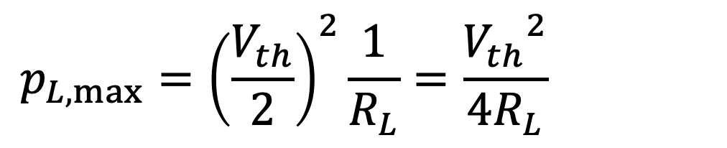
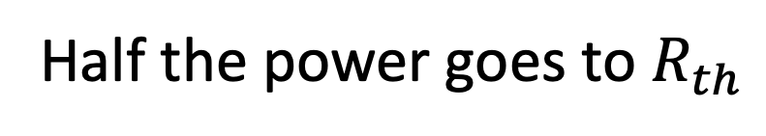
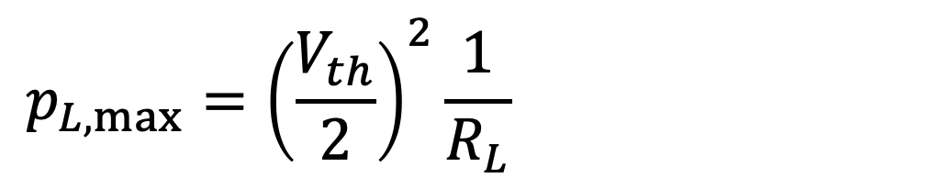
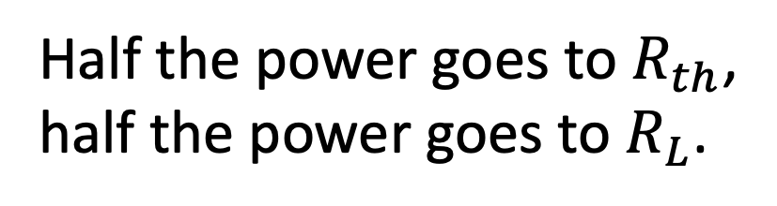
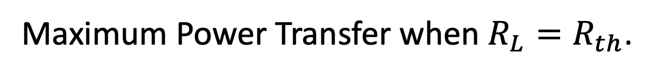
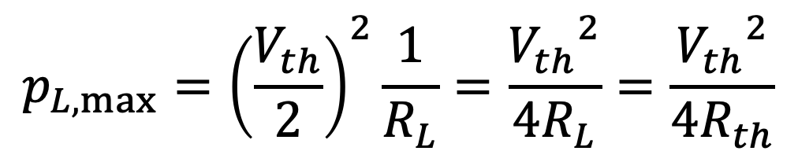
Maximum Power Transfer when $R_{L}=R_{th}$.
What is that power?
Voltage splits equally across resistors.
Maximum load power:
Half the power goes to $R_{th}$,
half the power goes to $R_{L}$.
Half the power goes to $R_{th}$
$$p_{L,max}={\left(\frac{V_{th}}{2}\right)}^{2}\frac{1}{R_{L}}=\frac{{V_{th}}^{2}}{4R_{L}}=\frac{{V_{th}}^{2}}{4R_{th}}$$
$$p_{L,max}={\left(\frac{V_{th}}{2}\right)}^{2}\frac{1}{R_{L}}=\frac{{V_{th}}^{2}}{4R_{L}}=\frac{{V_{th}}^{2}}{4R_{th}}$$
$$p_{L,max}={\left(\frac{V_{th}}{2}\right)}^{2}\frac{1}{R_{L}}=\frac{{V_{th}}^{2}}{4R_{L}}=\frac{{V_{th}}^{2}}{4R_{th}}$$
But…
In general, power associated with “interior” of an equivalent circuit
is different from power associated with interior of original circuit.
Don’t confuse maximum power transfer with maximum efficiency!

Slide 6
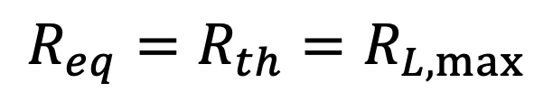
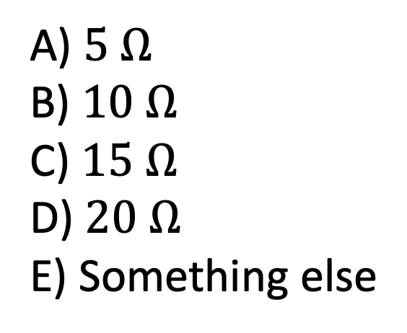

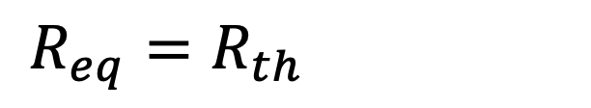
What load $R_{L}$ attached between terminals $a$ and $b$ will maximize the
power delivered to the load?
$$R_{eq}=R_{th}=R_{L,max}$$
$$R_{eq}=R_{th}=R_{L,max}$$
A) $5 Ω$
B) $10 Ω$
C) $15 Ω$
D) $20 Ω$
E) Something else
Only have an independent source.
Deactivate it and find equivalent resistance.
$$R_{th}=10+10∥10=10+5=15 Ω=R_{L,max}$$
$$R_{th}=10+10∥10=10+5=15 Ω=R_{L,max}$$
$$R_{th}=10+10∥10=10+5=15 Ω=R_{L,max}$$
$$R_{th}=10+10∥10=10+5=15 Ω=R_{L,max}$$

Slide 7

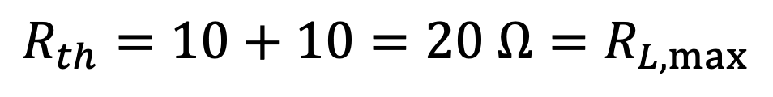
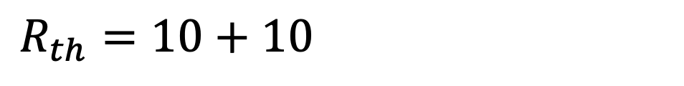

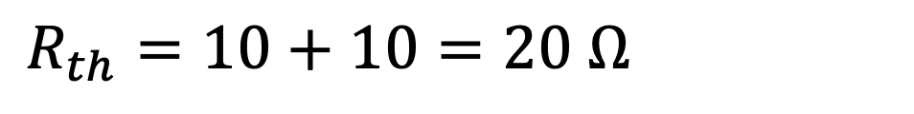
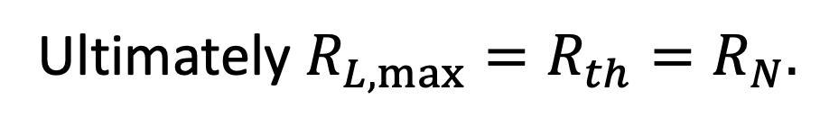
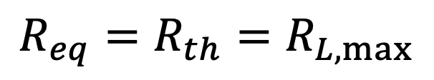
What load $R_{L}$ attached between terminals $a$ and $b$ will maximize the
power deliver to the load?
$$R_{eq}=R_{th}=R_{L,max}$$
$$R_{eq}=R_{th}=R_{L,max}$$
A) $5 Ω$
B) $10 Ω$
C) $15 Ω$
D) $20 Ω$
E) Something else
Only have an independent source.
Deactivate it and find equivalent resistance.
$$R_{th}=10+10=20 Ω=R_{L,max}$$
$$R_{th}=10+10=20 Ω=R_{L,max}$$
$$R_{th}=10+10=20 Ω=R_{L,max}$$
Note: Can think in terms of either
Thévenin or Norton equivalents.
Ultimately $R_{L,max}=R_{th}=R_{N}.$

Slide 8
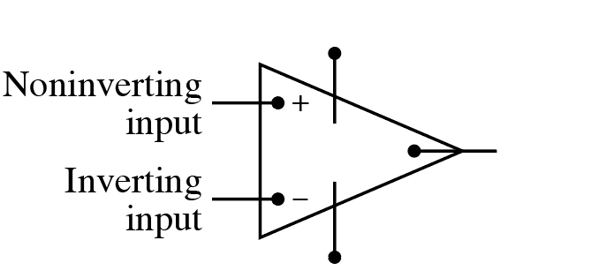
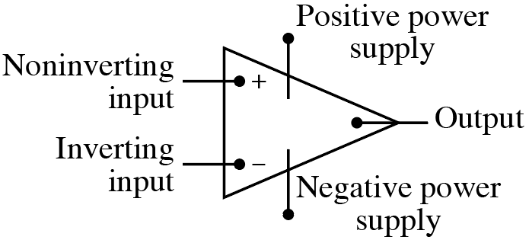
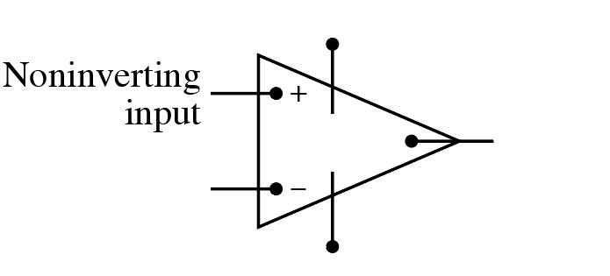
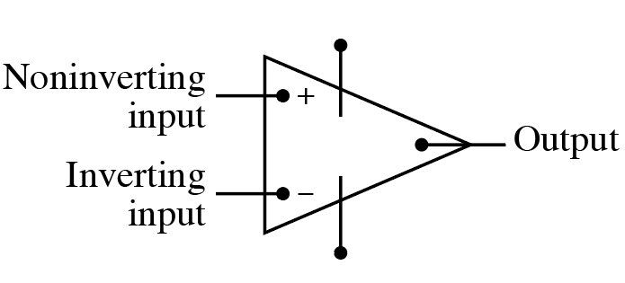
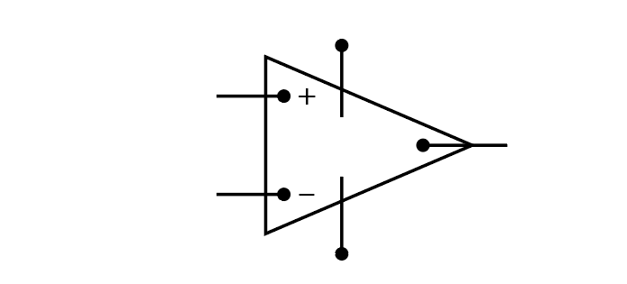

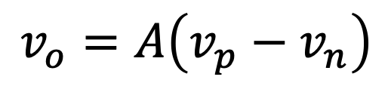
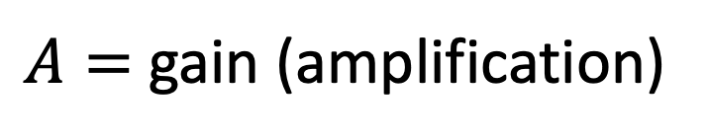


Operational Amplifiers
: Active devices with extremely high “gain.”
Two input terminals: one “noninverting” and one “inverting.”
One output terminal (voltage).
Output voltage is gain times voltage difference across noninverting
and inverting terminals.
$$v_{o}=A\left(v_{p}−v_{n}\right)$$
$A=$ gain (amplification)
Requires positive and negative power supplies.
$$v_{p}$$
$$v_{o}$$
$$v_{n}$$

Slide 9
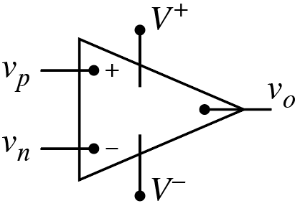
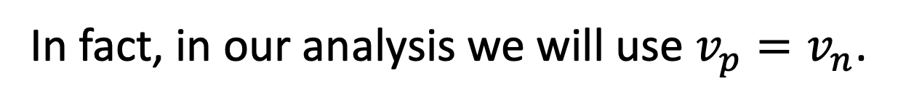
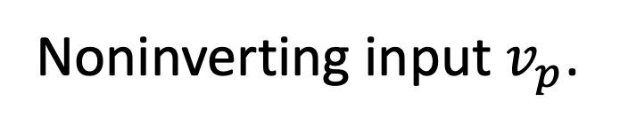
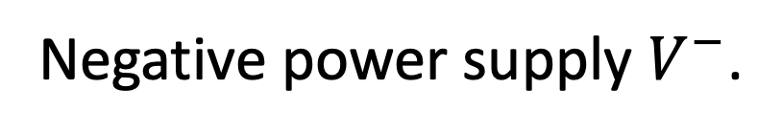
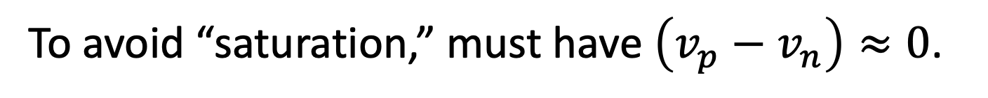
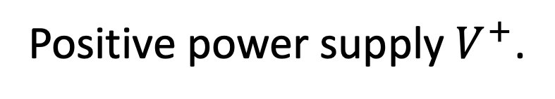
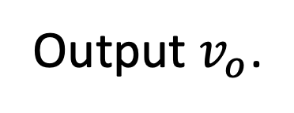




Operational Amplifiers (voltages)
Positive power supply $V^{+}$.
Noninverting input $v_{p}$.
Output $v_{o}$.
Inverting input $v_{n}$.
Negative power supply $V^{−}$.
Output $v_{o}=A\left(v_{p}−v_{n}\right)$.
But, output cannot be $>V^{+}$or $<V^{−}$.
Gain $A$ typically greater than ${10}^{4}$, i.e., very large.
Demonstrated in later lecture.
In practice, $A$ so large that it is typically well approximated by $∞$.
To avoid “saturation,” must have $\left(v_{p}−v_{n}\right)≈0$.
Op-amp saturated when
$v_{o}=V^{−}$ or $v_{o}=V^{+}$.
In fact, in our analysis we will use $v_{p}=v_{n}$.
??? How is that?
???
Use feedback to ensure difference between inputs “sufficiently small.”

Slide 10





Operational Amplifiers (currents)
Inputs $v_{n}$ and $v_{p}$“sense” voltages,
but they don’t draw any current.
Input resistance very high ($>{10}^{6} Ω$).
(Will take these to be
identically zero.)
Input resistance well approximated by $∞$.
$i_{p}≈0$ and $i_{n}≈0$.
Output behaves like an ideal voltage source.
$i_{o}$ will be whatever necessary to maintain $v_{o}$. (Output resistance $≈0$.)
$i_{o}$ will be whatever necessary to maintain $v_{o}$. (Output resistance $≈0$.)

Slide 11





Comment on schematics. Voltage can be:
Comment on schematics. Voltage can be:
$$+ \\ v_{a} \\ −$$
A node voltage (i.e., potential with respect to ground).
No need to specify polarity (it is implied).
Difference in potential from point to point in a circuit
(often associated with a single element).
Must specify polarity.
All points along by a wire are at the same potential.
May draw multiple grounds in a circuit.
Understood all are connected.
$$0 V$$
$$0 V$$
$$0 V$$
$$0 V$$

Slide 12




Consider:
$v_{f}$ and $v_{o}$ are point-to-point
voltages.
$$+ v_{f}−$$
Can draw multiple grounds
(interconnection understood).
Because $v_{o}$ is with respect to
ground, it is also a node
voltage.
Don’t need to explicitly
draw ground for $v_{o}$.
Typical representation of an op-amp circuit.
Also, often omit the voltage sources and
simply show specified voltage at inputs.
Often ignore op-amp power
supplies (not drawn).

Slide 13
Consider:
$v_{f}$ and $v_{o}$ are point-to-point
voltages.
$$+ v_{f}−$$
Can draw multiple grounds
(interconnection understood).
Because $v_{o}$ is with respect to
ground, it is also a node
voltage.
Don’t need to explicitly
draw ground for $v_{o}$.
Typical representation of an op-amp circuit.
Also, often omit the voltage sources and
simply show specified voltage at inputs.
Often ignore op-amp power
supplies (not drawn).

Slide 14





















Must provide “feedback” to prevent circuit from saturating.
What is inverting voltage $v_{n}$?
Op-amp not
saturated.
$$i_{f}$$
$$v_{o}+\frac{R_{s}}{R_{s}+R_{f}}\left(v_{o}−v_{a}\right)$$
A)
$$v_{a}$$
$$v_{n}$$
$$− v_{s}+$$
$$i_{n}$$
$$i_{f}$$
$$v_{a}−\frac{R_{s}}{R_{s}+R_{f}}\left(v_{o}−v_{a}\right)$$
$$v_{p}$$
B)
$$i_{f}=\frac{v_{o}−v_{a}}{R_{s}+R_{f}}$$
$$v_{a}+\frac{R_{s}}{R_{s}+R_{f}}\left(v_{o}−v_{a}\right)$$
C)
$$v_{n}=v_{a}+v_{s}$$
Knowing $i_{n}=0,$ can use voltage
division to find $v_{s}$. $R_{s}$ and $R_{f}$in series.
$$v_{b}+\frac{R_{s}}{R_{s}+R_{f}}\left(v_{o}−v_{a}\right)$$
Knowing $i_{n}=0,$ can use voltage
division to find $v_{s}$. $R_{s}$ and $R_{f}$in series.
D)
Having been told how op-amps behave,
also know that $v_{n}≈v_{p}=v_{b}$.
But…
Having been told how op-amps behave,
also know that $v_{n}≈v_{p}=v_{b}$.
Can equate and express
$v_{0}$ in terms of $v_{a}$ and $v_{b}$.
E)
$$v_{b}$$

Slide 15








Operational Amplifiers
Key Points!
$i_{p}≈0$ and $i_{n}≈0$.
$i_{o}$ will be whatever necessary to maintain $v_{o}$.
If not saturated (i.e., $V^{−}<v_{o}<V^{+}$):
IMPORTANT!
$$\left(v_{p}−v_{n}\right)≈0$$
$$v_{p}≈v_{n}$$
For analysis, will assume:
$$i_{p}=0$$
These assumptions are
the key to analyzing
op-amp circuits.
$$i_{n}=0$$
$$v_{p}=v_{n}$$
Notes:
jkhjghjghjgj

Slide 16



Feedback ensures that $v_{p}≈v_{n}$ (which we must have to avoid saturation).
Feedback ensures that $v_{p}≈v_{n}$ (which we must have to avoid saturation).
What is output voltage $v_{o}$ in terms
of input voltages $v_{a}$ and $v_{b}$?
$$v_{b}$$
Voltage at both op-amp input
terminals must be $v_{b}$.
$$i_{n}=0$$
$$v_{b}$$
Dictated by voltage source attached to noninverting input.
Write KCL at inverting terminal (no
current flow into inputs of op-amp):
Difference amplifier
of sorts. (Will revisit.)
$$\frac{v_{b}−v_{a}}{R_{s}}+\frac{v_{b}−v_{o}}{R_{f}}=0$$
$$\frac{v_{b}−v_{a}}{R_{s}}+\frac{v_{b}−v_{o}}{R_{f}}=0$$
$$\frac{v_{b}−v_{a}}{R_{s}}+\frac{v_{b}−v_{o}}{R_{f}}=0$$
Solve for $v_{o}.$
$$\frac{1}{R_{f}}v_{o}=\left(\frac{1}{R_{s}}+\frac{1}{R_{f}}\right)v_{b}−\frac{1}{R_{s}}v_{a}$$
$$v_{o}=\left(\frac{R_{f}}{R_{s}}+1\right)v_{b}−\frac{R_{f}}{R_{s}}v_{a}$$

