Slide 1
EE 261, Spring 2025, Lecture 20
Goals/Topics:
Midterm grade
Realistic op-amp model (i.e., why approx. model okay)
More on op-amp circuits
Introduction to inductors
Best viewed in
presentation mode
in PowerPoint.
Announcement:
HW 7 posted soonish. Due Sunday, Mar. 9th by midnight.

Slide 2
Midterm Grade
Informational only (no permanent record)
14% Homework (7% Mastering; 7% handwritten)
  Based on six Mastering and four handwritten assignments
  No scores dropped (2 will be dropped for final grade)
8% Clicker/Attendance
  Based on weeks 2 through 7
  No scores dropped (3 will be dropped for final grade)
  15 points not added to average (as will be done for final grade)
78% based on Test #1 (one exam is proxy for all exams)
Letter grade assigned using published conversion of score to grade
Rough approximation, but in the ballpark for how you were doing.

Slide 3
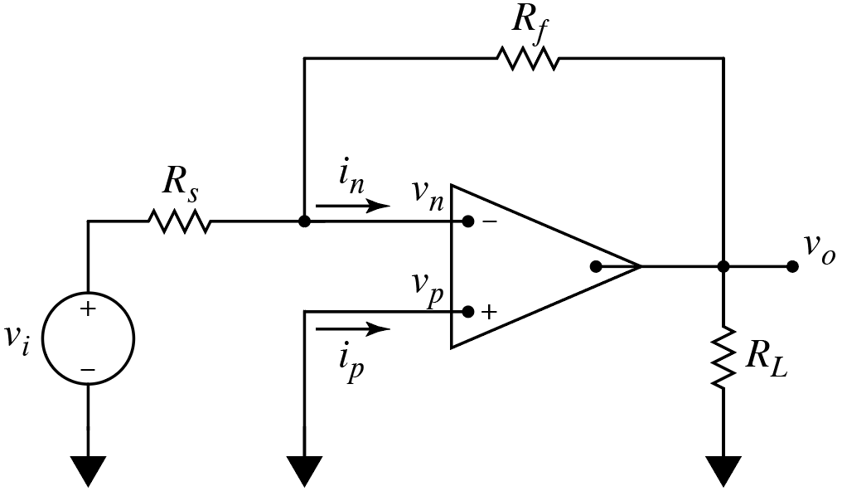
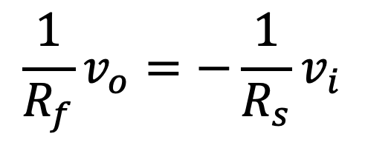

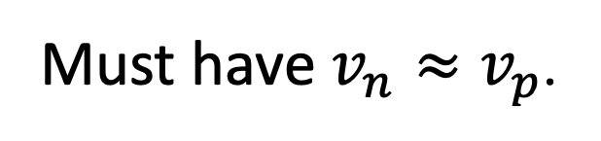
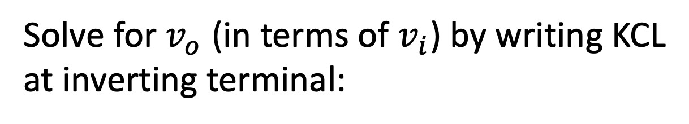

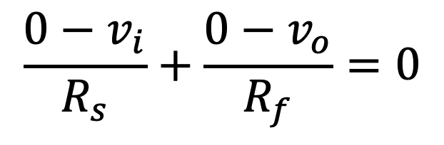
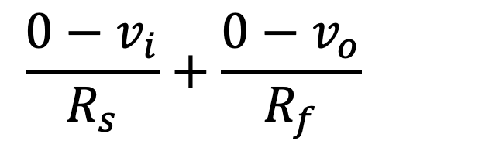
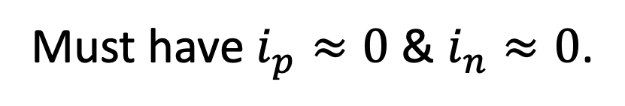

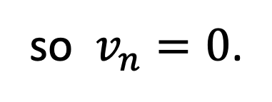
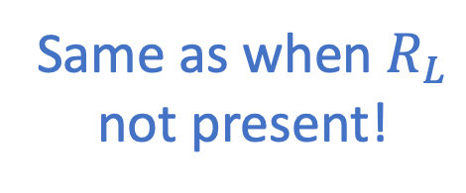
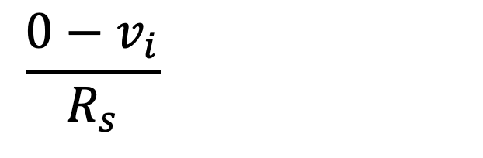



Recall: Inverting Amplifier
Assume not saturated.
Must have $v_{n}≈v_{p}$.
Noninverting terminal
tied to ground.
$$=0 A$$
$$0 V$$
$$0 V$$
$$v_{p}=0$$
so $v_{n}=0$.
$$=0 A$$
Not present when
previously analyzed.
Must have $i_{p}≈0$ & $i_{n}≈0$.
Solve for $v_{o}$ (in terms of $v_{i}$) by writing KCL
at inverting terminal:
Same as when $R_{L}$
not present!
$$\frac{0−v_{i}}{R_{s}}+\frac{0−v_{o}}{R_{f}}=0$$
$$\frac{0−v_{i}}{R_{s}}+\frac{0−v_{o}}{R_{f}}=0$$
$$\frac{0−v_{i}}{R_{s}}+\frac{0−v_{o}}{R_{f}}=0$$
$$\frac{1}{R_{f}}v_{o}=−\frac{1}{R_{s}}v_{i}$$
$$v_{o}=−\frac{R_{f}}{R_{s}}v_{i}$$

Slide 4
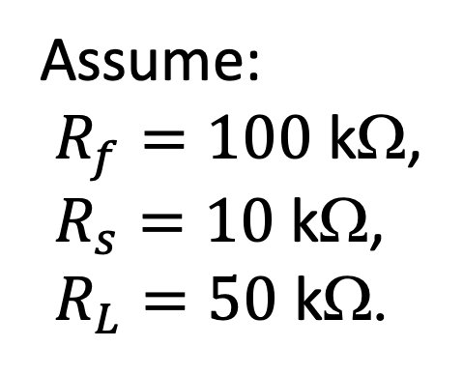

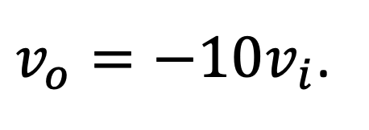
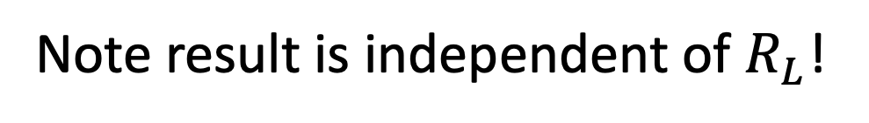
Recall: Inverting Amplifier
$$v_{o}=−\frac{R_{f}}{R_{s}}v_{i}$$
Assume:
$R_{f}=100$ kΩ,
$R_{s}=10$ kΩ,
$R_{L}=50$ kΩ.
$v_{o}=−10v_{i}$.
Note result is independent of $R_{L}$!
Result is a consequence of requiring $v_{p}=v_{n}$, $i_{p}=0$, and $i_{n}=0$.
But is any of this reasonable?

Slide 5
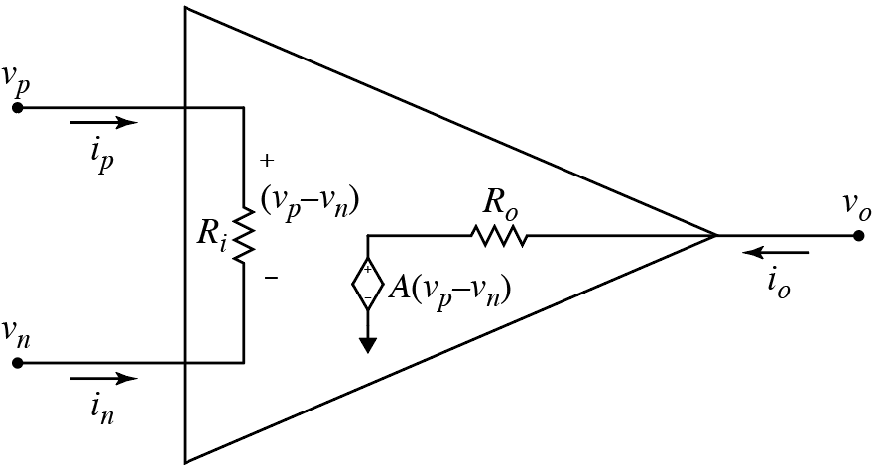
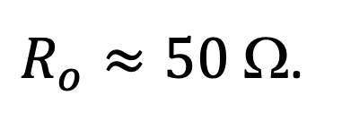
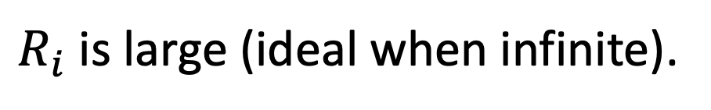
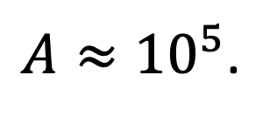
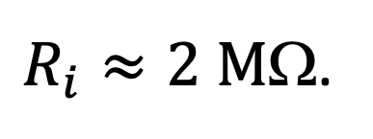
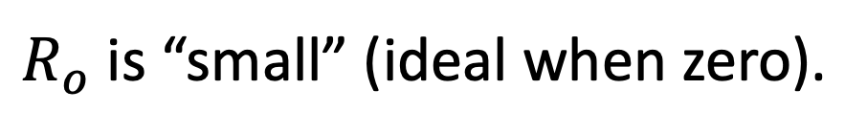
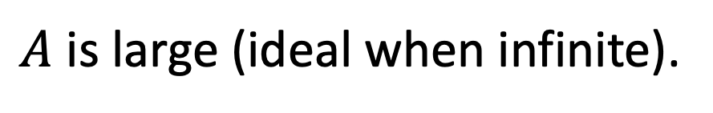
Realistic Op-Amp Model
Not uncommon to have:
$R_{i}$ is large (ideal when infinite).
$R_{i}≈2 M$Ω.
$A$ is large (ideal when infinite).
$A≈{10}^{5}$.
$R_{o}$ is “small” (ideal when zero).
$R_{o}≈50$ Ω.

Slide 6



Inverting Amplifier: Realistic Model
$$−$$
$$+$$
$$v_{p}=0$$

Slide 7
Inverting Amplifier: Realistic Model
Looks a bit messy.
Let’s redraw.
Reverse polarity of
dependent source.
Connect all the
grounds.
Remove some of the
bends.

Slide 8
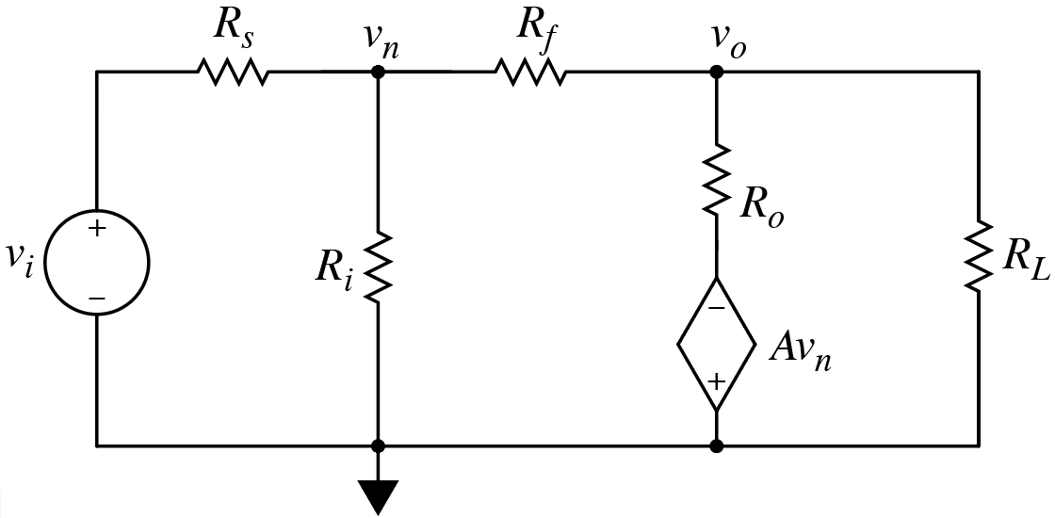
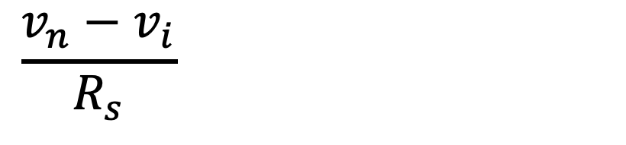
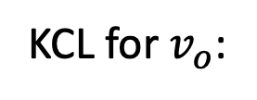
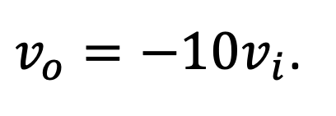
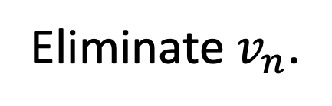
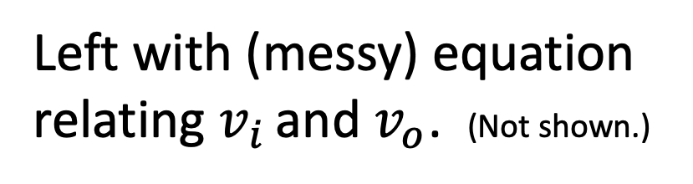
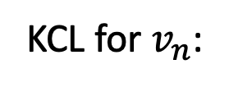
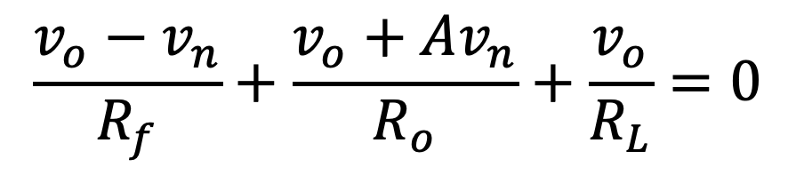
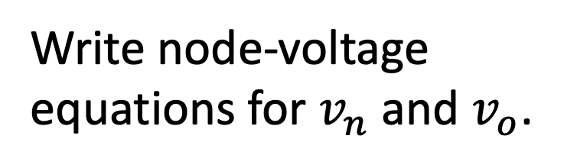
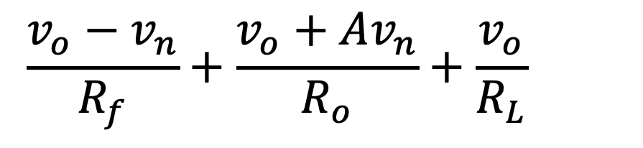
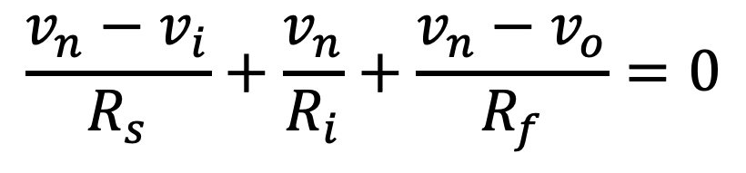
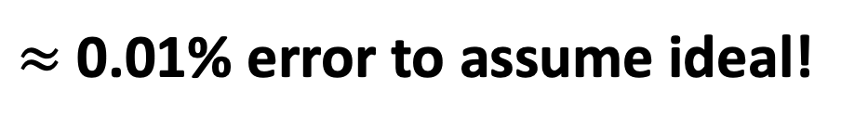
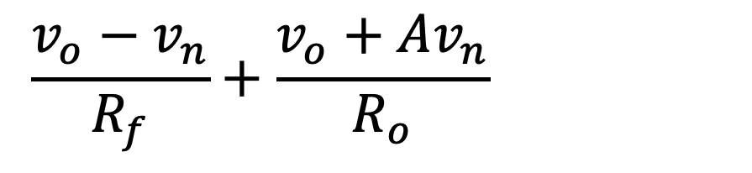
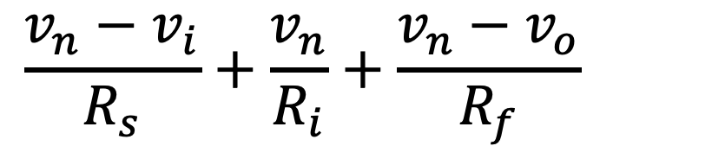

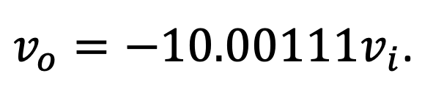
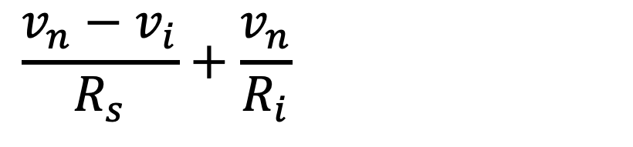
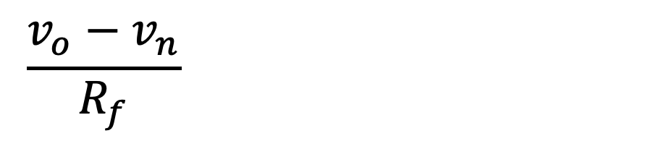
Inverting Amplifier: Realistic Model
Write node-voltage
equations for $v_{n}$ and $v_{o}$.
Two eqs.; three unknowns.
Eliminate $v_{n}$.
$$−Av_{n}$$
Left with (messy) equation
relating $v_{i}$ and $v_{o}$. (Not shown.)
KCL for $v_{n}$:
KCL for $v_{o}$:
$$\frac{v_{o}−v_{n}}{R_{f}}+\frac{v_{o}+Av_{n}}{R_{o}}+\frac{v_{o}}{R_{L}}=0$$
$$\frac{v_{o}−v_{n}}{R_{f}}+\frac{v_{o}+Av_{n}}{R_{o}}+\frac{v_{o}}{R_{L}}=0$$
$$\frac{v_{o}−v_{n}}{R_{f}}+\frac{v_{o}+Av_{n}}{R_{o}}+\frac{v_{o}}{R_{L}}=0$$
$$\frac{v_{n}−v_{i}}{R_{s}}+\frac{v_{n}}{R_{i}}+\frac{v_{n}−v_{o}}{R_{f}}=0$$
$$\frac{v_{o}−v_{n}}{R_{f}}+\frac{v_{o}+Av_{n}}{R_{o}}+\frac{v_{o}}{R_{L}}=0$$
$$\frac{v_{n}−v_{i}}{R_{s}}+\frac{v_{n}}{R_{i}}+\frac{v_{n}−v_{o}}{R_{f}}=0$$
$$\frac{v_{n}−v_{i}}{R_{s}}+\frac{v_{n}}{R_{i}}+\frac{v_{n}−v_{o}}{R_{f}}=0$$
$$\frac{v_{n}−v_{i}}{R_{s}}+\frac{v_{n}}{R_{i}}+\frac{v_{n}−v_{o}}{R_{f}}=0$$
and
Let: R_{f} = 100 kΩ, R_{s} = 10 kΩ, R_{L} = 50 kΩ; R_{i} = 2 MΩ, A = 10⁵, R_{o} = 50 Ω.
$v_{o}=−10.00111v_{i}$.
$v_{o}=−10v_{i}$.
$≈$ 0.01% error to assume ideal!
“realistic”
“ideal”
So generally okay to assume ideal.

Slide 9
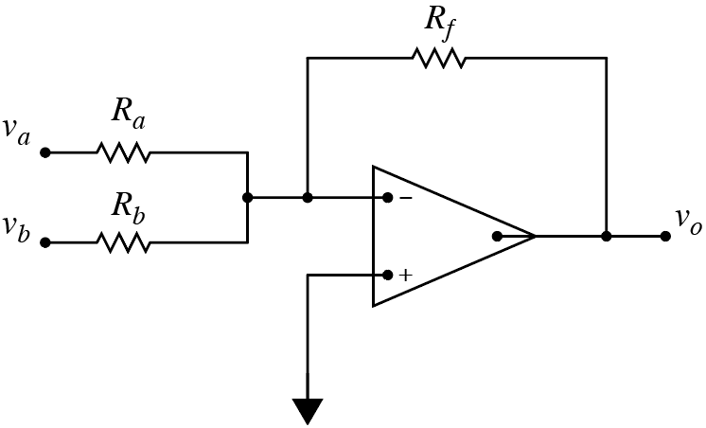
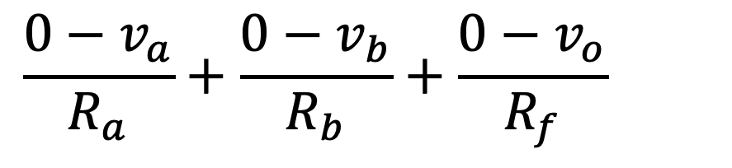
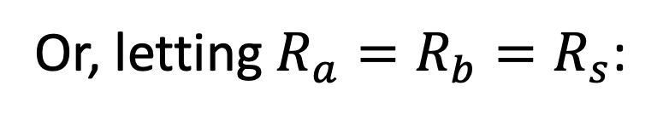
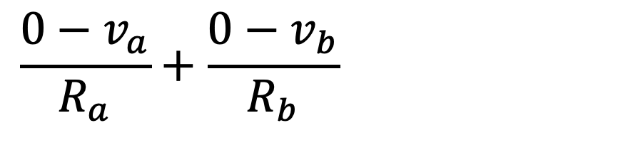
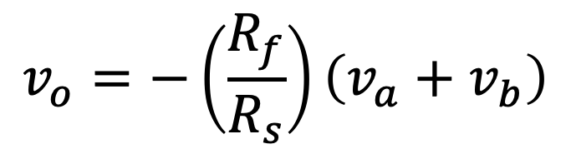
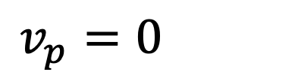
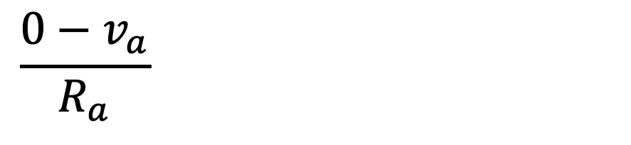
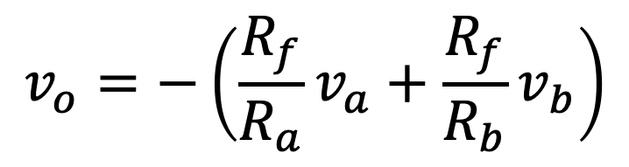
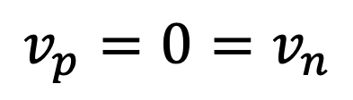

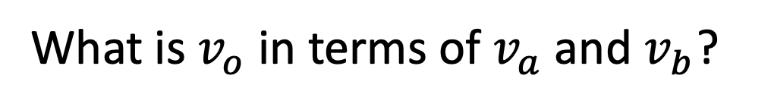


Summing Amplifier
What is $v_{o}$ in terms of $v_{a}$ and $v_{b}$?
$$0 V$$
$$v_{p}=0=v_{n}$$
$$v_{p}=0=v_{n}$$
$$0 A$$
$$0 V$$
Write KCL at inverting terminal.
$$\frac{0−v_{a}}{R_{a}}+\frac{{0−v}_{b}}{R_{b}}+\frac{{0−v}_{o}}{R_{f}}=0$$
$$v_{o}=−\left(\frac{R_{f}}{R_{a}}v_{a}+\frac{R_{f}}{R_{b}}v_{b}\right)$$
$$\frac{0−v_{a}}{R_{a}}+\frac{{0−v}_{b}}{R_{b}}+\frac{{0−v}_{o}}{R_{f}}=0$$
$$\frac{0−v_{a}}{R_{a}}+\frac{{0−v}_{b}}{R_{b}}+\frac{{0−v}_{o}}{R_{f}}=0$$
$$\frac{0−v_{a}}{R_{a}}+\frac{{0−v}_{b}}{R_{b}}+\frac{{0−v}_{o}}{R_{f}}=0$$
$$v_{o}=−\left(\frac{R_{f}}{R_{s}}\right)\left(v_{a}+v_{b}\right)$$
Or, letting $R_{a}=R_{b}=R_{s}$:

Slide 10











Consider:
Assume all resistors known and op-amp not saturated.
Given only $v_{1}$, can $v_{n}$ be determined?
Yes
No
Given only $v_{2}$ and $v_{3}$, can $v_{n}$ be
determined? Same as $v_{p}$.
Given only $v_{2}$ and $v_{3}$, can $v_{n}$ be
determined? Same as $v_{p}$.
$$+$$
$$v_{p}$$
$$−$$
Yes
No
$$v_{p}=\left(\frac{R_{4}}{R_{2}+R_{4}}\right)v_{2}+\left(\frac{R_{4}}{R_{3}+R_{4}}\right)v_{3}$$
?
Is $v_{p}$ given by the following?
Want superposition of contributions from $v_{2}$ and $v_{3}$?
$$v_{p}=\left(\frac{R_{3}||R_{4}}{R_{2}+R_{3}{||R}_{4}}\right)v_{2}+\left(\frac{R_{2}||R_{4}}{R_{3}+R_{2}||R_{4}}\right)v_{3}$$
Yes
No
$v_{3}$ set to zero.
$v_{2}$ set to zero.
But, “cleaner” to use KCL at $v_{p}$ to find $v_{p}$.

Slide 11




















Consider:
Want $v_{o}$ in terms of $v_{1}$, $v_{2}$, and $v_{3}$.
Use KCL at $v_{p}$and $v_{n}$.
At $v_{p}$:
$$\frac{v_{p}−v_{2}}{R_{2}}+\frac{v_{p}−v_{3}}{R_{3}}+\frac{v_{p}}{R_{4}}=0$$
$$\frac{v_{p}−v_{2}}{R_{2}}+\frac{v_{p}−v_{3}}{R_{3}}+\frac{v_{p}}{R_{4}}=0$$
$$\frac{v_{p}−v_{2}}{R_{2}}+\frac{v_{p}−v_{3}}{R_{3}}+\frac{v_{p}}{R_{4}}=0$$
$$0 A$$
$$\frac{v_{p}−v_{2}}{R_{2}}+\frac{v_{p}−v_{3}}{R_{3}}+\frac{v_{p}}{R_{4}}=0$$
$$0 A$$
Solve for $v_{p}$ in terms of $v_{2}$ and $v_{3}$.
Note that $v_{n}=v_{p}$.
At $v_{n}$:
FYI:
$$v_{p}={\left(\frac{1}{R_{2}}+\frac{1}{R_{3}}+\frac{1}{R_{4}}\right)}^{−1}\left(\frac{v_{2}}{R_{2}}+\frac{v_{3}}{R_{3}}\right)$$
$$\frac{v_{n}−v_{1}}{R_{1}}+\frac{v_{n}−v_{o}}{R_{f}}=0$$
$$\frac{v_{n}−v_{1}}{R_{1}}+\frac{v_{n}−v_{o}}{R_{f}}=0$$
$$\frac{v_{n}−v_{1}}{R_{1}}+\frac{v_{n}−v_{o}}{R_{f}}=0$$
$$\frac{v_{p}−v_{1}}{R_{1}}+\frac{v_{p}−v_{o}}{R_{f}}=0$$
$$v_{o}=R_{f}\left(\frac{1}{R_{1}}+\frac{1}{R_{f}}\right)v_{p}−\frac{R_{f}}{R_{1}}v_{1}$$
Solve for $v_{o}$, then plug in expression for $v_{p}$.
Solve for $v_{o}$, then plug in expression for $v_{p}$.

Slide 12



Inductors
N&R: “An inductor is an electrical component that opposes any
change in electrical current.”
Hold that thought.
Consider:
“A mass ($M$) is an object that opposes any change in velocity.”
$$F=Ma=M\frac{d(vel)}{dt}$$
$$\frac{d(vel)}{dt}=\frac{F}{M}$$
$$F=Ma=M\frac{d(vel)}{dt}$$
The larger $M$ gets, the smaller the change in velocity for a given force.
Inductors “oppose” changes in current in an analogous way to how
mass “opposes” changes in velocity.
Granted: Slightly goofy way to state things, but makes sense.

Slide 13





Inductors
Oppose how?
It gets complicated.
Charge in motion (current) creates a magnetic field.
Magnetic fields store energy and exert a force on other charges
in motion.
Inductors exploit this fact by tightly coupling currents and
magnetic fields.
Coils of wire (often wound around magnetic material cores).
Circuit representation:
Inductor

Slide 14













Inductors
“An inductor is an electrical component that opposes any change
in electrical current.”
Inductors characterized by their inductance, $L$, in
henries (H).
The larger $L$ is, the smaller the rate of
change in current for a given voltage.
Governing $i$-$v$ equation:
$$\int_{t_{0}}^{t}{ }$$
$$\int_{t_{0}}^{t}{ }$$
$$v_{L}\left(t\right)=L\frac{di_{L}\left(t\right)}{dt}$$
$$\frac{di_{L}\left(t\right)}{dt}=\frac{v_{L}\left(t\right)}{L}$$
$$di_{L}\left(t\right)=\frac{1}{L} v_{L}\left(t\right)dt$$
or
Integrate both sides from time $t_{o}$ to $t$:
Note initial condition.
$$i_{L}\left(t\right)−i_{L}\left(t_{0}\right)=\frac{1}{L}\int_{t_{0}}^{t}{v_{L}\left(t\right)dt}$$
$$i_{L}\left(t\right)=\frac{1}{L}\int_{t_{0}}^{t}{v_{L}\left(t\right)dt}+i_{L}\left(t_{0}\right)$$

