Slide 1
EE 261, Spring 2025, Lecture 21
Goals/Topics:
Test 2 results
More on inductors
Introduction to capacitors
Best viewed in
presentation mode
in PowerPoint.
Announcements: HW 7 posted (due Sunday, March 9th midnight).
And…

Slide 2
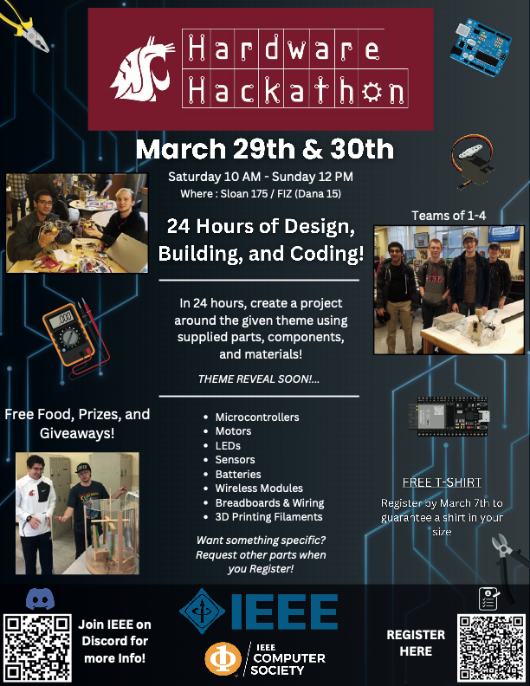


Slide 3

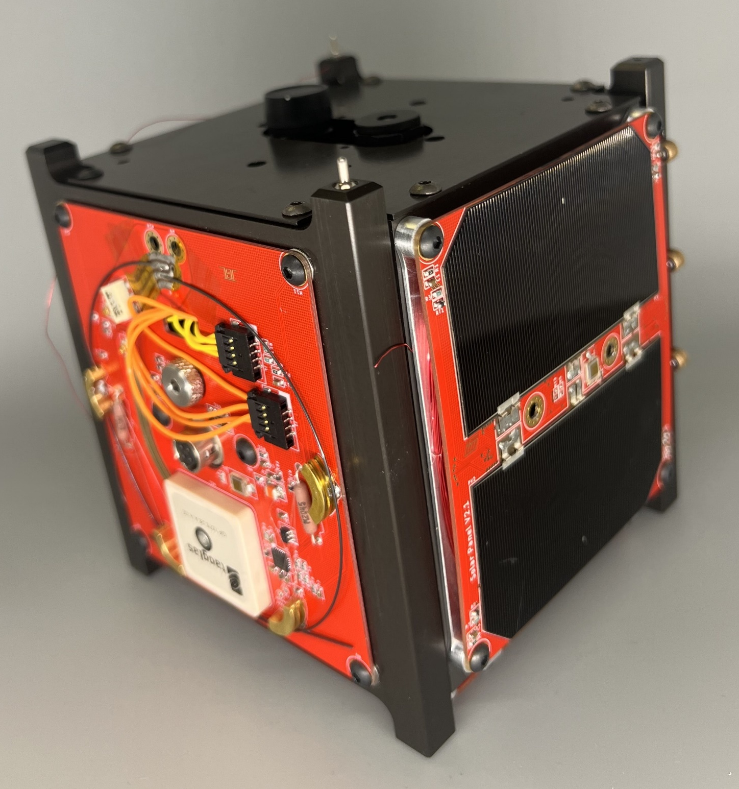
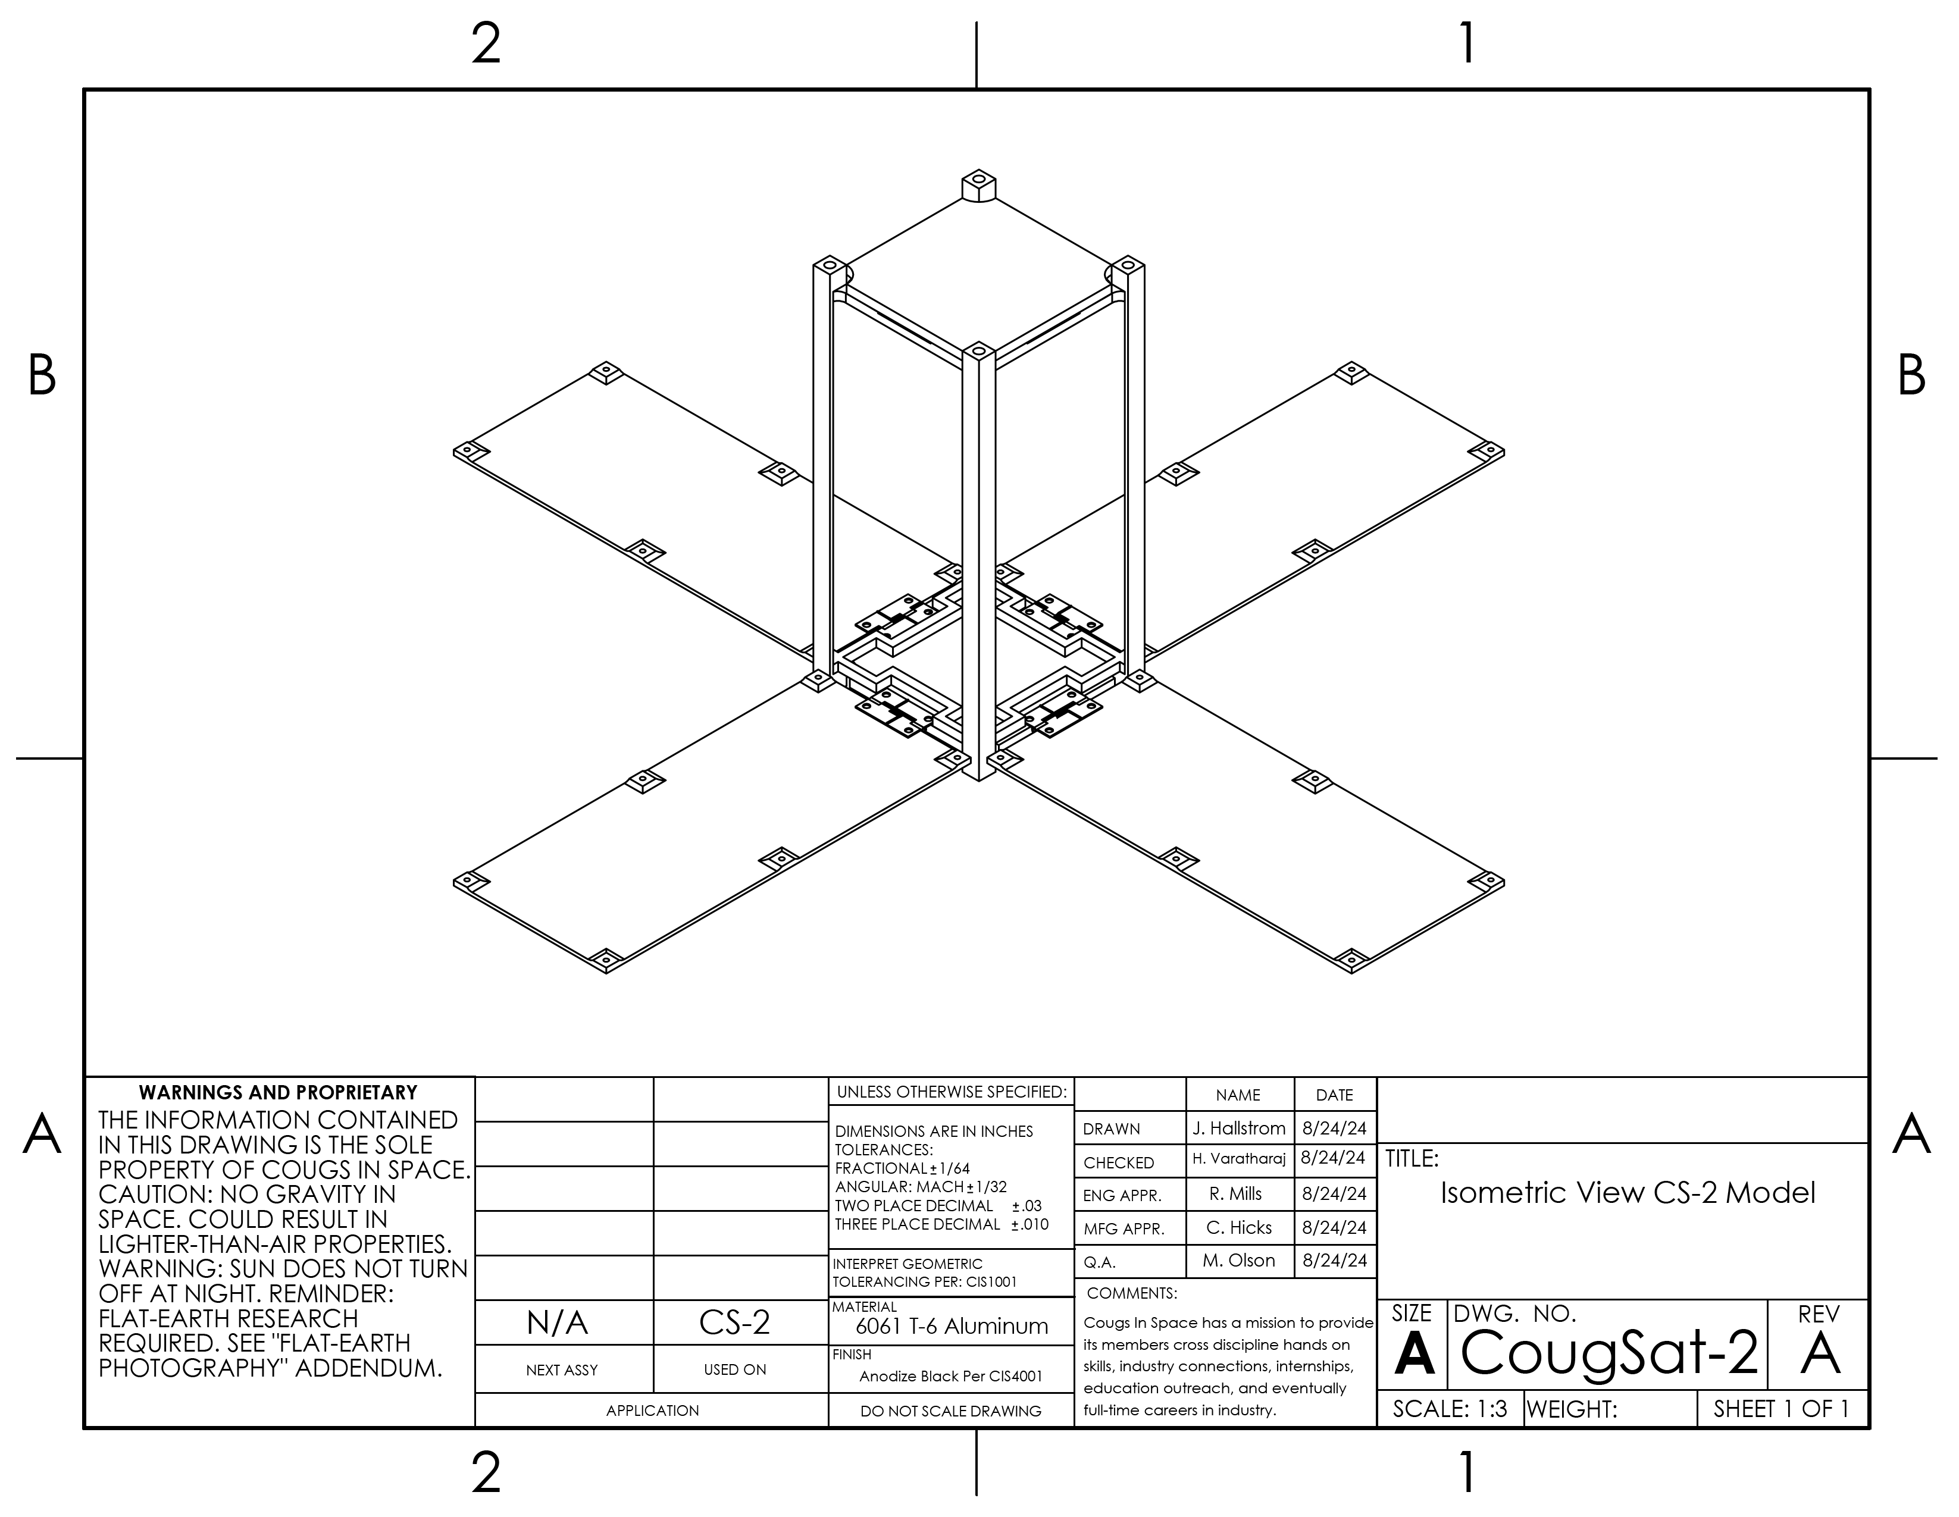
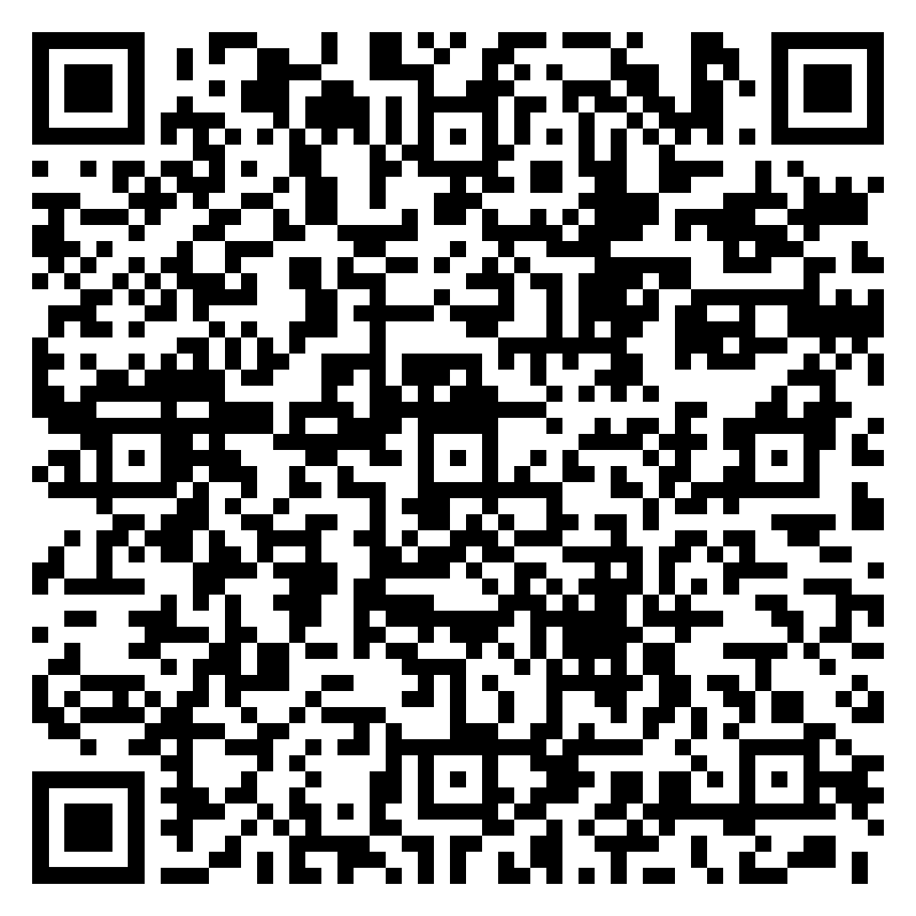
Excited by the Aerospace Industry?
Electrical Team:
PCB Design
PCB Assembly
Systems Integration
Soldering
Circuit Design
Board creation
Self-starters wanted
We are a satellite engineering club!
We focus on the development and assembly, through launch of CubeSat satellites from start to space!
Join us in Dana 306!
Meetings Sunday @ 12:30!
Questions? Join our
Microsoft Teams:

Slide 4
Test 2 Results:
 | Test 1
# of Students | 130
Average | 79.4
Std. Dev. | 15.2
Median | 80
High Score | (18 x) 100
 | Test 1 | Test 2
# of Students | 130 | 130
Average | 79.4 | 70.0
Std. Dev. | 15.2 | 16.6
Median | 80 | 68
High Score | (18 x) 100 | (4 x) 100
 | Test 1 | Test 2 | Avg. T1, T2
# of Students | 130 | 130 | 130
Average | 79.4 | 70.0 | 74.7
Std. Dev. | 15.2 | 16.6 | 14.5
Median | 80 | 68 | 75
High Score | (18 x) 100 | (4 x) 100 | (4 x) 100
B-
Solution available at Canvas and course website.
If you missed anything, please check out the solution.
Understand your mistakes and learn from them.

Slide 5
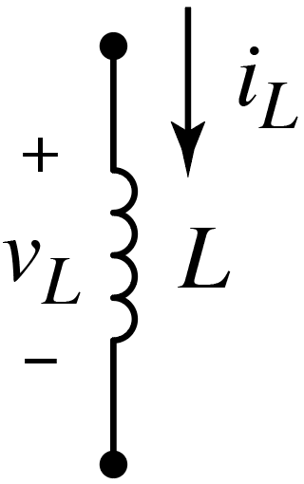
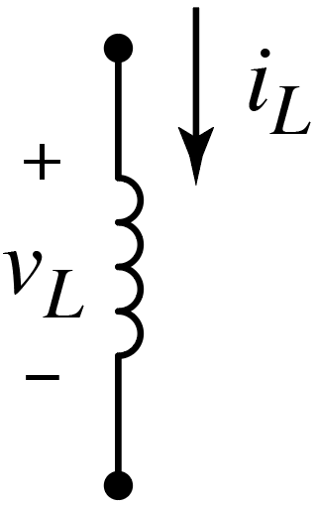
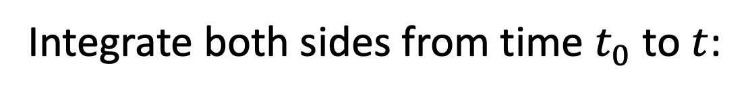
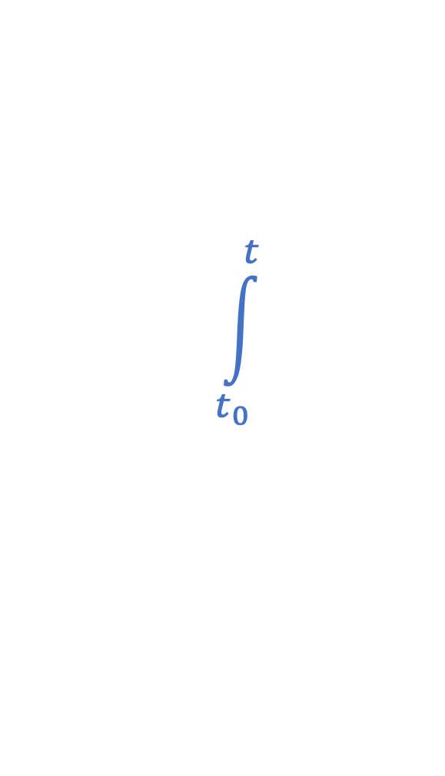
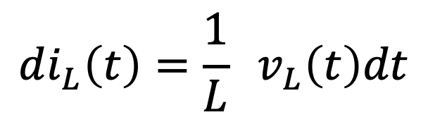
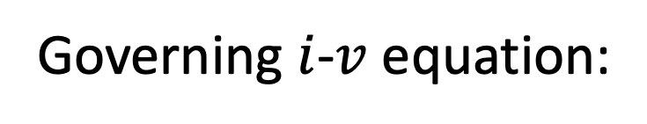
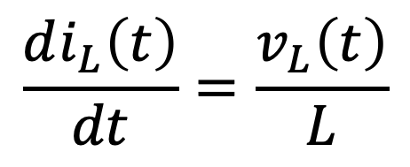
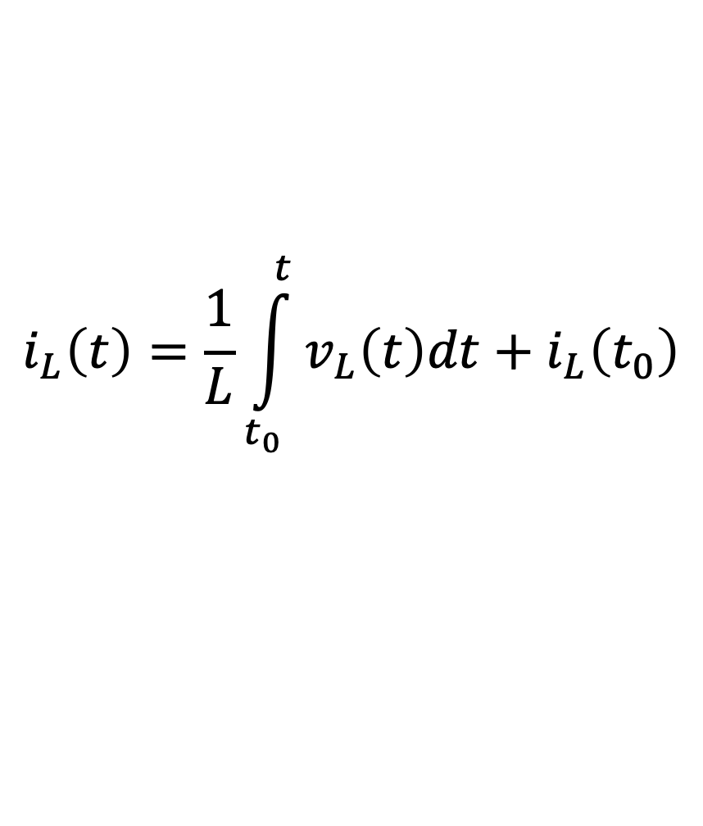
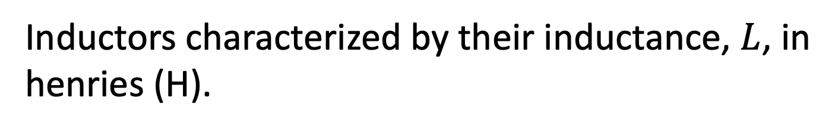
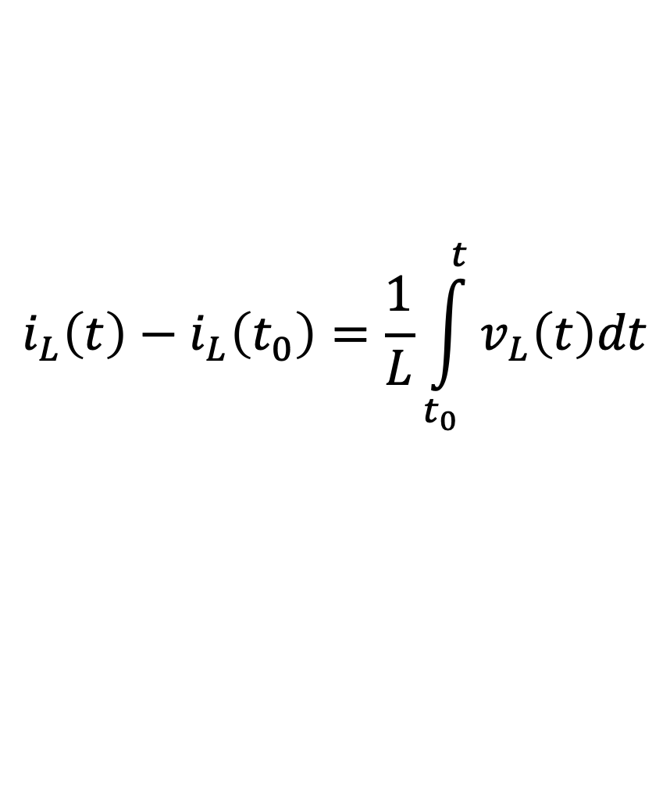
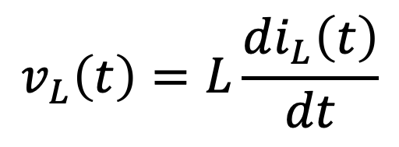
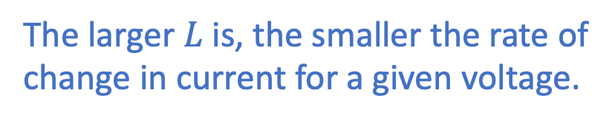

Recall: Inductors
“An inductor is an electrical component that opposes any change
in electrical current.”
Inductors characterized by their inductance, $L$, in
henries (H).
The larger $L$ is, the smaller the rate of
change in current for a given voltage.
Governing $i$-$v$ equation:
$$\int_{t_{0}}^{t}{ }$$
$$\int_{t_{0}}^{t}{ }$$
$$v_{L}\left(t\right)=L\frac{di_{L}\left(t\right)}{dt}$$
$$\frac{di_{L}\left(t\right)}{dt}=\frac{v_{L}\left(t\right)}{L}$$
$$di_{L}\left(t\right)=\frac{1}{L} v_{L}\left(t\right)dt$$
or
Integrate both sides from time $t_{0}$ to $t$:
Note initial condition.
$$i_{L}\left(t\right)−i_{L}\left(t_{0}\right)=\frac{1}{L}\int_{t_{0}}^{t}{v_{L}\left(t\right)dt}$$
$$i_{L}\left(t\right)=\frac{1}{L}\int_{t_{0}}^{t}{v_{L}\left(t\right)dt}+i_{L}\left(t_{0}\right)$$

Slide 6
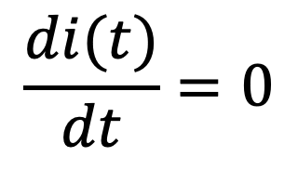
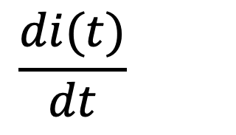
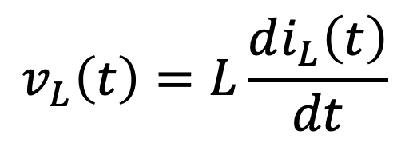
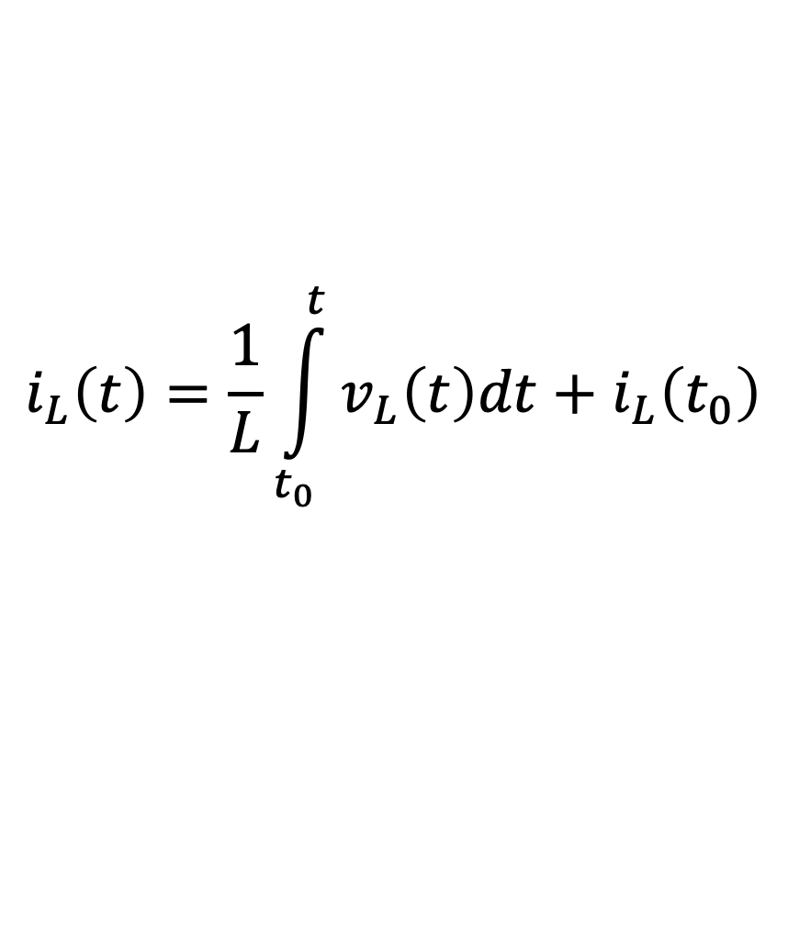
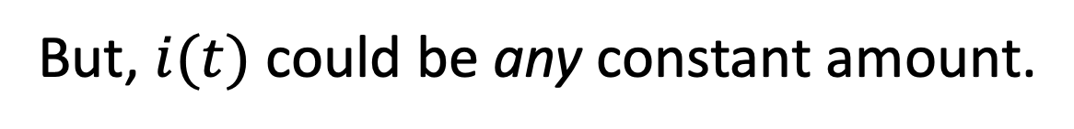
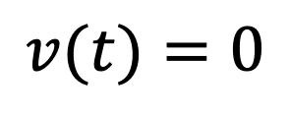
Inductors
$$i_{L}\left(t\right)=\frac{1}{L}\int_{t_{0}}^{t}{v_{L}\left(t\right)dt}+i_{L}\left(t_{0}\right)$$
$$v_{L}\left(t\right)=L\frac{di_{L}\left(t\right)}{dt}$$
or
If the current is not changing, an inductor behaves as:
If the current is not changing
A short circuit
An open circuit
A voltage source
A current source
None of these
Later we will see that from one
instant to the next, can be useful
to regard an inductor as akin to a
current source (current maintainer).
Schematic representation
suggestive of a (coil of)
wire, i.e., a short. That’s
essential what inductor
becomes if current
constant.
Schematic representation
suggestive of a (coil of)
wire, i.e., a short. That’s
essential what inductor
becomes if current
constant.
This relates to inductors
“opposing” changes in current.
Current
constant.
$$\frac{di(t)}{dt}=0$$
$$\frac{di(t)}{dt}=0$$
$$v(t)=0$$
But, $i(t)$ could be any constant amount.

Slide 7
Inductors
$$i_{L}\left(t\right)=\frac{1}{L}\int_{t_{0}}^{t}{v_{L}\left(t\right)dt}+i_{L}\left(t_{0}\right)$$
$$v_{L}\left(t\right)=L\frac{di_{L}\left(t\right)}{dt}$$
or
Things to note:
Inductors store energy.
(They can deliver or consume
power, but energy is never lost.)
If current is not changing, voltage across inductor
is zero.
Important!
Indistinguishable from a short circuit!
Why?
Current cannot change instantaneously.
Key to finding initial
and final conditions
in circuits we’ll soon
consider.
(Current must change continuously.)
Voltage can change discontinuously/instantaneously.
(Tends toward open-circuit behavior at high frequencies.)

Slide 8
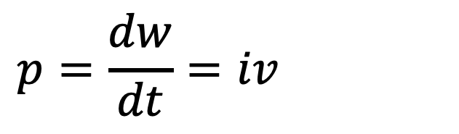
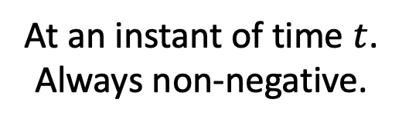
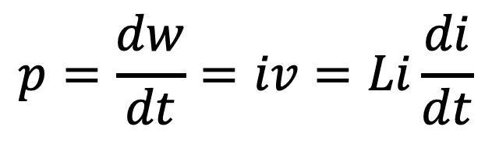
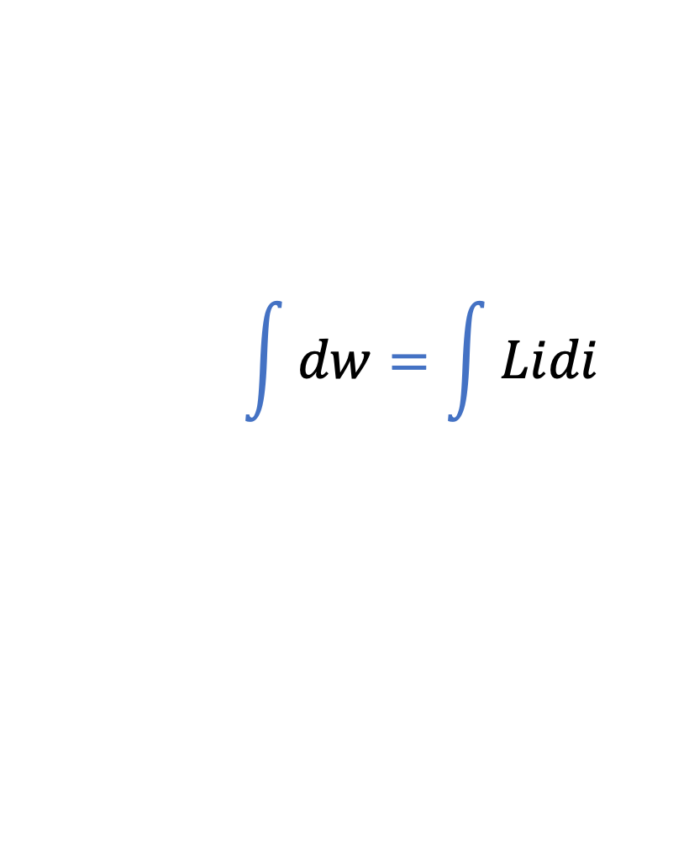
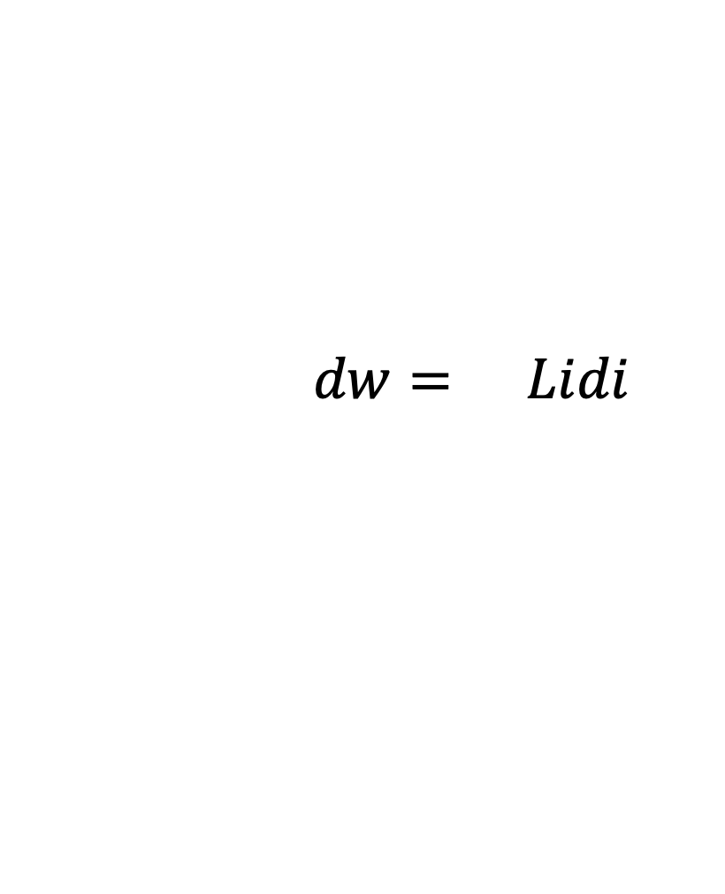
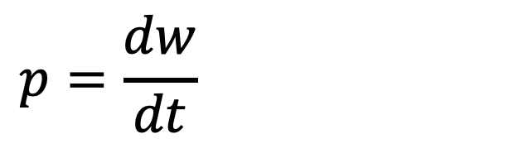
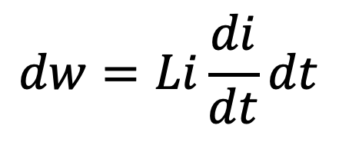
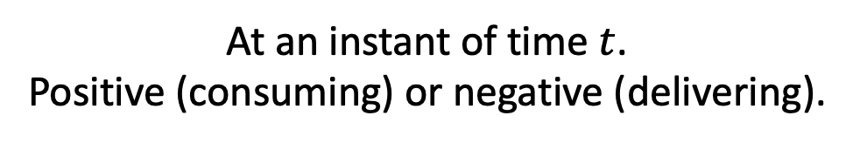
Inductor Power and Energy
$$p=\frac{dw}{dt}=iv=Li\frac{di}{dt}$$
$$p=\frac{dw}{dt}=iv=Li\frac{di}{dt}$$
$$p=\frac{dw}{dt}=iv=Li\frac{di}{dt}$$
$$\int{dw}=\int{Lidi}$$
$$dw=Li\frac{di}{dt}dt$$
$$\int{dw}=\int{Lidi}$$
Stored energy obtained by integrating both sides (from zero to $i$):
$$w\left(t\right)=\frac{1}{2}Li^{2}\left(t\right)$$
$$p\left(t\right)=Li\left(t\right)\frac{di\left(t\right)}{dt}$$
Stored Energy
Power
At an instant of time $t$.
Always non-negative.
At an instant of time $t$.
Positive (consuming) or negative (delivering).

Slide 9
Capacitors
Store equal and opposite amounts of charge on conducting plates
separated by a non-conducting gap.
(No net accumulation of charge!)
Conduction current is flow of actual charges in a conductor.
(Conduction current exists in wires.)
Displacement current is created by a changing electric field.
(Displacement current exists in gap between plates.)
Both currents have units of amperes and can be thought of as
equivalent in terms of “movement” of charge.
(Maxwell’s great contribution was postulating existence of
displacement current.)

Slide 10
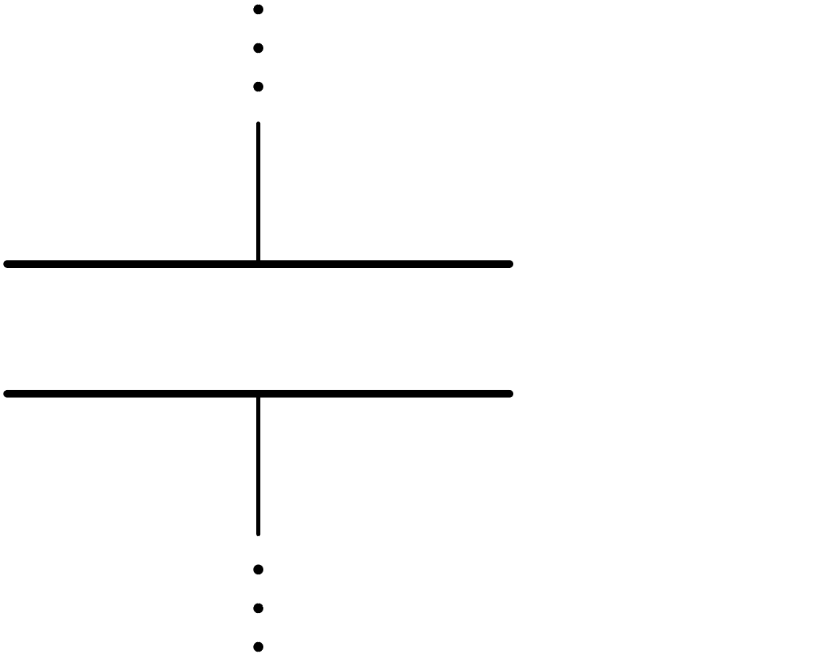
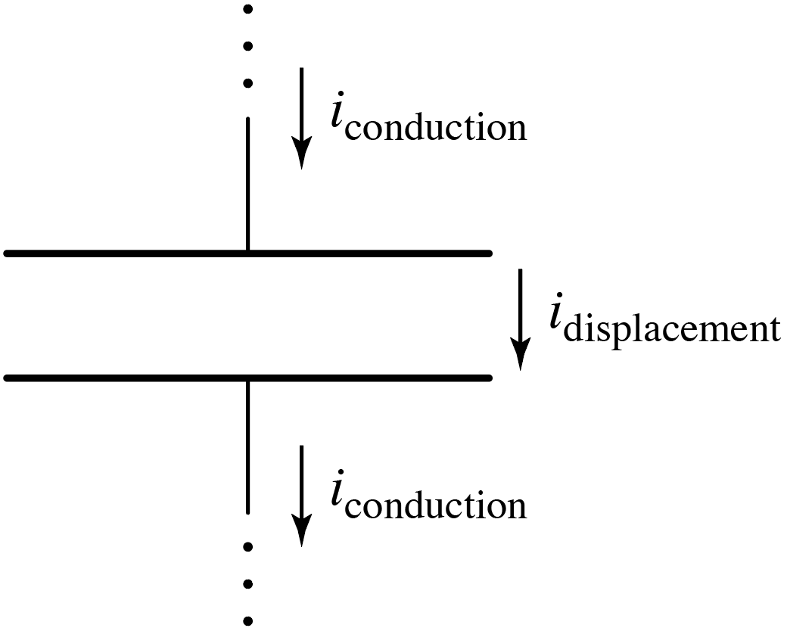
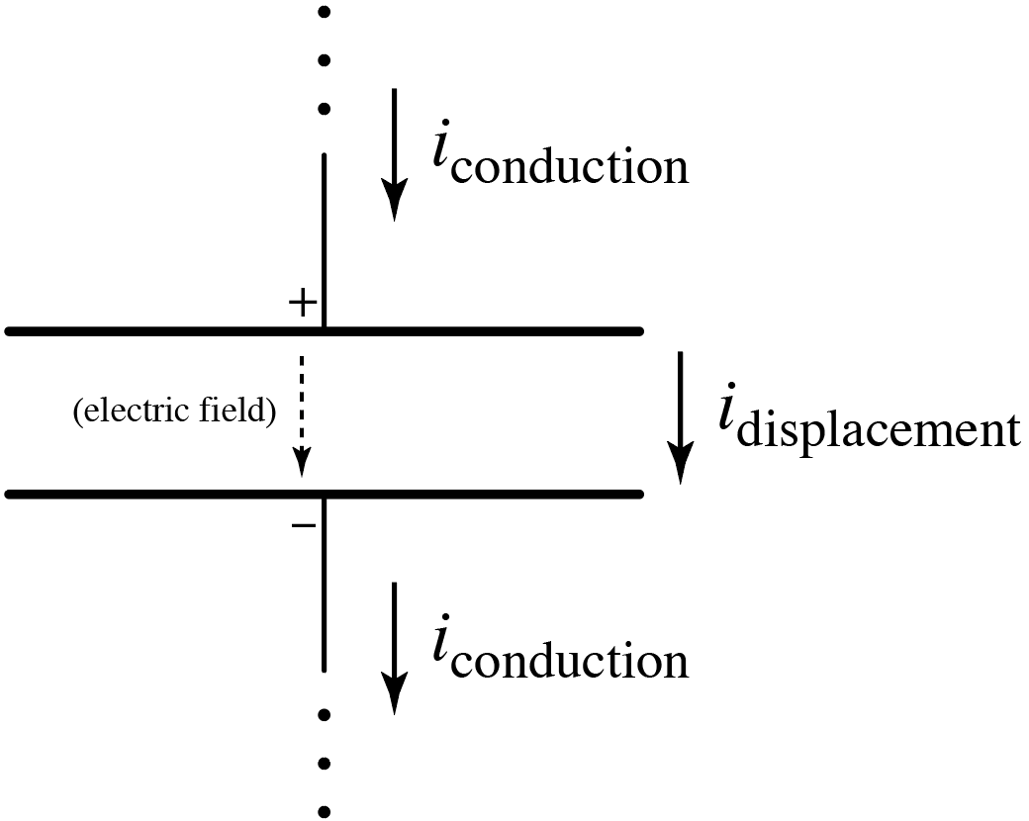
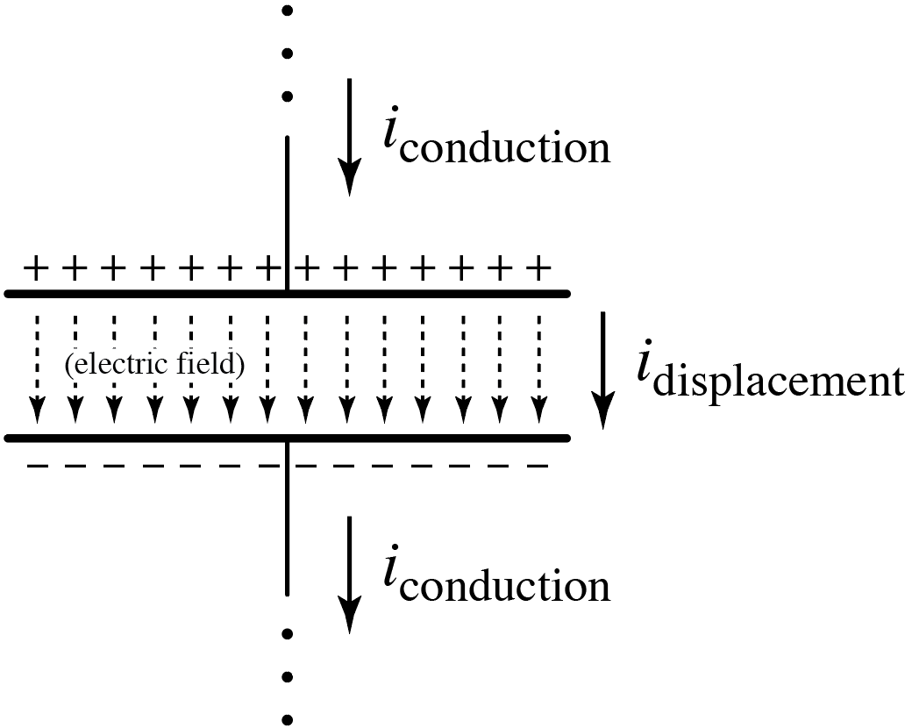
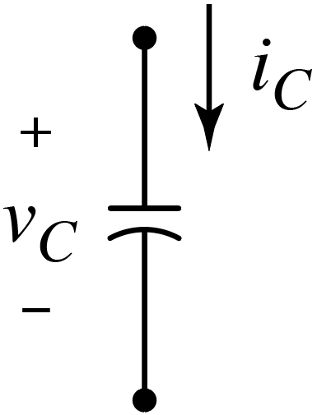
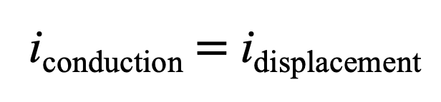
Capacitors
Circuit representation:
(Don’t worry about curvature of one of
the plates. Can draw both as straight.)
i_{conduction} $=$ i_{displacement}
KCL still holds at the circuit level. Net charge isn’t being accumulated anywhere.
KCL still holds at the circuit level. Net charge isn’t being accumulated anywhere.

Slide 11
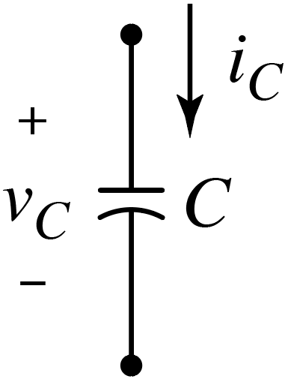
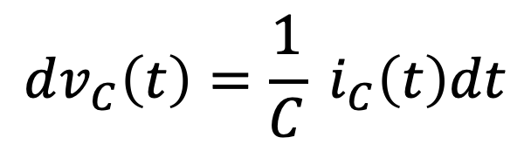
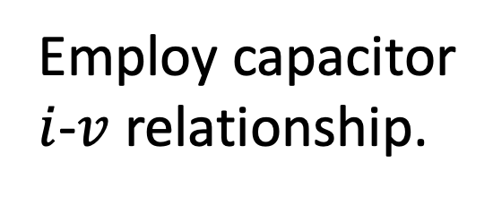
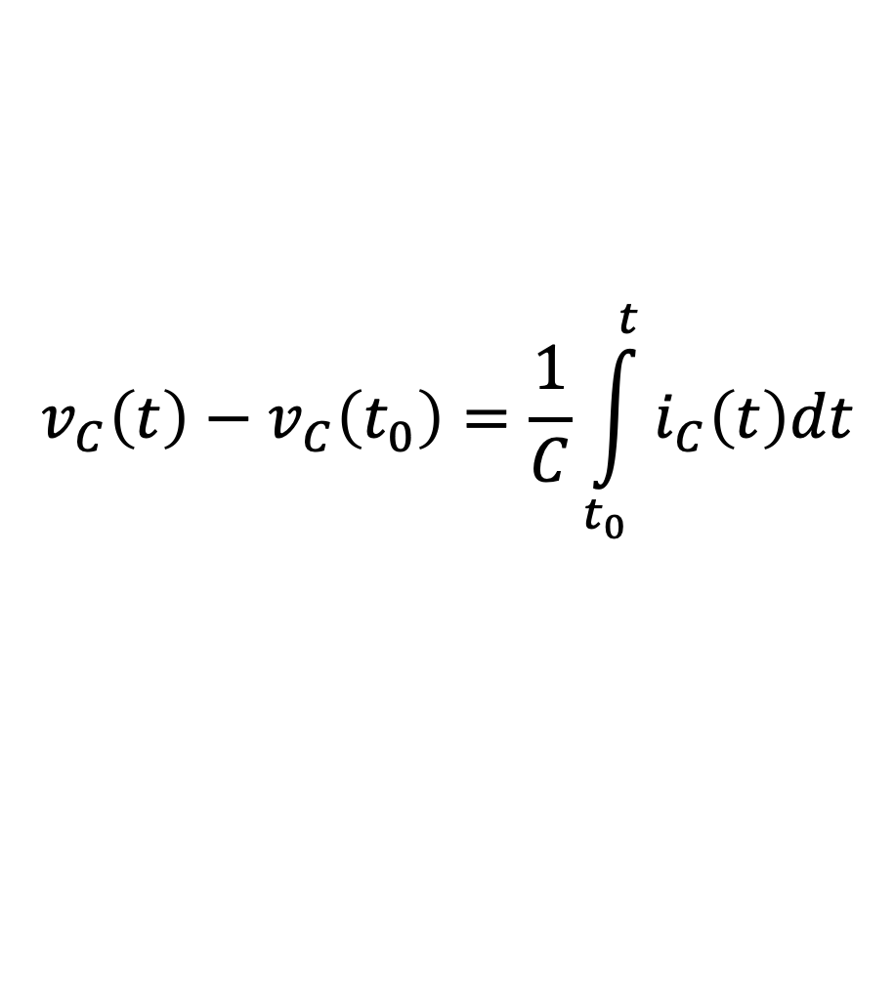
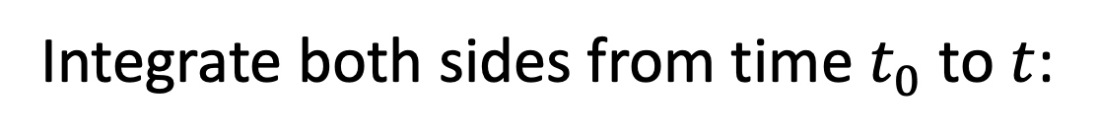
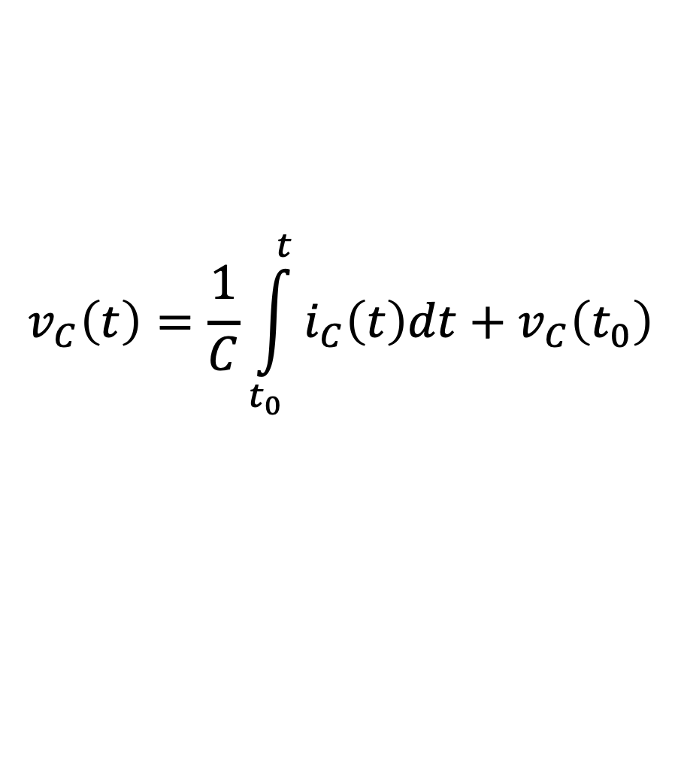
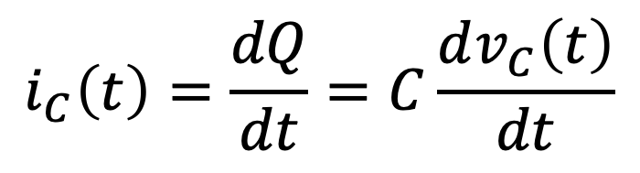

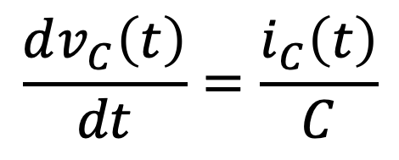
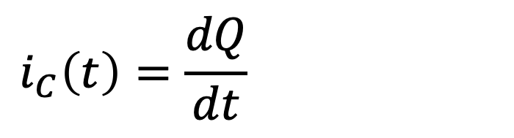
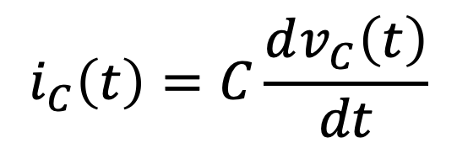
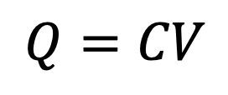
Capacitors
Capacitors characterized by their capacitance, C, in
farads (F).
(Could say capacitors “oppose”
changes in voltage.)
Governing $i$-$v$ equation:
$$\int_{t_{0}}^{t}{ }$$
$$\int_{t_{0}}^{t}{ }$$
$$i_{C}\left(t\right)=C\frac{dv_{C}\left(t\right)}{dt}$$
$$\frac{dv_{C}\left(t\right)}{dt}=\frac{i_{C}\left(t\right)}{C}$$
$$dv_{C}\left(t\right)=\frac{1}{C} i_{C}\left(t\right)dt$$
or
Integrate both sides from time $t_{0}$ to $t$:
Note initial condition.
$$v_{C}\left(t\right)−v_{C}\left(t_{0}\right)=\frac{1}{C}\int_{t_{0}}^{t}{i_{C}\left(t\right)dt}$$
$$v_{C}\left(t\right)=\frac{1}{C}\int_{t_{0}}^{t}{i_{C}\left(t\right)dt}+v_{C}\left(t_{0}\right)$$
$$i_{C}\left(t\right)=\frac{dQ}{dt}=C\frac{dv_{C}\left(t\right)}{dt}$$
$$i_{C}\left(t\right)=\frac{dQ}{dt}=C\frac{dv_{C}\left(t\right)}{dt}$$
Employ capacitor
$i$-$v$ relationship.
Recall:
$$Q=CV$$

Slide 12
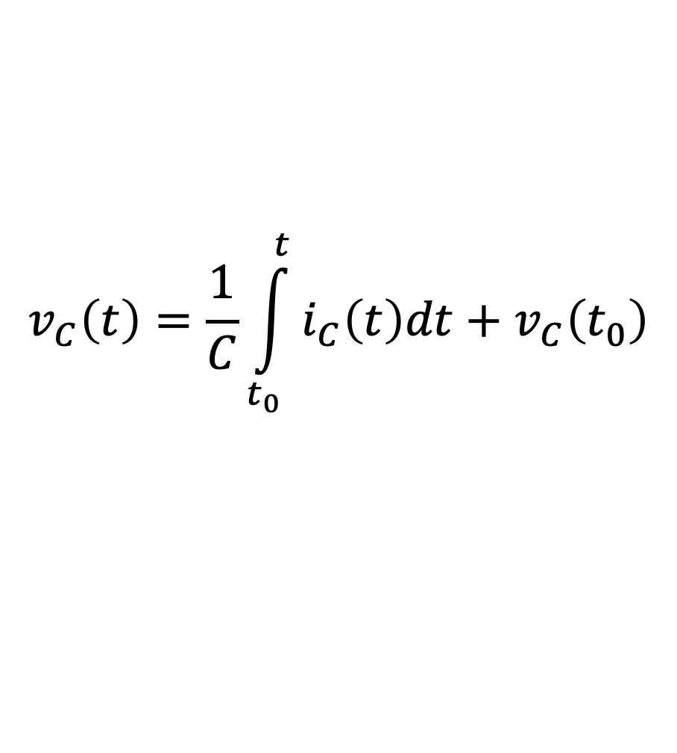
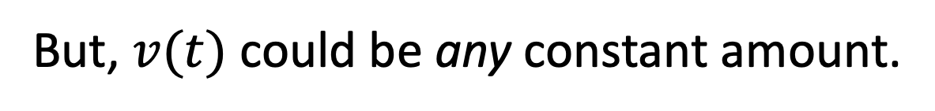
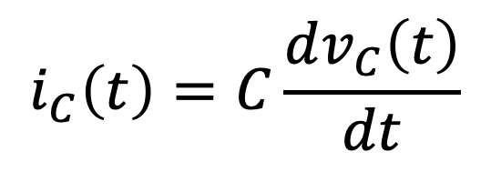



Capacitors
$$v_{C}\left(t\right)=\frac{1}{C}\int_{t_{0}}^{t}{i_{C}\left(t\right)dt}+v_{C}\left(t_{0}\right)$$
$$i_{C}\left(t\right)=C\frac{dv_{C}\left(t\right)}{dt}$$
If the voltage is not changing, a capacitor behaves as:
If the voltage is not changing
A short circuit
An open circuit
A voltage source
A current source
Something else
Later we will see that from one
instant to the next, can be useful
to regard a capacitor as akin to a
voltage source (voltage maintainer).
Schematic representation
is suggestive of an open
circuit. That’s essentially
what capacitor becomes
if voltage constant.
Schematic representation
is suggestive of an open
circuit. That’s essentially
what capacitor becomes
if voltage constant.
This relates to capacitors
“opposing” changes in voltage.
Voltage
constant.
$$\frac{dv(t)}{dt}=0$$
$$\frac{dv(t)}{dt}=0$$
$$i(t)=0$$
But, $v(t)$ could be any constant amount.

Slide 13








Recap: Inductors
$$i_{L}\left(t\right)=\frac{1}{L}\int_{t_{0}}^{t}{v_{L}\left(t\right)dt}+i_{L}\left(t_{0}\right)$$
$$v_{L}\left(t\right)=L\frac{di_{L}\left(t\right)}{dt}$$
representation
$v$ in terms of $i$
$i$ in terms of $v$
Include minus sign if current flowing into lower polarity terminal!
Capacitors
Passive sign convention always holds.
$$v_{C}\left(t\right)=\frac{1}{C}\int_{t_{0}}^{t}{i_{C}\left(t\right)dt}+v_{C}\left(t_{0}\right)$$
$$i_{C}\left(t\right)=C\frac{dv_{C}\left(t\right)}{dt}$$
representation
$i$ in terms of $v$
$v$ in terms of $i$

Slide 14


Capacitors
$$v_{C}\left(t\right)=\frac{1}{C}\int_{t_{0}}^{t}{i_{C}\left(t\right)dt}+v_{C}\left(t_{0}\right)$$
$$i_{C}\left(t\right)=C\frac{dv_{C}\left(t\right)}{dt}$$
Things to note:
Capacitors store energy.
(They can deliver or consume
power, but energy is never lost.)
If voltage is not changing, current through capacitor
is zero.
Important!
Indistinguishable from an open circuit!
Why?
Voltage cannot change instantaneously.
Key to finding initial
and final conditions
in circuits we’ll soon
consider.
(Voltage must change continuously.)
Current can change discontinuously/instantaneously.
(Tends toward short-circuit behavior at high frequencies.)

Slide 15










Capacitor Power and Energy
$$v_{C}\left(t\right)=\frac{1}{C}\int_{t_{0}}^{t}{i_{C}\left(t\right)dt}+v_{C}\left(t_{0}\right)$$
$$i_{C}\left(t\right)=C\frac{dv_{C}\left(t\right)}{dt}$$
$$p=\frac{dw}{dt}=vi=Cv\frac{dv}{dt}$$
$$p=\frac{dw}{dt}=vi=Cv\frac{dv}{dt}$$
$$p=\frac{dw}{dt}=vi=Cv\frac{dv}{dt}$$
$$\int{dw}=\int{Cvdv}$$
$$dw=Cv\frac{dv}{dt}dt$$
$$\int{dw}=\int{Cvdv}$$
Stored energy obtained by integrating both sides (from zero to $v$):
$$w\left(t\right)=\frac{1}{2}Cv^{2}\left(t\right)$$
Never
negative.
$$p\left(t\right)=Cv\left(t\right)\frac{dv\left(t\right)}{dt}$$
Negative or
positive.
Stored Energy
Power

