Slide 1
EE 261, Spring 2025, Lecture 24
Goals/Topics:
Review first-order system (exponential decay)
First-order RL circuit (natural response)
First-order RC circuit (natural response)
Best viewed in
presentation mode
in PowerPoint.
Announcement: HW 8 posted. Due Sunday, March 23rd.

Slide 2
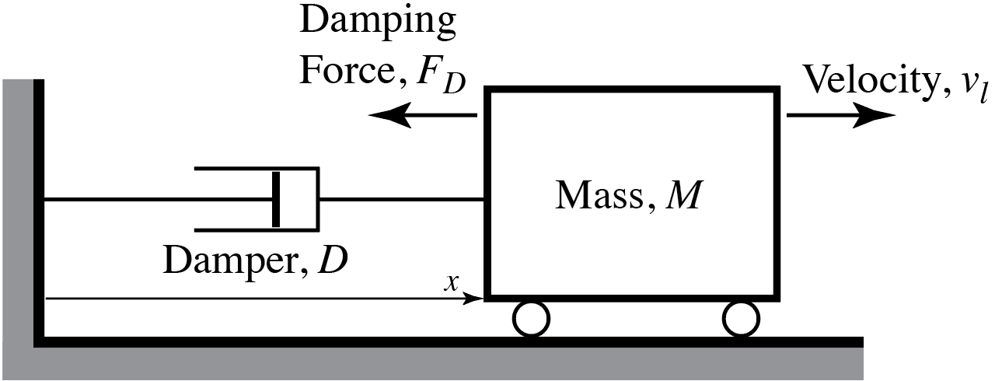
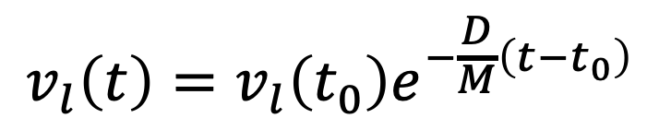
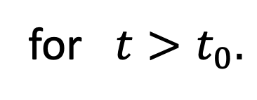
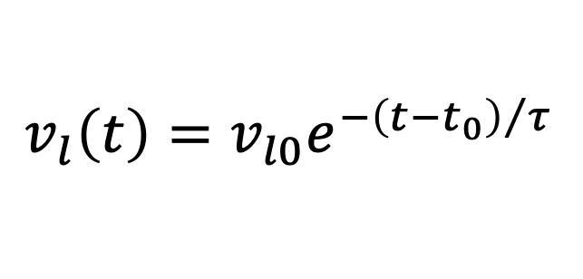
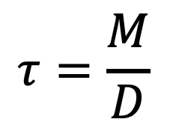
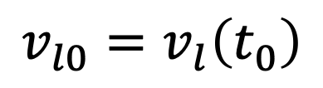
Recall: First-Order System
(Natural Response)
$$v_{l}\left(t\right)=v_{l}\left(t_{0}\right)e^{−\frac{D}{M}\left(t−t_{0}\right)}$$
Initial
condition.
Time at which initial
condition is known.
$$τ=\frac{M}{D}$$
Initial condition shorthand:
$$v_{l0}=v_{l}\left(t_{0}\right)$$
Define time constant:
Describes natural response
of “RL” and “RC” circuits.
$$v_{l}\left(t\right)=v_{l0}e^{−{\left(t−t_{0}\right)}/τ}$$
for $t>t_{0}.$
(Nearly) All (linear) first-order systems act in this way if no forcing
function is present. Said another way, all first-order systems have this
orm for their natural response.
(Nearly) All (linear) first-order systems act in this way if no forcing
function is present. Said another way, all first-order systems have this
form for their natural response.
Decaying exponential.
(Exception: If multiple storage elements present, finding voltage or current may require
an integration that yields a constant term in addition to decaying exponential. Ex. Prob. 7.17.)

Slide 3
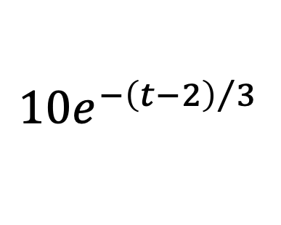
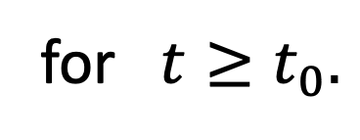
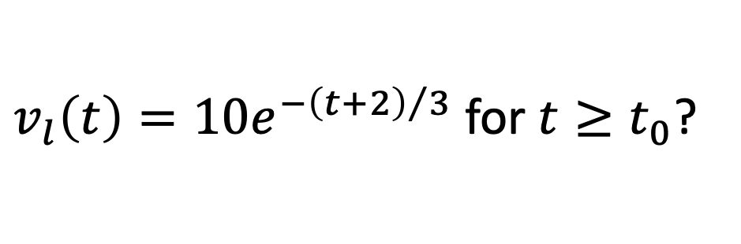

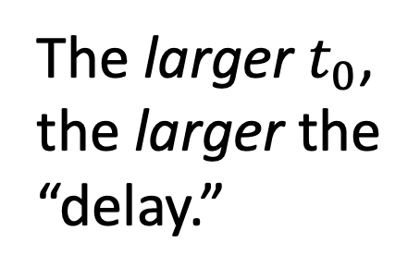
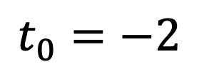

$$v_{l}\left(t\right)=v_{l}\left(t_{0}\right)e^{−{\left(t−t_{0}\right)}/τ}$$
for $t≥t_{0}.$
Which plot corresponds to
$v_{l}\left(t\right)=10e^{−{\left(t+2\right)}/3}$ for $t≥t_{0}$?
A or B
$$t_{0}=−2$$
A
B
$$10e^{−{\left(t−2\right)}/3}$$
The larger $t_{0}$,
the larger the
“delay.”
$$t_{0}=2$$
Both curves
asymptotically
approach zero at
the same rate.
Curves the same
except for being shifted.

Slide 4
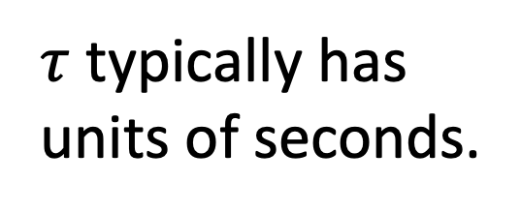
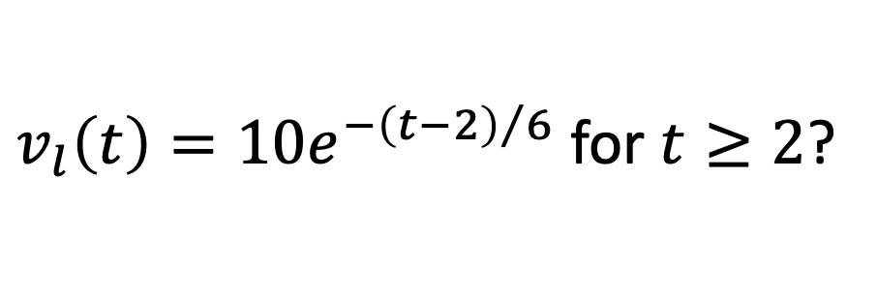
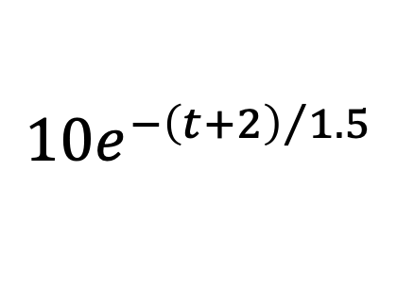
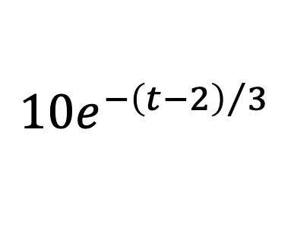

Which plot corresponds to
$v_{l}\left(t\right)=10e^{−{\left(t−2\right)}/6}$ for $t≥2$?
$$τ=6$$
A or B
The larger the
time constant,
the slower the
decay.
B
A
$$10e^{−{\left(t−2\right)}/3}$$
Exponent must
be unitless.
All curves
asymptotically
approach zero but
now at different rates.
$$10e^{−{\left(t+2\right)}/{1.5}}$$
$τ$ typically has
units of seconds.
Value decays by $e^{−1}$ (i.e., $≈36.79\%$) per time constant.

Slide 5
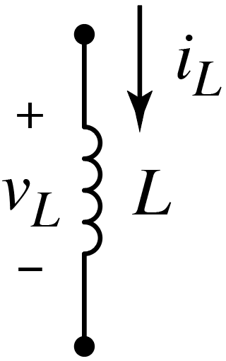
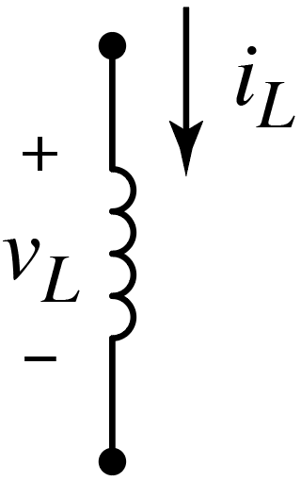
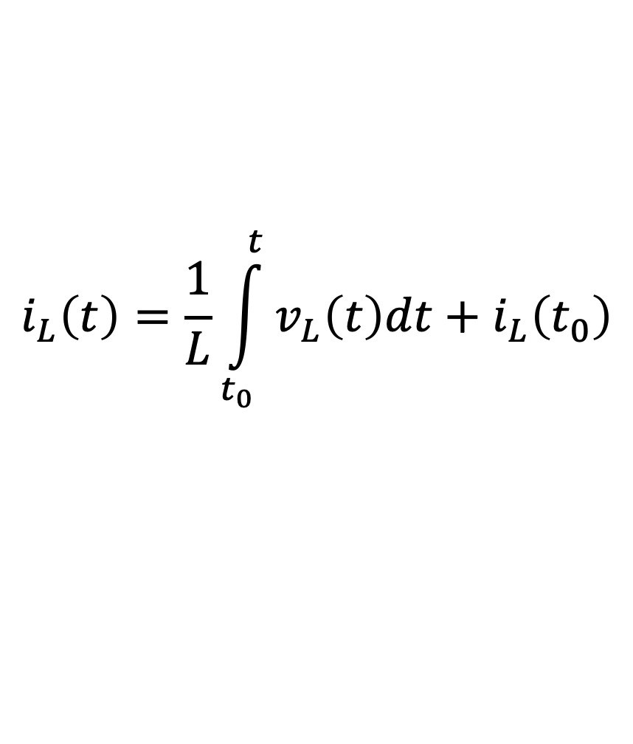
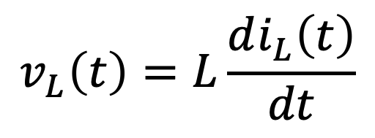

Inductors
Recall governing $i$-$v$ equations:
$$i_{L}\left(t\right)=\frac{1}{L}\int_{t_{0}}^{t}{v_{L}\left(t\right)dt}+i_{L}\left(t_{0}\right)$$
$$v_{L}\left(t\right)=L\frac{di_{L}\left(t\right)}{dt}$$
and
Recall important properties:
Behaves as a short circuit (wire) in steady-state (i.e.,
when no variation in time).
Current cannot change instantaneously.
(“Opposes” changes in current.)
Voltage can change discontinuously/instantaneously.
(Stores energy.)

Slide 6
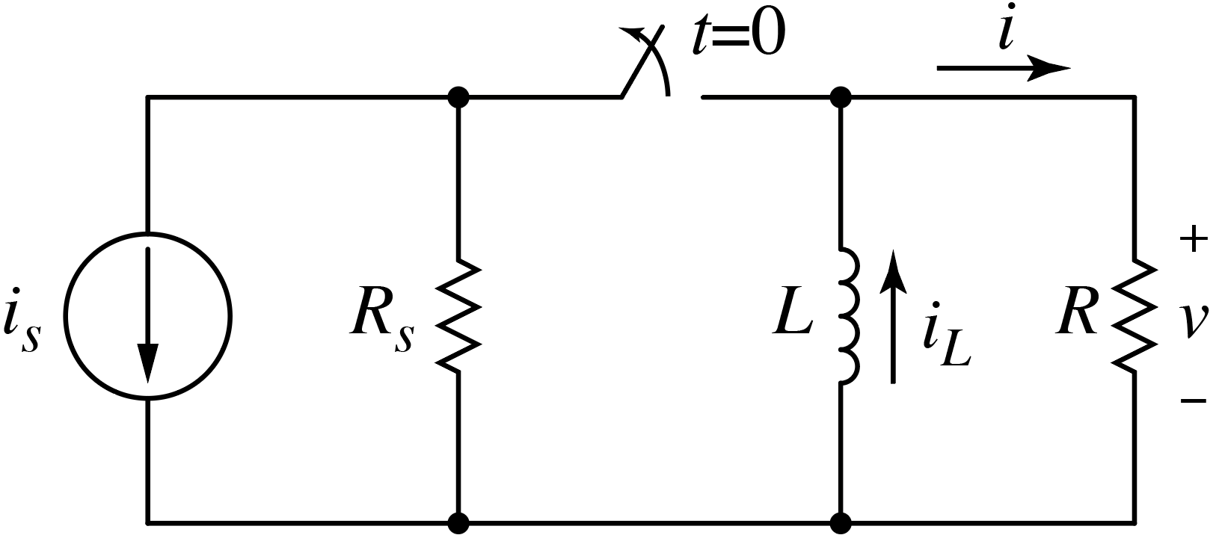
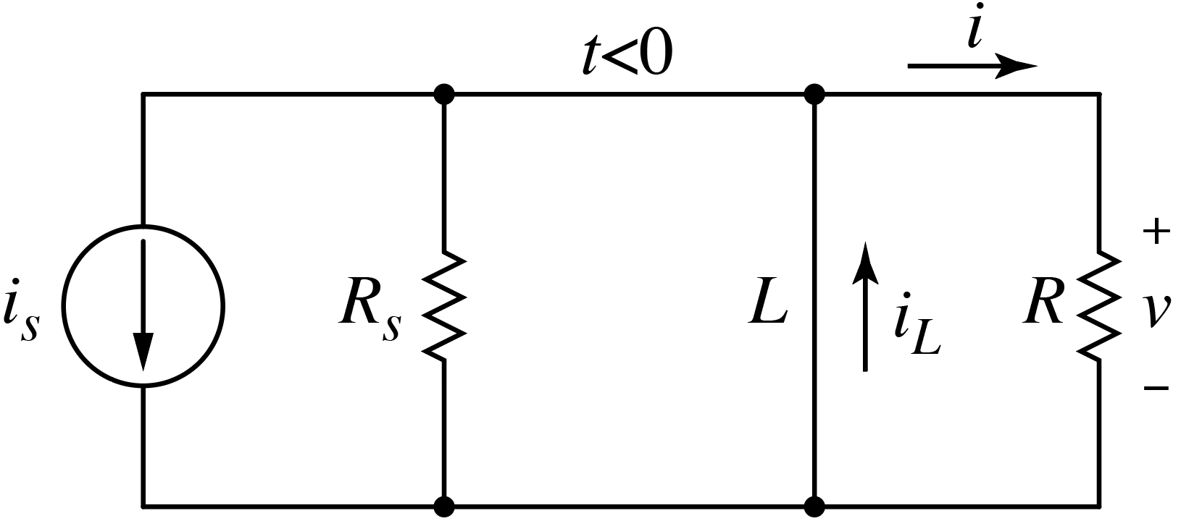
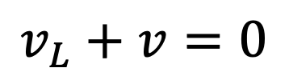
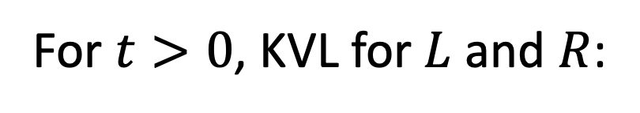
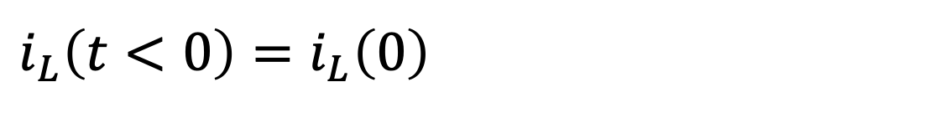
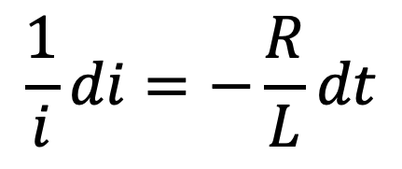
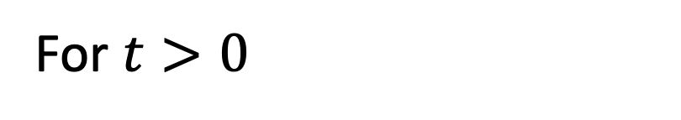

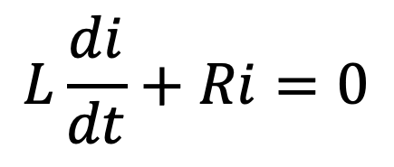
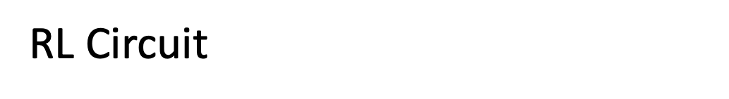
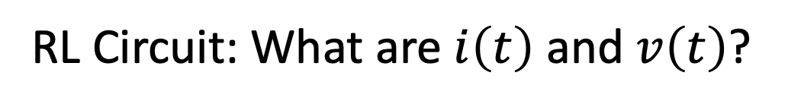
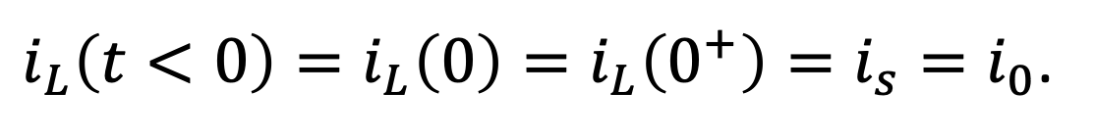
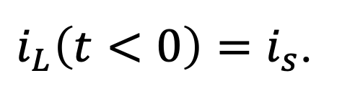
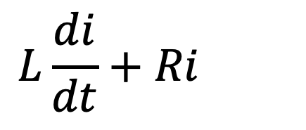
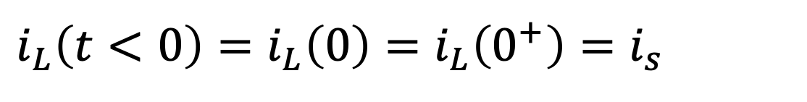
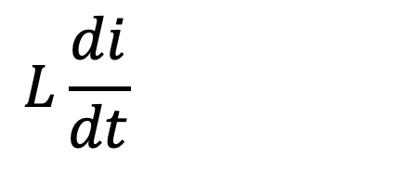
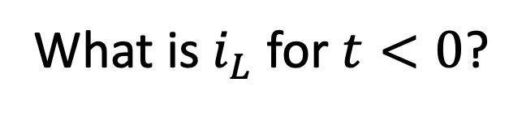
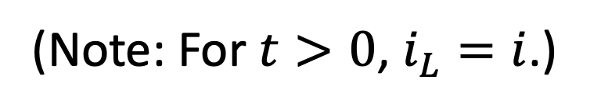
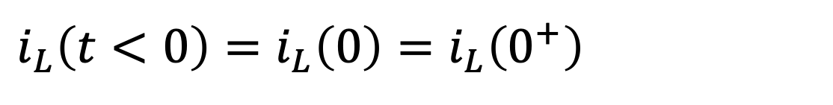
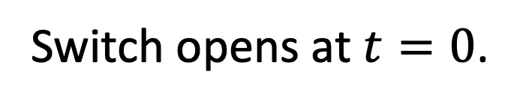
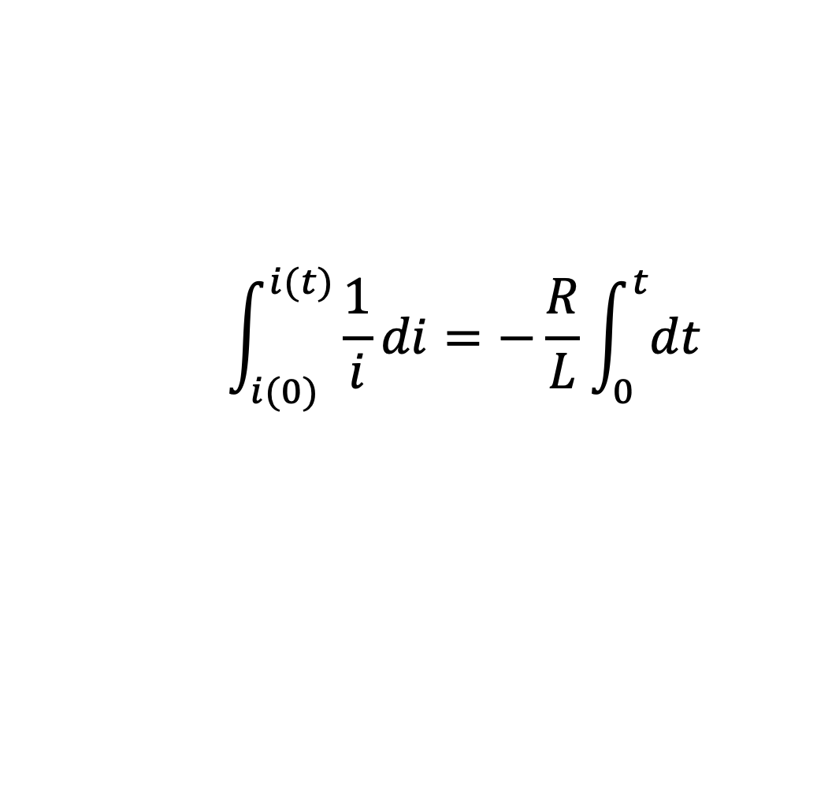
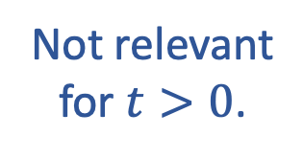
RL Circuit: What are $i\left(t\right)$ and $v\left(t\right)$?
RL Circuit: What are $i\left(t\right)$ and $v\left(t\right)$?
Switch opens at $t=0$.
(Assumed closed “for a long time,” i.e., circuit
in steady state prior to switch opening.)
$$−$$
$$v_{L}$$
$$+$$
What is $i_{L}$ for $t<0$?
Not relevant
for $t>0$.
$i_{L}\left(t<0\right)=i_{s}$.
$i_{L}\left(t<0\right)=i_{L}\left(0\right)=i_{L}\left(0^{+}\right)=i_{s}=i_{0}$.
$i_{L}\left(t<0\right)=i_{L}\left(0\right)=i_{L}\left(0^{+}\right)=i_{s}=i_{0}$.
$i_{L}\left(t<0\right)=i_{L}\left(0\right)=i_{L}\left(0^{+}\right)=i_{s}=i_{0}$.
Current cannot change instantly:
$i_{L}\left(t<0\right)=i_{L}\left(0\right)=i_{L}\left(0^{+}\right)=i_{s}=i_{0}$.
Initial condition.
For $t>0$, KVL for $L$ and $R$:
For $t>0$, KVL for $L$ and $R$:
$$v_{L}+v=0$$
(Note: For $t>0$, $i_{L}=i$.)
$$L\frac{di}{dt}+Ri=0$$
$$\int_{i(0)}^{i(t)}{\frac{1}{i}}di=−\frac{R}{L}\int_{0}^{t}{dt}$$
$$L\frac{di}{dt}+Ri=0$$
$$L\frac{di}{dt}+Ri=0$$
$$\frac{1}{i}di=−\frac{R}{L}dt$$

Slide 7
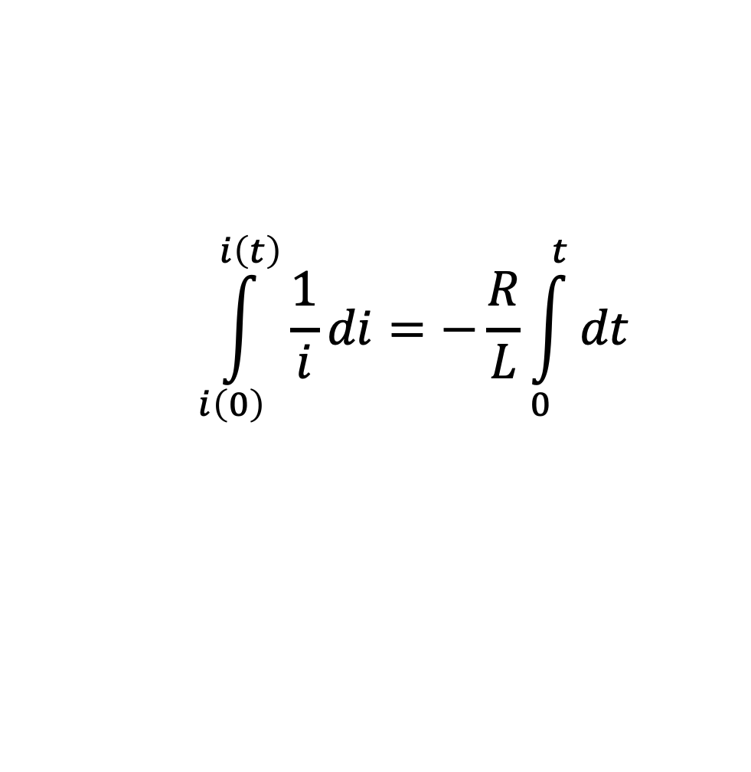
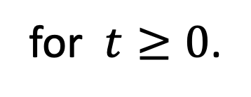
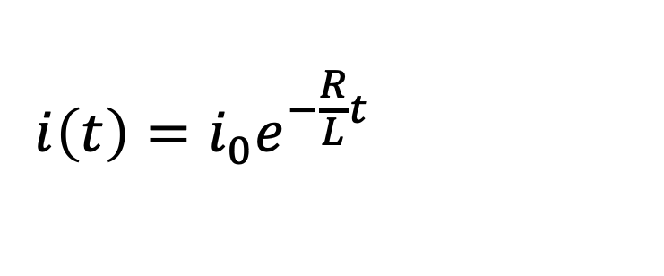
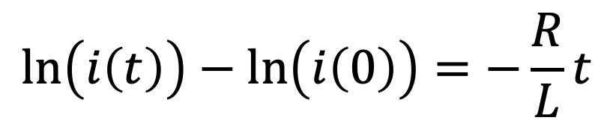
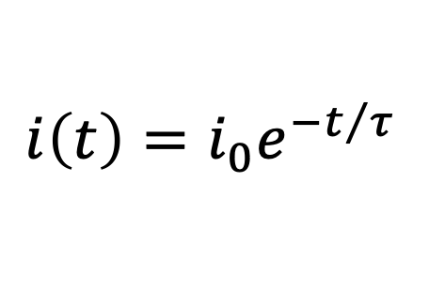

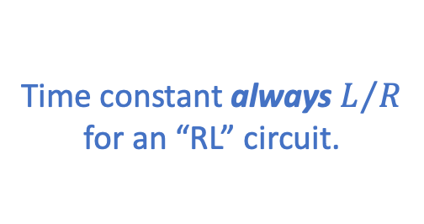
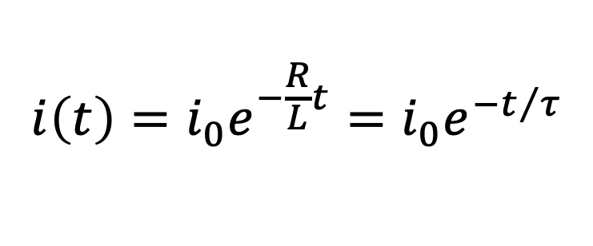
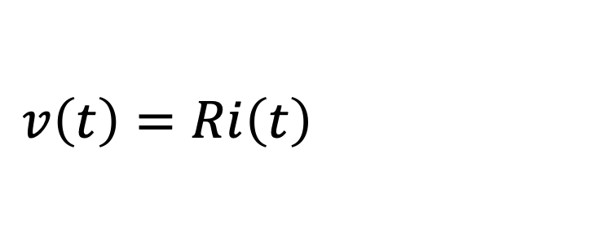




RL Circuit: What are $i\left(t\right)$ and $v\left(t\right)$?
$$\int_{i\left(0\right)}^{i\left(t\right)}{\frac{1}{i}di}=−\frac{R}{L}\int_{0}^{t}{dt}$$
$$i_{0}$$
$$\ln\left(i\left(t\right)\right)−\ln\left(i\left(0\right)\right)=−\frac{R}{L}t$$
Raise $e$ to the power on both sides and rearrange.
Time constant always $L/R$
for an “RL” circuit.
$$i\left(t\right)=i_{0}e^{−\frac{R}{L}t}=i_{0}e^{−t/τ}$$
$$i\left(t\right)=i_{0}e^{−\frac{R}{L}t}=i_{0}e^{−t/τ}$$
where
$$i_{0}=i\left(0\right)=i_{s}$$
and
$τ=L/R$.
$$i\left(t\right)=i_{0}e^{−t/τ}$$
$$v\left(t\right)=Ri\left(t\right)=Ri_{0}e^{−t/τ}$$
for $t≥0$.
$$v\left(t\right)=Ri\left(t\right)=Ri_{0}e^{−t/τ}$$
for $t≥0$.
(and a single storage element)
First-order RL circuits will always have this solution form for an unforced system
(“natural response”).
Just need to determine initial condition and time constant.

Slide 8






















Consider:
What is $v_{L}\left(0^{+}\right)$? (numeric poll)
$$10 Ω∥10 Ω$$
$2 A$ now flowing into $R_{eq}=5 Ω$.
$$\left(2 A\right)\left(5 Ω\right)=10 V$$
$$\left(2 A\right)\left(5 Ω\right)=10 V$$
At $t=0$, inductor voltage changed
instantaneously, from $20 V$ to $10 V$.
Circuit not in steady
state at $t=0^{−}$.
Given: $i_{L}\left(0^{−}\right)=2 A$
What is $v_{1}\left(0^{−}\right)$? (numeric poll)
$$\left(2 A\right)\left(10 Ω\right)=20 V$$
$$\left(2 A\right)\left(10 Ω\right)=20 V$$
Essentially has nothing to
do with$v_{L}={−Ldi_{L}}/{dt}$!
What is $v_{2}\left(0^{−}\right)$? (numeric poll)
$$\left(0 A\right)\left(10 Ω\right)=0 V$$
$$\left(0 A\right)\left(10 Ω\right)=0 V$$
What is $v_{L}\left(0^{−}\right)$?
Parallel with $v_{1}$.
$$20 V$$
Can’t change
instantly.
$$i_{L}\left(0^{+}\right)=i_{L}\left(0^{−}\right)=2 A$$
What is $i_{L}\left(0^{+}\right)$? (numeric poll)
$$i_{L}\left(0^{+}\right)=i_{L}\left(0^{−}\right)=2 A$$

Slide 9













Consider:
What is $v_{L}\left(0^{+}\right)$? (numeric poll)
$2 A$ now flowing into $R_{eq}=5 Ω$.
$$\left(2 A\right)\left(5 Ω\right)=10 V$$
Given:
$$L=50 mH$$
At $t=0$, inductor voltage changed
instantaneously, from $20 V$ to $10 V$.
Given: $i_{L}\left(0^{−}\right)=2 A$
What is $v_{L}\left(t>0\right)= ?$
Always:
$$v_{L}\left(t\right)=v_{0}e^{−{\left(t−t_{0}\right)}/τ}$$
for $t>t_{0}.$
$$τ=L/R=L/{R_{eq}}.$$
$$τ=L/R=L/{R_{eq}.}$$
After switch closes, $R_{eq}=10∥10=5 Ω.$
After switch closes, $R_{eq}=10∥10=5 Ω.$
$$τ={0.05 H}/5Ω=10 ms.$$
$$τ={0.05 H}/5Ω=10 ms.$$
$$v_{L}\left(t\right)=10e^{−100t} V$$
for $t>0.$
$$t_{0}=0.$$

Slide 10



Capacitors
Recall governing $i$-$v$ equations:
$$v_{C}\left(t\right)=\frac{1}{C}\int_{t_{0}}^{t}{i_{C}\left(t\right)dt}+v_{C}\left(t_{0}\right)$$
$$i_{C}\left(t\right)=C\frac{dv_{C}\left(t\right)}{dt}$$
and
Recall important properties:
Behaves as an open circuit in steady-state (i.e., when
no variation in time).
Voltage cannot change instantaneously.
(“Opposes” changes in voltage.)
Current can change discontinuously/instantaneously.
(Stores energy.)

Slide 11







Consider:
Circuit not in steady
state at $t=0^{−}$.
Given: $v_{C}\left(0^{−}\right)=10 V$
What is $v_{2}\left(0^{−}\right)$? (numeric poll)
(0 A)(20 Ω) = 0 V
(0 A)(20 Ω)
What is $v_{2}\left(0^{+}\right)$? (numeric poll)
Now parallel with $v_{C}$ & $v_{C}\left(0^{+}\right)=v\left(0^{−}\right)$.
10 V
Now parallel with $v_{C}$ & $v_{C}\left(0^{+}\right)=v\left(0^{−}\right)$.

