Slide 1
EE 261, Spring 2025, Lecture 25
Goals/Topics:
RC circuit initial conditions
Voltage division (and some basics) refresher
First-order RC circuit (natural response)
Forced responses
Best viewed in
presentation mode
in PowerPoint.
Announcement: Homework 8 due Sunday.

Slide 2
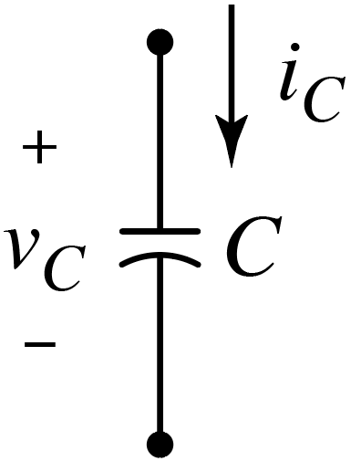
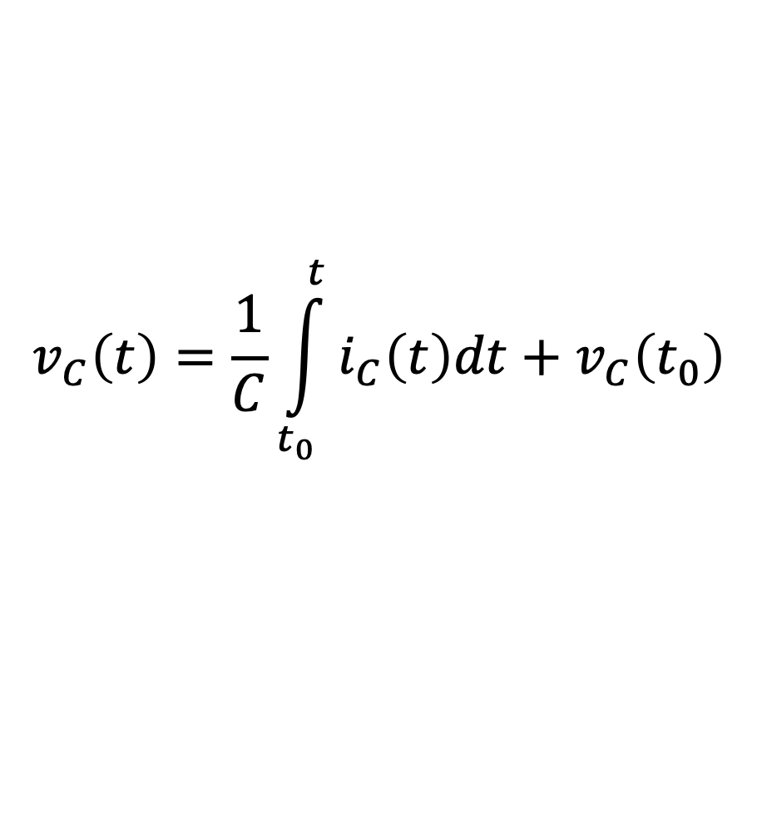
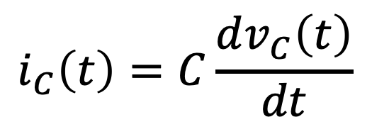

Recall Capacitors
Governing $i$-$v$ equations:
$$v_{C}\left(t\right)=\frac{1}{C}\int_{t_{0}}^{t}{i_{C}\left(t\right)dt}+v_{C}\left(t_{0}\right)$$
$$i_{C}\left(t\right)=C\frac{dv_{C}\left(t\right)}{dt}$$
and
Important properties:
Behaves as an open circuit in steady-state (i.e., when
no variation in time).
Voltage cannot change instantaneously.
(“Opposes” changes in voltage.)
Current can change discontinuously/instantaneously.
(Stores energy.)

Slide 3
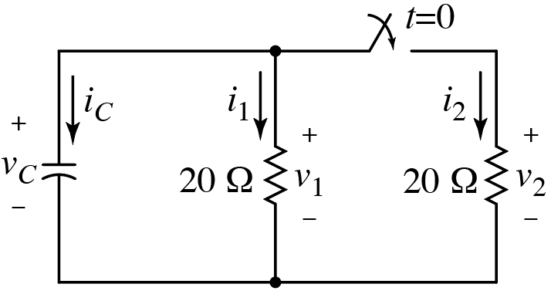




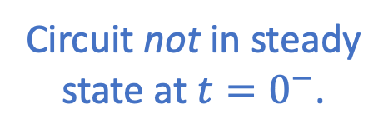

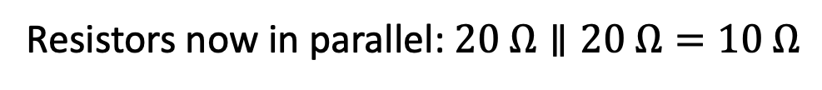
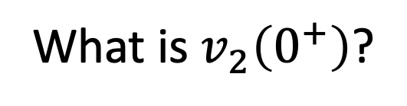
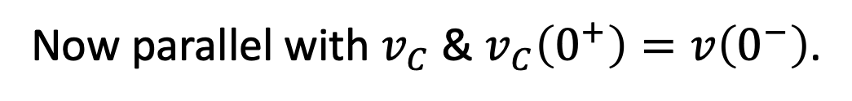
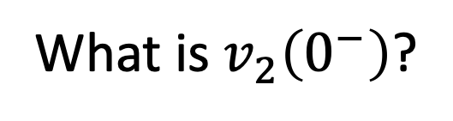
Recall:
Even if circuit not in steady-state,
at any given time, all circuits laws
we’ve already learned hold: Ohm’s law,
KVL, KCL, etc.
Even if circuit not in steady-state,
at any given time, all circuits laws
we’ve already learned hold: Ohm’s law,
KVL, KCL, etc.
$$=10 V$$
May not need to be concerned with
details of governing diff. eq. if we’re
interested in values at a particular time.
Circuit not in steady
state at $t=0^{−}$.
Given: $v_{C}\left(0^{−}\right)=10 V$
What is $v_{2}\left(0^{−}\right)$?
(0 A)(20 Ω) = 0 V
What is $v_{2}\left(0^{+}\right)$?
Now parallel with $v_{C}$ & $v_{C}\left(0^{+}\right)=v\left(0^{−}\right)$.
10 V
Now parallel with $v_{C}$ & $v_{C}\left(0^{+}\right)=v\left(0^{−}\right)$.
Ohm’s Law.
i_{C} = –i₁ = –0.5 A
i₁ = (10 V)/(20 Ω) = 0.5 A
i_{C} = –i₁
What is $i_{C}\left(0^{−}\right)$? (numeric poll)
i₁ = (10 V)/(20 Ω)
What is $i_{C}\left(0^{+}\right)$? (numeric poll)
i_{C} = –(10 V)/(10 Ω) = –1 A
Current changed
discontinuously.
i_{C} = –(10 V)/(10 Ω)
Resistors now in parallel: $20 Ω∥20 Ω=10 Ω$

Slide 4
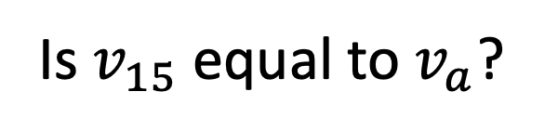
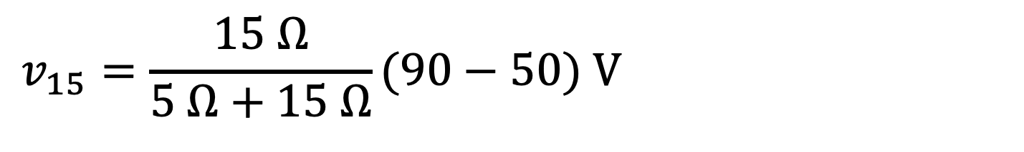
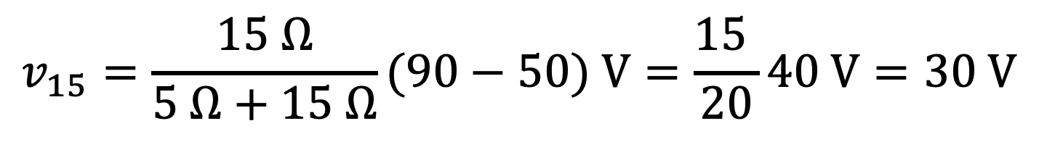
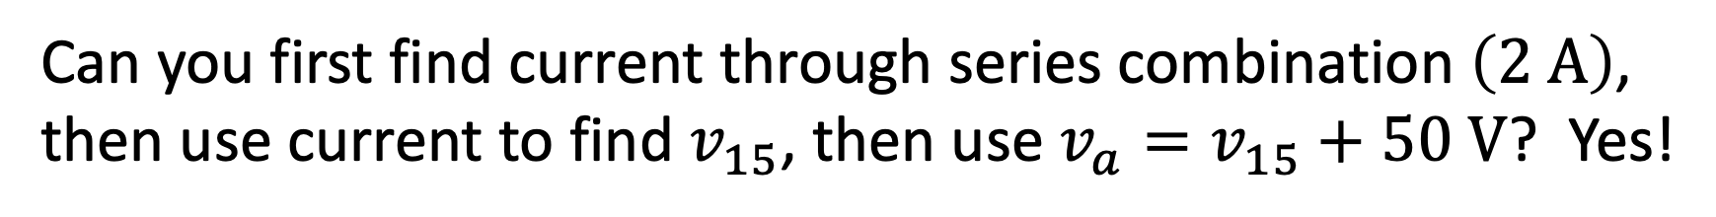
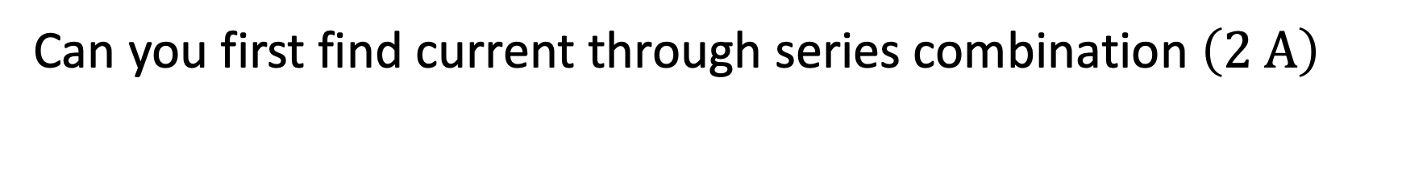
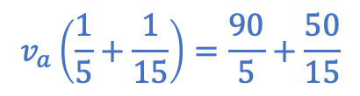
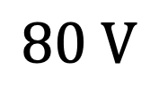
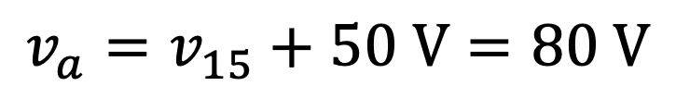
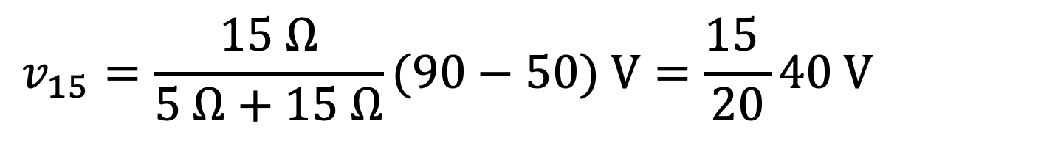
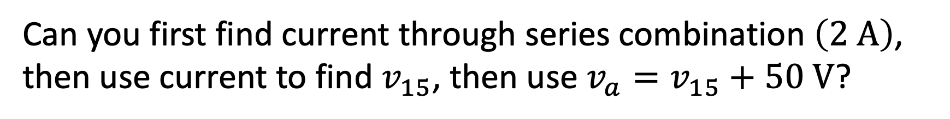
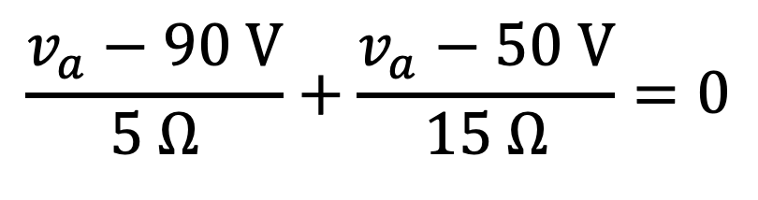
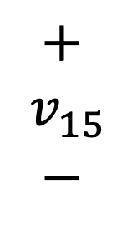
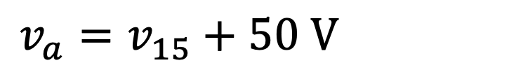
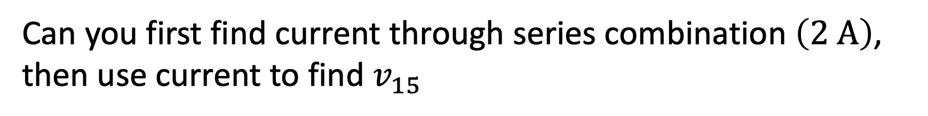


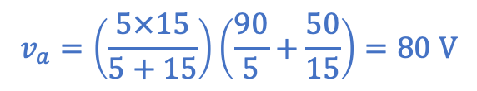
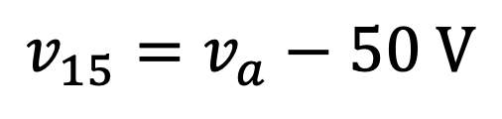
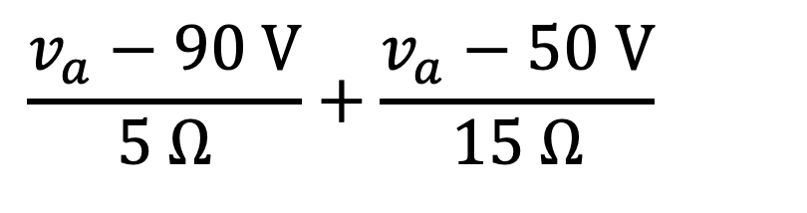
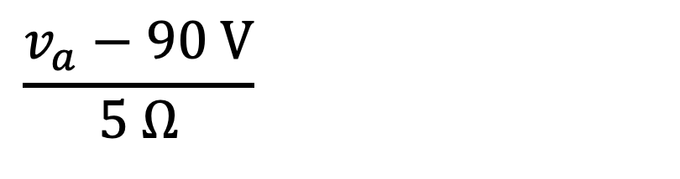
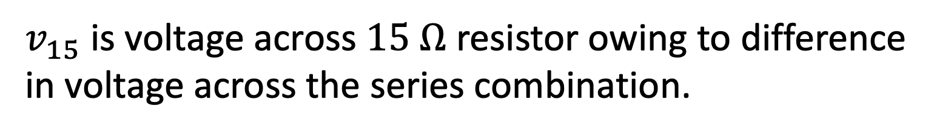
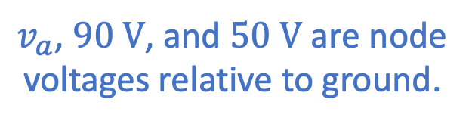
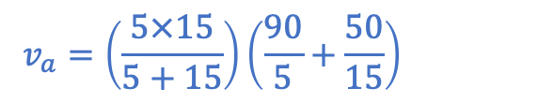
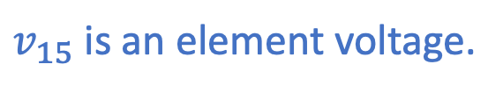
Voltage division check-up
$v_{15}$ is an element voltage.
(high polarity)$−$(low polarity)
Is $v_{15}$ equal to $v_{a}$?
A) Yes B) No
$$v_{15}=v_{a}−50 V$$
$$80 V$$
$v_{a}$, $90 V$, and $50 V$ are node
voltages relative to ground.
What is $v_{a}$? (numeric poll)
$v_{15}$ is voltage across $15 Ω$ resistor owing to difference
in voltage across the series combination.
$$v_{15}=\frac{15 Ω}{5 Ω+15 Ω}(90−50) V=\frac{15 }{20}40 V=30 V$$
$$v_{15}=\frac{15 Ω}{5 Ω+15 Ω}(90−50) V=\frac{15 }{20}40 V=30 V$$
$$v_{15}=\frac{15 Ω}{5 Ω+15 Ω}(90−50) V=\frac{15 }{20}40 V=30 V$$
$$+ \\ v_{15} \\ −$$
$$v_{a}\left(\frac{1}{5}+\frac{1}{15}\right)=\frac{90}{5}+\frac{50}{15}$$
$$v_{a}=v_{15}+50 V=65 V$$
$$v_{a}=v_{15}+50 V=80 V$$
$$v_{a}=\left(\frac{5×15}{5+15}\right)\left(\frac{90}{5}+\frac{50}{15}\right)=80 V$$
$$v_{a}=\left(\frac{5×15}{5+15}\right)\left(\frac{90}{5}+\frac{50}{15}\right)=80 V$$
$$\frac{v_{a}−90 V}{5 Ω}+\frac{v_{a}−50 V}{15 Ω}=0$$
$$\frac{v_{a}−90 V}{5 Ω}+\frac{v_{a}−50 V}{15 Ω}=0$$
$$\frac{v_{a}−90 V}{5 Ω}+\frac{v_{a}−50 V}{15 Ω}=0$$
Can you solve using KCL? Yes!
Can you solve using KCL? Yes!
Simplest?
Can you first find current through series combination $\left(2 A\right)$,
then use current to find $v_{15}$, then use $v_{a}=v_{15}+50 V$? Yes!
Can you first find current through series combination $\left(2 A\right)$,
then use current to find $v_{15}$, then use $v_{a}=v_{15}+50 V$? Yes!
Can you first find current through series combination $\left(2 A\right)$,
then use current to find $v_{15}$, then use $v_{a}=v_{15}+50 V$? Yes!
Can you first find current through series combination $\left(2 A\right)$,
then use current to find $v_{15}$, then use $v_{a}=v_{15}+50 V$? Yes!

Slide 5
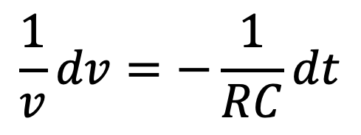
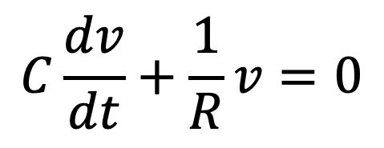
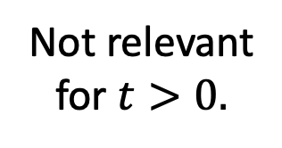
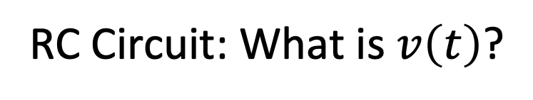
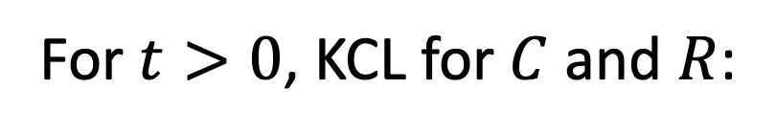
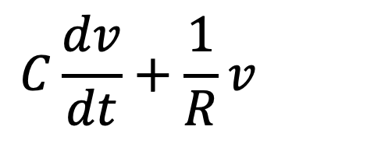
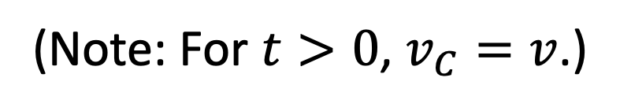
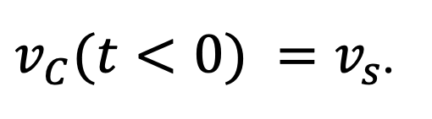
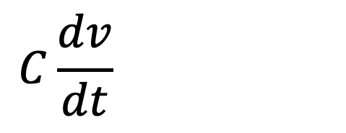
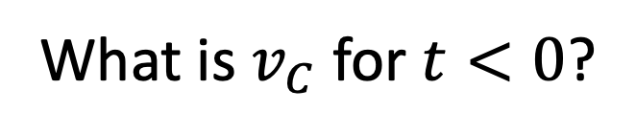
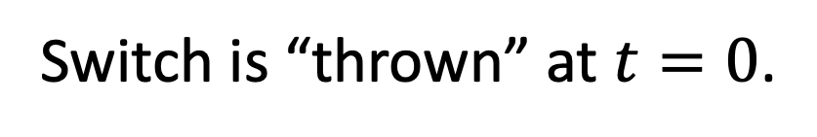
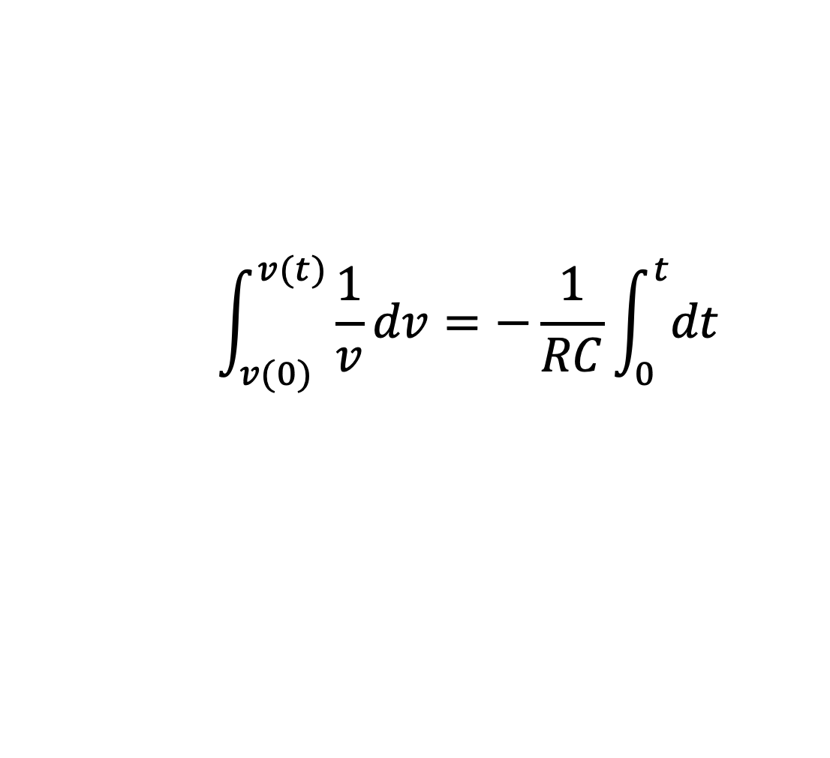
RC Circuit: What is $v\left(t\right)$?
RC Circuit
Switch is “thrown” at $t=0$.
(Assumed in left position “for a long time,” i.e.,
circuit in steady state prior to switch moving.)
What is $v_{C}$ for $t<0$?
Not relevant
for $t>0.$
$v_{C}(t<0) =v_{s}$.
Voltage can’t change instantly:
$$v_{C}\left(t<0\right)=v_{C}\left(0\right)=v_{C}\left(0^{+}\right)=v_{S}=v_{0}.$$
$$v_{C}\left(t<0\right)=v_{C}\left(0\right)=v_{C}\left(0^{+}\right)=v_{S}=v_{0}.$$
$$v_{C}\left(t<0\right)=v_{C}\left(0\right)=v_{C}\left(0^{+}\right)=v_{S}=v_{0}.$$
$$v_{C}\left(t<0\right)=v_{C}\left(0\right)=v_{C}\left(0^{+}\right)=v_{S}=v_{0}.$$
Initial condition.
For $t>0$, KCL for $C$ and $R$:
(Note: For $t>0$, $v_{C}=v$.)
$$C\frac{dv}{dt}+\frac{1}{R}v=0$$
$$\int_{v(0)}^{v(t)}{\frac{1}{v}}dv=−\frac{1}{RC}\int_{0}^{t}{dt}$$
$$C\frac{dv}{dt}+\frac{1}{R}v=0$$
$$C\frac{dv}{dt}+\frac{1}{R}v=0$$
$$\frac{1}{v}dv=−\frac{1}{RC}dt$$

Slide 6
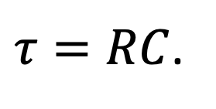
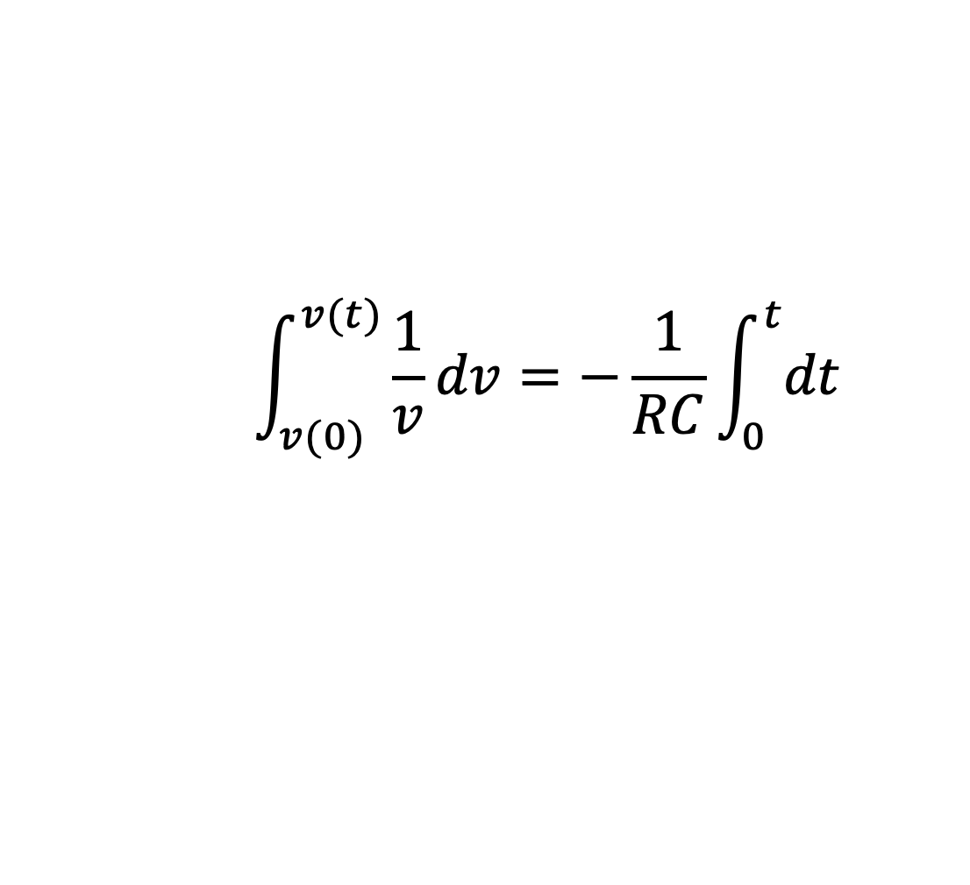
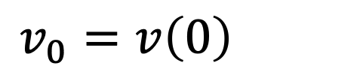
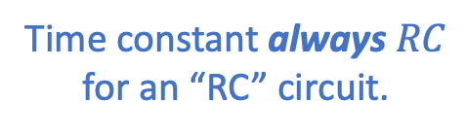

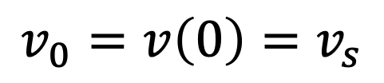






RC Circuit: What is v(t)?
$$\int_{v(0)}^{v(t)}{\frac{1}{v}}dv=−\frac{1}{RC}\int_{0}^{t}{dt}$$
Not relevant
for $t>0.$
$$\ln\left(v\left(t\right)\right)−\ln\left(v\left(0\right)\right)=−\frac{1}{RC}t$$
Time constant always $RC$
for an “RC” circuit.
$$v\left(t\right)=v_{0}e^{−\frac{1}{RC}t}=v_{0}e^{−t/τ}$$
$$v\left(t\right)=v_{0}e^{−\frac{1}{RC}t}=v_{0}e^{−t/τ}$$
where
$$v_{0}=v\left(0\right)=v_{s}$$
$$v_{0}=v\left(0\right)=v_{s}$$
and
$τ=RC$.
Same form as all
first-order circuits.
$$v\left(t\right)=v_{0}e^{−t/τ}$$
for $t>0$.
But, also:
$$v\left(t\right)=0$$
for $t<0$.

Slide 7












Recap:
$$M\frac{dv_{l}(t)}{dt}+Dv_{l}\left(t\right)=0$$
$$v_{l}\left(t\right)=v_{l0}e^{−{\left(t−t_{0}\right)}/τ}$$
&
$$τ=M/D$$
$$L\frac{di(t)}{dt}+Ri\left(t\right)=0$$
$$i\left(t\right)=i_{0}e^{−t/τ}$$
&
$$τ=L/R$$
$$C\frac{dv(t)}{dt}+\frac{1}{R}v\left(t\right)=0$$
$$v\left(t\right)=v_{0}e^{−t/τ}$$
&
$$τ=RC$$

Slide 8






Comments:
In previous slide, if switches thrown at $t_{0}$, replace $t$ with
with ${t−t}_{0}$ in solution, i.e., replace $e^{−t/τ}$ with $e^{−(t−t_{0})/τ}$.
All are governed by same type of differential equation:
  First-order system with constant coefficients.
  Homogeneous equation (no forcing function) which
  yields “natural response” of system.
Same solution: exponential decay.
Behavior dictated by constants and initial conditions.
$$\frac{df(t)}{dt}+\frac{1}{τ}f\left(t\right)=0$$
$$f\left(t\right)=f_{0}e^{−{\left(t−t_{0}\right)}/τ}$$
May be given or may have to determine from
circuit. Requires some additional information.
May be given or may have to determine from
circuit. Requires some additional information.
Initial condition: $f_{0}$.
Value at time $t_{0}$.
Time constant: $τ$.
Dictated solely by circuit (i.e., by diff. eq.).

Slide 9









What about more complicated arrangements of resistors?
Norton equivalent
of arbitrary circuit.
Doesn’t matter!
Replace all resistors with single equivalent resistance.
$$L\frac{di_{L}(t)}{dt}+R_{eq}i_{L}\left(t\right)=0$$
$$i_{L}\left(t\right)=i_{0}e^{−t/τ}$$
&
$$τ=L/{R_{eq}}$$
Essentially same as before.

Slide 10








Natural Response (no source present)
Forced Response (source present)
Original circuit can be much more complicated,
but inductor merely “sees” Norton equivalent!
Circuit for $t>0.$
$$R_{S}||R=R_{eq}$$
Will consider
only constant
forcing functions
(for now).
(Obtained via KCL at top
or bottom nodes or via
KVL around right mesh.)
and hence time constant
What is governing differential equation?
Circuit dictates.
What is initial condition?
Need additional information.
What is final condition?
Circuit dictates.
$$i\left(t=∞\right)=i_{∞}=is$$
$$i\left(t=∞\right)=i_{∞}=is$$
(Will see that solution only depends on $t_{0}$, $i_{0}$, $i_{∞}$, and $τ$.)

Slide 11





Natural Response (no source present)
Forced Response (source present)
Original circuit can be much more complicated,
but capacitor merely “sees” Thévenin equivalent!
(Obtained via KCL at upper
right corner or via KVL
around mesh.)
What is governing differential equation?
Circuit dictates.
What is initial condition?
Need additional information.
What is final condition?
Circuit dictates.
$$v_{C}\left(t=∞\right)=v_{∞}=vs$$
$$v_{C}\left(t=∞\right)=v_{∞}=vs$$
(Will see that solution only depends on $t_{0}$, $v_{0}$, $v_{∞}$, and $τ$.)

Slide 12





Guiding Facts:
Inductor current cannot change instantaneously.
Capacitor voltage cannot change instantaneously.
In steady state:
  Inductor behaves as a short circuit.
  Capacitor behaves as an open circuit.
Notation:
If a switch is thrown at $t=0$,
$t=0^{−}$ is instant before switch thrown,
$t=0^{+}$ is instant after switch thrown.
For inductors, $i_{L}\left(t=0^{−}\right)=i_{L}\left(t=0^{+}\right)$.
For capacitors, $v_{C}\left(t=0^{−}\right)=v_{C}\left(t=0^{+}\right)$.

Slide 13
Initial conditions: May have to find or may be given.
If initial conditions must be found (i.e., are not given):
Assume (or are told) steady state exists prior to any change.
Replace inductor with short and find current through short.
Replace capacitor with an open circuit and find voltage across open.
Final conditions: Independent of initial conditions.
Assume steady state exists after change (and a long time has elapsed).
Replace inductor with short and find current through short.
Replace capacitor with an open circuit and find voltage across open.
Simply find the current (for inductor) or voltage (for
capacitor) for what are now purely resistive circuits.
All analysis techniques we’ve considered are still relevant
when solving for these values.

Slide 14













Consider: Want $i\left(t\right)$.
(Forced system, i.e., step response.)
Assume (given) $i(0^{−}) = i0$.
$$−$$
$$v$$
$$+$$
(Not in steady state at $t=0^{−}$.)
For $t>0$, $R_{s}||R =R_{eq}$.
Note $i\left(∞\right)=i_{s}=i_{∞}$.
Note $i\left(∞\right)=i_{s}=i_{∞}$.
(Steady state at $t=∞$.)
$$\frac{v}{R_{eq}}$$
KCL at bottom node:
constant
$$−i_{s}+i\left(t\right)+\frac{L}{R_{eq}}\frac{di\left(t\right)}{dt}=0$$
$$−i_{s}+i\left(t\right)+\frac{L}{R_{eq}}\frac{di\left(t\right)}{dt}=0$$
$$−i_{s}+i\left(t\right)+\frac{L}{R_{eq}}\frac{di\left(t\right)}{dt}=0$$
$$−i_{s}+i\left(t\right)+\frac{L}{R_{eq}}\frac{di\left(t\right)}{dt}=0$$

