Slide 1
EE 261, Spring 2025, Lecture 26
Goals/Topics:
Forced response of first-order systems
Best viewed in
presentation mode
in PowerPoint.
Announcements: HW 8 due Sunday.
And…

Slide 2
“We are using the ESP32s (again) to output
PWM to a motor driver IC so the motor will
use the battery voltage supply and draw
current from that instead of drawing
current from the 3.3V ESP32 GPIO pin (and
potentially damaging the cheap microcontroller).
We will also be using Servos to output a certain
angle and implementing a joystick add-on to
control the servo on the x-axis of the joystick.”

Slide 3
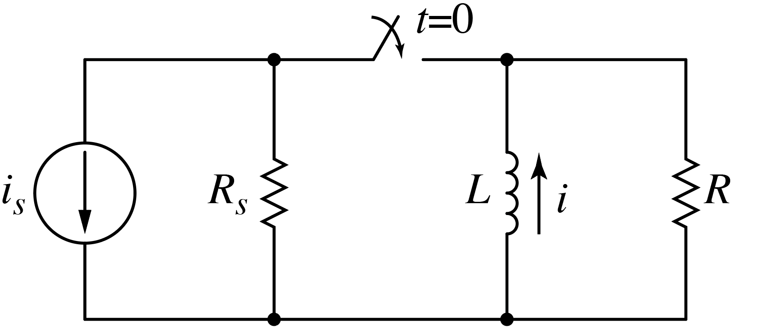
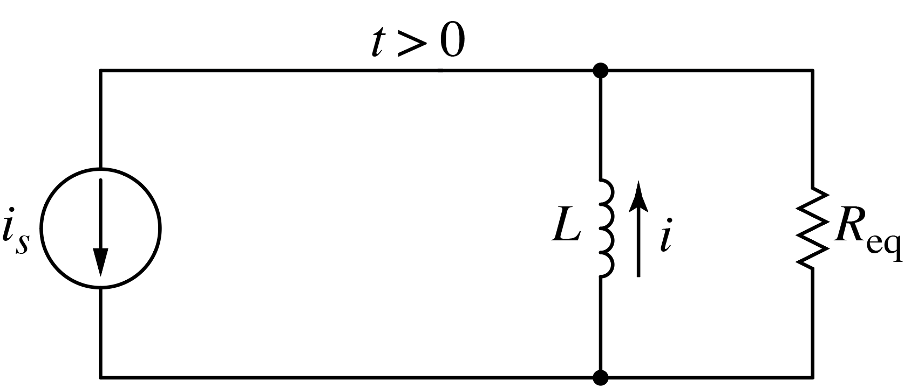
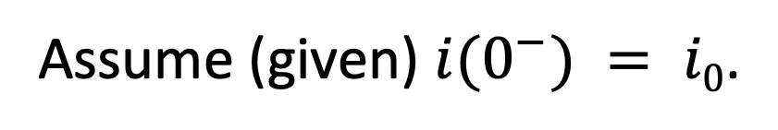

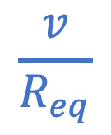
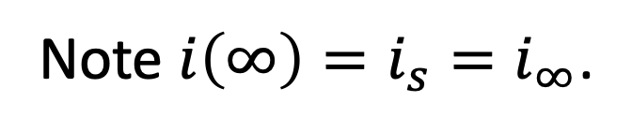
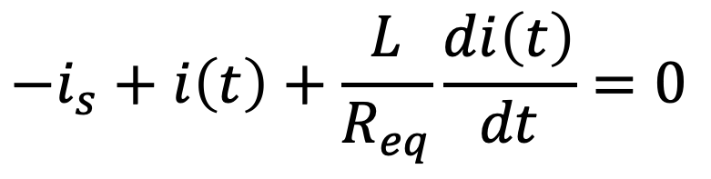
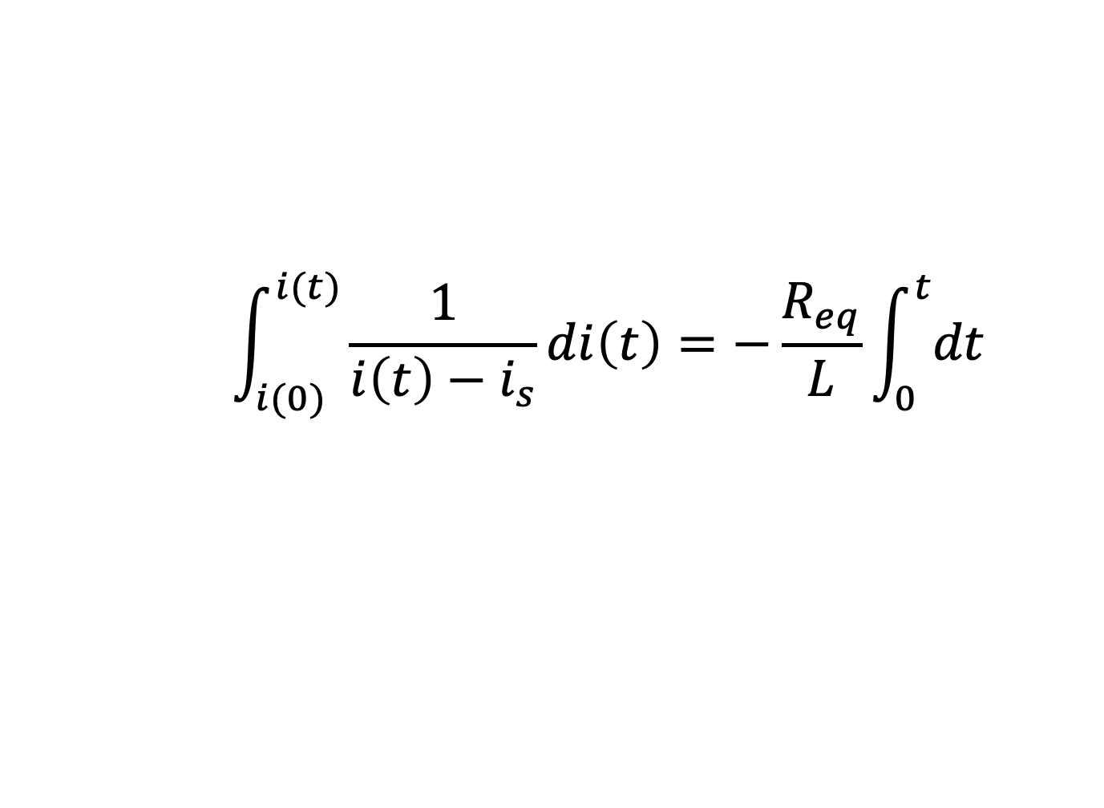

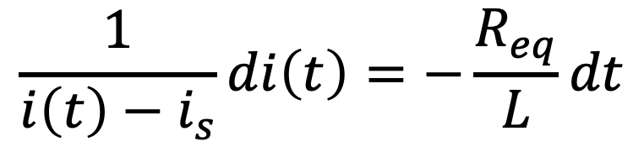

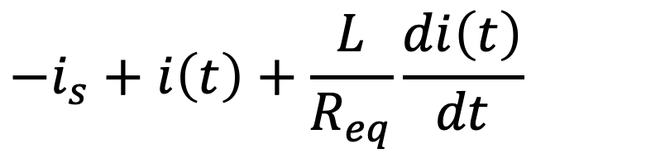
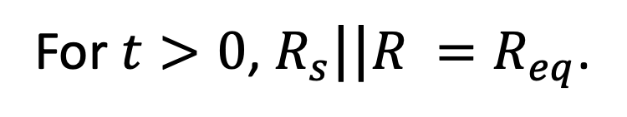
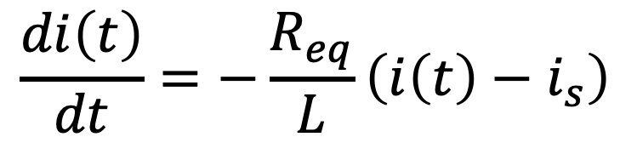
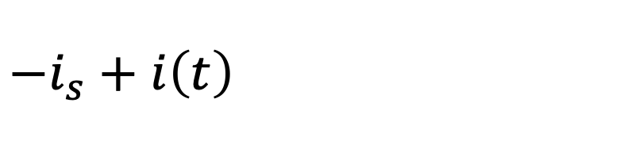

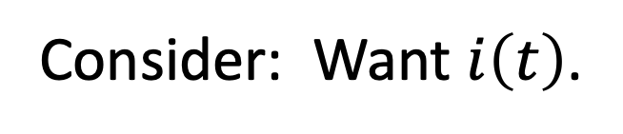
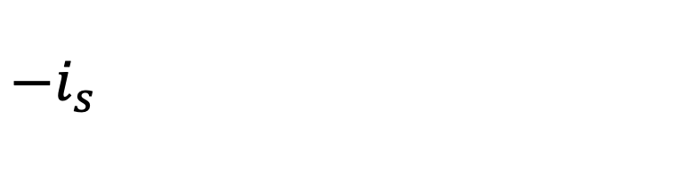
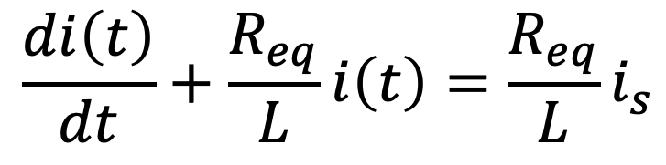
Consider: Want $i\left(t\right)$.
(Forced system, i.e., step response.)
Assume (given) $i(0^{−}) = i0$.
$$−$$
$$v$$
$$+$$
(Not in steady state at $t=0^{−}$.)
For $t>0$, $R_{s}||R =R_{eq}$.
Note $i\left(∞\right)=i_{s}=i_{∞}$.
Note $i\left(∞\right)=i_{s}=i_{∞}$.
(Steady state at $t=∞$.)
$$\frac{v}{R_{eq}}$$
KCL at bottom node:
constant
$$−i_{s}+i\left(t\right)+\frac{L}{R_{eq}}\frac{di\left(t\right)}{dt}=0$$
$$−i_{s}+i\left(t\right)+\frac{L}{R_{eq}}\frac{di\left(t\right)}{dt}=0$$
$$−i_{s}+i\left(t\right)+\frac{L}{R_{eq}}\frac{di\left(t\right)}{dt}=0$$
$$−i_{s}+i\left(t\right)+\frac{L}{R_{eq}}\frac{di\left(t\right)}{dt}=0$$
$$\frac{di\left(t\right)}{dt}+\frac{R_{eq}}{L}i\left(t\right)=\frac{R_{eq}}{L}i_{s}$$
$$\frac{di\left(t\right)}{dt}=−\frac{R_{eq}}{L}\left(i\left(t\right)−i_{s}\right)$$
$$\frac{1}{i\left(t\right)−i_{s}}di\left(t\right)=−\frac{R_{eq}}{L}dt$$
$$\int_{i(0)}^{i(t)}{\frac{1}{i\left(t\right)−i_{s}}di\left(t\right)}=−\frac{R_{eq}}{L}\int_{0}^{t}{dt}$$

Slide 4
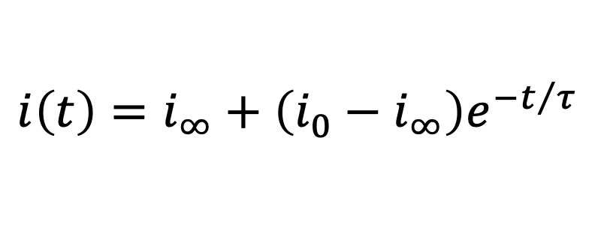
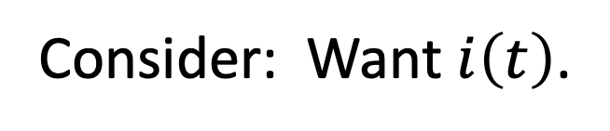
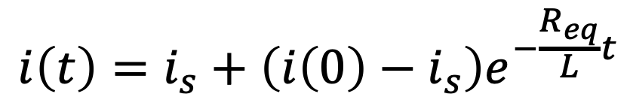

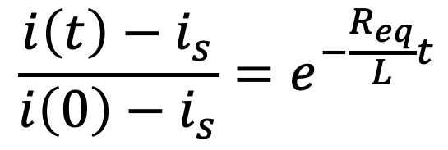

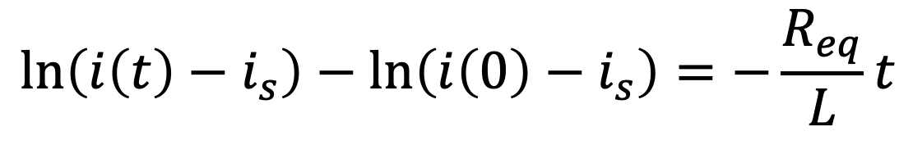
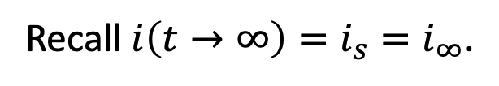
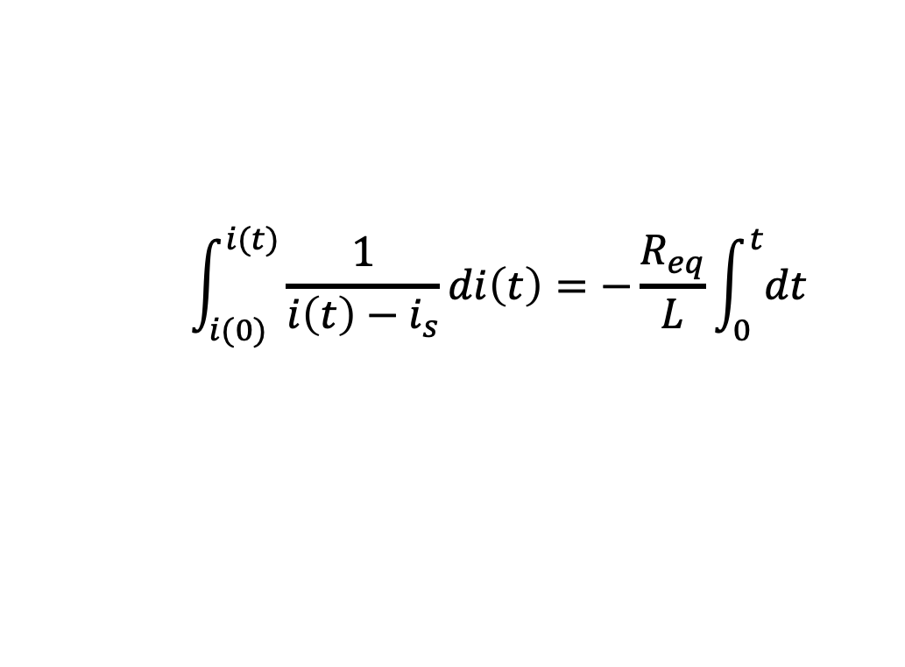
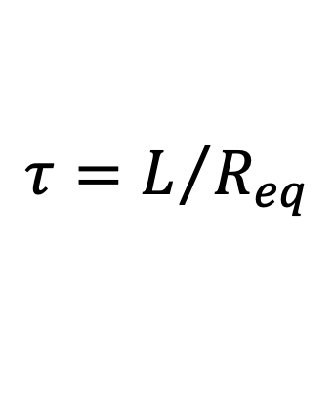
Consider: Want $i\left(t\right)$.
$$\int_{i(0)}^{i(t)}{\frac{1}{i\left(t\right)−i_{s}}di\left(t\right)}=−\frac{R_{eq}}{L}\int_{0}^{t}{dt}$$
$$\ln\left(i\left(t\right)−i_{s}\right)−\ln\left(i\left(0\right)−i_{s}\right)=−\frac{R_{eq}}{L}t$$
$$\frac{i\left(t\right)−i_{s}}{i\left(0\right)−i_{s}}=e^{−\frac{R_{eq}}{L}t}$$
Raise $e$ to the power of both sides.
Solve for $i\left(t\right).$
Exponential transition from initial state to final state.
$$i\left(t\right)=i_{s}+\left(i\left(0\right)−i_{s}\right)e^{−\frac{R_{eq}}{L}t}$$
$$i\left(t\right)=i_{∞}+\left(i_{0}−i_{∞}\right)e^{−t/τ}$$
Recall $i\left(t→∞\right)=i_{s}=i_{∞}$.
$$τ=L/{R_{eq}}$$
Solutions to first-order forced
systems always have this form!
Need initial condition, final condition,
time constant, and time of initial condition.
Need initial condition, final condition,
time constant, and time of initial condition.
Need initial condition, final condition,
time constant, and time of initial condition.
Need initial condition, final condition,
time constant, and time of initial condition.

Slide 5
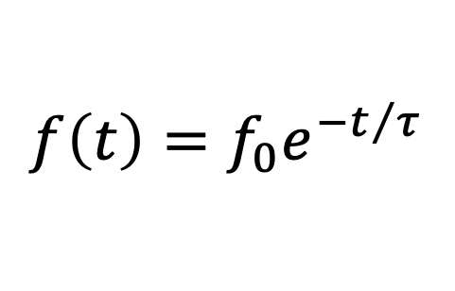
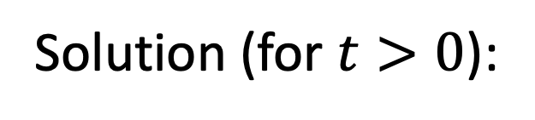
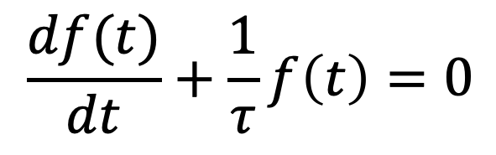
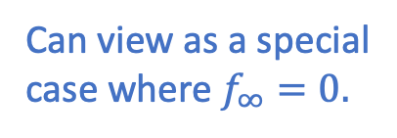
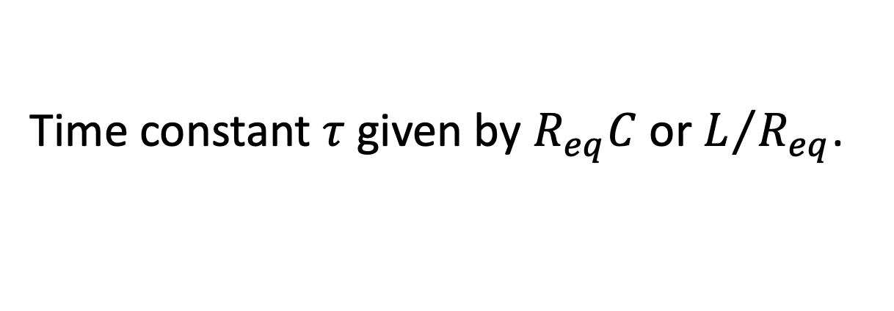
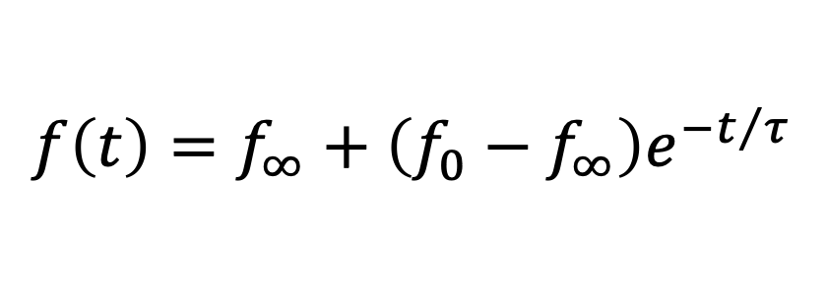
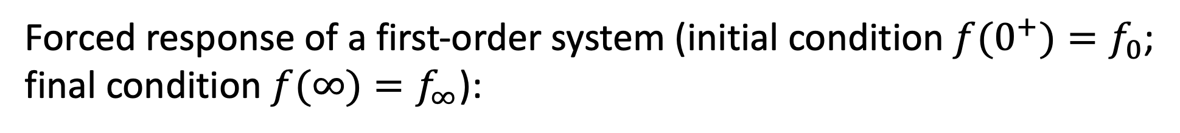
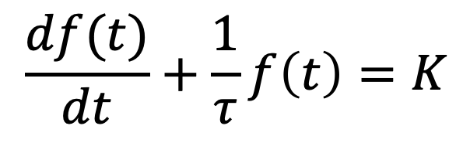
Natural response of first-order system (initial condition $f(0^{+})=f_{0}$):
Governing equation:
Solution (for $t>0$):
$$\frac{df(t)}{dt}+\frac{1}{τ}f\left(t\right)=0$$
$$f\left(t\right)=f_{0}e^{−t/τ}$$
Can view as a special
case where $f_{∞}=0.$
Forced response of a first-order system (initial condition $f(0^{+})=f_{0}$;
final condition $f(∞)=f_{∞}$):
Governing equation:
Solution (for $t>0$):
$$\frac{df(t)}{dt}+\frac{1}{τ}f\left(t\right)=K$$
$$f\left(t\right)=f_{∞}+\left(f_{0}−f_{∞}\right)e^{−t/τ}$$
Time constant $τ$ given by $R_{eq}C$ or $L/{R_{eq}}$.
All you really need to know!
(Letting $t→∞$, i.e., steady state, in differential equation yields: $f_{∞}=τK$.)

Slide 6
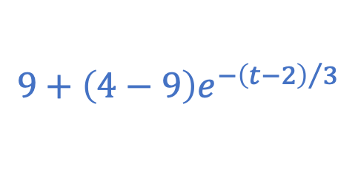
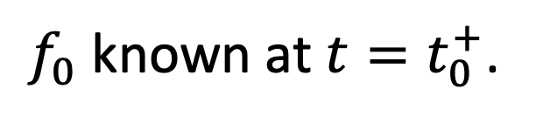
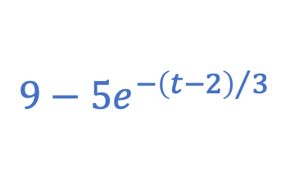
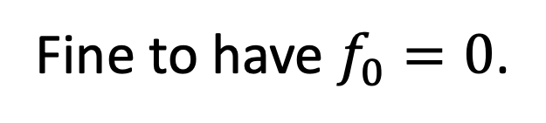
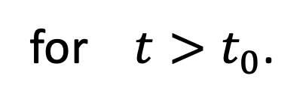
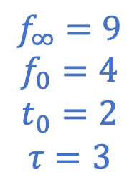
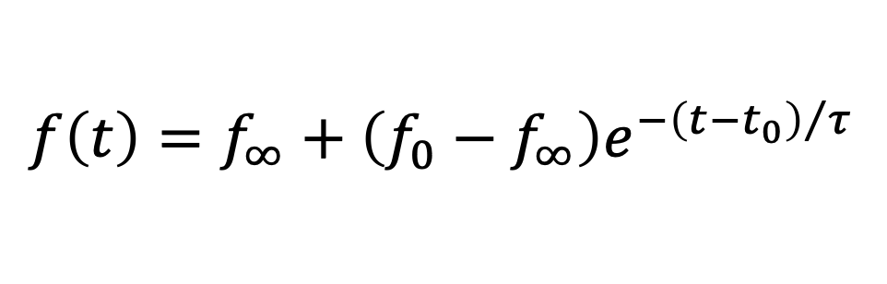
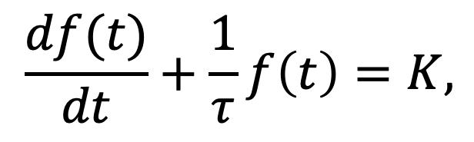
$$\frac{df(t)}{dt}+\frac{1}{τ}f\left(t\right)=K,$$
$$f\left(t\right)=f_{∞}+\left(f_{0}−f_{∞}\right)e^{−{\left(t−t_{0}\right)}/τ}$$
for $t>t_{0}$.
$f_{0}$ known at $t=t_{0}^{+}$.
Fine to have $f_{0}=0$.
$$f_{∞}=9$$
$$f_{0}=4$$
$$t_{0}=2$$
$$τ=3$$
or
$$9−5e^{−{\left(t−2\right)}/3}$$
$$9+\left(4−9\right)e^{−{\left(t−2\right)}/3}$$

Slide 7
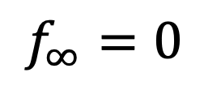
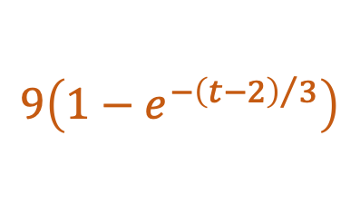
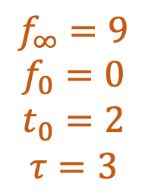
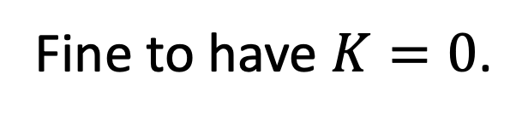
$$\frac{df(t)}{dt}+\frac{1}{τ}f\left(t\right)=K,$$
$$f\left(t\right)=f_{∞}+\left(f_{0}−f_{∞}\right)e^{−{\left(t−t_{0}\right)}/τ}$$
for $t>t_{0}$.
$f_{0}$ known at $t=t_{0}^{+}$.
Fine to have $f_{0}=0$.
$$f_{∞}=9$$
$$f_{0}=0$$
$$t_{0}=2$$
$$τ=3$$
Fine to have $K=0$.
or
$$9−5e^{−{\left(t−2\right)}/3}$$
$$f_{∞}=0$$
$$9+\left(4−9\right)e^{−{\left(t−2\right)}/3}$$
(Natural response.)
$$9\left(1−e^{−{\left(t−2\right)}/3}\right)$$

Slide 8
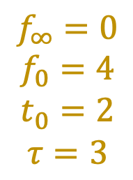
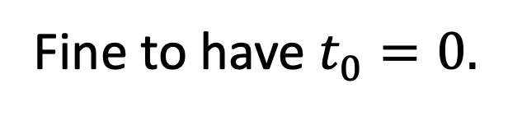
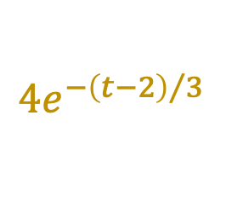
$$\frac{df(t)}{dt}+\frac{1}{τ}f\left(t\right)=K,$$
$$f\left(t\right)=f_{∞}+\left(f_{0}−f_{∞}\right)e^{−{\left(t−t_{0}\right)}/τ}$$
for $t>t_{0}$.
$f_{0}$ known at $t=t_{0}^{+}$.
Fine to have $f_{0}=0$.
$$f_{∞}=0$$
$$f_{0}=4$$
$$t_{0}=2$$
$$τ=3$$
Fine to have $K=0$.
or
$$9−5e^{−{\left(t−2\right)}/3}$$
$$f_{∞}=0$$
$$9+\left(4−9\right)e^{−{\left(t−2\right)}/3}$$
(Natural response.)
$$9\left(1−e^{−{\left(t−2\right)}/3}\right)$$
Fine to have $t_{0}=0.$
$$4e^{−{\left(t−2\right)}/3}$$

Slide 9

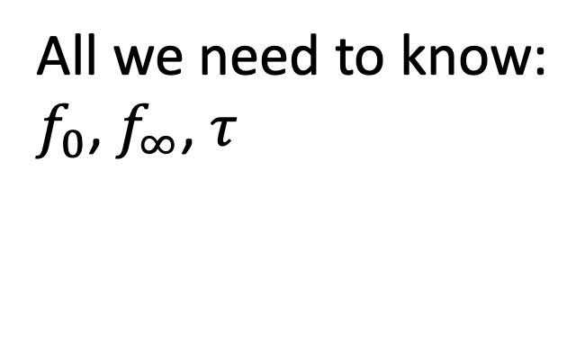
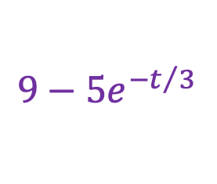
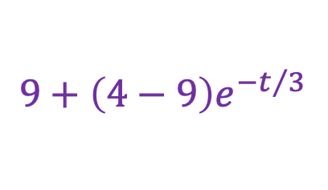






$$\frac{df(t)}{dt}+\frac{1}{τ}f\left(t\right)=K,$$
$$f\left(t\right)=f_{∞}+\left(f_{0}−f_{∞}\right)e^{−{\left(t−t_{0}\right)}/τ}$$
for $t>t_{0}$.
$f_{0}$ known at $t=t_{0}^{+}$.
$$9−5e^{−t/3}$$
or
Fine to have $f_{0}=0$.
$$9+\left(4−9\right)e^{−t/3}$$
$$f_{∞}=9$$
$$f_{0}=4$$
$$t_{0}=0$$
$$τ=3$$
Fine to have $K=0$.
or
$$9−5e^{−{\left(t−2\right)}/3}$$
$$f_{∞}=0$$
$$9+\left(4−9\right)e^{−{\left(t−2\right)}/3}$$
(Natural response.)
$$9\left(1−e^{−{\left(t−2\right)}/3}\right)$$
Fine to have $t_{0}=0.$
All we need to know:
$f_{0}$, $f_{∞}$, $τ$, and $t_{0}$ (and
that we have first-
order system).
$$4e^{−{\left(t−2\right)}/3}$$
All we need to know:
$f_{0}$, $f_{∞}$, $τ$, and $t_{0}$ (and
that we have first-
order system).
All we need to know:
$f_{0}$, $f_{∞}$, $τ$, and $t_{0}$ (and
that we have first-
order system).
All we need to know:
$f_{0}$, $f_{∞}$, $τ$, and $t_{0}$ (and
that we have first-
order system).
All we need to know:
$f_{0}$, $f_{∞}$, $τ$, and $t_{0}$ (and
that we have first-
order system).
All we need to know:
$f_{0}$, $f_{∞}$, $τ$, and $t_{0}$ (and
that we have first-
order system).

Slide 10







Consider:
In steady state
before switch
thrown.
What is $v_{C}(0^{−})$?
B
What is $v_{C}(∞)$?
C
$$\frac{R_{1}}{R_{1}+R_{2}}v_{a}$$
$$\frac{R_{2}}{R_{1}+R_{2}}v_{a}$$
$$\frac{R_{3}}{R_{3}+R_{4}}v_{b}$$
$$\frac{R_{4}}{R_{3}+R_{4}}v_{b}$$
A)
B)
C)
D)
E) None of the above.

Slide 11









Consider:
In steady state
before switch
thrown.
What is $v_{C}(0^{−})$?
What is $v_{C}(0^{+})$?
What is $v_{C}(∞)$?
$$v_{C}(0^{−})=\frac{R_{2}}{R_{1}+R_{2}}v_{a}$$
$$v_{C}(∞)=\frac{R_{3}}{R_{3}+R_{4}}v_{b}$$
$$v_{C}\left(0^{+}\right)=v_{C}(0^{−})$$
$R_{2}$ and $C$ in parallel.
Voltage varies
continuously.
$R_{3}$ and $C$ in parallel.
Capacitor is open circuit.
Capacitor is open circuit.
Voltage division across $R_{1}$ and $R_{2}$.
Voltage division across $R_{3}$ and $R_{4}$.

Slide 12



Consider:
In steady state
before switch
thrown.
What is $v_{R3}(0^{−})$?
C
What is $v_{R3}(0^{+})$?
B
What is $v_{R3}(∞)$?
C
$$\frac{R_{1}}{R_{1}+R_{2}}v_{a}$$
$$\frac{R_{2}}{R_{1}+R_{2}}v_{a}$$
$$\frac{R_{3}}{R_{3}+R_{4}}v_{b}$$
$$\frac{R_{4}}{R_{3}+R_{4}}v_{b}$$
A)
B)
C)
D)
E) None of the above.

Slide 13






Consider:
What is $v_{R3}(0^{−})$?
What is $v_{R3}(0^{+})$?
What is $v_{R3}(∞)$?
Resistor and capacitor now in parallel.
$$v_{R3}(0^{−})=\frac{R_{3}}{R_{3}+R_{4}}v_{b}$$
$$v_{R3}(∞)=\frac{R_{3}}{R_{3}+R_{4}}v_{b}$$
$$v_{R3}(0^{+})=v_{C}(0^{+})$$
Resistor voltage changes instantaneously.
$$v_{R3}(0^{+})=\frac{R_{2}}{R_{1}+R_{2}}v_{a}$$
Voltage division (and
capacitor not present).
Voltage division (and
capacitor is open circuit).

Slide 14








Consider:
Deactivated voltage
source acts as a short.
$$R_{eq}$$
$$R_{eq}=R_{3}∥R_{4}$$
What is $τ$ (for $t>0$)?
$$\frac{R_{3}R_{4}}{R_{3}+R_{4}}C$$
A) $R_{3}C$
B) $R_{4}C$
C) $\left(R_{3}+R_{4}\right)C$
D)
E) None of these.
Determine Thévenin or Norton resistance seen by the capacitor.
$τ=R_{eq}C$ or $L/R_{eq}$

Slide 15





Consider:
What is $v_{R3}\left(t>0\right)$?
Don’t need to derive differential equation!
First-order forced system.
$$v_{R3}\left(t\right)=v_{R3∞}+\left(v_{R30}−v_{R3∞}\right)e^{−t/τ}$$
Always have this form of a solution!
But what is $τ$?
All voltages and currents must vary at same rate.
Same time constant as pertains to capacitor voltage and current:
$$R_{eq}C$$
$$v_{R3}\left(t\right)=\frac{R_{3}}{R_{3}+R_{4}}v_{b}+\left(\frac{R_{2}}{R_{1}+R_{2}}v_{a}−\frac{R_{3}}{R_{3}+R_{4}}v_{b}\right)e^{−t/{\left(CR_{3}∥R_{4}\right)}}$$

