Slide 1
EE 261, Spring 2025, Lecture 27
Goals/Topics:
First-order system examples
Best viewed in
presentation mode
in PowerPoint.
Announcement: Homework 9 posted. Due Sunday March 30th.

Slide 2
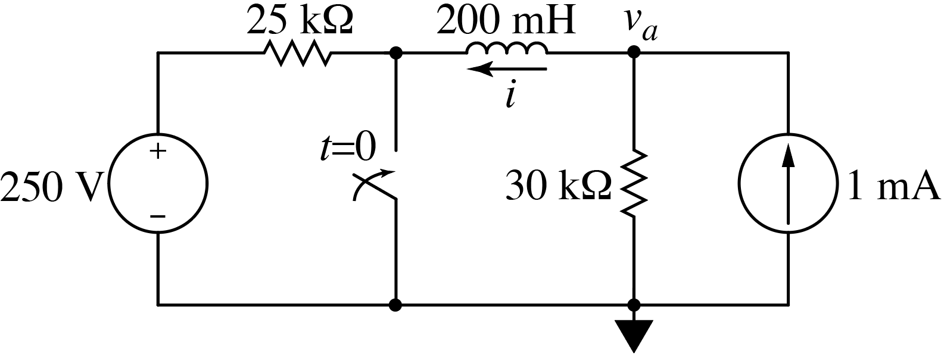
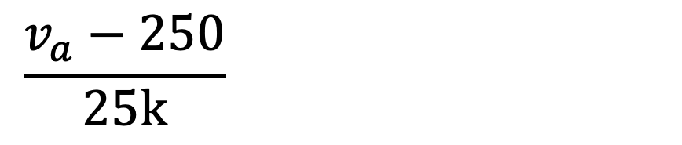
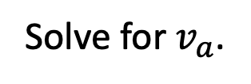
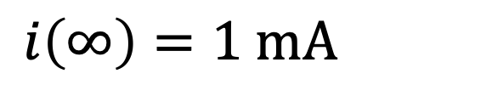
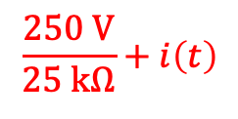
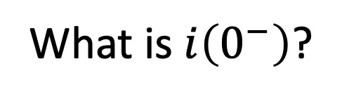
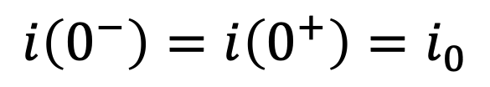
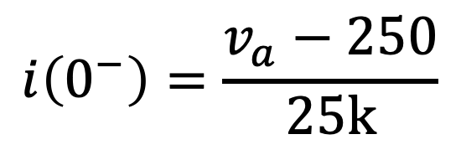
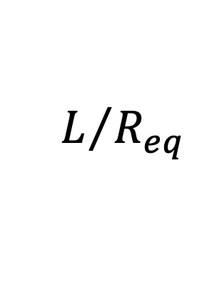
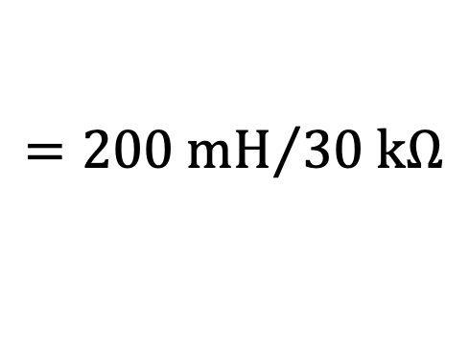
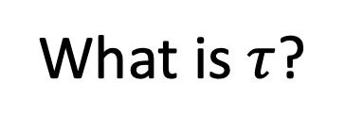
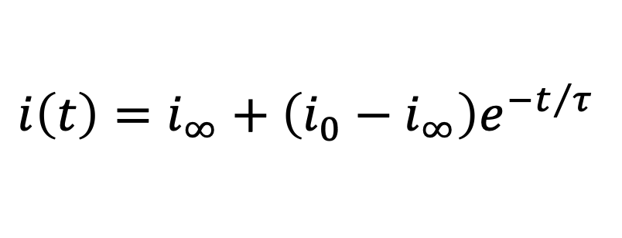
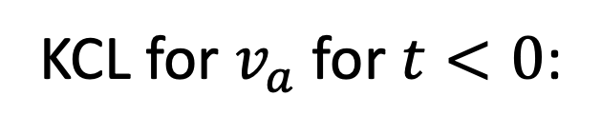
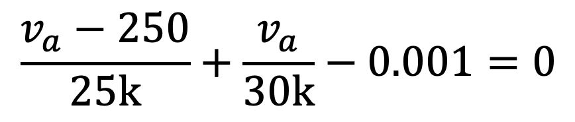
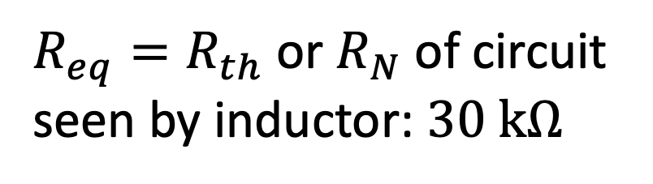
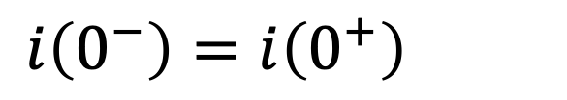
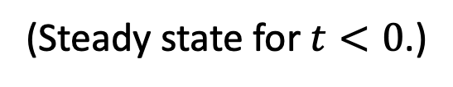
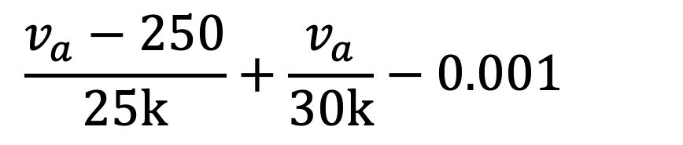
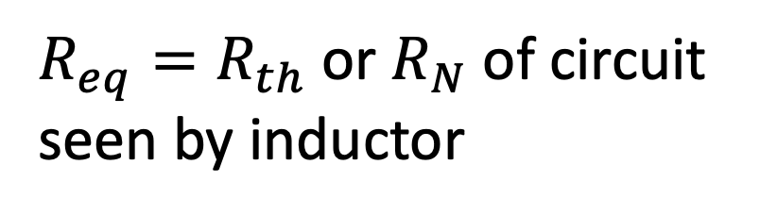
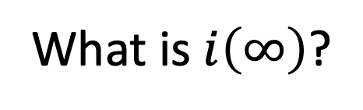
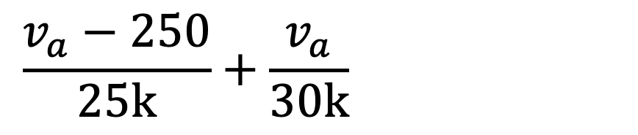
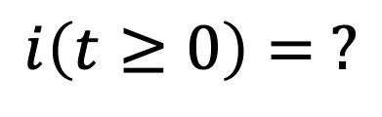
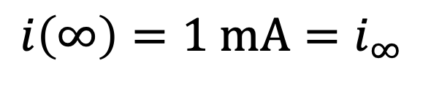
Consider:
$$i\left(t≥0\right)= ?$$
(Steady state for $t<0$.)
short
What is $i\left(0^{−}\right)$?
open
$$\frac{250 V}{25 kΩ}+i\left(t\right)$$
KCL for $v_{a}$ for $t<0$:
$$\frac{v_{a}−250}{25k}+\frac{v_{a}}{30k}−0.001=0$$
$$\frac{v_{a}−250}{25k}+\frac{v_{a}}{30k}−0.001=0$$
$$\frac{v_{a}−250}{25k}+\frac{v_{a}}{30k}−0.001=0$$
$$\frac{v_{a}−250}{25k}+\frac{v_{a}}{30k}−0.001=0$$
$$i\left(∞\right)=1 mA=i_{∞}$$
What is $i\left(∞\right)$?
$$i\left(∞\right)=1 mA=i_{∞}$$
(Inductor current; not switch current.)
Solve for $v_{a}$.
$$i\left(0^{−}\right)=\frac{v_{a}−250}{25k}$$
What is $τ$?
$$L/{R_{eq}}$$
$$={200 mH}/{30 kΩ}$$
$R_{eq}=R_{th}$ or $R_{N}$ of circuit
seen by inductor: $30 kΩ$
$R_{eq}=R_{th}$ or $R_{N}$ of circuit
seen by inductor: $30 kΩ$
$$i\left(0^{−}\right)=i\left(0^{+}\right)=i_{0}$$
$$i\left(0^{−}\right)=i\left(0^{+}\right)=i_{0}$$
✓
✓
✓
✓
$$i\left(t\right)=i_{∞}+\left(i_{0}−i_{∞}\right)e^{−t/τ}$$

Slide 3
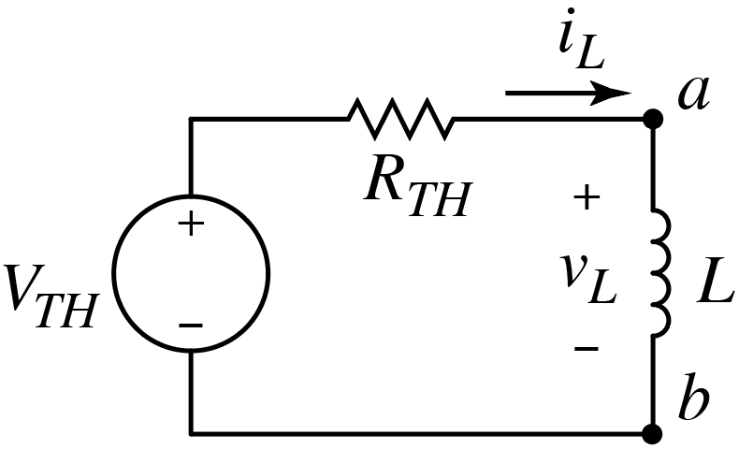
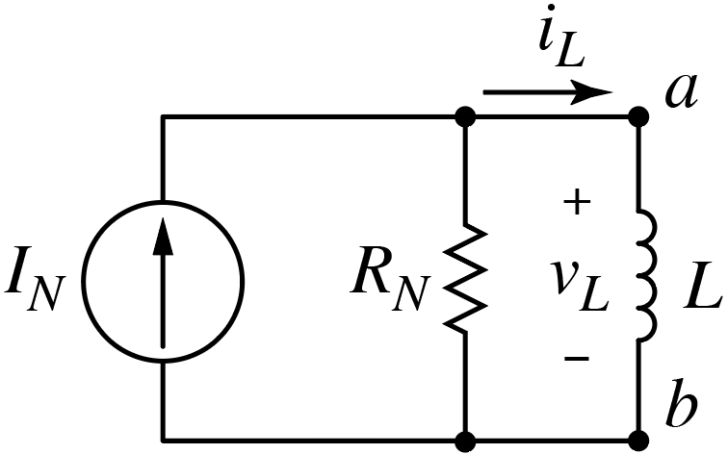
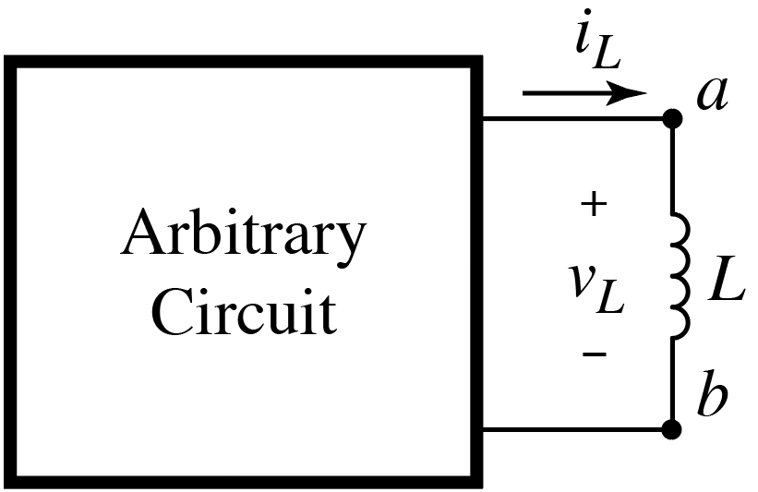
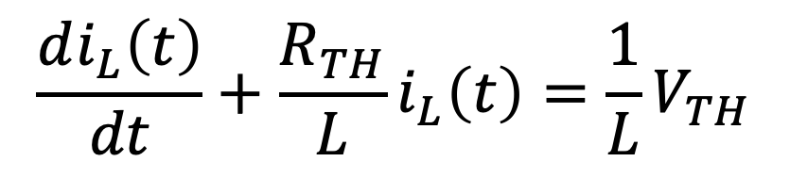
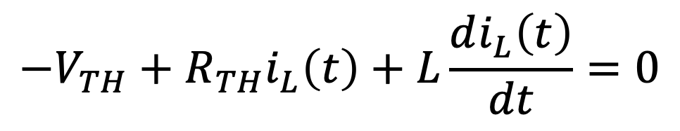
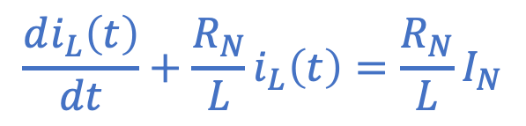
Circuit with an Inductor
$$\frac{di_{L}\left(t\right)}{dt}+\frac{R_{N}}{L}i_{L}\left(t\right)=\frac{R_{N}}{L}I_{N}$$
KVL for Thévenin circuit:
Same!
$$−V_{TH}+R_{TH}i_{L}\left(t\right)+L\frac{di_{L}\left(t\right)}{dt}=0$$
$$\frac{di_{L}\left(t\right)}{dt}+\frac{R_{TH}}{L}i_{L}\left(t\right)=\frac{1}{L}V_{TH}$$
Obtain similar equation using KCL for Norton circuit.
Assumed that we know (or can find) state of circuit at $t=0$ (or $t=t_{0}$).

Slide 4
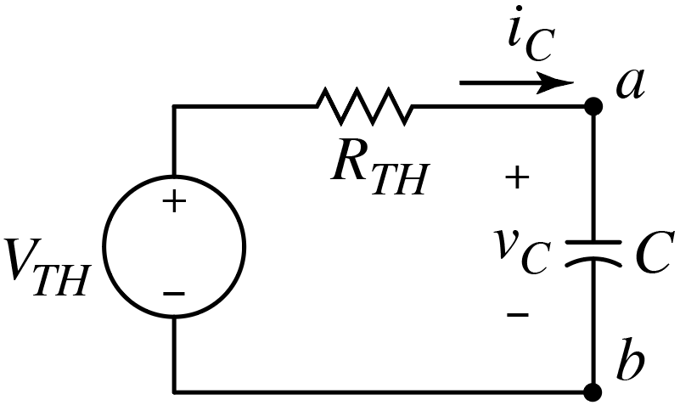
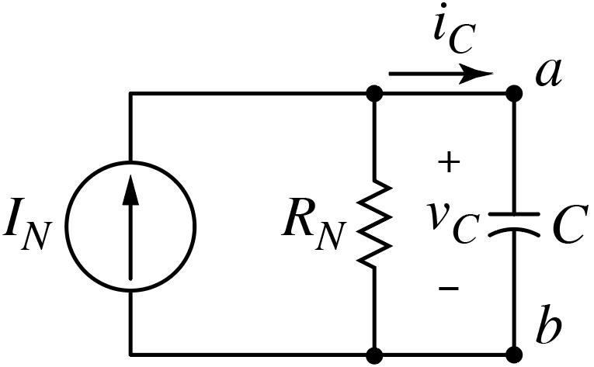
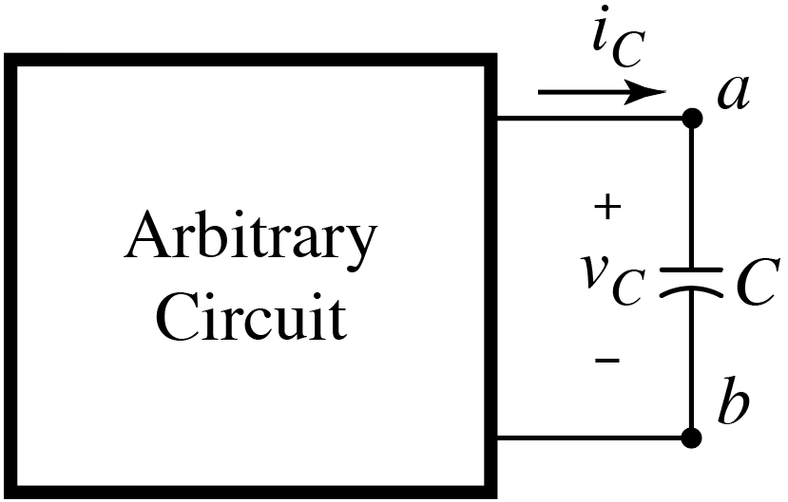
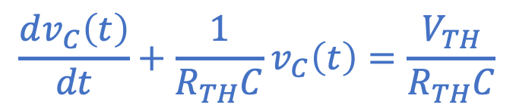
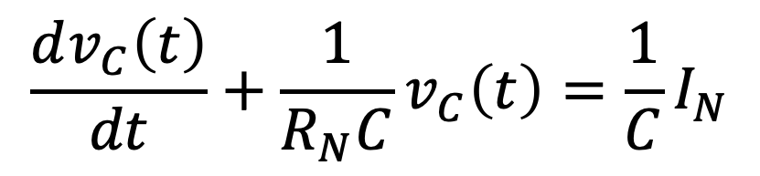
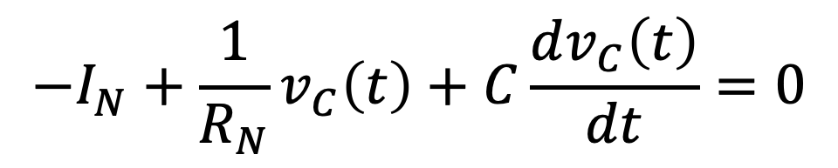
Circuit with a Capacitor
$$\frac{dv_{C}\left(t\right)}{dt}+\frac{1}{R_{TH}C}v_{C}\left(t\right)=\frac{V_{TH}}{R_{TH}C}$$
KCL for Norton circuit:
Same!
$$−I_{N}+\frac{1}{R_{N}}v_{C}\left(t\right)+C\frac{dv_{C}\left(t\right)}{dt}=0$$
$$\frac{dv_{C}\left(t\right)}{dt}+\frac{1}{R_{N}C}v_{C}\left(t\right)=\frac{1}{C}I_{N}$$
Obtain similar equation using KVL for Thévenin circuit.
Assumed that we know (or can find) state of circuit at $t=0$ (or $t=t_{0}$).

Slide 5
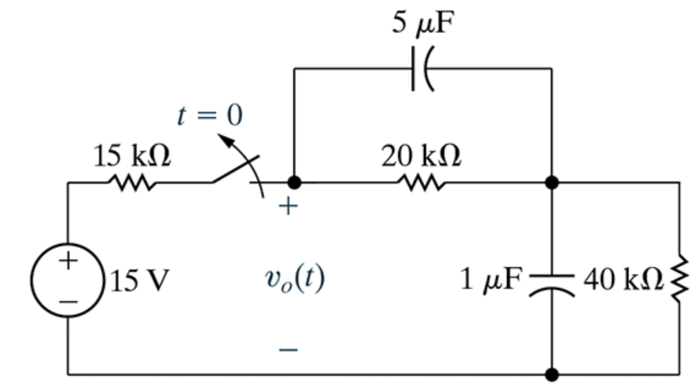
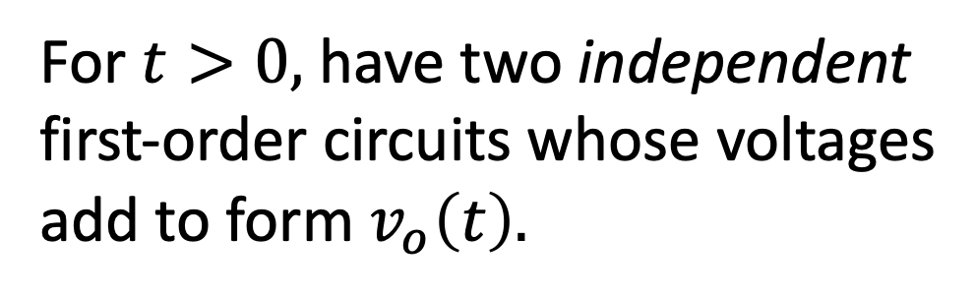

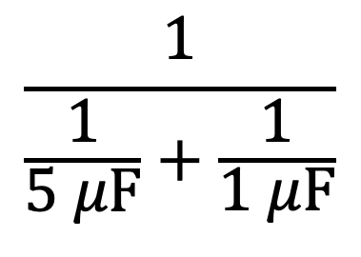
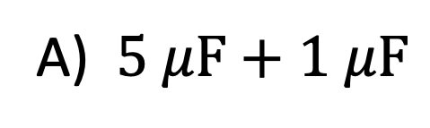
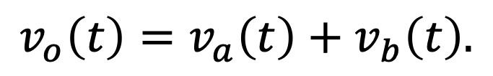


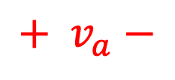
N&R Prob. 7.24
Want $v_{o}\left(t\right).$
$$+ v_{a}−$$
After switch is opened,
equivalent capacitance is:
$$i=0$$
$$+$$
$$v_{b}$$
$$−$$
A) $5 μF+1 μF$
(add)
$$\frac{1}{\frac{1}{5 μF}+\frac{1}{1 μF}}$$
B)
(inverse sum
of inverses)
For $t>0,$have two independent
first-order circuits whose voltages
add to form $v_{o}\left(t\right).$
C) Something else
D) They cannot be combined
Neither parallel nor series.
Current not exchanged between
meshes once switch opened.
$$v_{o}\left(t\right)=v_{a}\left(t\right)+v_{b}\left(t\right).$$
Can consider as converse of HW Prob. 7.32.

Slide 6
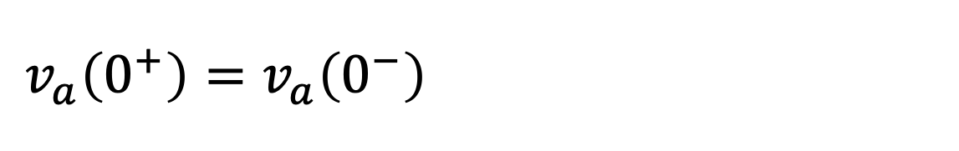
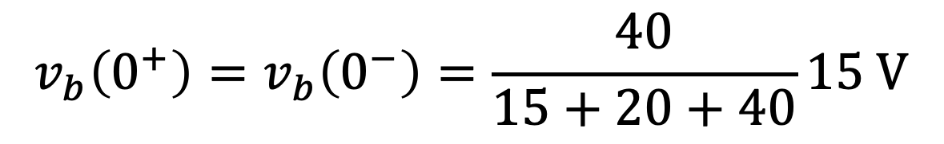
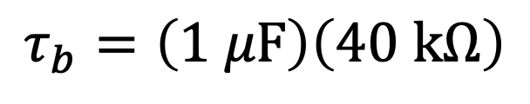
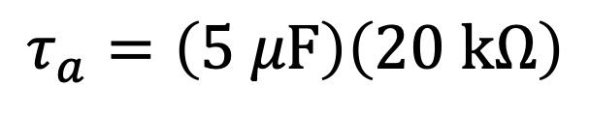
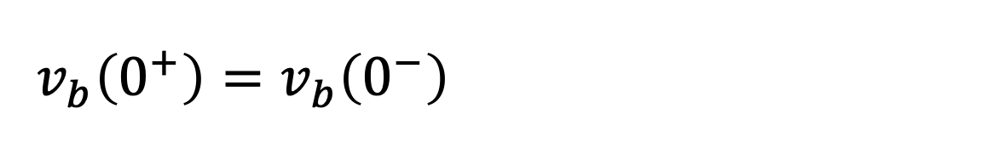
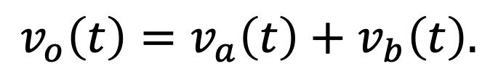
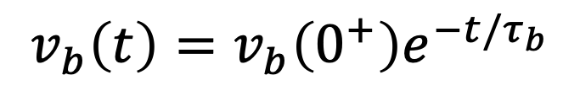


N&R Prob. 7.24
Want $v_{o}\left(t\right).$
$$+ v_{a}−$$
$$i=0$$
$$v_{o}\left(t\right)=v_{a}\left(t\right)+v_{b}\left(t\right).$$
$$+$$
$$v_{b}$$
$$−$$
✓
✓
$$v_{a}\left(t\right)=v_{a}\left(0^{+}\right)e^{−t/τ_{a}}$$
✓
✓
$$v_{b}\left(t\right)=v_{b}\left(0^{+}\right)e^{−t/τ_{b}}$$
$$v_{a}\left(0^{+}\right)=v_{a}\left(0^{−}\right)=\frac{20}{15+20+40}15 V$$
$$v_{a}\left(0^{+}\right)=v_{a}\left(0^{−}\right)=\frac{20}{15+20+40}15 V$$
$$τ_{a}=\left(5 μF\right)\left(20 kΩ\right)$$
$$v_{b}\left(0^{+}\right)=v_{b}\left(0^{−}\right)=\frac{40}{15+20+40}15 V$$
$$v_{b}\left(0^{+}\right)=v_{b}\left(0^{−}\right)=\frac{40}{15+20+40}15 V$$
$$τ_{b}=\left(1 μF\right)\left(40 kΩ\right)$$
Can consider as converse of HW Prob. 7.32.

Slide 7













Consider:
Steady state for $t<0.$
$$50 V$$
$i_{L}\left(t\right)=$ ?
$v_{1}\left(t\right)=$?
Need:
$i_{L}\left(0^{+}\right)=$ ?
$i_{L}\left(∞\right)=$?
$τ=$?
short
ignore
For $t<0$:
$$10∥40=8 Ω$$
$v_{1}=\frac{8}{120+8}800 V=50 V$
$v_{1}=\frac{8}{120+8}800 V=50 V$
$$i_{L}\left(0^{−}\right)={v_{1}}/{10}=5 A=i_{L}\left(0^{+}\right)=i_{0}$$
? (numeric poll)

Slide 8
Consider:
Steady state for $t<0.$
$$50 V$$
$i_{L}\left(t\right)=$ ?
$v_{1}\left(t\right)=$?
Need:
$i_{L}\left(0^{+}\right)=$ ?
$i_{L}\left(∞\right)=$?
$τ=$?
short
ignore
For $t<0$:
$$10∥40=8 Ω$$
$v_{1}=\frac{8}{120+8}800 V=50 V$
$v_{1}=\frac{8}{120+8}800 V=50 V$
$$i_{L}\left(0^{−}\right)={v_{1}}/{10}=5 A=i_{L}\left(0^{+}\right)=i_{0}$$
$$i_{L}\left(0^{−}\right)={v_{1}}/{10}=5 A=i_{L}\left(0^{+}\right)=i_{0}$$
$$i_{L}\left(0^{−}\right)={v_{1}}/{10}=5 A=i_{L}\left(0^{+}\right)=i_{0}$$
$$i_{L}\left(0^{−}\right)={v_{1}}/{10}=5 A=i_{L}\left(0^{+}\right)=i_{0}$$

Slide 9




Consider:
Steady state for $t<0.$
$i_{L}\left(t\right)=$ ?
$v_{1}\left(t\right)=$?
Need:
✓
ignore
$i_{L}\left(0^{+}\right)=$ ?
$i_{L}\left(∞\right)=$?
$τ=$?
short
ignore
For $t<0$:
$$10∥40=8 Ω$$
$v_{1}=\frac{8}{120+8}800 V=50 V$
$v_{1}=\frac{8}{120+8}800 V=50 V$
$$i_{L}\left(0^{−}\right)={v_{1}}/{10}=5 A=i_{L}\left(0^{+}\right)=i_{0}$$
$$i_{L}\left(0^{−}\right)={v_{1}}/{10}=5 A=i_{L}\left(0^{+}\right)=i_{0}$$
$$i_{L}\left(0^{−}\right)={v_{1}}/{10}=5 A=i_{L}\left(0^{+}\right)=i_{0}$$
$$i_{L}\left(0^{−}\right)={v_{1}}/{10}=5 A=i_{L}\left(0^{+}\right)=i_{0}$$
$$R_{eq1}=8∥40∥10=4 Ω$$
For $t$ → ∞:
$$R_{eq1}=8∥40∥10=4 Ω$$
$i_{L}\left(∞\right)=\frac{R_{eq1}}{10}50 A=20 A=i_{∞}$
? (numeric poll)

Slide 10




Consider:
Steady state for $t<0.$
$i_{L}\left(t\right)=$ ?
$v_{1}\left(t\right)=$?
Need:
R_{th}
✓
✓
✓
ignore
$i_{L}\left(0^{+}\right)=$ ?
$i_{L}\left(∞\right)=$?
$τ=$?
short
For $t<0$:
$$10∥40=8 Ω$$
$v_{1}=\frac{8}{120+8}800 V=50 V$
$v_{1}=\frac{8}{120+8}800 V=50 V$
$$i_{L}\left(0^{−}\right)={v_{1}}/{10}=5 A=i_{L}\left(0^{+}\right)=i_{0}$$
$$i_{L}\left(0^{−}\right)={v_{1}}/{10}=5 A=i_{L}\left(0^{+}\right)=i_{0}$$
$$i_{L}\left(0^{−}\right)={v_{1}}/{10}=5 A=i_{L}\left(0^{+}\right)=i_{0}$$
$$i_{L}\left(0^{−}\right)={v_{1}}/{10}=5 A=i_{L}\left(0^{+}\right)=i_{0}$$
$$R_{eq1}=8∥40∥10=4 Ω$$
For $t$ → ∞:
$$R_{eq1}=8∥40∥10=4 Ω$$
$i_{L}\left(∞\right)=\frac{R_{eq1}}{10}50 A=20 A=i_{∞}$
$i_{L}\left(∞\right)=\frac{R_{eq1}}{10}50 A=20 A=i_{∞}$
$i_{L}\left(∞\right)=\frac{R_{eq1}}{10}50 A=20 A=i_{∞}$
$$τ=L/{R_{th}}={0.04}/{\left(10+8∥40\right)}=2.4 ms$$
$$τ=L/{R_{th}}={0.04}/{\left(10+8∥40\right)}=2.4 ms$$
For $t>0$:
$$τ=L/{R_{th}}={0.04}/{\left(10+8∥40\right)}=2.4 ms$$
$$i_{L}\left(t\right)=i_{∞}+\left(i_{0}−i_{∞}\right)\exp\left({−t}/τ\right)$$

Slide 11











Consider:
Steady state for $t<0.$
$$i_{0}=5 A$$
$$i_{∞}=20 A$$
$$τ=2.4 ms$$
For $t>0$:
$$i_{L}\left(t\right)=i_{∞}+\left(i_{0}−i_{∞}\right)\exp\left({−t}/τ\right)$$
$$=20−15\exp\left(−416.7t\right) A$$
$v_{1}\left(t\right)=$?
KVL:
$v_{1}\left(t\right)=10i_{L}+L{di_{L}}/{dt}$
$=\left(200−150\exp\left(−416.7t\right)\right)+0.04\left(15×416.7\right)\exp\left(−416.7t\right)$
$$=200+100\exp\left(−416.7t\right) V$$
Note: $v_{1}\left(0^{−}\right)=50 V≠v_{1}\left(0^{+}\right)=300 V$
Note: $v_{1}\left(0^{−}\right)=50 V≠v_{1}\left(0^{+}\right)=300 V$
Note: $v_{1}\left(0^{−}\right)=50 V≠v_{1}\left(0^{+}\right)=300 V$

Slide 12









Consider:
Steady state for $t<0.$
NOTE: Time varying currents
and voltages must have
same temporal form.
$\exp\left({−t}/τ\right)$ variation for all.
$$τ=L/{R_{th}}$$
Why?
For $t>0$:
$$i_{L}\left(t\right)=i_{∞}+\left(i_{0}−i_{∞}\right)\exp\left({−t}/τ\right)$$
$$\left(8 Ω∥40 Ω\right)\left(50 A−5 A\right)$$
$v_{1}\left(t\right)=$?
$v_{1}\left(t\right)=10i_{L}+L{di_{L}}/{dt}$
$$\left(8 Ω∥40 Ω∥10 Ω\right)\left(50 A\right)$$
But, this is also true:
$$v_{1}\left(t\right)=v_{1}\left(∞\right)+\left(v_{1}\left(0^{+}\right)−v_{1}\left(∞\right)\right)\exp\left({−t}/τ\right)$$
However, to use this, you must determine $v_{1}\left(0^{+}\right)$ and $v_{1}\left(∞\right)$.
That may be easy, but may be simpler to use
$$v_{1}\left(t\right)=10i_{L}+L{di_{L}}/{dt}.$$

Slide 13




N&R Prob. 7.17
Steady state prior to $t=0.$
Want $v_{o}\left(t\right)$ and $i_{o}\left(t\right).$
Related to this
mechanical scenario:
Relative velocity $\left(v_{2}−v_{1}\right)$
goes to zero, but in general
as $t→∞, v_{1}=v_{2}≠0.$

Slide 14
















$$i_{0}\left(0^{−}\right)=0=i_{0}\left(0^{+}\right)$$
N&R Prob. 7.17
Steady state prior to $t=0.$
$$i_{0}\left(0^{−}\right)=0=i_{0}\left(0^{+}\right)$$
Want $v_{o}\left(t\right)$ and $i_{o}\left(t\right).$
$i_{0}\left(∞\right)= ?$ Hmm…
Can combined inductors
to form a single equivalent
inductance.
$$+$$
$$v_{a}$$
$$−$$
$$−$$
$$v_{b}$$
$$+$$
$$L_{eq}=20+\left(80∥48\right) mH$$
“Simple” $RL$ circuit.
$i\left(0^{+}\right)$, $i\left(∞\right)$, and $τ$ easy
to find.
$$i\left(t\right)$$
$$i\left(0^{+}\right)=5 mA.$$
$$i\left(∞\right)=0.$$
$$v_{a}\left(t\right)=0.02\frac{di\left(t\right)}{dt}.$$
Obtain constant term
in addition to
decaying exponential.
Find $i\left(t\right)$.
$v_{b}\left(t\right)=2500i\left(t\right)$.
$$v_{o}\left(t\right)=−v_{b}\left(t\right)−v_{a}\left(t\right).$$
Integrate $v_{o}\left(t\right)$ appropriately to find $i_{o}\left(t\right)$.

