Slide 1
EE 261, Spring 2025, Lecture 28
Goals/Topics:
Switching (multiple state changes), 1st–order system
Bounded and unbounded responses
(negative resistance with dependent sources)
Best viewed in
presentation mode
in PowerPoint.
Announcements:
Homework 9 due Sunday, March 30th.
Test 3 next Friday, April 4th. Spark G45 at 7:00 p.m.
Homework 10 posted soon.

Slide 2


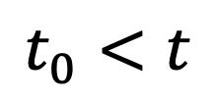
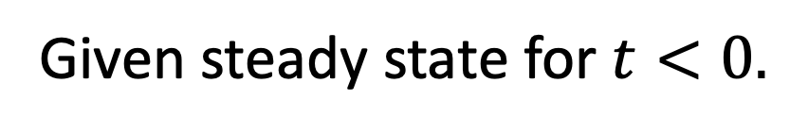
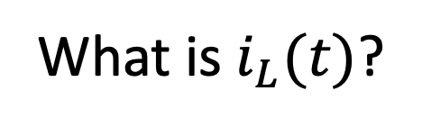
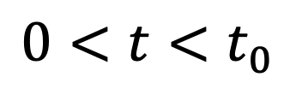
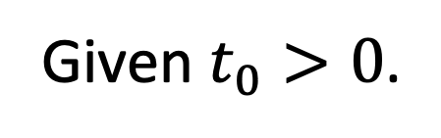


Switching: More than one state change.
Given steady state for $t<0.$
Given $t_{0}>0$.
What is $i_{L}(t)$?
Second state
change.
open$→$short$→$open
First state
change.
$$t<0$$
$$i_{L}\left(0^{−}\right)=i_{L}\left(0^{+}\right)$$
$$0<t<t_{0}$$
$$i_{L}\left(t_{0}^{−}\right)=i_{L}\left(t_{0}^{+}\right)$$
$$t_{0}<t$$
initial
conditions
initial
conditions
Forced.
Unforced.
Forced.

Slide 3
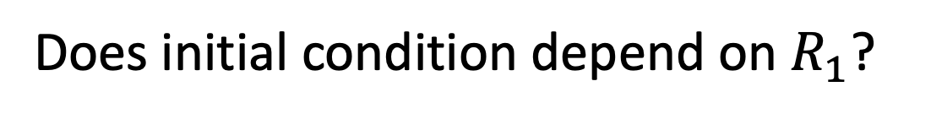
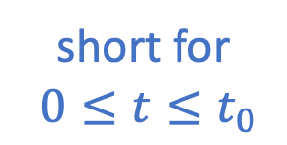
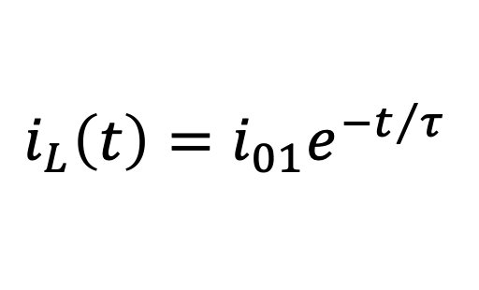
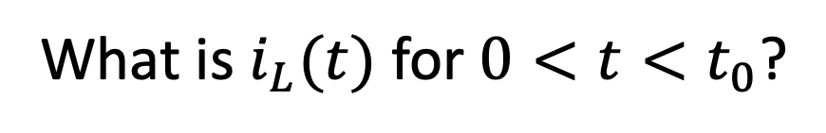
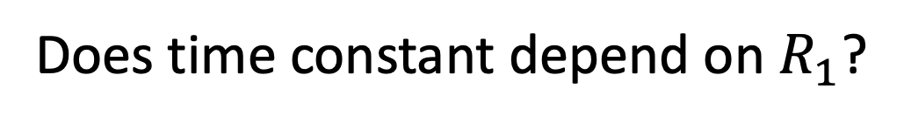
Switching: More than one state change.
Given steady state for $t<0.$
Given $t_{0}>0$.
What is $i_{L}(t)$?
What is $i_{L}(t)$ for $0<t<t_{0}$?
Second state
change.
Ignore a second switch will do
something in the future!
short for
$0≤t≤t_{0}$
First state
change.
Circuit cannot anticipate
future changes.
Homogeneous system: Just need natural response.
$$i_{L}\left(t\right)=i_{01}e^{−t/τ}$$
Need initial condition ($i_{L}\left(0^{−}\right)=i_{L}\left(0^{+}\right)$) and time constant ($τ$).
Does initial condition depend on $R_{1}$?
A) Yes B) No
First switch has not
created short yet.
Does time constant depend on $R_{1}$?
A) Yes B) No
Short present and “removes”
left side from consideration.

Slide 4
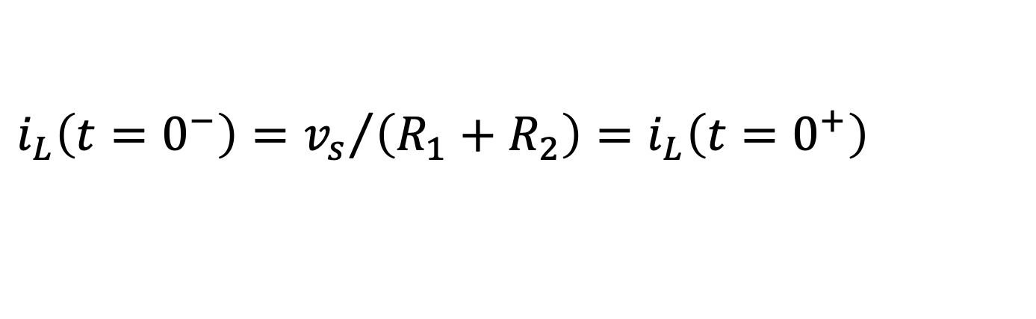
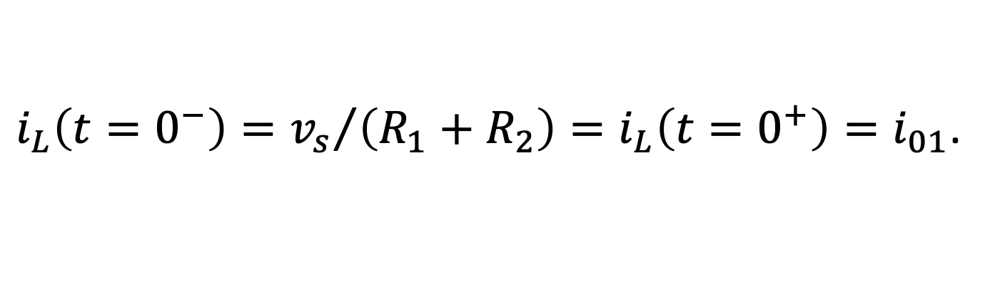
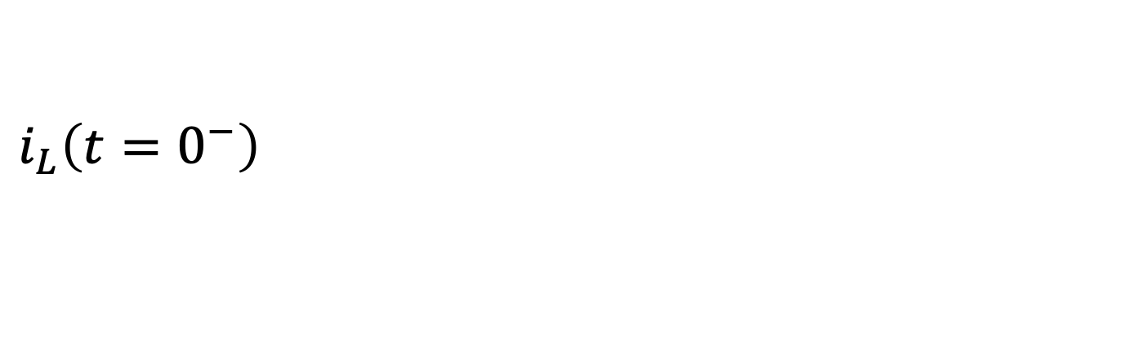
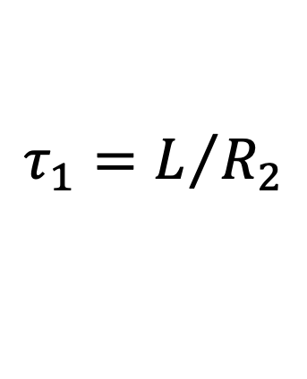
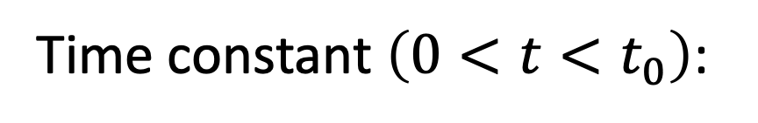
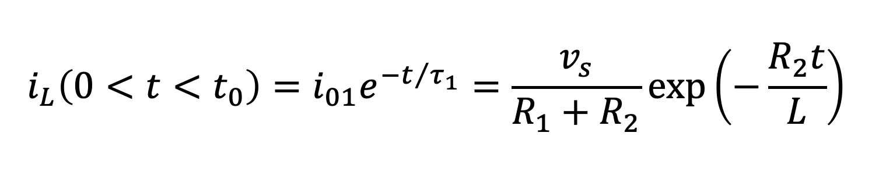
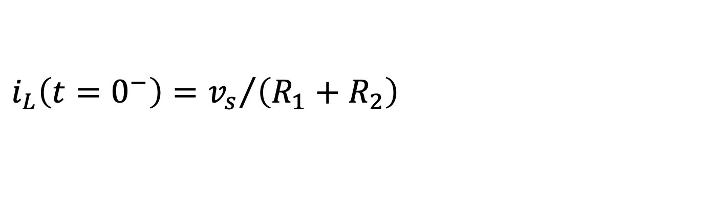
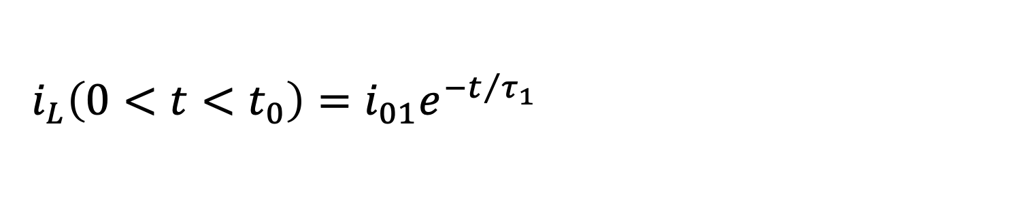
Switching: More than one state change.
Given steady state for $t<0.$
Given $t_{0}>0$.
What is $i_{L}(t)$?
What is $i_{L}(t)$ for $0<t<t_{0}$?
Second state
change.
Ignore a second switch will do
something in the future!
short
short
First state
change.
Circuit cannot anticipate
future changes.
open
Homogeneous system: Just need natural response.
$$i_{L}\left(t\right)=i_{01}e^{−t/τ}$$
$i_{L}\left(t=0^{−}\right)={v_{s}}/{\left({R_{1}+R}_{2}\right)}=i_{L}\left(t=0^{+}\right)=i_{01}$.
$i_{L}\left(t=0^{−}\right)={v_{s}}/{\left({R_{1}+R}_{2}\right)}=i_{L}\left(t=0^{+}\right)=i_{01}$.
$i_{L}\left(t=0^{−}\right)={v_{s}}/{\left({R_{1}+R}_{2}\right)}=i_{L}\left(t=0^{+}\right)=i_{01}$.
Initial condition:
$i_{L}\left(t=0^{−}\right)={v_{s}}/{\left({R_{1}+R}_{2}\right)}=i_{L}\left(t=0^{+}\right)=i_{01}$.
Time constant $\left(0<t<t_{0}\right)$:
$$τ_{1}=L/{R_{2}}$$
$$i_{L}\left(0<t<t_{0}\right)=i_{01}e^{−t/{τ_{1}}}=\frac{v_{s}}{R_{1}+R_{2}}\exp\left(−\frac{R_{2}t}{L}\right)$$
$$i_{L}\left(0<t<t_{0}\right)=i_{01}e^{−t/{τ_{1}}}=\frac{v_{s}}{R_{1}+R_{2}}\exp\left(−\frac{R_{2}t}{L}\right)$$
Could write $i_{L}\left(0≤t≤t_{0}\right)$ since current varies continuously.

Slide 5
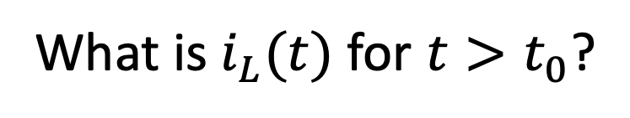
Switching: More than one state change.
Given steady state for $t<0.$
What is $i_{L}(t)$ for $t>t_{0}$?
Back to forced response!
open
short
An aside: An open in series with anything is an open circuit.¹
A short in parallel with anything is a short circuit.²
1. An open in series with a current source is an invalid circuit.
2. A short in parallel with a voltage source is an invalid circuit.

Slide 6
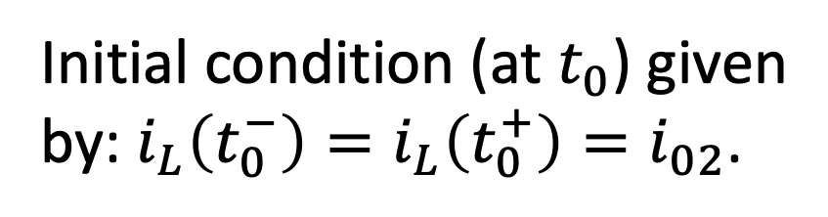
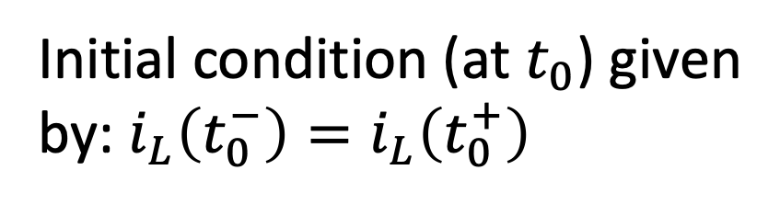
Switching: More than one state change.
Given steady state for $t<0.$
What is $i_{L}(t)$ for $t>t_{0}$?
Back to forced response!
open
Initial condition (at $t_{0}$) given
by: $i_{L}\left(t_{0}^{−}\right)=i_{L}\left(t_{0}^{+}\right)=i_{02}$.
Initial condition (at $t_{0}$) given
by: $i_{L}\left(t_{0}^{−}\right)=i_{L}\left(t_{0}^{+}\right)=i_{02}$.
$$0<t<t_{0}$$
$$i_{L}\left(t_{0}^{−}\right)=i_{L}\left(t_{0}^{+}\right)$$
$$t_{0}<t$$
initial
conditions
Unforced.
Forced.

Slide 7
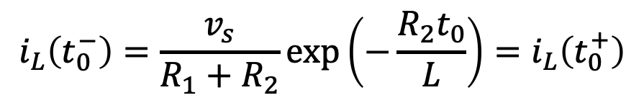
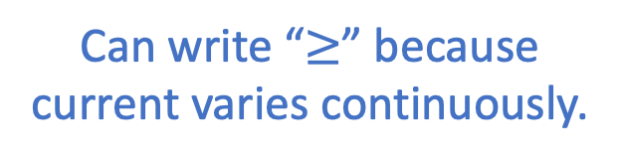
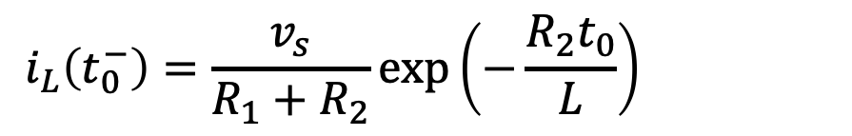
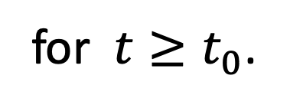
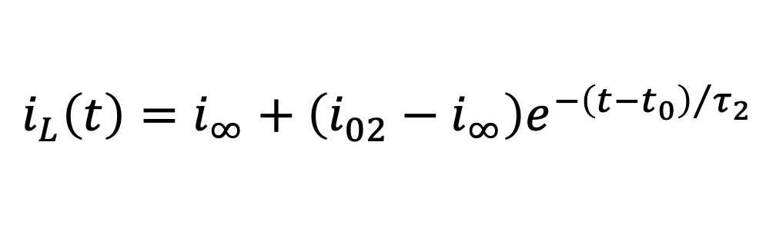
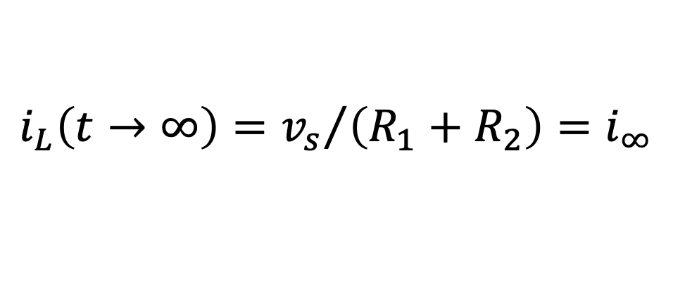
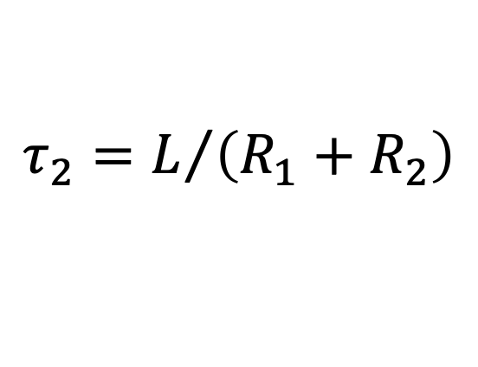
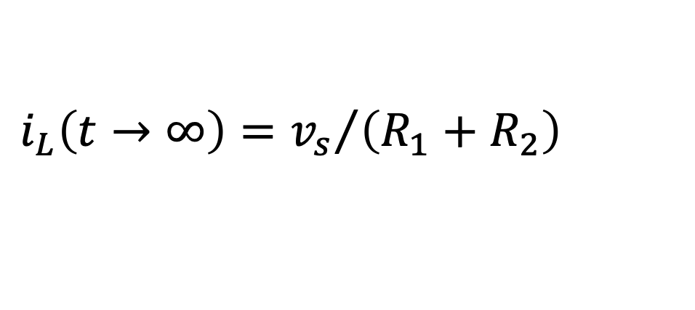
Switching: More than one state change.
Given steady state for $t<0.$
What is $i_{L}(t)$ for $t>t_{0}$?
Back to forced response!
open
Initial condition (at $t_{0}$) given
by: $i_{L}\left(t_{0}^{−}\right)=i_{L}\left(t_{0}^{+}\right)=i_{02}$.
$$i_{L}\left(t_{0}^{−}\right)=\frac{v_{s}}{R_{1}+R_{2}}\exp\left(−\frac{R_{2}t_{0}}{L}\right)=i_{L}\left(t_{0}^{+}\right)$$
$$i_{L}\left(t_{0}^{−}\right)=\frac{v_{s}}{R_{1}+R_{2}}\exp\left(−\frac{R_{2}t_{0}}{L}\right)=i_{L}\left(t_{0}^{+}\right)$$
(From analysis on previous slide.)
Final condition given by:
$$i_{L}\left(t→∞\right)={v_{s}}/{\left({R_{1}+R}_{2}\right)}=i_{∞}$$
$$i_{L}\left(t→∞\right)={v_{s}}/{\left({R_{1}+R}_{2}\right)}=i_{∞}$$
Time constant:
$$τ_{2}=L/{\left({R_{1}+R}_{2}\right)}$$
Can write “$≥$” because
current varies continuously.
Note delay.
$$i_{L}\left(t\right)=i_{∞}+\left(i_{02}−i_{∞}\right)e^{−{\left({t−t}_{0}\right)}/{τ_{2}}}$$
for $t≥t_{0}$.

Slide 8
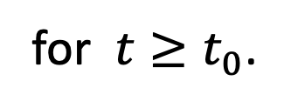
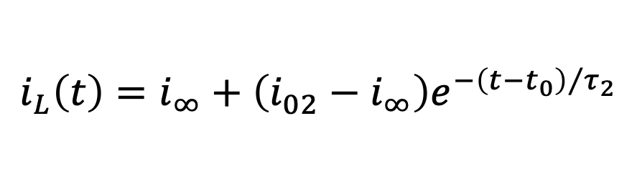
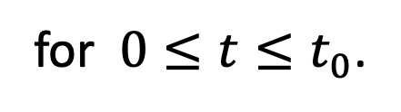
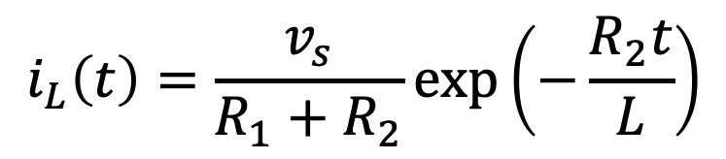
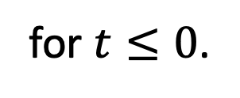
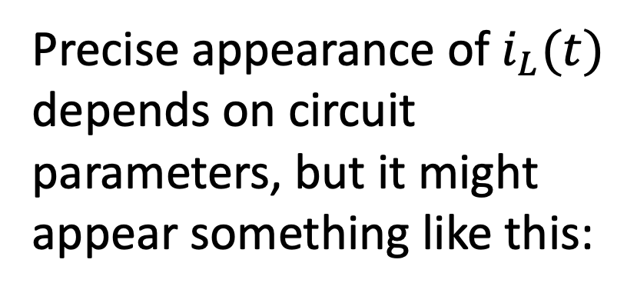
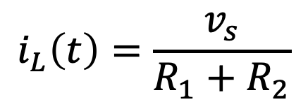
Switching: More than one state change.
$$i_{L}\left(t\right)=\frac{v_{s}}{R_{1}+R_{2}}$$
for $t≤0$.
(Steady state.)
$$i_{L}\left(t\right)=\frac{v_{s}}{R_{1}+R_{2}}\exp\left(−\frac{R_{2}t}{L}\right)$$
for $0≤t≤t_{0}$.
(Natural response.)
$$i_{L}\left(t\right)=i_{∞}+\left(i_{02}−i_{∞}\right)e^{−{\left({t−t}_{0}\right)}/{τ_{2}}}$$
for $t≥t_{0}$.
(Forced response.)
Precise appearance of $i_{L}(t)$
depends on circuit
parameters, but it might
appear something like this:
Steady
state.
Natural
response.
Forced response.

Slide 9
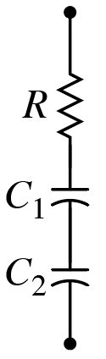
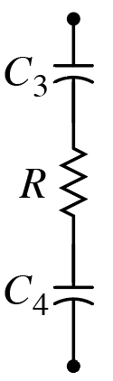
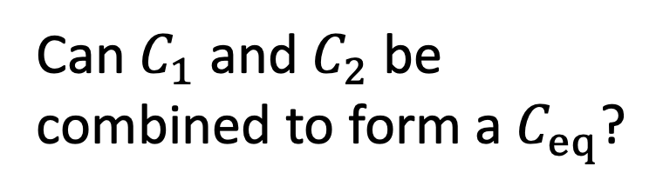
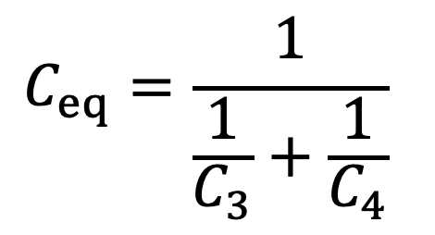
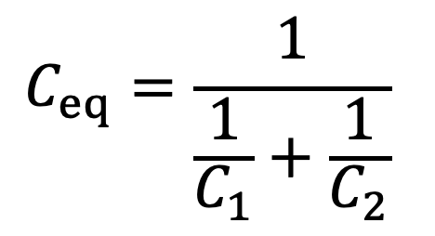
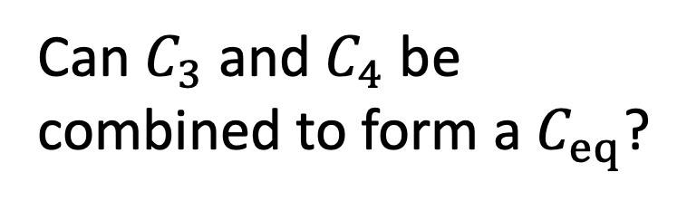
Consider:
Can $C_{1}$ and $C_{2}$ be
combined to form a $C_{eq}$?
Can $C_{3}$ and $C_{4}$ be
combined to form a $C_{eq}$?
A) Yes
B) No
A) Yes
B) No
$$C_{eq}=\frac{1}{\frac{1}{C_{1}}+\frac{1}{C_{2}}}$$
$$C_{eq}=\frac{1}{\frac{1}{C_{3}}+\frac{1}{C_{4}}}$$
Order or series elements does not matter.

Slide 10
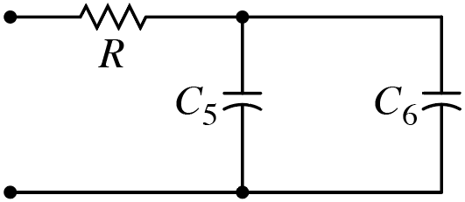
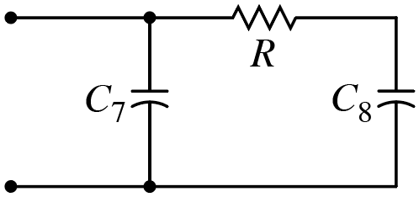
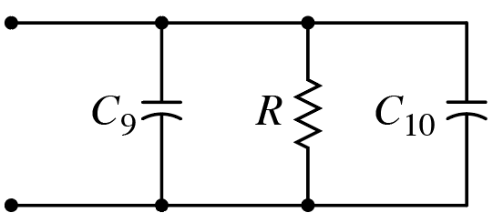
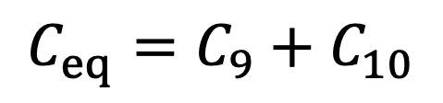
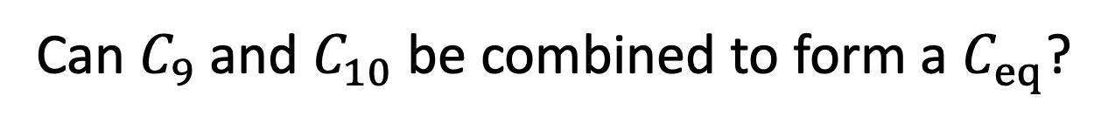
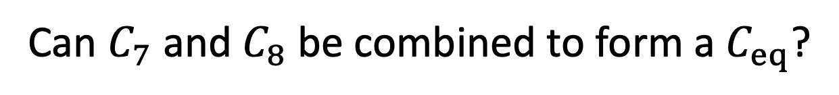
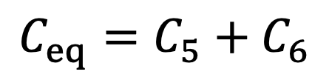
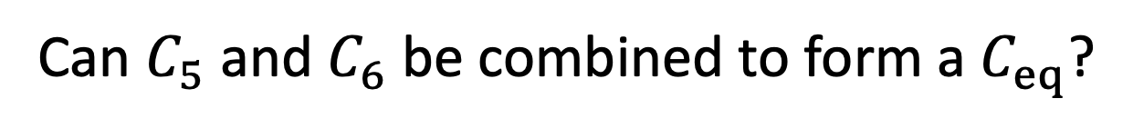

Can $C_{5}$ and $C_{6}$ be combined to form a $C_{eq}$?
A) Yes
B) No
$$C_{eq}=C_{5}+C_{6}$$
Capacitors in parallel.
Can $C_{7}$ and $C_{8}$ be combined to form a $C_{eq}$?
$C_{7}$ and $C_{8}$ are neither in
parallel nor in series.
A) Yes
B) No
(If no other inductors or capacitors in
circuit, behavior governed by second-order diff. eq.)
Can $C_{9}$ and $C_{10}$ be combined to form a $C_{eq}$?
A) Yes
B) No
$$C_{eq}=C_{9}+C_{10}$$
Capacitors in parallel.
Arrangement of parallel elements does not matter.

Slide 11




Consider:
Pulsed source.
$i_{1}\left(t\right)=$ ?
$v_{1}\left(t\right)=$ ?
What are reasonable guesses for shape of $i_{1}\left(t\right)$ and $v_{1}\left(t\right)$?
$$v_{1}=L\frac{di_{1}}{dt}$$
$v_{1}=−i_{1}R$ for $t>75 μs$

Slide 12









Bounded Natural Response:
$$\frac{df(t)}{dt}+\frac{1}{τ}f\left(t\right)=0$$
Decays to zero
assuming $τ>0$.
$$f\left(t\right)=f_{0}e^{−t/τ}$$
$$\frac{df(t)}{dt}=−\frac{1}{τ}f_{0}e^{−t/τ}$$
(Goes to infinity
if $τ<0$.)
Unbounded Natural Response:
$$\frac{df(t)}{dt}−\frac{1}{τ}f\left(t\right)=0$$
Goes to infinity
assuming $τ>0$.
$$f\left(t\right)=f_{0}e^{+t/τ}$$
(Decays to zero
if $τ<0$.)

Slide 13











Consider: Circuit with only dependent sources
These are purely resistive and require a test source to
determine equivalent resistance.
$$R_{th}={v_{t}}/{i_{t}}$$
$$i_{t}$$
$$R_{th}={v_{t}}/{\left(i_{R}+3i_{R}\right)}={v_{t}}/{\left(4i_{R}\right)}$$
$$R_{th}={v_{t}}/{\left(i_{R}+3i_{R}\right)}={v_{t}}/{\left(4i_{R}\right)}$$
$$i_{R}={v_{t}}/{24 Ω}$$
$$R_{th}={v_{t}}/{\left(4\left[{v_{t}}/{24 Ω}\right]\right)}=6 Ω$$
$$R_{th}={v_{t}}/{\left(4\left[{v_{t}}/{24 Ω}\right]\right)}=6 Ω$$
$$R_{th}= ?$$
$$R_{th}=6 Ω$$

Slide 14













Consider:
$$R_{th}={v_{t}}/{i_{t}}$$
$$i_{t}$$
$$R_{th}={v_{t}}/{\left(i_{R}−3i_{R}\right)}=−{v_{t}}/{\left(2i_{R}\right)}$$
$$R_{th}={v_{t}}/{\left(i_{R}−3i_{R}\right)}=−{v_{t}}/{\left(2i_{R}\right)}$$
$$i_{R}={v_{t}}/{24 Ω}$$
$$R_{th}=−{v_{t}}/{\left(2\left[{v_{t}}/{24 Ω}\right]\right)}=−12 Ω$$
$$R_{th}=−{v_{t}}/{\left(2\left[{v_{t}}/{24 Ω}\right]\right)}=−12 Ω$$
$$i_{t}={v_{t}}/{R_{th}}=−{v_{t}}/{12 Ω}$$
$$i_{t}={v_{t}}/{R_{th}}=−{v_{t}}/{12 Ω}$$
$$R_{th}= ?$$
$$R_{th}=−12 Ω$$
Current flows into positive terminal of
voltage source. Power delivered to test
source.
Current flows into positive terminal of
voltage source. Power delivered to test
source.

Slide 15














Bounded Response:
Unbounded Response:
$$R_{th}=6 Ω$$
$$R_{th}=−12 Ω$$
KCL
$$C\frac{{dv}_{C}}{dt}+\frac{v_{C}}{R_{th}}=0$$
$$C\frac{{dv}_{C}}{dt}+\frac{v_{C}}{R_{th}}=0$$
$$C\frac{{dv}_{C}}{dt}+\frac{v_{C}}{R_{th}}=0$$
$$τ=R_{th}C=\left(−12 Ω\right)C$$
$$τ=R_{th}C=\left(6 Ω\right)C$$
$$τ=R_{th}C=\left(−12 Ω\right)C$$
$$τ=R_{th}C=\left(6 Ω\right)C$$
$v_{C}(t)$ decays to zero
as $t→∞$.
$v_{C}(t)$ heads to $∞$ as
$t→∞$ (until something
breaks or saturates or…).
$$v_{C}\left(t\right)=v_{0}e^{−t/τ}$$

