Slide 1
EE 261, Spring 2025, Lecture 30
Goals/Topics:
Types of natural responses for parallel RLC circuits:
Overdamped response
Underdamped response
Critically damped response
Best viewed in presentation mode in PowerPoint.
And for all stable second-order systems!
Announcements:
Homework 10 posted. Due Apr. 2nd (handwritten) & 3rd (Mastering).
Test 3 next Friday, Apr. 4th. Spark G45 at 7:00 p.m.
(Optional) Review session Apr. 4th at regular lecture time.

Slide 2
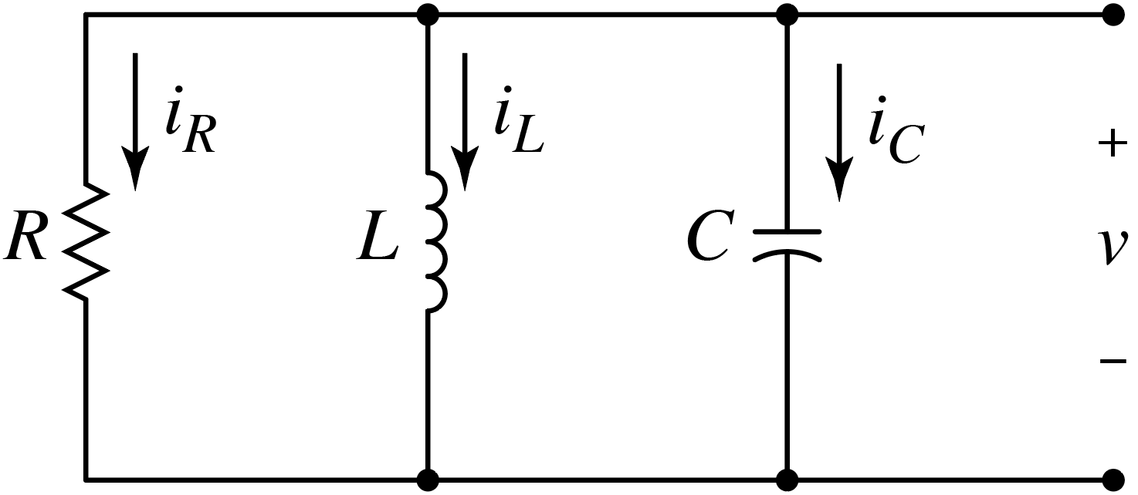
Recall parallel RLC circuit (want $v\left(t\right)$):
KCL yields:
$$\frac{d^{2}v\left(t\right)}{{dt}^{2}}+\frac{1}{RC}\frac{dv\left(t\right)}{dt}+\frac{1}{LC}v\left(t\right)=0$$
Assuming $v\left(t\right)=Ae^{st}$ yields:
Characteristic polynomial:
$$As^{2}e^{st}+\frac{As}{RC}e^{st}+\frac{A}{LC}e^{st}=0$$
$$s^{2}+\frac{s}{RC}+\frac{1}{LC}=0$$
General solution:
Factor out $Ae^{st}$.
$$v\left(t\right)=A_{1}e^{s_{1}t}+A_{2}e^{s_{2}t}$$
$s_{1}$ and $s_{2}$ dictated by circuit.
$A_{1}$ and $A_{2}$ dictated by initial conditions.
Would know or could figure out the things that cannot change instantaneously.
Would know $v_{C}\left(0\right)$(i.e., $v(0)$) and $i_{L}(0)$.

Slide 3
Characteristic Polynomial:
$$a$$
$$b$$
$$c$$
Need “roots” of this equation.
$$1 s^{2}+\frac{1}{RC}s+\frac{1}{LC}=0$$
$$1 s^{2}+\frac{1}{RC}s+\frac{1}{LC}=0$$
(Parallel RLC circuit.)
$$b=\frac{1}{RC}$$
Quadratic formula:
$$=−\frac{b}{2}±\sqrt{{\left(\frac{b}{2}\right)}^{2}−c}$$
$$\frac{−b±\sqrt{b^{2}−4ac}}{2a}$$
$$c=\frac{1}{LC}$$
$$a=1$$
Yields two solutions:
Move $2$ into square root.
$$s_{1}=−\frac{1}{2RC}+\sqrt{{\left(\frac{1}{2RC}\right)}^{2}−\frac{1}{LC}}$$
$$s_{2}=−\frac{1}{2RC}−\sqrt{{\left(\frac{1}{2RC}\right)}^{2}−\frac{1}{LC}}$$
$$v\left(t\right)=A_{1}e^{s_{1}t}+A_{2}e^{s_{2}t}$$
General solution!
What are $A$’s?
}
$$v\left(0\right)=A_{1}e^{s_{1}t}+A_{2}e^{s_{2}t}$$
$$=A_{1}+A_{2}$$
$v\left(0\right)$ and $dv(0)/dt$ are (known) initial conditions.
$$t=0$$
$$\frac{dv\left(0\right)}{dt}=A_{1}s_{1}e^{s_{1}t}+A_{2}s_{2}e^{s_{2}t}$$
$$=A_{1}s_{1}+A_{2}s_{2}$$
Solve for $A_{1}$ and $A_{2}$.
$$t=0$$

Slide 4
$$s_{1}=−\frac{1}{2RC}+\sqrt{{\left(\frac{1}{2RC}\right)}^{2}−\frac{1}{LC}}$$
General solution:
$$v\left(t\right)=A_{1}e^{s_{1}t}+A_{2}e^{s_{2}t}$$
$$s_{2}=−\frac{1}{2RC}−\sqrt{{\left(\frac{1}{2RC}\right)}^{2}−\frac{1}{LC}}$$
$s_{1}$ and $s_{2}$ dictated by circuit.
$A_{1}$ and $A_{2}$ dictated by initial conditions.
(Assume $v_{C}\left(0\right)=v(0)$ and $i_{L}(0)$ given or can be found.)
$$α≜\frac{1}{2RC}$$
$$ω_{0}≜\frac{1}{\sqrt{LC}}$$
Define:
(Damping coefficient or “neper frequency.”)
and
(Natural or “resonant” frequency.)
$$s_{1,2}=−α±\sqrt{α^{2}−ω_{0}^{2}}$$
Units of inverse seconds, $s^{−1}$.
Characteristic polynomial:
Could be written as:
$$s^{2}+\frac{s}{RC}+\frac{1}{LC}=0$$
$$s^{2}+2αs+ω_{0}^{2}=0$$

Slide 5
$$s_{1}=−\frac{1}{2RC}+\sqrt{{\left(\frac{1}{2RC}\right)}^{2}−\frac{1}{LC}}$$
General solution:
$$v\left(t\right)=A_{1}e^{s_{1}t}+A_{2}e^{s_{2}t}$$
$$s_{2}=−\frac{1}{2RC}−\sqrt{{\left(\frac{1}{2RC}\right)}^{2}−\frac{1}{LC}}$$
$s_{1}$ and $s_{2}$ dictated by circuit.
$A_{1}$ and $A_{2}$ dictated by initial conditions.
(Assume $v_{C}\left(0\right)=v(0)$ and $i_{L}(0)$ given or can be found.)
$$α≜\frac{1}{2RC}$$
$$ω_{0}≜\frac{1}{\sqrt{LC}}$$
Define:
(Damping coefficient or “neper frequency.”)
and
(Natural or “resonant” frequency.)
$$s_{1,2}=−α±\sqrt{α^{2}−ω_{0}^{2}}$$
Units of inverse seconds, $s^{−1}$.
Three possibilities (if $α≠0)$:
$$s_{1,2}=−α±\sqrt{α^{2}−ω_{0}^{2}}$$
ω₀ < α: Overdamped → Real and distinct roots.
ω₀ > α: Underdamped → Complex conjugate roots.
ω₀ = α: Critically damped → Repeated real roots.
$$s_{1,2}=−α±j\sqrt{ω_{0}^{2}−α^{2}}$$
$$s_{1}=s_{2}=−α$$

Slide 6
Overdamped System ($ω_{0}<α$)
Real and distinct roots.
$$s_{1,2}=−α±\sqrt{α^{2}−ω_{0}^{2}}$$
Two negative real numbers.
$$A_{1}= ?$$
$$i_{R}\left(0\right)$$
Known at $t=0$.
$$v\left(t\right)=A_{1}e^{s_{1}t}+A_{2}e^{s_{2}t}$$
$$t=0$$
$$A_{2}= ?$$
$$\frac{dv\left(0\right)}{dt}=−\frac{1}{C}\left(\frac{v_{C}\left(0\right)}{R}+i_{L}\left(0\right)\right)$$
$$\frac{dv\left(0\right)}{dt}=−\frac{1}{C}\left(\frac{v_{C}\left(0\right)}{R}+i_{L}\left(0\right)\right)$$
$$v\left(0\right)=A_{1}+A_{2}=v_{C}\left(0\right)$$
Assumed known.
$$v\left(0\right)=A_{1}+A_{2}=v_{C}\left(0\right)$$
$$v\left(0\right)=A_{1}+A_{2}=v_{C}\left(0\right)$$
$${\left.\frac{dv\left(t\right)}{dt}\right|}_{t=0}=A_{1}s_{1}+A_{2}s_{2}= ?$$
$${\left.\frac{dv\left(t\right)}{dt}\right|}_{t=0}=A_{1}s_{1}+A_{2}s_{2}= ?$$
$${\left.\frac{dv\left(t\right)}{dt}\right|}_{t=0}=A_{1}s_{1}+A_{2}s_{2}= ?$$
$${\left.\frac{dv\left(t\right)}{dt}\right|}_{t=0}=A_{1}s_{1}+A_{2}s_{2}= ?$$
Equations in matrix form:
Hmm…
$$\left[\begin{matrix}1 & 1 \\ s_{1} & s_{2}\end{matrix}\right]\left[\begin{matrix}A_{1} \\ A_{2}\end{matrix}\right]=\left[\begin{matrix}v_{C}\left(0\right) \\ −\frac{1}{C}\left(\frac{v_{C}\left(0\right)}{R}+i_{L}\left(0\right)\right)\end{matrix}\right]$$
$$\left[\begin{matrix}1 & 1 \\ s_{1} & s_{2}\end{matrix}\right]\left[\begin{matrix}A_{1} \\ A_{2}\end{matrix}\right]=\left[\begin{matrix}v_{C}\left(0\right) \\ −\frac{1}{C}\left(\frac{v_{C}\left(0\right)}{R}+i_{L}\left(0\right)\right)\end{matrix}\right]$$
$$\left[\begin{matrix}1 & 1 \\ s_{1} & s_{2}\end{matrix}\right]\left[\begin{matrix}A_{1} \\ A_{2}\end{matrix}\right]=\left[\begin{matrix}v_{C}\left(0\right) \\ −\frac{1}{C}\left(\frac{v_{C}\left(0\right)}{R}+i_{L}\left(0\right)\right)\end{matrix}\right]$$
Assumed $i_{L}\left(t=0\right)$known.
$$i_{R}+i_{L}+i_{C}=0$$
Not known (yet).
$$i_{C}\left(0\right)=C\frac{dv\left(0\right)}{dt}=−i_{R}\left(0\right)−i_{L}\left(0\right)$$
$$i_{C}\left(0\right)=C\frac{dv\left(0\right)}{dt}=−i_{R}\left(0\right)−i_{L}\left(0\right)$$
Solve for $A_{1}$ and $A_{2}$.

Slide 7
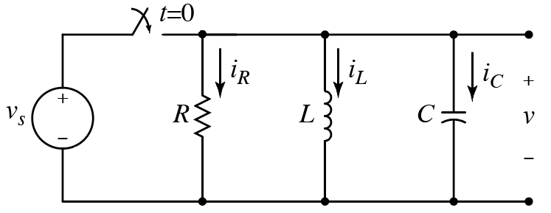
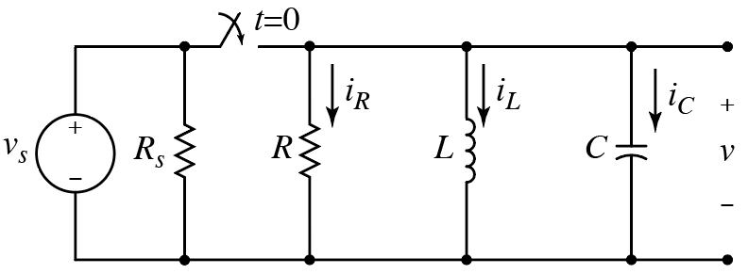
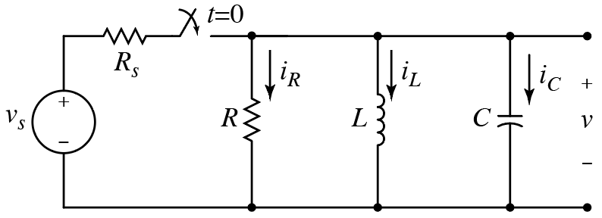
Source values are arbitrary.
Is this a “well-behaved” circuit?
A) Yes B) No
Current through capacitor can/ will change instantaneously.
(Same as previous clicker question!)
Is this a “well-behaved” circuit?
Voltage across capacitor cannot change instantaneously.
A) Yes B) No
Is this a “well-behaved” circuit?
A) Yes B) No
Essentially same as previous circuits.
$$+ { v}_{R} −$$
Is this a “well-behaved” circuit?
Thévenin circuit introduced at $t=0$.
A) Yes B) No
$$v_{R}\left(0^{+}\right)=v_{s}−v_{C}(0^{+})$$
Any difference between $v_{s}$ and capacitor voltage appears across $R_{s}$.

Slide 8
Underdamped System ($ω_{0}>α$; i.e., $1/{\sqrt{LC}}>1/{2RC}$)
Complex conjugate roots.
$$s_{1,2}=−α±j\sqrt{ω_{0}^{2}−α^{2}}=−α±jω_{d}$$
$$s_{1,2}=−α±j\sqrt{ω_{0}^{2}−α^{2}}=−α±jω_{d}$$
$$ω_{d}≜\sqrt{ω_{0}^{2}−α^{2}}$$
(Damped frequency.)
$\cos\left(θ\right)$ is even: $\cos\left(θ\right)=\cos\left(−θ\right)$
$\cos\left(θ\right)$ is even: $\cos\left(θ\right)=\cos\left(−θ\right)$
Define:
$\sin\left(θ\right)$ is odd: $\sin\left(θ\right)=−sin\left(−θ\right)$
$\sin\left(θ\right)$ is odd: $\sin\left(θ\right)=−sin\left(−θ\right)$
$$v\left(t\right)=A_{1}e^{s_{1}t}+A_{2}e^{s_{2}t}$$
Euler’s formula:
$$e^{jθ}=\cos\left(θ\right)+j\sin\left(θ\right)$$
$$=A_{1}e^{\left(−α+jω_{d}\right)t}+A_{2}e^{\left(−α−jω_{d}\right)t}$$
Or:
$$e^{−jθ}=\cos\left(θ\right)−j\sin\left(θ\right)$$
$$=A_{1}e^{−αt}e^{jω_{d}t}+A_{2}e^{−αt}e^{−jω_{d}t}$$
Combined:
$$=e^{−αt}\left(A_{1}e^{jω_{d}t}+A_{2}e^{−jω_{d}t}\right)$$
$$e^{±jθ}=\cos\left(θ\right)±j\sin\left(θ\right)$$

Slide 9
Underdamped System ($ω_{0}>α$; i.e., $1/{\sqrt{LC}}>1/{2RC}$)
Complex conjugate roots.
$$s_{1,2}=−α±j\sqrt{ω_{0}^{2}−α^{2}}$$
$$v\left(t\right)=e^{−αt}\left(A_{1}e^{jω_{d}t}+A_{2}e^{−jω_{d}t}\right)$$
Use Euler’s formula.
$$=e^{−αt}\left(A_{1}\cos\left(ω_{d}t\right)+jA_{1}\sin\left(ω_{d}t\right)+A_{2}\cos\left(ω_{d}t\right)−jA_{2}\sin\left(ω_{d}t\right)\right)$$

Slide 10
Underdamped System ($ω_{0}>α$; i.e., $1/{\sqrt{LC}}>1/{2RC}$)
Complex conjugate roots.
$$s_{1,2}=−α±j\sqrt{ω_{0}^{2}−α^{2}}$$
$$v\left(t\right)=e^{−αt}\left(A_{1}e^{jω_{d}t}+A_{2}e^{−jω_{d}t}\right)$$
Use Euler’s formula.
$$=e^{−αt}\left(A_{1}\cos\left(ω_{d}t\right)+jA_{1}\sin\left(ω_{d}t\right)+A_{2}\cos\left(ω_{d}t\right)−jA_{2}\sin\left(ω_{d}t\right)\right)$$
{
{
$$=e^{−αt}\left(\left[A_{1}+A_{2}\right]\cos\left(ω_{d}t\right)+j\left[A_{1}−A_{2}\right]\sin\left(ω_{d}t\right)\right)$$
Arbitrary number.
Arbitrary number.
$$=e^{−αt}\left(B_{1}\cos\left(ω_{d}t\right)+B_{2}\sin\left(ω_{d}t\right)\right)$$
$α$ and $ω_{d}$ dictated by circuit (R, L, and C values).
$$v\left(t\right)=B_{1}e^{−αt}\cos\left(ω_{d}t\right)+B_{2}e^{−αt}\sin\left(ω_{d}t\right)$$
$B_{1}$ and $B_{2}$ dictated by initial conditions.
Decaying oscillations.

Slide 11
Underdamped System ($ω_{0}>α$; i.e., $1/{\sqrt{LC}}>1/{2RC}$)
Complex conjugate roots.
$$s_{1,2}=−α±j\sqrt{ω_{0}^{2}−α^{2}}$$
$$v\left(t\right)=B_{1}e^{−αt}\cos\left(ω_{d}t\right)+B_{2}e^{−αt}\sin\left(ω_{d}t\right)$$
$B_{1}$ and $B_{2}=$ ?
$$1$$
$$1$$
$$1$$
$$0$$
$$v\left(0\right)=v_{C}\left(0\right)=B_{1}e^{0}\cos\left(0\right)+B_{2}e^{0}\sin\left(0\right)=B_{1}$$
$$v\left(0\right)=v_{C}\left(0\right)=B_{1}e^{0}\cos\left(0\right)+B_{2}e^{0}\sin\left(0\right)=B_{1}$$
$$v\left(0\right)=v_{C}\left(0\right)=B_{1}e^{0}\cos\left(0\right)+B_{2}e^{0}\sin\left(0\right)=B_{1}$$
$$i_{C}=−\left(i_{R}+i_{L}\right)=C\frac{dv}{dt}$$
$$i_{C}=−\left(i_{R}+i_{L}\right)=C\frac{dv}{dt}$$
$$B_{1}=v_{C}\left(0\right)$$
Recall:
$$\frac{dv\left(0\right)}{dt}=−\frac{1}{C}\left(\frac{v_{C}\left(0\right)}{R}+i_{L}\left(0\right)\right)=−αB_{1}+B_{2}ω_{d}$$
$$\frac{dv\left(0\right)}{dt}=−\frac{1}{C}\left(\frac{v_{C}\left(0\right)}{R}+i_{L}\left(0\right)\right)=−αB_{1}+B_{2}ω_{d}$$
Solve for $B_{2}$.
$$\frac{dv\left(t\right)}{dt}=−αB_{1}e^{−αt}\cos\left(ω_{d}t\right)−ω_{d}B_{1}e^{−αt}\sin\left(ω_{d}t\right)$$
$$\frac{dv\left(t\right)}{dt}=−αB_{1}e^{−αt}\cos\left(ω_{d}t\right)−ω_{d}B_{1}e^{−αt}\sin\left(ω_{d}t\right)$$
$$1$$
$$1$$
$$0$$
$$0$$
$$1$$
$$1$$
$$−αB_{2}e^{−αt}\sin\left(ω_{d}t\right)+ω_{d}B_{2}e^{−αt}\cos\left(ω_{d}t\right)$$
$$−αB_{2}e^{−αt}\sin\left(ω_{d}t\right)+ω_{d}B_{2}e^{−αt}\cos\left(ω_{d}t\right)$$
$$t=0$$

Slide 12
Critically Damped System ($ω_{0}=α$)
Repeated Roots
$$\frac{d^{2}v\left(t\right)}{{dt}^{2}}+\frac{1}{RC}\frac{dv\left(t\right)}{dt}+\frac{1}{LC}v\left(t\right)=0$$
$$\frac{d^{2}v\left(t\right)}{{dt}^{2}}+2α\frac{dv\left(t\right)}{dt}+ω_{0}^{2}v\left(t\right)=0$$
$$s_{1,2}=−α±\sqrt{α^{2}−ω_{0}^{2}}=−α$$
$$s_{1,2}=−α±\sqrt{α^{2}−ω_{0}^{2}}=−α$$
$$s_{1}=s_{2}=−α=s$$
$$s_{1}=s_{2}=−α=s$$
$$v\left(t\right)=A_{1}e^{s_{1}t}+A_{2}e^{s_{2}t}$$
?
?
?
?
$$v\left(t\right)=A_{1}e^{−αt}+A_{2}e^{−αt}=\left(A_{1}+A_{2}\right)e^{−αt}={Ae}^{−αt}=Ae^{st}$$
$$v\left(t\right)=A_{1}e^{−αt}+A_{2}e^{−αt}=\left(A_{1}+A_{2}\right)e^{−αt}={Ae}^{−αt}=Ae^{st}$$
$$v\left(t\right)=A_{1}e^{−αt}+A_{2}e^{−αt}=\left(A_{1}+A_{2}\right)e^{−αt}={Ae}^{−αt}=Ae^{st}$$
$$v\left(t\right)=A_{1}e^{−αt}+A_{2}e^{−αt}=\left(A_{1}+A_{2}\right)e^{−αt}={Ae}^{−αt}=Ae^{st}$$
Cannot satisfy two initial conditions ($v\left(0\right)$ and ${dv\left(0\right)}/{dt}$) with this!
Something needs fixing…

