Slide 1
EE 261, Spring 2025, Lecture 31
Goals/Topics:
Comments on Test 3
Critically damped system
Homework comment (Prob. 8.19)
Best viewed in presentation mode in PowerPoint.
Announcements:
Homework 10 posted. Due tonight (handwritten) & 3rd (Mastering).
Test 3 Friday, Apr. 4th. Spark G45 at 7:00 p.m.
(Optional) Review session Apr. 4th at regular lecture time.

Slide 2
Test 3 Friday, Apr. 4th at 7:00 p.m. in Spark G45:
Same overall structure as Test 1 and Test 2
Material:
Through Sec. 8.2 of N&R (natural response of parallel RLC circuits)
Anything covered in lecture, on HW, or clicker “quizzes” is fair game
Up to three pages of notes ($8.5′′×11′′$, front and back)
Will provide a copy of Table 8.2 of N&R (as last page of exam)
Minimum of 50 minutes of effort (or penalty for early submission)
Bring a calculator
No other electronic devices
Do your own work!

Slide 3
Concepts for Test 1 (on which Tests 2 and 3 build)
Voltage ($v$), current ($i$), power ($p=iv$)
Passive sign convention
Resistors and Ohm’s law ($v=iR$)
Parallel (same voltage) and series (same current) elements (Don’t let this trip you up!)
Current division and voltage division (Not critical knowledge, but a convenient shortcut.)
Y-to-Δ and Δ-to-Y transformations
KCL and KVL

Slide 4
Concepts for Test 2 (on which Tests 3 builds)
Node-voltage analysis
Mesh-current analysis
Thévenin equivalent circuits
Norton equivalent circuits
Superposition / Source deactivation
Maximum power transfer
Operational amplifiers
}
Still relevant to Test 3 material.

Slide 5
New concepts for Test 3
How do series and parallel inductor and capacitor combine?
Inductor fundamentals
Capacitor fundamentals
Add: series inductors and parallel capacitors
Inverse of sum of inverses: parallel inductors and series capacitors
What is steady-state behavior?
Inductor is a short circuit
Capacitor is an open circuit
60% of exam relates to this?
What can and cannot change instantaneously?
Inductor current definitely cannot change instantaneously
Capacitor voltage definitely cannot change instantaneously
Beyond that, all other quantities may be able to change instantaneously, but perhaps cannot owing to circuit arrangement (e.g., voltage of a resistor in parallel with a capacitor).
Inductor current definitely cannot change instantaneously
Capacitor voltage definitely cannot change instantaneously
Beyond that, all other quantities may be able to change instantaneously, but perhaps cannot owing to circuit arrangement (e.g., voltage of a resistor in parallel with a capacitor)
Immediately after a state change (e.g., a switch is thrown):
Inductor acts like a current source (maintains/establishes a current)
Capacitor acts like a voltage source (maintains/establishes a voltage)

Slide 6
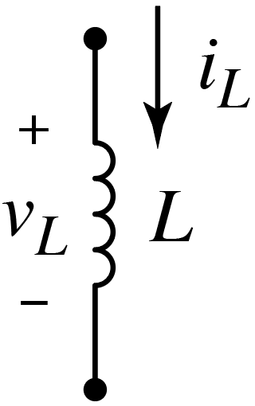
Recall: Inductors
$$i_{L}\left(t\right)=\frac{1}{L}\int_{t_{0}}^{t}{v_{L}\left(t\right)dt}+i_{L}\left(t_{0}\right)$$
$$v_{L}\left(t\right)=L\frac{di_{L}\left(t\right)}{dt}$$
or
Steady state.
If the current is not changing, an inductor behaves as:
A short circuit
An open circuit
A voltage source
A current source
None of these
Later we will see that from one instant to the next, can be useful to regard an inductor as akin to a current source.
Schematic representation suggestive of a (coil) of wire, i.e., a short. That’s essential what inductor becomes if current constant.
This relates to inductors “opposing” changes in current.
$$\frac{di(t)}{dt}=0$$
$$v(t)=0$$
But, $i(t)$ could be any constant amount.

Slide 7
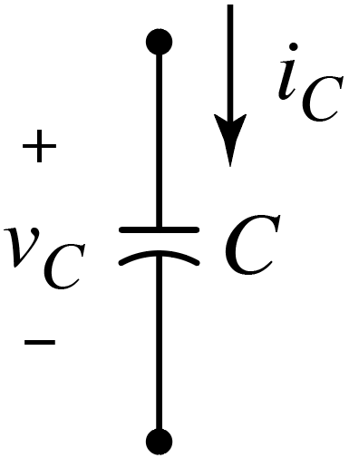
Recall: Capacitors
$$v_{C}\left(t\right)=\frac{1}{C}\int_{t_{0}}^{t}{i_{C}\left(t\right)dt}+v_{C}\left(t_{0}\right)$$
$$i_{C}\left(t\right)=C\frac{dv_{C}\left(t\right)}{dt}$$
Steady state.
If the voltage is not changing, a capacitor behaves as:
A short circuit
An open circuit
A voltage source
A current source
Something else
Later we will see that from one instant to the next, can be useful to regard a capacitor as akin to a voltage source.
Schematic representation is suggestive of an open circuit. That’s essentially what capacitor becomes if voltage constant.
This relates to capacitors “opposing” changes in voltage.
$$\frac{dv(t)}{dt}=0$$
$$i(t)=0$$
But, $v(t)$ could be any constant amount.

Slide 8
New concepts for Test 3
Inductor fundamentals
Capacitor fundamentals
Mutual inductance (dot convention $+$ passive sign convention)
Natural response of a first-order system (RL or RC circuit)
Step/forced response of a first-order system (RL or RC circuit)
Almost all you need to know is the following:
$$f\left(t\right)=f_{∞}+\left(f_{0}−f_{∞}\right)e^{−t/τ}$$
Might or might not correspond to $f\left(0^{−}\right)$.
Time constant $τ$ given by $R_{eq}C$ or $L/{R_{eq}}$.
$f_{∞}$ is zero for natural response.
$f_{0}=f\left(0^{+}\right)$, initial condition.
If initial condition known at $t=t_{0}$, replace $t$ with $t−t_{0}$ in exponent and $f_{0}$ is $f\left(t_{0}^{+}\right)$.

Slide 9
New concepts for Test 3
Talked about but not exam: Unbounded response.
Inductor fundamentals
Capacitor fundamentals
Mutual inductance (dot convention $+$ passive sign convention)
Natural response of a first-order system (RL or RC circuit)
Step/forced response of a first-order system (RL or RC circuit)
Switched circuits (multiple state changes)
Integrating amplifiers
Natural response of parallel RLC circuit
$α=1/{\left(2RC\right)}$ and $ω_{0}=1/{\sqrt{LC}}$
$ω_{0}<α$: Overdamped → Real and distinct roots.
$ω_{0}>α$: Underdamped → Complex conjugate roots.
$ω_{0}=α$: Critically damped → Repeated real roots.
Will provide Table 8.2.

Slide 10
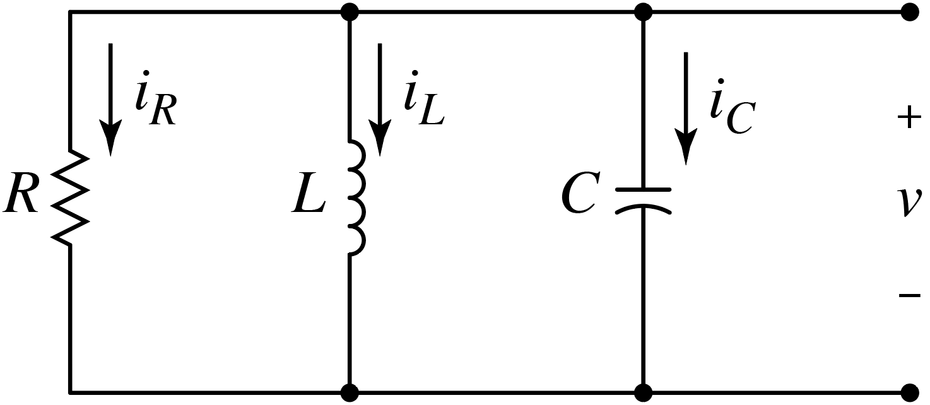
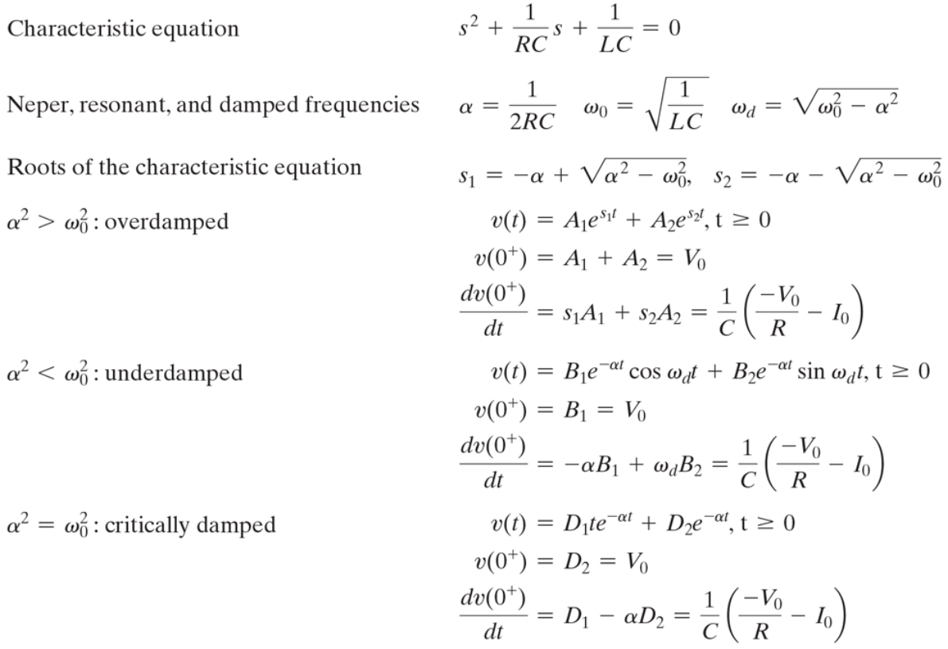
Table 8.2 of N&R: Natural response of parallel RLC circuit.
Don’t have to square to do comparison.
Response:
{
Two equations, two unknowns:
Note: $V_{0}=v_{C}\left(0^{+}\right)$
$$I_{0}=i_{L}\left(0^{+}\right)$$

Slide 11
Table 8.2 of N&R: Natural response of parallel RLC circuit.
Don’t have to square to do comparison.
Note: $V_{0}=v_{C}\left(0^{+}\right)$
$$I_{0}=i_{L}\left(0^{+}\right)$$
Response:
{
Two equations, two unknowns:
Haven’t discussed details yet.

Slide 12
Critically Damped System ($ω_{0}=α$)
Repeated Roots
$$\frac{d^{2}v\left(t\right)}{{dt}^{2}}+\frac{1}{RC}\frac{dv\left(t\right)}{dt}+\frac{1}{LC}v\left(t\right)=0$$
$$\frac{d^{2}v\left(t\right)}{{dt}^{2}}+2α\frac{dv\left(t\right)}{dt}+ω_{0}^{2}v\left(t\right)=0$$
$$s_{1,2}=−α±\sqrt{α^{2}−ω_{0}^{2}}=−α$$
$$s_{1,2}=−α±\sqrt{α^{2}−ω_{0}^{2}}=−α$$
$$s_{1}=s_{2}=−α=s$$
$$s_{1}=s_{2}=−α=s$$
$$v\left(t\right)=A_{1}e^{s_{1}t}+A_{2}e^{s_{2}t}$$
?
?
?
?
$$v\left(t\right)=A_{1}e^{−αt}+A_{2}e^{−αt}=\left(A_{1}+A_{2}\right)e^{−αt}={Ae}^{−αt}=Ae^{st}$$
$$v\left(t\right)=A_{1}e^{−αt}+A_{2}e^{−αt}=\left(A_{1}+A_{2}\right)e^{−αt}={Ae}^{−αt}=Ae^{st}$$
$$v\left(t\right)=A_{1}e^{−αt}+A_{2}e^{−αt}=\left(A_{1}+A_{2}\right)e^{−αt}={Ae}^{−αt}=Ae^{st}$$
$$v\left(t\right)=A_{1}e^{−αt}+A_{2}e^{−αt}=\left(A_{1}+A_{2}\right)e^{−αt}={Ae}^{−αt}=Ae^{st}$$
Cannot satisfy two initial conditions ($v\left(0\right)$ and ${dv\left(0\right)}/{dt}$) with this!
Something needs fixing…

Slide 13
Critically Damped System ($ω_{0}=α$)
Recall why exponential function works for solving diff. eq.
Differentiation doesn’t change temporal behavior.
$$\frac{d}{dt}\left(te^{st}\right)=e^{st}+ste^{st}$$
$$\frac{d}{dt}\left(te^{st}\right)=e^{st}+ste^{st}$$
$$\frac{d}{dt}\left(te^{st}\right)=e^{st}+ste^{st}$$
Consider:
$$te^{st}$$
Just need to determine constants so everything balances/cancels.
Let:
(Sum of two independent functions despite same exponents.)
$$v\left(t\right)=D_{1}{te}^{st}+D_{2}e^{st}$$
{
Take derivate:
Arbitrary number.
Arbitrary number.
{
$$\frac{dv\left(t\right)}{dt}=D_{1}e^{st}+sD_{1}te^{st}+sD_{2}e^{st}=sD_{1}te^{st}+\left(D_{1}+sD_{2}\right)e^{st}$$
$$\frac{dv\left(t\right)}{dt}=D_{1}e^{st}+sD_{1}te^{st}+sD_{2}e^{st}=sD_{1}te^{st}+\left(D_{1}+sD_{2}\right)e^{st}$$
$$\frac{dv\left(t\right)}{dt}=D_{1}e^{st}+sD_{1}te^{st}+sD_{2}e^{st}=sD_{1}te^{st}+\left(D_{1}+sD_{2}\right)e^{st}$$
$$\frac{dv\left(t\right)}{dt}=D_{1}e^{st}+sD_{1}te^{st}+sD_{2}e^{st}=sD_{1}te^{st}+\left(D_{1}+sD_{2}\right)e^{st}$$
We’re back to the form we started with, but with new coefficients. That’s what we need to solve diff. eq.!
$$=G_{1}te^{st}+G_{2}e^{st}$$
We’re back to the form we started with, but with new coefficients. That’s what we need to solve diff. eq.!
General solution for critically damped circuit.
$$v\left(t\right)=D_{1}{te}^{−αt}+D_{2}e^{−αt}$$
What are $D_{1}$ and $D_{2}$?
Use initial conditions.
$$\frac{dv\left(0\right)}{dt}=D_{1}−αD_{2}=−\frac{1}{C}\left(\frac{v_{C}\left(0\right)}{R}+i_{L}\left(0\right)\right)$$
$$\frac{dv\left(0\right)}{dt}=D_{1}−αD_{2}=−\frac{1}{C}\left(\frac{v_{C}\left(0\right)}{R}+i_{L}\left(0\right)\right)$$
$$v\left(0\right)=D_{2}=v_{C}\left(0\right)$$
$$v\left(0\right)=D_{2}=v_{C}\left(0\right)$$
Solve for $D_{1}$.

Slide 14
Are you here today?
No
No
Yes
Yes
Yes

Slide 15
Natural response for a 2nd-order system (general)
$$ω_{d}^{2}=ω_{0}^{2}−α^{2}$$
$$s_{1,2}=−α±\sqrt{α^{2}−ω_{0}^{2}}=−α±jω_{d}$$
$$s_{1,2}=−α±\sqrt{α^{2}−ω_{0}^{2}}=−α±jω_{d}$$
Roots of characteristic eq.:
Overdamped System
: Real and distinct roots ($ω_{0}<α$).
$$v\left(t\right)=A_{1}e^{s_{1}t}+A_{2}e^{s_{2}t}$$
Critically Damped System
: Repeated (real) roots ($ω_{0}=α$)
$$v\left(t\right)=D_{1}{te}^{−αt}+D_{2}e^{−αt}$$
Underdamped System
: Complex conjugate roots ($ω_{0}>α$).
$$v\left(t\right)=B_{1}e^{−αt}\cos\left(ω_{d}t\right)+B_{2}e^{−αt}\sin\left(ω_{d}t\right)$$
All this is true for parallel and series combinations of RLC!
But, parallel and series configuration have different constants.

Slide 16
Natural response of parallel RLC circuit: Summary
$$α=\frac{1}{2RC}$$
$$ω_{0}=\frac{1}{\sqrt{LC}}$$
$$ω_{d}^{2}=ω_{0}^{2}−α^{2}$$
$$\left[\begin{matrix}1 & 1 \\ s_{1} & s_{2}\end{matrix}\right]\left[\begin{matrix}A_{1} \\ A_{2}\end{matrix}\right]=\left[\begin{matrix}v_{C}\left(0\right) \\ −\frac{1}{C}\left(\frac{v_{C}\left(0\right)}{R}+i_{L}\left(0\right)\right)\end{matrix}\right]$$
Overdamped:
$$v\left(t\right)=A_{1}e^{s_{1}t}+A_{2}e^{s_{2}t}$$
Critically damped:
$$v\left(t\right)=D_{1}{te}^{−αt}+D_{2}e^{−αt}$$
$$\left[\begin{matrix}0 & 1 \\ 1 & −α\end{matrix}\right]\left[\begin{matrix}D_{1} \\ D_{2}\end{matrix}\right]=\left[\begin{matrix}v_{C}\left(0\right) \\ −\frac{1}{C}\left(\frac{v_{C}\left(0\right)}{R}+i_{L}\left(0\right)\right)\end{matrix}\right]$$
Underdamped:
$$v\left(t\right)=B_{1}e^{−αt}\cos\left(ω_{d}t\right)+B_{2}e^{−αt}\sin\left(ω_{d}t\right)$$
$α$, $ω_{0}$, and equations for $A$’s, $B$’s, and $D$’s, different for series circuit.
$$\left[\begin{matrix}1 & 0 \\ −α & ω_{d}\end{matrix}\right]\left[\begin{matrix}B_{1} \\ B_{2}\end{matrix}\right]=\left[\begin{matrix}v_{C}\left(0\right) \\ −\frac{1}{C}\left(\frac{v_{C}\left(0\right)}{R}+i_{L}\left(0\right)\right)\end{matrix}\right]$$
(But types of possible responses the same!)

Slide 17
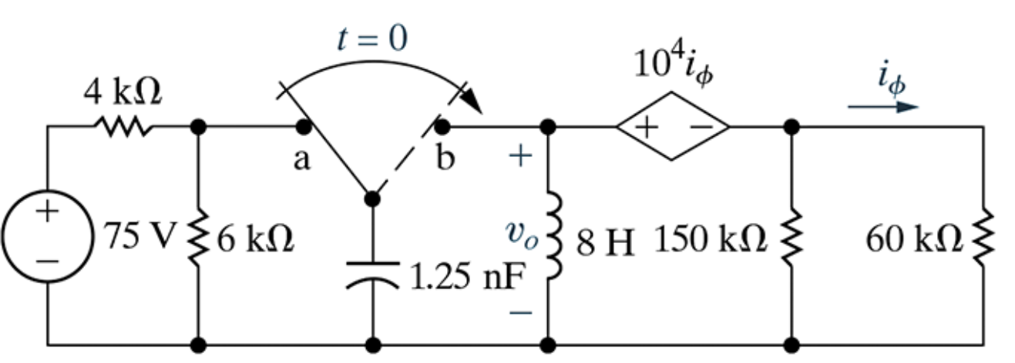
Prob. 8.19. $v_{0}\left(t>0\right)= ?$
Steady-state information from here (mostly).
$$v_{C}\left(0^{−}\right)$$

Slide 18
Prob. 8.19. $v_{0}\left(t>0\right)= ?$
Parallel RLC circuit.
$$t>0$$
Steady-state information from here (mostly).
Circuit for $t>0.$
Need: $α=1/{\left(2R_{eq}C\right)}$ & $ω_{0}=1/{\sqrt{LC}}$
$$v_{C}\left(0^{−}\right)$$

Slide 19
Prob. 8.19. $v_{0}\left(t>0\right)= ?$
Parallel RLC circuit.
$$t>0$$
$$R_{eq}$$
Circuit for $t>0.$
Need: $α=1/{\left(2R_{eq}C\right)}$ & $ω_{0}=1/{\sqrt{LC}}$
What is $R_{eq}$?
Need a test source to determine.

