Slide 1
EE 261, Spring 2025, Lecture 32
Goal/Topic:
Forced response of parallel RLC circuits
Best viewed in
presentation mode
in PowerPoint.
Announcements:
HW 11 posted. Due Sunday, Apr. 13th.
Test 3 returned Wednesday.
Will largely skip series RLC circuits (response same as parallel RLC).

Slide 2


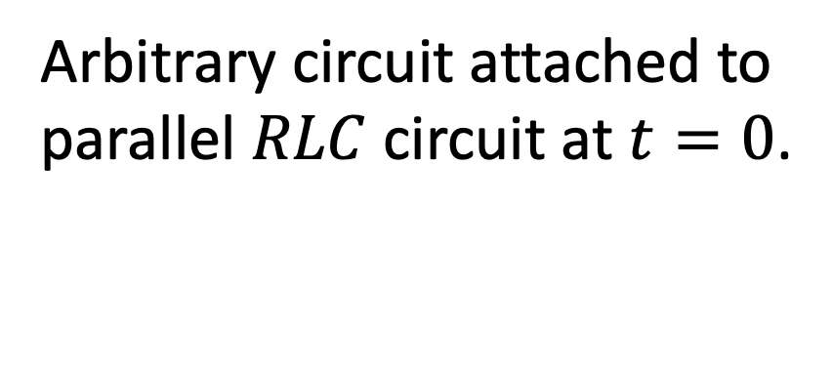
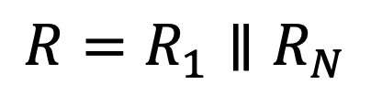


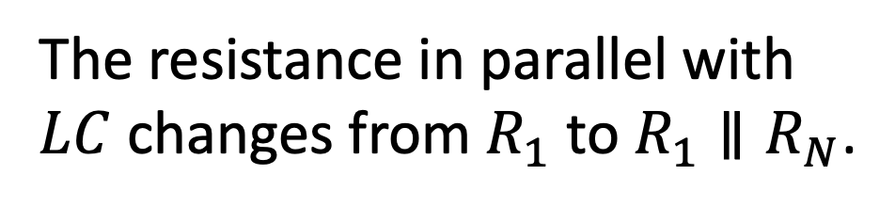
Forced Parallel RLC
Arbitrary circuit attached to
parallel $RLC$ circuit at $t=0$.
Can represent circuit by its
Norton equivalent.
Arbitrary circuit attached to
parallel $RLC$ circuit at $t=0$.
Can represent arbitrary circuit
by its Norton equivalent.
Norton equivalent.
After switch is thrown, there
is a current source and a
parallel $RLC$ combination.
The resistance in parallel with
$LC$ changes from $R_{1}$ to $R_{1}∥R_{N}$.
The resistance in parallel with
$LC$ changes from $R_{1}$ to $R_{1}∥R_{N}$.
Call this equivalent resistance
simply $R.$
$$R=R_{1}∥R_{N}$$

Slide 3
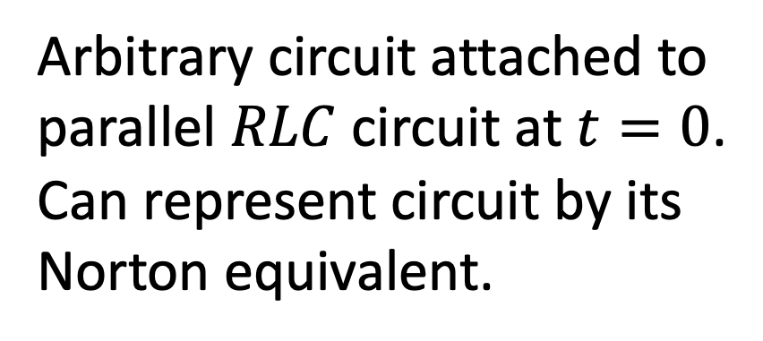
Forced Parallel RLC
Arbitrary circuit attached to
parallel $RLC$ circuit at $t=0$.
Can represent circuit by its
Norton equivalent.
Arbitrary circuit attached to
parallel $RLC$ circuit at $t=0$.
Can represent circuit by its
Norton equivalent.
After switch is thrown, there
is a current source and a
parallel $RLC$ combination.
The resistance in parallel with
$LC$ changes from $R_{1}$ to $R_{1}∥R_{N}$.
Call this equivalent resistance
simply $R.$
$$R=R_{1}∥R_{N}$$

Slide 4
Forced Parallel RLC
Arbitrary circuit attached to
parallel $RLC$ circuit at $t=0$.
Can represent circuit by its
Norton equivalent.
Arbitrary circuit attached to
parallel $RLC$ circuit at $t=0$.
Can represent circuit by its
Norton equivalent.
After switch is thrown, there
is a current source and a
parallel $RLC$ combination.
The resistance in parallel with
$LC$ changes from $R_{1}$ to $R_{1}∥R_{N}$.
Call this equivalent resistance
simply $R.$
$$R=R_{1}∥R_{N}$$

Slide 5


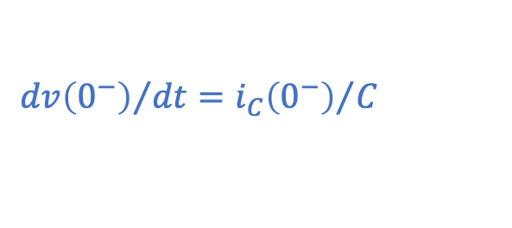
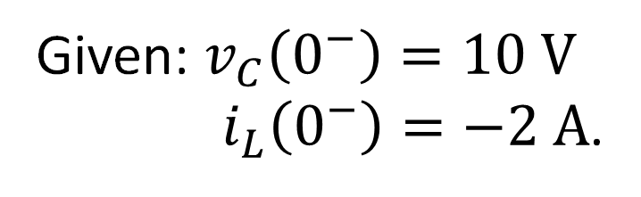





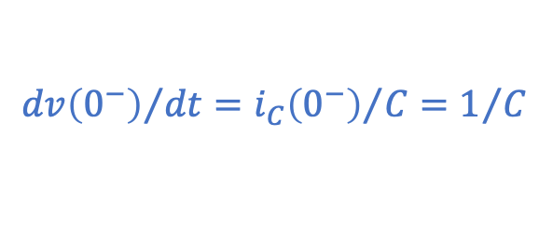





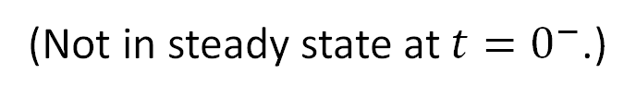

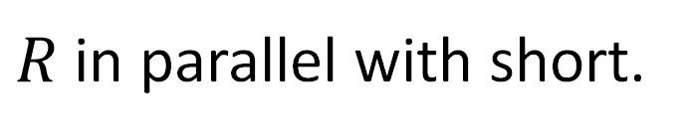
Consider:
(Forced response.)
Given: $v_{C}\left(0^{−}\right)=10 V$
$i_{L}\left(0^{−}\right)=−2 A$.
(Not in steady state at $t=0^{−}$.)
What is $i_{R}\left(0^{−}\right)$?
$$i_{R}\left(0^{−}\right)={v_{C}\left(0^{−}\right)}/{10 Ω}=1 A$$
$$i_{R}\left(0^{−}\right)={v_{C}\left(0^{−}\right)}/{10 Ω}=1 A$$
KCL: $i_{C}={−i}_{R}−i_{L}=−1−\left(−2\right)=1 A$
KCL: $i_{C}={−i}_{R}−i_{L}=−1−\left(−2\right)=1 A$
What is $i_{C}\left(0^{−}\right)$? (numeric poll)
KCL: $i_{C}={−i}_{R}−i_{L}=−1−\left(−2\right)=1 A$
At $t=0^{−}$, is $v_{C}$ increasing or decreasing?
A) Increasing B) Decreasing
Positive current into positive terminal.
$${dv\left(0^{−}\right)}/{dt}={i_{C}\left(0^{−}\right)}/C=1/C$$
But, total energy in system decreasing.
$${dv\left(0^{−}\right)}/{dt}={i_{C}\left(0^{−}\right)}/C=1/C$$
What is $i_{R}\left(∞\right)$? (numeric poll)
$R$ in parallel with short.
$$0 A$$
$$i_{L}\left(∞\right)={100 V}/{10 Ω}=10 A$$
What is $i_{L}\left(∞\right)$? (numeric poll)
$$i_{L}\left(∞\right)={100 V}/{10 Ω}=10 A$$

Slide 6
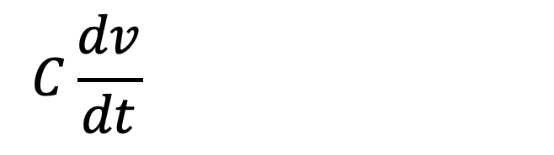
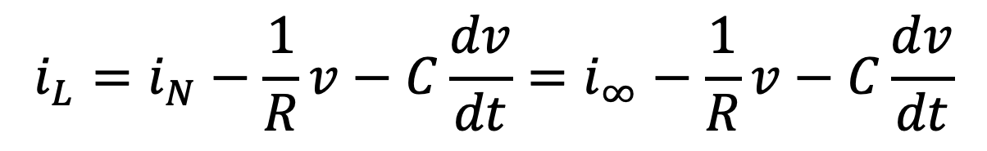
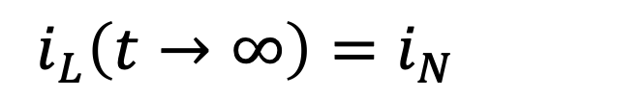
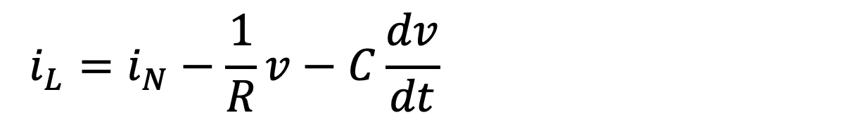

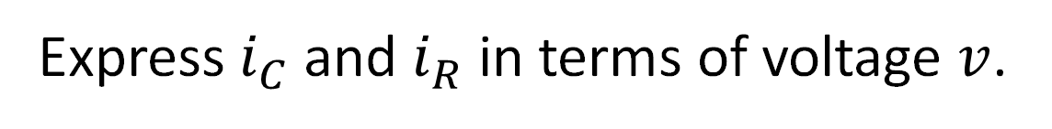

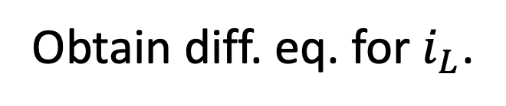
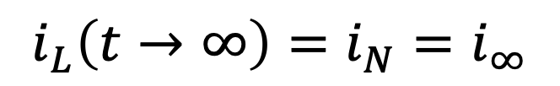
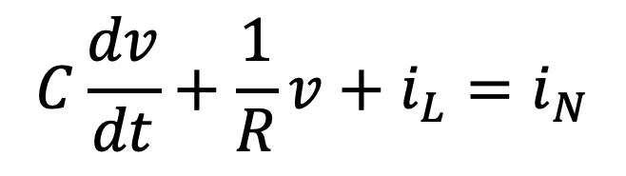
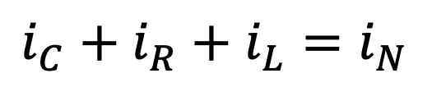
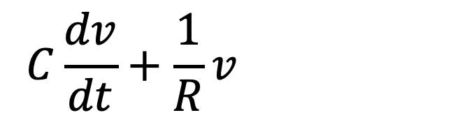

Parallel RLC Circuit: Forced (Step) Response
Obtain diff. eq. for $i_{L}$.
(Considered $v$ for unforced system.)
First, note:
$$i_{L}\left(t→∞\right)=i_{N}=i_{∞}$$
$$i_{L}\left(t→∞\right)=i_{N}=i_{∞}$$
KCL at top:
$$i_{C}+i_{R}+i_{L}=i_{N}$$
Express $i_{C}$ and $i_{R}$ in terms of voltage $v$.
$$C\frac{dv}{dt}+\frac{1}{R}v+i_{L}=i_{N}$$
$$C\frac{dv}{dt}+\frac{1}{R}v+i_{L}=i_{N}$$
$$C\frac{dv}{dt}+\frac{1}{R}v+i_{L}=i_{N}$$
$$v=L\frac{di_{L}}{dt}$$
And, we know:
An important aside. Rearrange:
An important aside. Rearrange:
If we know $v$, we
can obtain $i_{L}$.
Hold that thought!
$$i_{L}=i_{N}−\frac{1}{R}v−C\frac{dv}{dt}=i_{∞}−\frac{1}{R}v−C\frac{dv}{dt}$$
$$i_{L}=i_{N}−\frac{1}{R}v−C\frac{dv}{dt}=i_{∞}−\frac{1}{R}v−C\frac{dv}{dt}$$
(‡)

Slide 7
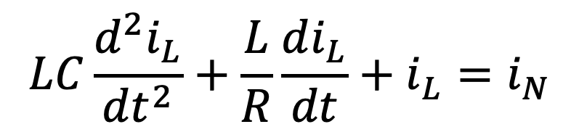


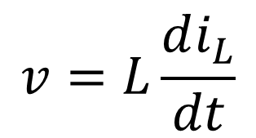
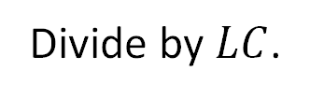

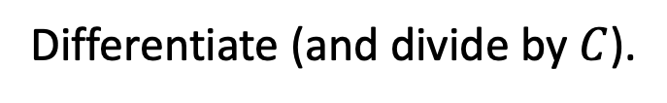
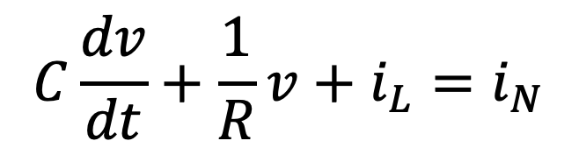
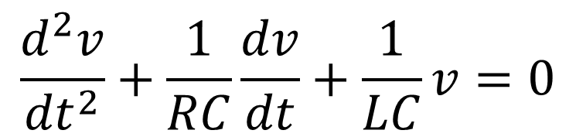




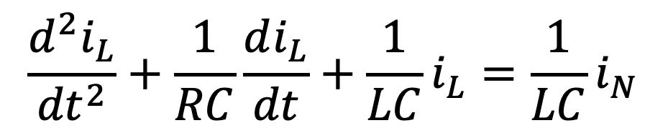

Parallel RLC Circuit: Step Response
$$C\frac{dv}{dt}+\frac{1}{R}v+i_{L}=i_{N}$$
$$v=L\frac{di_{L}}{dt}$$
Substitute in:
$$LC\frac{d^{2}i_{L}}{{dt}^{2}}+\frac{L}{R}\frac{di_{L}}{dt}+i_{L}=i_{N}$$
$$\frac{d^{2}i_{L}}{{dt}^{2}}+\frac{1}{RC}\frac{di_{L}}{dt}+\frac{1}{LC}i_{L}=\frac{1}{LC}i_{N}$$
Divide by $LC$.
Go back to KCL and think in terms of voltage:
$$i_{C}$$
$$i_{R}$$
$$i_{L}$$
constant
$$\frac{d}{dt}\left[C\frac{dv}{dt}+\frac{v}{R}+ \frac{1}{L}\int_{0}^{t}{vdt}+i_{L}\left(0\right)=i_{N}\right]$$
$$\frac{d}{dt}\left[C\frac{dv}{dt}+\frac{v}{R}+ \frac{1}{L}\int_{0}^{t}{vdt}+i_{L}\left(0\right)=i_{N}\right]$$
Differentiate (and divide by $C$).
Differentiate (and divide by $C$).
Same equation as for
natural response!
$$\frac{d^{2}v}{{dt}^{2}}+\frac{1}{RC}\frac{dv}{dt}+\frac{1}{LC}v=0$$
Same types of solutions must pertain!

Slide 8
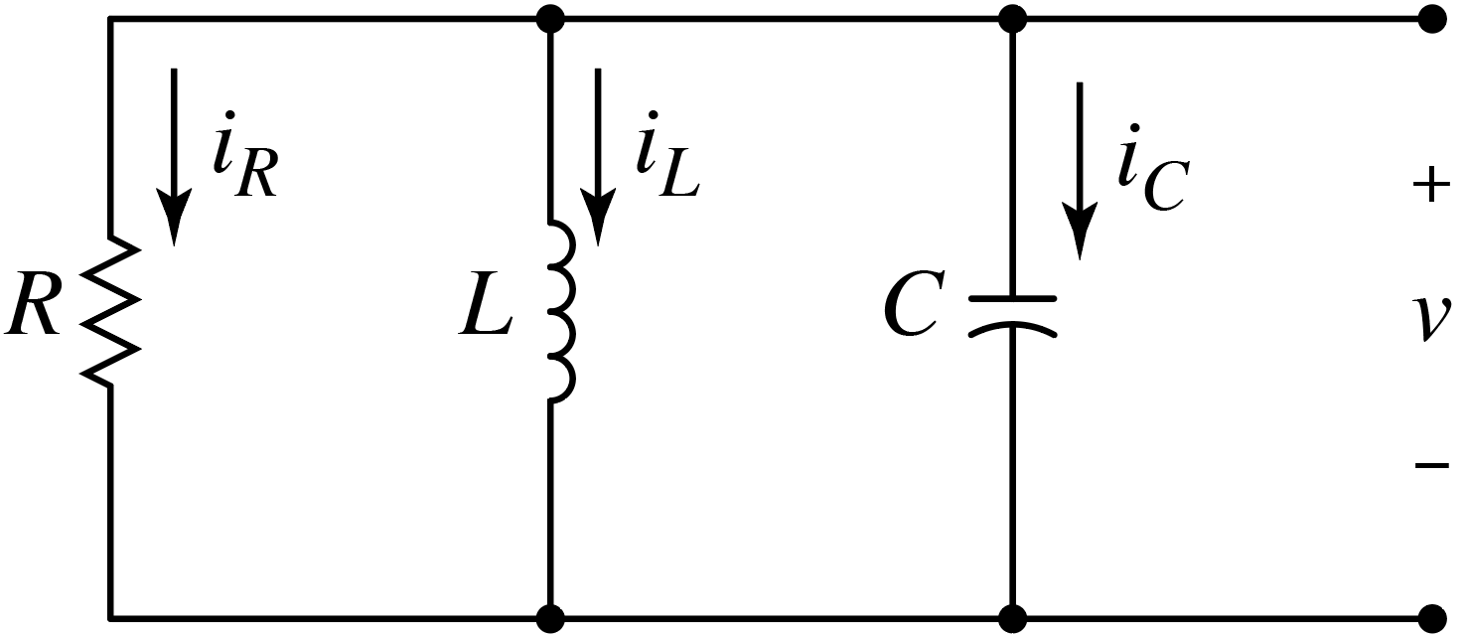




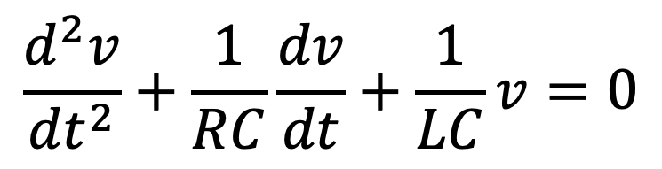

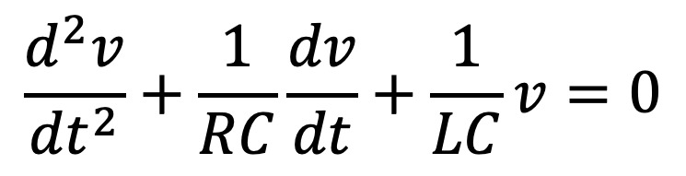

But why???
Natural response:
$$\frac{d^{2}v}{{dt}^{2}}+\frac{1}{RC}\frac{dv}{dt}+\frac{1}{LC}v=0$$
All energy eventually dissipated
by the resistor. $v$ goes to zero.
All energy eventually dissipated
by the resistor. $v$ goes to zero.
Here $i_{L}\left(∞\right)=0.$
Forced response:
$$\frac{d^{2}v}{{dt}^{2}}+\frac{1}{RC}\frac{dv}{dt}+\frac{1}{LC}v=0$$
All current eventually goes
through inductor which acts
like short. $v$ goes to zero.
All current eventually goes
through inductor which acts
like short. $v$ goes to zero.
Same types of solutions must pertain!
Here $i_{L}\left(∞\right)=i_{N}.$

Slide 9

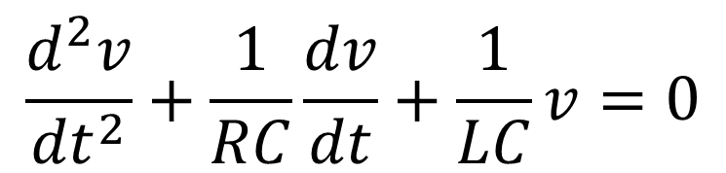
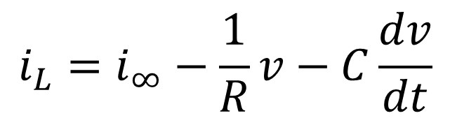


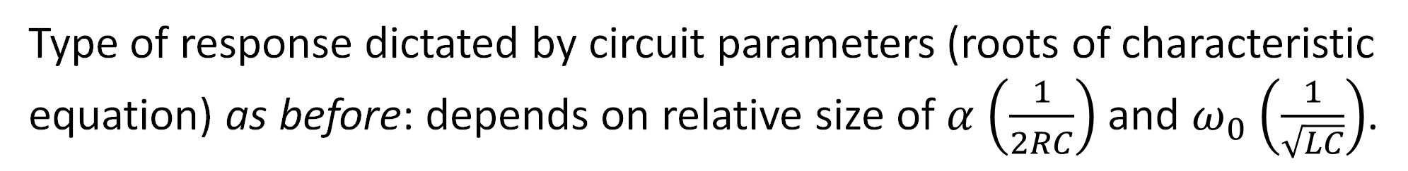
Parallel RLC Circuit: Step Response
Recall:
$$\frac{d^{2}v}{{dt}^{2}}+\frac{1}{RC}\frac{dv}{dt}+\frac{1}{LC}v=0$$
$$i_{L}=i_{∞}−\frac{1}{R}v−C\frac{dv}{dt}$$
(‡)
Same equation as before (for $v(t)$), hence same general solutions!
Overdamped:
$$v\left(t\right)=A_{1}e^{s_{1}t}+A_{2}e^{s_{2}t}$$
Critically Damped:
$$v\left(t\right)=D_{1}{te}^{−αt}+D_{2}e^{−αt}$$
Underdamped:
$$v\left(t\right)=B_{1}e^{−αt}\cos\left(ω_{d}t\right)+B_{2}e^{−αt}\sin\left(ω_{d}t\right)$$
Type of response dictated by circuit parameters (roots of characteristic
equation) as before: depends on relative size of $α$ $\left(\frac{1}{2RC}\right)$ and $ω_{0}$ $\left(\frac{1}{\sqrt{LC}}\right)$.
Type of response dictated by circuit parameters (roots of characteristic
equation) as before: depends on relative size of $α$ $\left(\frac{1}{2RC}\right)$ and $ω_{0}$ $\left(\frac{1}{\sqrt{LC}}\right)$.

Slide 10
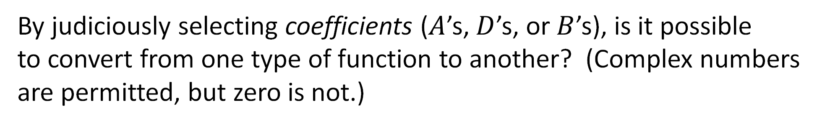





Overdamped:
$$v\left(t\right)=A_{1}e^{s_{1}t}+A_{2}e^{s_{2}t}$$
Critically Damped:
$$v\left(t\right)=D_{1}{te}^{−αt}+D_{2}e^{−αt}$$
Underdamped:
$$v\left(t\right)=B_{1}e^{−αt}\cos\left(ω_{d}t\right)+B_{2}e^{−αt}\sin\left(ω_{d}t\right)$$
By differentiating one type of a function, it is possible to obtain
a different type of a function? Ex. overdamped $→$ underdamped
By differentiating one type of a function, it is possible to obtain
a different type of a function? Ex. overdamped $→$ underdamped,
or underdamped $→$ none of the above.
A) Yes B) No
By judiciously selecting coefficients ($A$’s, $D$’s, or $B$’s), is it possible
to convert from one type of function to another? (Complex numbers
are permitted, but zero is not.)
By judiciously selecting coefficients ($A$’s, $D$’s, or $B$’s), is it possible
to convert from one type of function to another? (Complex numbers
are permitted, but zero is not.)
A) Yes B) No

Slide 11

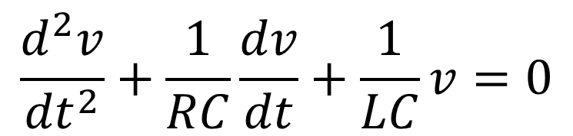


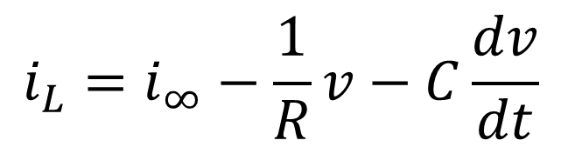

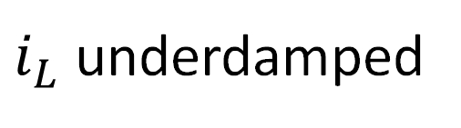

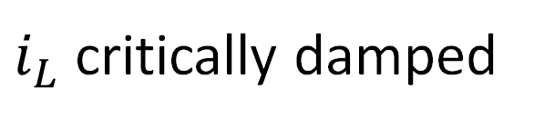
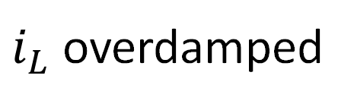

Parallel RLC Circuit: Step Response
$$\frac{d^{2}v}{{dt}^{2}}+\frac{1}{RC}\frac{dv}{dt}+\frac{1}{LC}v=0$$
$$i_{L}=i_{∞}−\frac{1}{R}v−C\frac{dv}{dt}$$
(‡)
Same equation as before (for $v(t)$), hence same general solutions!
Overdamped:
$$v\left(t\right)=A_{1}e^{s_{1}t}+A_{2}e^{s_{2}t}$$
$i_{L}$ overdamped
$+$ constant.
Critically Damped:
$$v\left(t\right)=D_{1}{te}^{−αt}+D_{2}e^{−αt}$$
$i_{L}$ critically damped
$+$ constant.
Underdamped:
$$v\left(t\right)=B_{1}e^{−αt}\cos\left(ω_{d}t\right)+B_{2}e^{−αt}\sin\left(ω_{d}t\right)$$
$i_{L}$ underdamped
$+$ constant.
Plugging these $v\left(t\right)$’s into (‡) yields same functional forms,
but with different constants and constant term $i_{∞}$ appears.

Slide 12

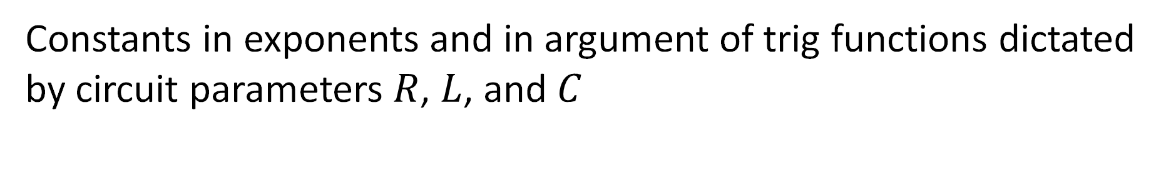
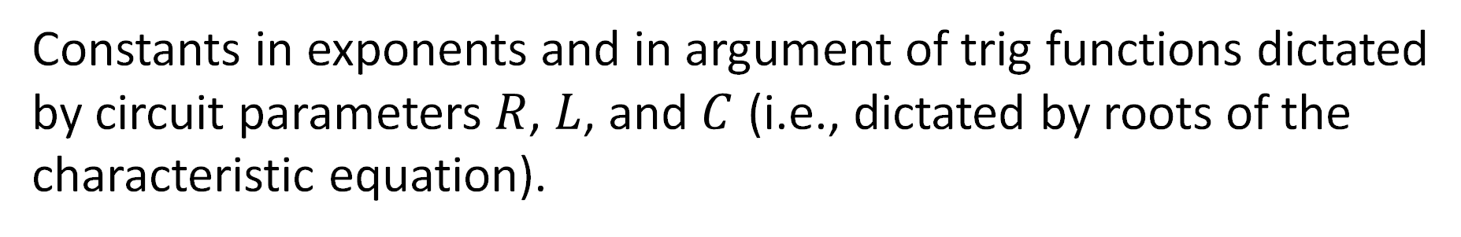
Parallel RLC Circuit: Step Response
Overdamped:
$$i_{L}\left(t\right)=i_{∞}+A_{1}^{′}e^{s_{1}t}+A_{2}^{′}e^{s_{2}t}$$
Critically Damped:
$$i_{L}\left(t\right)=i_{∞}+D_{1}^{′}{te}^{−αt}+D_{2}^{′}e^{−αt}$$
Underdamped:
$$i_{L}\left(t\right)=i_{∞}+B_{1}^{′}e^{−αt}\cos\left(ω_{d}t\right)+B_{2}^{′}e^{−αt}\sin\left(ω_{d}t\right)$$
Constants in exponents and in argument of trig functions dictated
by circuit parameters $R$, $L$, and $C$ (i.e., dictated by roots of the
characteristic equation).
Constants in exponents and in argument of trig functions dictated
by circuit parameters $R$, $L$, and $C$ (i.e., dictated by roots of the
characteristic equation).
“Arbitrary” constants dictated by initial (and final) conditions.

Slide 13
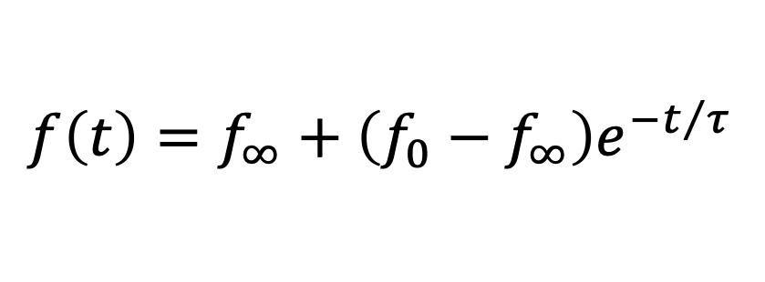


Recall first-order system forced response general solution:
steady state
transient
Assumes constant
forcing function.
$$f\left(t\right)=f_{∞}+\left(f_{0}−f_{∞}\right)e^{−t/τ}$$
Second-order system forced response general solution:
steady state
transient
Overdamped:
$$f\left(t\right)=f_{∞}+A_{1}^{′}e^{s_{1}t}+A_{2}^{′}e^{s_{2}t}$$
Critically Damped:
$$f\left(t\right)=f_{∞}+D_{1}^{′}{te}^{−αt}+D_{2}^{′}e^{−αt}$$
Underdamped:
$$f\left(t\right)=f_{∞}+B_{1}^{′}e^{−αt}\cos\left(ω_{d}t\right)+B_{2}^{′}e^{−αt}\sin\left(ω_{d}t\right)$$
The $A^{′}$s, $D^{′}$s, and $B^{′}$s depend on initial (and final) conditions.
If we are considering any circuit quantity, the same general
forms of the solution pertain, i.e., a constant (final value)
plus a time-varying function (that fades away).
If we are considering any circuit quantity, the same general
forms of the solution pertain, i.e., a constant (final value)
plus a time-varying function (that fades away).
If we are considering any circuit quantity, the same general
forms of the solution pertain, i.e., a constant (final value)
plus a time-varying function (that fades away).

Slide 14
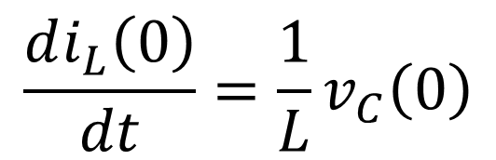
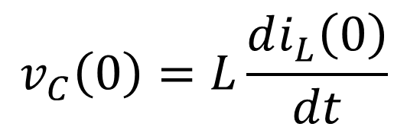
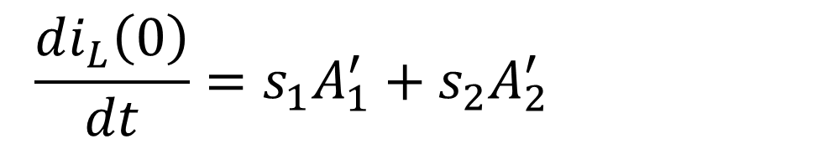

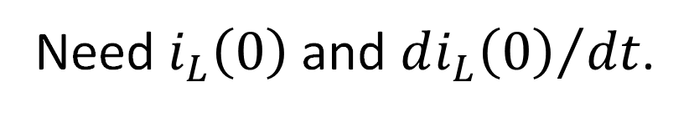
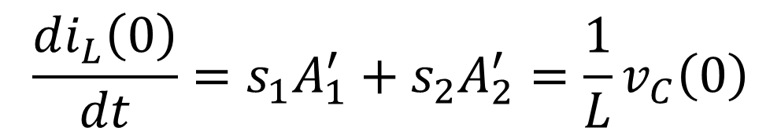


Evaluating “Arbitrary” Constants: Using Initial Conditions
Would typically know
$i_{L}\left(0\right)$ and $v_{C}\left(0\right)=v\left(0\right)$.
Need $i_{L}\left(0\right)$ and ${di_{L}\left(0\right)}/{dt}$.
Voltage across inductor
same as across capacitor:
$$v_{C}\left(0\right)=L\frac{di_{L}\left(0\right)}{dt}$$
$$\frac{di_{L}\left(0\right)}{dt}=\frac{1}{L}v_{C}\left(0\right)$$
Consider overdamped:
$$i_{L}\left(t\right)=i_{∞}+A_{1}^{′}e^{s_{1}t}+A_{2}^{′}e^{s_{2}t}$$
Obtained above.
Known initial condition.
$$\frac{di_{L}\left(0\right)}{dt}=s_{1}A_{1}^{′}+s_{2}A_{2}^{′}=\frac{1}{L}v_{C}\left(0\right)$$
$$\frac{di_{L}\left(0\right)}{dt}=s_{1}A_{1}^{′}+s_{2}A_{2}^{′}=\frac{1}{L}v_{C}\left(0\right)$$
$$i_{L}\left(0\right)=i_{∞}+A_{1}^{′}+A_{2}^{′}$$
Two equations;
two unknowns.
Known final condition.
Known initial condition.

Slide 15


Evaluating “Arbitrary” Constants: Using Initial Conditions
Overdamped:
$$i_{L}\left(t\right)=i_{∞}+A_{1}^{′}e^{s_{1}t}+A_{2}^{′}e^{s_{2}t}$$
$$\left[\begin{matrix}1 & 1 \\ s_{1} & s_{2}\end{matrix}\right]\left[\begin{matrix}A_{1}^{′} \\ A_{2}^{′}\end{matrix}\right]=\left[\begin{matrix}i_{L}\left(0\right)−i_{∞} \\ \frac{1}{L}v_{C}\left(0\right)\end{matrix}\right]$$

Slide 16






Evaluating “Arbitrary” Constants: Using Initial Conditions
Have $i_{L}\left(0\right)$ and
$$\frac{di_{L}\left(0\right)}{dt}=\frac{1}{L}v_{C}\left(0\right).$$
Critically damped:
$$i_{L}\left(t\right)=i_{∞}+D_{1}^{′}{te}^{−αt}+D_{2}^{′}e^{−αt}$$
$$\frac{di_{L}\left(0\right)}{dt}=D_{1}^{′}−αD_{2}^{′}=\frac{1}{L}v_{C}\left(0\right)$$
$$\frac{di_{L}\left(0\right)}{dt}=D_{1}^{′}−αD_{2}^{′}=\frac{1}{L}v_{C}\left(0\right)$$
$$i_{L}\left(0\right)=i_{∞}+D_{2}^{′}$$
$$\left[\begin{matrix}0 & 1 \\ 1 & −α\end{matrix}\right]\left[\begin{matrix}D_{1}^{′} \\ D_{2}^{′}\end{matrix}\right]=\left[\begin{matrix}i_{L}\left(0\right)−i_{∞} \\ \frac{1}{L}v_{C}\left(0\right)\end{matrix}\right]$$

Slide 17




Evaluating “Arbitrary” Constants: Using Initial Conditions
Have $i_{L}\left(0\right)$ and
$$\frac{di_{L}\left(0\right)}{dt}=\frac{1}{L}v_{C}\left(0\right).$$
Underdamped:
$$i_{L}\left(t\right)=i_{∞}+B_{1}^{′}e^{−αt}\cos\left(ω_{d}t\right)+B_{2}^{′}e^{−αt}\sin\left(ω_{d}t\right)$$
$$\frac{di_{L}\left(0\right)}{dt}=−αB_{1}^{′}+ω_{d}B_{2}^{′}=\frac{1}{L}v_{C}\left(0\right)$$
$$\frac{di_{L}\left(0\right)}{dt}=−αB_{1}^{′}+ω_{d}B_{2}^{′}=\frac{1}{L}v_{C}\left(0\right)$$
$$i_{L}\left(0\right)=i_{∞}+B_{1}^{′}$$
$$\left[\begin{matrix}1 & 0 \\ −α & ω_{d}\end{matrix}\right]\left[\begin{matrix}B_{1}^{′} \\ B_{2}^{′}\end{matrix}\right]=\left[\begin{matrix}i_{L}\left(0\right)−i_{∞} \\ \frac{1}{L}v_{C}\left(0\right)\end{matrix}\right]$$
Matrix equations from
this and previous slides
provided in N&R Table 8.3.

