Slide 1
EE 261, Spring 2025, Lecture 33
Goals/Topics:
Test 3 results
2nd-order systems wrap-up
Review of complex numbers
Best viewed in
presentation mode
in PowerPoint.
Announcements: HW 11 due Sunday, Apr. 13th, by midnight.
Notes on complex numbers posted.
Links to material on complex numbers and calculators posted.
See Canvas “Modules > Week 13” or course website Lecture 33.

Slide 2
Test 3 Results
 | Test 1 | Test 2 | Test 3 | Combined
Average | 79.5 | 75.9 | 72.9 | 74.6
Std. Dev. | 16.8 | 21.4 | 22.2 | 14.8
Median | 82 | 83 | 78 | 73.3
High Score | (4 x) 100 | (8 x) 100 | (12 x) 100
B–
 | Test 1 | Test 2 | Test 3
Average | 79.7 | 70.3 | 74.3
Std. Dev. | 14.7 | 16.4 | 19.6
Median | 80 | 68.5 | 77
High Score | (17 x) 100 | (4 x) 100 | (9 x) 100
Solution has been posted.
Notes posted for “How well do I have to do on final to obtain grade X?”

Slide 3
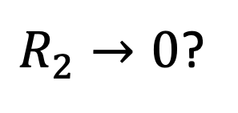
Consider:
short
$R_{2}→0$?
Parallel RLC circuit.
Behavior still governed by a second-order diff. eq. (to be shown).
Are L and C in series?
Are L and C in parallel?
A) Yes
B) No
A) Yes
B) No
But textbook only covers series or parallel RLC circuits???
Still obtain either underdamped, critically damped, or overdamped response.
But, coefficients are a mix of those obtained from either a series circuit or a parallel circuit.
Still obtain either underdamped, critically damped, or overdamped response.
Coefficients are a mix of those obtained from either a series circuit or a parallel circuit.

Slide 4
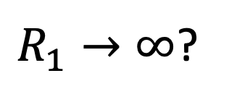
Consider:
$R_{2}→0$?
Parallel RLC circuit.
open
Or,
$R_{1}→∞$?
Series RLC circuit.
Behavior still governed by a second-order diff. eq. (to be shown).
Are L and C in series?
Are L and C in parallel?
A) Yes
B) No
A) Yes
B) No
But textbook only covers series or parallel RLC circuits???
Still obtain either underdamped, critically damped, or overdamped response.
But, coefficients are a mix of those obtained from either a series circuit or a parallel circuit.

Slide 5
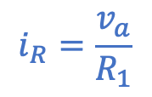
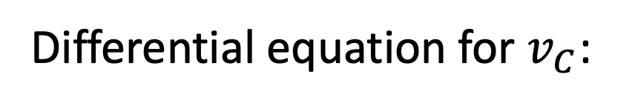

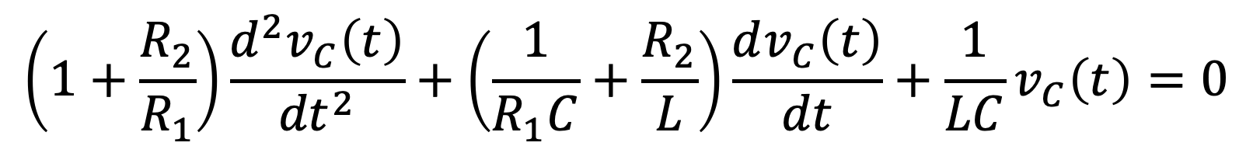

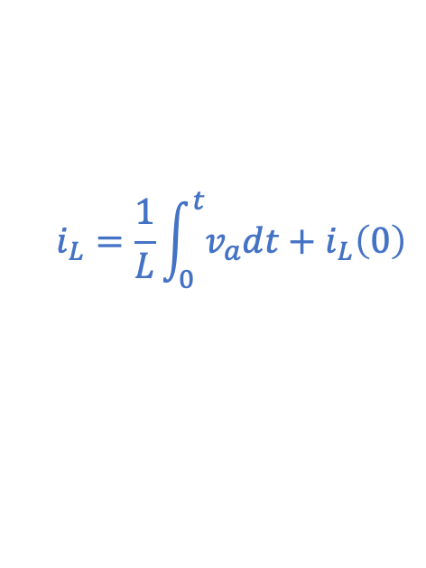
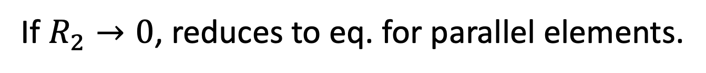
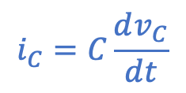
Consider:
short
Put these together to
get diff. eq.:
$$i_{R}+i_{L}+i_{C}=0$$
$$i_{R}=\frac{v_{a}}{R_{1}}$$
$$i_{C}=C\frac{dv_{C}}{dt}$$
$$i_{L}=\frac{1}{L}\int_{0}^{t}{v_{a}dt}+i_{L}\left(0\right)$$
$$v_{a}=R_{2}i_{C}+v_{C}$$
Differential equation for $v_{C}$:
Obtained via KCL at top left node and $i$-$v$ relationships.
$$\left(1+\frac{R_{2}}{R_{1}}\right)\frac{d^{2}v_{C}\left(t\right)}{{dt}^{2}}+\left(\frac{1}{R_{1}C}+\frac{R_{2}}{L}\right)\frac{dv_{C}\left(t\right)}{dt}+\frac{1}{LC}v_{C}\left(t\right)=0$$
If $R_{2}→0$, reduces to eq. for parallel elements.

Slide 6

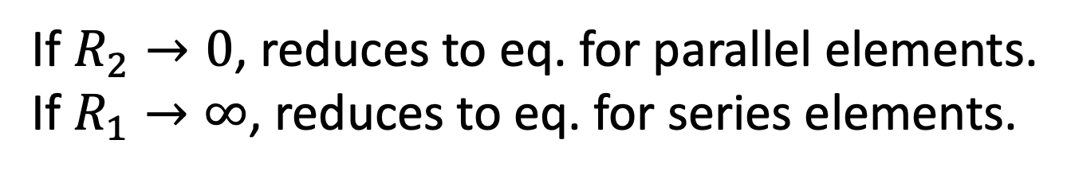
Consider:
Put these together to
get diff. eq.:
$$i_{R}+i_{L}+i_{C}=0$$
open
$$i_{R}=\frac{v_{a}}{R_{1}}$$
$$i_{C}=C\frac{dv_{C}}{dt}$$
$$i_{L}=\frac{1}{L}\int_{0}^{t}{v_{a}dt}+i_{L}\left(0\right)$$
$$v_{a}=R_{2}i_{C}+v_{C}$$
Differential equation for $v_{C}$:
Obtained via KCL at top left node and $i$-$v$ relationships.
$$\left(1+\frac{R_{2}}{R_{1}}\right)\frac{d^{2}v_{C}\left(t\right)}{{dt}^{2}}+\left(\frac{1}{R_{1}C}+\frac{R_{2}}{L}\right)\frac{dv_{C}\left(t\right)}{dt}+\frac{1}{LC}v_{C}\left(t\right)=0$$
}
If $R_{2}→0$, reduces to eq. for parallel elements.
If $R_{1}→∞$, reduces to eq. for series elements.
Circuit is a hybrid of
parallel and series!

Slide 7
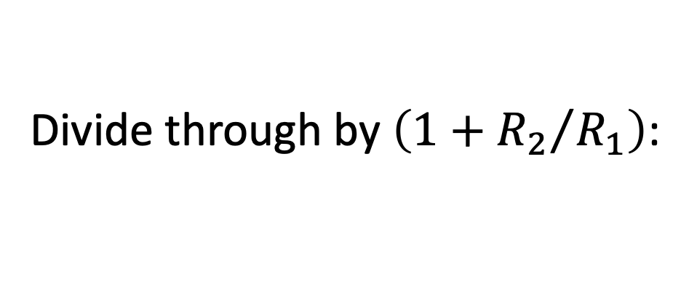
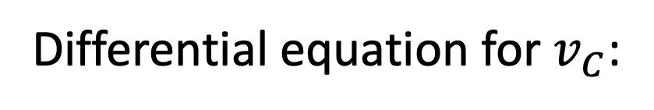
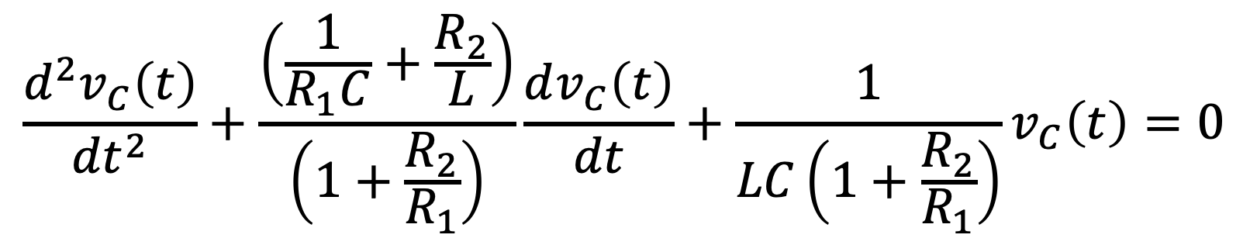
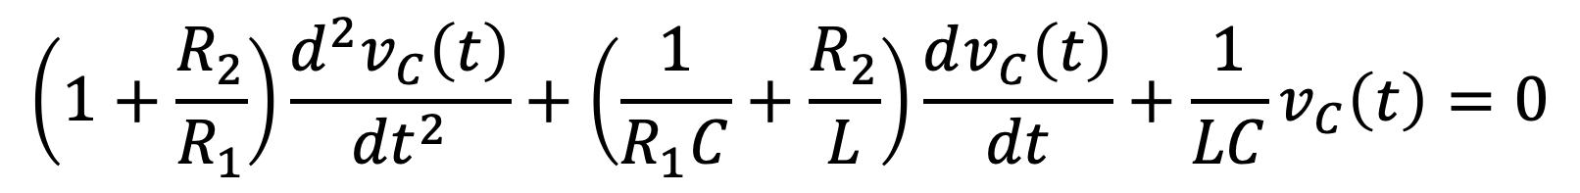
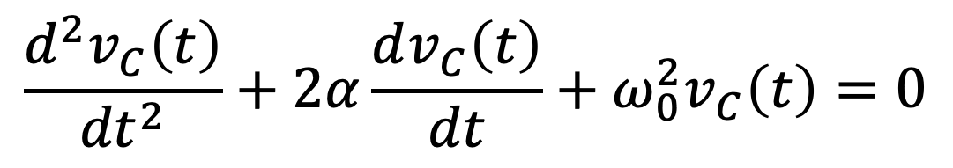
Differential equation for $v_{C}$:
$$\left(1+\frac{R_{2}}{R_{1}}\right)\frac{d^{2}v_{C}\left(t\right)}{{dt}^{2}}+\left(\frac{1}{R_{1}C}+\frac{R_{2}}{L}\right)\frac{dv_{C}\left(t\right)}{dt}+\frac{1}{LC}v_{C}\left(t\right)=0$$
Divide through by $\left(1+{R_{2}}/{R_{1}}\right)$:
$$\frac{d^{2}v_{C}\left(t\right)}{{dt}^{2}}+\frac{\left(\frac{1}{R_{1}C}+\frac{R_{2}}{L}\right)}{\left(1+\frac{R_{2}}{R_{1}}\right)}\frac{dv_{C}\left(t\right)}{dt}+\frac{1}{LC\left(1+\frac{R_{2}}{R_{1}}\right)}v_{C}\left(t\right)=0$$
But, can rewrite this as:
Overdamped,
underdamped, or
critically damped.
$$\frac{d^{2}v_{C}\left(t\right)}{{dt}^{2}}+2α\frac{dv_{C}\left(t\right)}{dt}+ω_{0}^{2}v_{C}\left(t\right)=0$$
Same form as before!
Yields same types of solutions.

Slide 8
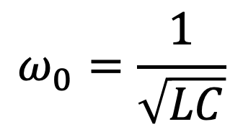
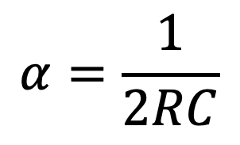
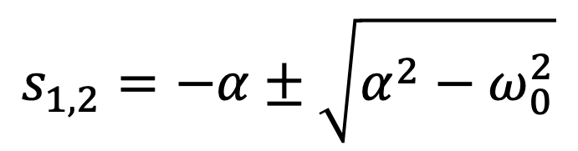
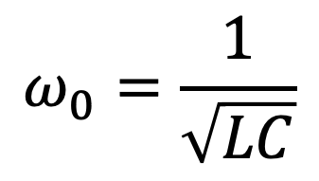
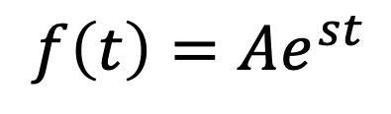
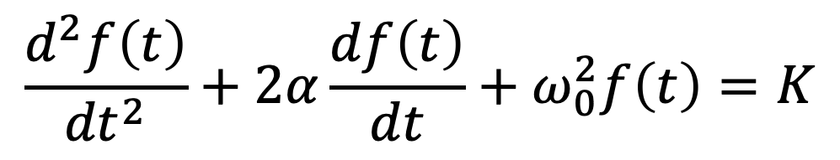

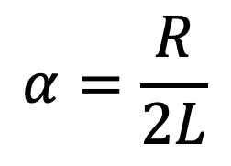
General Second-Order System (RLC or RL² or RC² circuit)
$$\frac{d^{2}f\left(t\right)}{{dt}^{2}}+2α\frac{df\left(t\right)}{dt}+ω_{0}^{2}f\left(t\right)=K$$
$$α=\frac{R}{2L}$$
$$ω_{0}=\frac{1}{\sqrt{LC}}$$
Series:
$$α=\frac{1}{2RC}$$
$$ω_{0}=\frac{1}{\sqrt{LC}}$$
Parallel:
For homogeneous solution ($K=0$), assume:
$$f\left(t\right)=Ae^{st}$$
Yields characteristic equation
with roots given by:
$$s_{1,2}=−α±\sqrt{α^{2}−ω_{0}^{2}}$$

Slide 9
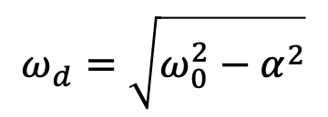
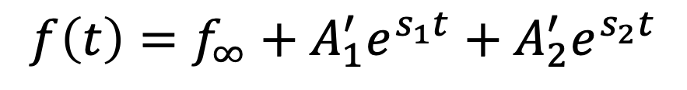
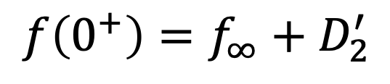
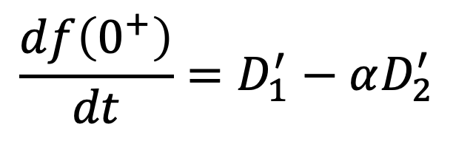
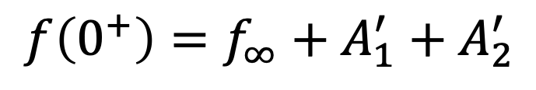
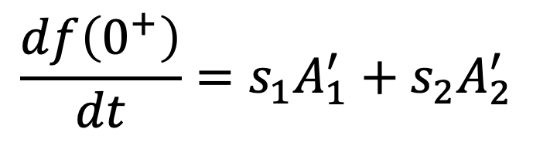
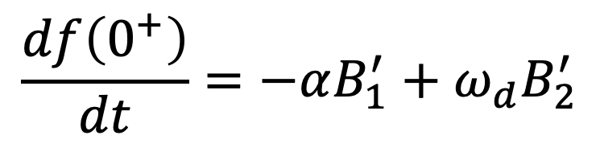
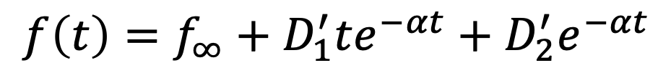
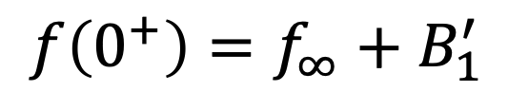
General Second-Order System (RLC or RL² or RC² circuit)
$$\frac{d^{2}f\left(t\right)}{{dt}^{2}}+2α\frac{df\left(t\right)}{dt}+ω_{0}^{2}f\left(t\right)=K$$
Overdamped:
$$f\left(t\right)=f_{∞}+A_{1}^{′}e^{s_{1}t}+A_{2}^{′}e^{s_{2}t}$$
$$\frac{df\left(0^{+}\right)}{dt}=s_{1}A_{1}^{′}+s_{2}A_{2}^{′}$$
$$f\left(0^{+}\right)=f_{∞}+A_{1}^{′}+A_{2}^{′}$$
and
Critically Damped:
$$f\left(t\right)=f_{∞}+D_{1}^{′}{te}^{−αt}+D_{2}^{′}e^{−αt}$$
$$\frac{df\left(0^{+}\right)}{dt}=D_{1}^{′}−αD_{2}^{′}$$
$$f\left(0^{+}\right)=f_{∞}+D_{2}^{′}$$
and
$$ω_{d}=\sqrt{ω_{0}^{2}−α^{2}}$$
Underdamped:
$$f\left(t\right)=f_{∞}+B_{1}^{′}e^{−αt}\cos\left(ω_{d}t\right)+B_{2}^{′}e^{−αt}\sin\left(ω_{d}t\right)$$
$$\frac{df\left(0^{+}\right)}{dt}=−αB_{1}^{′}+ω_{d}B_{2}^{′}$$
$$f\left(0^{+}\right)=f_{∞}+B_{1}^{′}$$
and

Slide 10
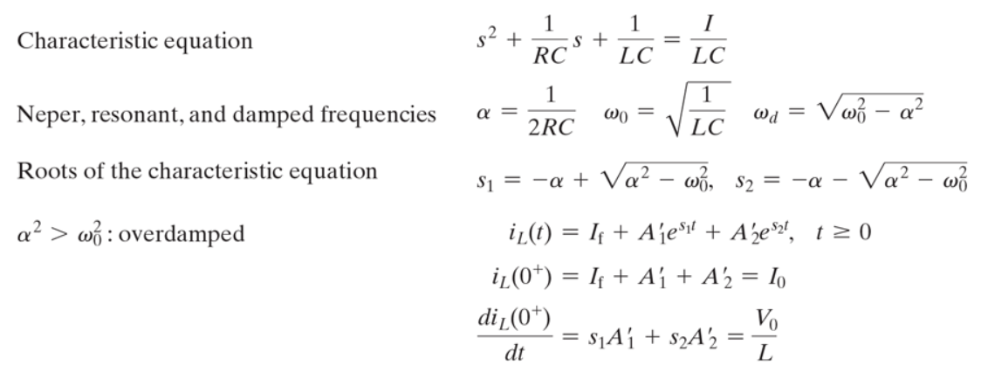

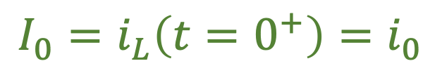
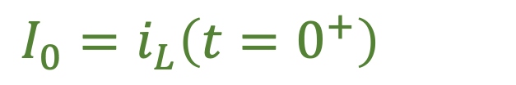
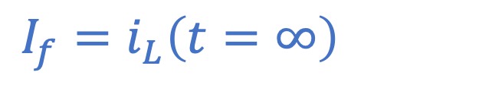
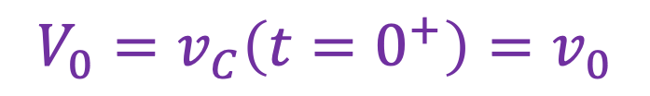


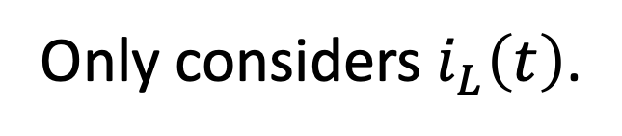
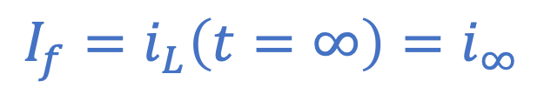
N&R Table 8.3 (step response of parallel RLC circuit)
Wrong!
$$=0$$
Fixed!
$$I_{f}=i_{L}\left(t=∞\right)=i_{∞}$$
$$I_{f}=i_{L}\left(t=∞\right)=i_{∞}$$
$$I_{0}=i_{L}\left(t=0^{+}\right)=i_{0}$$
$$I_{0}=i_{L}\left(t=0^{+}\right)=i_{0}$$
$$V_{0}=v_{C}\left(t=0^{+}\right)=v_{0}$$
$$V_{0}=v_{C}\left(t=0^{+}\right)=v_{0}$$
Only considers $i_{L}\left(t\right)$.
What about voltage?

Slide 11

Sinusoidal (Harmonic) Voltage and Currents
(sometimes called “signals”)
“sinusoidal” implies
either sines or cosines.
Want to consider circuits with sinusoidal excitation.
Will assume all sources oscillate at same frequency.
Thus, all voltages and currents also oscillate at same frequency.
Assume steady-state behavior, i.e., transients have died out.
Circuit contains inductors and/or capacitors (and resistors).
Can avoid derivatives and integrals entirely if we think in terms of
complex numbers.
Many forms of excitation are already sinusoidal.
Furthermore, can represent any signal as a superposition of
sinusoids (Fourier analysis).
But, this is sinusoidal steady-state (not the constant steady-state
we have considered so far; inductor $≠$ short, capacitor $≠$open).
Obtain algebraic instead of differential equations!

Slide 12


Complex Numbers
Real number line. Or, real axis.
Real number line. Or, real axis.
Imaginary axis. Like real number line, but rotated $90°$.
Imaginary axis. Like real number line, but rotated $90°$.
Real axis $+$ Imaginary axis $=$ Complex plane.
Physicists and mathematicians
prefer to use $i$ instead of $j$.
$j$ used to indicate displacement in the “imaginary” direction.

Slide 13
Complex Numbers
Add two
real numbers.

Slide 14
Complex Numbers
Multiply two
real numbers.

Slide 15
Complex Numbers
Add two (negative)
real numbers.

Slide 16

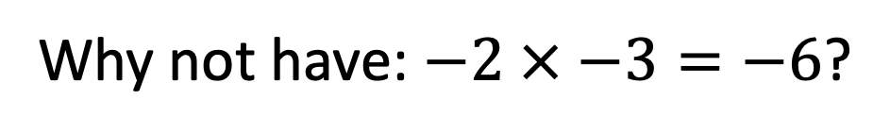
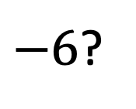
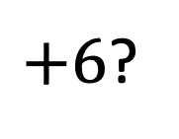
Complex Numbers
Multiply two
(negative) real
numbers.
?
Why?
Why not have: $−2 × −3=−6$?
?
Or, in other words, why not have $−1 × −1=−1$?
?
That way, solution to $x^{2}+9=0$ would be $x=−3.$
Hmmm…
But what would $2 × −3$ equal?
$+6$?
$−6$?
Won’t work. Can’t make consistent.

Slide 17
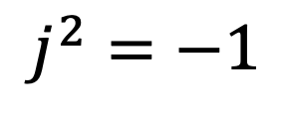

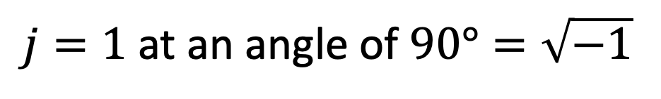
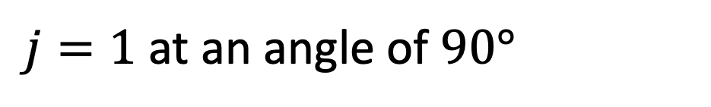
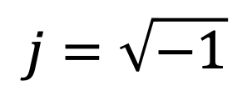
Complex Numbers
$$j=\sqrt{−1}$$
Add two
imaginary numbers.
$$j^{2}=−1$$
But, in addition to $j$ implying a direction, we should think of $j$ itself
as actually having both a value (magnitude) and an angle/direction.
$j=1$ at an angle of $90°=\sqrt{−1}$
Relative to
positive real axis.
$j=1$ at an angle of $90°=\sqrt{−1}$
In fact, all numbers in the complex plane have a magnitude and angle.
Instead of $j2$ and $j3$, could write $2\sqrt{−1}$ and $3\sqrt{−1}$, respectively.

Slide 18
Complex Numbers
$$j=\sqrt{−1}$$
$$j^{2}=−1$$
Multiply two numbers.
Multiply their magnitudes and add their angles.
Relates to Euler’s formula: multiplying exponentials $→$ add exponents.
Relates to Euler’s formula: multiplying exponentials $→$ add exponents.

Slide 19
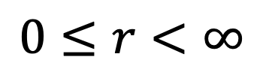
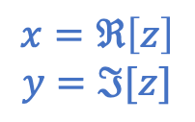


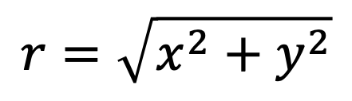

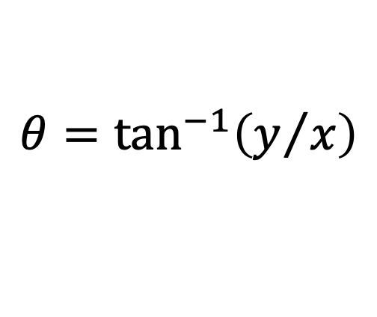
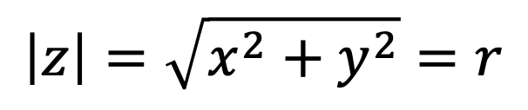
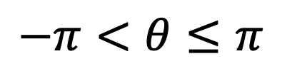

Complex Numbers
Polar representation
$x$ and $y$ are real.
The $j$ is understood
and typically not written.
$$r=\sqrt{x^{2}+y^{2}}$$
$$j=\sqrt{−1}$$
$$0≤r<∞$$
$$x=ℜ\left[z\right]$$
$$y=ℑ[z]$$
$$θ=\tan^{−1}\left(y/x\right)$$
$$j^{2}=−1$$
(Provided $x≥0$, else add $π$.)
$$−π<θ≤π$$
or
$$0≤θ<2π$$
$$\left|z\right|=\sqrt{x^{2}+y^{2}}=r$$
$$z=x+jy=r\left(\cos\left(θ\right)+j\sin\left(θ\right)\right)=re^{jθ}=r∠θ$$
$$z=x+jy=r\left(\cos\left(θ\right)+j\sin\left(θ\right)\right)=re^{jθ}=r∠θ$$
$$z=x+jy=r\left(\cos\left(θ\right)+j\sin\left(θ\right)\right)=re^{jθ}=r∠θ$$
$$z=x+jy=r\left(\cos\left(θ\right)+j\sin\left(θ\right)\right)=re^{jθ}=r∠θ$$
Cartesian
polar

