Slide 1
EE 261, Spring 2025, Lecture 34
Goals/Topics:
More on complex numbers
Euler’s formula
Best viewed in
presentation mode
in PowerPoint.
Announcements: HW 11 due Sunday, Apr. 13th.
And…

Slide 3

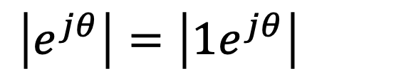

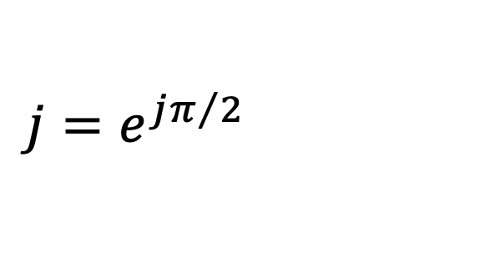

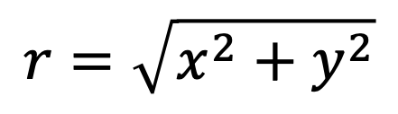
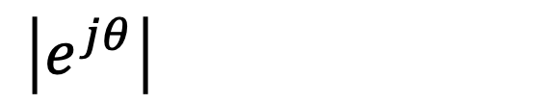

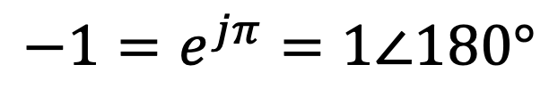
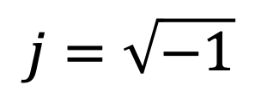
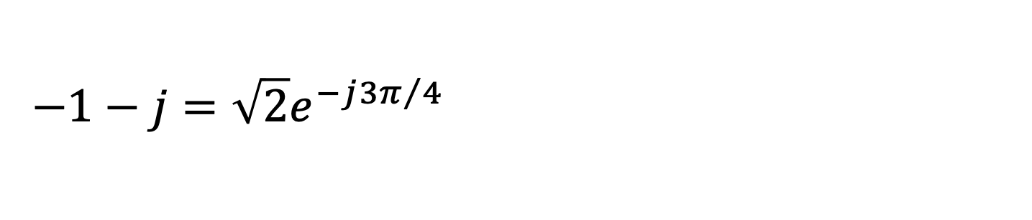
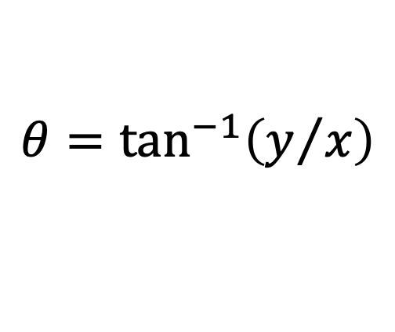
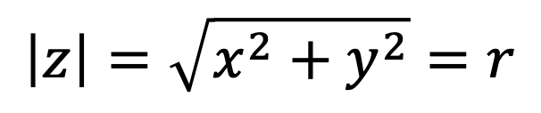

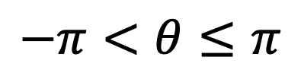
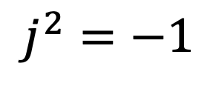

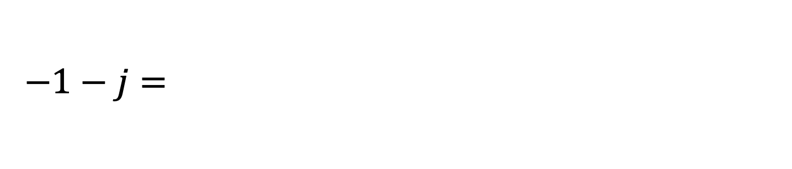

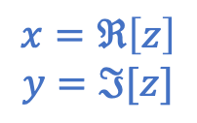
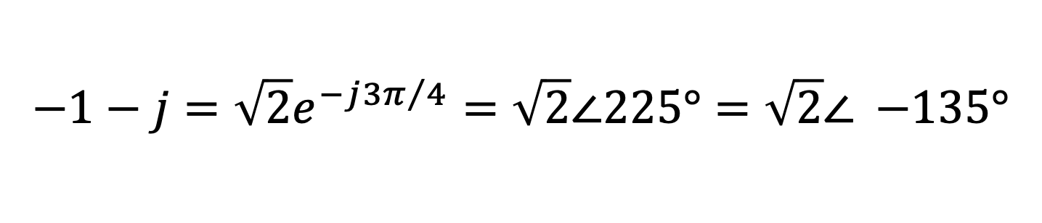
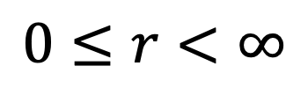
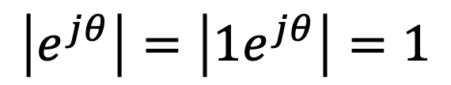
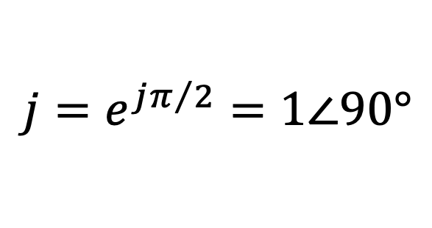
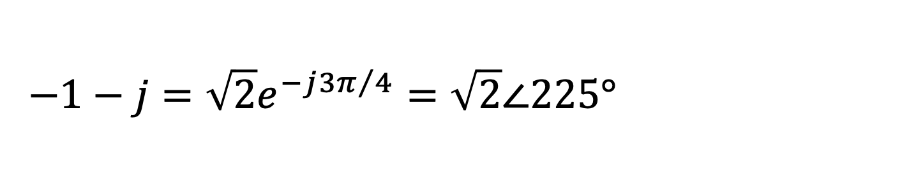
Complex Numbers
Polar representation
$x$ and $y$ are real.
The $j$ is understood
and typically not written.
$$r=\sqrt{x^{2}+y^{2}}$$
$$j=\sqrt{−1}$$
$$0≤r<∞$$
$$x=ℜ\left[z\right]$$
$$y=ℑ[z]$$
$$θ=\tan^{−1}\left(y/x\right)$$
$$j^{2}=−1$$
(Provided $x≥0$, else add $π$.)
$$−π<θ≤π$$
or
$$0≤θ<2π$$
$$\left|z\right|=\sqrt{x^{2}+y^{2}}=r$$
$$\left|e^{jθ}\right|=\left|1e^{jθ}\right|=1$$
A point on
unit circle.
$$\left|e^{jθ}\right|=\left|1e^{jθ}\right|=1$$
$$\left|e^{jθ}\right|=\left|1e^{jθ}\right|=1$$
$$z=x+jy=r\left(\cos\left(θ\right)+j\sin\left(θ\right)\right)=re^{jθ}=r∠θ$$
$$z=x+jy=r\left(\cos\left(θ\right)+j\sin\left(θ\right)\right)=re^{jθ}=r∠θ$$
$$z=x+jy=r\left(\cos\left(θ\right)+j\sin\left(θ\right)\right)=re^{jθ}=r∠θ$$
$$z=x+jy=r\left(\cos\left(θ\right)+j\sin\left(θ\right)\right)=re^{jθ}=r∠θ$$
Cartesian
polar
$$−1=e^{jπ}=1∠180°$$
$$−1=e^{jπ}=1∠180°$$
What are the following in polar form?
$$−1=e^{jπ}=1∠180°$$
$$−1−j=\sqrt{2}e^{−j{3π}/4}=\sqrt{2}∠225°=\sqrt{2}∠(−135°$$
$$−1−j=\sqrt{2}e^{−j{3π}/4}=\sqrt{2}∠225°=\sqrt{2}∠(−135°$$
$$−1−j=\sqrt{2}e^{−j{3π}/4}=\sqrt{2}∠225°=\sqrt{2}∠(−135°$$
$$j=e^{jπ/2}=1∠90°$$
$$−1−j=\sqrt{2}e^{−j{3π}/4}=\sqrt{2}∠225°=\sqrt{2}∠(−135°$$
$$j=e^{jπ/2}=1∠90°$$
$$j=e^{jπ/2}=1∠90°$$

Slide 4
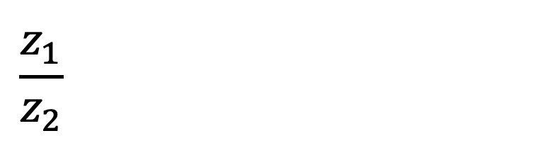
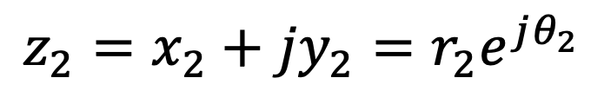
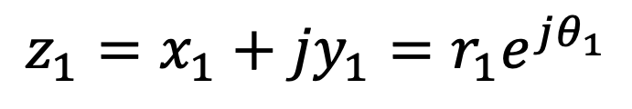
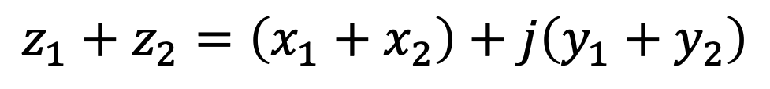
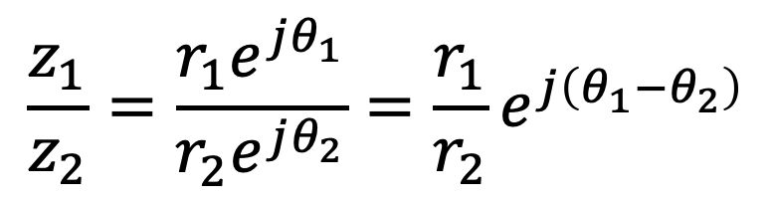
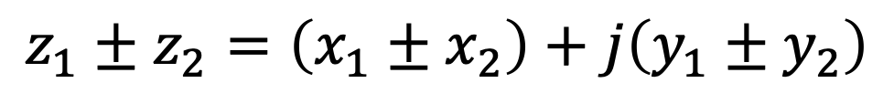
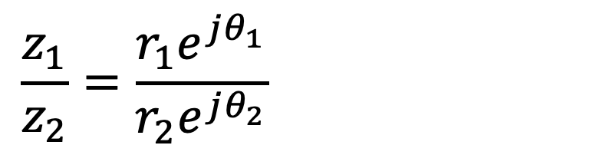
Given two numbers:
$$z_{1}=x_{1}+{jy}_{1}=r_{1}e^{jθ_{1}}$$
$$z_{2}=x_{2}+{jy}_{2}=r_{2}e^{jθ_{2}}$$
Addition & subtraction convenient in rectangular form:
$$z_{1}±z_{2}=\left(x_{1}±x_{2}\right)+j\left(y_{1}±y_{2}\right)$$
$$z_{1}+z_{2}=\left(x_{1}+x_{2}\right)+j\left(y_{1}+y_{2}\right)$$
Multiplication & division convenient in polar form:
$$z_{1}z_{2}=\left(r_{1}e^{jθ_{1}}\right)\left(r_{2}e^{jθ_{2}}\right)=r_{1}r_{2}e^{j\left(θ_{1}+θ_{2}\right)}$$
$$z_{1}z_{2}=\left(r_{1}e^{jθ_{1}}\right)\left(r_{2}e^{jθ_{2}}\right)=r_{1}r_{2}e^{j\left(θ_{1}+θ_{2}\right)}$$
$$z_{1}z_{2}=\left(r_{1}e^{jθ_{1}}\right)\left(r_{2}e^{jθ_{2}}\right)=r_{1}r_{2}e^{j\left(θ_{1}+θ_{2}\right)}$$
$$\frac{z_{1}}{z_{2}}=\frac{r_{1}e^{jθ_{1}}}{r_{2}e^{jθ_{2}}}=\frac{r_{1}}{r_{2}}e^{j\left(θ_{1}−θ_{2}\right)}$$
$$\frac{z_{1}}{z_{2}}=\frac{r_{1}e^{jθ_{1}}}{r_{2}e^{jθ_{2}}}=\frac{r_{1}}{r_{2}}e^{j\left(θ_{1}−θ_{2}\right)}$$
$$\frac{z_{1}}{z_{2}}=\frac{r_{1}e^{jθ_{1}}}{r_{2}e^{jθ_{2}}}=\frac{r_{1}}{r_{2}}e^{j\left(θ_{1}−θ_{2}\right)}$$

Slide 5
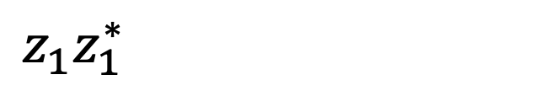
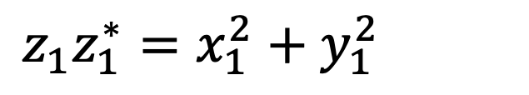

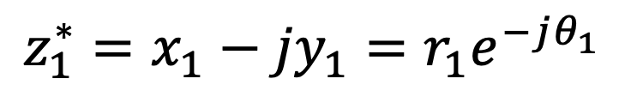
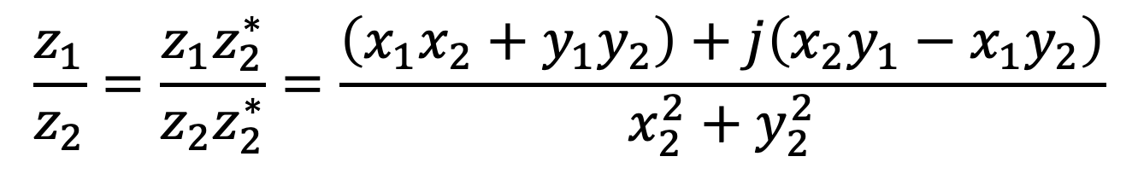
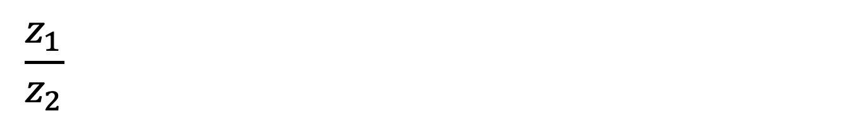
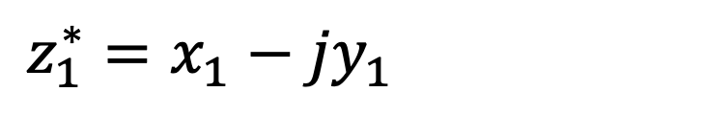
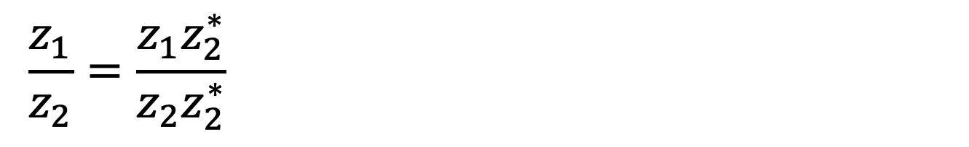
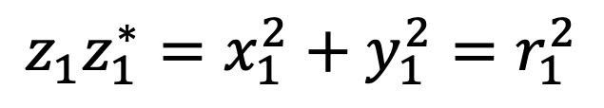
Given two numbers:
$$z_{1}=x_{1}+{jy}_{1}=r_{1}e^{jθ_{1}}$$
$$z_{2}=x_{2}+{jy}_{2}=r_{2}e^{jθ_{2}}$$
Then express all this in
polar from. Messy!
Can you add & subtraction polar form?
Sort of.
$$r_{1}e^{jθ_{1}}±r_{2}e^{jθ_{2}}=\left(r_{1}\cos\left(θ_{1}\right)±r_{2}\cos\left(θ_{2}\right)\right)+j\left(r_{1}\sin\left(θ_{1}\right)±r_{2}\sin\left(θ_{2}\right)\right)$$
$$r_{1}e^{jθ_{1}}±r_{2}e^{jθ_{2}}=\left(r_{1}\cos\left(θ_{1}\right)±r_{2}\cos\left(θ_{2}\right)\right)+j\left(r_{1}\sin\left(θ_{1}\right)±r_{2}\sin\left(θ_{2}\right)\right)$$
Can you multiply & divide in rectangular form?
Yes.
$$\left(x_{1}+{jy}_{1}\right)\left(x_{2}+{jy}_{2}\right)=\left(x_{1}x_{2}−y_{1}y_{2}\right)+j\left(x_{1}y_{2}+x_{2}y_{1}\right)$$
$$\left(x_{1}+{jy}_{1}\right)\left(x_{2}+{jy}_{2}\right)=\left(x_{1}x_{2}−y_{1}y_{2}\right)+j\left(x_{1}y_{2}+x_{2}y_{1}\right)$$
Aside: Obtain complex conjugate by changing sign of imaginary part.
$$z_{1}^{∗}=x_{1}−{jy}_{1}=r_{1}e^{−jθ_{1}}$$
$$z_{1}^{∗}=x_{1}−{jy}_{1}=r_{1}e^{−jθ_{1}}$$
$$z_{1}^{∗}=x_{1}−{jy}_{1}=r_{1}e^{−jθ_{1}}$$
$$z_{1}z_{1}^{∗}=x_{1}^{2}+y_{1}^{2}=r_{1}^{2}$$
$$z_{1}z_{1}^{∗}=x_{1}^{2}+y_{1}^{2}=r_{1}^{2}$$
$$z_{1}z_{1}^{∗}=x_{1}^{2}+y_{1}^{2}=r_{1}^{2}$$
Cartesian division:
$$\frac{z_{1}}{z_{2}}=\frac{z_{1}z_{2}^{∗}}{z_{2}z_{2}^{∗}}=\frac{\left(x_{1}x_{2}+y_{1}y_{2}\right)+j\left(x_{2}y_{1}−x_{1}y_{2}\right)}{x_{2}^{2}+y_{2}^{2}}$$
$$\frac{z_{1}}{z_{2}}=\frac{z_{1}z_{2}^{∗}}{z_{2}z_{2}^{∗}}=\frac{\left(x_{1}x_{2}+y_{1}y_{2}\right)+j\left(x_{2}y_{1}−x_{1}y_{2}\right)}{x_{2}^{2}+y_{2}^{2}}$$
$$\frac{z_{1}}{z_{2}}=\frac{z_{1}z_{2}^{∗}}{z_{2}z_{2}^{∗}}=\frac{\left(x_{1}x_{2}+y_{1}y_{2}\right)+j\left(x_{2}y_{1}−x_{1}y_{2}\right)}{x_{2}^{2}+y_{2}^{2}}$$

Slide 6
But, MATLAB makes everything rather hassle free!
It handles complex numbers “natively.”
It provides many functions for working with complex number. Ex.:
It provides many functions for working with complex number. Ex.:
abs(), angle(), atan2(), real(), imag(), rad2deg(), deg2rad(), pi, exp(), …
See posted “MATLAB and Complex Numbers” PDF.
But, on test, have to be able to work with
complex numbers using your calculator.

Slide 7
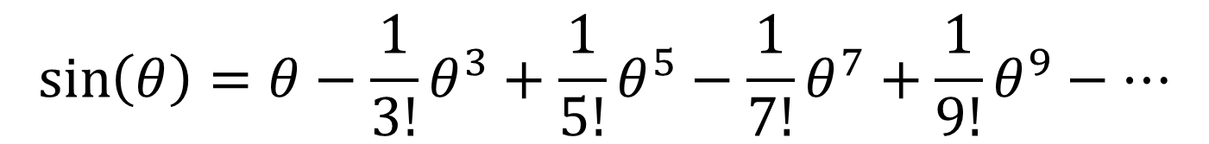
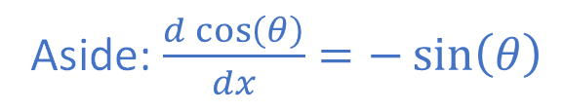
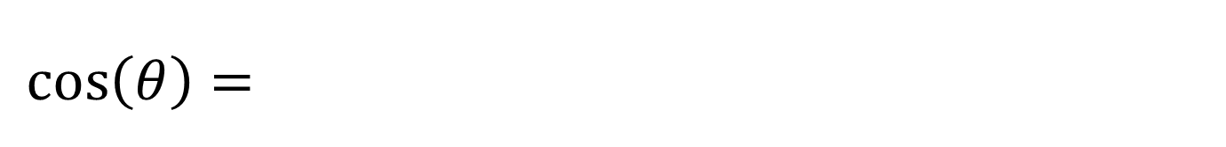
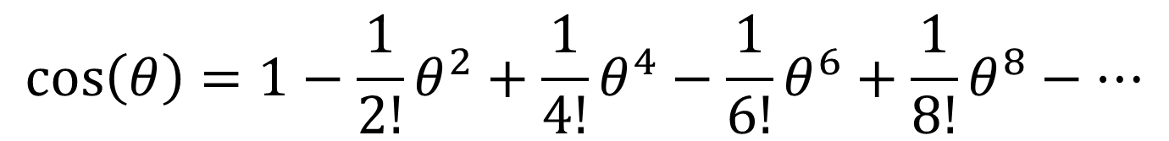
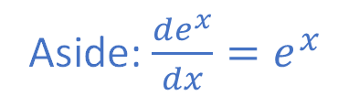
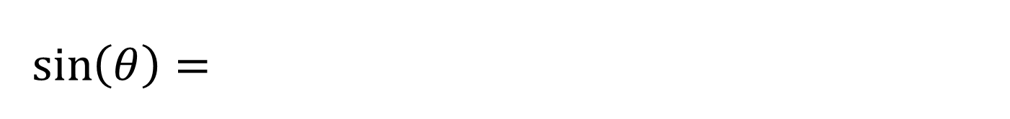
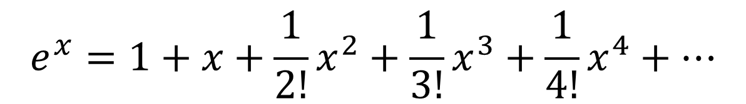
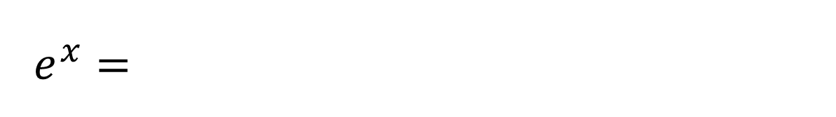

Taylor Series (Euler’s formula derivation)
$$f\left(x\right)=f\left(0\right)+f^{′}\left(0\right)x+\frac{f^{′′}\left(0\right)}{2!}x^{2}+\frac{f^{′′′}\left(0\right)}{3!}x^{3}+\frac{f^{\left(IV\right)}\left(0\right)}{4!}x^{4}+⋯$$
$$e^{x}=1+x+\frac{1}{2!}x^{2}+\frac{1}{3!}x^{3}+\frac{1}{4!}x^{4}+⋯$$
$$e^{x}=1+x+\frac{1}{2!}x^{2}+\frac{1}{3!}x^{3}+\frac{1}{4!}x^{4}+⋯$$
Aside: $\frac{de^{x}}{dx}=e^{x}$
$$\cos\left(θ\right)=1−\frac{1}{2!}θ^{2}+\frac{1}{4!}θ^{4}−\frac{1}{6!}θ^{6}+\frac{1}{8!}θ^{8}−⋯$$
$$\cos\left(θ\right)=1−\frac{1}{2!}θ^{2}+\frac{1}{4!}θ^{4}−\frac{1}{6!}θ^{6}+\frac{1}{8!}θ^{8}−⋯$$
Aside: $\frac{d\cos\left(θ\right)}{dx}=−\sin\left(θ\right)$
$$\sin\left(θ\right)=θ−\frac{1}{3!}θ^{3}+\frac{1}{5!}θ^{5}−\frac{1}{7!}θ^{7}+\frac{1}{9!}θ^{9}−⋯$$
$$\sin\left(θ\right)=θ−\frac{1}{3!}θ^{3}+\frac{1}{5!}θ^{5}−\frac{1}{7!}θ^{7}+\frac{1}{9!}θ^{9}−⋯$$
Aside: $\frac{d\sin\left(θ\right)}{dx}=\cos\left(θ\right)$
$$e^{jθ}=1+jθ−\frac{1}{2!}θ^{2}−j\frac{1}{3!}θ^{3}+\frac{1}{4!}θ^{4}+j\frac{1}{5!}θ^{5}−\frac{1}{6!}θ^{6}−⋯$$
$$e^{jθ}=1+jθ−\frac{1}{2!}θ^{2}−j\frac{1}{3!}θ^{3}+\frac{1}{4!}θ^{4}+j\frac{1}{5!}θ^{5}−\frac{1}{6!}θ^{6}−⋯$$
$$e^{jθ}=1+jθ−\frac{1}{2!}θ^{2}−j\frac{1}{3!}θ^{3}+\frac{1}{4!}θ^{4}+j\frac{1}{5!}θ^{5}−\frac{1}{6!}θ^{6}−⋯$$

Slide 8

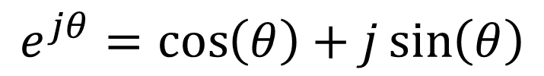

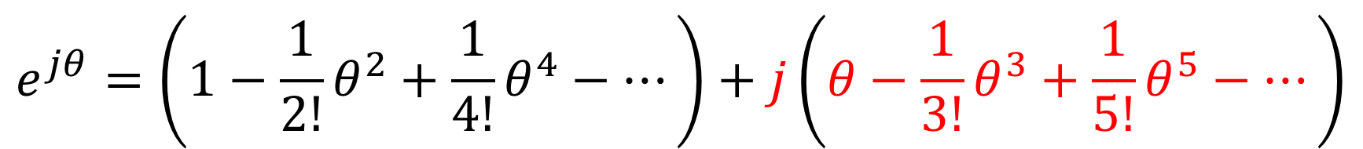
Taylor Series (Euler’s formula derivation)
$$e^{jθ}=1+jθ−\frac{1}{2!}θ^{2}−j\frac{1}{3!}θ^{3}+\frac{1}{4!}θ^{4}+j\frac{1}{5!}θ^{5}−\frac{1}{6!}θ^{6}−⋯$$
Group real and imaginary parts.
$$\cos\left(θ\right)$$
$$\sin\left(θ\right)$$
$$e^{jθ}=\left(1−\frac{1}{2!}θ^{2}+\frac{1}{4!}θ^{4}−…\right)+j\left(θ−\frac{1}{3!}θ^{3}+\frac{1}{5!}θ^{5}−…\right)$$
$$e^{jθ}=\cos\left(θ\right)+j\sin\left(θ\right)$$
Euler’s formula!
$$z=x+jy=r\cos\left(θ\right)+j r\sin\left(θ\right)$$
$$z=x+jy=r\cos\left(θ\right)+j r\sin\left(θ\right)$$
$$=r\left(\cos\left(θ\right)+j\sin\left(θ\right)\right)=re^{jθ}=r∠θ$$
$$=r\left(\cos\left(θ\right)+j\sin\left(θ\right)\right)=re^{jθ}=r∠θ$$
$$=r\left(\cos\left(θ\right)+j\sin\left(θ\right)\right)=re^{jθ}=r∠θ$$
Engineering shorthand.

Slide 9
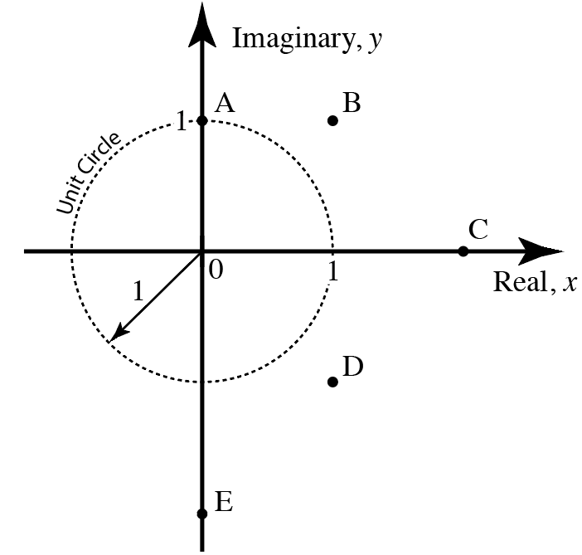
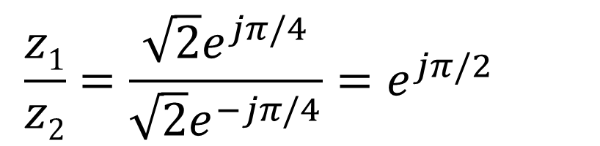
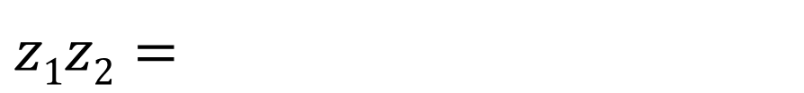
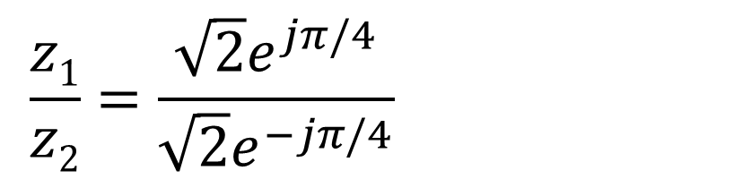

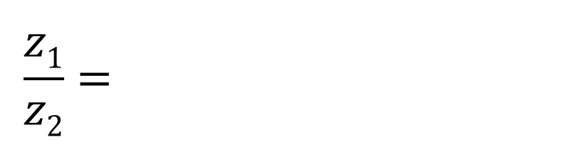
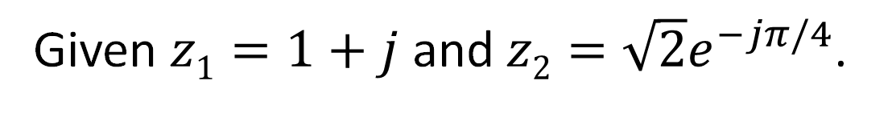
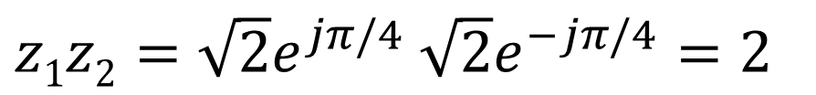



Cartesian
polar
Given $z1=1+j$ and $z2=\sqrt{2}e^{−jπ/4}$.
(For the following, helpful to think about repre-
sentation of these numbers in both forms.)
Which point corresponds to the following?
?
$$z2=1−j$$
D
$$z2=1−j$$
$$\frac{z1}{z2}=\frac{\sqrt{2}e^{jπ/4}}{\sqrt{2}e^{−jπ/4}}=e^{jπ/2}=j$$
$$\frac{z1}{z2}=\frac{\sqrt{2}e^{jπ/4}}{\sqrt{2}e^{−jπ/4}}=e^{jπ/2}=j$$
$$\frac{z1}{z2}=\frac{\sqrt{2}e^{jπ/4}}{\sqrt{2}e^{−jπ/4}}=e^{jπ/2}=j$$
$$\frac{z1}{z2}=\frac{\sqrt{2}e^{jπ/4}}{\sqrt{2}e^{−jπ/4}}=e^{jπ/2}=j$$
?
A
?
C
$z1z2=\sqrt{2}e^{jπ/4}$ $\sqrt{2}e^{−jπ/4}=2$
$z1z2=\sqrt{2}e^{jπ/4}$ $\sqrt{2}e^{−jπ/4}=2$
$z1z2=\sqrt{2}e^{jπ/4}$ $\sqrt{2}e^{−jπ/4}=2$
?
$$z2−z1=\left(1−j\right)−\left(1+j\right)=−j2$$
$$z2−z1=\left(1−j\right)−\left(1+j\right)=−j2$$
$$z2−z1=\left(1−j\right)−\left(1+j\right)=−j2$$
E

Slide 10
Complex Numbers and Sinusoidal “Signals”
$$Ae^{jφ}e^{jωt}=Ae^{j\left(ωt+φ\right)}=A\cos\left(ωt+φ\right)+jA\sin\left(ωt+φ\right)$$
$$Ae^{jφ}e^{jωt}=Ae^{j\left(ωt+φ\right)}=A\cos\left(ωt+φ\right)+jA\sin\left(ωt+φ\right)$$
Consider:
$$Ae^{jφ}e^{jωt}=Ae^{j\left(ωt+φ\right)}=A\cos\left(ωt+φ\right)+jA\sin\left(ωt+φ\right)$$
Complex
constant.
Complex function
of time.
Euler’s formula.

Slide 11


Complex Numbers and Sinusoidal “Signals”
Consider:
$$Ae^{jφ}e^{jωt}=Ae^{j\left(ωt+φ\right)}=A\cos\left(ωt+φ\right)+jA\sin\left(ωt+φ\right)$$
How does $e^{jωt}$move in the complex plane as a function of time?
$e^{jωt}$ moves counterclockwise around the “unit circle.”
Let $ℜ[]$ be “the real part of.”
$$ℜ\left[Ae^{jφ}e^{jωt}\right]=A\cos\left(ωt+φ\right)$$
So this must also describe
any harmonic signal.
This describes any and
every harmonic signal.
Need one (complex) number and
the frequency to know everything.
If all signals varying at same frequency,
this one number tells you everything!

Slide 12









Sinusoidal (Harmonic) Signals
$$v\left(t\right)=V_{m}\cos\left(ωt+φ\right)=V_{m}\cos\left(\left(2πf\right)t+φ\right)=V_{m}\cos\left(\frac{2π}{T}t+φ\right)$$
$$v\left(t\right)=V_{m}\cos\left(ωt+φ\right)=V_{m}\cos\left(\left(2πf\right)t+φ\right)=V_{m}\cos\left(\frac{2π}{T}t+φ\right)$$
$$v\left(t\right)=V_{m}\cos\left(ωt+φ\right)=V_{m}\cos\left(\left(2πf\right)t+φ\right)=V_{m}\cos\left(\frac{2π}{T}t+φ\right)$$
$ω=$ radians/second, $s^{−1}$
$f=$ cycles/second, $s^{−1}$, Hz
$$f=\frac{1}{T}$$
$φ=$ radians
$T=$ seconds/cycle, $s$
$$ω=2πf=\frac{2π}{T}$$
$$ω=2πf=\frac{2π}{T}$$

Slide 13


$${\left.e^{jωt}\right|}_{ω=1}=\cos\left(t\right)+j\sin\left(t\right)$$

Slide 14





$$e^{jφ}e^{jωt}={\left.e^{j\left(ωt+φ\right)}\right|}_{\begin{aligned}ω=1 \\ φ=π/3\end{aligned}}$$
$$e^{jφ}e^{jωt}={\left.e^{j\left(ωt+φ\right)}\right|}_{\begin{aligned}ω=1 \\ φ=π/3\end{aligned}}$$
$$e^{jφ}e^{jωt}={\left.e^{j\left(ωt+φ\right)}\right|}_{\begin{aligned}ω=1 \\ φ=π/3\end{aligned}}$$
$$=\cos\left(t+π/3\right)+j\sin\left(t+π/3\right)$$

