Slide 1
EE 261, Spring 2025, Lecture 35
Goals/Topics:
Phasors
Impedance (resistance but with complex numbers)
Circuit laws in sinusoidal steady state
Best viewed in presentation mode in PowerPoint.
Announcement:
Homework 12 posted (due Sunday, Apr. 20th).

Slide 2
Phasors
Real part: $ℜ[ ]$
Phasor transform: $𝒫[ ]$
(script “P”)
Because of Euler’s formula.
$$V_{m}\cos\left(ωt+φ\right)=ℜ\left[V_{m}e^{j\left(ωt+φ\right)}\right]=ℜ\left[V_{m}e^{jφ}e^{jωt}\right]$$
$$V_{m}\cos\left(ωt+φ\right)=ℜ\left[V_{m}e^{j\left(ωt+φ\right)}\right]=ℜ\left[V_{m}e^{jφ}e^{jωt}\right]$$
$$V_{m}\cos\left(ωt+φ\right)=ℜ\left[V_{m}e^{j\left(ωt+φ\right)}\right]=ℜ\left[V_{m}e^{jφ}e^{jωt}\right]$$
(bold; non-italic)
$$𝒫\left[V_{m}\cos\left(ωt+φ\right)\right]=𝒫\left[ℜ\left[V_{m}e^{jφ}e^{jωt}\right]\right]=V_{m}e^{jφ}=V_{m}∠φ=V$$
$$𝒫\left[V_{m}\cos\left(ωt+φ\right)\right]=𝒫\left[ℜ\left[V_{m}e^{jφ}e^{jωt}\right]\right]=V_{m}e^{jφ}=V_{m}∠φ=V$$
$$𝒫\left[V_{m}\cos\left(ωt+φ\right)\right]=𝒫\left[ℜ\left[V_{m}e^{jφ}e^{jωt}\right]\right]=V_{m}e^{jφ}=V_{m}∠φ=V$$
$$𝒫\left[V_{m}\cos\left(ωt+φ\right)\right]=𝒫\left[ℜ\left[V_{m}e^{jφ}e^{jωt}\right]\right]=V_{m}e^{jφ}=V_{m}∠φ=V$$
$$𝒫\left[V_{m}\cos\left(ωt+φ\right)\right]=𝒫\left[ℜ\left[V_{m}e^{jφ}e^{jωt}\right]\right]=V_{m}e^{jφ}=V_{m}∠φ=V$$
time domain (has $t$’s; no $j$’s)
frequency domain (has $j$’s; no $t$’s)
$V$ is a phasor.
Phasors are simply complex numbers that provide the magnitude ($V_{m}$) and phase ($φ$) of a signal.
($e^{jωt}$ is common to all voltages and currents. Doesn’t provide much information. Okay to ignore.)
$𝒫[ ]$discards/masks $e^{jωt}$.
Given a phasor, need to have $ω$ to reconstruct “time domain” signal.
$ω$ must be specified separately (phasor does not provide that).
$𝒫[ ]$converts signals from the time domain to the frequency domain.

Slide 3
Consider:
?
$$e^{j(ωt+φ)}$$
$$\frac{d}{dt}\left(V_{m}\cos\left(ωt+φ\right)\right)=ℜ\left[\frac{d}{dt}\left(V_{m}e^{jφ}e^{jωt}\right)\right]=ℜ\left[jωV_{m}e^{jφ}e^{jωt}\right]$$
$$\frac{d}{dt}\left(V_{m}\cos\left(ωt+φ\right)\right)=ℜ\left[\frac{d}{dt}\left(V_{m}e^{jφ}e^{jωt}\right)\right]=ℜ\left[jωV_{m}e^{jφ}e^{jωt}\right]$$
$$\frac{d}{dt}\left(V_{m}\cos\left(ωt+φ\right)\right)=ℜ\left[\frac{d}{dt}\left(V_{m}e^{jφ}e^{jωt}\right)\right]=ℜ\left[jωV_{m}e^{jφ}e^{jωt}\right]$$
$$\frac{d}{dt}\left(V_{m}\cos\left(ωt+φ\right)\right)=ℜ\left[\frac{d}{dt}\left(V_{m}e^{jφ}e^{jωt}\right)\right]=ℜ\left[jωV_{m}e^{jφ}e^{jωt}\right]$$
Combine exponents. Use Euler’s formula.
Combine exponents. Use Euler’s formula.
$$=−ωV_{m}\sin\left(ωt+φ\right)$$
$$=ℜ\left[jωV_{m}\left\{\cos\left(ωt+φ\right)+j\sin\left(ωt+φ\right)\right\}\right]$$
$$=ℜ\left[jωV_{m}\cos\left(ωt+φ\right)−ωV_{m}\sin\left(ωt+φ\right)\right]$$
imaginary
real
$$=−ωV_{m}\sin\left(ωt+φ\right)$$
These are equal!
Differentiation in the time domain (all real values) is same as multiplication by $jω$ in the frequency domain (complex values)!
$$\frac{d}{dt}$$
time domain
$$jω$$
frequency domain

Slide 4
Phasors (from previous slide)
$$𝒫\left[V_{m}\cos\left(ωt+φ\right)\right]=𝒫\left[ℜ\left[V_{m}e^{jφ}e^{jωt}\right]\right]=V_{m}e^{jφ}=V$$
$$𝒫\left[V_{m}\cos\left(ωt+φ\right)\right]=𝒫\left[ℜ\left[V_{m}e^{jφ}e^{jωt}\right]\right]=V_{m}e^{jφ}=V$$
$$𝒫\left[V_{m}\cos\left(ωt+φ\right)\right]=𝒫\left[ℜ\left[V_{m}e^{jφ}e^{jωt}\right]\right]=V_{m}e^{jφ}=V$$
$$𝒫\left[V_{m}\cos\left(ωt+φ\right)\right]=𝒫\left[ℜ\left[V_{m}e^{jφ}e^{jωt}\right]\right]=V_{m}e^{jφ}=V$$
$$𝒫\left[\frac{d}{dt}\left(V_{m}cos\left(ωt+φ\right)\right)\right]=𝒫\left[ℜ\left[jωV_{m}e^{jφ}e^{jωt}\right]\right]=jωV_{m}e^{jφ}=jωV$$
$$𝒫\left[\frac{d}{dt}\left(V_{m}cos\left(ωt+φ\right)\right)\right]=𝒫\left[ℜ\left[jωV_{m}e^{jφ}e^{jωt}\right]\right]=jωV_{m}e^{jφ}=jωV$$
$$𝒫\left[\frac{d}{dt}\left(V_{m}cos\left(ωt+φ\right)\right)\right]=𝒫\left[ℜ\left[jωV_{m}e^{jφ}e^{jωt}\right]\right]=jωV_{m}e^{jφ}=jωV$$
$$𝒫\left[\frac{d}{dt}\left(V_{m}cos\left(ωt+φ\right)\right)\right]=𝒫\left[ℜ\left[jωV_{m}e^{jφ}e^{jωt}\right]\right]=jωV_{m}e^{jφ}=jωV$$
Inverse phasor transform: $𝒫^{−1}[ ]$
Reconstruct time-domain signal.
Multiply phasor by $e^{jωt}$. Take real part.
$$𝒫^{−1}\left[V_{m}e^{jφ}\right]=ℜ\left[V_{m}e^{jφ}e^{jωt}\right]=V_{m}cos\left(ωt+φ\right)$$
$$𝒫^{−1}\left[V_{m}e^{jφ}\right]=ℜ\left[V_{m}e^{jφ}e^{jωt}\right]=V_{m}cos\left(ωt+φ\right)$$
$$𝒫^{−1}\left[V_{m}e^{jφ}\right]=ℜ\left[V_{m}e^{jφ}e^{jωt}\right]=V_{m}cos\left(ωt+φ\right)$$
$𝒫[ ]$transform from time domain to frequency domain.
$𝒫^{−1}[ ]$transform from frequency domain to time domain.

Slide 5
$i$-$v$ Relationships in Sinusoidal Steady State
Claim that if $i$ and $v$ varying harmonically ($e^{jωt}$ dependence), for a resistor, inductor, or capacitor, they are related by
$$\frac{d}{dt}↔jω$$
$$v\left(t\right)=L\frac{di\left(t\right)}{dt},$$
$$i\left(t\right)=C\frac{dv\left(t\right)}{dt}.$$
$$v\left(t\right)=Ri\left(t\right),$$

Slide 6
$i$-$v$ Relationships in Sinusoidal Steady State
Claim that if $i$ and $v$ varying harmonically ($e^{jωt}$ dependence), for a resistor, inductor, or capacitor, they are related by
$$\frac{d}{dt}↔jω$$
$$v\left(t\right)=Ri\left(t\right),$$
$$v\left(t\right)=jωLi\left(t\right),$$
$$i\left(t\right)=jωCv\left(t\right).$$
No more derivatives!
However, we don’t actually want to do things quite like this.
Want to maintain a clean separation between time domain and frequency domain.
We are either in the time domain (and have $t$’s and purely real numbers and trig functions), or…
we are in the frequency domain (and there are complex numbers and no $t$’s).
→ Phasors
→ Phasors and impedances.
(magnitude and phase)
(analogous to resistance, i.e., “voltage over current”)

Slide 7
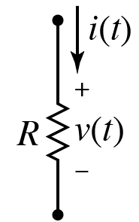
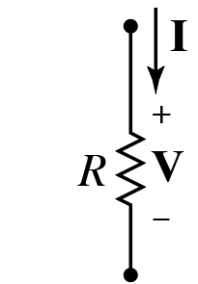
$i$-$v$ Relationships in Sinusoidal Steady State: Resistor
$$v\left(t\right)=Ri\left(t\right)$$
$$𝒫\left[v\left(t\right)\right]=𝒫\left[Ri\left(t\right)\right]$$
Take phasor transform of both sides.
$$V=RI$$
$$\frac{V}{I}=R$$
Time domain.
Frequency domain.
Ohm’s law in the frequency domain.
The angle (i.e., the “phase”) of $V$ and $I$ must be the same.
Resistance $R$ is real and scales magnitude but doesn’t change angle.

Slide 8
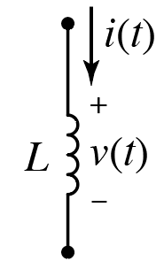
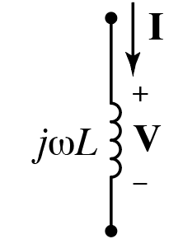
$i$-$v$ Relationships in Sinusoidal Steady State: Inductor
$$v\left(t\right)=L\frac{di\left(t\right)}{dt}$$
$$𝒫\left[v\left(t\right)\right]=𝒫\left[L\frac{di\left(t\right)}{dt}\right]$$
Take phasor transform of both sides.
$$V=jωLI$$
$$\frac{V}{I}=jωL$$
Time domain.
Frequency domain.
Ohm’s law in the frequency domain.
Current and voltage $90°$ out of phase (recall $j=e^{jπ/2}$).

Slide 9
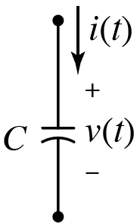
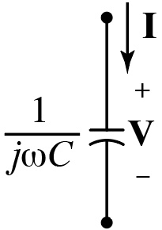
$i$-$v$ Relationships in Sinusoidal Steady State: Capacitor
$$i\left(t\right)=C\frac{dv\left(t\right)}{dt}$$
$$𝒫\left[i\left(t\right)\right]=𝒫\left[C\frac{dv\left(t\right)}{dt}\right]$$
Take phasor transform of both sides.
$$I=jωCV$$
$$\frac{V}{I}=\frac{1}{jωC}=−j\frac{1}{ωC}$$
$$\frac{V}{I}=\frac{1}{jωC}=−j\frac{1}{ωC}$$
Time domain.
Frequency domain.
$$\frac{1}{j}=\left(\frac{1}{j}\right)\left(\frac{j}{j}\right)=\frac{j}{−1}=−j$$
Ohm’s law in the frequency domain.
$$\frac{1}{j}=\left(\frac{1}{j}\right)\left(\frac{j}{j}\right)=\frac{j}{−1}=−j$$
$$\frac{1}{j}=\left(\frac{1}{j}\right)\left(\frac{j}{j}\right)=\frac{j}{−1}=−j$$
$$\frac{1}{j}=\left(\frac{1}{j}\right)\left(\frac{j}{j}\right)=\frac{j}{−1}=−j$$
Current and voltage $90°$ out of phase (recall $−j=e^{−jπ/2}$).

Slide 10
Impedance
For resistive circuits, given source values and resistances ($R=v/i$), can use algebra to solve for voltages and currents throughout the circuit.
For resistive circuits,
For resistive circuits, given source values and resistances ($R=v/i$),
For sinusoidal steady state,
For sinusoidal steady state, define impedance as the ratio of the voltage phasor to the current phasor:
$Z=V/I$.
For an arbitrary circuit in sinusoidal steady state, given source values and impedances ($Z=V/I$),
For an arbitrary circuit in sinusoidal steady state, given source values and impedances ($Z=V/I$), can use algebra to solve for voltages and currents throughout the circuit.
For an arbitrary circuit in sinusoidal steady state,
No more derivatives or integrals!
Algebra involves complex numbers.
Currents and voltages expressed in phasor form.

Slide 11
Impedance, Z
→ Ratio of Voltage to Current
(phasors)
Note: Passive sign convention is the same as always.
Change sign if current flows into the lower polarity terminal.
$$\frac{V}{I}=R$$
$$\frac{V}{I}=jωL$$
$$\frac{V}{I}=\frac{1}{jωC}=−j\frac{1}{ωC}$$
$$\frac{V}{I}=\frac{1}{jωC}=−j\frac{1}{ωC}$$
In general: $Z=V/I=R+jX$
or $V=IZ$
Units of ohms (Ω).
$R$ is the resistance (always positive for a passive circuit).
$X$ is the reactance (positive [inductive] or negative [capacitive]).
Aside: Impedance is a complex number, but not a phasor.

Slide 12
$$G=\frac{1}{R}$$
Inverse of resistance $R$ is conductance $G$.
$$V=IR$$
$$I=VG$$
Series resistances add.
Parallel conductances add.
$$Y=\frac{1}{Z}$$
Inverse of impedance $Z$is admittance $Y$.
$$V=IZ$$
$$I=VY$$
(To be shown in a bit.)
(To be shown in a bit.)
$$Z=R+jX$$
Series impedances add.
Parallel admittances add.
$$Y=G+jB$$
$G$ is conductance.
$B$ is susceptance.
Note! For complex impedances, $Y=1/Z$, but $G≠1/R$ and $B≠1/X$.
Complex conjugate of denominator.
$$\frac{1}{Z}=\frac{1}{R+jX}=\left(\frac{1}{R+jX}\right)\left(\frac{R−jX}{R−jX}\right)=\frac{R}{R^{2}+X^{2}}−j\frac{X}{R^{2}+X^{2}}=G+jB$$
$$\frac{1}{Z}=\frac{1}{R+jX}=\left(\frac{1}{R+jX}\right)\left(\frac{R−jX}{R−jX}\right)=\frac{R}{R^{2}+X^{2}}−j\frac{X}{R^{2}+X^{2}}=G+jB$$
$$\frac{1}{Z}=\frac{1}{R+jX}=\left(\frac{1}{R+jX}\right)\left(\frac{R−jX}{R−jX}\right)=\frac{R}{R^{2}+X^{2}}−j\frac{X}{R^{2}+X^{2}}=G+jB$$
$$\frac{1}{Z}=\frac{1}{R+jX}=\left(\frac{1}{R+jX}\right)\left(\frac{R−jX}{R−jX}\right)=\frac{R}{R^{2}+X^{2}}−j\frac{X}{R^{2}+X^{2}}=G+jB$$
$$\frac{1}{Z}=\frac{1}{R+jX}=\left(\frac{1}{R+jX}\right)\left(\frac{R−jX}{R−jX}\right)=\frac{R}{R^{2}+X^{2}}−j\frac{X}{R^{2}+X^{2}}=G+jB$$
$$G=\frac{R}{R^{2}+X^{2}}$$
$$B=−\frac{X}{R^{2}+X^{2}}$$
and

Slide 13
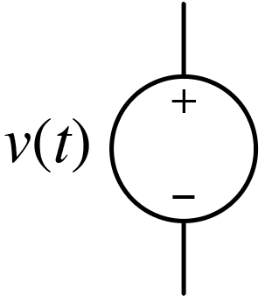
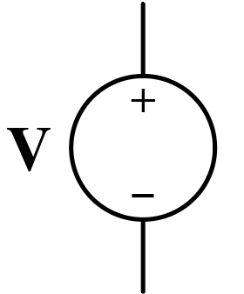
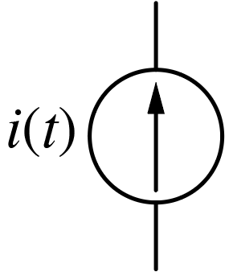
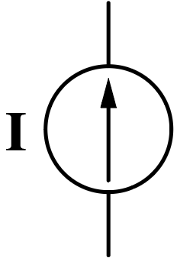
Phasor Specification of Sources
Notation: $Ae^{jθ}$ often written as $A∠θ$.
$$120∠30° V$$
$$=\left(60\sqrt{3}+j60\right) V$$
$$=120e^{jπ/6} V$$
$$=120∠π/6 V$$
$$120\cos\left(ωt+30°\right) V$$
Frequency $ω$ not explicitly shown.
$$7\cos\left(ωt+π/4\right) A$$
Must be provided separately.
$$7∠45° A$$
$$=\left(7/{\sqrt{2}}+j7/{\sqrt{2}}\right) A$$
$$=7e^{jπ/4} A$$
Phasors most often (and most conveniently) expressed in polar form.
$$=7∠π/4 A$$

Slide 14
Phasor Specification of Sources
$$60∠0° V$$
$$60\cos\left(ωt\right) V$$
Note that $60∠0°$ is the same as the purely real number $60$.
So why not just write “$60 V$”?
You can, but the “$∠0°$” serves as a reminder that this is a sinusoidal voltage rather than a constant one.
You can, but the “$∠0°$” serves as a reminder that this is a sinusoidal voltage rather than a constant one.
NOTE: $ωt$ is radians. Convert any phase shift to radians before adding to $ωt$. Ensure calculator in radian mode as appropriate.
NOTE: $ωt$ is radians. Convert any phase shift to radians before adding to $ωt$. Ensure calculator in radian mode as appropriate.
NOTE: $ωt$ is radians. Convert any phase shift to radians before adding to $ωt$. Ensure calculator in radian mode as appropriate.

Slide 15
Circuit Analysis
Bottom line: Represent sources in terms of their phasors, represent elements in terms of their impedances,
Bottom line: Represent sources in terms of their phasors, represent elements in terms of their impedances, solve for unknown quantities exactly as you would with a resistive circuit.
Bottom line: Represent sources in terms of their phasors,
All the circuit analysis techniques previously considered for resistive circuits with constant sources
All the circuit analysis techniques previously considered for resistive circuits with constant sources pertain to ones with impedance and phasors
All the circuit analysis techniques previously considered for resistive circuits with constant sources pertain to ones with impedance and phasors (simply use complex numbers instead of real ones!).
(Will consider power later.)

Slide 16
time domain
KVL:
$$v_{1}+v_{2}+⋯+v_{n}=0$$
Aside: $𝒫\left[ \right]$ is a linear operator.
$$𝒫\left[v_{1}+v_{2}+⋯+v_{n}\right]=0$$
$$𝒫\left[Av_{1}+Bv_{2}\right]=𝒫\left[Av_{1}\right]+𝒫\left[Bv_{2}\right]$$
frequency domain
$$V_{1}+V_{2}+⋯+V_{n}=0$$
$$=AV_{1}+BV_{2}$$
Sum of voltage phasors around a closed loop must be zero.
KCL:
$$i_{1}+i_{2}+⋯+i_{n}=0$$
$$𝒫\left[i_{1}+i_{2}+⋯+i_{n}\right]=0$$
$$I_{1}+I_{2}+⋯+I_{n}=0$$
Sum of current phasors into or out of a node must be zero.
Or, sum of phasors into a node equals sum of phasors out.

Slide 17
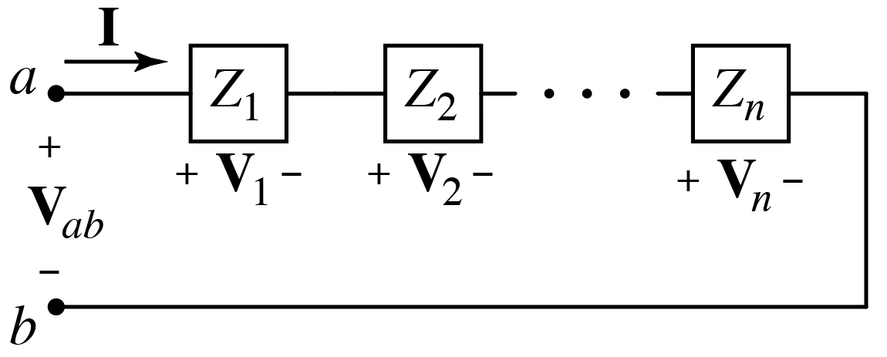
Series Elements
Voltage Division
$$V_{k}=Z_{k}I=Z_{k}\frac{V_{ab}}{Z_{eq}}=\frac{Z_{k}}{Z_{eq}}V_{ab}$$
$$V_{k}=Z_{k}I=Z_{k}\frac{V_{ab}}{Z_{eq}}=\frac{Z_{k}}{Z_{eq}}V_{ab}$$
$$V_{k}=Z_{k}I=Z_{k}\frac{V_{ab}}{Z_{eq}}=\frac{Z_{k}}{Z_{eq}}V_{ab}$$
Same form as we had with resistances.
$$V_{ab}=Z_{1}I+Z_{2}I+⋯+Z_{n}I$$
$$V_{ab}=\left(Z_{1}+Z_{2}+⋯+Z_{n}\right)I=Z_{eq}I$$
$$V_{ab}=\left(Z_{1}+Z_{2}+⋯+Z_{n}\right)I=Z_{eq}I$$
$$Z_{eq}=Z_{1}+Z_{2}+⋯+Z_{n}$$
Series impedances add.
Note: Doesn’t matter if a $Z$ is due to $R$, $L$, or $C$.
All combine in the same way!

Slide 18
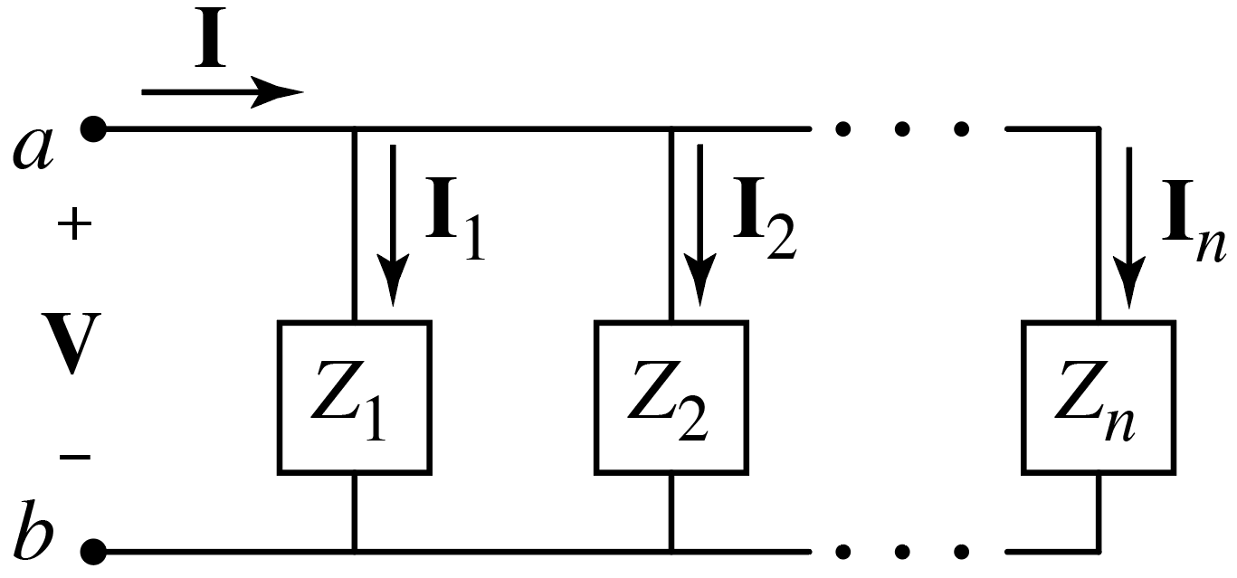
Parallel Elements
Current Division
$$I_{k}=\frac{V}{Z_{k}}=\frac{IZ_{eq}}{Z_{k}}=\frac{Z_{eq}}{Z_{k}}I$$
$$I_{k}=\frac{V}{Z_{k}}=\frac{IZ_{eq}}{Z_{k}}=\frac{Z_{eq}}{Z_{k}}I$$
$$I_{k}=\frac{V}{Z_{k}}=\frac{IZ_{eq}}{Z_{k}}=\frac{Z_{eq}}{Z_{k}}I$$
Same form as we had with resistances.
$$I=\frac{V}{Z_{1}}+\frac{V}{Z_{2}}+⋯+\frac{V}{Z_{n}}$$
Parallel admittances add.
$$Y_{eq}=Y_{1}+Y_{2}+⋯+Y_{n}$$
$$I=\left(\frac{1}{Z_{1}}+\frac{1}{Z_{2}}+⋯+\frac{1}{Z_{n}}\right)V=\frac{1}{Z_{eq}}V=\left(Y_{1}+Y_{2}+⋯+Y_{n}\right)V=Y_{eq}V$$
$$I=\left(\frac{1}{Z_{1}}+\frac{1}{Z_{2}}+⋯+\frac{1}{Z_{n}}\right)V=\frac{1}{Z_{eq}}V=\left(Y_{1}+Y_{2}+⋯+Y_{n}\right)V=Y_{eq}V$$
$$I=\left(\frac{1}{Z_{1}}+\frac{1}{Z_{2}}+⋯+\frac{1}{Z_{n}}\right)V=\frac{1}{Z_{eq}}V=\left(Y_{1}+Y_{2}+⋯+Y_{n}\right)V=Y_{eq}V$$
$$I=\left(\frac{1}{Z_{1}}+\frac{1}{Z_{2}}+⋯+\frac{1}{Z_{n}}\right)V=\frac{1}{Z_{eq}}V=\left(Y_{1}+Y_{2}+⋯+Y_{n}\right)V=Y_{eq}V$$
$$\frac{1}{Z_{eq}}=\frac{1}{Z_{1}}+\frac{1}{Z_{2}}+⋯+\frac{1}{Z_{n}}$$
Parallel impedance combine like parallel resistors: inverse of sum of inverses.

