Slide 1
EE 261, Spring 2025, Lecture 36
Goals/Topics:
More circuit fundamentals (sinusoidal steady-state)
More complex number fundamentals
(MATLAB tools)
Phasor conversion
Circuit analysis examples
Best viewed in
presentation mode
in PowerPoint.
Announcements:
Homework 12 due Sunday, Apr. 20th.
Final exam Wednesday, Apr. 30, 1:30 p.m. to 3:30+ p.m. (Fulmer 226).
And…

Slide 2



Slide 3
Recall:
(in phasor form)
Impedances are just like resistances: ratio of voltage to current.
Impedances are just like resistances: ratio of voltage to current.
Series impedances add.
Equivalent of parallel impedances is inverse of sum of inverses.
(Product over sum works for two—and only two— parallel
impedances.)
Keep in mind impedances can have positive or negative imaginary
parts (and imaginary parts associated with energy storage, not
energy consumption).
Keep in mind impedances can have positive or negative imaginary
parts (and imaginary parts associated with energy storage, not
energy consumption).

Slide 4
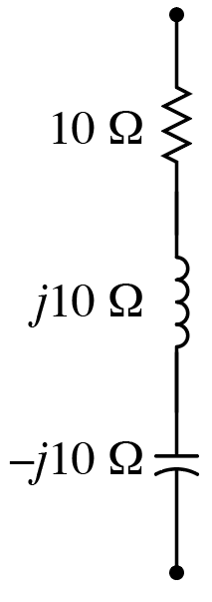
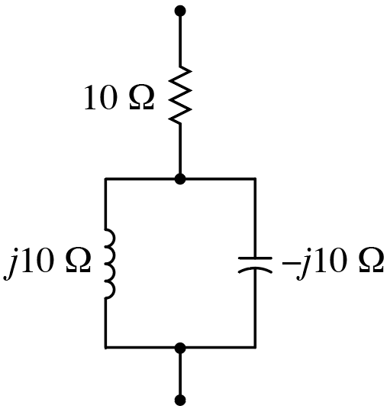

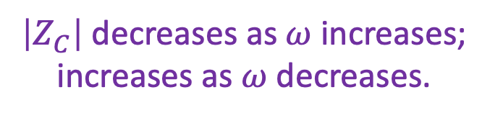

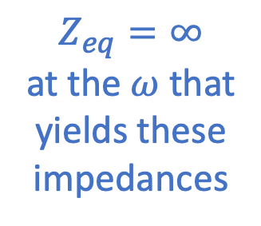
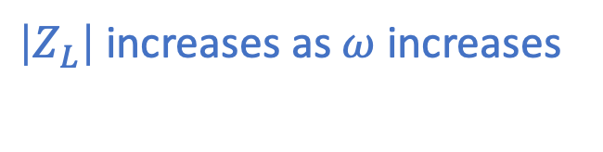
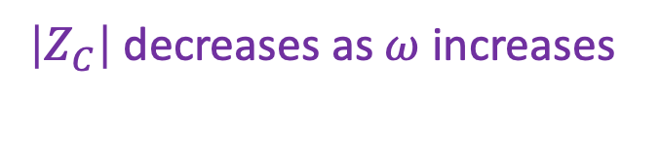
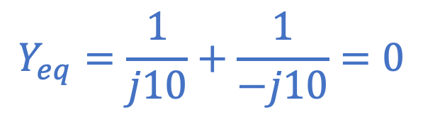

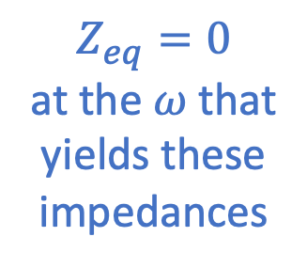
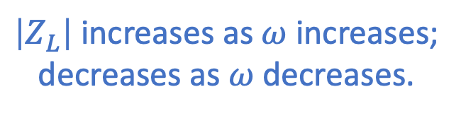

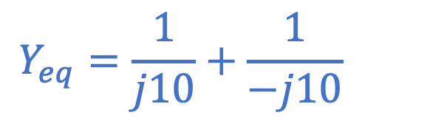

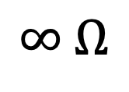
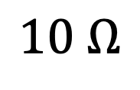
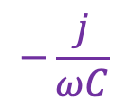
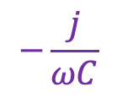
What is equivalent impedance for the following?
$$Y_{eq}=\frac{1}{j10}+\frac{1}{−j10}=0$$
$$Y_{eq}=\frac{1}{j10}+\frac{1}{−j10}=0$$
$\left|Z_{L}\right|$ increases as $ω$ increases;
decreases as $ω$ decreases.
$\left|Z_{L}\right|$ increases as $ω$ increases;
decreases as $ω$ decreases.
$$Z_{eq}=\frac{1}{Y_{eq}}$$
}
}
$$Z_{eq}=0$$
at the $ω$ that
yields these
impedances
$$Z_{eq}=∞$$
at the $ω$ that
yields these
impedances
Cancel
$$jωL$$
$$jωL$$
$$−\frac{j}{ωC}$$
$\left|Z_{C}\right|$ decreases as $ω$ increases;
increases as $ω$ decreases.
$$−\frac{j}{ωC}$$
$\left|Z_{C}\right|$ decreases as $ω$ increases;
increases as $ω$ decreases.
$$Z_{eq}=$$
$$10 Ω$$
$$Z_{eq}=$$
$$∞ Ω$$
A) $10 Ω$, B) $0 Ω$, C) $∞ Ω$, D) $10+j20 Ω$, E) None of these.
Way in which impedance changes for changes
in frequencies key to creating “filters.”
Circuits II

Slide 5
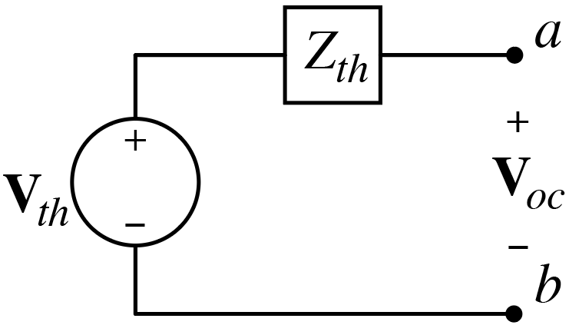
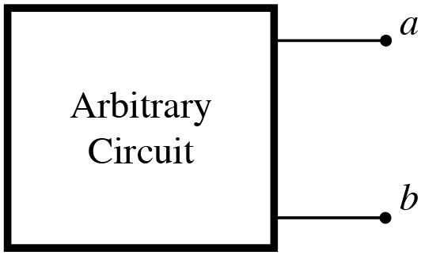
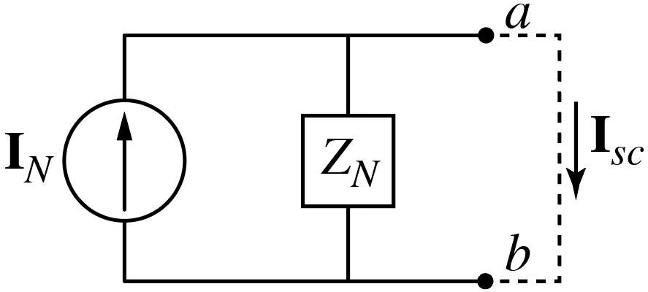
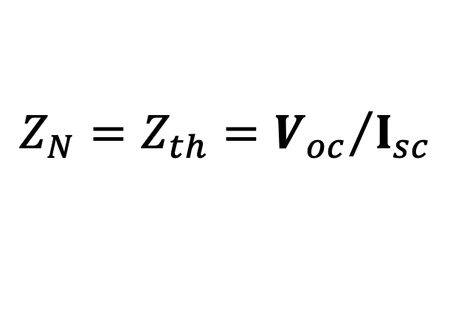
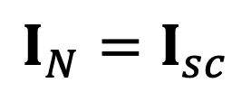
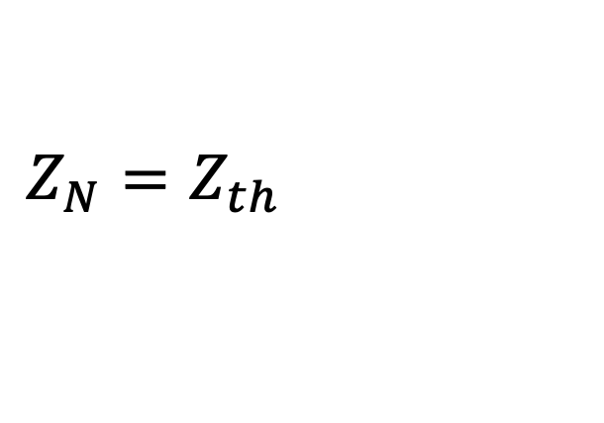
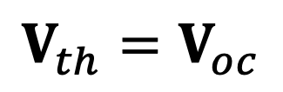
Equivalent Circuits
Any arrangement of sources and impedances can be reduced to
a single impedance and a single source.
Thévenin equivalent.
$$V_{th}=V_{oc}$$
$$I_{N}=I_{sc}$$
$$Z_{N}=Z_{th}={V_{oc}}/{I_{sc}}$$
$$Z_{N}=Z_{th}={V_{oc}}/{I_{sc}}$$
Norton equivalent.

Slide 6
Recall, for sinusoidal steady state:
All the circuit analysis techniques previously considered for resistive
circuits with constant sources pertain to ones with impedance and
phasors (simply use complex numbers instead of real ones).
KVL, KCL, voltage division, current division, … $→$ All the same as before.
Series impedances add.
(But with complex numbers.)
Parallel impedance combine as inverse of sum of inverses.
Thévenin and Norton equivalent circuits: Same as before (but with
phasors and impedances, i.e., complex numbers).
Node-voltage and mesh-current analysis: Same as before (but with
phasors and impedances, i.e., complex numbers).

Slide 7
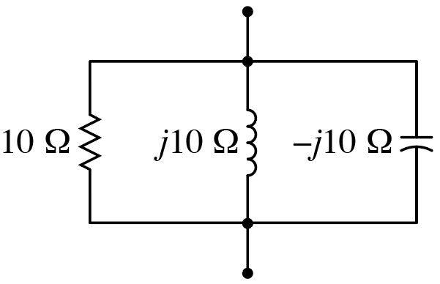

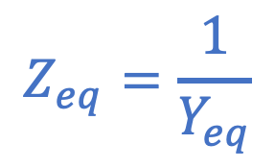
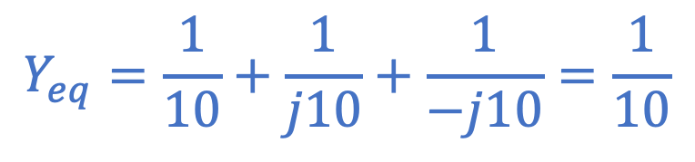
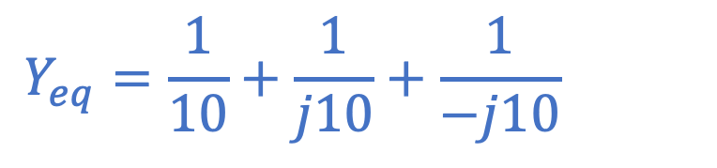
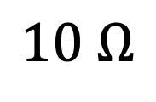
What is equivalent impedance for the following?
Anything in parallel with
an open circuit appears
as that “anything.”
Parallel combination
appears as an open circuit.
$$Y_{eq}=\frac{1}{10}+\frac{1}{j10}+\frac{1}{−j10}=\frac{1}{10}$$
$$Y_{eq}=\frac{1}{10}+\frac{1}{j10}+\frac{1}{−j10}=\frac{1}{10}$$
$$Z_{eq}=\frac{1}{Y_{eq}}$$
$$Z_{eq}=$$
$$10 Ω$$
A) $10 Ω$, B) $0 Ω$, C) $∞ Ω$, D) $10+j20 Ω$, E) None of these.

Slide 8
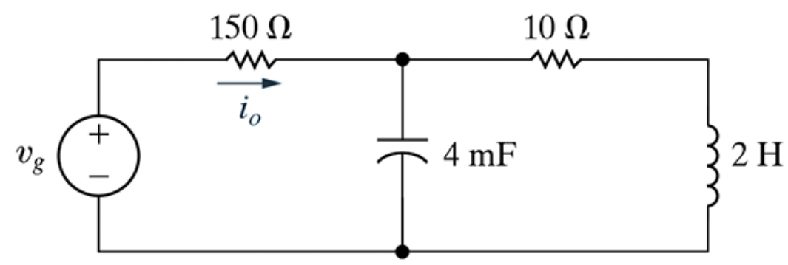
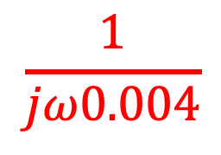
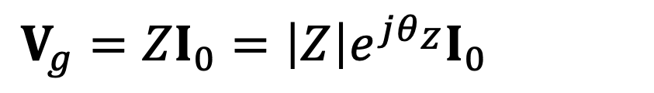

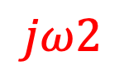
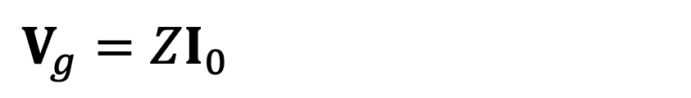
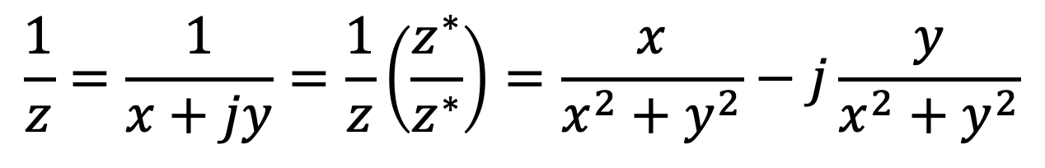
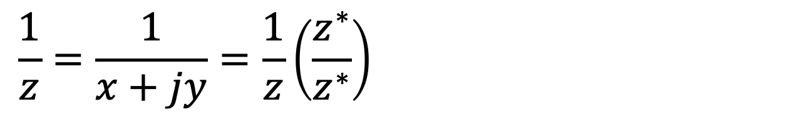
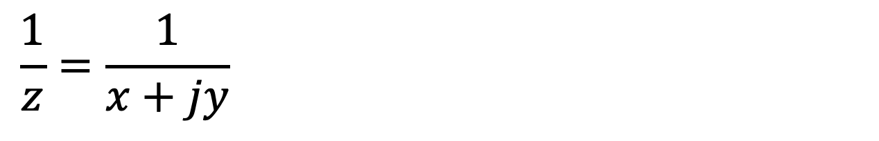

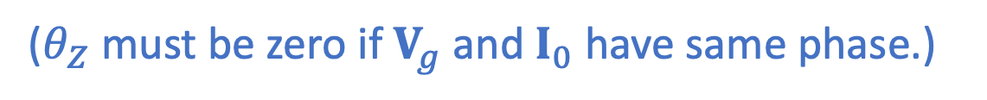


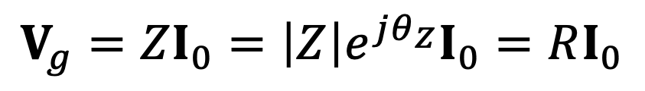
N&R Prob. 9.34
(HW Mastering.)
At what frequency is $i_{0}$
in phase with $v_{g}$?
$$10$$
$$\frac{1}{jω0.004}$$
$$jω2$$
Impedance seen by
source must be purely real.
$$V_{g}=ZI_{0}=\left|Z\right|e^{jθ_{Z}}I_{0}=RI_{0}$$
$$V_{g}=ZI_{0}=\left|Z\right|e^{jθ_{Z}}I_{0}=RI_{0}$$
$$V_{g}=ZI_{0}=\left|Z\right|e^{jθ_{Z}}I_{0}=RI_{0}$$
($θ_{Z}$ must be zero if $V_{g}$ and $I_{0}$ have same phase.)
Does $150 Ω$ resistor factor into solution?
No.
Need equivalent impedance of remaining elements to be purely real.
If impedance is purely real, admittance $\left(Y=1/Z\right)$ is purely real.
$$\frac{1}{z}=\frac{1}{x+jy}=\frac{1}{z}\left(\frac{z^{∗}}{z^{∗}}\right)=\frac{x}{x^{2}+y^{2}}−j\frac{y}{x^{2}+y^{2}}$$
$$\frac{1}{z}=\frac{1}{x+jy}=\frac{1}{z}\left(\frac{z^{∗}}{z^{∗}}\right)=\frac{x}{x^{2}+y^{2}}−j\frac{y}{x^{2}+y^{2}}$$
Following may
come in handy:
$$\frac{1}{z}=\frac{1}{x+jy}=\frac{1}{z}\left(\frac{z^{∗}}{z^{∗}}\right)=\frac{x}{x^{2}+y^{2}}−j\frac{y}{x^{2}+y^{2}}$$
What frequency makes total admittance real (susceptance zero)?

Slide 9
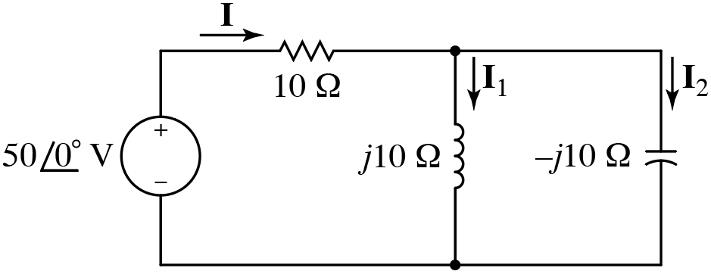
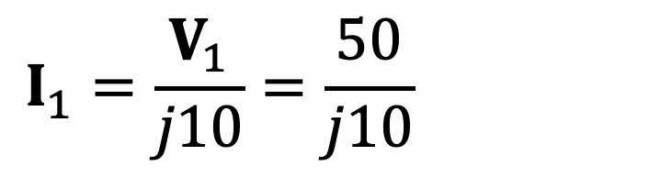
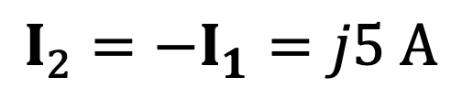
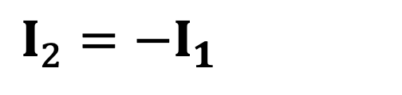
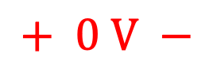

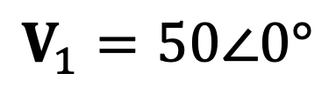
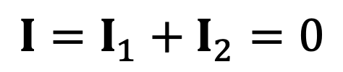
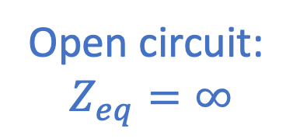


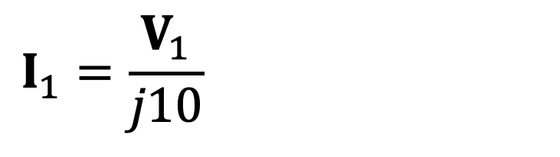








Consider:
$$+ 0 V −$$
Open circuit:
$Z_{eq}=∞$
$$50\cos\left(ωt\right)$$
$$+$$
$$V_{1}$$
$$−$$
Recall Ohm’s Law:
$$V=IZ$$
Recall KVL.
Same as just “$50 V$”
but angle emphasizes
this is a phasor.
$$I_{1}=\frac{V_{1}}{j10}=\frac{50}{j10}=−j5 A$$
In time domain?
$$I_{1}=\frac{V_{1}}{j10}=\frac{50}{j10}=−j5 A$$
$$I_{1}=\frac{V_{1}}{j10}=\frac{50}{j10}=−j5 A$$
$$V_{1}=50∠0°$$
$$i_{1}\left(t\right)=5\sin\left(ωt\right)$$
D
C
?
?
$$I=$$
$$0$$
$$I_{1}=$$
$$−j5 A$$
$$I=I_{1}+I_{2}=0$$
$$I=I_{1}+I_{2}=0$$
$$I_{2}=−I_{1}=j5 A$$
$$I_{2}=−I_{1}=j5 A$$
A) $5 A$, B) $j5 A$, C) $−j5 A$, D) $0$, E) None of these.
In steady state, inductor and capacitor exchange energy, but they do not draw any
energy from source. Energy got to inductor and capacitor in a prior transient.
In steady state, inductor and capacitor exchange energy, but they do not draw any
energy from source. Energy got to inductor and capacitor in a prior transient.

Slide 10













Phasor Transforms:
?
$$𝒫\left[A\cos\left(ωt+θ\right)+B\sin\left(ωt+φ\right)\right]=$$
Want a single complex number that gives magnitude and phase of
the sum of these two functions.
Recall:
$$e^{jωt}=\cos\left(ωt\right)+j\sin\left(ωt\right)$$
Euler’s formula.
$$ℜ\left[e^{jωt}\right]=\cos\left(ωt\right)$$
$$ℜ\left[e^{jωt}\right]=\cos\left(ωt\right)$$
$$ℜ\left[−je^{jωt}\right]=\sin\left(ωt\right)$$
$$ℜ\left[−je^{jωt}\right]=\sin\left(ωt\right)$$
$$ℜ\left[Ae^{jωt}\right]=A\cos\left(ωt\right)$$
$$ℜ\left[{−jBe}^{jωt}\right]=B\sin\left(ωt\right)$$
$$ℜ\left[Ae^{jθ}e^{jωt}\right]=A\cos\left(ωt+θ\right)$$
$$ℜ\left[−jBe^{jφ}e^{jωt}\right]=B\sin\left(ωt+φ\right)$$
$$𝒫\left[A\cos\left(ωt+θ\right)\right]=Ae^{jθ}$$
$$𝒫\left[B\sin\left(ωt+φ\right)\right]=−jBe^{jφ}$$
$$=Be^{j\left(φ−π/2\right)}$$

Slide 11




Phasor Transforms:
?
$$𝒫\left[A\cos\left(ωt+θ\right)+B\sin\left(ωt+φ\right)\right]=$$
$$𝒫\left[v_{1}\left(t\right)+v_{2}\left(t\right)\right]=𝒫\left[v_{1}\left(t\right)\right]+𝒫\left[v_{2}\left(t\right)\right]=V_{1}+V_{2}$$
$$𝒫\left[v_{1}\left(t\right)+v_{2}\left(t\right)\right]=𝒫\left[v_{1}\left(t\right)\right]+𝒫\left[v_{2}\left(t\right)\right]=V_{1}+V_{2}$$
$$𝒫\left[v_{1}\left(t\right)+v_{2}\left(t\right)\right]=𝒫\left[v_{1}\left(t\right)\right]+𝒫\left[v_{2}\left(t\right)\right]=V_{1}+V_{2}$$
$$𝒫\left[A\cos\left(ωt+θ\right)\right]=Ae^{jθ}$$
$$𝒫\left[B\sin\left(ωt\right)\right]=−jB=Be^{−jπ/2}$$
$$𝒫\left[B\sin\left(ωt\right)\right]=−jB=Be^{−jπ/2}$$
Aside: This shows that $\sin\left(ωt\right)=\cos\left(ωt−π/2\right)$
$$𝒫\left[B\sin\left(ωt+φ\right)\right]=−jBe^{jφ}=Be^{j\left(φ−π/2\right)}$$
$$𝒫\left[B\sin\left(ωt+φ\right)\right]=−jBe^{jφ}=Be^{j\left(φ−π/2\right)}$$
$$𝒫\left[A\cos\left(ωt+θ\right)+B\sin\left(ωt+φ\right)\right]=Ae^{jθ}+Be^{j\left(φ−π/2\right)}$$
Add two terms on right side and express the result in polar form.

Slide 12










Example: $v\left(t\right)=5\cos\left(ωt+π/6\right)+14\sin\left(ωt+37°\right)$
What is $V$?
What is $v\left(t\right)$ (as a single sinusoid)?
Recall: $𝒫\left[A\cos\left(ωt+θ\right)+B\sin\left(ωt+φ\right)\right]=Ae^{jθ}+Be^{j\left(φ−π/2\right)}$
Using MATLAB to add phasors:
5*exp(j*pi/6) + 14*exp(j*(deg2rad(37) - pi/2))
5*exp(j*pi/6) + 14*exp(j*(deg2rad(37) - pi/2))
12.7555 – 8.6809i
But, want polar form, i.e., $\left|V\right|∠V$.
abs(12.7555 – 8.6809i)
15.4292
$$=\left|V\right|$$
rad2deg(angle(12.7555 – 8.6809i))
$$=∠V$$
rad2deg(angle(12.7555 – 8.6809i))
-34.2377$°$
Careful! Mix of radians and degrees.
$V=15.4∠$ $−34.2°$
and
$v\left(t\right)=15.4\cos\left(ωt−34.2°\right)$
Aside: $15.4≠\sqrt{5^{2}+{14}^{2}}$

Slide 13








Phasor Transforms:
?
$$𝒫\left[A\cos\left(ω_{1}t+θ\right)+B\sin\left(ω_{2}t+φ\right)\right]=$$
Cannot combine phasors at different frequencies!
$$𝒫\left[−6\cos\left(3πt+π/8\right)\right]=−6e^{jπ/8}=6e^{±jπ}e^{jπ/8}=6e^{j{9π}/8}$$
$$𝒫\left[−6\cos\left(3πt+π/8\right)\right]=−6e^{jπ/8}=6e^{±jπ}e^{jπ/8}=6e^{j{9π}/8}$$
$$𝒫\left[−6\cos\left(3πt+π/8\right)\right]=−6e^{jπ/8}=6e^{±jπ}e^{jπ/8}=6e^{j{9π}/8}$$
$$𝒫\left[−6\cos\left(3πt+π/8\right)\right]=−6e^{jπ/8}=6e^{±jπ}e^{jπ/8}=6e^{j{9π}/8}$$
$=6∠202.5°=6e^{−j7π/8}=6∠$ $−157.5°$
$=6∠202.5°=6e^{−j7π/8}=6∠$ $−157.5°$
$=6∠202.5°=6e^{−j7π/8}=6∠$ $−157.5°$
All of these
are acceptable.
Typically the “sign” is incorporated in the phase.
$$−1=e^{+jπ}=e^{−jπ}$$

Slide 14














Consider:
$$ω$$
$$v_{s}\left(t\right)=25\sin\left(4000 t\right) V$$
$i_{o}\left(t\right)=$ ?
Use frequency domain!
$$j10 Ω$$
$$−j25 V$$
$$−j20 Ω$$
$$V_{s}=−j25 V$$
$$Z_{L}=jωL=j4000×0.0025=j10 Ω$$
$$Z_{L}=jωL=j4000×0.0025=j10 Ω$$
$$Z_{L}=jωL=j4000×0.0025=j10 Ω$$
$$Z_{C}={−j}/{\left(ωC\right)}={−j}/{\left(4000×12.5×{10}^{−6}\right)}=−j20 Ω$$
$$Z_{C}={−j}/{\left(ωC\right)}={−j}/{\left(4000×12.5×{10}^{−6}\right)}=−j20 Ω$$
$$Z_{C}={−j}/{\left(ωC\right)}={−j}/{\left(4000×12.5×{10}^{−6}\right)}=−j20 Ω$$

