Slide 1
EE 261, Spring 2025, Lecture 38
Goals/Topics:
Ideal transformers
Instantaneous (and average) power
Best viewed in
presentation mode
in PowerPoint.
Announcements:
HW 13 due Sunday, Apr. 27th (last one!).
Final exam Wednesday, Apr. 30, 1:30 to 3:30+ p.m., Fulmer 226.
Review session, Tuesday, Apr. 29, 6:10 p.m., Sloan 175.
Course evaluations open. 1% added to overall score for individuals
who complete survey.

Slide 2
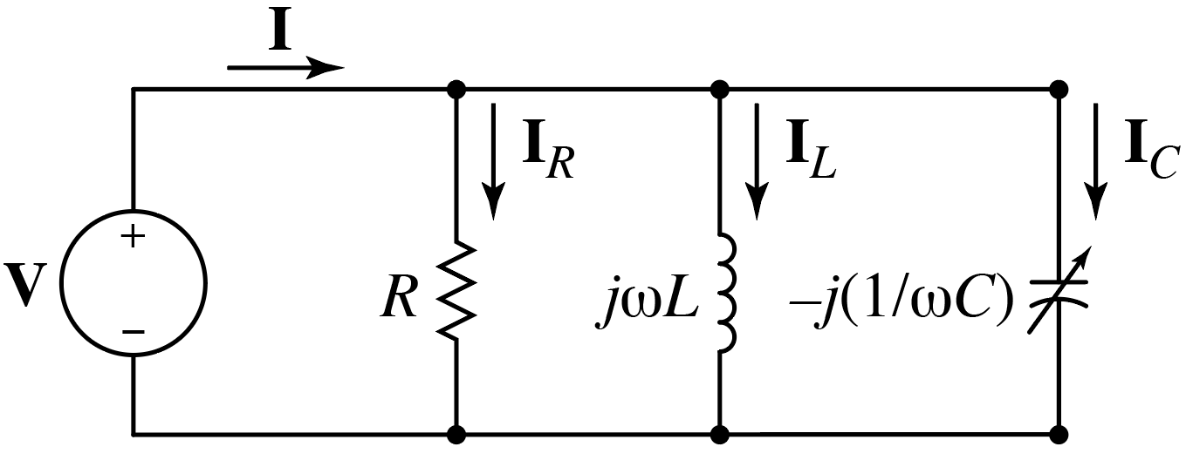
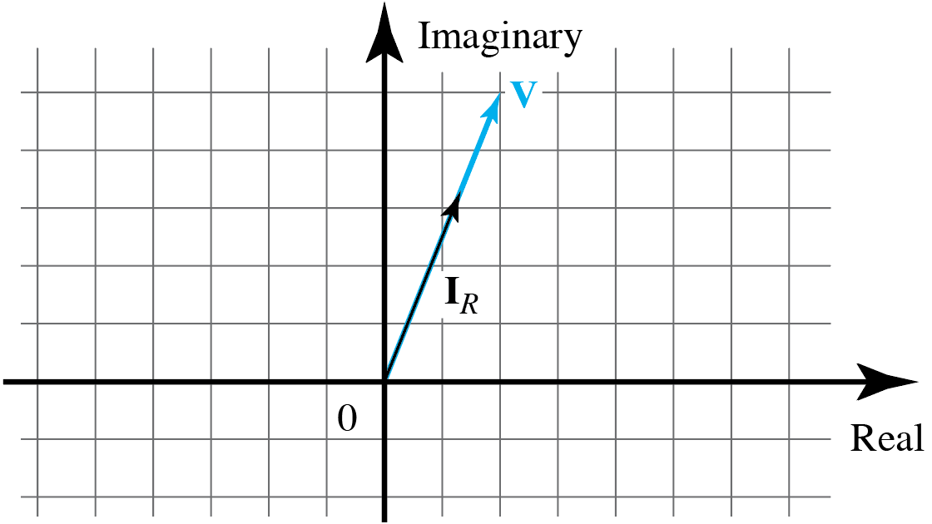
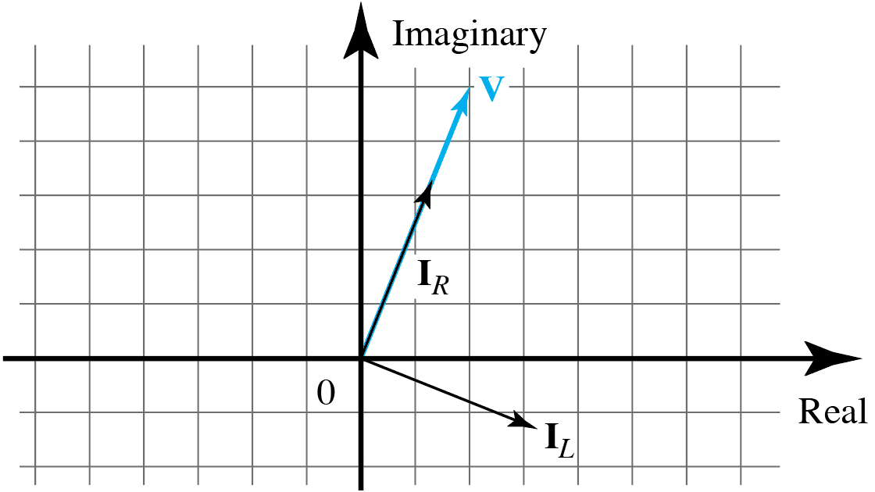
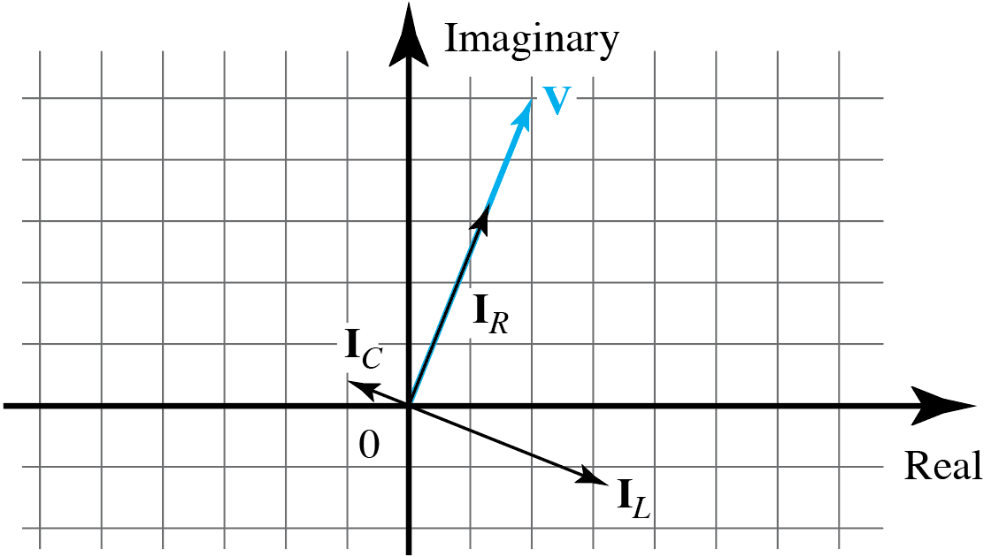
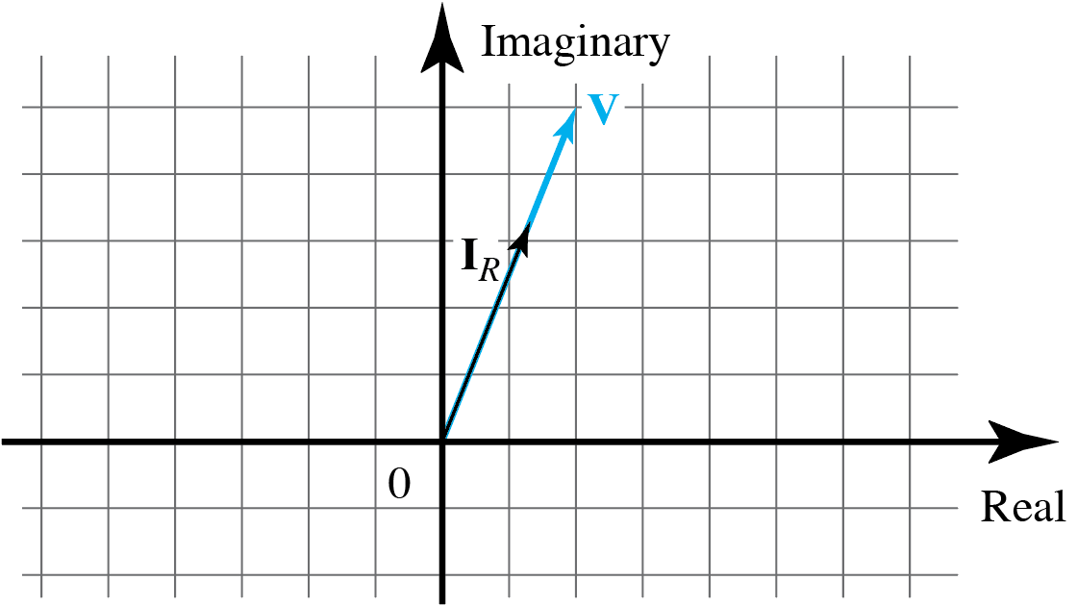
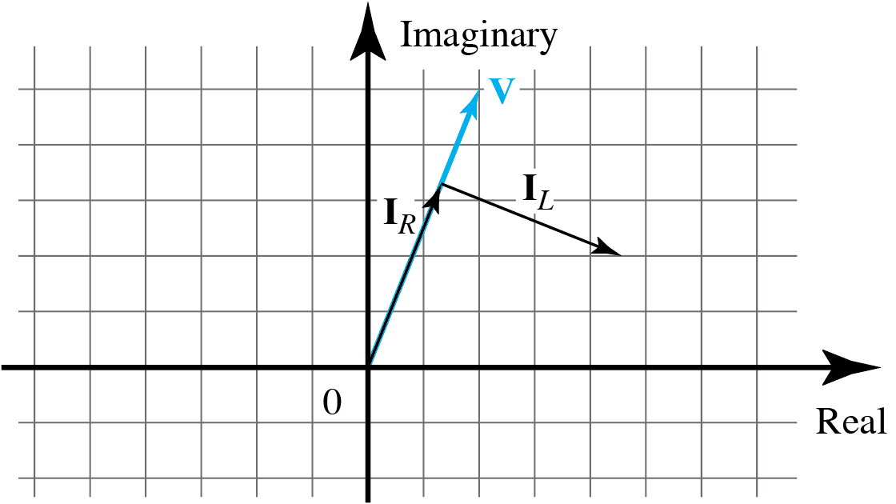
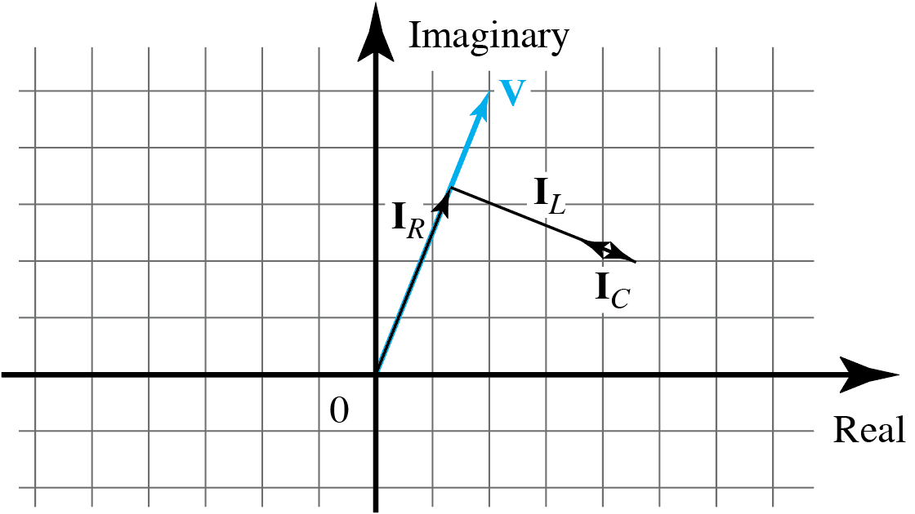
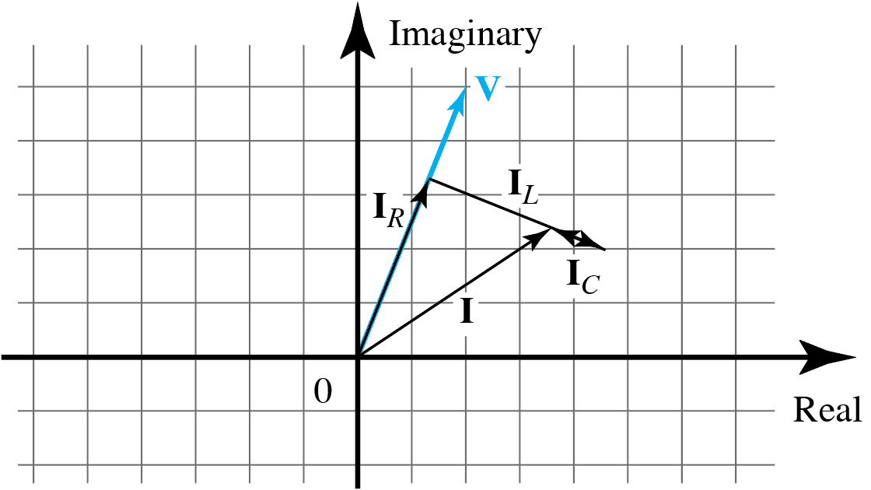
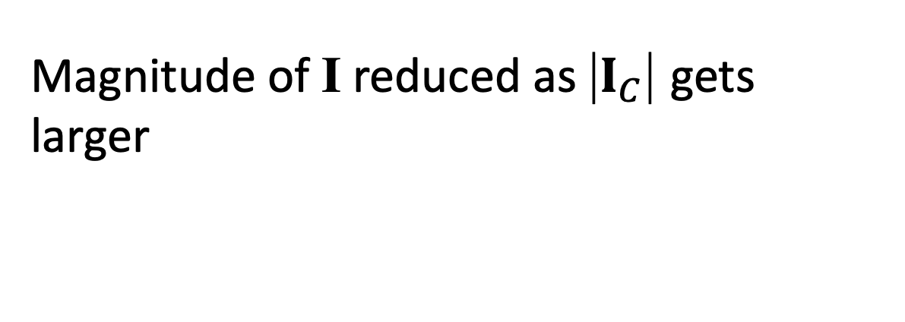
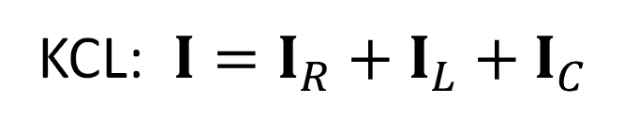
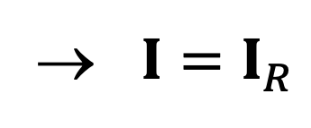
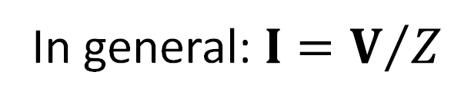
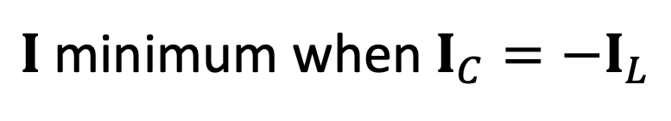

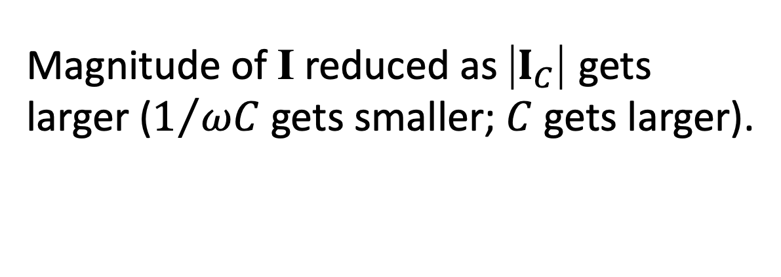
Phasor Diagram: Parallel Circuit, Variable Capacitor
KCL: $I=I_{R}+I_{L}+I_{C}$
Magnitude of I reduced as |$I_{C}$| gets larger ($1/{ωC}$ gets smaller; $C$ gets larger).
Magnitude of I reduced as |$I_{C}$| gets larger ($1/{ωC}$ gets smaller; $C$ gets larger).
Ideally $I_{C}$is such that $I$is minimized.
In general: $I=V/Z$
$I$minimum when $I_{C}={−I}_{L}$
→ $I=I_{R}$

Slide 3
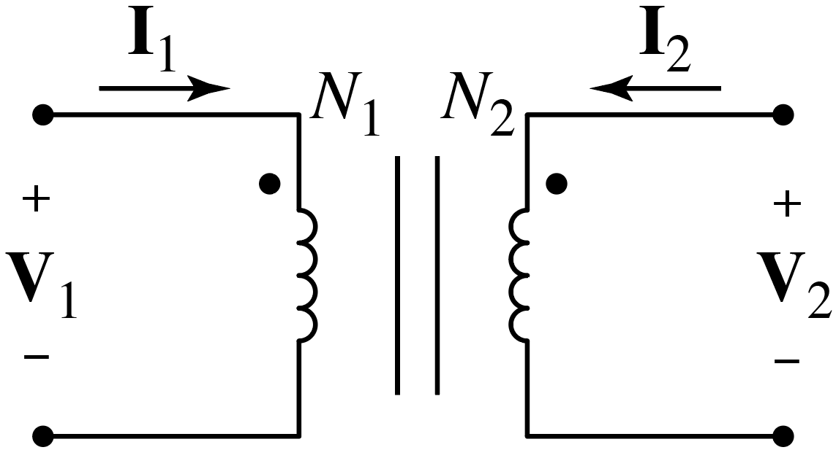
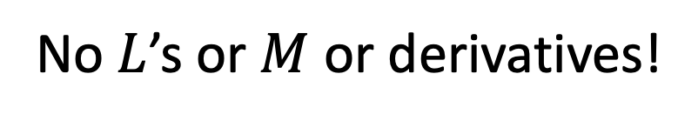
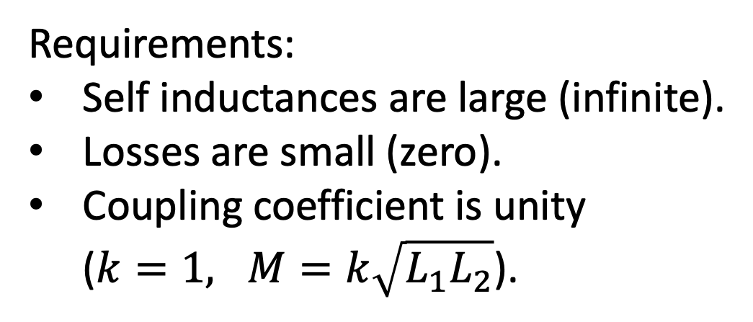
Ideal Transformer
Previously consider mutually coupled inductors.
Under certain circumstances, in sinusoidal steady state, voltage and
current phasors in the inductors (coils) can simply be related by the
“turns ratio.”
No $L$’s or $M$ or derivatives!
Circuit diagram:
Requirements:
Self inductances are large (infinite).
Losses are small (zero).
Coupling coefficient is unity
($k=1, M=k\sqrt{L_{1}L_{2}}$).
Although these cannot be exactly achieved, in practice it is possible
to get close to these conditions.
$N_{1}$ and $N_{2}$ are the number of turns in each inductor (coil).
(Several additional details in textbook but do not directly concern us. See Sec. 9.11.)

Slide 4
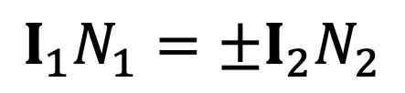
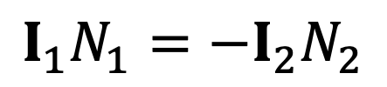
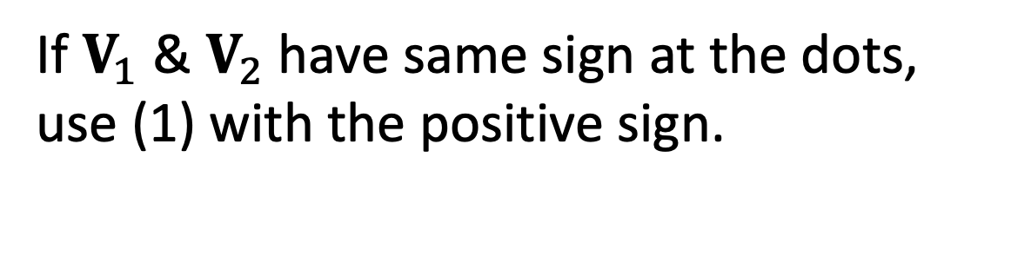
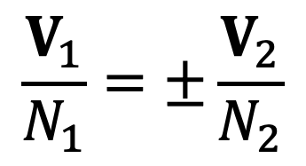
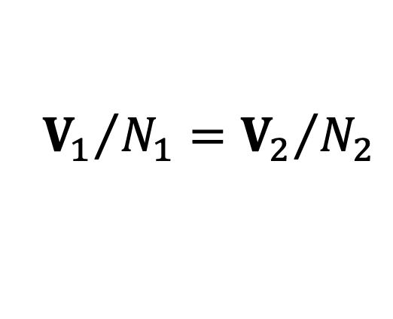
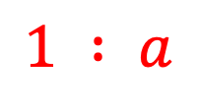
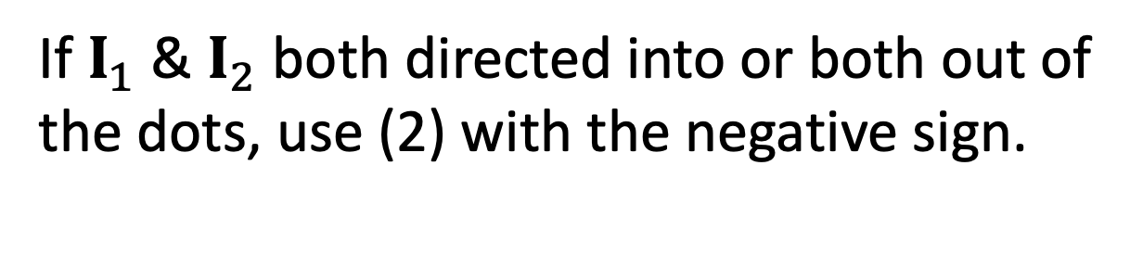
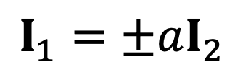
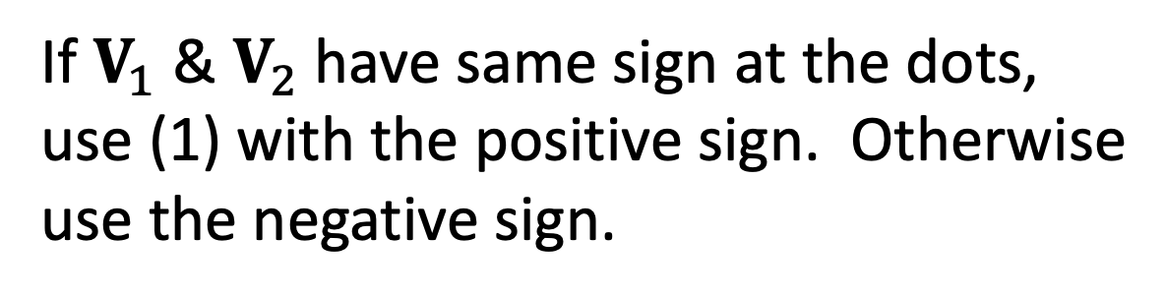
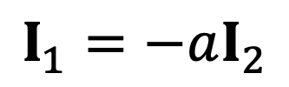
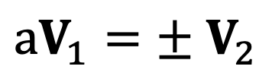
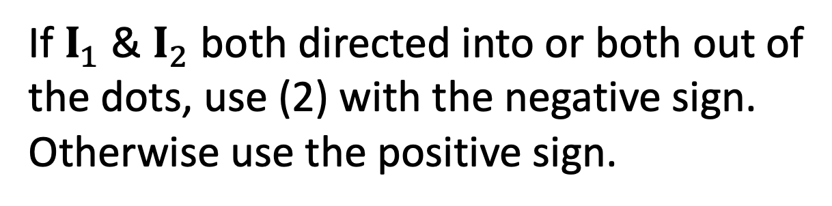
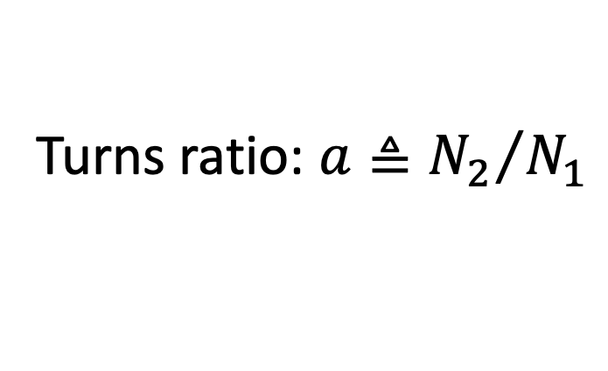
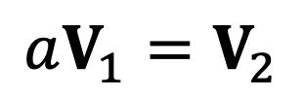
Ideal Transformer
$$\frac{V_{1}}{N_{1}}=±\frac{V_{2}}{N_{2}}$$
(1)
$$I_{1}N_{1}=±I_{2}N_{2}$$
(2)
Dot convention:
If $V_{1}$ & $V_{2}$have same sign at the dots,
use (1) with the positive sign. Otherwise
use the negative sign.
If $V_{1}$ & $V_{2}$have same sign at the dots,
use (1) with the positive sign. Otherwise
use the negative sign.
Circuit diagram:
$$1 : a$$
If $I_{1}$ & $I_{2}$ both directed into or both out of
the dots, use (2) with the negative sign.
Otherwise use the positive sign.
If $I_{1}$ & $I_{2}$ both directed into or both out of
the dots, use (2) with the negative sign.
Otherwise use the positive sign.
Turns ratio: $a≜{N_{2}}/{N_{1}}$
${aV}_{1}=±$ $V_{2}$
(1*)
&
$$I_{1}=±aI_{2}$$
(2*)
For transformer shown here:
$${V_{1}}/{N_{1}}={V_{2}}/{N_{2}}$$
or
$$aV_{1}=V_{2}$$
$$I_{1}N_{1}=−I_{2}N_{2}$$
or
$$I_{1}=−aI_{2}$$

Slide 5
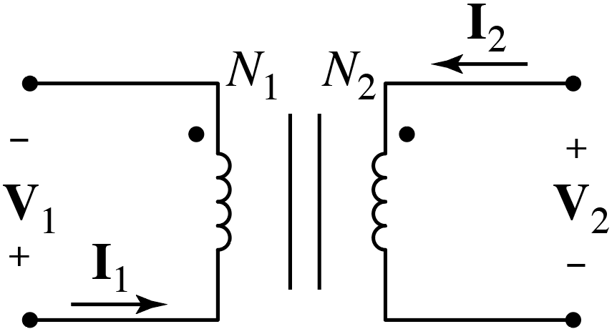
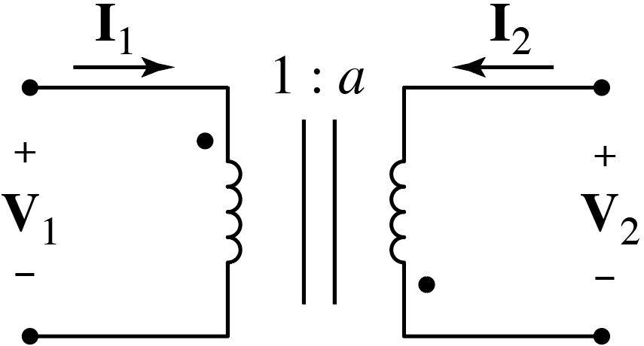
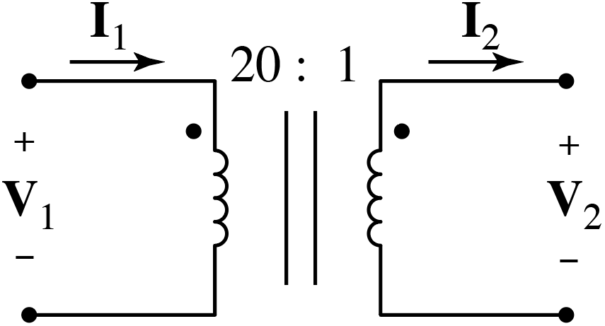
Ideal Transformer
V₁/N₁ = –V₂/N₂
I₁N₁ = I₂N₂
a V₁ = –V₂
I₁ = a I₂
a = 1/20
a = 7/3
(1/20)V₁ = V₂
I₁ = (1/20) I₂
(7/3)V₁ = –V₂
I₁ = –(7/3)I₂

Slide 6
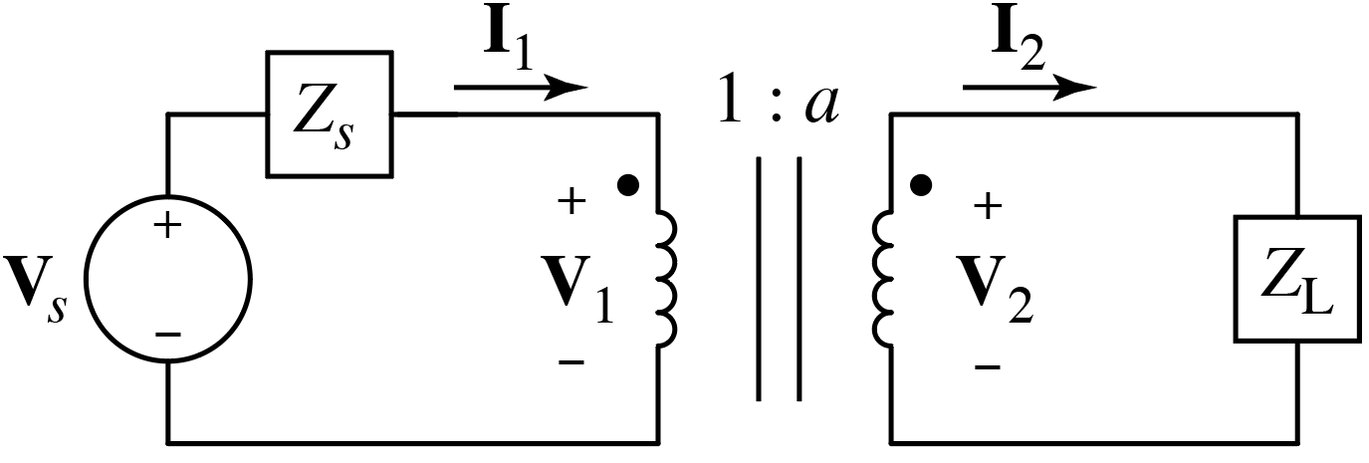

Transforming a Load
(Removing transformer.)
$$Z_{in}$$
Z_{in} = V₁/ I₁ = ?
Z_{in} = V₁/ I₁ = ?
Transformer
governing eq.
Ohm’s law.
I₂ = V₂ / Z_{L} = a V₁ / Z_{L}
V₂ = a V₁
I₂ = V₂ / Z_{L}
Z_{in} = Z_{L} / a²
Result is independent
of the dots and assumed
direction of currents and
polarity of voltages!
I₁ = a I₂ = a² V₁ / Z_{L}
I₁ = a I₂
Z_{in} = V₁/ I₁ = V₁/ (a² V₁ / Z_{L}) = Z_{L} / a²
Z_{in} = V₁/ I₁ = V₁/ (a² V₁ / Z_{L})
Z_{in} = V₁/ I₁
Turns ratio is the only thing that matters.

Slide 7
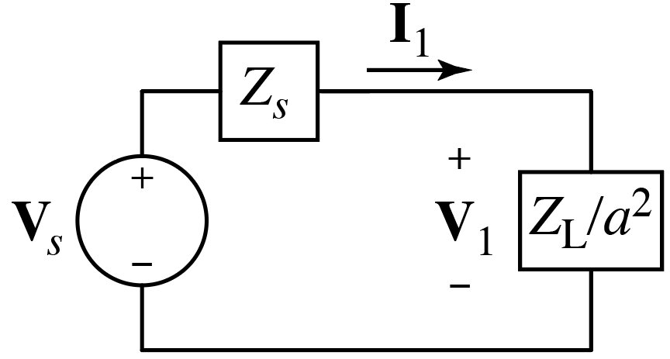

Transforming a Load
Can use a transformer
to match a load to the
source circuit for max
power transfer.
Impedance seen by source:
$$Z_{s}+Z_{L}/a^{2}$$
Transformers important in many other application (e.g., power distribution).

Slide 8
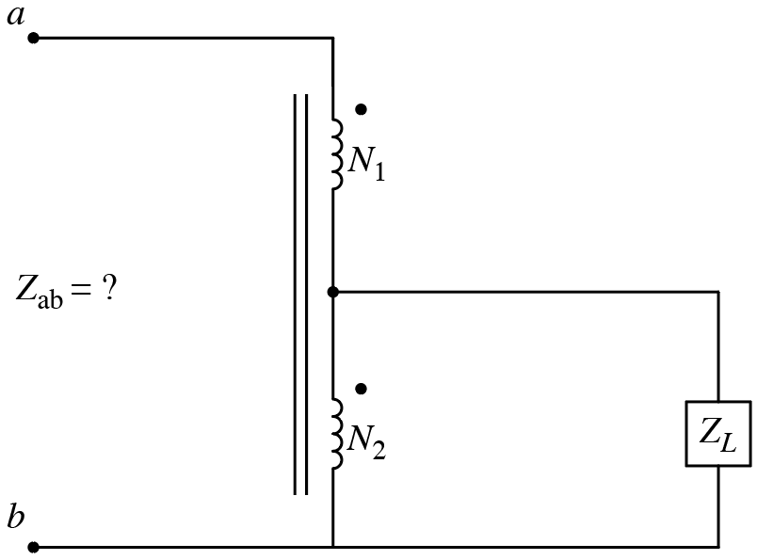
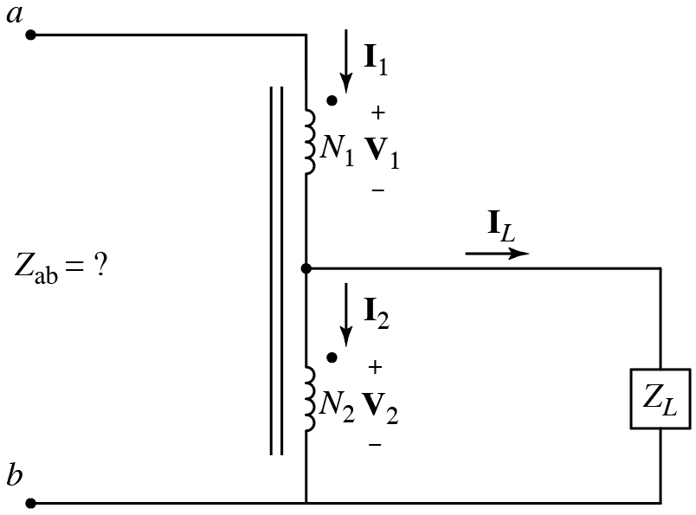
Consider
Same as:

Slide 9



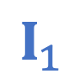


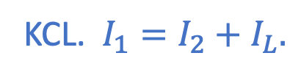
$$I_{1}$$
Consider
What is Z_{ab}?
$$Z_{ab}={V_{ab}}/{I_{1}}$$
$$V_{ab}=V_{1}+V_{2}$$
$$+$$
$$V_{ab}$$
$$−$$
A) V₁/I₁
B) V₂/I_{L}
C) (V₁ + V₂)/I₁
D) V₁/(I₁ + I₂)
Ohm’s law.
$$+ \\ V_{2} \\ −$$
How are I₁ and I₂ related?
A) N₁I₁ = N₂I₂
B) N₁I₁ = –N₂I₂
C) I₁/N₁ = I₂/N₂
D) I₁/N₁ = –I₂/N₂
A) I₁ + I₂
B) I₁ – I₂
C) V₂/Z_{L}
D) V₁/Z_{L}
Dot convention for
ideal transformer.
KCL. $I_{1}=I_{2}+I_{L}.$
KCL. $I_{1}=I_{2}+I_{L}.$
What is I_{L}?
Ohm’s law.

Slide 10
Consider
}
Z_{ab} = (V₁ + V₂)/I₁ (1)
N₁I₁ = –N₂I₂ (2)
From previous
slide.
I_{L}= I₁ – I₂ = V₂/Z_{L} (3)
V₁/N₁ = V₂/N₂ (4)
Dot convention
ideal transformer.
Use (4) in (1) to replace V₁:
Z_{ab} = (N₁/N₂ + 1) V₂ /I₁ (5)
Use (6) to find V₂ /I₁ and use in (5):
Use (2) in (3) to replace I₂:
Z_{ab} = Z_{L} (1+ N₁/N₂)²
(1 + N₁/N₂) I₁ = V₂/Z_{L} (6)

Slide 11
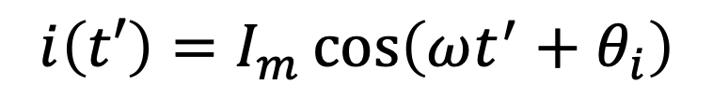
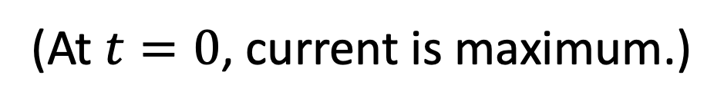
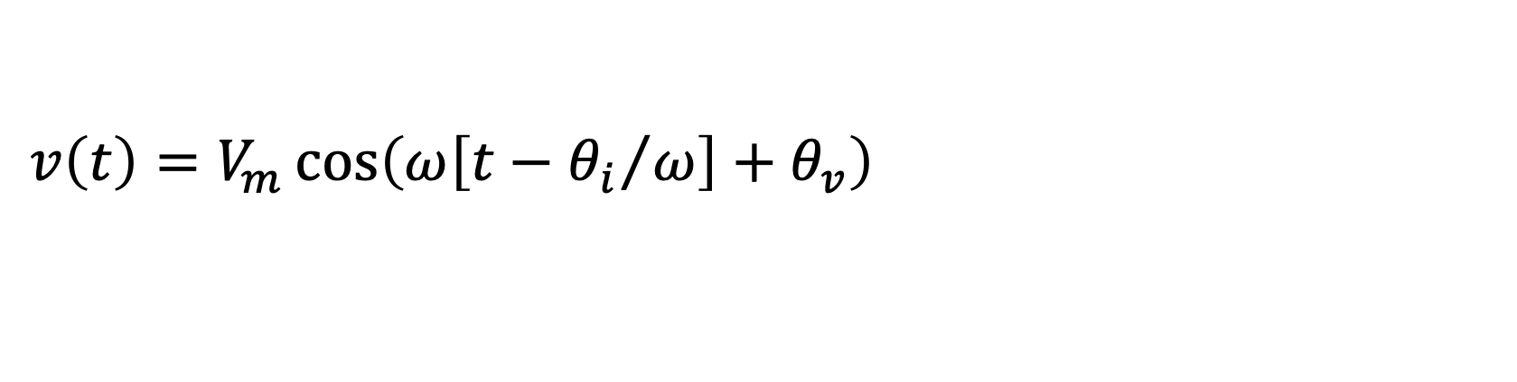
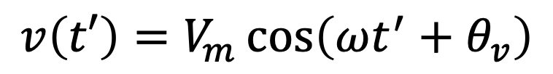
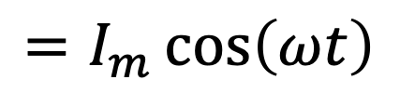
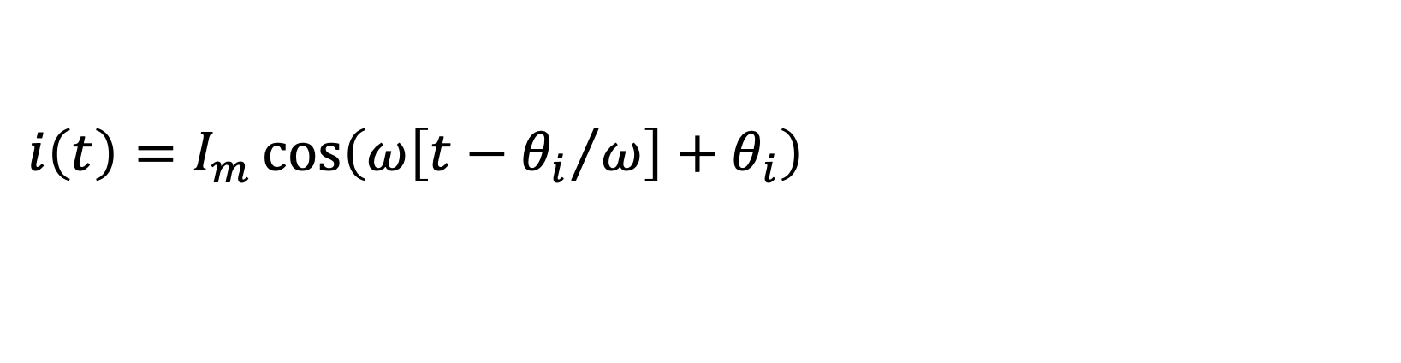
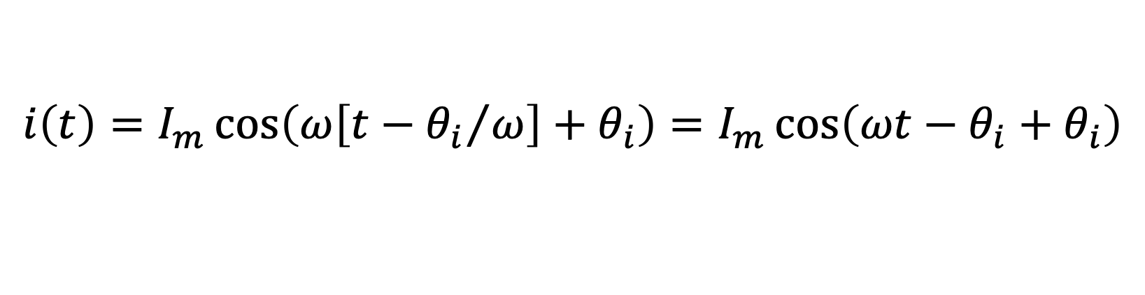

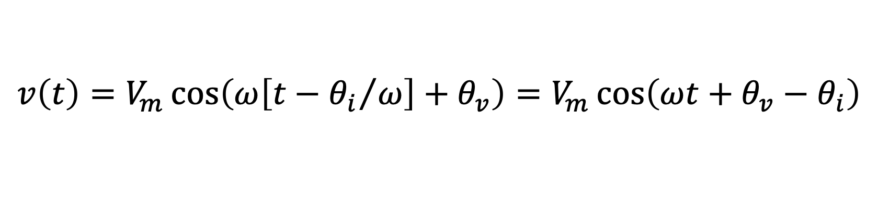
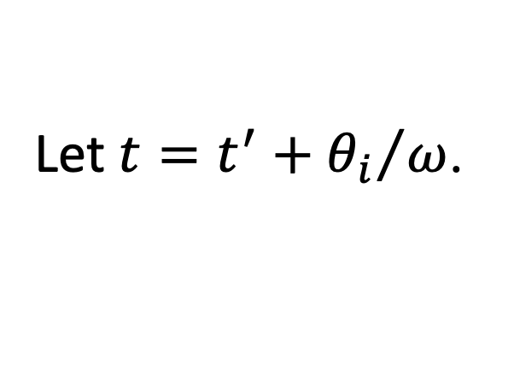

Instantaneous Power
Consider a voltage and current in a circuit given by:
$$v\left(t′\right)=V_{m}\cos\left(ωt^{′}+θ_{v}\right)$$
$$i\left(t′\right)=I_{m}\cos\left(ωt^{′}+θ_{i}\right)$$
Shift to a new time axis.
Let $t=t^{′}+{θ_{i}}/ω$.
$$t^{′}=t−{θ_{i}}/ω$$
$$v\left(t\right)=V_{m}\cos\left(ω\left[t−{θ_{i}}/ω\right]+θ_{v}\right)=V_{m}\cos\left(ωt+θ_{v}−θ_{i}\right)$$
$$v\left(t\right)=V_{m}\cos\left(ω\left[t−{θ_{i}}/ω\right]+θ_{v}\right)=V_{m}\cos\left(ωt+θ_{v}−θ_{i}\right)$$
$$i\left(t\right)=I_{m}\cos\left(ω\left[t−{θ_{i}}/ω\right]+θ_{i}\right)=I_{m}\cos\left(ωt−θ_{i}+θ_{i}\right)$$
$$i\left(t\right)=I_{m}\cos\left(ω\left[t−{θ_{i}}/ω\right]+θ_{i}\right)=I_{m}\cos\left(ωt−θ_{i}+θ_{i}\right)$$
$$=I_{m}\cos\left(ωt\right)$$
(At $t=0$, current is maximum.)
Instantaneous power, $p\left(t\right)=v\left(t\right)i\left(t\right)$, given by:
$$p\left(t\right)=V_{m}I_{m}\cos\left(ωt+θ_{v}−θ_{i}\right)\cos\left(ωt\right)$$

