Slide 1
EE 261, Spring 2025, Lecture 40
Goals/Topics:
Complex power
Course review
Comments on final exam
Best viewed in
presentation mode
in PowerPoint.
Announcements:
HW 13 due Sunday, Apr. 27th.
Final exam Wednesday, Apr. 30, 1:30 to 3:30+ p.m., Fulmer 226.
Review session, Tuesday, Apr. 29, 6:10 p.m., Sloan 175.
Course evaluations open. 1% added to overall score for individuals
who complete survey.

Slide 2


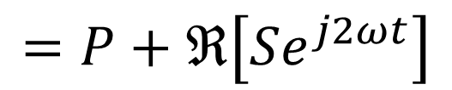
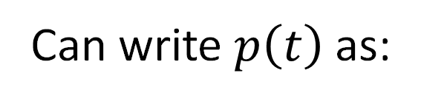

Recall instantaneous power (for sinusoidal signals):
$$p\left(t\right)=v\left(t\right)i\left(t\right)=P+P\cos\left(2ωt\right)−Q\sin\left(2ωt\right)$$
$$p\left(t\right)=v\left(t\right)i\left(t\right)=P+P\cos\left(2ωt\right)−Q\sin\left(2ωt\right)$$
where
$$P≜\left({V_{m}I_{m}}/2\right)\cos\left(θ_{v}−θ_{i}\right)$$
Average (real) power. Watts.
$$Q≜\left({V_{m}I_{m}}/2\right)\sin\left(θ_{v}−θ_{i}\right)$$
Reactive (quadrature) power.
Volt-amps reactive (VAR).
{
Can write $p\left(t\right)$ as:
a complex number
$$p\left(t\right)=P+ℜ\left[Pe^{j2ωt}+jQe^{j2ωt}\right]=P+ℜ\left[\left(P+jQ\right)e^{j2ωt}\right]$$
$$p\left(t\right)=P+ℜ\left[Pe^{j2ωt}+jQe^{j2ωt}\right]=P+ℜ\left[\left(P+jQ\right)e^{j2ωt}\right]$$
$$=P+ℜ\left[Se^{j2ωt}\right]$$
where $S≜P+jQ$ is the complex power.

Slide 3
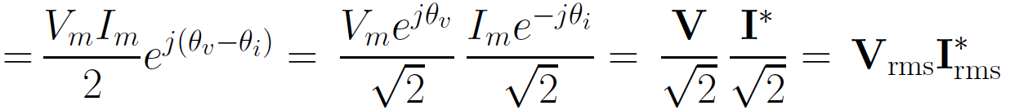
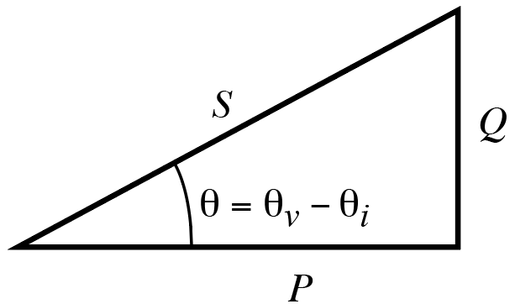
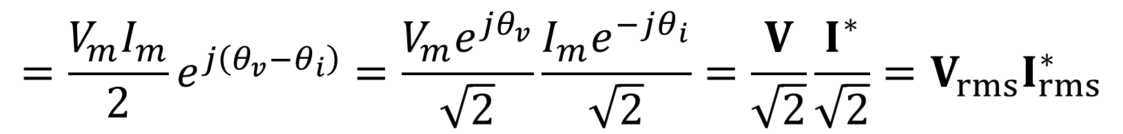


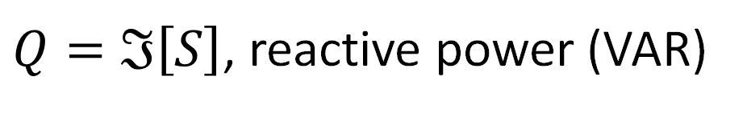
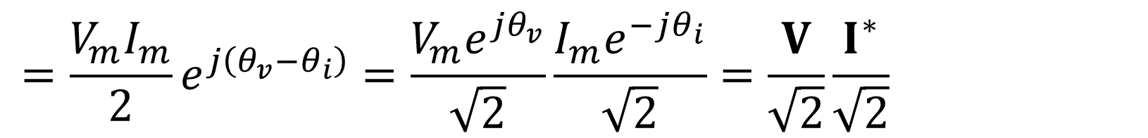

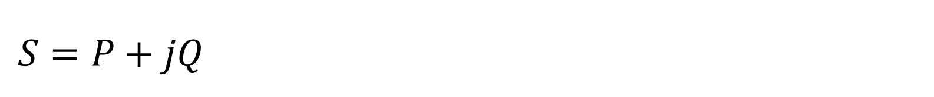
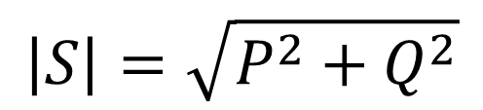
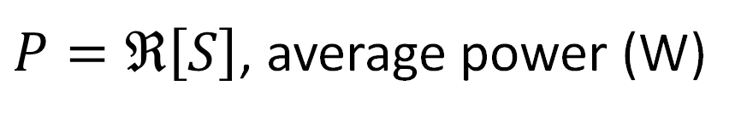
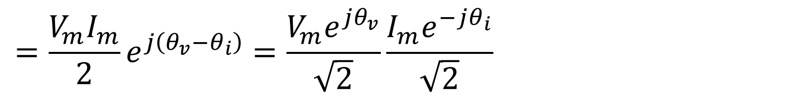
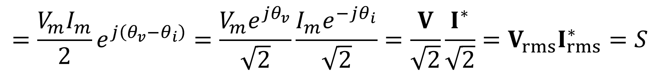
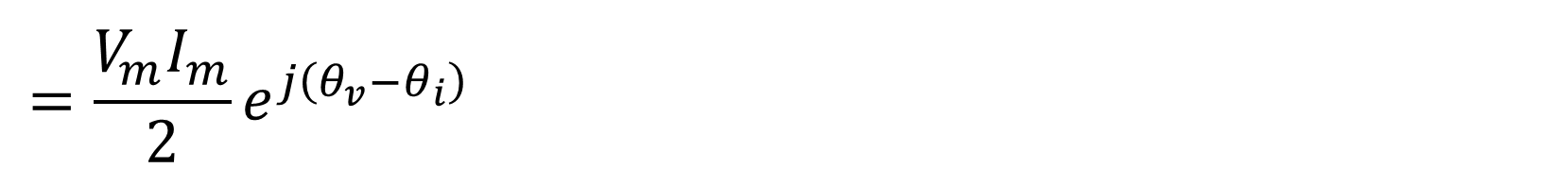
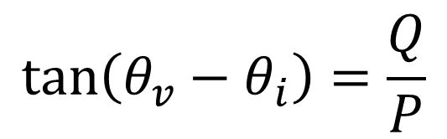
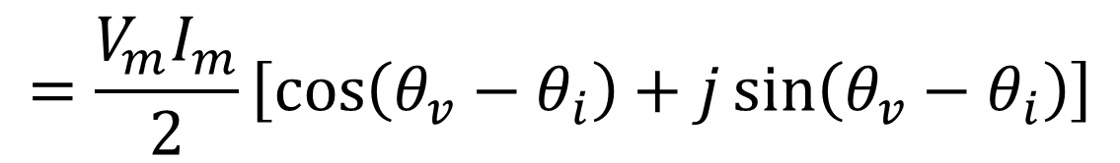
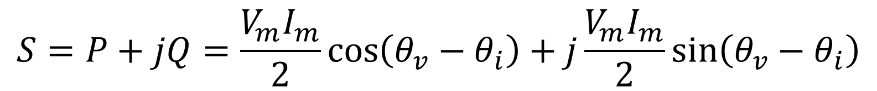
Complex Power
Complex Power (plus alternative form)
$$\tan\left(θ_{v}−θ_{i}\right)=\frac{Q}{P}$$
$$S=P+jQ$$
$$\left|S\right|=\sqrt{P^{2}+Q^{2}}$$
$P=ℜ\left[S\right]$, average power (W)
$$=\frac{V_{m}I_{m}}{2}\sin\left(θ_{v}−θ_{i}\right)$$
$Q=ℑ\left[S\right]$, reactive power (VAR)
$$=\frac{V_{m}I_{m}}{2}\cos\left(θ_{v}−θ_{i}\right)$$
$$S=P+jQ=\frac{V_{m}I_{m}}{2}\cos\left(θ_{v}−θ_{i}\right)+j\frac{V_{m}I_{m}}{2}\sin\left(θ_{v}−θ_{i}\right)$$
$$S=P+jQ=\frac{V_{m}I_{m}}{2}\cos\left(θ_{v}−θ_{i}\right)+j\frac{V_{m}I_{m}}{2}\sin\left(θ_{v}−θ_{i}\right)$$
$$=\frac{V_{m}I_{m}}{2}\left[\cos\left(θ_{v}−θ_{i}\right)+j\sin\left(θ_{v}−θ_{i}\right)\right]$$
(Well, for EE’s and those
interested in power.)
Important!
$$=\frac{V_{m}I_{m}}{2}e^{j\left(θ_{v}−θ_{i}\right)}=\frac{V_{m}e^{jθ_{v}}}{\sqrt{2}}\frac{I_{m}e^{−jθ_{i}}}{\sqrt{2}}=\frac{V}{\sqrt{2}}\frac{I^{∗}}{\sqrt{2}}=V_{rms}I_{rms}^{∗}$$
$$=\frac{V_{m}I_{m}}{2}e^{j\left(θ_{v}−θ_{i}\right)}=\frac{V_{m}e^{jθ_{v}}}{\sqrt{2}}\frac{I_{m}e^{−jθ_{i}}}{\sqrt{2}}=\frac{V}{\sqrt{2}}\frac{I^{∗}}{\sqrt{2}}=V_{rms}I_{rms}^{∗}$$
$$=\frac{V_{m}I_{m}}{2}e^{j\left(θ_{v}−θ_{i}\right)}=\frac{V_{m}e^{jθ_{v}}}{\sqrt{2}}\frac{I_{m}e^{−jθ_{i}}}{\sqrt{2}}=\frac{V}{\sqrt{2}}\frac{I^{∗}}{\sqrt{2}}=V_{rms}I_{rms}^{∗}$$
$$=\frac{V_{m}I_{m}}{2}e^{j\left(θ_{v}−θ_{i}\right)}=\frac{V_{m}e^{jθ_{v}}}{\sqrt{2}}\frac{I_{m}e^{−jθ_{i}}}{\sqrt{2}}=\frac{V}{\sqrt{2}}\frac{I^{∗}}{\sqrt{2}}=V_{rms}I_{rms}^{∗}$$
$$=\frac{V_{m}I_{m}}{2}e^{j\left(θ_{v}−θ_{i}\right)}=\frac{V_{m}e^{jθ_{v}}}{\sqrt{2}}\frac{I_{m}e^{−jθ_{i}}}{\sqrt{2}}=\frac{V}{\sqrt{2}}\frac{I^{∗}}{\sqrt{2}}=V_{rms}I_{rms}^{∗}=S$$
* = complex conjugate

Slide 4
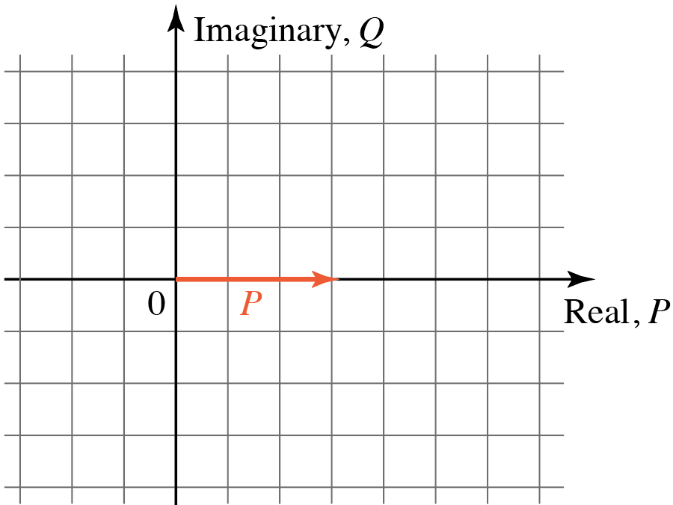
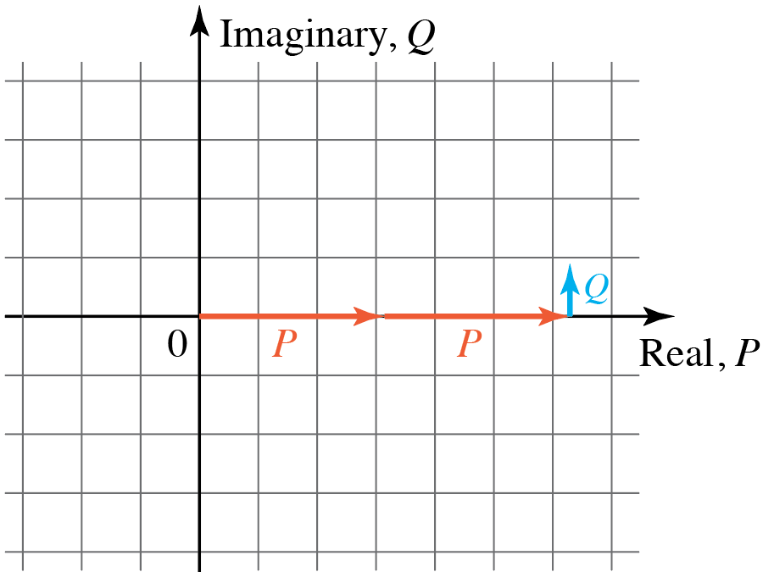
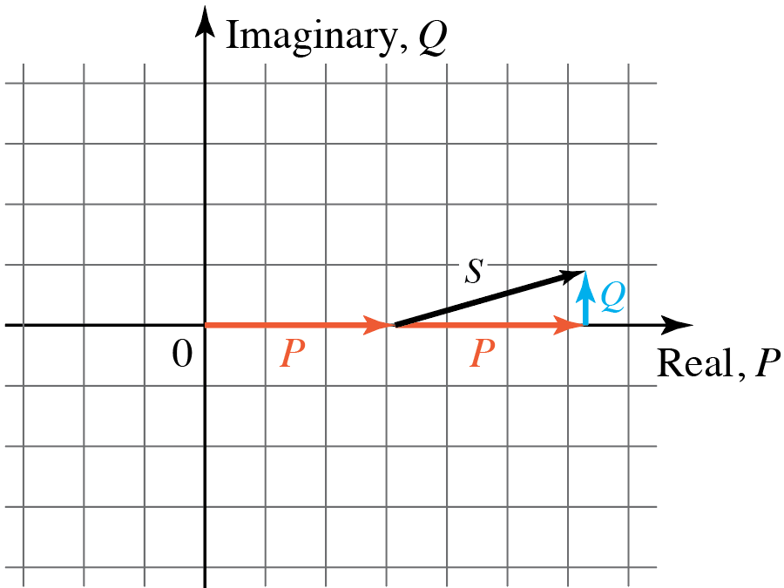
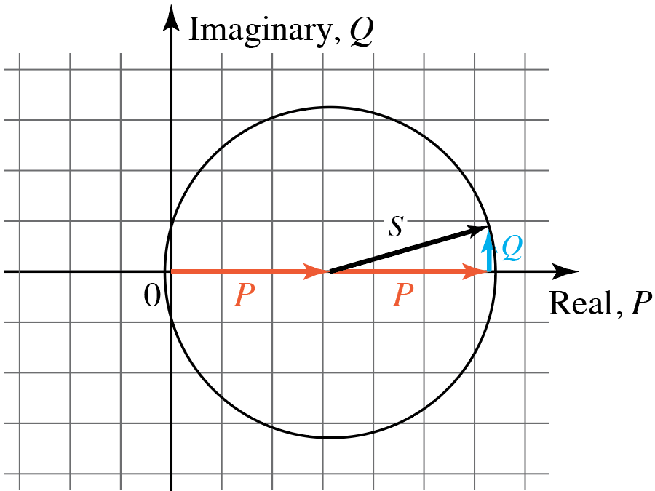
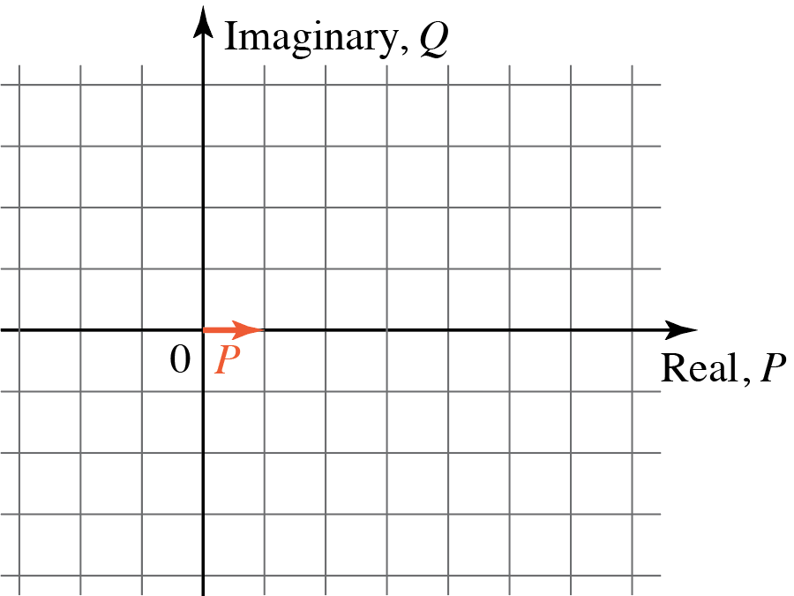
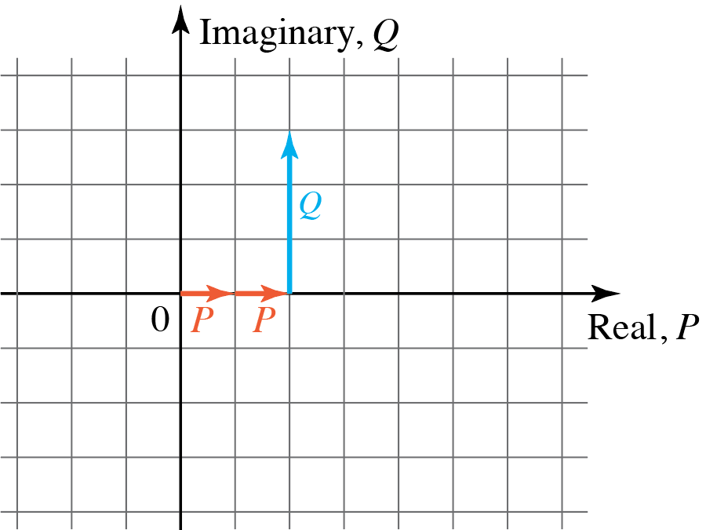
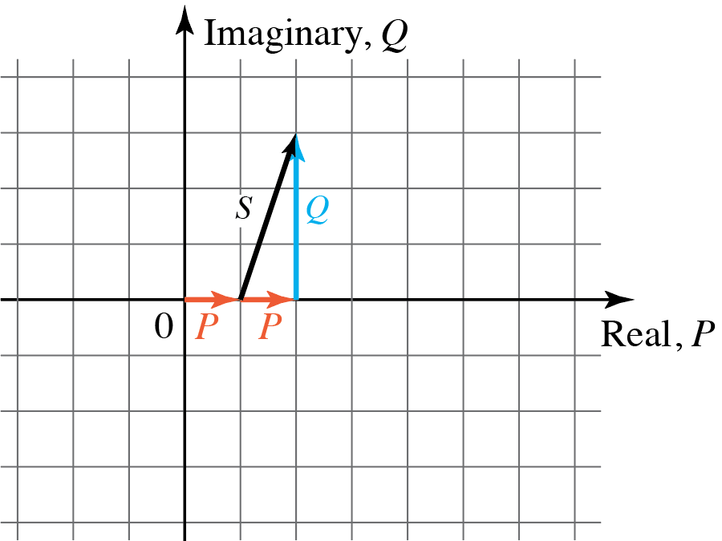
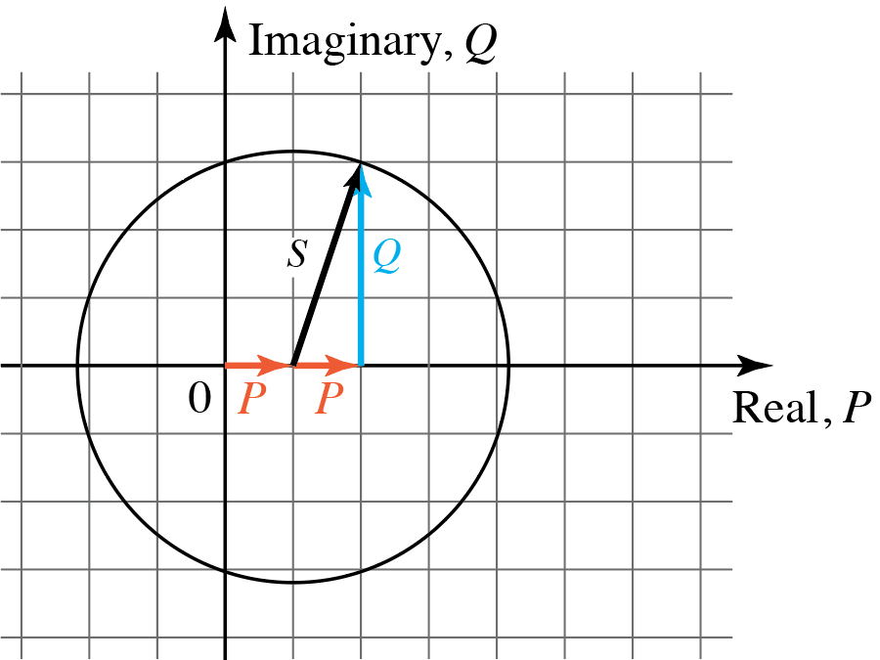

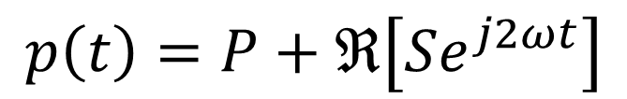
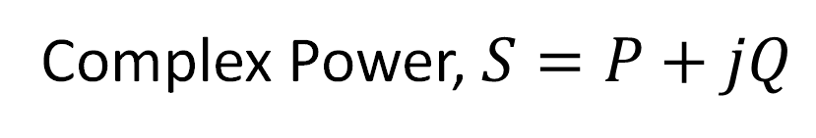

Complex Power, $S=P+jQ$
$$p\left(t\right)=P+P\cos\left(2ωt\right)−Q\sin\left(2ωt\right)$$
Example 1:
Example 2:
$$Se^{j2ωt}$$
$$p\left(t\right)=P+ℜ\left[Se^{j2ωt}\right]$$
For a given circuit, $P$, $Q$, and $S$ do not
change, but $Se^{j2ωt}$ does.

Slide 5
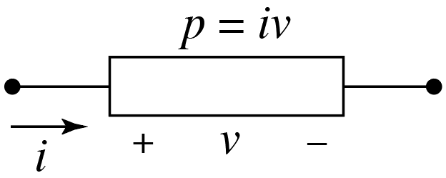
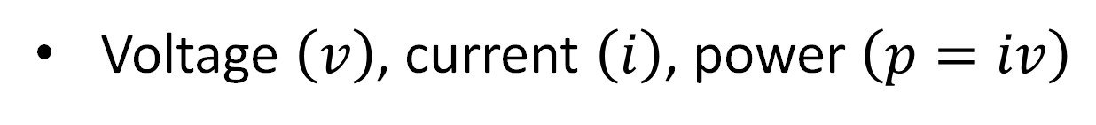
Concepts from Test 1
Voltage $\left(v\right)$, current $\left(i\right)$, power $\left(p=iv\right)$

Slide 6
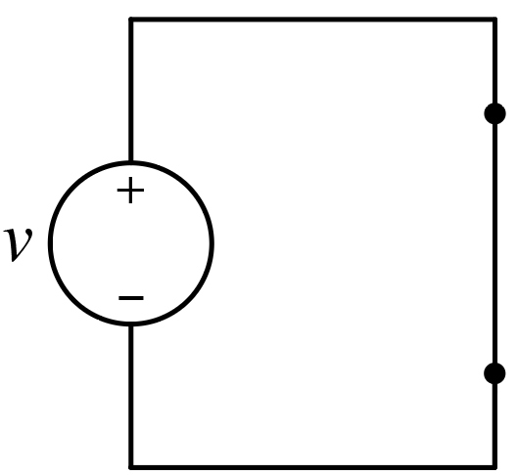
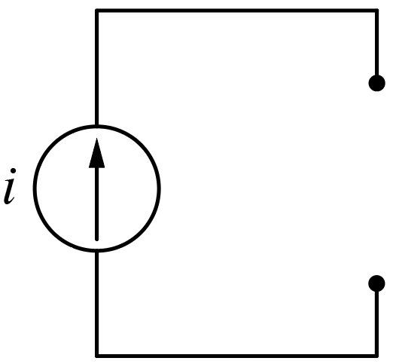
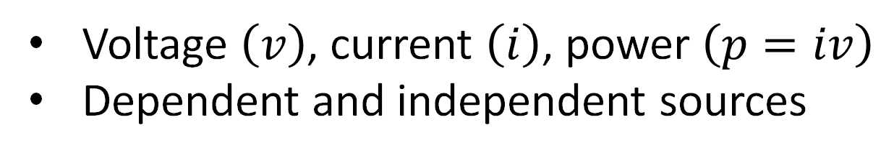
Concepts from Test 1
Voltage $\left(v\right)$, current $\left(i\right)$, power $\left(p=iv\right)$
Dependent and independent sources
Valid and invalid ways of arranging sources

Slide 7
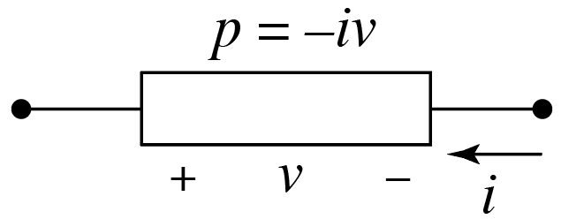
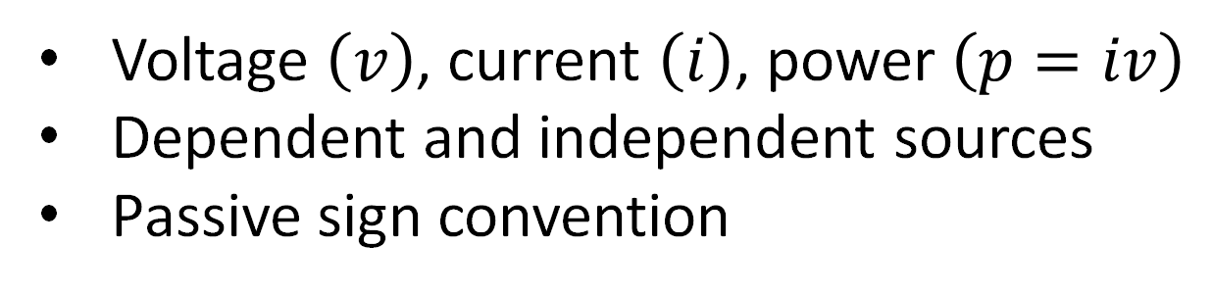
Concepts from Test 1
Voltage $\left(v\right)$, current $\left(i\right)$, power $\left(p=iv\right)$
Dependent and independent sources
Passive sign convention

Slide 8
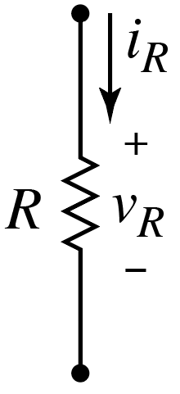
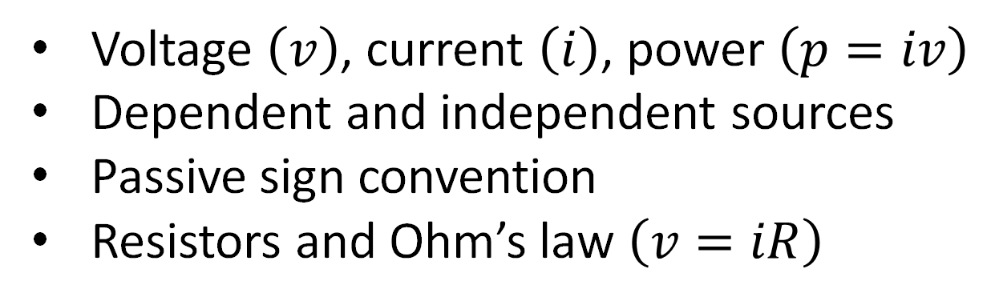
Concepts from Test 1
Voltage $\left(v\right)$, current $\left(i\right)$, power $\left(p=iv\right)$
Dependent and independent sources
Passive sign convention
Resistors and Ohm’s law $\left(v=iR\right)$

Slide 9
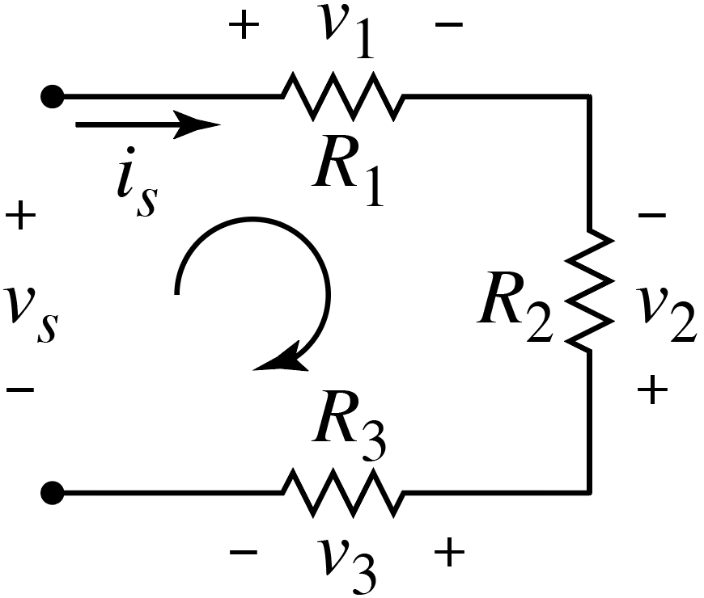
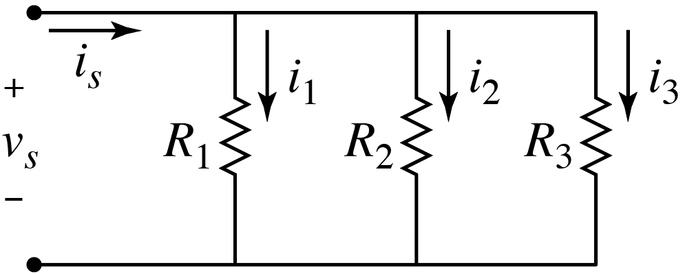
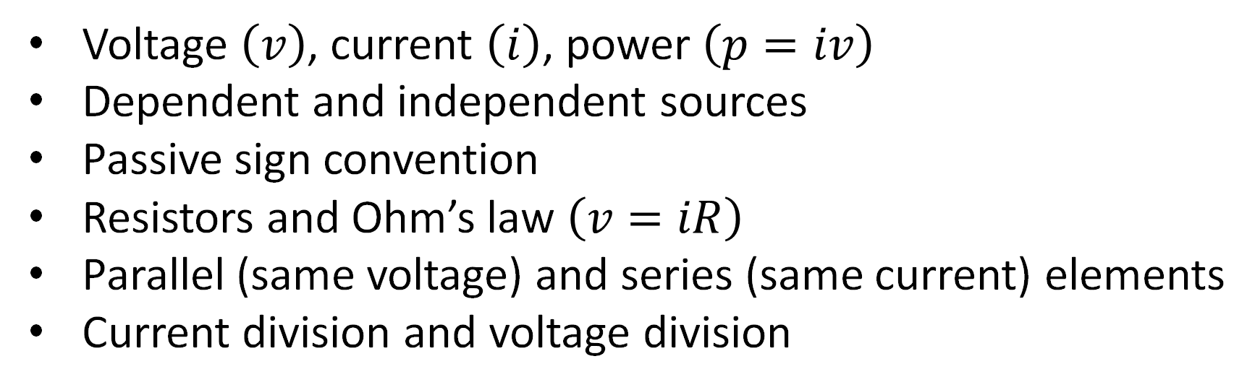
Concepts from Test 1
Voltage $\left(v\right)$, current $\left(i\right)$, power $\left(p=iv\right)$
Dependent and independent sources
Passive sign convention
Resistors and Ohm’s law $\left(v=iR\right)$
Parallel (same voltage) and series (same current) elements
Current division and voltage division
Equivalent resistances:
Inverse of inverses for parallel;
Sum for series.

Slide 10
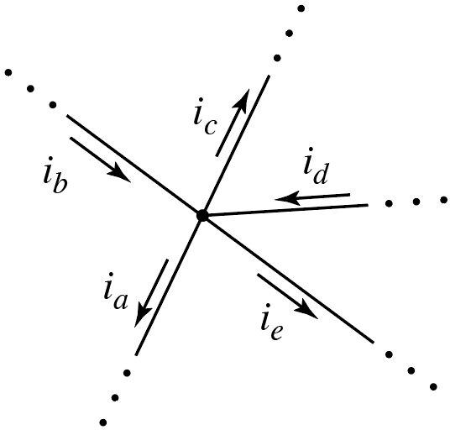
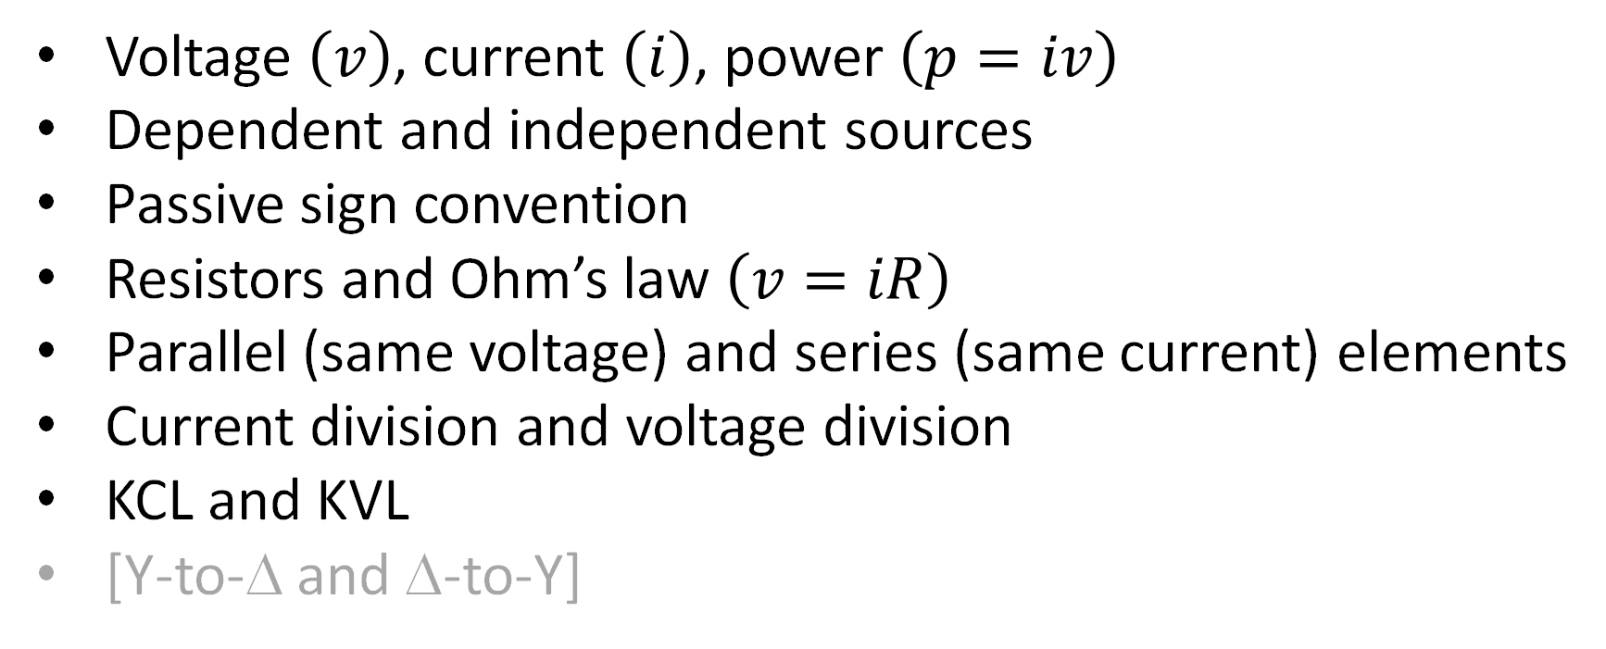
Concepts from Test 1
Voltage $\left(v\right)$, current $\left(i\right)$, power $\left(p=iv\right)$
Dependent and independent sources
Passive sign convention
Resistors and Ohm’s law $\left(v=iR\right)$
Parallel (same voltage) and series (same current) elements
Current division and voltage division
KCL and KVL
[Y-to-Δ and Δ-to-Y]
Equivalent resistances:
Inverse of inverses for parallel;
Sum for series.

Slide 11


Concepts from Test 2
Node-voltage analysis (KCL)
$$V_{a}$$
$$V_{b}$$

Slide 12


















Concepts from Test 2
Node-voltage analysis (KCL)
Mesh-current analysis (KVL)
$$V_{a}$$
$$V_{b}$$
$$+$$
$$−$$
$$+$$
$$−$$
$$+$$
$$I_{b}$$
$$−$$
$$+$$
$$−$$
$$I_{a}$$
$$−$$
$$+$$
$$+$$
$$−$$
$$+$$
$$−$$
$$+$$
$$I_{c}$$
$$−$$
$$+$$
$$−$$
$$−$$
$$+$$

Slide 13
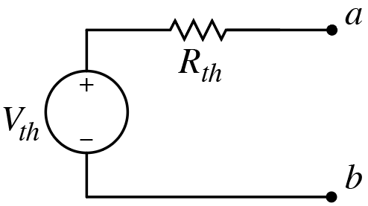
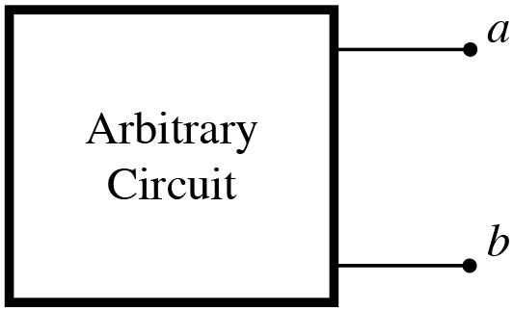
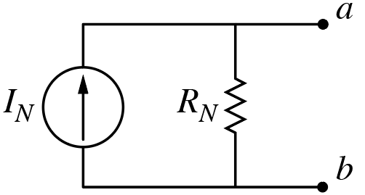
Concepts from Test 2
Node-voltage analysis (KCL)
Mesh-current analysis (KVL)
Thévenin and Norton equivalent circuits
[Source transformation]

Slide 14
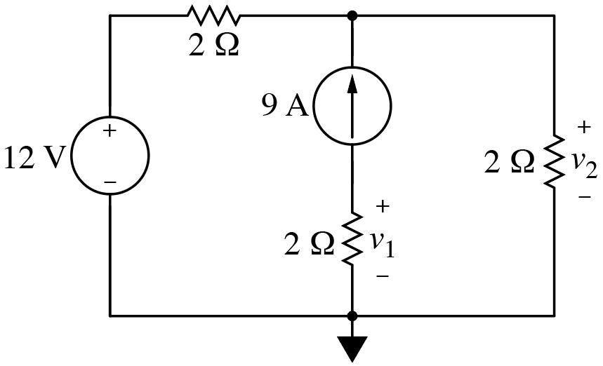
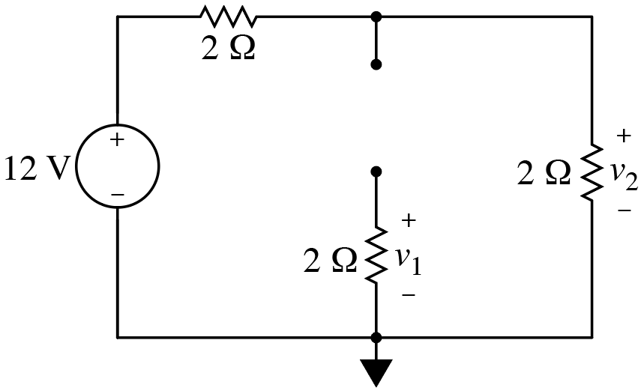
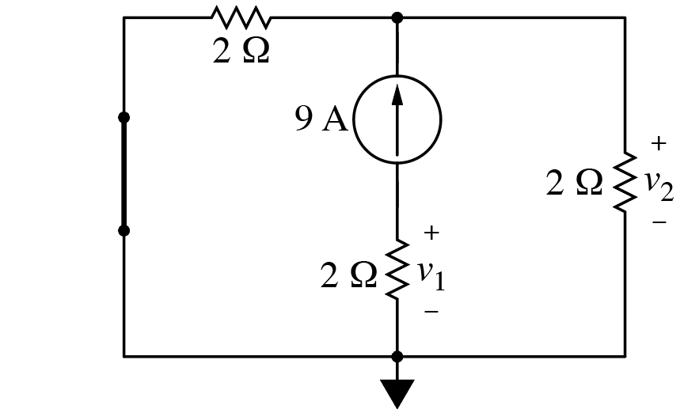
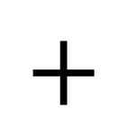
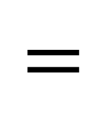
Concepts from Test 2
Node-voltage analysis (KCL)
Mesh-current analysis (KVL)
Thévenin and Norton equivalent circuits
[Source transformation]
Superposition (source deactivation)
$$=$$
$$+$$

Slide 15
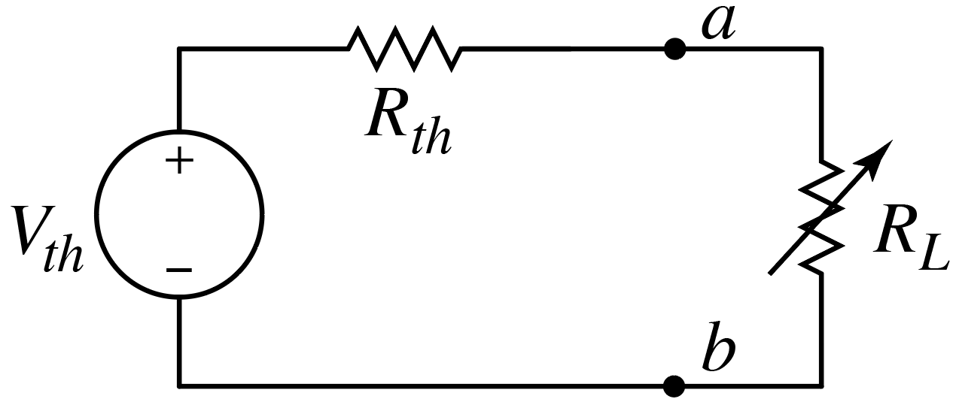
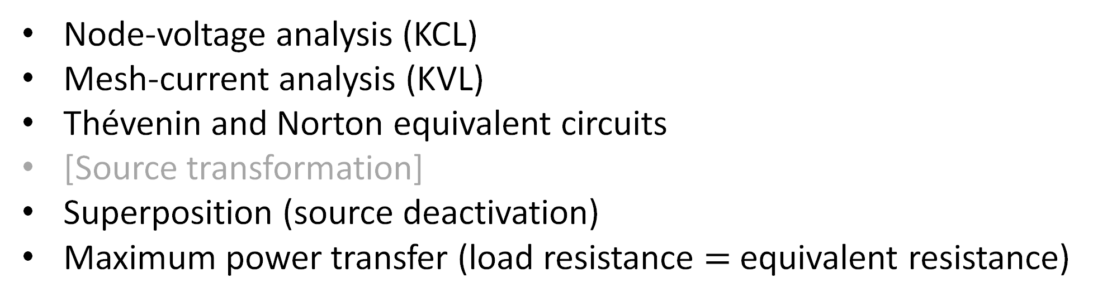
Concepts from Test 2
Node-voltage analysis (KCL)
Mesh-current analysis (KVL)
Thévenin and Norton equivalent circuits
[Source transformation]
Superposition (source deactivation)
Maximum power transfer (load resistance $=$ equivalent resistance)

Slide 16





Concepts from Test 2
Node-voltage analysis (KCL)
Mesh-current analysis (KVL)
Thévenin and Norton equivalent circuits
[Source transformation]
Superposition (source deactivation)
Maximum power transfer (load resistance $=$ equivalent resistance)
Operational amplifiers
$$i_{p}=0$$
$$i_{n}=0$$
$$v_{p}=v_{n}$$

Slide 17




Concepts from Test 3
Inductor & capacitor fundamentals
$$v_{L}\left(t\right)=L\frac{di_{L}\left(t\right)}{dt}$$
$$i_{C}\left(t\right)=C\frac{dv_{C}\left(t\right)}{dt}$$
Current cannot
change instantaneously.
Voltage cannot
change instantaneously.
Short circuit in (dc) steady state.
Open circuit in (dc) steady state.

Slide 18

Concepts from Test 3
Inductor & capacitor fundamentals
Mutual inductance

Slide 19




Concepts from Test 3
Inductor & capacitor fundamentals
Mutual inductance
Natural response of a first-order system (RL or RC circuit)
$$f\left(t\right)=f_{0}e^{−{\left(t−t_{0}\right)}/τ}$$
$τ=R_{eq}C$ (or $τ=L/R_{eq}$)
$τ=R_{eq}C$ (or $τ=L/R_{eq}$)

Slide 20


Concepts from Test 3
Inductor & capacitor fundamentals
Mutual inductance
Natural response of a first-order system (RL or RC circuit)
Step response of a first-order system (RL or RC circuit)
$$f\left(t\right)=f_{∞}+\left(f_{0}−f_{∞}\right)e^{−t/τ}$$

Slide 21

Concepts from Test 3
Inductor & capacitor fundamentals
Mutual inductance
Natural response of a first-order system (RL or RC circuit)
Step response of a first-order system (RL or RC circuit)
Switching
[Unbounded response]

Slide 22

Concepts from Test 3
Inductor & capacitor fundamentals
Mutual inductance
Natural response of a first-order system (RL or RC circuit)
Step response of a first-order system (RL or RC circuit)
Switching
[Unbounded response]
Integrating amplifier

Slide 23

Concepts from Test 3
Inductor & capacitor fundamentals
Mutual inductance
Natural response of a first-order system (RL or RC circuit)
Step response of a first-order system (RL or RC circuit)
Switching
[Unbounded response]
Integrating amplifier
Natural response of parallel RLC circuit
Either:
Overdamped
Critically damped
Underdamped

Slide 24
New Since Test 3
Step response of a parallel second-order system
Constant plus a transient that is either:
Overdamped
Critically damped
Underdamped

Slide 25

New Since Test 3
Step response of a parallel second-order system
Sinusoidal steady-state $\left(∂/{∂t}→jω\right)$.
All previous circuit analysis techniques still apply!
  KCL, KVL, Ohm’s Law, node-voltage, mesh-current, …
  Work with complex numbers instead of real numbers
  Sources represented by phasors
  $R$’s, $L$’s, and $C$’s represented as impedances: $V=ZI$
  Impedances ($R, jωL,−j/ωC$) combine in same way as resistances
Ideal transformers
Instantaneous, average, and complex power
RMS values

Slide 26
Final Exam
Wednesday, Apr. 30th, 1:30 p.m.–3:30⁺ p.m., Fulmer 226.
Comprehensive with emphasis on material since Test #3.
  40% (or more) from material related to Tests 1–3.
  Old exams may be useful study aids (all posted with solutions).
Rules and format largely same as previous exams (just longer).
Expecting minimum of 70 minutes of effort.
Up to four sheets of notes (can write on front and back; 8 “pages”).
Bring a calculator.
  Be able to do basic complex arithmetic—see HW 13!
  You may provide complex numbers in polar or rectangular form.
Do your own work.

Slide 27
The End
(Sort of — don’t forget review or final!)
Good luck on the final.
Thanks!

