Slide 1
Review Session
(For Test 2)

Slide 2
Some comments about test:
Voltage division and/or current division may prove useful.
If something is easy, don’t make it hard
(or at least not harder than it needs to be).
Unless told otherwise, you are free to use whatever solution
technique leads to the answer. But, document your work!
If you have extra time, consider checking your work using another
solution technique. For example, if you used mesh current,
consider solving the problem again using node voltage.
If you have extra time, consider checking your work using another
solution technique. For example, if you used mesh current,
consider solving the problem again using node voltage.
But, if you obtain two different answers, it’s up to you to reconcile
them! If you aren’t able to converge to a single answer, be sure to
indicate which answer you think is correct.
But, if you obtain two different answers, it’s up to you to reconcile
them! If you aren’t able to converge to a single answer, be sure to
indicate which answer you think is correct.

Slide 3
Assume resistances and current source are known. “…” represents
unknown additional parts of circuit. Can resistor currents be found?
Assume resistances and current source are known. “…” represents
unknown additional parts of circuit. Can resistor currents be found?
Assume resistances and current source are known. “…” represents
unknown additional parts of circuit. Can resistor currents be found?
Yes or No
Yes or No
Yes or No
Yes or No
Yes or No
Yes or No

Slide 4
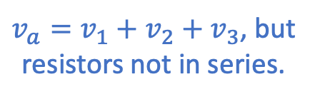
Assume resistances and voltage source are known. “…” represents
unknown additional parts of circuit. Can resistor voltages be found?
Assume resistances and voltage source are known. “…” represents
unknown additional parts of circuit. Can resistor voltages be found?
Assume resistances and voltage source are known. “…” represents
unknown additional parts of circuit. Can resistor voltages be found?
Yes or No
Yes or No
Yes or No
$v_{a}=v_{1}+v_{2}+v_{3}$, but
resistors not in series.
Yes or No
Yes or No

Slide 5
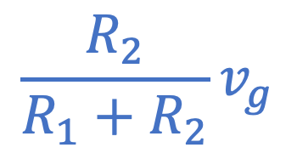
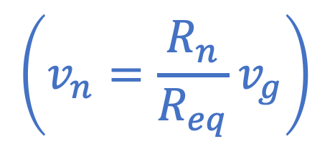
$$\frac{R_{2}}{R_{1}+R_{2}}v_{g}$$
$$\left(v_{n}=\frac{R_{n}}{R_{eq}}v_{g}\right)$$
What is voltage here?

Slide 6
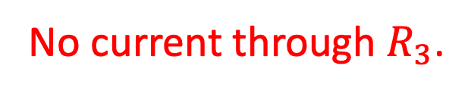
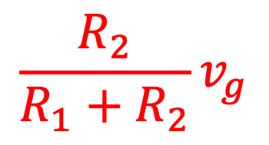
$$\frac{R_{2}}{R_{1}+R_{2}}v_{g}$$
What is voltage here?
$$\frac{R_{2}}{R_{1}+R_{2}}v_{g}$$
What is voltage here?
No current through $R_{3}$.

Slide 7
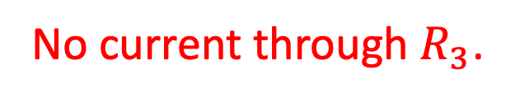
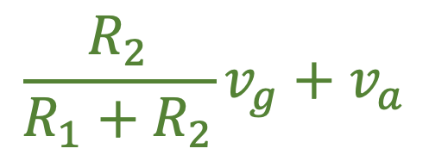

$$\frac{R_{2}}{R_{1}+R_{2}}v_{g}$$
What is voltage here?
What is voltage here?
$$\frac{R_{2}}{R_{1}+R_{2}}v_{g}+v_{a}$$
$$\frac{R_{2}}{R_{1}+R_{2}}v_{g}$$
What is voltage here?
No current through $R_{3}$.

Slide 8
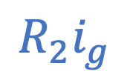
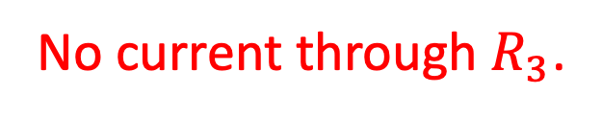
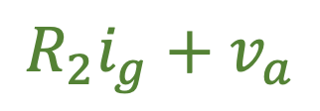
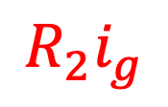
What is voltage here?
$$R_{2}i_{g}$$
What is voltage here?
$$R_{2}i_{g}+v_{a}$$
What is voltage here?
$$R_{2}i_{g}$$
No current through $R_{3}$.

Slide 9
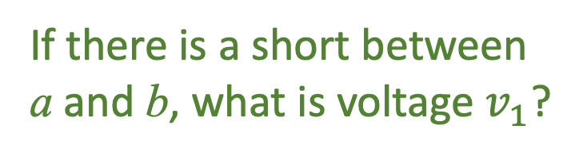
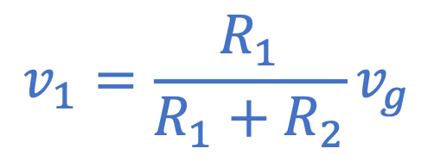
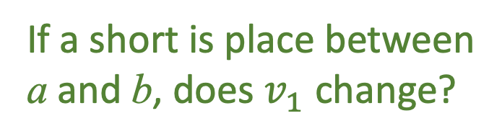
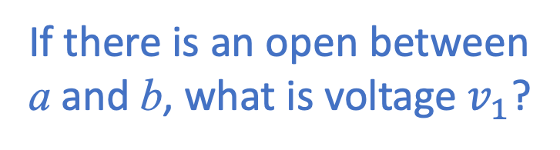
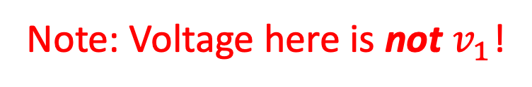
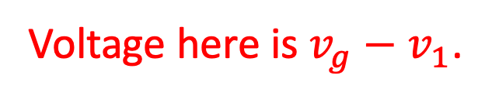
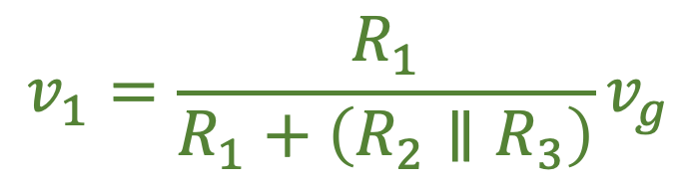
Voltage here is $v_{g}−v_{1}$.
If there is an open between
a and b, what is voltage $v_{1}$?
Note: Voltage here is not $v_{1}$!
$$v_{1}=\frac{R_{1}}{R_{1}+R_{2}}v_{g}$$
If a short is place between
a and b, does $v_{1}$ change?
Yes!
Resistance seen by source changes.
Thus, current that flows changes.
Resistance seen by source changes.
Thus, current that flows changes.
If there is a short between
a and b, what is voltage $v_{1}$?
$$v_{1}=\frac{R_{1}}{R_{1}+\left(R_{2}∥R_{3}\right)}v_{g}$$
Node voltages and element voltages are only the same when the element is
tied to ground and the higher polarity of the element voltage is at the node.

Slide 10
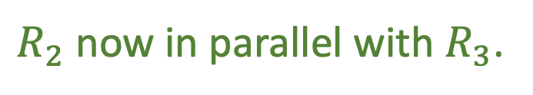
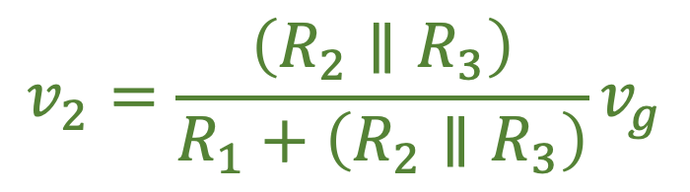

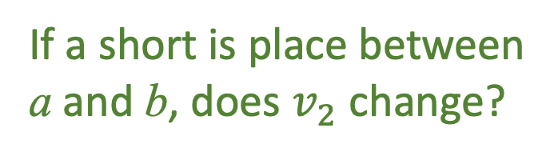

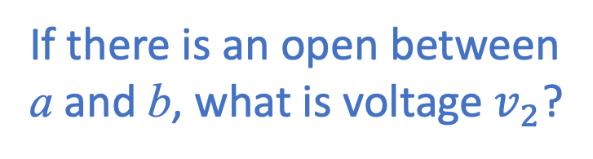
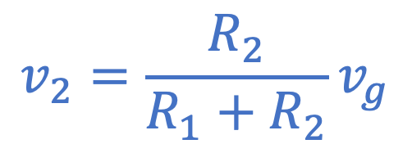
If there is an open between
a and b, what is voltage $v_{2}$?
$$v_{2}$$
$$v_{2}=\frac{R_{2}}{R_{1}+R_{2}}v_{g}$$
$$+ \\ v_{2}$$
$$−$$
If a short is place between
a and b, does $v_{2}$ change?
Yes!
$R_{2}$ now in parallel with $R_{3}$.
$$v_{2}=\frac{\left(R_{2}∥R_{3}\right)}{R_{1}+\left(R_{2}∥R_{3}\right)}v_{g}$$
Node voltages and element voltages are only
the same when the element is tied to ground
and the higher polarity of the element voltage is at the node.

Slide 11




Are $R_{1}$ and $R_{2}$ in series?
No.
Don’t have same current.
Are $R_{1}$ and $R_{4}$ in series?
Yes.
Do have same current.
Previous claim: Order of series
elements doesn’t matter.
Can $R_{1}$ and $R_{4}$ be swapped?
Yes, but there’s a right and a wrong way.
This works! (Essentially
same as circuit above.)
Wrong! (Assuming we want $V_{ab}$ unchanged!)

Slide 12
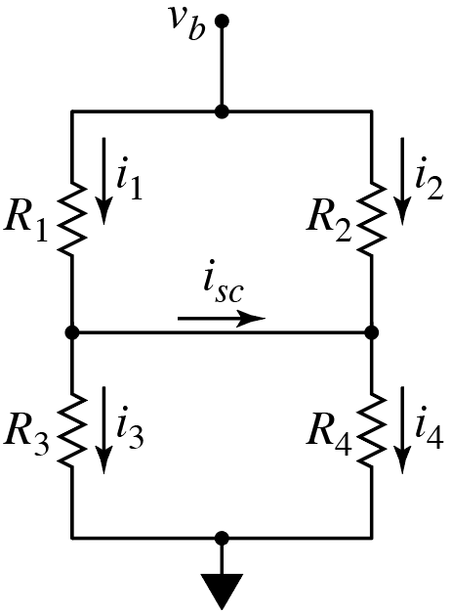
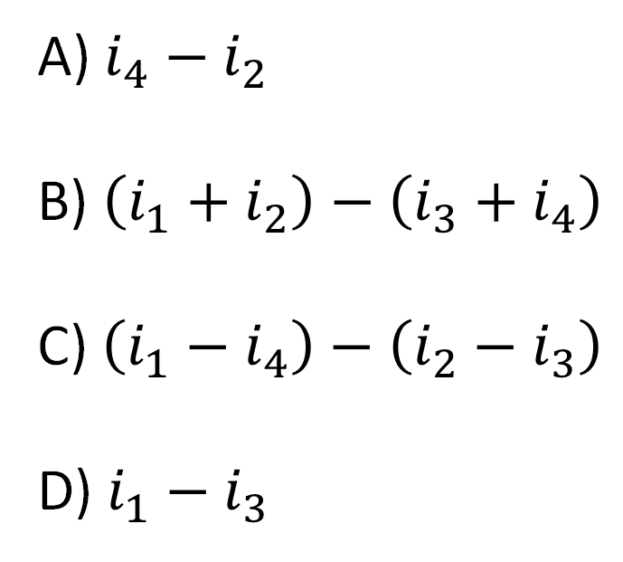

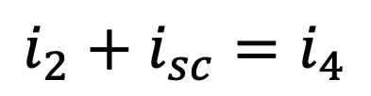
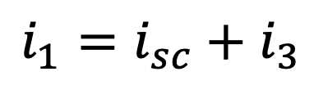
Consider:
What is $i_{sc}$?
A) $i_{4}−i_{2}$
B) $\left(i_{1}+i_{2}\right)−\left(i_{3}+i_{4}\right)$
C) $\left(i_{1}−i_{4}\right)−\left(i_{2}−i_{3}\right)$
D) $i_{1}−i_{3}$
Both true.
Use KCL.
$$i_{1}=i_{sc}+i_{3}$$
or
$$i_{2}+i_{sc}=i_{4}$$

Slide 13
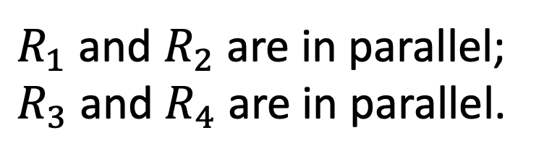
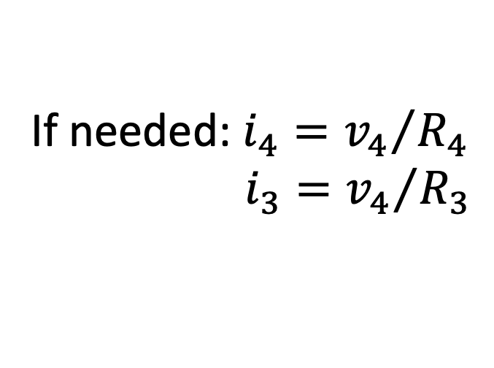
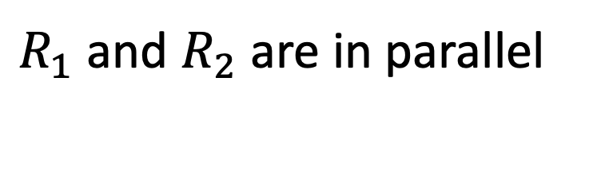

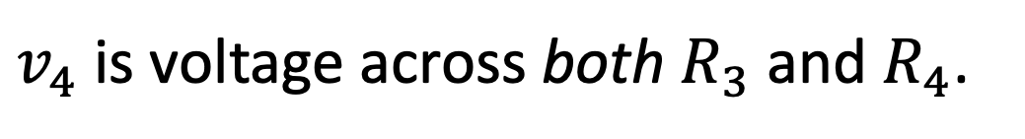
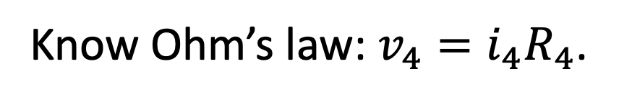
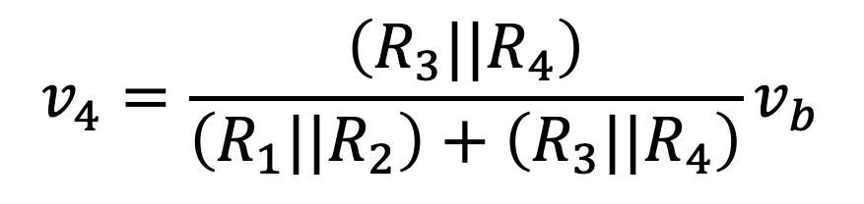
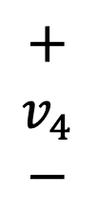
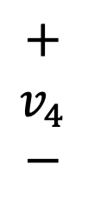
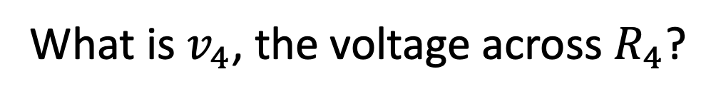
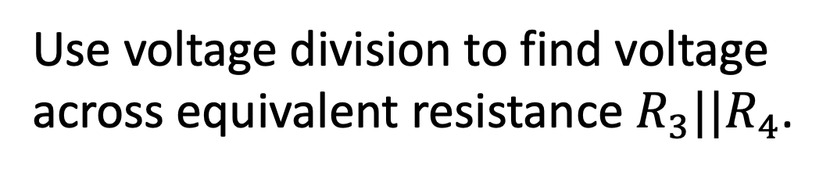
Consider:
What is $v_{4}$, the voltage across $R_{4}$?
Know Ohm’s law: $v_{4}=i_{4}R_{4}$.
So, have to find $i_{4}$, right?
No, don’t have to work that hard!
$R_{1}$ and $R_{2}$ are in parallel;
$R_{3}$ and $R_{4}$ are in parallel.
$R_{1}$ and $R_{2}$ are in parallel;
$R_{3}$ and $R_{4}$ are in parallel.
$$+$$
$$v_{4}$$
$$−$$
$$+$$
$$v_{4}$$
$$−$$
$v_{4}$ is voltage across both $R_{3}$ and $R_{4}$.
Use voltage division to find voltage
across equivalent resistance $R_{3}||R_{4}$.
If needed: $i_{4}={v_{4}}/{R_{4}}$
$i_{3}={v_{4}}/{R_{3}}$
$$v_{4}=\frac{\left(R_{3}||R_{4}\right)}{\left(R_{1}||R_{2}\right)+\left(R_{3}||R_{4}\right)}v_{b}$$

Slide 14
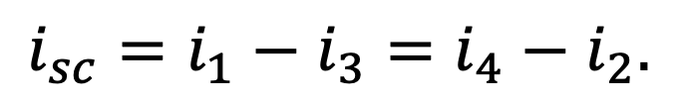

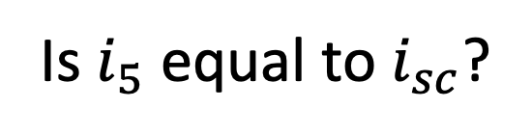
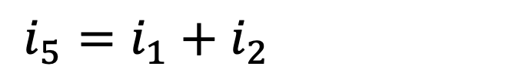
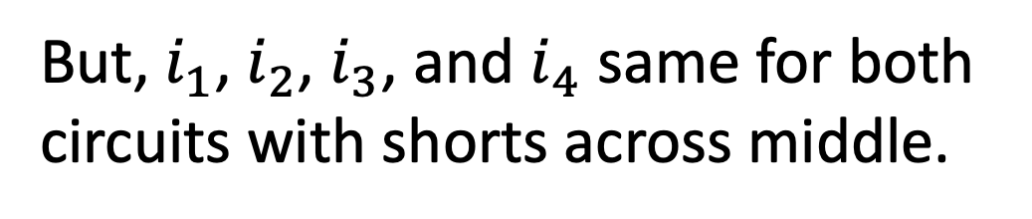
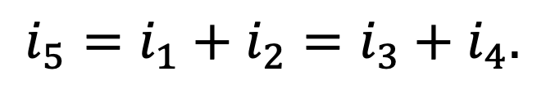
Consider:
Alternative arrangement
of short.
Start with this.
Place short across center.
Is $i_{5}$ equal to $i_{sc}$?
Nope!
Use KCL to determine.
$$i_{sc}=i_{1}−i_{3}=i_{4}−i_{2}.$$
$$i_{sc}=i_{1}−i_{3}=i_{4}−i_{2}.$$
But, $i_{1}$, $i_{2}$, $i_{3}$, and $i_{4}$ same for both
circuits with shorts across middle.
$$i_{5}=i_{1}+i_{2}=i_{3}+i_{4}.$$
$$i_{5}=i_{1}+i_{2}=i_{3}+i_{4}.$$
Also, central wire at same potential with both circuits.

Slide 15
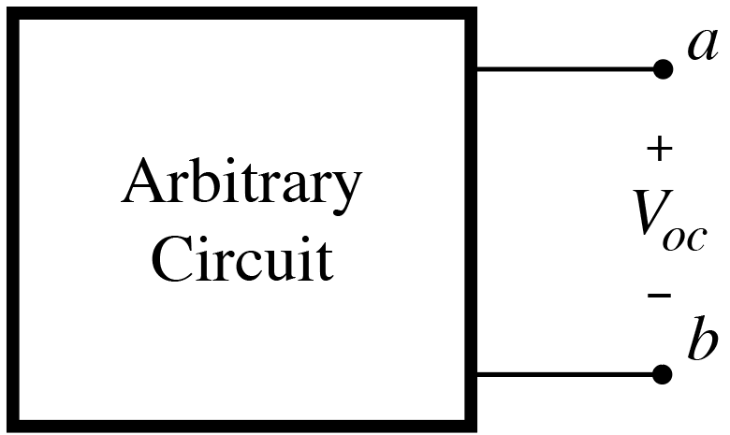
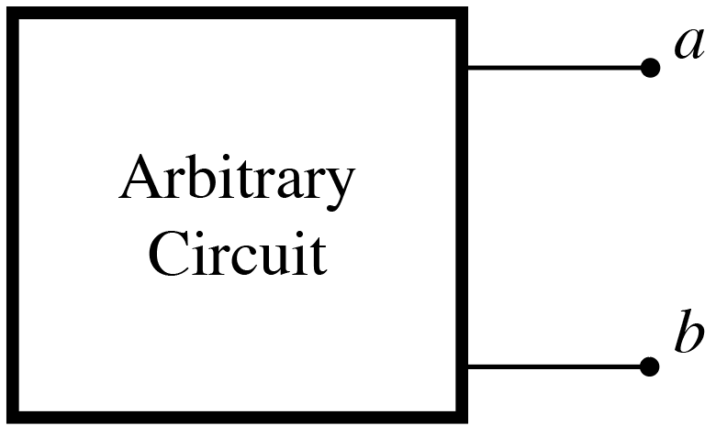
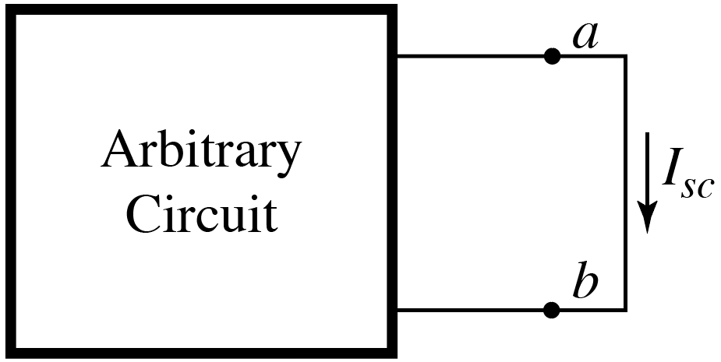
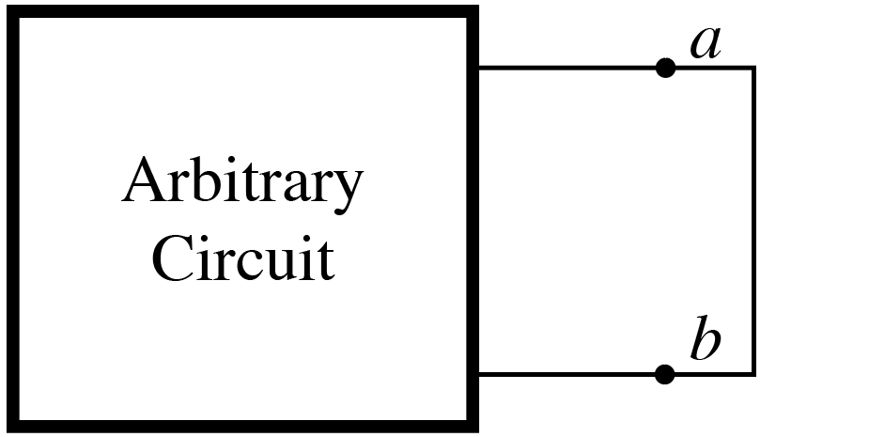

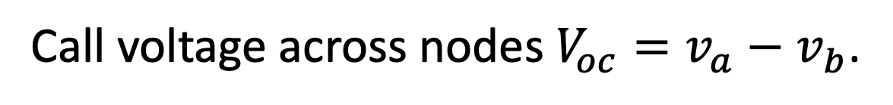
Thévenin and Norton Equivalent Circuits
Given arbitrary circuit with access to
nodes a and b.
Call voltage across nodes $V_{oc}=v_{a}−v_{b}$.
Keep circuit inside box, but short terminals a and b.
Short creates a new circuit.
Call current in short $I_{sc}$.
Obtain $V_{oc}$ and $I_{sc}$by whatever means convenient.

Slide 16
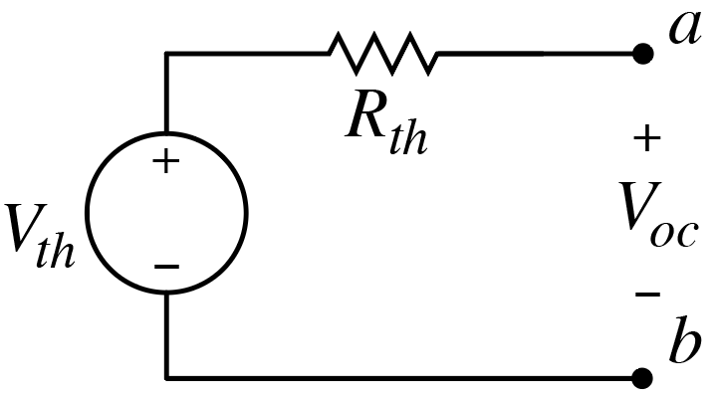
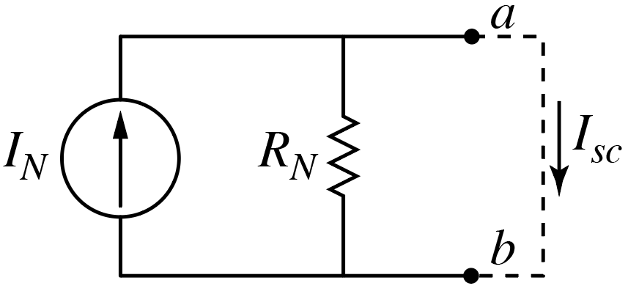





Thévenin and Norton Equivalent Circuits
Can replace arbitrary circuit with
its Thévenin equivalent.
$$V_{th}=V_{oc}$$
and
$$R_{th}={V_{oc}}/{I_{sc}}$$
Can replace arbitrary circuit with
its Norton equivalent.
$$I_{N}=I_{sc}$$
and
$$R_{N}={V_{oc}}/{I_{sc}}$$
Note: $R_{N}=R_{th}$

Slide 17








Thévenin and Norton Equivalent Circuits
Shortcut available for finding $R_{th}$ (or $R_{N}$) when circuit contains only
independent source:
Deactivate all sources. Then find resistance between a and b.
Example:
What are $R_{th}$and $V_{th}$?
$$R_{th}=R_{3}$$
Need to determine $V_{oc}$ or $I_{sc}$ to
determine equivalent source.
No current through $R_{3}$ when
open circuit present.
$$V_{oc}=v_{g}=V_{th}$$
$$V_{oc}=v_{g}=V_{th}$$
$R_{1}$, $R_{2}$, and $i_{g}$ don’t matter in terms of the equivalent circuit!

Slide 18







Want mesh analysis to find Norton equivalent between $a$ and $b$.
How many meshes are there?
$$3$$
Do we need a supermesh?
Yes, combining mesh 1 and 2.
What is constraint equation
relating $i_{1}$ and $i_{2}$?
$$i_{1}=i_{2}+i_{a}$$
$$\left(1\right)$$
KVL for supermesh?
KVL for mesh 3?
$$i_{1}R_{1}+i_{2}R_{3}+i_{2}R_{4}+\left(i_{1}−i_{3}\right)R_{2}=0$$
$$\left(2\right)$$
$$\left(i_{3}−i_{1}\right)R_{2}+v_{b}=0$$
$$\left(3\right)$$
Three equations; three unknows.
Solve for the currents.

Slide 19






Want mesh analysis to find Norton equivalent between $a$ and $b$.
We now have currents $i_{1}$, $i_{2}$,
and $i_{3}$.
What is the Norton resistance?
Only have independent sources.
Deactivate sources and find
remaining resistance between
$a$ and $b$.
$$R_{N}=\left(R_{1}+R_{3}\right)∥R_{4}$$
What is $V_{ab}=V_{oc}=V_{th}$?
$$V_{th}=v_{b}+{i_{2}R}_{4}$$
What is Norton current?
$$I_{N}={V_{th}}/{R_{N}}$$

Slide 20















Recall: Inverting Amplifier
Important!
Must have $v_{n}≈v_{p}$.
Noninverting terminal
tied to ground.
$$0 V$$
$$=0 A$$
$$0 V$$
$$v_{p}=0$$
so $v_{n}≈0$.
$$=0 A$$
Not present when
previously analyzed.
Must have $i_{p}≈0$
and $i_{n}≈0$.
Solve for $v_{o}$ by writing KCL at inverting terminal:
Important!
$$\frac{0−v_{i}}{R_{s}}+\frac{0−v_{o}}{R_{f}}=0$$
$$\frac{1}{R_{f}}v_{o}=−\frac{1}{R_{s}}v_{i}$$
$$v_{o}=−\frac{R_{f}}{R_{s}}v_{i}$$
Independent of $R_{L}$!

Slide 21






Inverting Amplifier
$$v_{o}=−\frac{R_{f}}{R_{s}}v_{i}$$
$$i_{o}$$
Assume:
$R_{f}=100$ kΩ,
$R_{s}=10$ kΩ,
$R_{L}=50$ kΩ.
$v_{o}=−10v_{i}$.
Result is independent of $R_{L}$!
Is $i_{o}$ independent of $R_{L}$?
No!
$v_{o}$ is fixed (by ratio of $R_{f}$ and $R_{s}$), but $i_{o}$ depends on all resistors (& $v_{i}$).

Slide 22
Node-Voltage Analysis
Use KCL at each non-reference essential node to obtain
equations relating voltages.
However, voltage source connecting two (non-reference) nodes
requires a supernode.
Voltage source between nodes allows one voltage to be
expressed in terms of other (thus eliminating one
unknown/equation from solution).
Alternatively, can continue to specify two separate voltages,
but need to incorporate into solution the equation relating the
two node voltages (constraint equation).
Obtain other desired quantities from node voltages as needed.

Slide 23
Mesh-Current Analysis
Use KVL for each mesh to obtain equations relating currents.
However, current source common to two meshes requires a
supermesh.
Current source common to two meshes allows one mesh
current to be expressed in terms of other (thus eliminating
one unknown/equation from solution).
Alternatively, can continue to specify two separate mesh
currents, but need to incorporate into solution the equation
relating two mesh currents (constraint equation).
Obtain other desired quantities from mesh currents as needed.

