Slide 1

Benchmarks 2014
Behrooz Shirazi
School of EECS

Slide 2
EECS Benchmarks
Benchmark | Goal
National rankings (Graduate programs) According to US News and World Report and National Research Council (NRC) | Top 50 by 2020
Research performance (expenditures) -- Total and per tenured and tenure track faculty | Exceed peers’ median/avg
Student to faculty ratio UG: students to total instructional faculty GR: students to tenured and tenure track faculty | Better than peers’ median/avg
UG degrees awarded Total and per instructional resources (TTF+NTTF+TA FTE) | Exceed Peers’ median/avg
UG student placement (jobs or grad school) at graduation | 75%+

Slide 3
Peers
Land grant universities
  University of Missouri-Columbia
  University of Tennessee-Knoxville
  Colorado State University
  Virginia Polytechnic Institute and
  State University
  Kansas State University
  Mississippi State University
  University of Florida
  Cornell University
  Louisiana State University
  Auburn University
  University of Wisconsin-Madison
  Texas A&M University
  Oklahoma State University
  Michigan State University
  The Ohio State University
  University of Illinois at Urbana-Champaign
  Purdue University
  Iowa State University
  University of California-Davis
  University of Minnesota -Twin Cities
  Washington State University
  North Carolina State University
Both EECS and Peers’ data is collected from ASEE (http://profiles.asee.org)

Slide 4
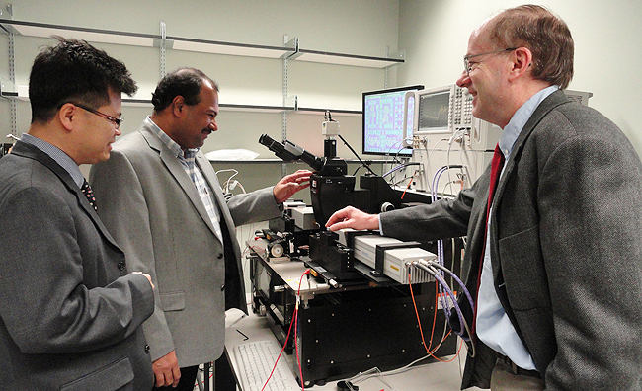
Rankings benchmark

Slide 5
Grad Program Rankings (US News)
EE ranking (out of 256 EE/CE programs):
  Colorado State, Syracuse, UC Riverside (67)
  Oregon State, NJIT, Texas Tech (76)
CS ranking (out of 437 CS programs) – no new ranking since 2010:
  Oregon State (63), Colorado State (79), Florida State (79)
2007 | 2008 | 2009 | 2010 | 2011 | 2012 | 2013
77 | 68 | 65 | 79 | 75 | 72 | 60
Top 30%
2007 | 2008 | 2009 | 2010
N/R | N/R | N/R | 79
Top 18%

Slide 6
2012 NRC Rankings, EE@WSU
Overall
  46-103
    University of Maryland-College Park, Electrical Engineering
    Drexel University, Electrical and Computer Engineering
    University of Notre Dame Electrical Engineering
    Columbia University in the City of New York, Electrical Engineering
    University of Illinois at Chicago, Electrical and Computer Engineering
    Washington State University, Electrical Engineering
    University of Arkansas, Electrical Engineering
    University of California-Davis, Electrical and Computer Engineering
    University of Nebraska-Lincoln, Electrical Engineering
    University of New Mexico-Main Campus, Electrical and Computer Engineering
    Case Western Reserve, University Electrical Engineering
136 ranked by NRC

Slide 7
2012 NRC Rankings, CS@WSU
Overall
  50-105
    University of Central Florida, Computer Sciences
    North Carolina State University at Raleigh, Computer Sciences
    University of Florida, Computer Engineering
    College of William and Mary, Computer Sciences
    Kansas State University, Computer Science
    Washington State University, Computer Science
    Oregon State University, Computer Science
    The University of Alabama, Computer Sciences
    George Washington University, Computer Science
    Western Michigan University, Computer Sciences
    University of Delaware, Computer and Information Sciences
126 ranked by NRC

Slide 8
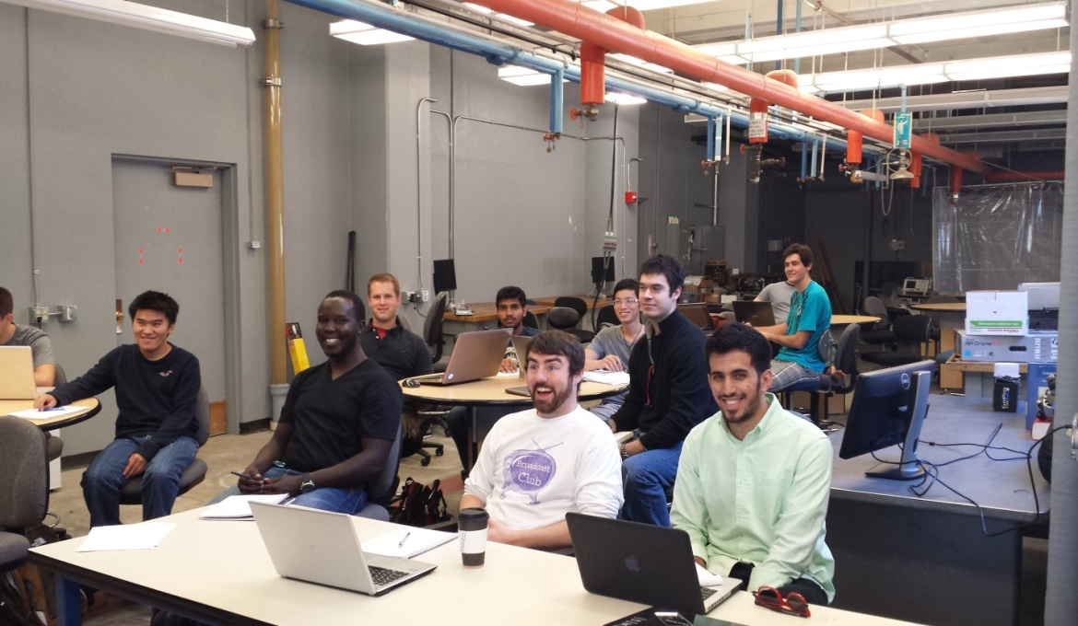
Research productivity benchmark

Slide 9
EECS Research expenditures

Slide 10
Research $ per faculty
* TTF: Tenured and tenure track faculty

Slide 11
Comparison to peers (2013)
 | Total Research Expenditures | Rank among Peers
EECS | $7.58M | 19 out of 22
Peers Median | $17.30M | N/A
Peers Average | $27.06M | N/A
 | Research $ per (tenure track) Faculty | Rank among Peers
EECS | 280,852 | 16 out of 22
Peers Median | 316,717 | N/A
Peers Average | 376,397 | N/A

Slide 12
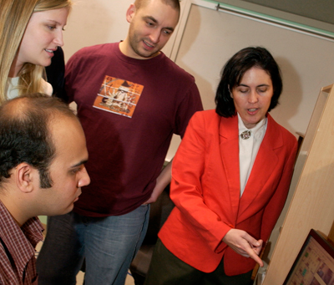
Student to faculty ratio benchmark

Slide 13
EECS in numbers
Fall 2014 Full-time, non-temporary faculty positions
 | Pullman |  | Total
 | Tenure Track | Non-Tenure Track
Electrical Engineering | 20 | 2 | 22
Computer Engineering | 2 | 1 | 3
Computer Science | 14 | 5 | 19
Total | 36 | 8 | 44
Joining to EESC in Fall 2014 : 3 TT in EE, 1 NTT in EE, 4 TT in CptS, 1 NTT in CptS

Slide 14
EECS in numbers
* Fall 2001 also includes Tri-Cities students

Slide 15
EECS in numbers
* Fall 2001 also includes Tri-Cities students
80% PhD
Fall 2014 Undergraduate Freshman and Transfer Students: CptS 146; EE 87; CptE 48

Slide 16
Comparison to peers (2013)
 | UG*/All Faculty Ratio | Rank among Peers
EECS | 14.65 | 1 out of 22
Peers Median | 8.83 | N/A
Peers Average | 9.33 | N/A
 | GR**/Tenure track Faculty | Rank among Peers
EECS | 6.63 | 14 out of 22
Peers Median | 7.77 | N/A
Peers Average | 7.56 | N/A
* UG = total certified (Junior + Senior) students
** GR = total MS and PhD students

Slide 17
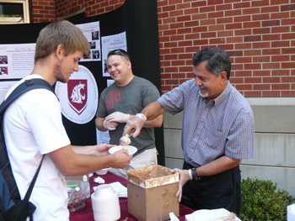
UG Degrees Awarded benchmark

Slide 18
EECS in numbers

Slide 19
Comparison to peers (2013)
 | UG degrees granted | Rank among Peers
EECS | 120 | 15 out of 22
Peers Median | 209.50 | N/A
Peers Average | 186.50 | N/A
 | UG degrees per teaching resources* | Rank among Peers
EECS | 2.41 | 2 out of 22
Peers Median | 1.77 | N/A
Peers Average | 1.74 | N/A
* Teaching resources: Tenure track faculty + Non-Tenure track faculty + TA FTEs

Slide 20
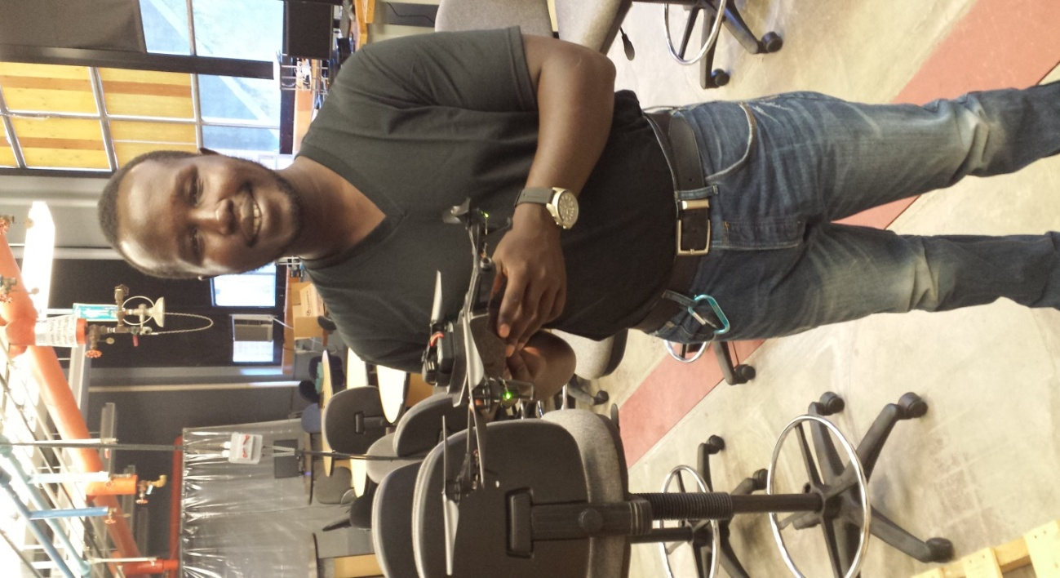
UG student placement benchmark

Slide 21
UG student placement
Based on exit interviews of EECS graduating students:
Year | With at least one job offer | Entering graduate school | Total Percentage Placed | With internships
2014 | 41% | 1% | 42% | 58%
2013 | 44% | 10% | 54% | 63%
2012* | 61% | 10% | 71% | 61%
2011 | 61% | 19% | 80% | 53%
2010 | 53% | 12% | 65% | 65%
2009 | 49% | 13% | 62% | N/A
2008 | 65% | 16% | 81% | N/A
* Exit surveys after 2012 are mandatory (voluntary before then)

Slide 22
UG student placement
Based on exit interviews of EECS graduating students:
Year | With at least one job offer |  |  |  |  | Entering graduate school |  |  |  |  | Total Percentage Placed
 | CptS-BS | CptS-BA | CptE | EE | Overall | CptS-BS | CptS-BA | CptE | EE | Overall | CptS-BS | CptS-BA | CptE | EE | Overall
2014 | 50% | 43% | 46% | 31% | 41% | 0% | 0% | 8% | 0% | < 1% | 50% | 43% | 54% | 31% | 41%
2013 | 70% | 25% | 40% | 32% | 44% | 12% | 0% | 7% | 11% | 10% | 82% | 25% | 47% | 43% | 54%

Slide 23
UG student placement
Based on exit interviews of EECS graduating students:
Year | With internships | Sought employment | Have at least one job offer (among those who sought employment)
2014 | 58% | 41% | 45% (CptS BS 52%, CptS BA 50%, CptE 50%, EE 35%)
2013 | 63% | 84% | 54% (CptS BS 85%, CptS BA 33%, CptE 46%, EE 39%)
* Exit surveys after 2012 are mandatory (voluntary before then)

Slide 24
Student placement – based on exit interviews
87 hires for Spring 2012 through Summer 2013
Company | Number of Hires
SEL | 9
Boeing | 7
Micron | 7
Microsoft | 7
Isilon | 7
PSE | 3
Anvil Engineering | 2
Apptio | 2
CH2M Hill | 2
Chief Architect | 2
Cowlitz PUD | 2
Fast Enterprises | 2
Garmin AT | 2
AHA - Comtech EF Data | 1
Amazon | 1
Applied Physics Lab at the University of Washington | 1
Company | Number of Hires
Boise Inc | 1
Carnegie Mellon University Robotics Institute | 1
Chelan County PUD | 1
Clearwater Paper | 1
Colmac Coil Mfg. | 1
Cowlitz County PUD | 1
Decagon Devices | 1
Eaton Corp | 1
FUJITSU Japan | 1
Garmin | 1
Hawaiian Electric Company | 1
HiLine Engineering & Fabrication Inc. | 1
Honeywell | 1
Infinium Engineering and Consulting | 1
Johns Hopkins University | 1
Lee & Hayes | 1
Company | Number of Hires
Marchex | 1
Neon Mob Obvious Corporation | 1
PNNL | 1
Power Engineers | 1
Qumulo | 1
Saudi Aramco Oil Company | 1
Schenieder Electric | 1
SoySource | 1
TCS | 1
Texas Instruments | 1
Universal Avionics | 1
US Air Force | 1
Verizon Wireless | 1
Weyerhauser | 1

Slide 25
Some key eecs alums
Paul Allen (co-founder of Microsoft)
Ed Schweitzer (founder and President of SEL)
Harold Frank (founder of Applied Magnetics)
Gaymond Schultz (founder and VP of Engineering of Stratacom)
Terry Heng (Senior VP at Motorola and CEO of Gridline Communications)
Doug Allred (Senior VP at Cisco)
Joe Jachinowski (founder of IMPAC, President and CEO of Elekta, Inc.)
Floyd Rogers (Software Design Engineer at Microsoft)
Judy Huie-Rogers (Boeing)
Bill Gaines (Director of Tacoma Public Utilities)
Gary Steele (CEO of ProofPoint)
Clint Cole (founder and CEO of Digilent)
C. Gus Grant (founder of Focus Systems, Inc.)
Robert Baker (Senior VP at Intel Corp.)
Thor Culverhouse (President and CEO of Stratavia)
Ashok Dhawan (CEO of Mobius)
Debbie Gracio (Division Director, Computational & Statistical Analytics Division, PNNL)
Sara Moss (CEO and founder of The Code Works)
Gerri Martin-Flickinger (CIO Adobe)
Steve Seroshek (CEO and founder of Avaunt Technologies, Inc.)
…

Slide 26
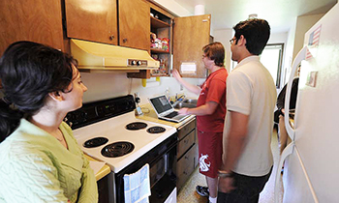
Summary

Slide 27
Summary
EECS has come a long way in the past 6 years
  Research expenditures: $2.5M to $7.5M (3X increase)
  GR students: from 113 to 152 (40% increase)
  UG students: from 552 to 896 (60% increase)
Work to do:
  Continue to make improvements in rankings
  Continue increasing research expenditures
  Reduce UG student/faculty ratio by adding more faculty
  Increase GR student/faculty ratio by increasing the PhD student population

