Slide 1

Assessment of WSU EECS Program
2013-14 Cycle
Highlights

Slide 2
We Have Documented Our Assessment Process!
New Assessment Manuals for CS, and EE/CE
  Soon available at abet.eecs.wsu.edu
Manuals specify detailed processes for
  collecting assessment data
  analyzing data
  making decisions based on data
By participating in this retreat, YOU are integrally involved in this process!

Slide 3
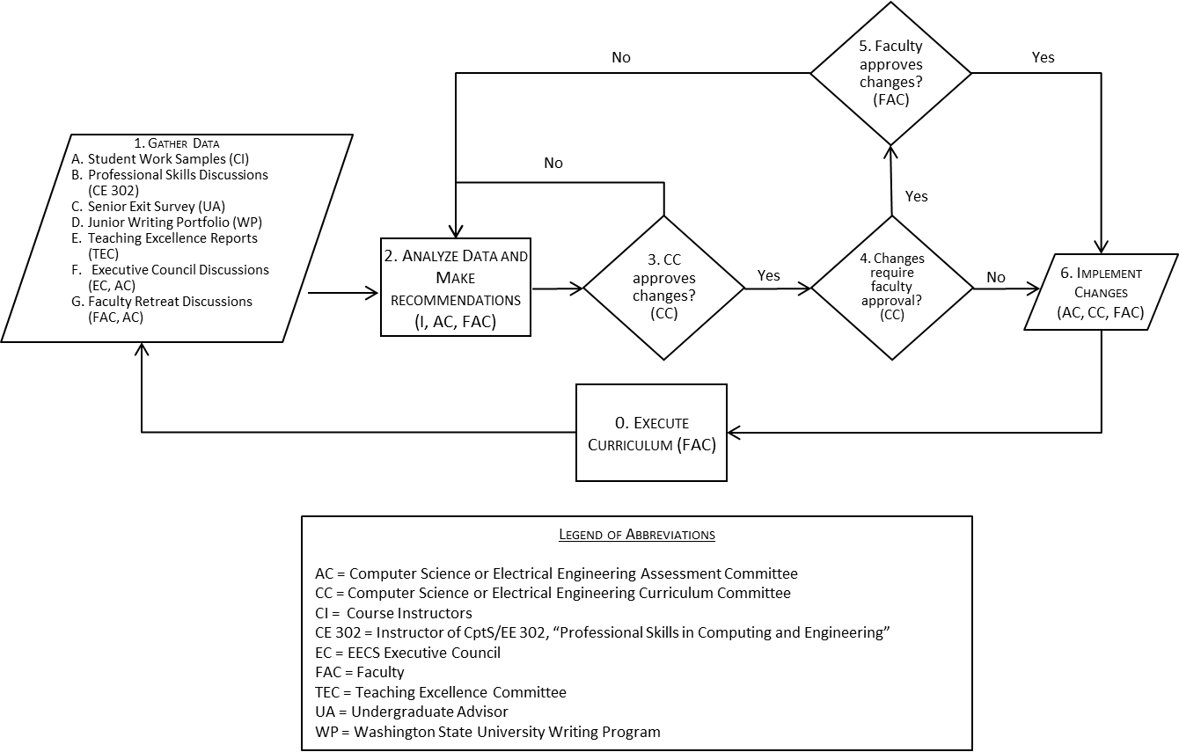
Overview of Assessment Process

Slide 4
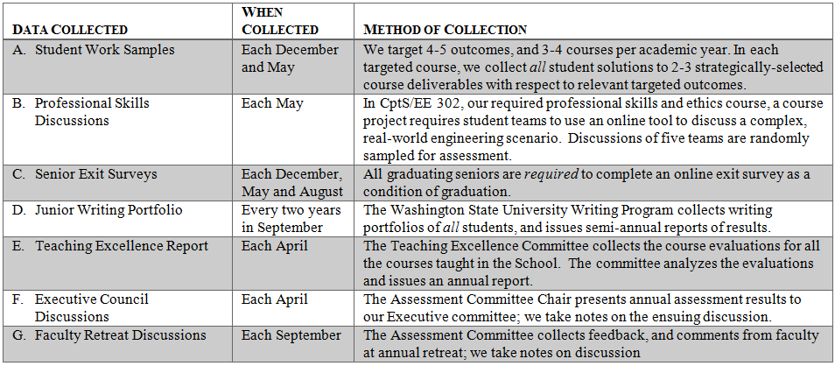
We Collect Seven Forms of Assessment Data

Slide 5
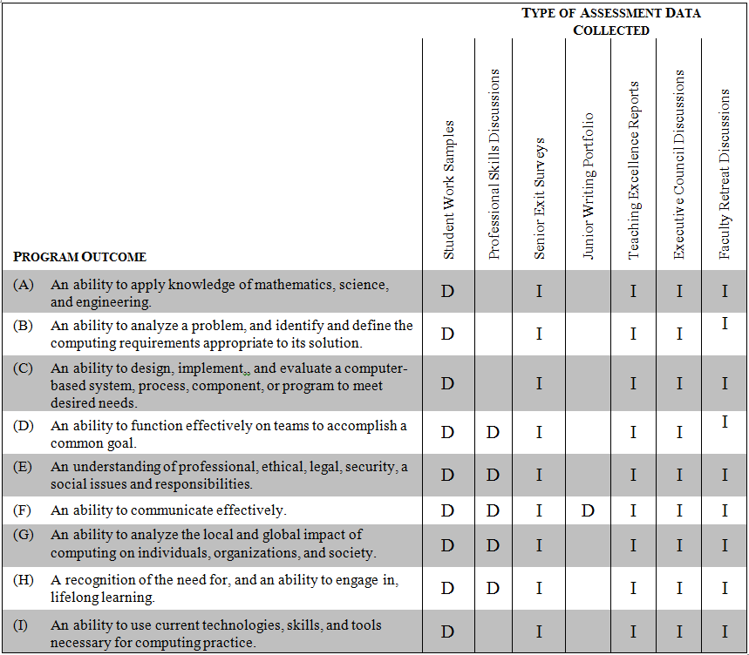
Assessment Data vis-à-vis Outcomes

Slide 6
Student Work Samples:
Engage Students in Assessment Process
Require instructors to publish ABET Outcomes to be achieved in their course syllabi
Encourage instructors to explicitly discuss ABET assessment process with students
  Target outcomes for course
  Four-level assessment scale (Unsatisfactory, Needs Improvement, Capable, Exemplary)
  Expectation that “Capable” level be reached by all passing students

Slide 7
Professional Skills Discussions:
Save Discussion for CS Breakout

Slide 8
Senior Exit Surveys
Administered online via Surveymonkey
Open near the end of each semester
Seniors required to take survey as condition of graduation
2013-14 survey respondents:
  49 in CptS
  65 in EE
  18 in CE

Slide 9
Senior Exit Survey:
Gender
CptS: 87% male, 13% female
EE: 91% male, 3% female, 6% undisclosed
CE: 100% male

Slide 10
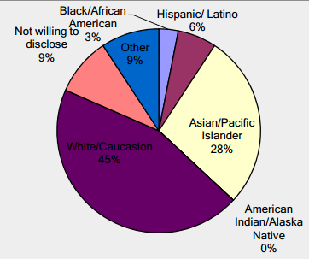
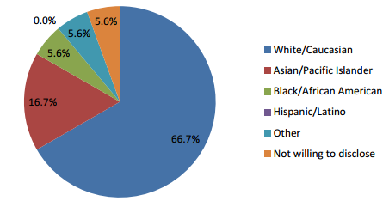
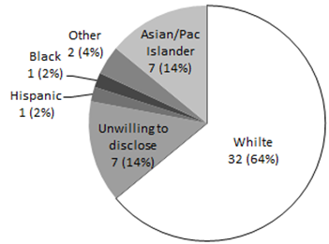
Senior Exit Survey:
Ethnicity
CE
EE
CptS

Slide 11
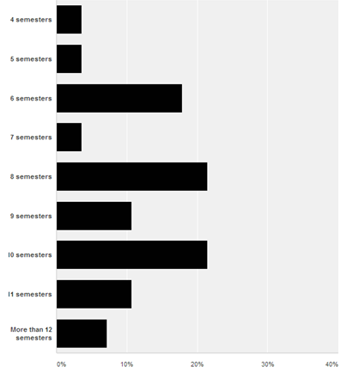
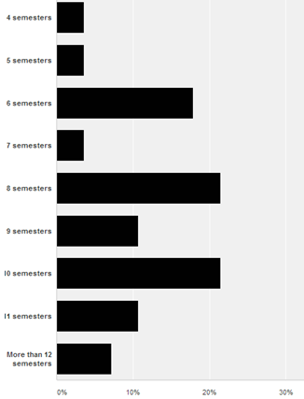
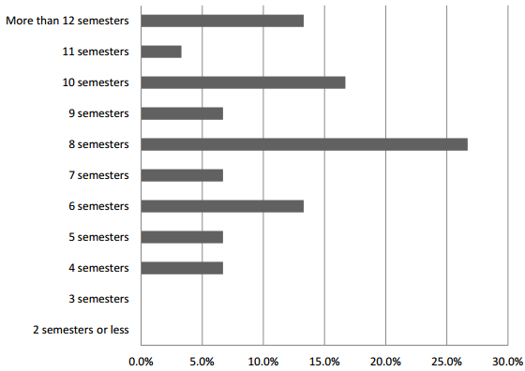
Senior Exit Survey:
Semesters to Graduation
EE
CE
CptS

Slide 12
Senior Exit Survey:
Success at Job-Seeking and Grad School
Sought employment: EE 85%, CE 94%, CptS 84%
Received offer: EE 35%, CE 47%, CptS 49% (our established goal is 80%)
Applied/accepted to grad school: EE: 3/7, CE: 1/1, CptS: 4/4 (overall 67% acceptance rate)
Is 80% goal realistic?
  Should we adjust the goal to “getting an interview?” (EE: 80%, CE: 82.3%, CptS: 88%)
  Should we establish different goals for students based on GPA?

Slide 13
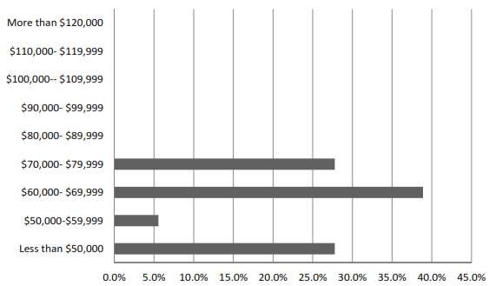
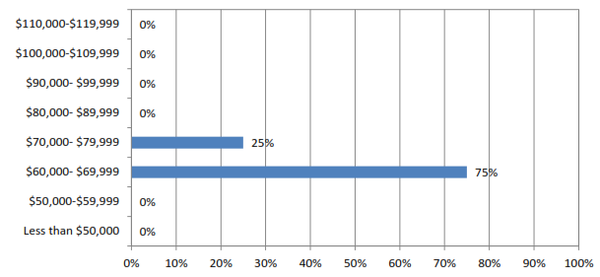
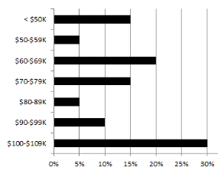
Senior Exit Survey:
Starting Salaries
EE
CE
CptS

Slide 14
Senior Exit Survey:
Perceived Attainment of Outcomes
Students across all three programs perceived a level of attainment below our target (4 out of 5 on a 5-point scale) for most outcomes
Are we setting the bar too high?
Suggestion: Use the same scale in the surveys as we use for other ABET ratings? (a 4-point scale, with “Capable” being the target)
Thoughts?

Slide 15
Junior Writing Portfolio
Across all three programs, we achieved the following pass rates
  EE: 79.6%, of whom 5.6% passed with distinction
  CE: 80.7%, of whom 5.2% passed with distinction
  CptS: 88%, of whom 9.8% passed with distinction
We met target pass rate (80%)
“Pass with distinction” target (10%) not quite met
Do we really need “pass with distinction” target?

Slide 16
Teaching Excellence Reports
Save for breakout sessions

Slide 17
Executive Council Discussions
Recommendations:
  Retain Senior Design requirement for BA in CptS
  Integrate explicit soft skills training into EE/CptS 302
Comments and discussion?

Slide 18
Unresolved Issues from Past Assessment Cycles (1)
Students self-report inadequate preparation for entrepreneurship (Are we setting the bar too high?)
Anecdotally, cheating is a rampant problem
  Is it really a problem? What evidence do we have?
  Should we try to collect data on cheating?
  Are there best practices for addressing the problem that we can implement?

Slide 19
Unresolved Issues from Past Assessment Cycles (2)
(From 2012-13 Faculty Retreat) Students have been kicked out of the computer labs by Pullman Police late at night due to vandalism
We recommended
  labs be kept open,
  install keycard readers on doors
  Encourage self-policing by students
Follow-up? Has this been done?

Slide 20
Unresolved Issues from Past Assessment Cycles (3)
(From 2012-13 Faculty Retreat) Faculty not attending student forum in fall
We recommended
  EECS director should emphasize attendance through e-mail reminders
Follow-up? Has this situation improved?

