Slide 1
Monte Carlo Methods

Slide 2
Learn from complete sample returns
Only defined for episodic tasks
Can work in different settings
On-line: no model necessary
Simulated: no need for full model

Slide 3
DP doesn’t need any experience
MC doesn’t need a full model
Learn from actual or simulated experience
MC expense independent of total # of states
MC has no bootstrapping
Not harmed by Markov violations

Slide 4
Every-Visit MC: average returns every time s is visited in an episode
First-visit MC: average returns only first time s is visited in an episode
Both converge asymptotically

Slide 5
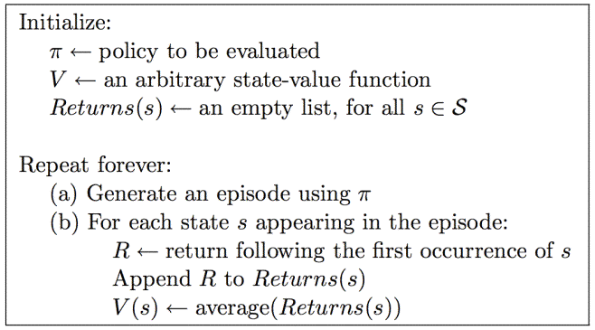
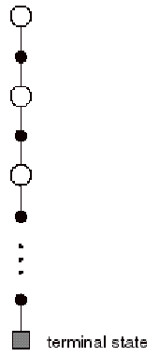
1st Visit MC for V^{π}
What about control?

Slide 6
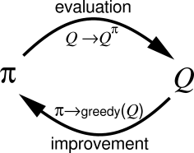
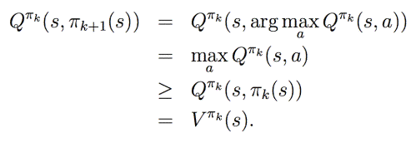
Want to improve policy by greedily following Q

Slide 7
MC can estimate Q when model isn’t available
Want to learn Q*
Converges asymptotically if every state-action pair is visited “enough”
Need to explore: why?
Exploring starts: every state-action pair has non-zero probability of being starting pair
Why necessary?
Still necessary if π is probabilistic?

Slide 8
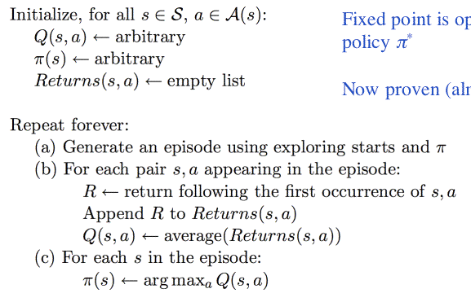
MC for Control (Exploring Starts)

Slide 9
Q₀(.,.) = 0
π₀ = ?
Action: 1 or 2
State: amount of money
Transition: based on state, flip outcome, and action
Reward: amount of money
Return: money at end of episode

Slide 10
MC for Control, On-Policy
Soft policy:
π(s,a) > 0 for all s,a
ε-greedy
Can prove version of policy improvement for soft policies

Slide 11
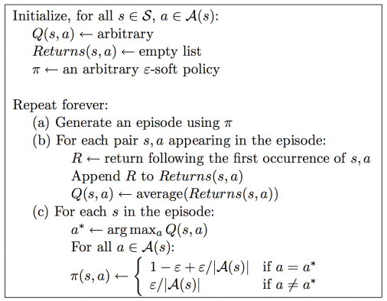
MC for Control, On-Policy

Slide 12
Off-Policy Control
Why consider off-policy methods?

Slide 13
Off Policy Control
Learn about π while following π’
Behavior policy vs. Estimation policy

Slide 14
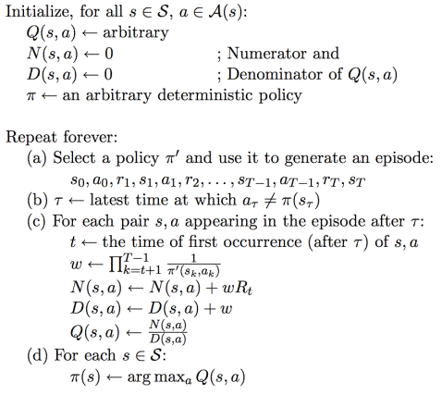

Slide 15
Off policy learning
Why only learn from tail?
How choose policy to follow?

Slide 16
