Slide 1
Schedule for next 2 weeks

Slide 2
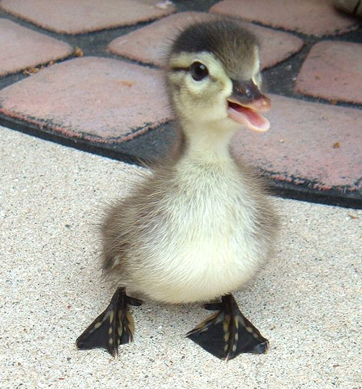
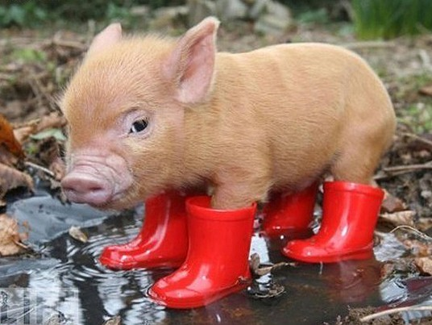
5) Finding shortest path with costs

Slide 3
C
A
F
S
D
B
G
E
In this problem the start state is S, and the goal state is G. Assume that ordering is defined by, and ties are always broken by choosing the state that comes first alphabetically.
What is the order of states expanded using Depth First Search? Assume DFS terminates as soon as it reaches G.
Notes:
SABDFG

Slide 4
Occupancy Grid, accounting for C-Space
start
goal

Slide 5
Big Picture
Occupancy grids perform exhaustive search across the state space.
Represent and evaluate a far greater number of world states than the robot would actually need to traverse
What can we do differently?

Slide 6
Roadmap Algorithms
Idea:
Avoid searching entire space
Pre-compute a (hopefully) small graph (i.e., a roadmap) such that staying on the “roads” will avoid obstacles
Find a path from q_{start} to closest point on roadmap
Use roadmap to find path to q_{goal}

Slide 7
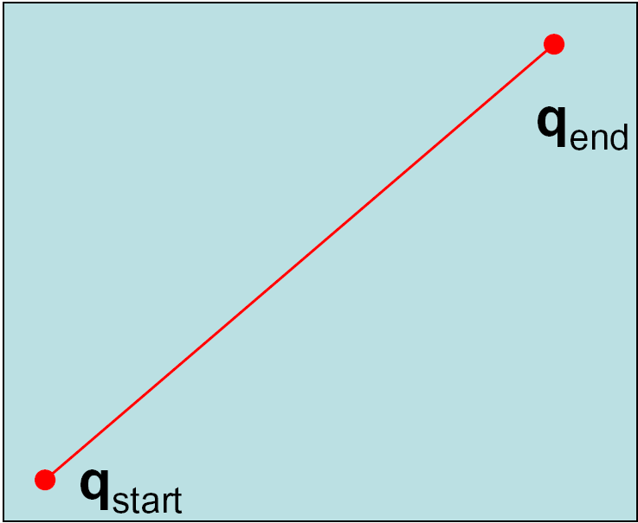
Shortest Path between Two Points

Slide 8
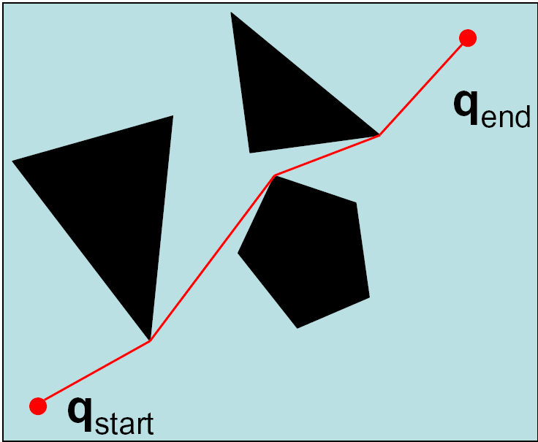
Shortest Path with Obstacles

Slide 9
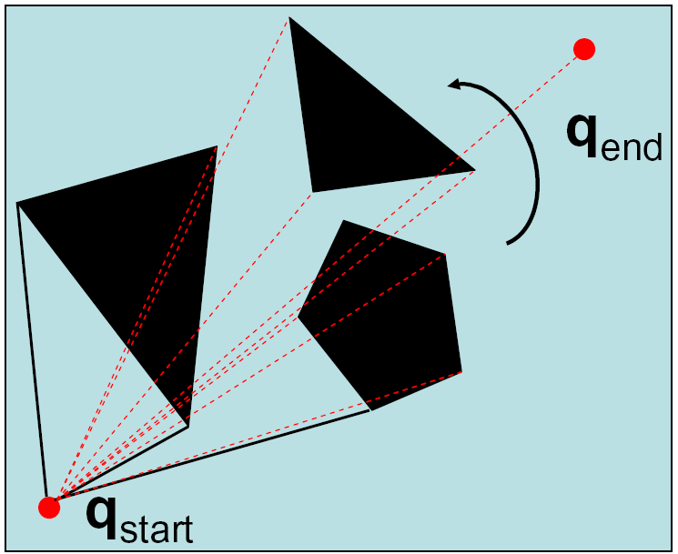
Sweep Algorithms

Slide 10
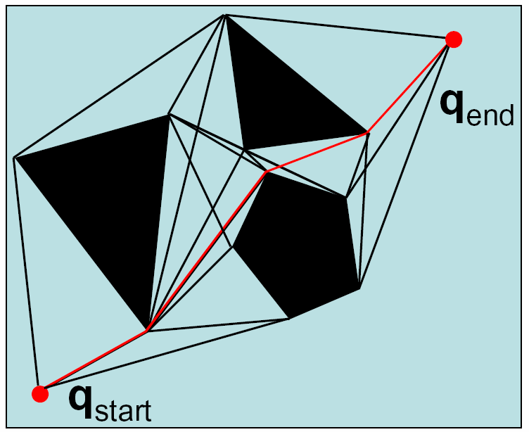
Visibility Graph

Slide 11
Visibility Graphs
Shortest path but…
Stays as close as possible to the obstacles
Deviations from path can lead to collisions
Requires polygonal obstacles

Slide 12
Other Alternatives…
What if we care more about keeping our robot safe than about optimality?

Slide 13
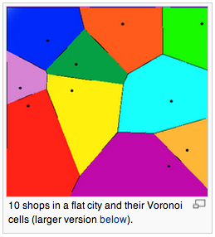
Other Alternatives…
What if we care more about keeping our robot safe than about optimality?
The other extreme: stay away from obstacles as far as possible

Slide 14
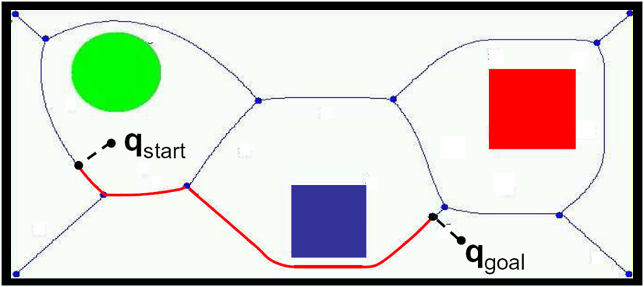
Voronoi Diagram
Control is easy:

Slide 15
Voronoi Diagram
Control is easy: stay equidistant away from closest obstacles

Slide 16
Voronoi Diagrams
Difficult to compute in higher dimensions
Staying away from obstacles is not necessarily the best heuristic
Can lead to paths that are much too conservative
Can be unstable: small changes in obstacle configuration can lead to large changes in the diagram
Fortune’s Algorithm

Slide 17
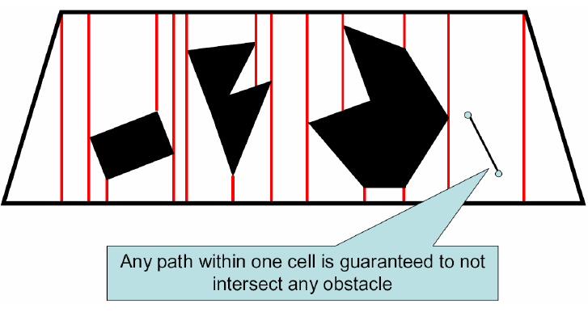
Exact Cell Decomposition
How would this be used?

Slide 18
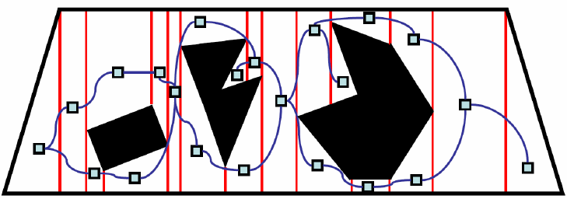
Exact Cell Decomposition
Identify adjacent cells

Slide 19
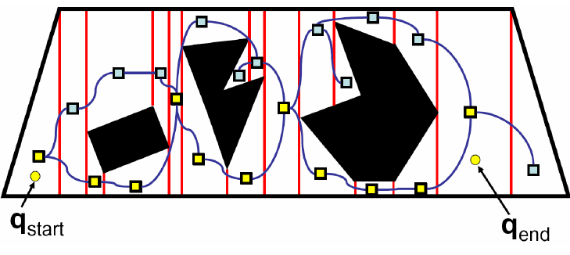
Exact Cell Decomposition
Plan over this graph
How can we improve the path?

Slide 20
Example of Adaptive Decomposition
Quadtrees

Slide 21
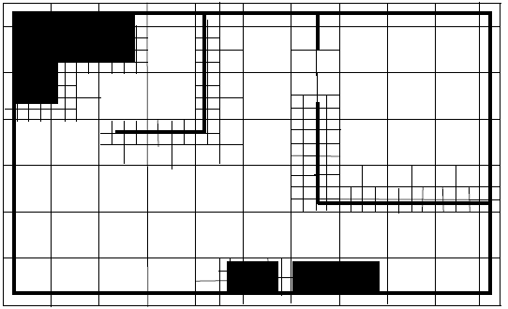
Example of Adaptive Decomposition
Quadtrees
Each internal node has 4 children
Recursively sub-divide space into quadrants

Slide 22
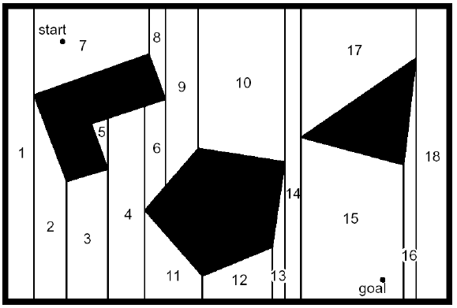
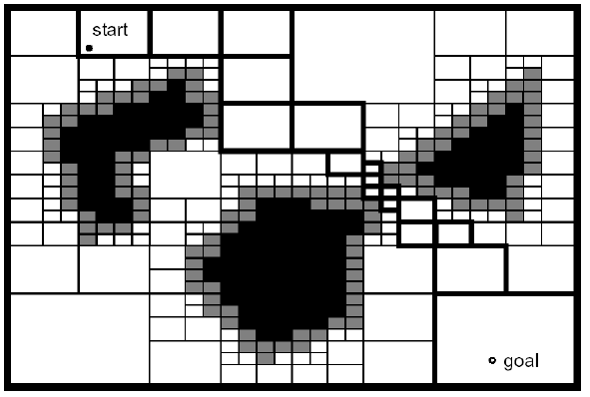
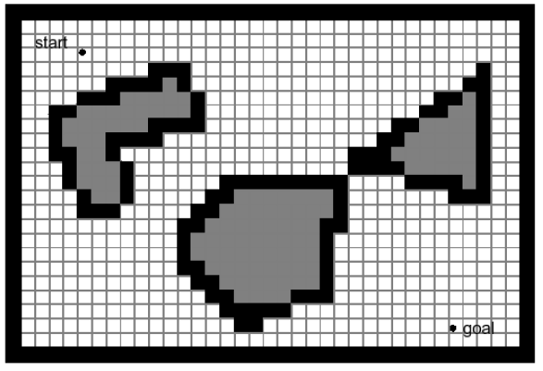
Exact vs. fixed vs. adaptive
Pros and Cons?

Slide 23
Considerations
Difficulty in constructing map
Computational complexity
Planning over map
Constructing map
Map Accuracy
Memory Needed

Slide 24
Kinematics
Move were you want to go
Navigation
Given a Map, and Path planning: Decide where you want to go, and then use Kinematics
Maps
Representation: Turn the real world into a map I can plan over
Localization
Given a map, how do I know where I am?
Map building
Oh man, how do I construct a map? Well, it probably depends on where I am and how I move….

Slide 25
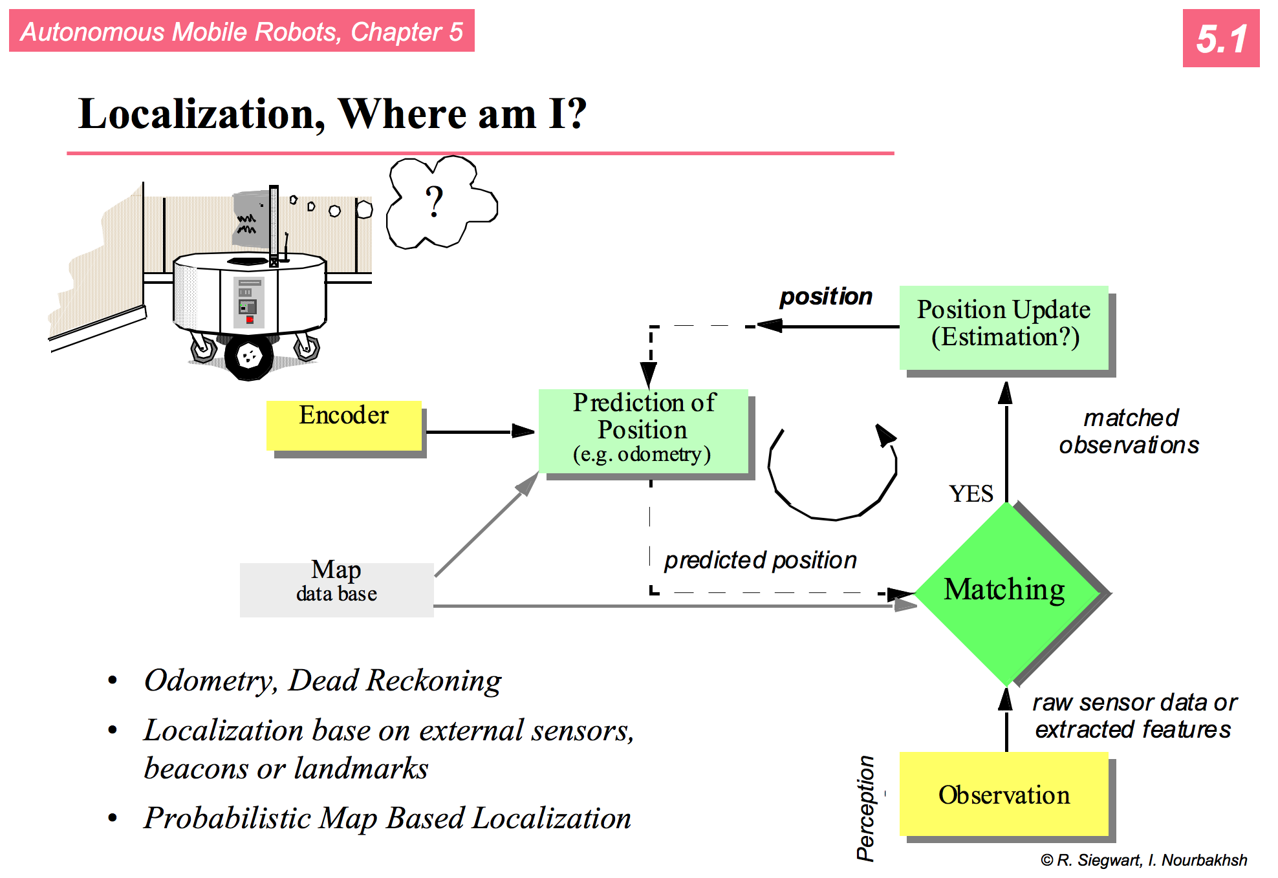

Slide 26
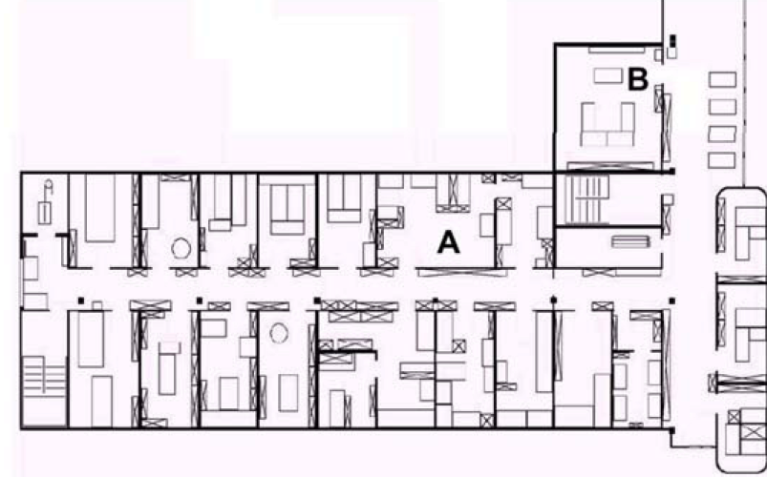
How to navigate between A and B?
Two components to this task:
Navigation without hitting obstacles
Detection of goal location
Possible by following always the left wall
How to detect that the goal is reached?
“behavior based navigation”
It can work in some environments but not in all

Slide 27
How to navigate between A and B?
Map based navigation relies on a map
Assuming that the map is known, at every time step the robot has to localize itself in the map.
How?
If we know the start position, we can use wheel odometry or dead reckoning.

Slide 28
Odometry and Mapping
Create a map as the robot is exploring the environment.
If we assume that our odometry is perfect, could get something like this:
Can’t trust odometry so we must localize as we’re mapping.

Slide 29
Challenges
Effector noise / Odometry Error
Distance movement estimation
Turn error: turning estimation
Drift Error: difference in error of wheels
Sensor noise
False positive readings, false negative readings, noisy readings
Sensor aliasing
Multiple locations appear the same to the sensors

Slide 30
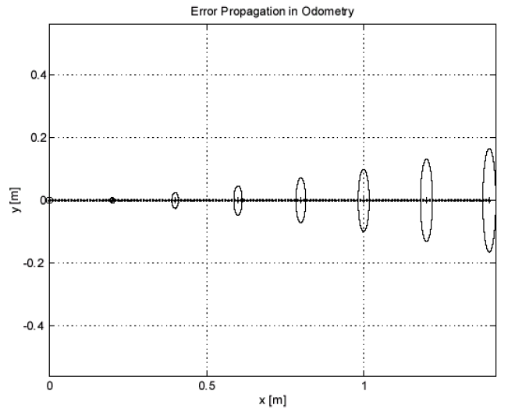
Simple error model from kinematics

Slide 31
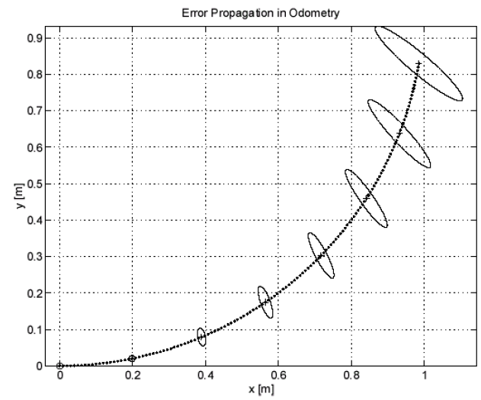
but now add in turning…

Slide 32
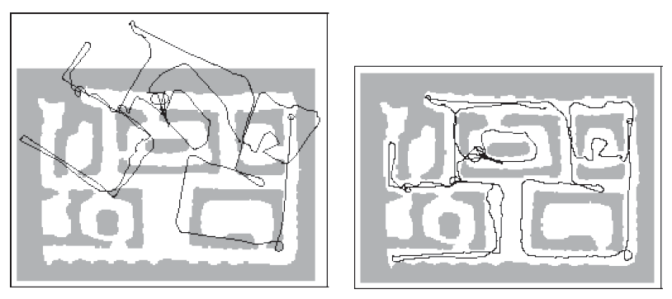
and this leads to things like
(Dieter Fox @ CMU)

