Slide 1
Suggested Machine Learning Class:
  https://www.udacity.com/course/machine-learning-supervised-learning--ud675
https://www.youtube.com/watch?v=XIDHrWQe5FQ

Slide 2

Lab 1
Installation troubles?
ROS Impressions
  Good, Bad, Ugly
Prep for Lab 2
Wait List

Slide 3
Real World Environment
Motion Control
Perception
Path
Environment Model, Local Map
Cognition
Position
Global Map
Localization

Slide 4
Today’s Objectives
Be able to explain why vision is non-trivial
Explain how to calculate distances and positions with stereo cameras
List the different types of sensors
Quantify ways in which one sensor differs from another

Slide 5
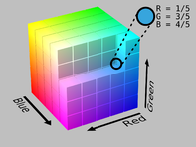
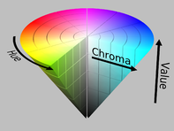
HSV
TurtleBot
  Driving around with keyboard
  Vision : red ball
  Mapping

Slide 6
Simple Vision
How would I find the red ball?
What if it’s moving?

Slide 7
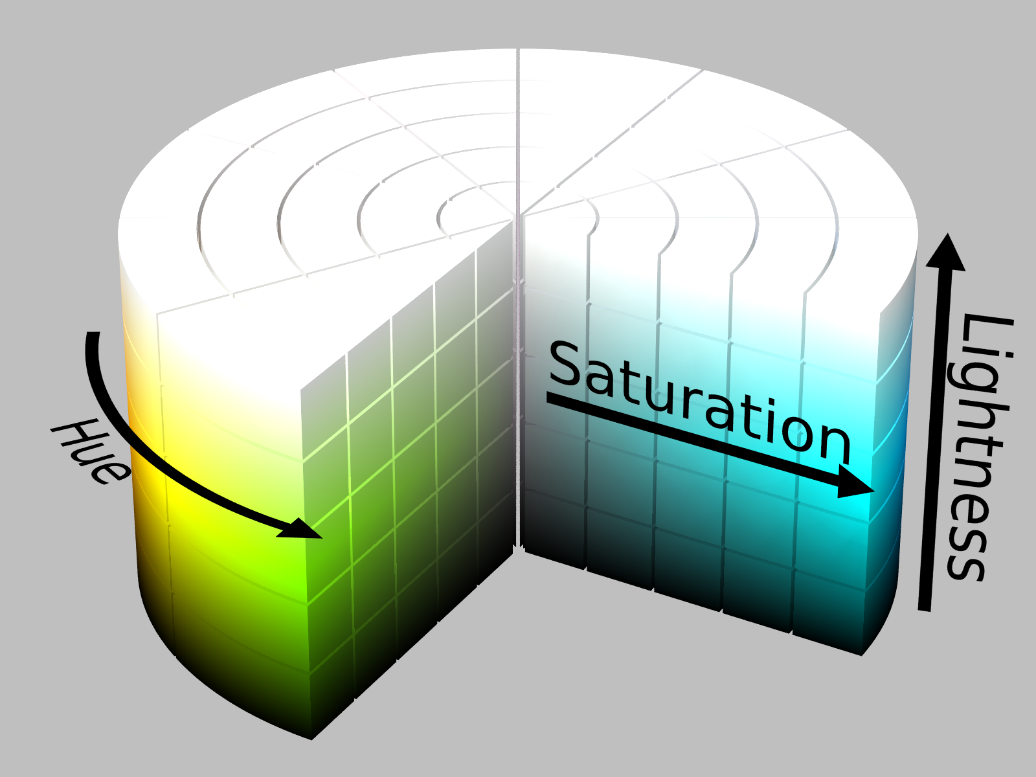

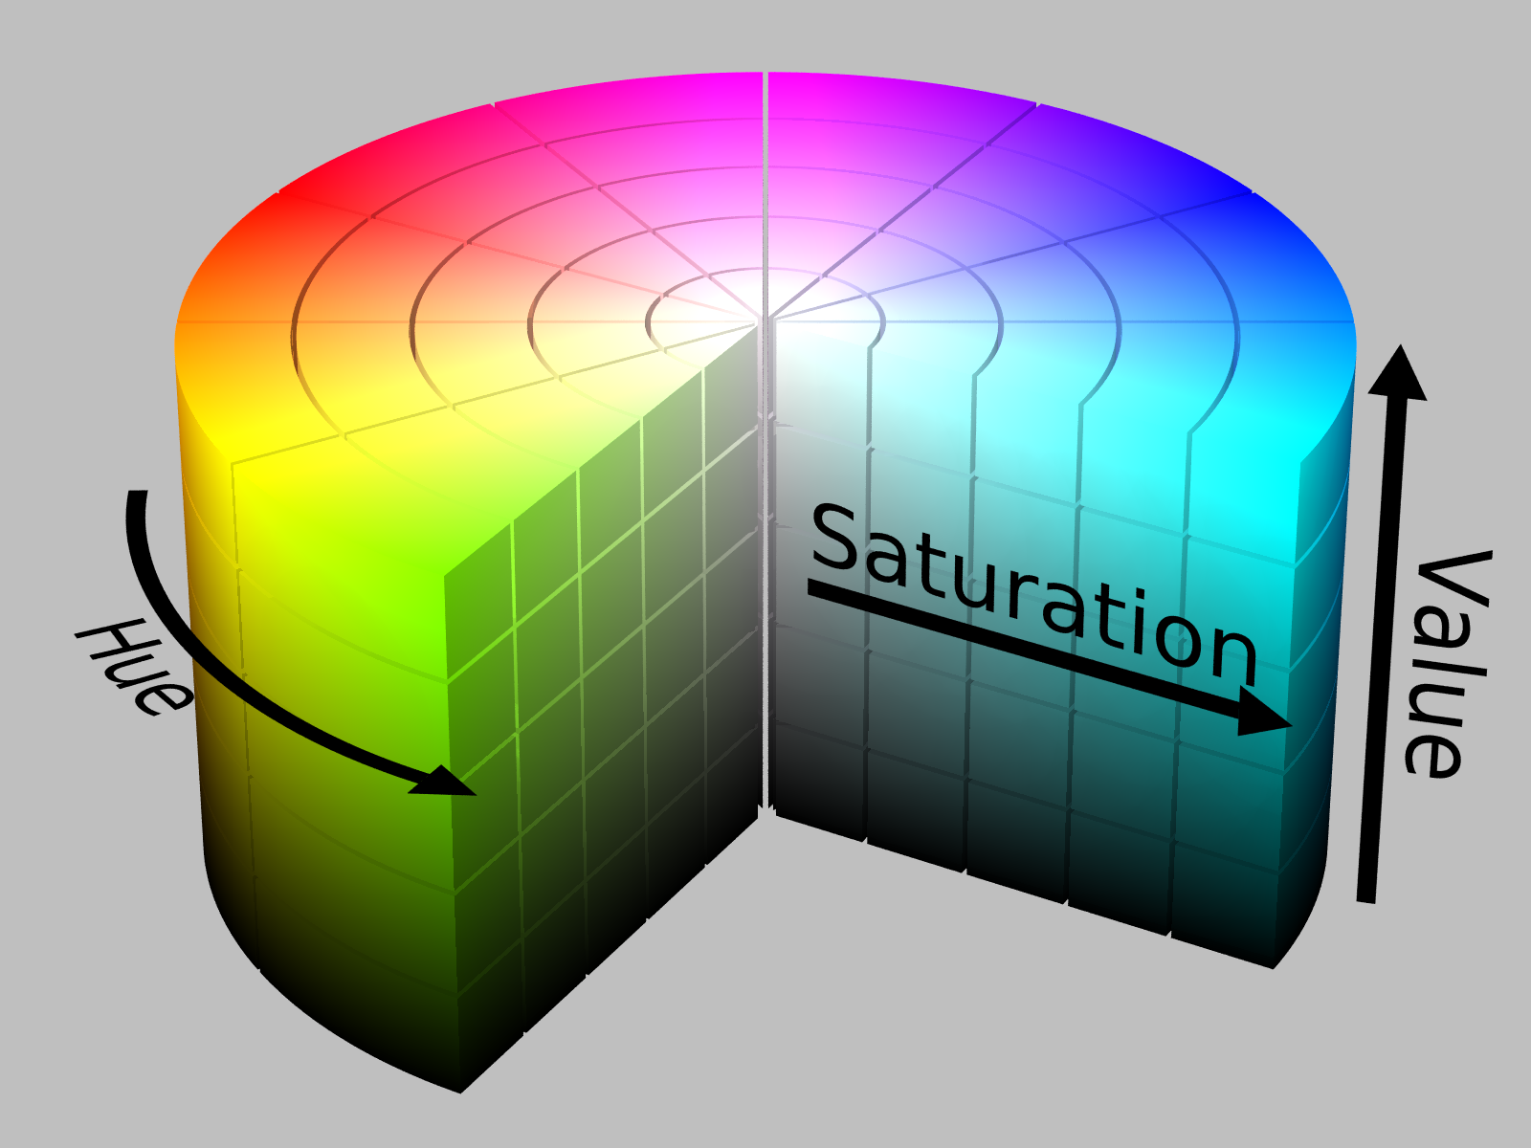
RGB, HSL, HSV

Slide 8
RGB, HSL, HSV
HSL, HSV: easier to define, closer to human vision
http://colorizer.org/

Slide 9
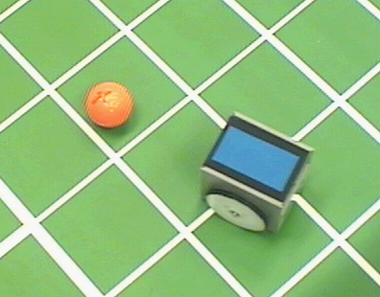
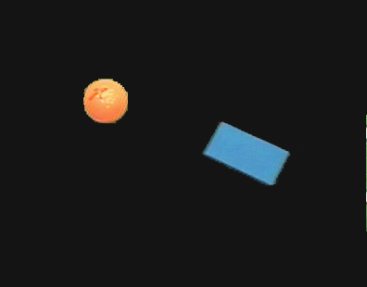
Color Tracking Sensors
Motion estimation of ball and robot for soccer playing using color tracking

Slide 10
Pixy
http://techcrunch.com/2013/08/19/pixy/

Slide 11
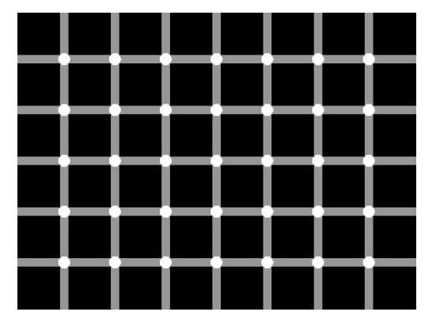
How many black spots?

Slide 12
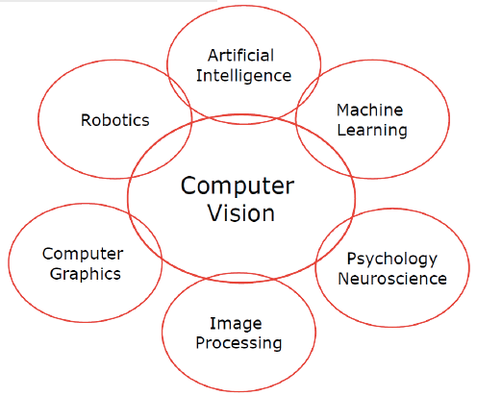

Slide 13
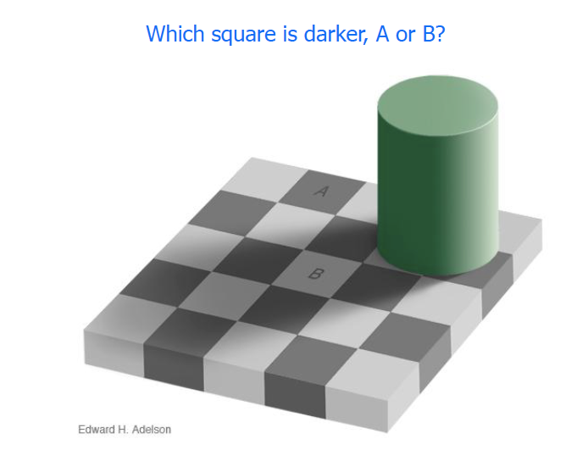

Slide 15
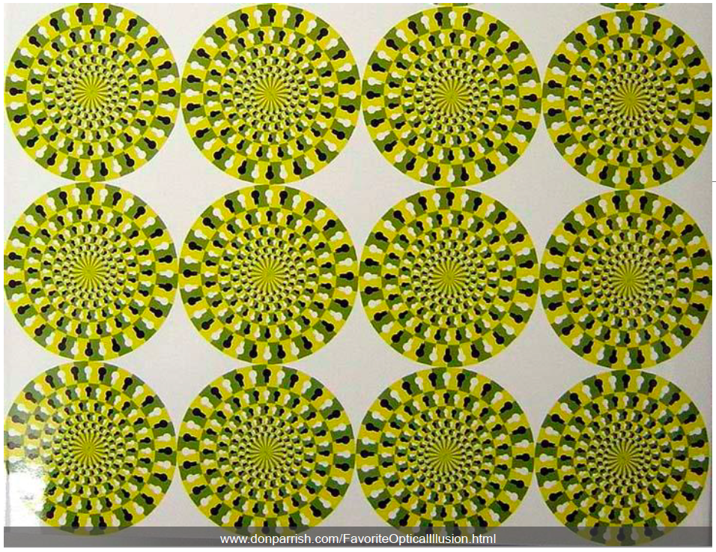

Slide 16
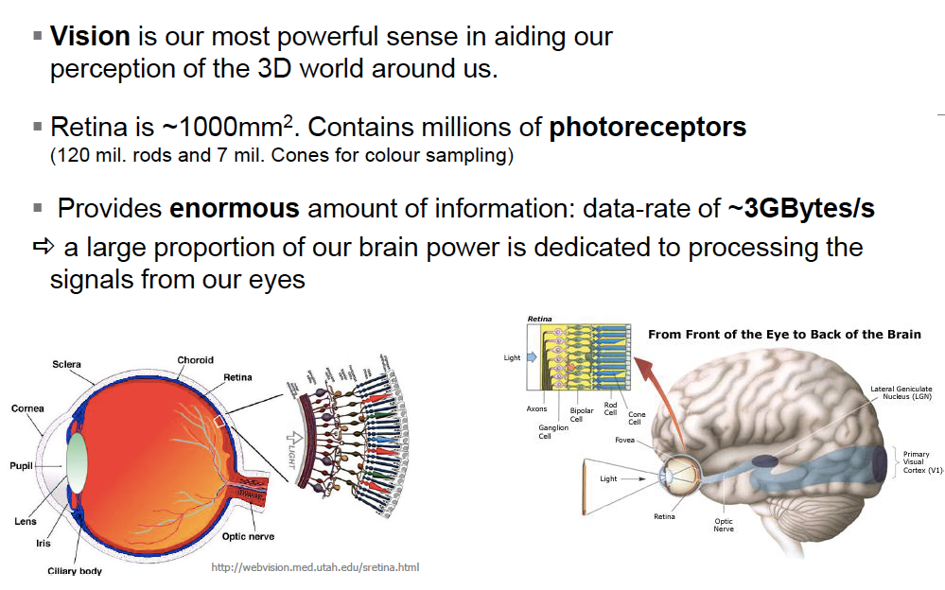

Slide 17
Perception
4
Sensors
Uncertainty
Features
Localization
"Position"
Cognition
Global Map
Environment Model
Path
Local Map
Perception
Real World
Motion Control
Environment

Slide 18
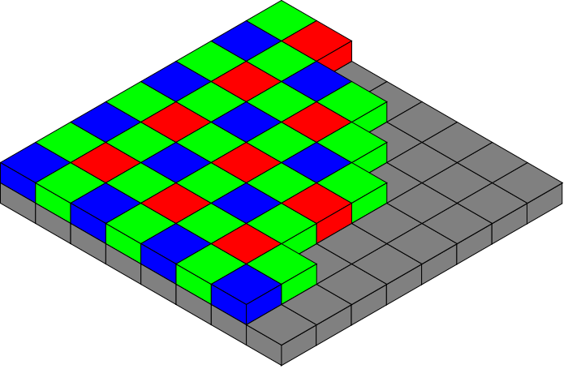
Vision-based Sensors: Hardware
CCD (light-sensitive, discharging capacitors of 5 to 25 micron)
  Charge-coupled device, 1969 at AT&T Bell Labs
CMOS (Complementary Metal Oxide Semiconductor technology) sensor
  Active pixel sensor
  Cheaper, lower power, traditionally lower quality
Notes:
Bayer pattern

Slide 19
OpenCV
Free for personal & commercial use
C++, C, Python, Java
Windows, Linux, OS X, iOS, Android
>9m downloads
Lots of tutorials

Slide 20
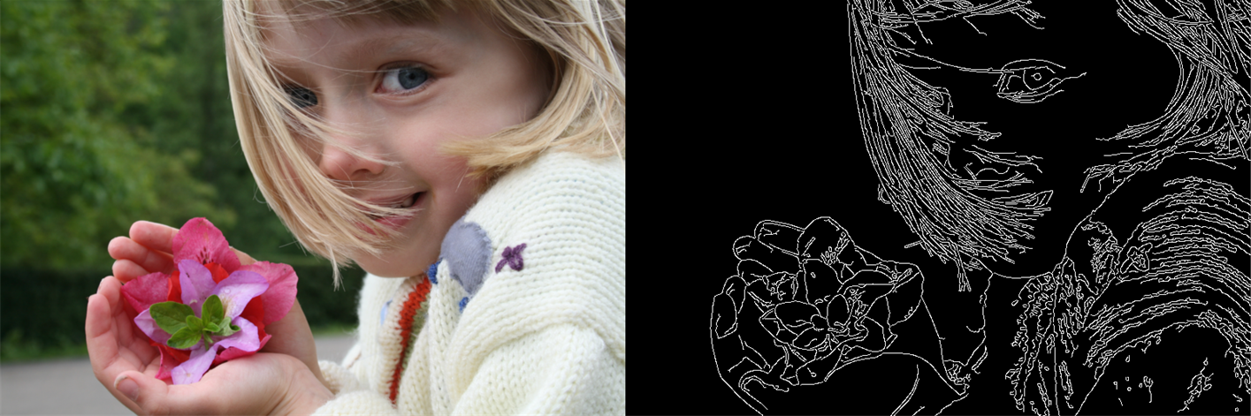
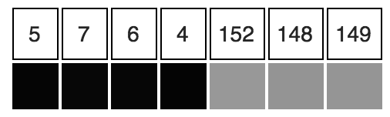
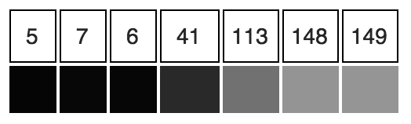
Blob (color) detection
  http://docs.opencv.org/master/d0/d7a/classcv_1_1SimpleBlobDetector.html
Edge Detection
  http://en.wikipedia.org/wiki/Edge_detection
  Canny edge detection: John F. Canny, 1986
  http://docs.opencv.org/2.4/doc/tutorials/imgproc/imgtrans/canny_detector/canny_detector.html

Slide 21
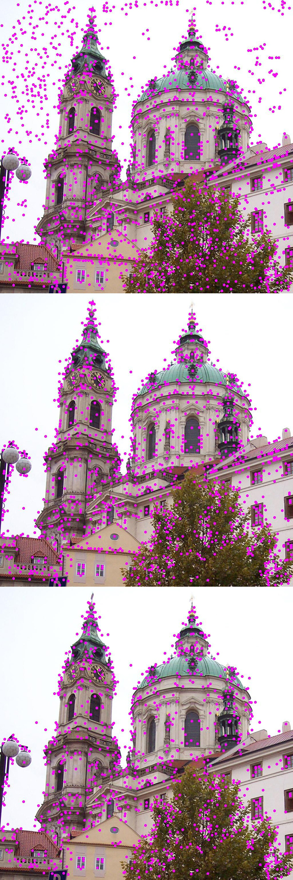
SIFT (Scale Invariant Feature Transform) features
  http://docs.opencv.org/master/da/df5/tutorial_py_sift_intro.html
  Detect objects despite changes to scale, noise, orientation, illumination
Deep Learning
  http://deep.host22.com/
  http://deeplearning.net/

Slide 22
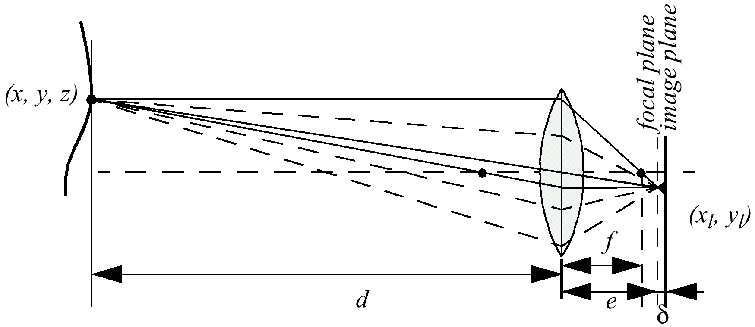
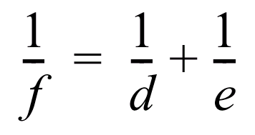
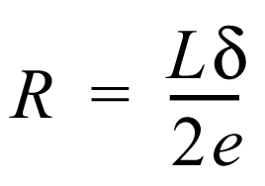
Depth from Focus
f = focal length
d= z = distance to object
e = where focused image is formed
L = diameter of lens
“Blur Circle”:
Notes:
f/z = x_l/x = y_l/y
X_l = f/z * x

Slide 23
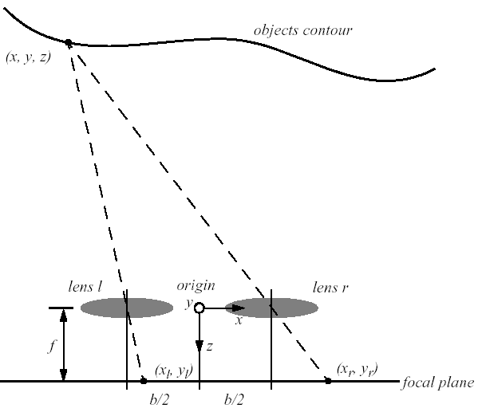




Stereo Vision
Idealized camera geometry for stereo vision
  Disparity between two images -> Computing of depth

Slide 24
Stereo Vision
Distance is inversely proportional to disparity
  closer objects can be measured more accurately
Disparity is proportional to b, horizontal distance between lenses
  For a given disparity error, the accuracy of the depth estimate increases with increasing baseline b.
  However, as b is increased, some objects may appear in one camera, but not in the other.
A point visible from both cameras produces a conjugate pair.
  Conjugate pairs lie on epipolar line (parallel to the x-axis for the arrangement in the figure above)

Slide 25
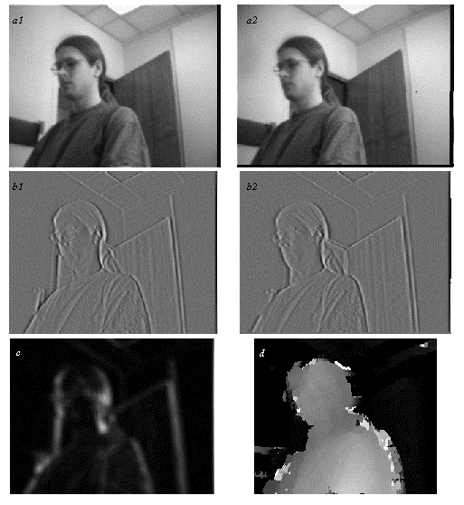
Stereo Vision Example
Extracting depth information from a stereo image
  a1 and a2: left and right image
  b1 and b2: vertical edge filtered
  left and right image
  c: confidence image:
  bright = high confidence (good texture)
  d: depth image:
  bright = close; dark = far
Artificial example: a bunch of fence posts

Slide 26
http://wiki.ros.org/camera_calibration/Tutorials/StereoCalibration
  How would you need to move the checkerboard?
http://wiki.ros.org/image_geometry
Notes:
Left, right, top, bottom for x & y
Various angles: skew
Different depths: size
Tilted: x,y, size

Slide 27
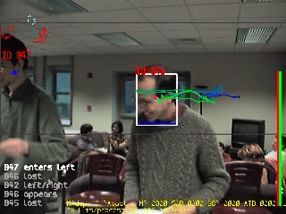
Adaptive Human-Motion Tracking

Slide 28
What would be some good questions to ask to see if students understand material?

Slide 29
Kinect Skeleton Tracking
https://www.youtube.com/watch?v=JjXZAnBzE3Y

Slide 30
Classification of Sensors
Proprioceptive sensors
  measure values internally to the system (robot),
  e.g. motor speed, wheel load, heading of the robot, battery status
Exteroceptive sensors
  information from the robots environment
  distances to objects, intensity of the ambient light, unique features.
Passive sensors
  energy coming for the environment
Active sensors
  emit their proper energy and measure the reaction
  better performance, but some influence on envrionment

Slide 31
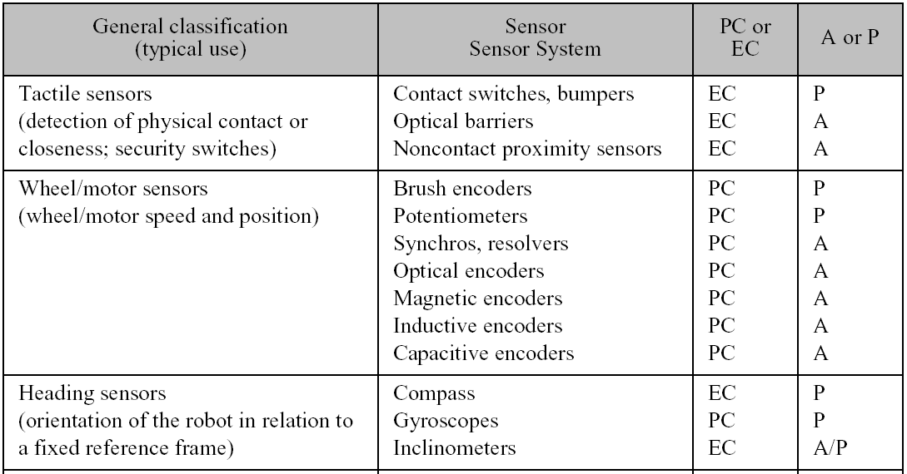
General Classification (1)

Slide 32
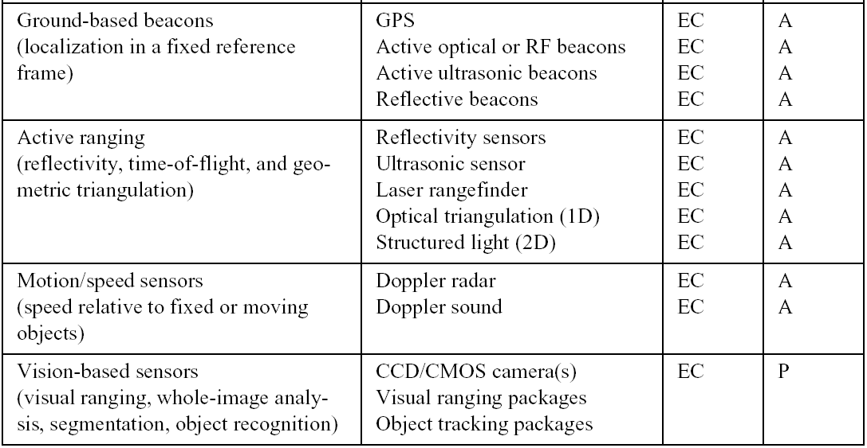
General Classification (2)

Slide 33
Free Write
What makes a good sensor?
How do you differentiate between sensors?

