Slide 1
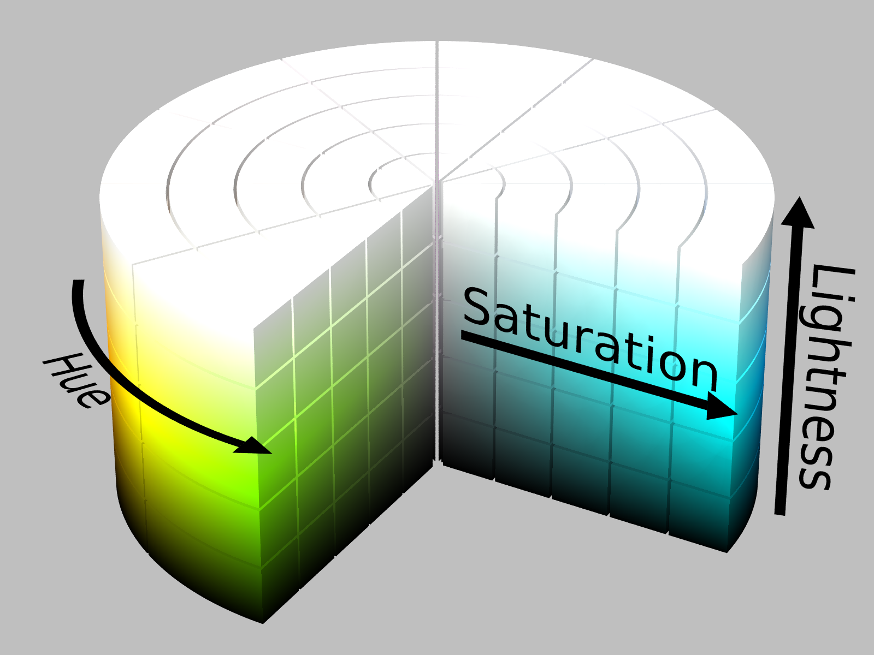
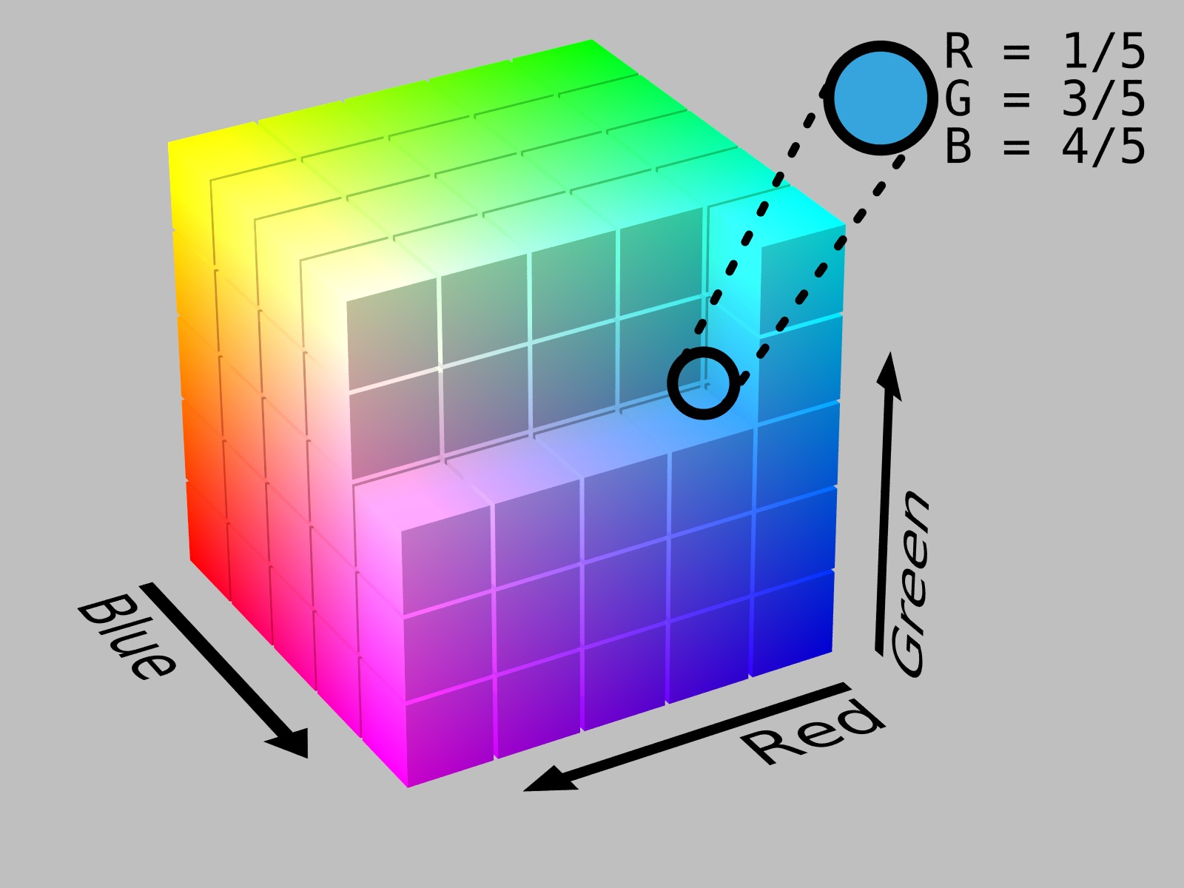
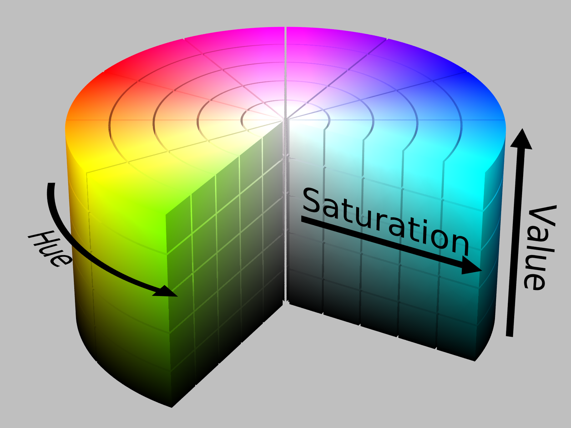
RGB, HSL, HSV
HSL, HSV: easier to define, closer to human vision
http://colorizer.org/

Slide 2
Lab 2: Movement
Lab 3: Vision

Slide 3
Classification of Sensors
Proprioceptive sensors
measure values internally to the system (robot),
e.g. motor speed, wheel load, heading of the robot, battery status
Exteroceptive sensors
information from the robots environment
distances to objects, intensity of the ambient light, unique features.
Passive sensors
energy coming for the environment
Active sensors
emit their proper energy and measure the reaction
better performance, but some influence on envrionment

Slide 4
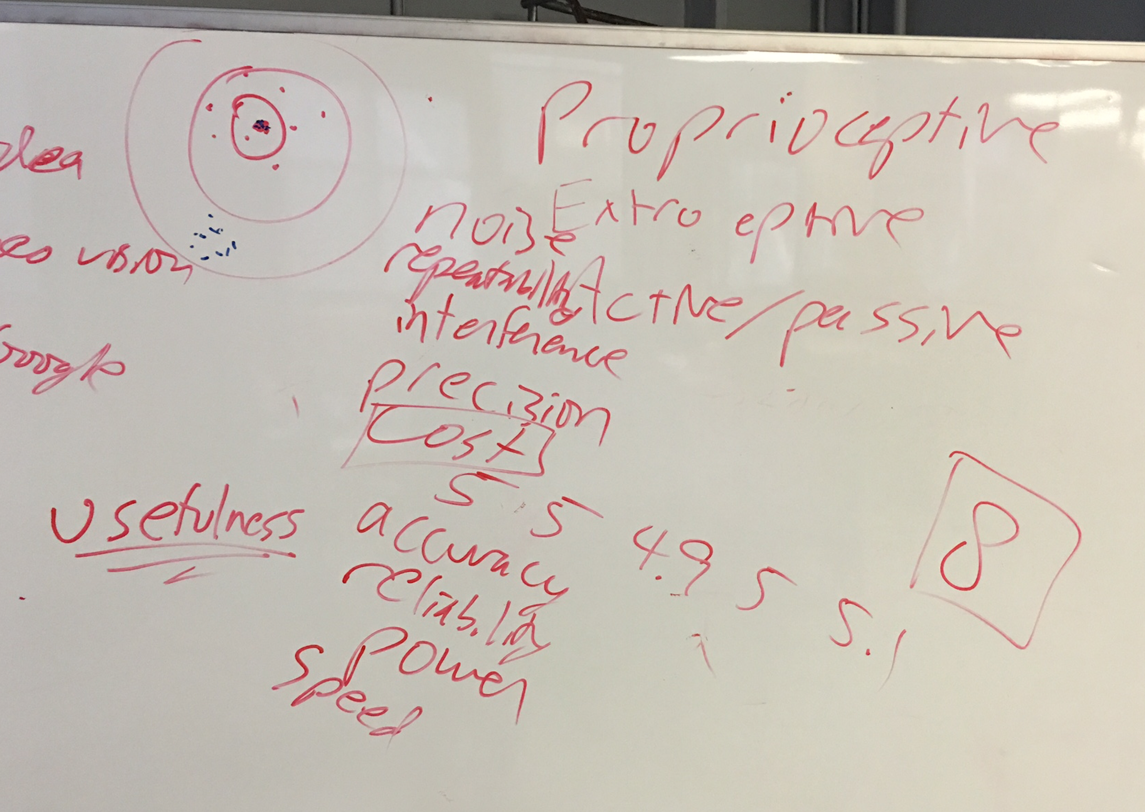
What makes a good sensor?
How do you differentiate between sensors?

Slide 5
Characterizing Sensor Performance (1)
Measurement in real world environment is error prone
Basic sensor response ratings
Dynamic range
ratio between lower and upper limits, usually in decibels (dB, power)
e.g. power measurement from 1 Milliwatt to 20 Watts
e.g. voltage measurement from 1 Millivolt to 20 Volt
20 instead of 10 because square of voltage is equal to power
Range
upper limit

Slide 6
Characterizing Sensor Performance (2)
Basic sensor response ratings (cont.)
Resolution
minimum difference between two values
usually: lower limit of dynamic range = resolution
for digital sensors it is usually the analog-to-digital conversion
e.g. 5V / 255 (8 bit)
Linearity
variation of output signal as function of the input signal
linearity is less important when signal is after treated with a computer
Bandwidth or Frequency
the speed with which a sensor can provide a stream of readings
usually there is an upper limit depending on the sensor and the sampling rate
Lower limit is also possible, e.g. acceleration sensor

Slide 7
Insitu
vs.
in situ

Slide 8
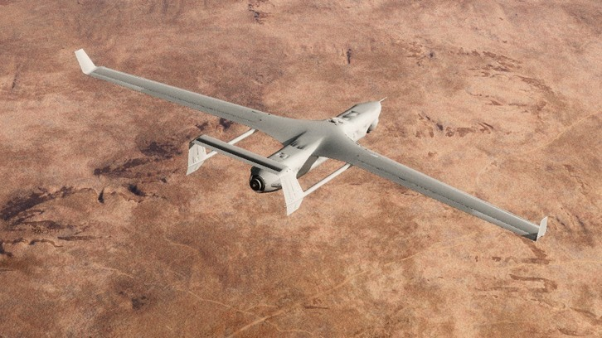
vs.
in situ
in its original place
"mosaics and frescoes have been left in situ”
in position
"her guests were all in situ"
In the aerospace industry, equipment on-board aircraft must be tested in situ, or in place, to confirm everything functions properly as a system. Individually, each piece may work but interference from nearby equipment may create unanticipated problems.

Slide 9
In Situ Sensor Performance (1)
Sensitivity
ratio of output change to input change
however, in real world environment, the sensor has very often high sensitivity to other environmental changes, e.g. illumination
Cross-sensitivity
sensitivity to environmental parameters that are orthogonal to the target parameters (e.g., compass responding to building materials)
Error / Accuracy
difference between the sensor’s output and the true value
m = measured value
v = true value
error

Slide 10
In Situ Sensor Performance (2)
Characteristics that are especially relevant for real world environments
Systematic error ➔ deterministic errors
caused by factors that can (in theory) be modeled ➔ prediction
Random error ➔ non-deterministic
no prediction possible
however, they can be described probabilistically
Precision
reproducibility of sensor results
Notes:
e.g. calibration of a laser sensor or of the distortion cause by the optic of a camera
e.g. Hue instability of camera, black level noise of camera ..

Slide 11
Characterizing Error: Challenges in Mobile Robotics
Mobile Robot: perceive, analyze and interpret state
Measurements are dynamically changing and error prone
Examples:
changing illuminations
specular reflections
light or sound absorbing surfaces
cross-sensitivity of robot sensor to robot pose and robot-environment dynamics
rarely possible to model ➔ appear as random errors
systematic errors and random errors may be well defined in controlled environment

Slide 12
Multi-Modal Error Distributions
Behavior of sensors modeled by probability distribution (random errors)
usually very little knowledge about causes of random errors
often probability distribution is assumed to be symmetric or even Gaussian
however, may be very wrong….
Sonar (ultrasonic) sensor might overestimate the distance in real environment and is therefore not symmetric
Sonar sensor might be best modeled by two modes: 1. the case that the signal returns directly 2. the case that the signals returns after multi-path reflections
Stereo vision system might correlate to images incorrectly, thus causing results that make no sense at all…

Slide 13
Wheel / Motor Encoders (1)
measure position or speed of the wheels
Integrate wheel movements to get an estimate of robots position ➔ odometry
optical encoders are proprioceptive sensors
position estimation in relation to a fixed reference frame is only valuable for short movements
typical resolutions: 2000 increments per revolution.

Slide 14
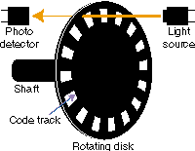
Wheel / Motor Encoders (2)

Slide 15
Wheel / Motor Encoders (2)

Slide 16
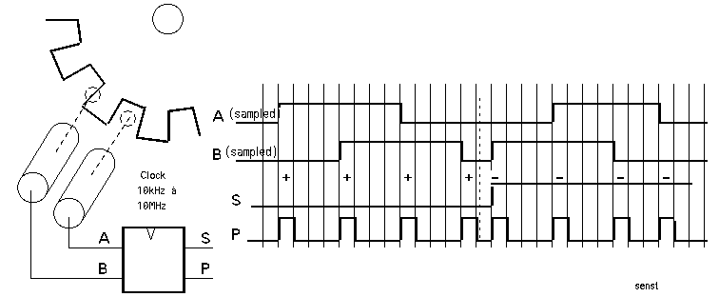
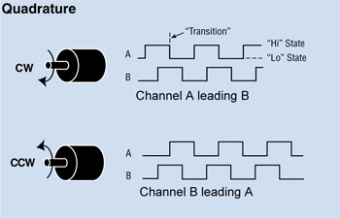
Wheel / Motor Encoders (3)

Slide 17
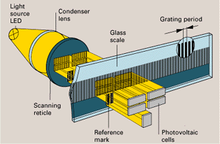
Wheel / Motor Encoders (2)
4.1.3
scanning reticle fields
scale slits
Notice what happen when the direction changes:

Slide 18
Heading Sensors
Proprioceptive (gyroscope, inclinometer) or Exteroceptive (compass)
Determine the robot’s orientation
Heading + velocity integrates to position estimate
Dead reckoning (ships)
Location + Orientation = Pose

Slide 19
Compass
~2000 B.C.
Chinese suspended a piece of naturally magnetite from a silk thread and used it to guide a chariot over land
Magnetic field on earth
absolute measure for orientation
Large variety of solutions to measure the earth magnetic field
Major drawbacks
weakness of the earth field
easily disturbed by magnetic objects or other sources
not feasible for indoor environments

Slide 20
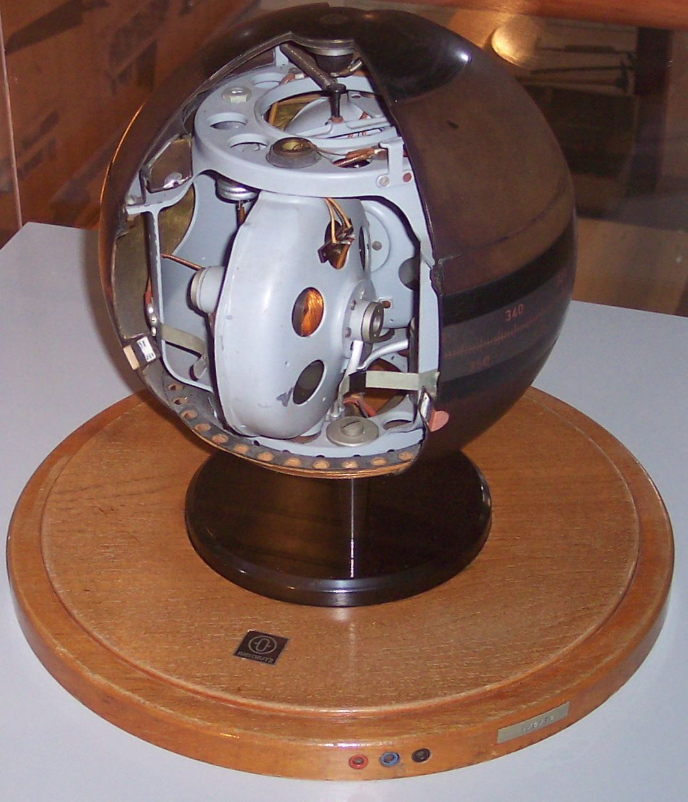
Gyrocompass
Patented in 1885
Practical in 1906 (Germany)
Find true north as determined by Earth’s rotation
Not affected by ship’s composition, variety in magnetic field, etc.

Slide 21
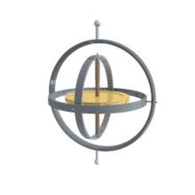
Gyroscope
Heading sensors keep the orientation to a fixed frame
absolute measure for the heading of mobile system
Mechanical Gyroscopes
Drift: 0.1° in 6 hours
Spinning axis is aligned with north-south meridian, earth’s rotation has no effect on gyro’s horizontal axis
If points east-west, horizontal axis reads the earth rotation
Optical Gyroscopes (1980s)
2 laser beams in opposite direction
around circle
Bandwidth >100 kHz
Resolution < 0.0001 degrees/hr

Slide 22
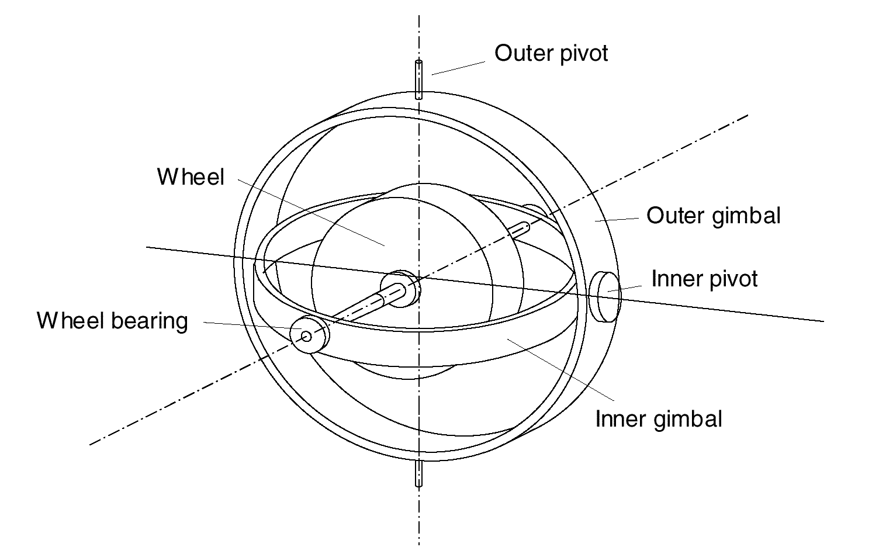
Mechanical Gyroscopes
Concept: inertial properties of a fast spinning rotor
gyroscopic precession
Angular momentum associated with a spinning wheel keeps the axis of the gyroscope inertially stable.
Reactive torque tao (tracking stability) is proportional to the spinning speed w, the precession speed W and the wheels inertia I.
No torque can be transmitted from the outer pivot to the wheel axis
spinning axis will therefore be space-stable
Quality: 0.1° in 6 hours
If the spinning axis is aligned with the north-south meridian, the earth’s rotation has no effect on the gyro’s horizontal axis
If it points east-west, the horizontal axis reads the earth rotation

Slide 23
Rate gyros
4.1.4
Same basic arrangement shown as regular mechanical gyros
But: gimble(s) are restrained by a torsional spring
enables to measure angular speeds instead of the orientation.
Others, more simple gyroscopes, use Coriolis forces to measure changes in heading.

Slide 24
Optical Gyroscopes
Early 1980: first installed in airplanes
Angular speed (heading) sensors using two monochromic light / laser beams from same source
On is traveling clockwise, the other counterclockwise
Laser beam traveling in direction of rotation
slightly shorter path -> shows a higher frequency
difference in frequency Δf of the two beams is proportional to the angular velocity Ω of the cylinder
New solid-state optical gyroscopes based on the same principle are build using microfabrication technology
MUCH more accurate than mechanical

Slide 25
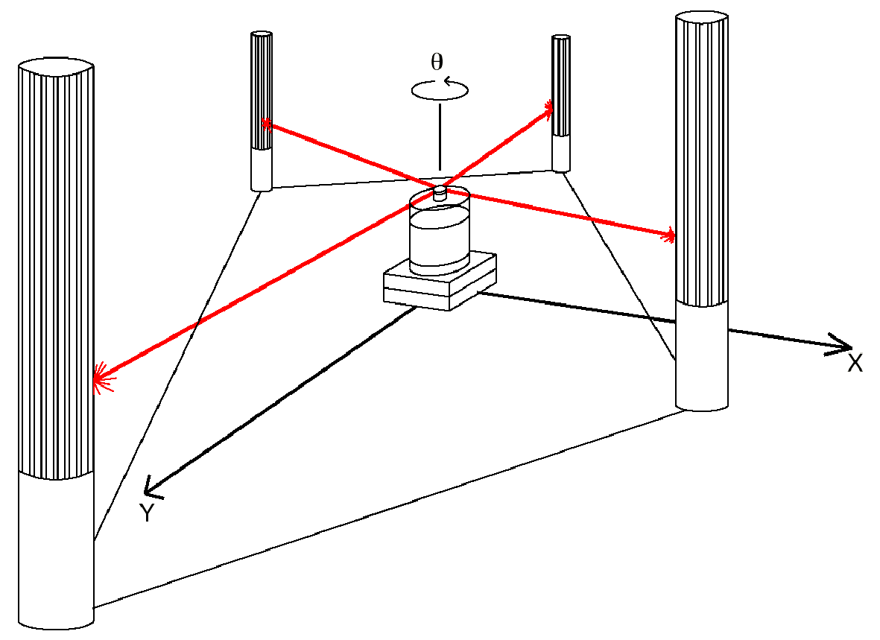
Ground-Based Active and Passive Beacons
Beacons are signaling guiding devices with a precisely known positions
Beacon-base navigation is used since the humans started to travel
Natural beacons (landmarks) like stars, mountains, or the sun
Artificial beacons like lighthouses
Global Positioning System revolutionized modern navigation technology
key sensor for outdoor mobile robotics
GPS not applicable indoors
Major drawback with the use of beacons in indoor:
Beacons require environment changes: costly
Limit flexibility and adaptability to changing environments
Key design choice in Robocup
https://www.youtube.com/watch?v=Kc8ty9mog-I

Slide 26
Global Positioning System (GPS) (1)
Developed for military use, now commercial
24 satellites (including some spares)
Orbit earth every 12 hours at a height of 20.190 km
Location of GPS receiver determined through time of flight measurement
Technical challenges:
Time synchronization between individual satellites and GPS receiver
Real time update of the exact location of the satellites
Precise measurement of the time of flight
Interferences with other signals

Slide 27
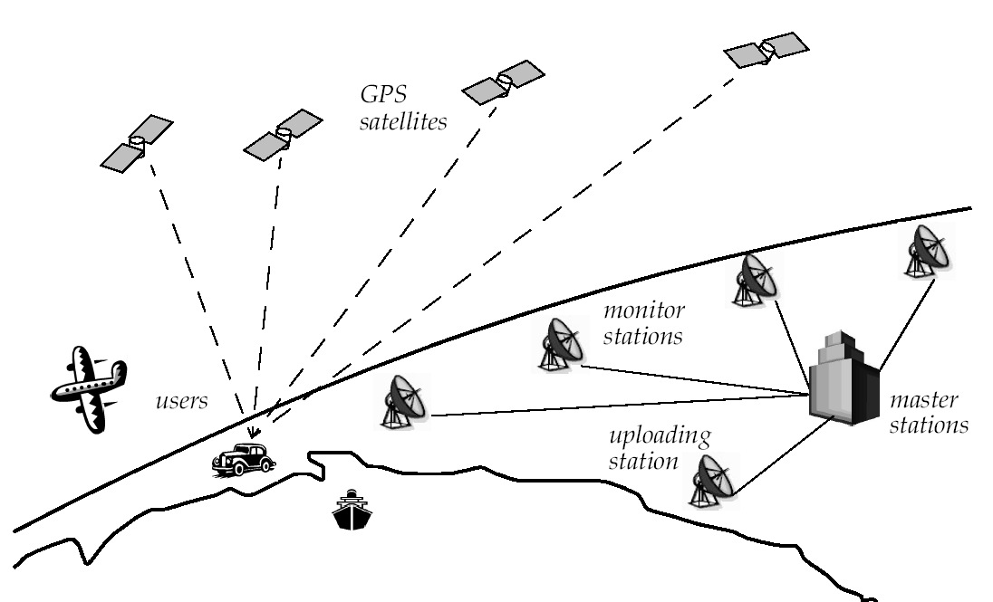
Global Positioning System (GPS) (2)
How many satellites do you need to see?
Notes:
3 for position (assume at sea level)
4 for position + time (more accurate)

Slide 28
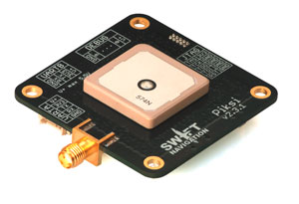
Global Positioning System (GPS) (3)
Time synchronization:
atomic clocks on each satellite, monitored from different ground stations
electromagnetic radiation propagates at light speed (0.3 m / nanosecond)
position accuracy proportional to precision of time measurement
Real time update of exact location of satellites:
Monitoring satellites from a number of widely distributed ground stations
master station analyses all measurements & transmits actual position to each satellite
Exact measurement of the time of flight:
quartz clock on the GPS receivers are not very precise
four satellite allows identification of position values (x, y, z) and clock correction ΔT
Position accuracies down to a ~2 meters
Improvement: Differential GPS
~10cm
Need fixed, known location
Piski: http://swiftnav.com/piksi.html
Project possibilities here!

Slide 29
“Indoor GPS”
If you could set up something on a robot and a bunch of somethings in the environment, how could you localize?
Notes:
Received Signal Strength Indication

Slide 30
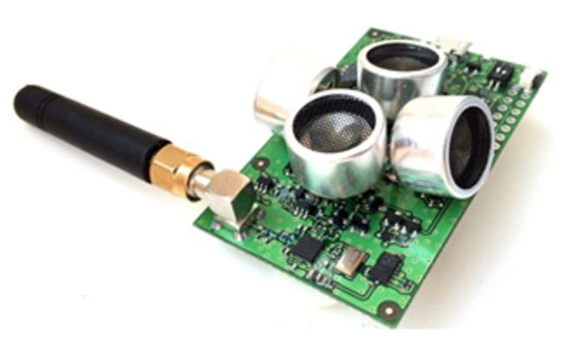
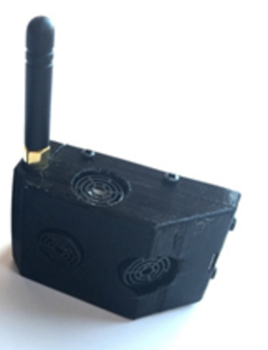
“Indoor GPS”
http://www.marvelmind.com/
https://www.youtube.com/watch?v=UMCkqU5k6rg
Sound
Wi-Fi
RSSI
fingerprinting
angle of arrival
Time of Flight
Notes:
Received Signal Strength Indication

Slide 31
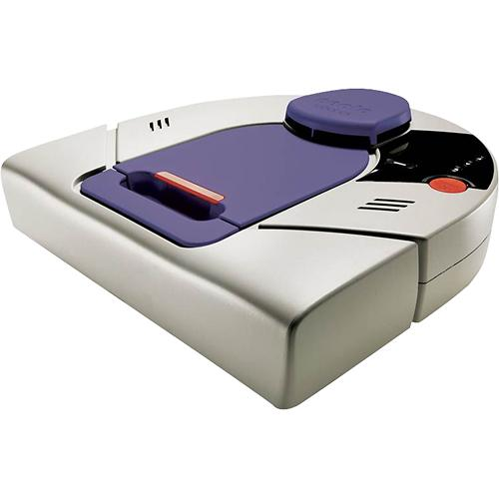
Neato
On-board Room Positioning System (RPS) technology
Maps with only one projector!

Slide 32
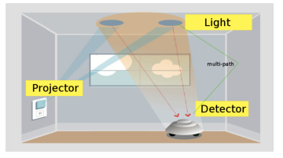
Neato
https://www.researchgate.net/publication/221070323_Vector_field_SLAM

Slide 33
So Far…
Compass
Wheel encoders
Gyroscope
v.s. Accelerometer?
GPS
Beacons
Sound
WiFi
Etc.
Notes:
Gyroscope = orientation
Non-rotational. Crystals get stressed under movement, causing voltage
Quantified Self movement
Iphone = accelerometer + compass

