Slide 1
James Irwin
james.irwin@email.wsu.edu
Mon 1-5pm
Tue 1:30-4pm
Amirkhosro Vosughi
amirkhosro.vosughi@email.wsu.edu
Mostly grading, will have some office hours

Slide 2
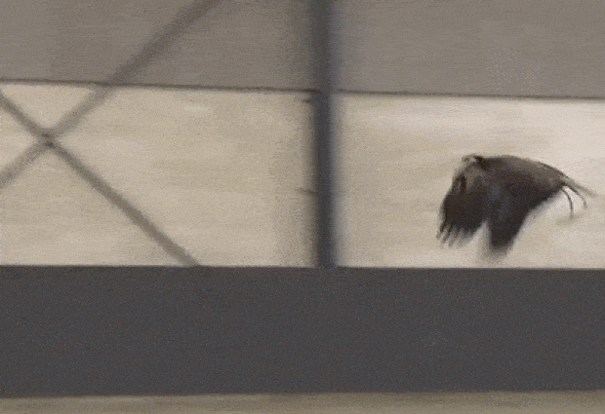
IEEE Spectrum: Dutch Police Training Eagles to Take Down Drones

Slide 3
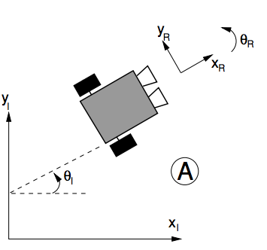
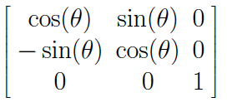
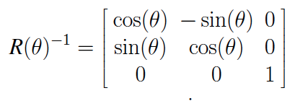
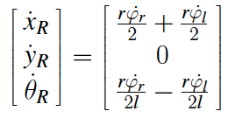
Robot Position: ξ_{I}=[x_{I},y_{I},θ_{I}]^{T}
Mapping between frames
ξ_{R}=R(θ)ξ_{I}
R(θ)=
l: distance from wheel to center of rotation
r: radius of a wheel
ξ_{I}=R(θ)⁻¹ξ_{R}
Notes:
Write out E^dot_R = Rmatix E^dot_I

Slide 4
ξ_{I}=R(θ)⁻¹ξ_{R}
l: distance from wheel to center of rotation
r: radius of a wheel

Slide 5
Example 3/3
A Create robot has wheels with a 5 cm radius which are 30 cm apart. Both wheels rotating forward at 1 rad per second. What are[x_{R},y_{R},θ_{R}]^{T} in m/s and rad/s? What are[x_{I},y_{I},θ_{I}]^{T} in m/s and rad/s?

Slide 6
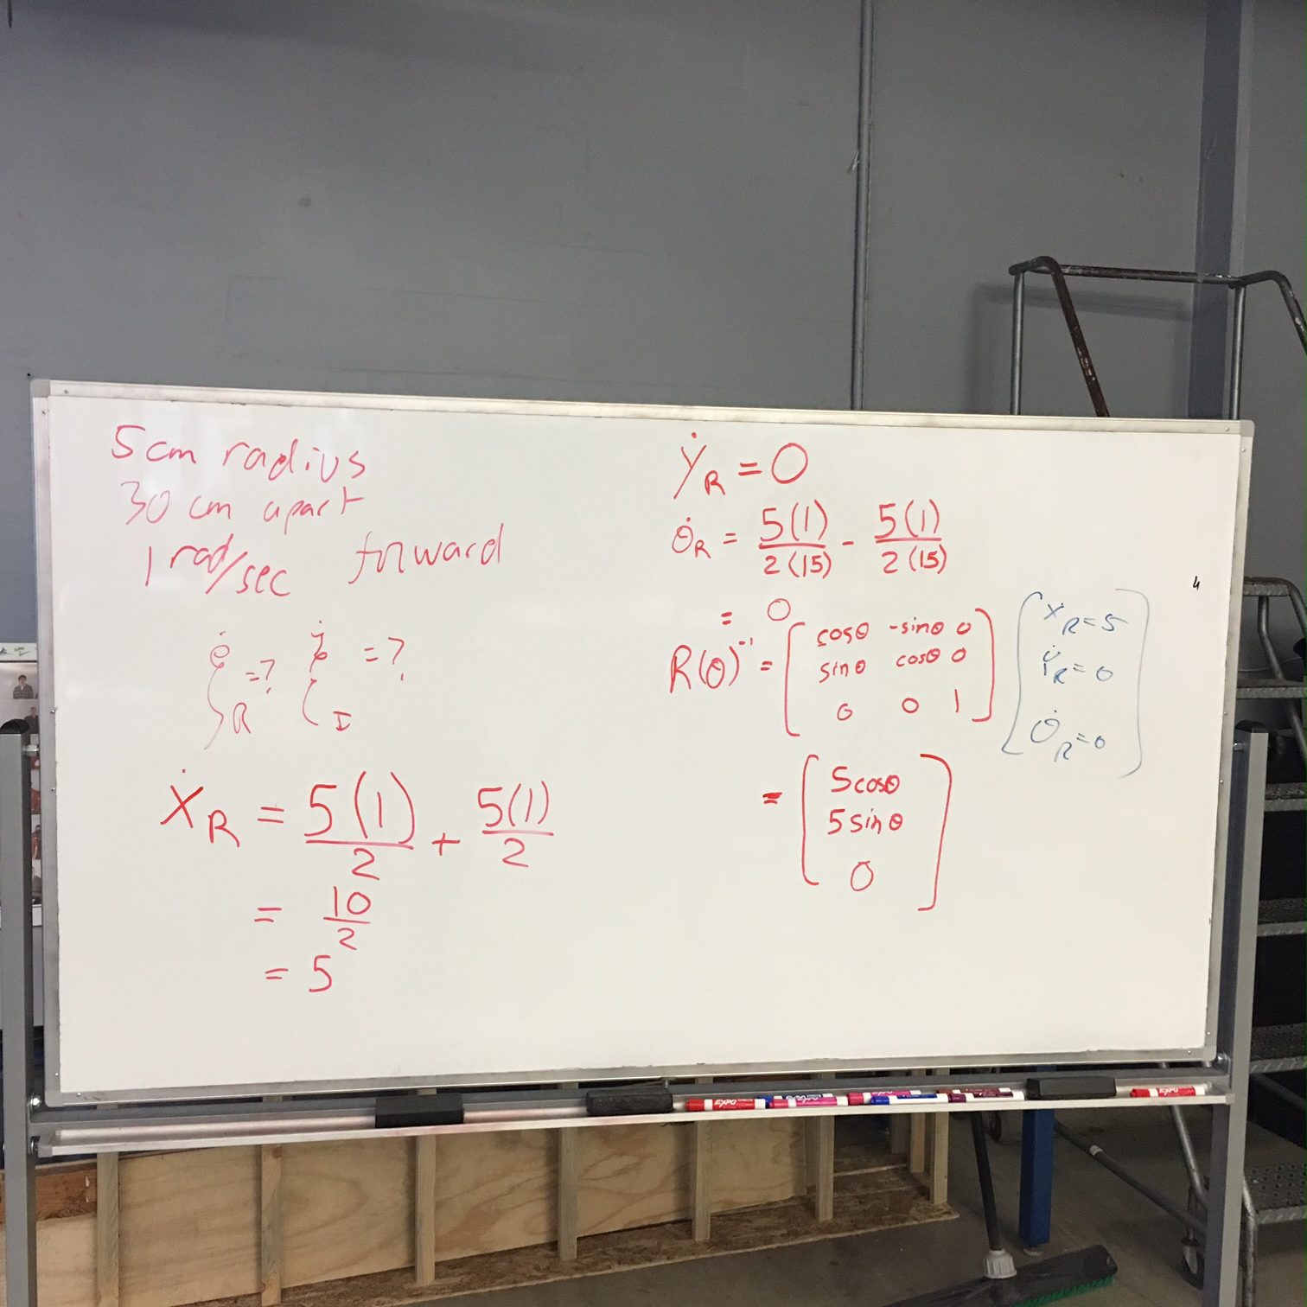
Worked problem

Slide 7
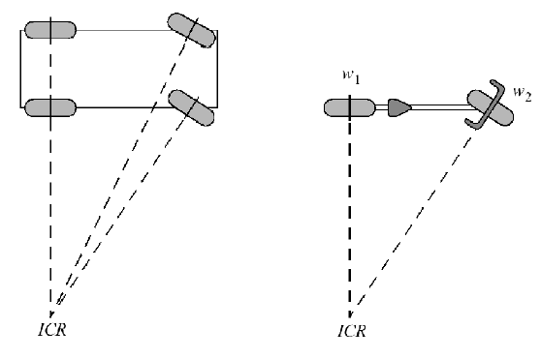
Sliding constraint
Standard wheel has no lateral motion
Move in circle whose center is on “zero motion line” through the axis
Instantaneous Center of Rotation

Slide 8
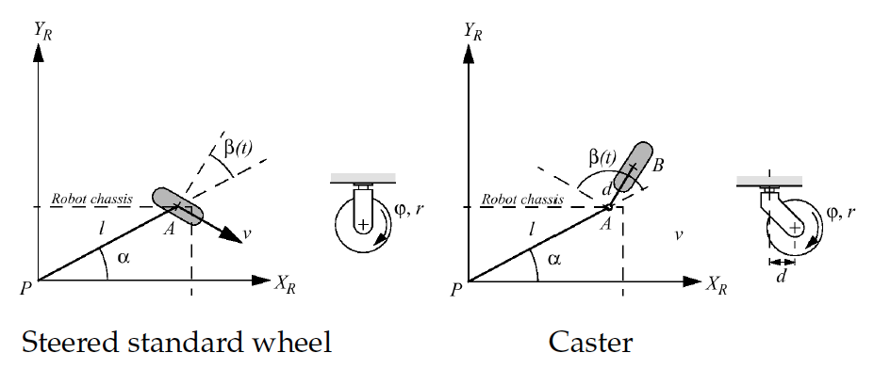
More complex
Steered standard wheel
Caster wheel
More parameters

Slide 9
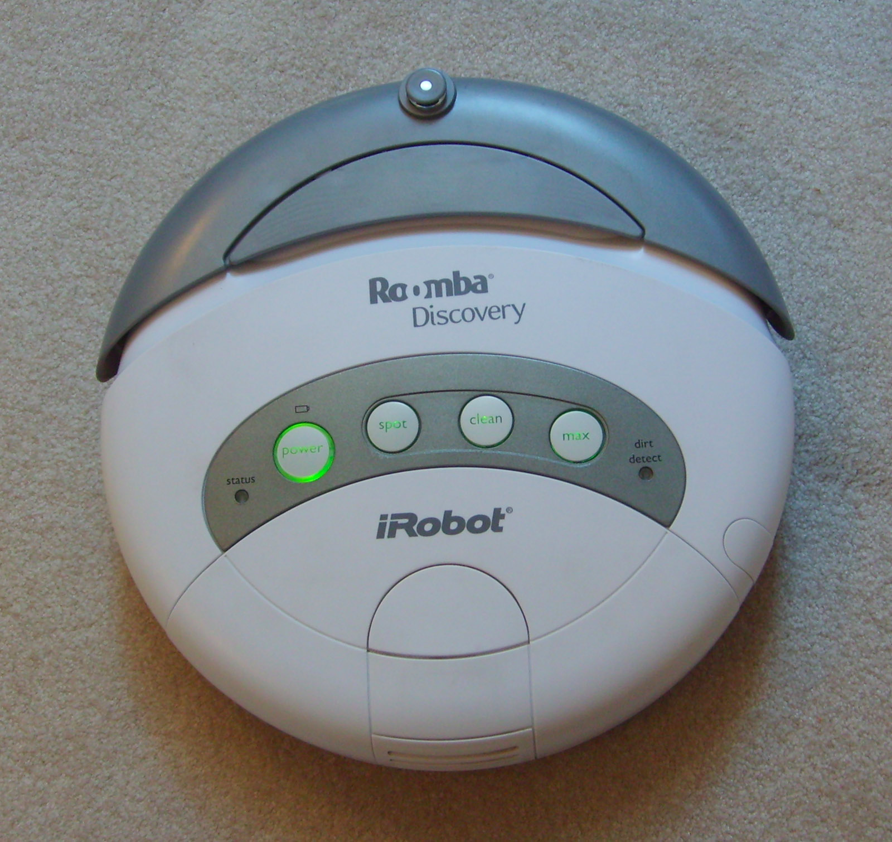
Differential drive
Rotation not constrained
Can move in any circle it wants to
Easy to move around

Slide 10
Mobile Robot Locomotion
Instantaneous center of rotation (ICR) or Instantaneous center of curvature (ICC)
A cross point of all axes of the wheels

Slide 11
Degree of Mobility
# degrees of freedom of robot chassis that can be immediately manipulated through changes in wheel velocity
Cannot move anywhere (No ICR)
Fixed arc motion (Only one ICR)
Degree of mobility : 0
Degree of mobility : 1
Fully free motion
(ICR can be located at any position)
Variable arc motion (line of ICRs)
Degree of mobility : 2
Degree of mobility : 3
Notes:
Zero motion line
Instantaneous Center of Rotation
Ackerman steering (car) vs bicycle: same degree of mobilitiy & ICR
2nd steering wheel of car isn’t independent

Slide 12
Degree of Steerability
The number of centered orientable wheels that can be steered independently in order to steer the robot
Indirect impact on robot chassis pose
No centered orientable wheels
Degree of steerability : 0
One centered orientable wheel
Two mutually dependent centered orientable wheels
Two mutually independent centered orientable wheels
Degree of steerability : 1
Degree of steerability : 2

Slide 13
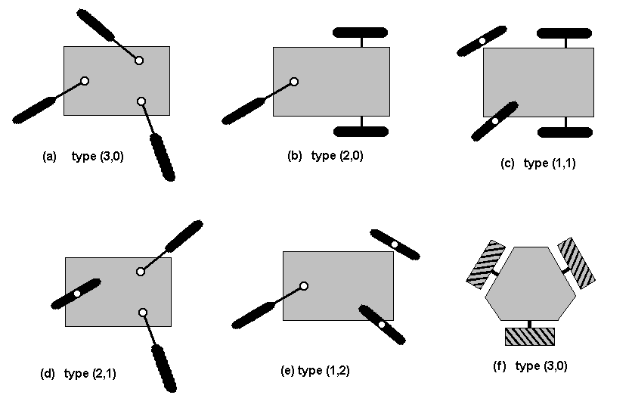
Degree of Maneuverability
The overall degrees of freedom that a robot can manipulate:
Degree of Mobility 3 2 2 1 1
Degree of Steerability 0 0 1 1 2
Examples of robot types (degree of mobility, degree of steerability)

Slide 14
Degree of Maneuverability
Notes:
# degrees of freedom robot can manipulate
2: ICR is on a line
3: ICR can be anywhere

Slide 15
There is no ideal drive configuration that simultaneously maximizes stability, maneuverability, and controllability
Example: typically inverse correlation between controllability and maneuverability

Slide 16
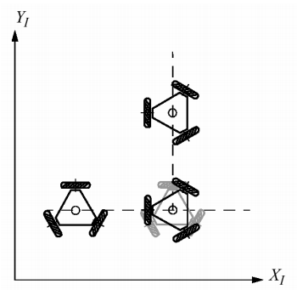
Holonomic Robots
Holonomic kinematic constraint can be expressed as explicit function of position variables only
Non-holonomic constraint requires addition information
Fixed/steered standard wheels impose non-holonomic constraints

Slide 17
Holonomicity
If the controllable degrees of freedom is equal to the total degrees of freedom then the robot is said to be holonomic
Holonomic constraints reduce the number of degrees of freedom of the system
If the controllable degrees of freedom are less than the total degrees of freedom it is non-holonomic
A robot is considered to be redundant if it has more controllable degrees of freedom than degrees of freedom in its task space

Slide 18
Why study holonomic constraints?
How many independent motions can our turtlebot robot produce?
2 at the most
How many DOF in the task space does the robot need to control?
3 DOF
The difference implies that our system has holonomic constraints

Slide 19
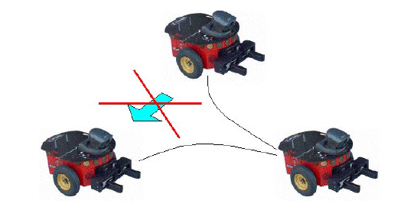
Non-holonomic constraint
A non-holonomic constraint is a constraint on the feasible velocities of a body
So what does that mean? Your robot can move in some directions (forward
and backward), but not others (sideward)
The robot can instantly
move forward and backward,
but can not move sideward
Parallel parking,
Series of maneuvers

Slide 20
Kinematic model for car-like robot
Control Input
Driving type: Forward wheel drive
Y
ϕ
: forward vel
: steering vel
θ
X

Slide 21
Kinematic model for car-like robot
Y
ϕ
θ
non-holonomic constraint:
X
: forward velocity
: steering velocity

Slide 22
Dynamic Model
Dynamic model
Y
ϕ
θ
X

Slide 23
Open loop control vs. Closed loop control
Car’s cruse control

Slide 25
The World consists of...
Obstacles
Places where the robot can’t (shouldn’t) go
Free Space
Unoccupied space within the world
Robots “might” be able to go here
There may be unknown obstacles
The state may be unreachable

Slide 26
Configuration Space (C-Space)
Configuration Space: the space of all possible robot configurations.
Data structure that allows us to represent occupied and free space in the environment

Slide 27
Configuration Space
Point robot (no constraints)
C
C_{free}
q_{goal}
C_{obs}
q_{init}
For a point robot moving in 2-D plane, C-space is

Slide 28
What if the robot is not a point?

Slide 29
What if the robot is not a point?
Expand obstacle(s)
Reduce robot

Slide 30
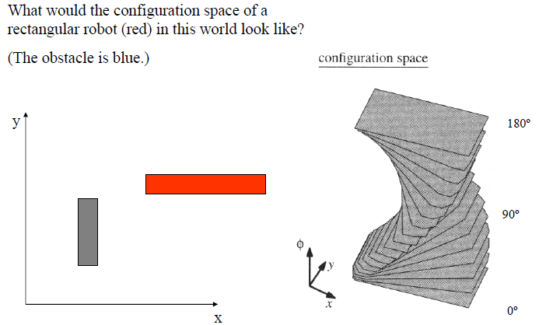
What if we want to preserve the angular component?

Slide 31
If we want to preserve the angular component…

Slide 32
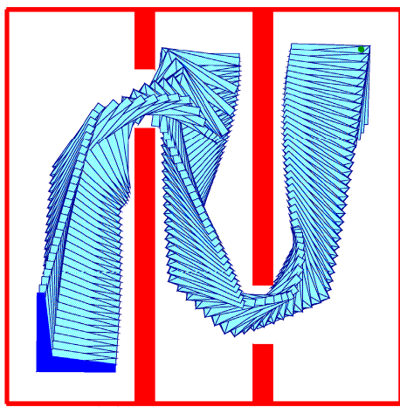
Rigid Body Planning

Slide 33
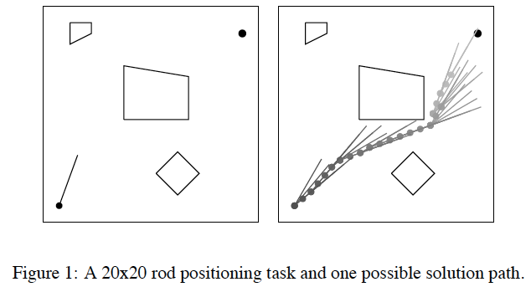
Transfer in Reinforcement Learning via Shared Features: Konidaris, Scheidwasser, and Barto, 2012

Slide 34
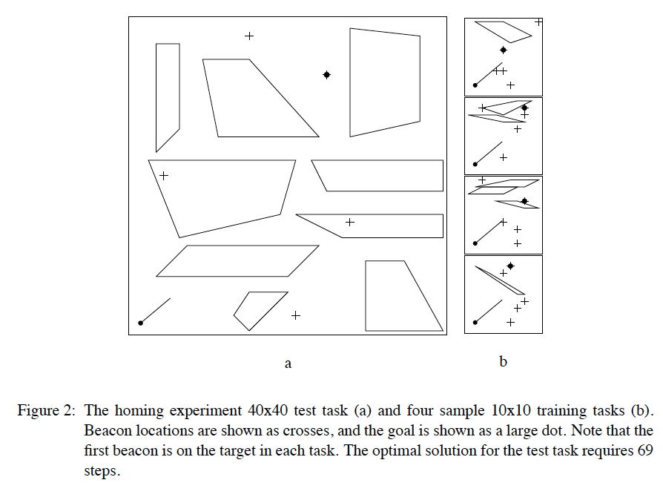

Slide 36
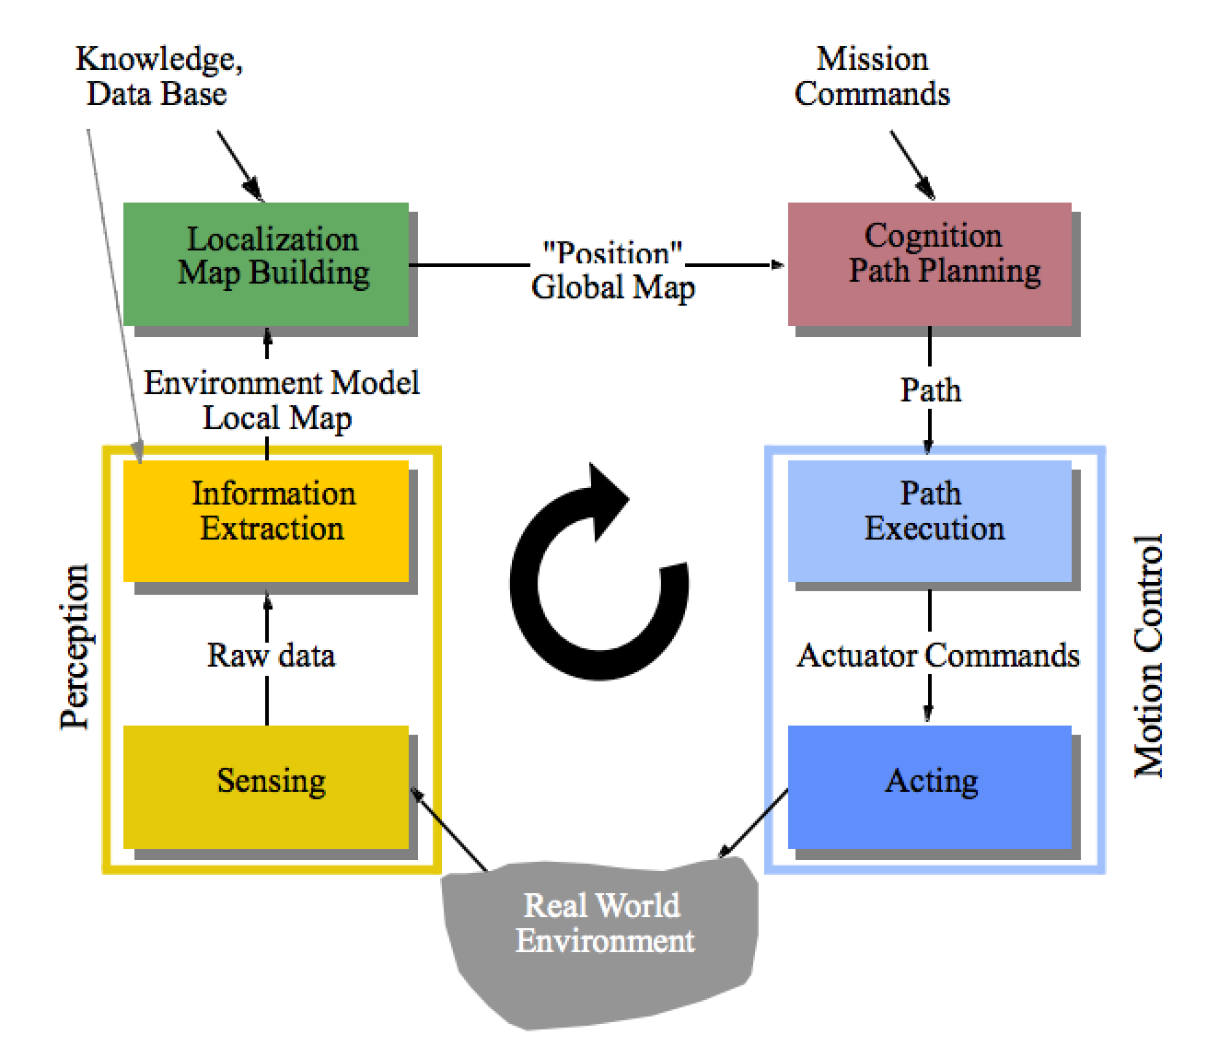
Open loop control vs. Closed loop control
Recap
Control Architectures
Sensors & Vision
Control & Kinematics
Notes:
https://vid.me/UJSI

