Slide 1
Degree of Maneuverability
Notes:
# degrees of freedom robot can manipulate
2: ICR is on a line
3: ICR can be anywhere

Slide 2
What if the robot is not a point?
Expand obstacle(s)
Reduce robot

Slide 3
Implementation of a Gaussian process-based machine learning grasp predictor. Goins, Carpenter, Wong, & Balasubramanian, 2015
With the goal of advancing the state of automatic robotic grasping, we present a novel approach that combines machine learning techniques and physical validation on a robotic platform to develop a comprehensive grasp predictor. After collecting a large grasp sample set (522 grasps), we first conduct a statistical analysis of the predictive ability of grasp quality metrics that are commonly used in the robotics literature. We then apply principal component analysis and Gaussian process (GP) algorithms on the grasp metrics that are discriminative to build a classifier, validate its performance, and compare the results to existing grasp planners. The key findings are as follows: (i) several of the existing grasp metrics are weak predictors of grasp quality when implemented on a robotic platform; (ii) the GP-based classifier significantly improves grasp prediction by combining multiple grasp metrics to increase true positive classification at low false positive rates; (iii) The GP classifier can be used generate new grasps to improve bad grasp samples by performing a local search to find neighboring grasps which have improved contact points and higher success rate.

Slide 5
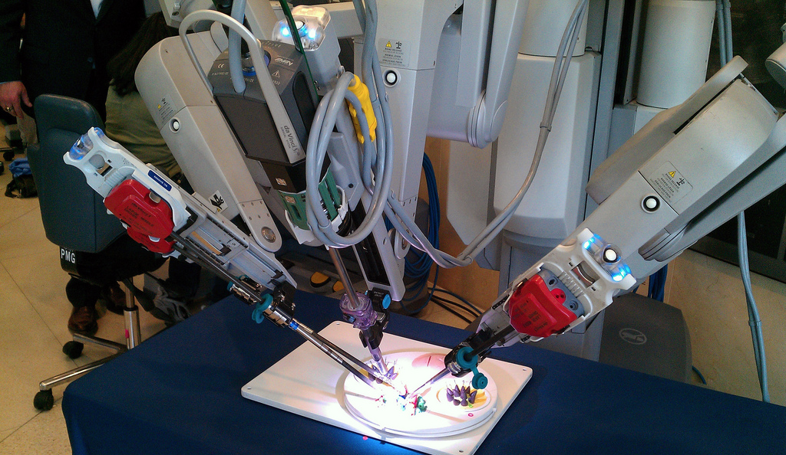
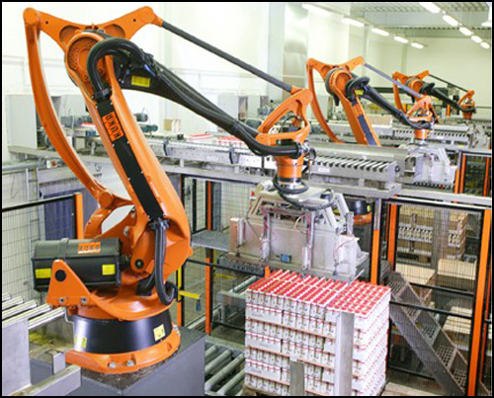
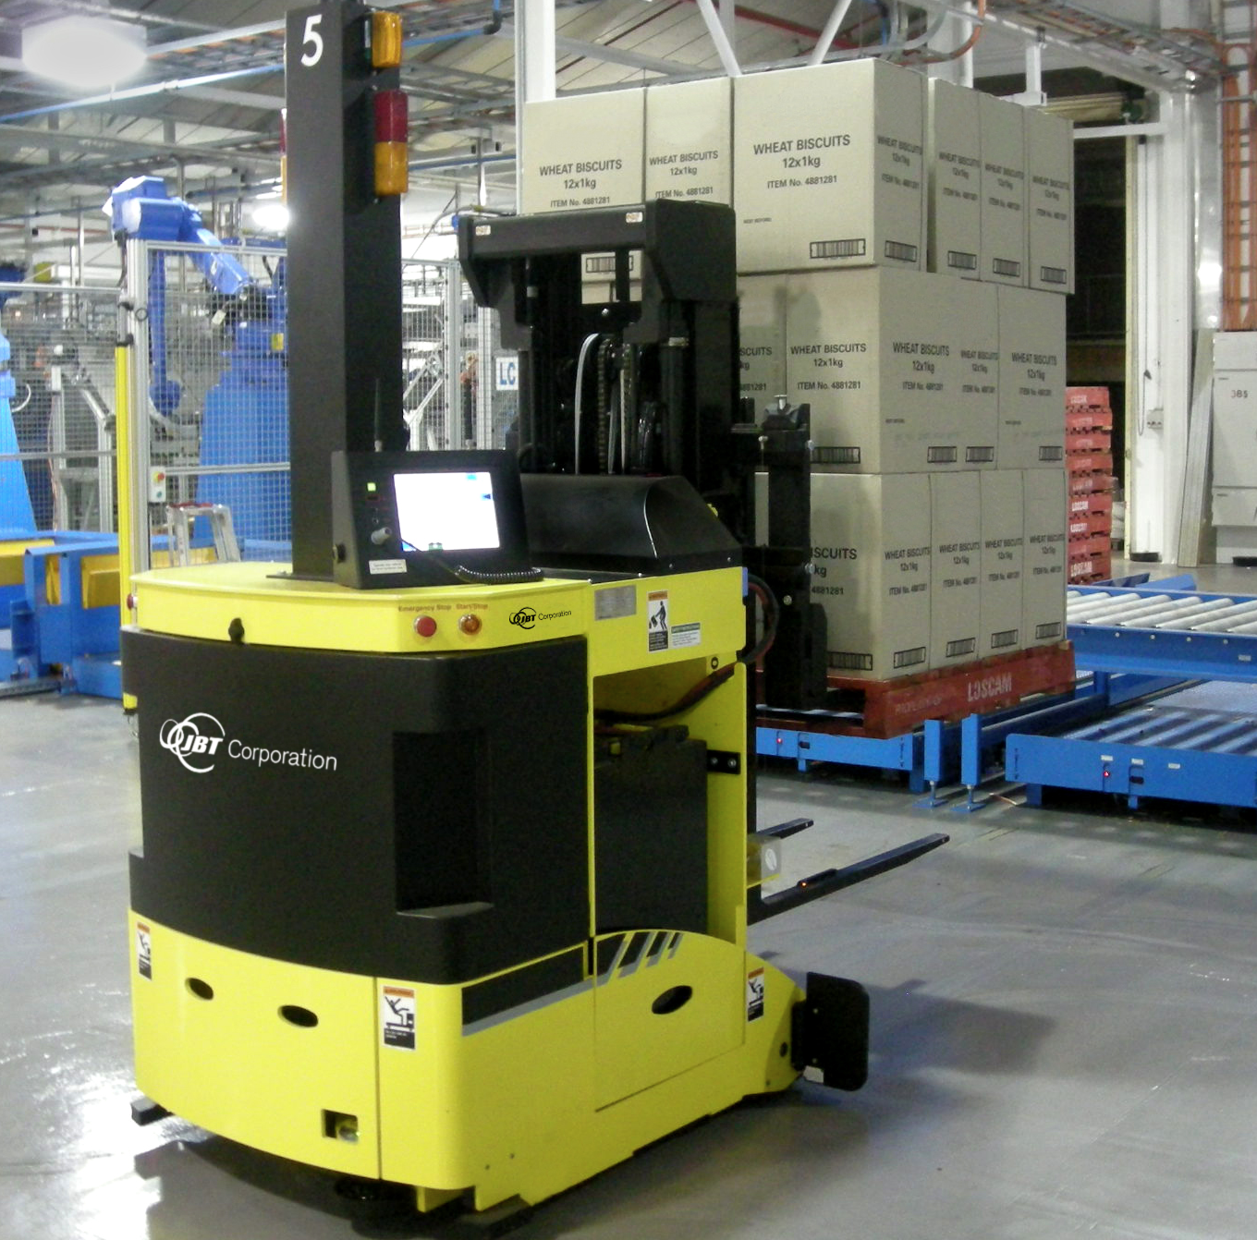
Manipulators

Slide 6
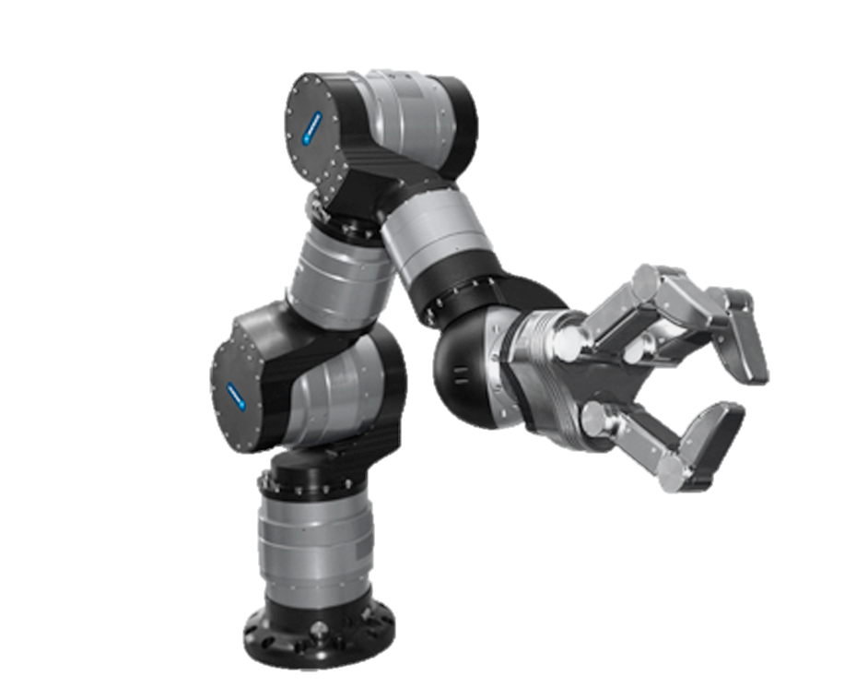
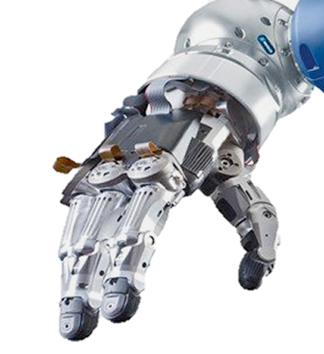
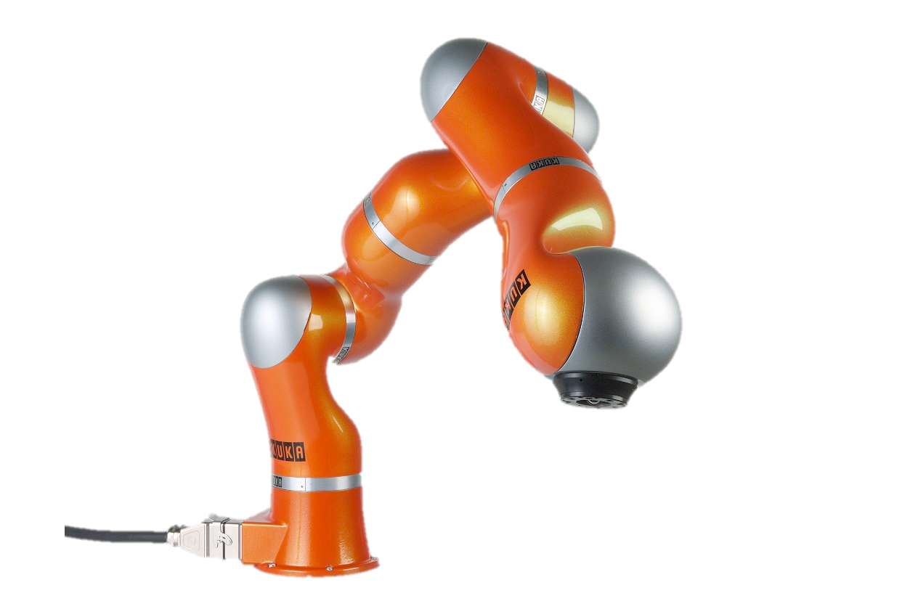
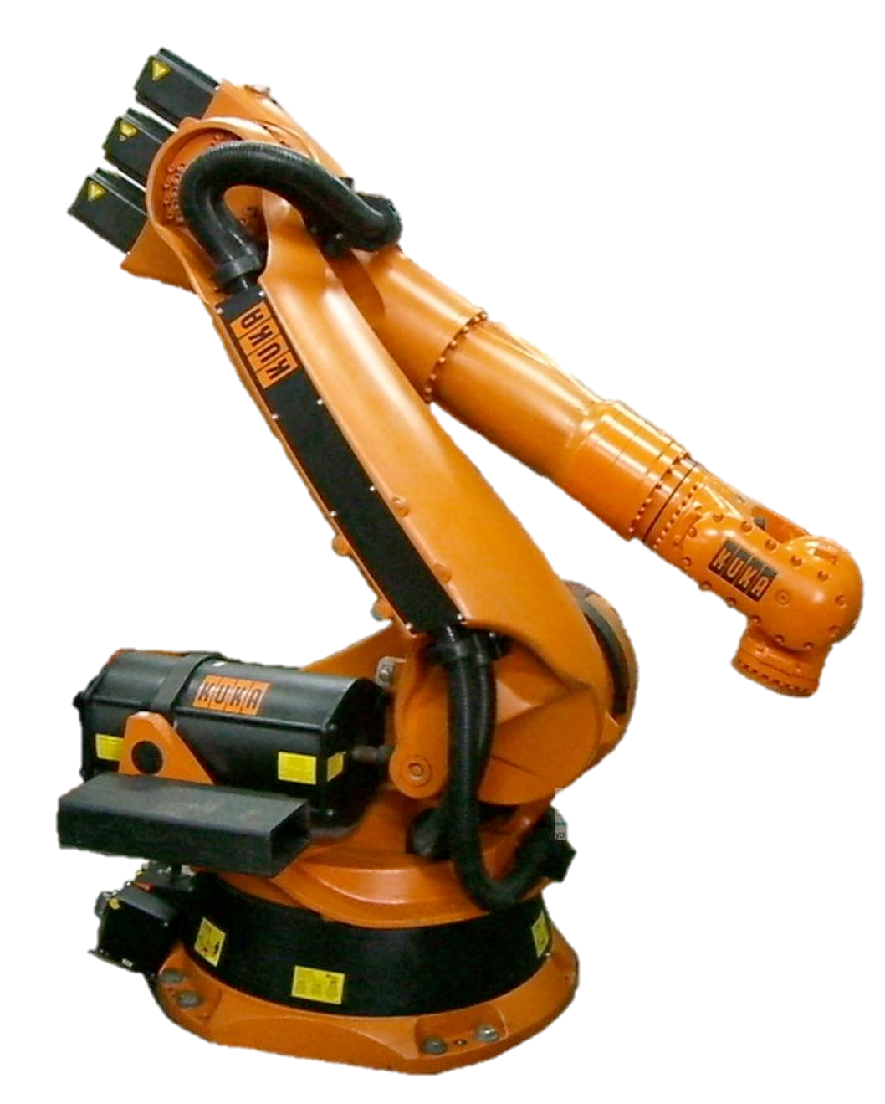
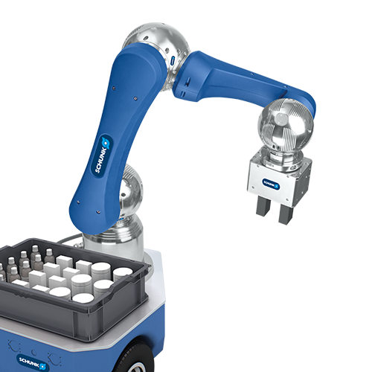
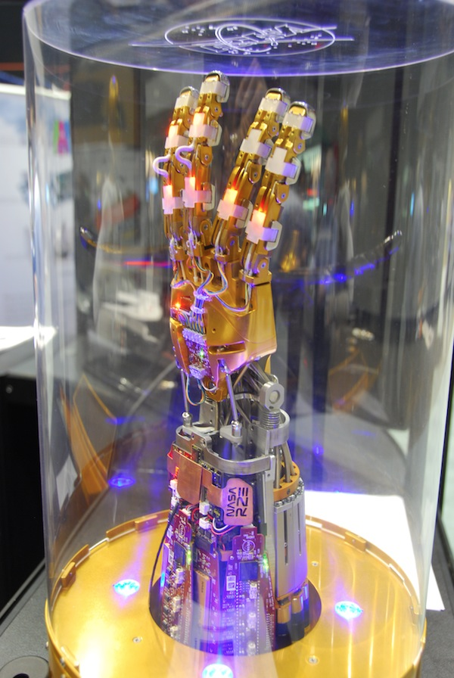
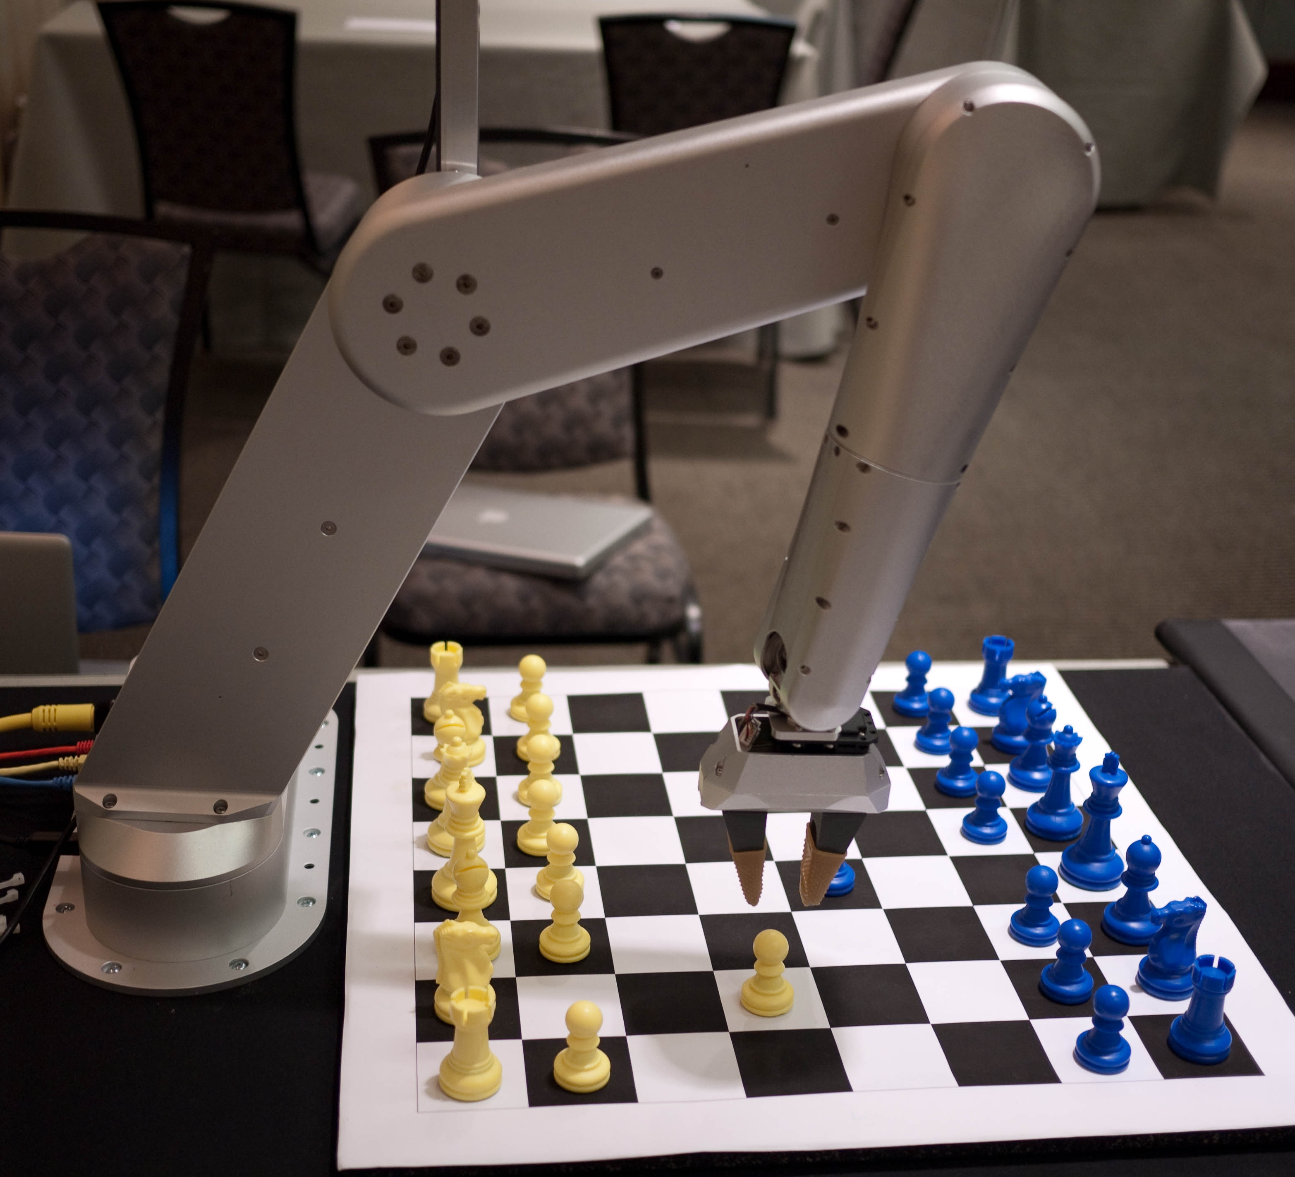
Manipulators

Slide 7
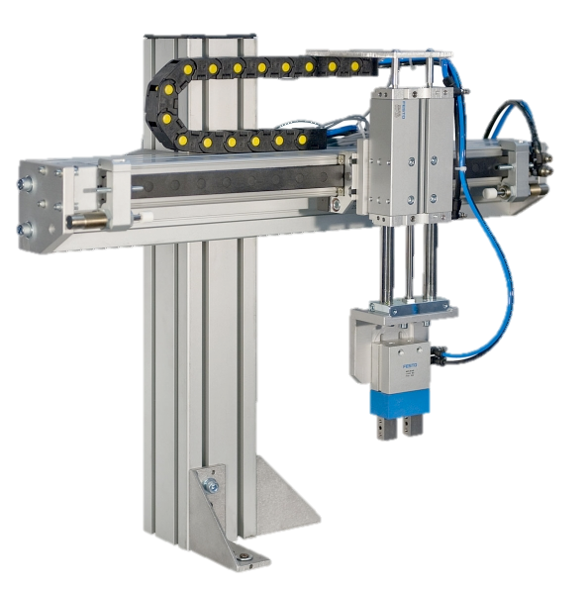
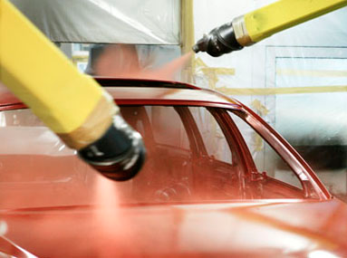
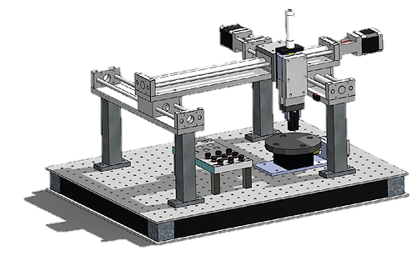
Manipulators

Slide 8
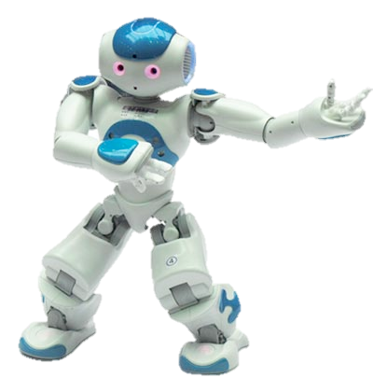
Manipulation
What is a manipulator?
Manipulates something in the world
Physically alter the world through contact
As a primary goal
But not its own position
When is this desirable?
Dangerous workspaces
Space; foundries; underwater; factories
Dirty
Dull Boring, repetitive, unpleasant work
Human-intractable workspaces
Too small; too big; too much precision needed
Notes:
Ben’s work: moving & opening cabinet

Slide 9
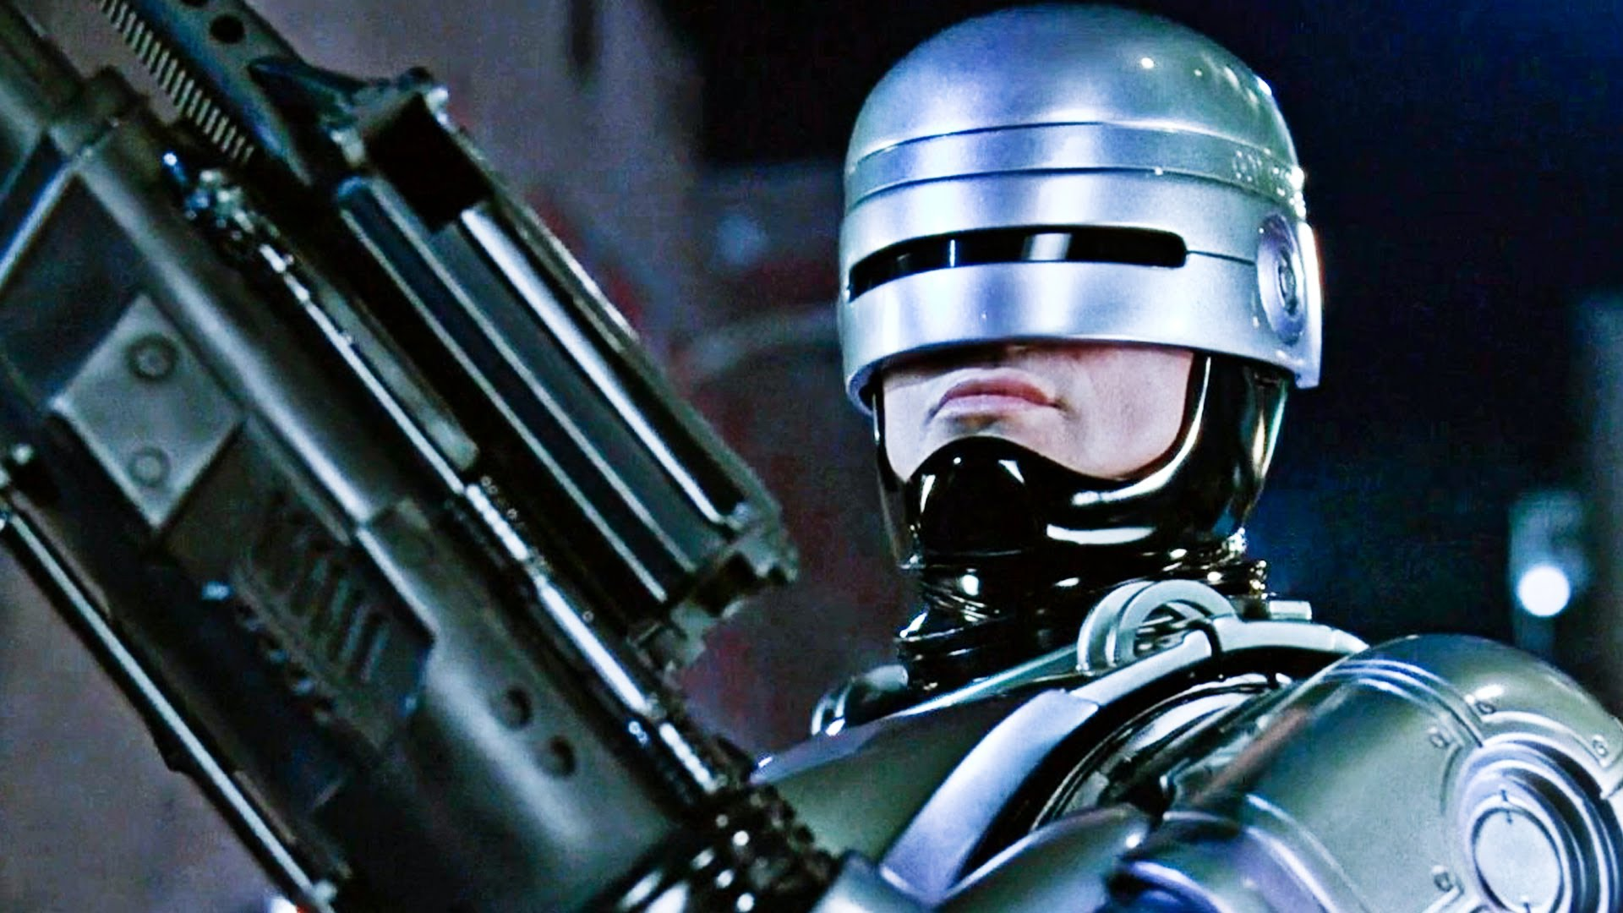
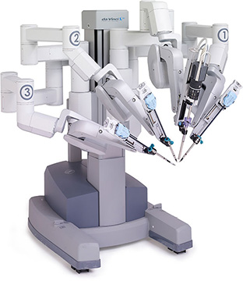
Current
Industrial
Welding
Drilling
Attaching (screws, rivets)
Painting
Loading/unloading
Surgery
Space exploration
Chores
Patient care
Delivery
Future
Elder care
Entertainment
Environment sampling
Compliant-material interactions (sewing)
Battery changing
Police work
Plus: more chores, more patient care, more surgery, more space, &c. (but better)
Davinci
Robot

Slide 10
Terminology
Actuator
Generates motion or force; usually a motor
“Drive type”
DoFs
End Effector
Device at the end of an arm; interacts with environment
Gripper
What it sounds like: a type of manipulator

Slide 11
Manipulator Robot
Modeled as a chain of rigid links connected by joints
Links: unjointed length of robot
Joints: translational or rotational movement
Joints have DoFs
Sliding or jointed
Manipulator / End Effectors
Grippers / Tools
Sensors
Links
End Effector (gripper)
Joints

Slide 12
Characterization
Types
By drive
By actuation
Tendons
Direct servoing
Underactuation
By motion
Prismatic (linear)
Revolute (rotational)
By Characteristics
Payload
Working area/radius
Notes:
Underactuation is a technical term used in robotics and control theory to describe mechanical systems that cannot be commanded to follow arbitrary trajectories in configuration space.
A standard automobile is underactuated due to the nonholonomic constraints imposed by the wheels. That is, a car cannot accelerate in a direction perpendicular to the direction the wheels are facing. A similar argument can be made for boats, planes and most other vehicles.

Slide 13
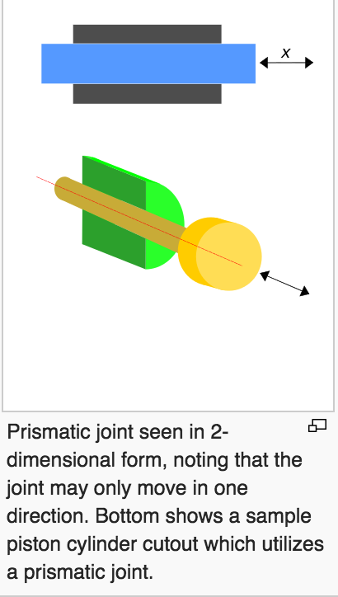
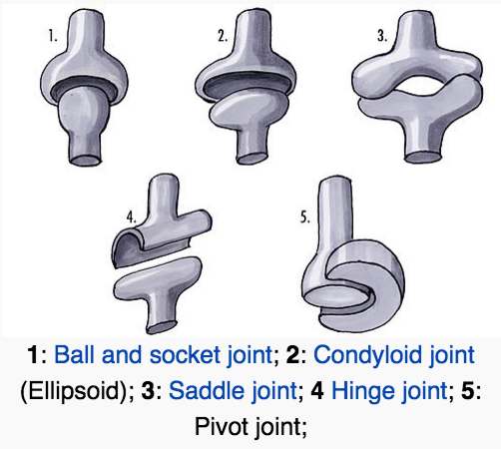
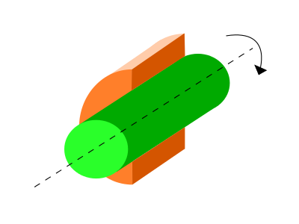
Joints
Prismatic: sliding / translational
Revolute: rotational

Slide 14
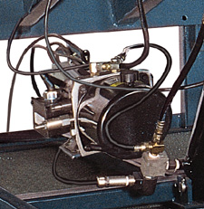
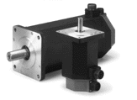
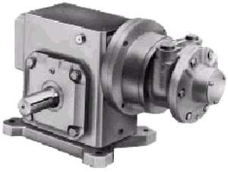
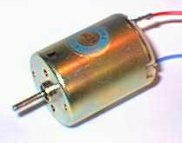
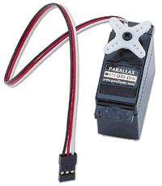
Actuators
Pneumatic Cylinder
Hydraulic Motor
Stepper Motor
Pneumatic Motor
DC Motor
Servo Motor

Slide 15
DC vs. servo motor
https://www.youtube.com/watch?v=mSowgNx5u7I
Pneumatic vs. Hydraulic
http://machinedesign.com/linear-motion/what-s-difference-between-pneumatic-hydraulic-and-electrical-actuators

Slide 16
When Do We Use…
Hydraulic/pneumatic
Heavy loads, high speeds
Sometimes hard to control (esp. pneumatic)
Doesn’t produce sparks
Pneumatic Cylinder
Pneumatic Motor
Hydraulic Motor

Slide 17
When Do We Use…
Most common robotic actuators: combinations of different electro-mechanical devices
Stepper motor
Subdivides a rotation into # increments
Open Loop
Servo Motor
Subdivides a rotation arbitrarily
Closed Loop
Notes:
The servo motor is actually an assembly of four things: a normal DC motor, a gear reduction unit, a position-sensing device (usually a potentiometer—a volume control knob), and a control circuit.
Stepper motors have some inherent ability to control position, as they have built-in output steps.
A servomotor consumes power as it rotates to the commanded position but then the servomotor rests. Stepper motors run warm to the touch because they continue to consume power to lock in and hold the commanded position.
Therefore, on first power up, the controller will have to activate the stepper motor and turn it to a known position, e.g. until it activates an end limit switch. This can be observed when switching on an inkjet printer; the controller will move the ink jet carrier to the extreme left and right to establish the end positions.
The lack of feedback of a stepper motor limits its performance, as the stepper motor can only drive a load that is well within its capacity, otherwise missed steps under load may lead to positioning errors and the system may have to be restarted or recalibrated.
There has been increasing popularity in closed loop stepper motors in recent years. They act like servomotors but have some differences in their software control to get smooth motion.

Slide 18
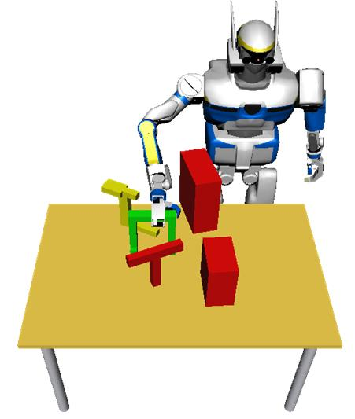
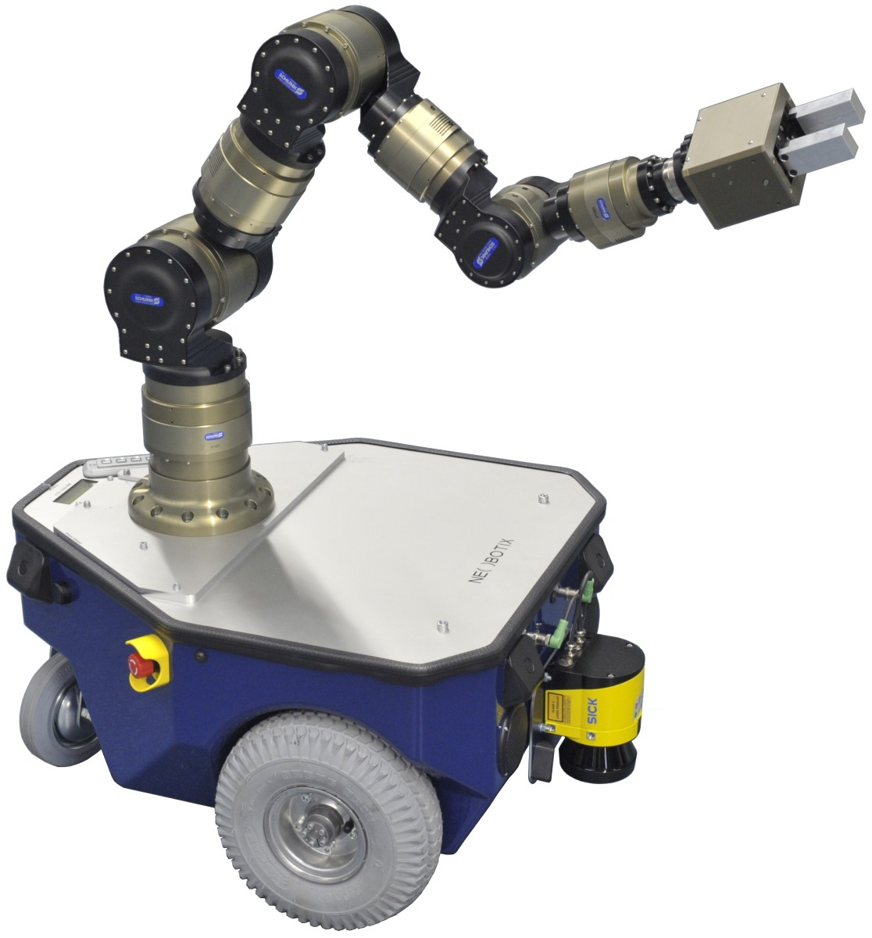
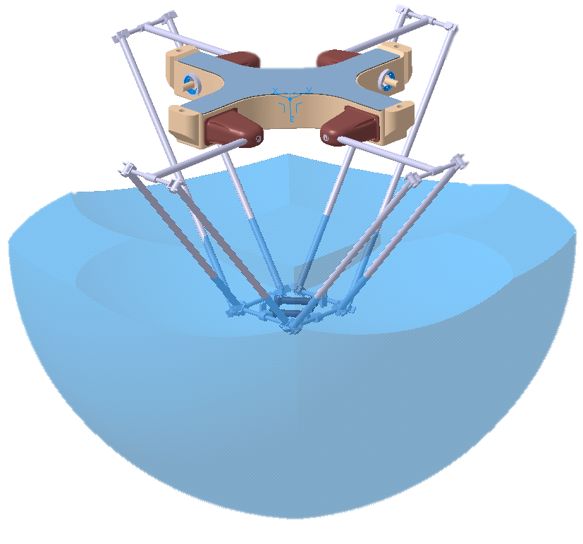
Manipulation Configurations & Grasping

Slide 19
Manipulation Configurations & Grasping

Slide 20
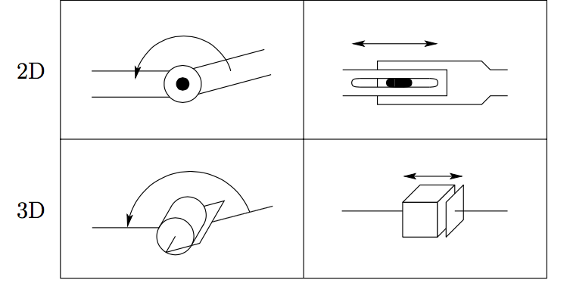
P(rismatic) & R(evolute)
A kinematic chain of rigid links connected by joints
“Kinematics is the branch of classical mechanics which describes the motion of objects and groups of objects.”
Prismatic (denoted P)
Sliding / translational / linear; allows a linear relative motion between 2 links
Revolute (denoted R)
Rotational; allows relative rotation between two links
Spong, Hutchinson, Vidyasagar. Robot Modeling and Control. 2006.
Notes:
REPRESENTING JOINTS

Slide 21
Joints: Denotation
A joint represents a connection between two links
Denotation of relative displacement between links
θ for revolute joint
d for prismatic joint
Denotation of axis of motion
z_{i} between link i and link i+1
Axis of rotation of a revolute joint
Axis of translation of a prismatic joint
Spong, Hutchinson, Vidyasagar. Robot Modeling and Control. 2006.
Notes:
Kinematics is the branch of classical mechanics which describes the motion of points, bodies (objects) and systems of bodies (groups of objects) without consideration of the causes of motion. Kinematics as a field of study is often referred to as the "geometry of motion".

Slide 22
Configuration Space
Configuration
Specification of location of every point on manipulator.
How can we specify?
Links are rigid
Base is (assumed to be) fixed
So if we know values for the joint variables
Angle for R joints (θ), offset for P joints (d)
We know everything!
Manip. configuration ≣ a set of values for joint variables
Set of all possible configurations is the configuration space.
Links
Base
Spong, Hutchinson, Vidyasagar. Robot Modeling and Control. 2006.
Notes:
Kinematics is the branch of classical mechanics which describes the motion of points, bodies (objects) and systems of bodies (groups of objects) without consideration of the causes of motion. Kinematics as a field of study is often referred to as the "geometry of motion".

Slide 23
DoFs for Manipulation
A system has n DoFs if exactly n parameters are required to completely specify the configuration.
For a manipulator:
Configuration can be specified by n joint parameters, so
# of DoFs = dimension of the configuration space
So, # number of joints determines DoFs
Rigid object in 3D space has six parameters
3 positioning (x, y, z), 3 orientation (roll, pitch and yaw angles)
DoFs < 6 ⇒ arm cannot reach every point in workspace with arbitrary orientation.
Spong, Hutchinson, Vidyasagar. Robot Modeling and Control. 2006.
Notes:
Kinematics is the branch of classical mechanics which describes the motion of points, bodies (objects) and systems of bodies (groups of objects) without consideration of the causes of motion. Kinematics as a field of study is often referred to as the "geometry of motion".

Slide 24
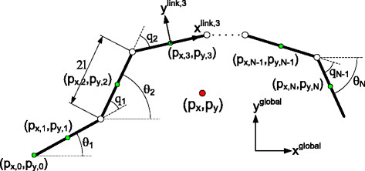
Notes on DoFs
DoFs < 6 ⇒ arm cannot reach every point in workspace with arbitrary orientation
Sometimes you need more
E.g., dealing with obstacles
DoFs > 6 is kinematically redundant
Difficulty of control problem as # DoFs grows
Increases rapidly with the number of links
Every 2 links need a joint
Spong, Hutchinson, Vidyasagar. Robot Modeling and Control. 2006.
Ehsan Rezapour. Pettersen, Gravdahl, Liljebäck, Kelasidi. Robotics and Biomimetics. 2014.
Notes:
Kinematics is the branch of classical mechanics which describes the motion of points, bodies (objects) and systems of bodies (groups of objects) without consideration of the causes of motion. Kinematics as a field of study is often referred to as the "geometry of motion".

Slide 25
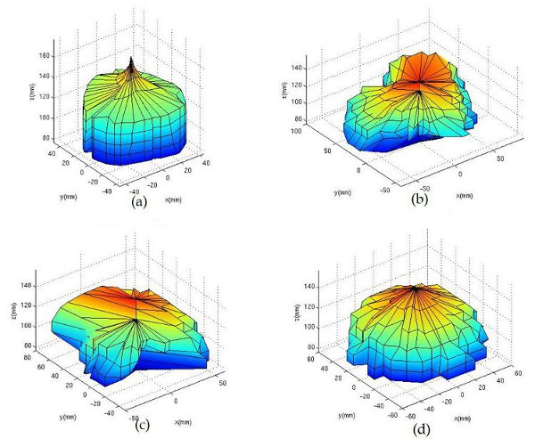
Workspaces
Configuration only provides geometry
Workspace
Set of all possible positions of end effector
In practice, these can be complex
Dexterous workspace
Set of points where end effector can be any orientation
Subset of workspace
Spong, Hutchinson, Vidyasagar. Robot Modeling and Control. 2006.
engineerjau.wordpress.com/2013/07/07/on-the-basis-of-workspaces-of-robotic-manipulators-part-1

Slide 26
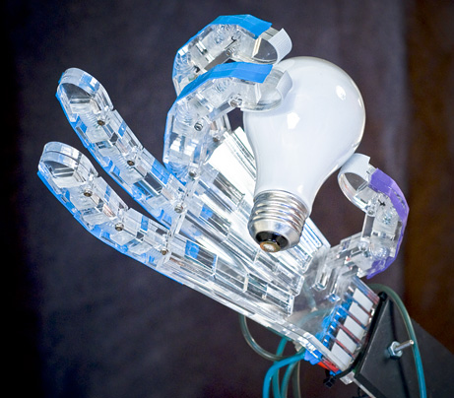
Grippers
Four categories of robot grippers:
Impactive
Jaws or claws which physically grasp by direct impact upon the object
Ingressive
Pins, needles or hackles penetrate surface
Textile, carbon and fiberglass handling
Astrictive
Suction forces applied to surface
Vacuum, magneto- or electroadhesion
Kontugutive / Contigutive
Requiring direct contact for adhesion
Glue, surface tension or freezing
grasping
Monkman, Hesse, Steinmann, Schunk. Robot Grippers. 2007.
news.nationalgeographic.com/news/2009/05/090505-robot-hand-picture.html

Slide 27
Universal Gripper: Video
https://www.youtube.com/watch?v=0d4f8fEysf8
https://www.youtube.com/watch?v=KBTrtQQKl7o

Slide 28
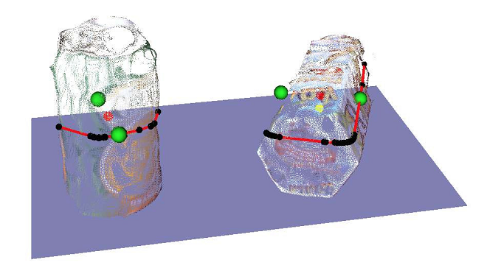
Grasps
Grasp:
A set of contact points on an object’s surface
Goal: constrain object’s movement
www.intechopen.com/books/robot-arms/robotic-grasping-of-unknown-objects1
news.nationalgeographic.com/news/2009/05/090505-robot-hand-picture.html

Slide 29
Grasps
Grasps vary by:
Hand (gripper)
Object being grasped
Type of motion desired
For each hand or hand/object pair:
Where to grasp it?
How hard?
Then what?
Additional constraints (e.g., don’t spill)
Drinking
www.madry.pro
León, Morales, Sancho-Bru. Robot Grasping Foundations. 2013

Slide 30
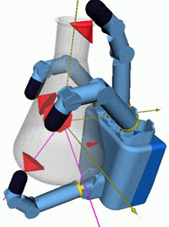
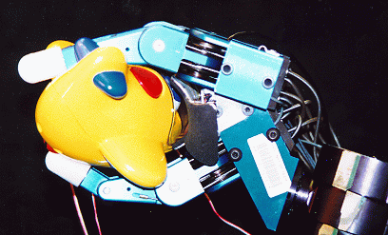
The Grasping Problem
Grasps are not obvious (easy to calculate)
Any given object has arbitrary contact points
Hand has geometry constraints, etc.
Synthesized trial-and-error
For a hand/object pair:
Different grasp types planned and analyzed
Real trial and error
www.cs.columbia.edu/~cmatei/graspit/
www.programmingvision.com/research.html
www.cc.gatech.edu/gvu/people/faculty/nancy.pollard/grasp.html

Slide 31
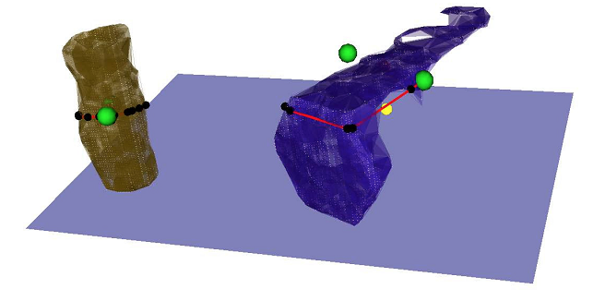
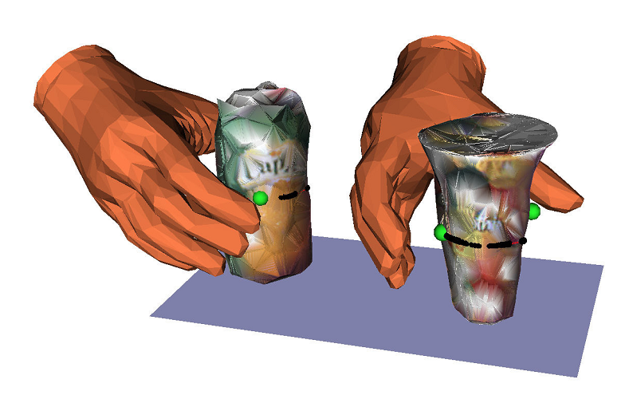
Grasp Planning
Grasp synthesis: Find suitable set of contacts, given
Object model
Constraints on allowable contacts
Grasp points are determined
Mostly assume point contacts
Larger areas usually discretized
Contact model defines the force the manipulator exerts on contact areas
Grasp analysis
Is that grasp stable?
León, Morales, Sancho-Bru. Robot Grasping Foundations. 2013.
www.intechopen.com/books/robot-arms/robotic-grasping-of-unknown-objects1

Slide 32
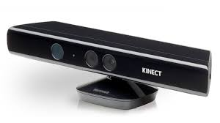
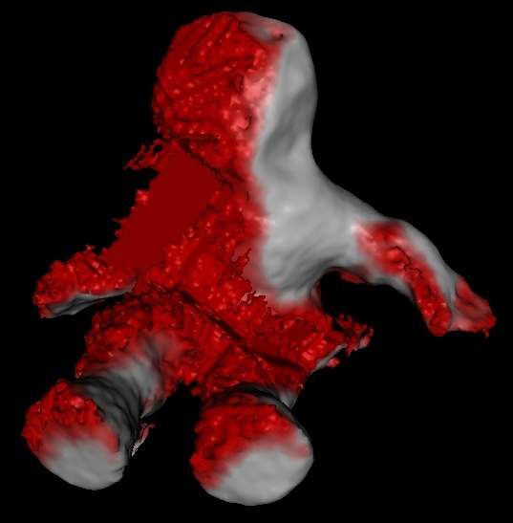
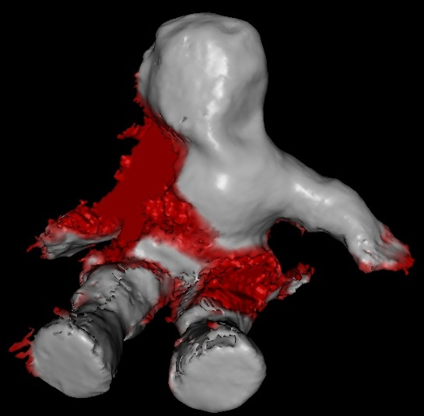
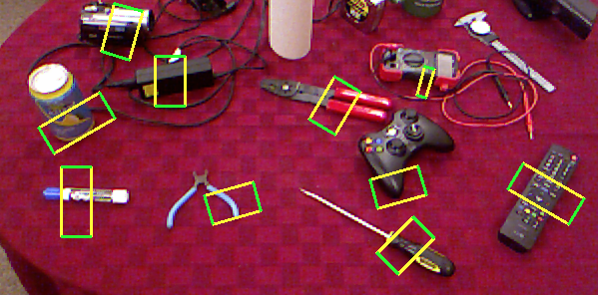
Ongoing Research
How do you get the object model?
What are the constraints?
Background knowledge, mathematical modeling, …
www.madry.pro
www.cs.washington.edu/robotics/3d-in-hand

Slide 33
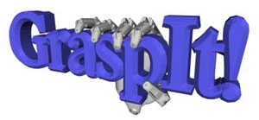
https://www.youtube.com/watch?v=rJAti2ymAnY

Slide 34
Implementation of a Gaussian process-based machine learning grasp predictor. Goins, Carpenter, Wong, & Balasubramanian, 2015
With the goal of advancing the state of automatic robotic grasping, we present a novel approach that combines machine learning techniques and physical validation on a robotic platform to develop a comprehensive grasp predictor. After collecting a large grasp sample set (522 grasps), we first conduct a statistical analysis of the predictive ability of grasp quality metrics that are commonly used in the robotics literature. We then apply principal component analysis and Gaussian process (GP) algorithms on the grasp metrics that are discriminative to build a classifier, validate its performance, and compare the results to existing grasp planners. The key findings are as follows: (i) several of the existing grasp metrics are weak predictors of grasp quality when implemented on a robotic platform; (ii) the GP-based classifier significantly improves grasp prediction by combining multiple grasp metrics to increase true positive classification at low false positive rates; (iii) The GP classifier can be used generate new grasps to improve bad grasp samples by performing a local search to find neighboring grasps which have improved contact points and higher success rate.

