Slide 1

4 Proposed Research Projects
SmartHome
  Encouraging patients with mild cognitive disabilities to use digital memory notebook for activities of daily living
Diabetes
  Encouraging patients to use program and follow exercise advice to maintain glucose levels
Machine Learning Curriculum Development
  Automatically construct a set of tasks such that it’s faster to learn the set than to directly learn the final (target) task
Lifelong Machine Learning
  Get a team of parrot drones and turtlebots to coordinate for a search and rescue. Build a library of past tasks to learn the n+1st task faster
  All at risk because of the government shutdown

Slide 2
Thu
Homework
(some?) labs
Contest : only 1 try
  Will open classroom early

Slide 3
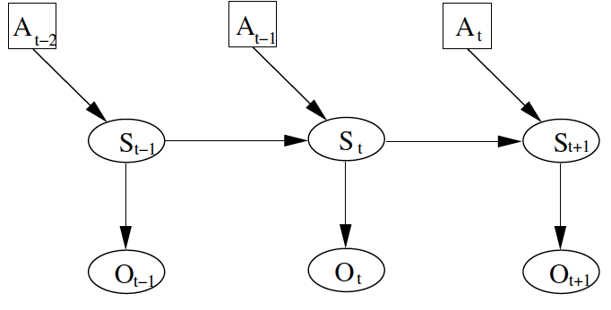
General approach:
A: action
S: pose
O: observation
Position at time t depends on position previous position and action, and current observation

Slide 4
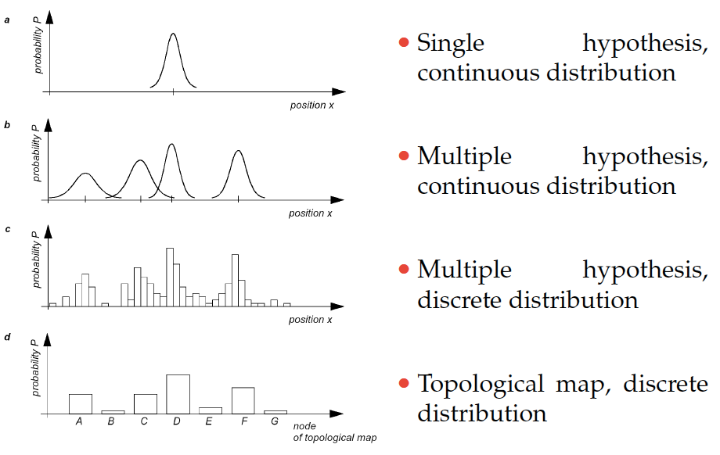
Models of Belief

Slide 5

Axioms of Probability Theory
$Pr⁡(A)$ denotes probability that proposition A is true.
$Pr⁡(¬A)$ denotes probability that proposition A is false.

Slide 6
A Closer Look at Axiom 3
B

Slide 7

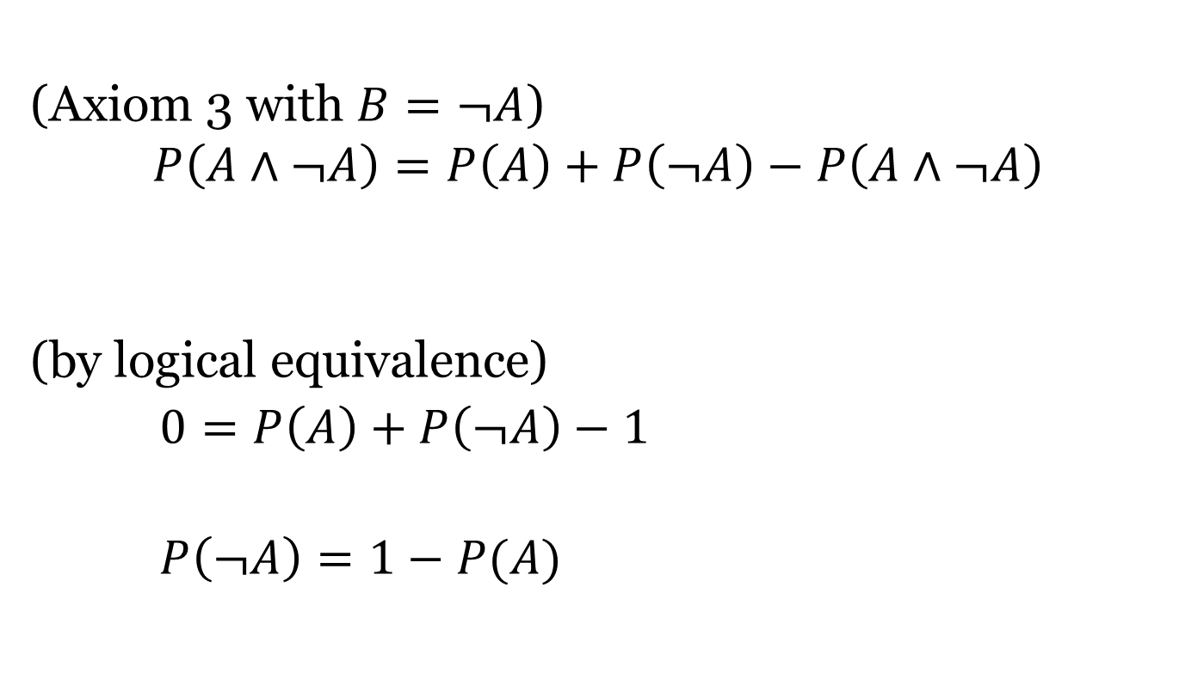
Using the Axioms to Prove $P\left(¬A\right)=1−P\left(A\right)$
(Axiom 3 with )
(by logical equivalence)
∨

Slide 8
Discrete Random Variables
X denotes a random variable.
X can take on a countable number of values in {x₁, x₂, …, x_{n}}.
P(X=x_{i}), or P(x_{i}), is the probability that the random variable X takes on value x_{i}.
P(x_{i}) is called probability mass function.
E.g.

Slide 9

Continuous Random Variables
$X$ takes on values in the continuum.
$p(X=x)$, or $p(x)$, is a probability density function.
E.g.
p(x)
x

Slide 10
Probability Density Function
Magnitude of curve could be greater than 1 in some areas. The total area under the curve must add up to 1.
p(x)
x
Since continuous probability functions are defined for an infinite number of points over a continuous interval, the probability at a single point is always 0.

Slide 11
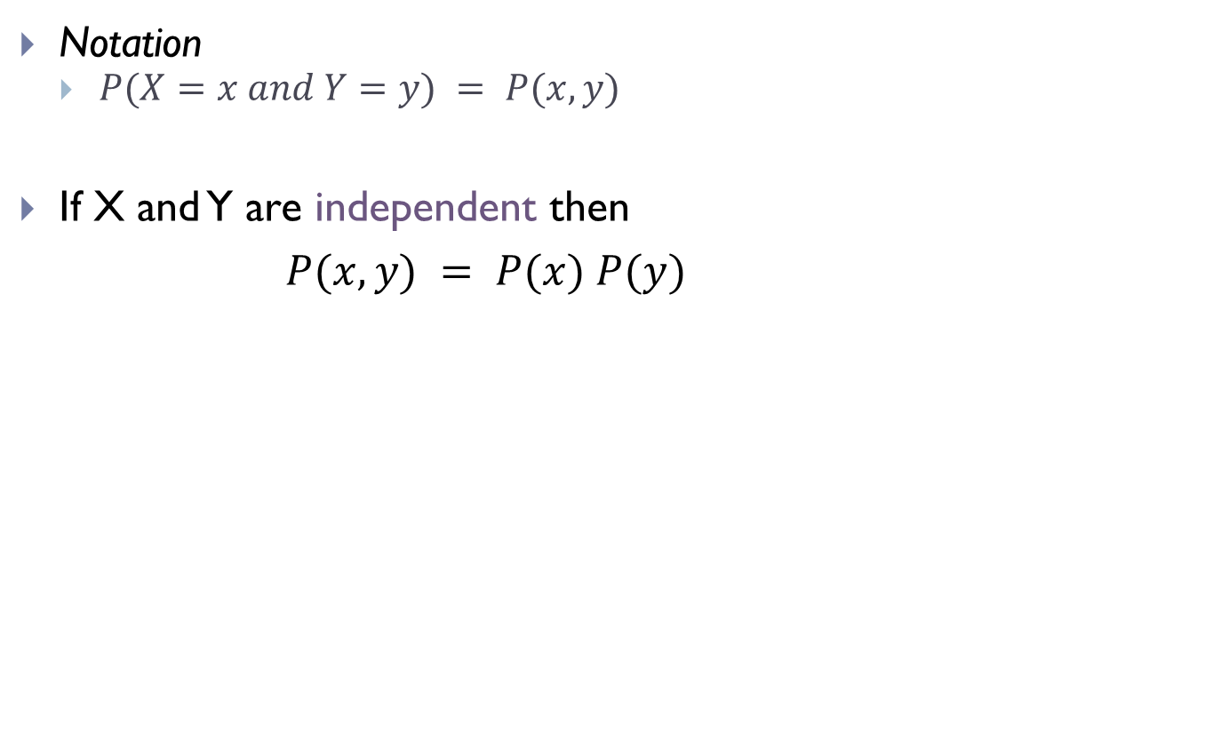
Joint Probability
Notation
  $P(X=x and Y=y) = P(x,y)$
If X and Y are independent then
$P(x,y) = P(x) P(y)$

Slide 12
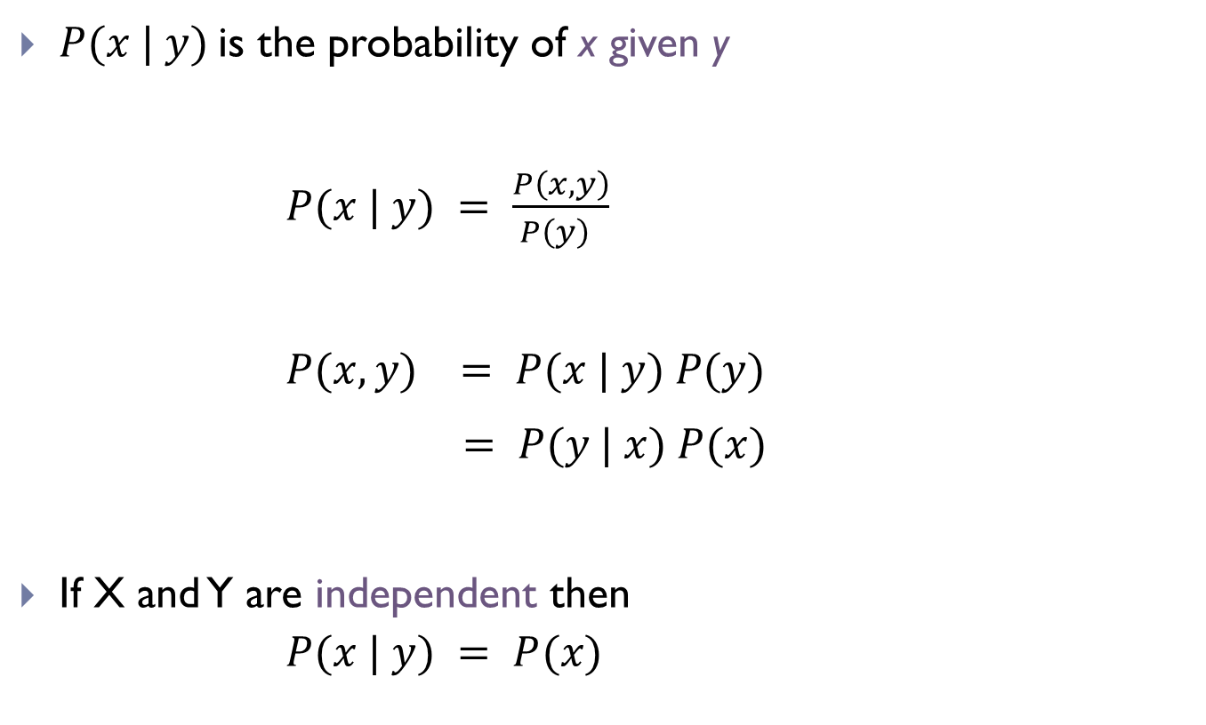
Conditional Probability
is the probability of x given y
If X and Y are independent then

Slide 13
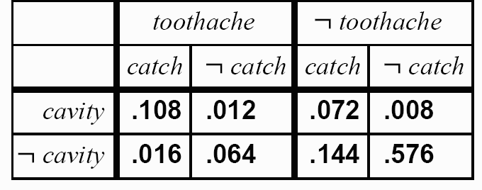
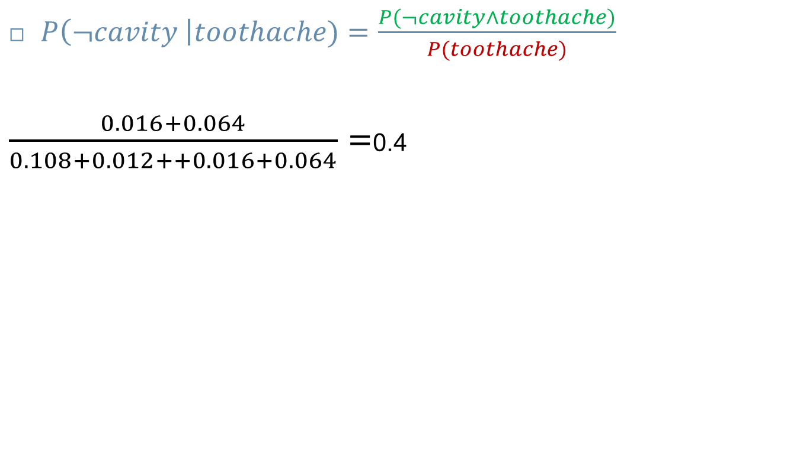
Inference by Enumeration
  $P\left(¬cavity \right|toothache)=\frac{P(¬cavity∧toothache)}{P(toothache)}$
$\frac{0.016+0.064}{0.108+0.012++0.016+0.064}$ =0.4

Slide 14
Law of Total Probability
Discrete case
Continuous case

Slide 15
Bayes Formula
If y is a new sensor reading:
→
Prior probability distribution
→
Posterior (conditional) probability distribution
→
Model of the characteristics of the sensor
→
Does not depend on x

Slide 16
Bayes Formula

Slide 17
Normalization
Algorithm:

Slide 18
Conditioning
Law of total probability:

Slide 19
Bayes Rule with Background Knowledge

Slide 20
Conditional Independence
equivalent to
and

Slide 21
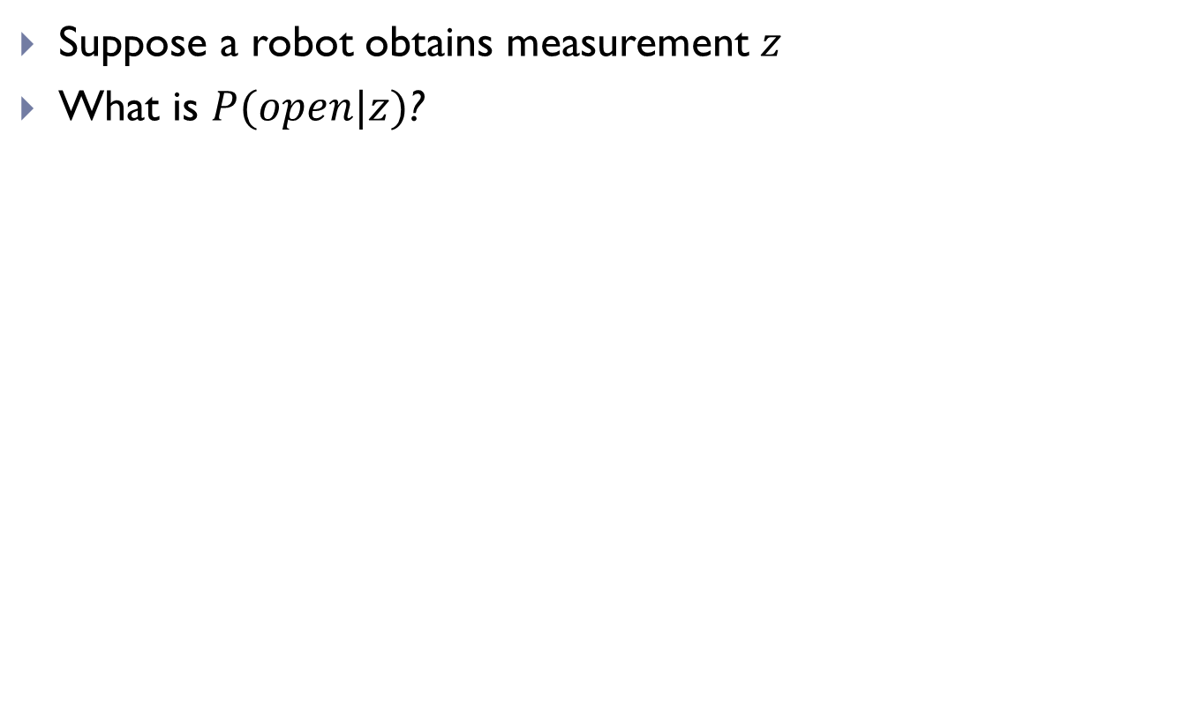
Simple Example of State Estimation
Suppose a robot obtains measurement $z$
What is $P(open|z)$?

Slide 22
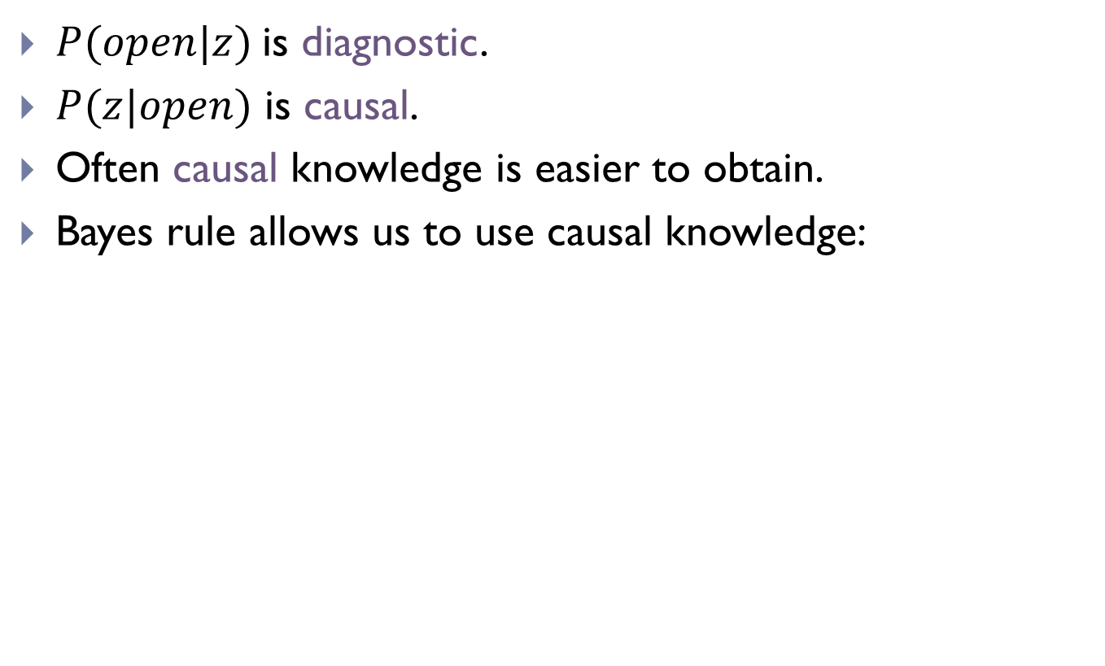
Causal vs. Diagnostic Reasoning
$P(open|z)$is diagnostic.
$P(z|open)$ is causal.
Often causal knowledge is easier to obtain.
Bayes rule allows us to use causal knowledge:
Comes from sensor model.

Slide 23
Example
P(z|open) = 0.6 P(z|¬open) = 0.3
P(open) = P(¬open) = 0.5
$z$ raises the probability that the door is open.

Slide 24

Combining Evidence
Suppose our robot obtains another observation z₂.
How can we integrate this new information?
More generally, how can we estimate
P(x| z₁...z_{n} )?

Slide 25
Recursive Bayesian Updating
Markov assumption: z_{n} is independent of z₁,...,z_{n-1} if we know x.

Slide 26
Example: 2nd Measurement
P(z₂|open) = 0.5 P(z₂|¬open) = 0.6
P(open|z₁)=2/3
$z2$lowers the probability that the door is open.

Slide 27
Actions
Often the world is dynamic since
  actions carried out by the robot,
  actions carried out by other agents,
  or just the time passing by
change the world.
How can we incorporate such actions?

Slide 28
Typical Actions
Actions are never carried out with absolute certainty.
In contrast to measurements, actions generally increase the uncertainty.
(Can you think of an exception?)

Slide 29
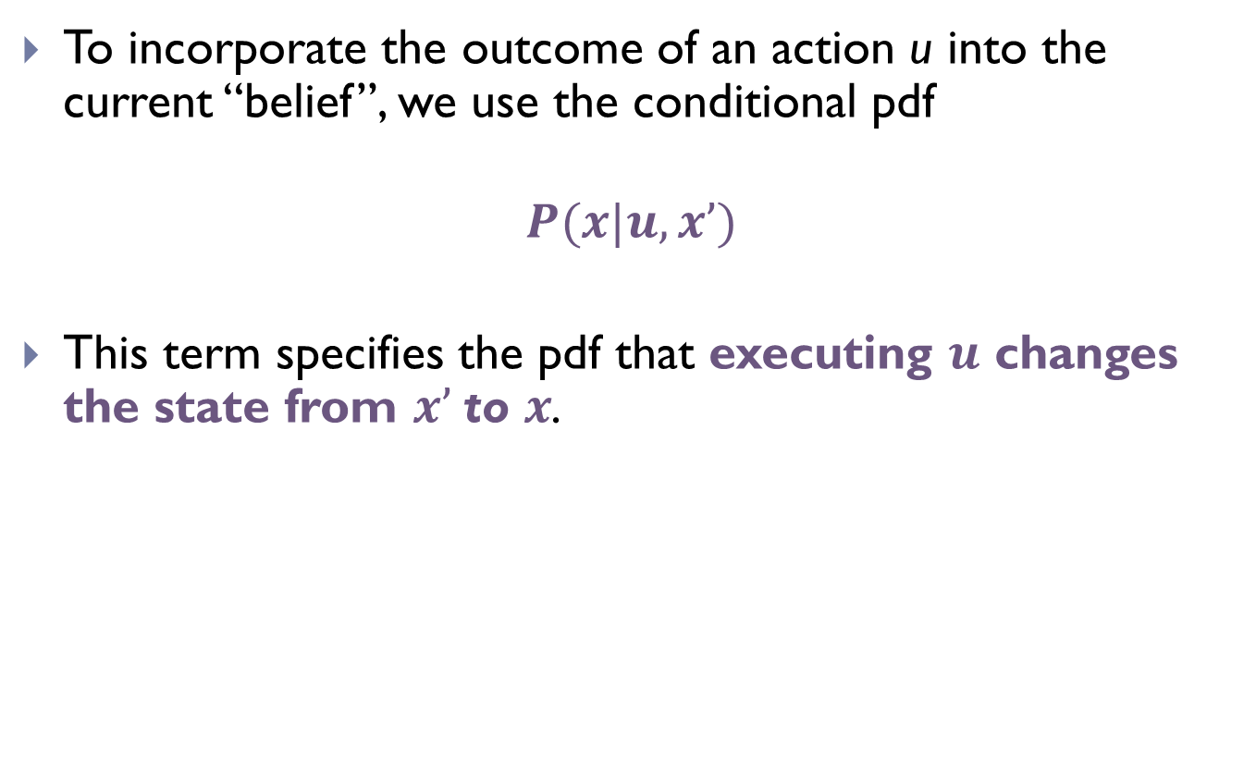
Modeling Actions
To incorporate the outcome of an action u into the current “belief”, we use the conditional pdf
$$P(x|u,x’)$$
This term specifies the pdf that executing $u$ changes the state from $x’$to $x$.

Slide 30
Example: Closing the door

Slide 31
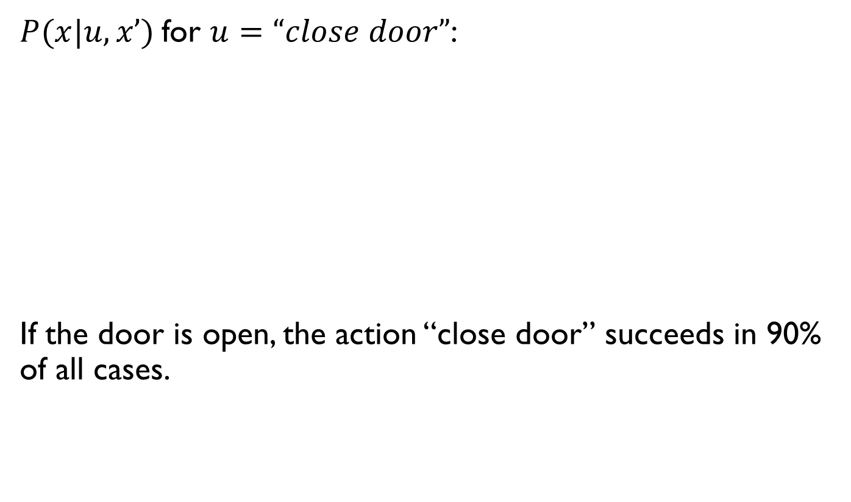
for :
If the door is open, the action “close door” succeeds in 90% of all cases.

Slide 32

Integrating the Outcome of Actions
Continuous case:
Discrete case:
$$P\left(closed | u\right)=P\left(closed | u,open\right)P\left(open\right)+$$
$P\left(closed | u, closed\right)P(closed)$
Applied to status of door, given that we just (tried to) close it?

Slide 33
Integrating the Outcome of Actions
Continuous case:
Discrete case:
$$P\left(closed | u\right)=P\left(closed | u,open\right)P\left(open\right)+$$
$P\left(closed | u, closed\right)P(closed)$
P(closed | u) = P(closed | u, open) P(open) + P(closed|u, closed) P(closed)

Slide 34
Example: The Resulting Belief

Slide 35
Example: The Resulting Belief
OK… but then what’s the chance that it’s still open?

Slide 36
Example: The Resulting Belief

Slide 37
Summary
Bayes rule allows us to compute probabilities that are hard to assess otherwise.
Under the Markov assumption, recursive Bayesian updating can be used to efficiently combine evidence.

Slide 38
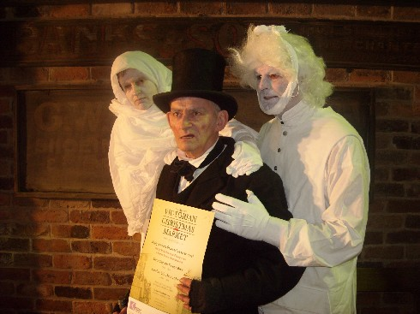
Quiz from Lectures Past
If events a and b are independent,
    p(a, b) = p(a) × p(b)
If events a and b are not independent,
  p(a, b) = p(a) × p(b|a) = p(b) × p (a|b)
p(c|d) = p (c , d) / p(d) = p((d|c) p(c)) / p(d)

Slide 39


Example

Slide 40
Example
P(s)
s

Slide 41
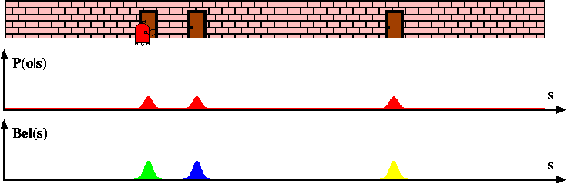
Example

Slide 42
Example
How does the probability distribution change if the robot now senses a wall?

Slide 43

Example 2
0.2 | 0.2 | 0.2 | 0.2 | 0.2

Slide 44
Example 2
0.2 | 0.2 | 0.2 | 0.2 | 0.2
Probability should go down.
Robot senses yellow.
Probability should go up.

Slide 45
Example 2
0.2 | 0.2 | 0.2 | 0.2 | 0.2
States that match observation
  Multiply prior by 0.6
States that don’t match observation
  Multiply prior by 0.2
Robot senses yellow.
0.04 | 0.12 | 0.12 | 0.04 | 0.04

Slide 46
Example 2
0.04 | 0.12 | 0.12 | 0.04 | 0.04
Sums to 0.36
!
Normalize (divide by total)
The probability distribution no longer sums to 1!
.111 | .333 | .333 | .111 | .111

Slide 47
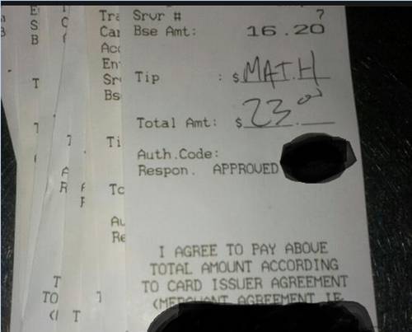
Nondeterministic Robot Motion
.111 | .333 | .333 | .111 | .111
R
The robot can now move Left and Right.

Slide 48
Nondeterministic Robot Motion
.111 | .333 | .333 | .111 | .111
R
The robot can now move Left and Right.
When executing “move x steps to right” or left:
.8: move x steps
.1: move x-1 steps
.1: move x+1 steps

Slide 49
Nondeterministic Robot Motion
0 | 1 | 0 | 0 | 0
Right 2
When executing “move x steps to right”:
.8: move x steps
.1: move x-1 steps
.1: move x+1 steps
The robot can now move Left and Right.
0 | 0 | 0.1 | 0.8 | 0.1

Slide 50
Nondeterministic Robot Motion
0 | 0.5 | 0 | 0.5 | 0
Right 2
When executing “move x steps to right”:
.8: move x steps
.1: move x-1 steps
.1: move x+1 steps
The robot can now move Left and Right.
0.4 | 0.05 | 0.05 | 0.4 | (0.05+0.05) 0.1

Slide 51
Nondeterministic Robot Motion
0 | 0.5 | 0 | 0.5 | 0
What is the probability distribution after 1000 moves?

Slide 52
Example

Slide 53
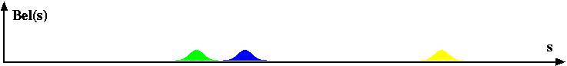
Example
Right

Slide 54
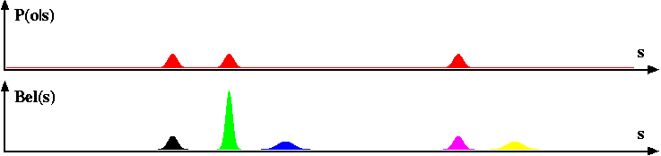
Example

Slide 55
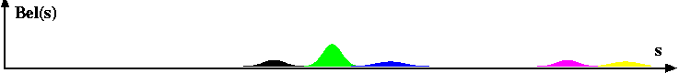
Example
Right

Slide 56
Localization
Gain Information
Lose
Information
Sense
Move
Initial Belief

