Slide 1


Slide 2
CNN Headline: “Police: 8-year-old shoots, kills elderly caregiver after playing video game.”
1st sentence: “An 8-year-old Louisiana boy intentionally shot and killed his elderly caregiver after playing a vilent video game, authorities say.”
First, how did the kid get a gun and load it without the caregiver noticing?
Second, why was an 8 year old playing GTA?

Slide 3
Reminders
Lab 1 due at 11:59pm TODAY
No class on Thursday
  But Dana 3 will be open
Piazza (sorry, not pizza)
Lab 2: ARDrone
  Charge the batteries
  Don’t leave charging
  When flying, have someone “spot” for you

Slide 4
Last Time
Reactive vs. Deliberative Architecture
Temporal vs. Control Decomposition
Serial vs. Parallel Decision making
Subsumption Architecture
Quick ROS overview
How would I find the red ball?

Slide 5
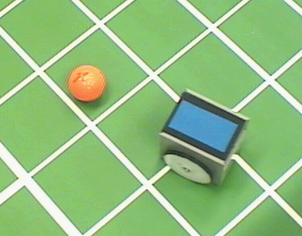
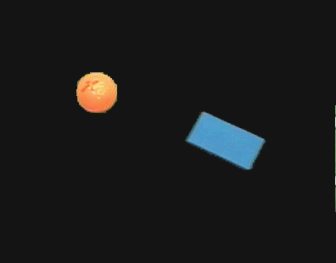
Color Tracking Sensors
4.1.8
Motion estimation of ball and robot for soccer playing using color tracking

Slide 6
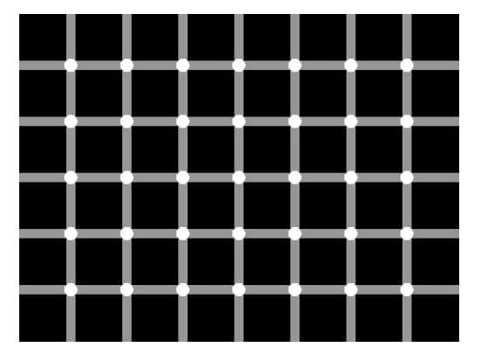
How many black spots?

Slide 7
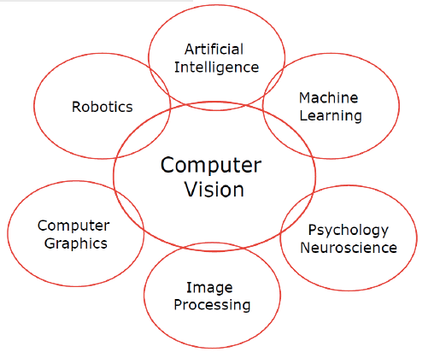

Slide 8
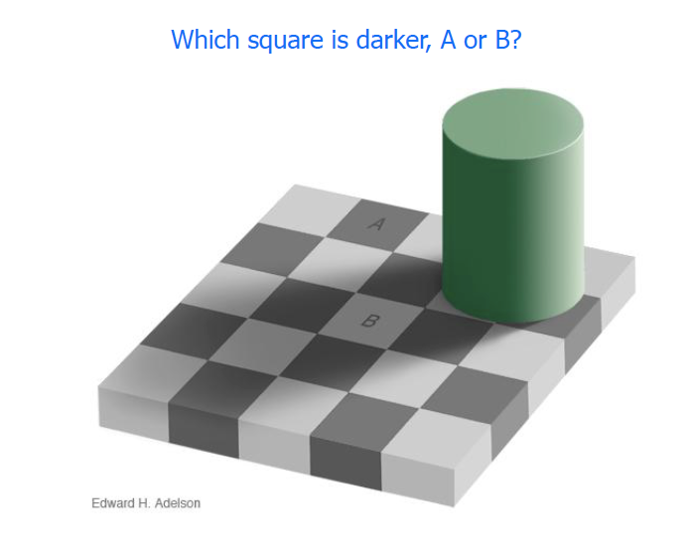

Slide 10
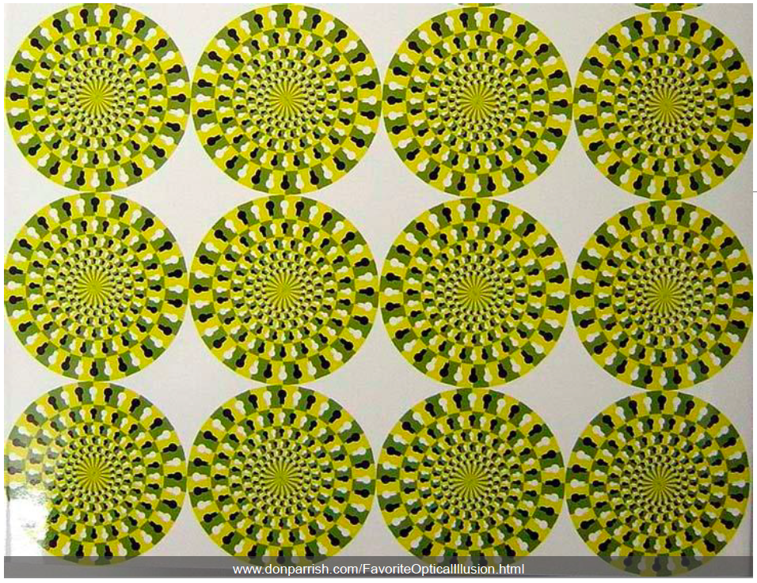

Slide 11
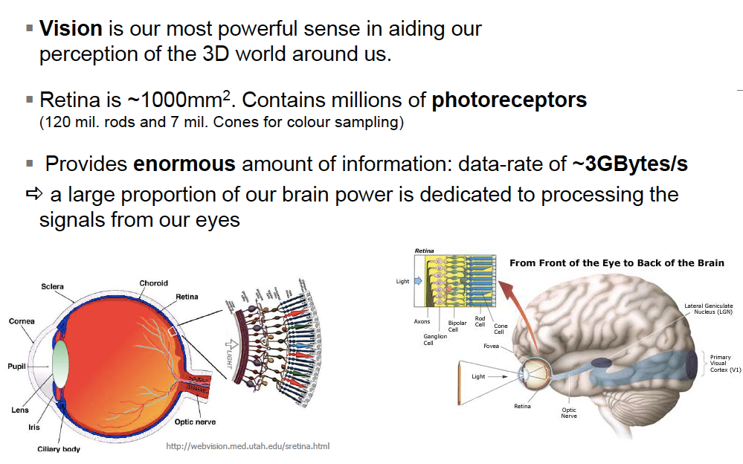

Slide 12
Perception
4
Sensors
Uncertainty
Features
Localization
"Position"
Cognition
Global Map
Environment Model
Path
Local Map
Perception
Real World
Motion Control
Environment

Slide 13
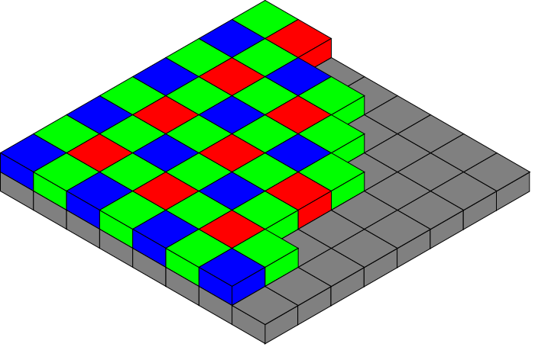
Vision-based Sensors: Hardware
4.1.8
CCD (light-sensitive, discharging capacitors of 5 to 25 micron)
  Charge-coupled device, 1969 at AT&T Bell Labs
CMOS (Complementary Metal Oxide Semiconductor technology) sensor
  Active pixel sensor
  Cheaper, lower power, traditionally lower quality
Notes:
Bayer pattern

Slide 14
Blob (color) detection
  Lab 2
Edge Detection
  http://en.wikipedia.org/wiki/Edge_detection
SIFT (Scale Invariant Feature Transform) features
  http://www.aishack.in/2010/05/sift-scale-invariant-feature-transform/
Deep Learning
  http://deep.host22.com/
  http://deeplearning.net/

Slide 15
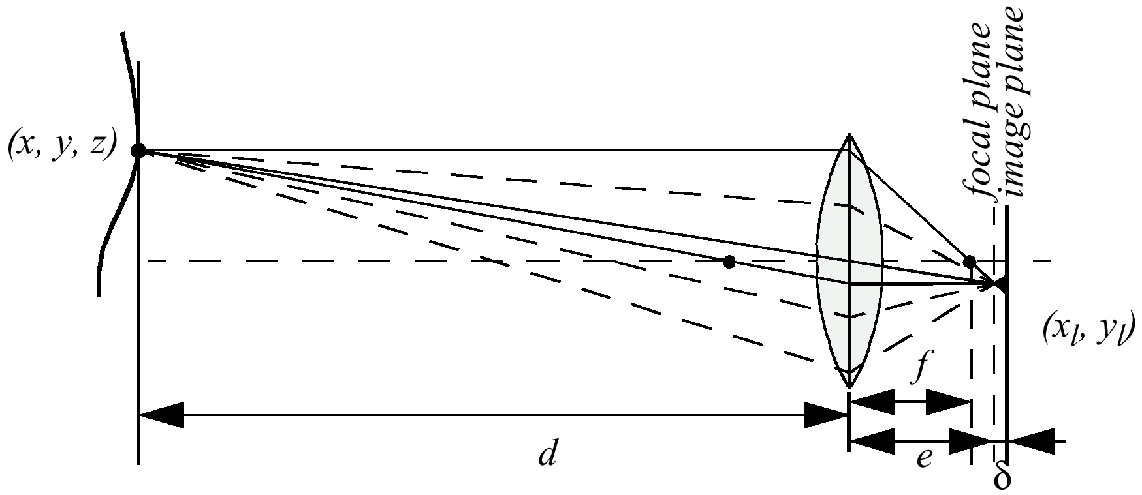
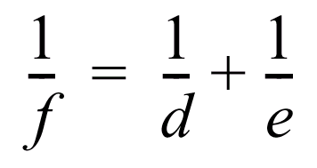
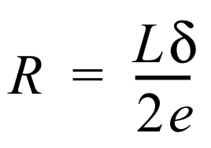
Depth from Focus (1)
4.1.8

Slide 16
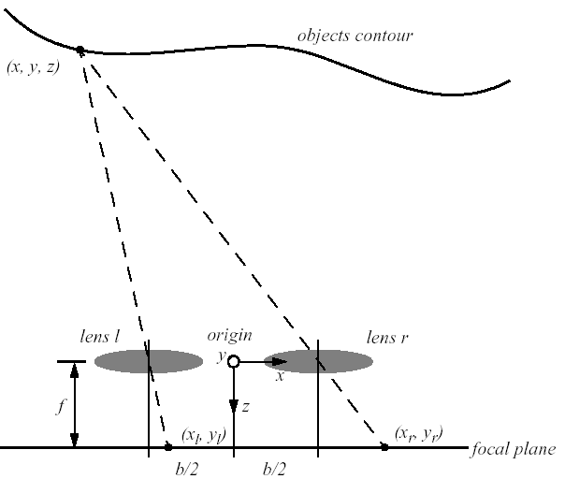




Stereo Vision
4.1.8
Idealized camera geometry for stereo vision
  Disparity between two images -> Computing of depth
  From the figure it can be seen that

Slide 17
Stereo Vision
4.1.8
Distance is inversely proportional to disparity
  closer objects can be measured more accurately
Disparity is proportional to b, horizontal distance between lenses
  For a given disparity error, the accuracy of the depth estimate increases with increasing baseline b.
  However, as b is increased, some objects may appear in one camera, but not in the other.
A point visible from both cameras produces a conjugate pair.
  Conjugate pairs lie on epipolar line (parallel to the x-axis for the arrangement in the figure above)

Slide 18
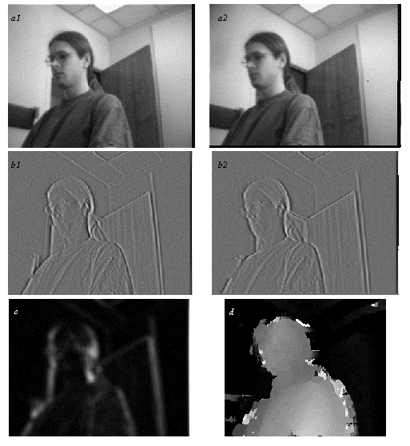
Stereo Vision Example
4.1.8
Extracting depth information from a stereo image
  a1 and a2: left and right image
  b1 and b2: vertical edge filtered
  left and right image;
  filter = [1 2 4 -2 -10 -2 4 2 1]
  c: confidence image:
  bright = high confidence (good texture)
  d: depth image:
  bright = close; dark = far
Artificial example: a bunch of fenceposts?

Slide 19
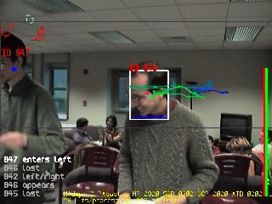
Adaptive Human-Motion Tracking
4.1.8

Slide 20
Intermission
http://www.youtube.com/watch?v=gA5bwqVN5LM

Slide 22
Classification of Sensors
4.1.1
Proprioceptive sensors
  measure values internally to the system (robot),
  e.g. motor speed, wheel load, heading of the robot, battery status
Exteroceptive sensors
  information from the robots environment
  distances to objects, intensity of the ambient light, unique features.
Passive sensors
  energy coming for the environment
Active sensors
  emit their proper energy and measure the reaction
  better performance, but some influence on envrionment

Slide 23
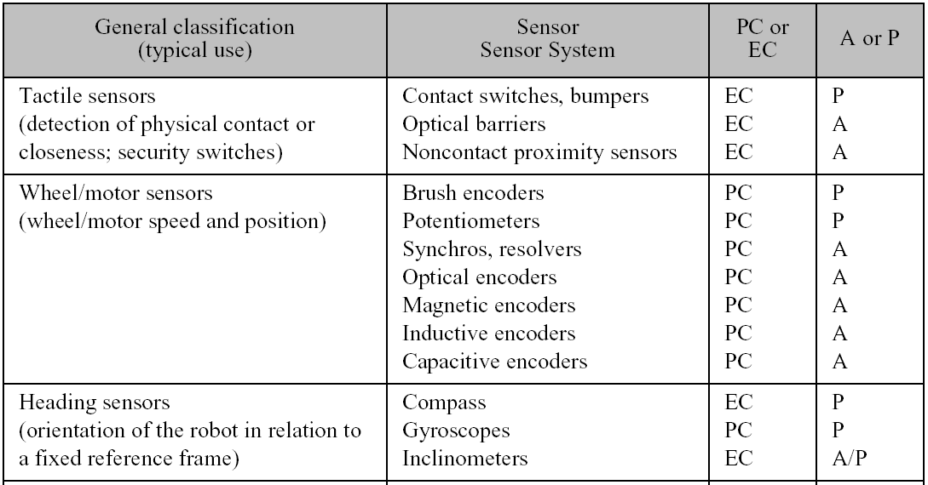
General Classification (1)
4.1.1

Slide 24
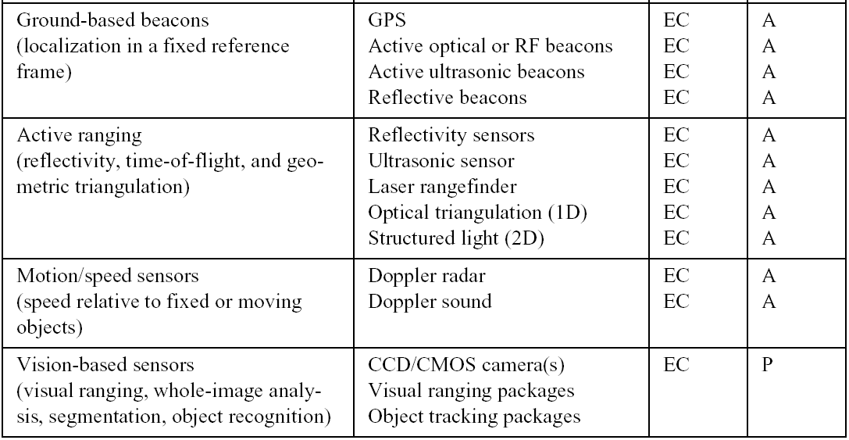
General Classification (2)
4.1.1

Slide 25
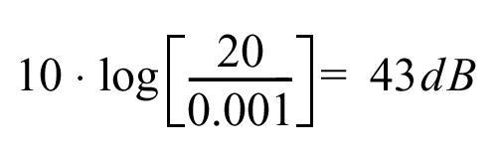
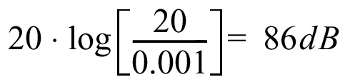
Characterizing Sensor Performance (1)
4.1.2
Measurement in real world environment is error prone
Basic sensor response ratings
  Dynamic range
    ratio between lower and upper limits, usually in decibels (dB, power)
    e.g. power measurement from 1 Milliwatt to 20 Watts
    e.g. voltage measurement from 1 Millivolt to 20 Volt
    20 instead of 10 because square of voltage is equal to power!!
  Range
    upper limit

Slide 26
Characterizing Sensor Performance (2)
4.1.2
Basic sensor response ratings (cont.)
  Resolution
    minimum difference between two values
    usually: lower limit of dynamic range = resolution
    for digital sensors it is usually the analog-to-digital conversion
      e.g. 5V / 255 (8 bit)
  Linearity
    variation of output signal as function of the input signal
    linearity is less important when signal is after treated with a computer
  Bandwidth or Frequency
    the speed with which a sensor can provide a stream of readings
    usually there is an upper limit depending on the sensor and the sampling rate
    Lower limit is also possible, e.g. acceleration sensor

Slide 27
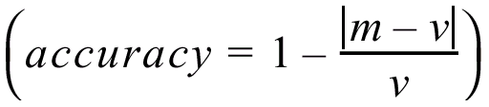
In Situ Sensor Performance (1)
4.1.2
Characteristics that are especially relevant for real world environments
Sensitivity
  ratio of output change to input change
  however, in real world environment, the sensor has very often high sensitivity to other environmental changes, e.g. illumination
Cross-sensitivity
  sensitivity to environmental parameters that are orthogonal to the target parameters (e.g., compass responding to building materials)
Error / Accuracy
  difference between the sensor’s output and the true value
m = measured value
v = true value
error

Slide 28

In Situ Sensor Performance (2)
4.1.2
Characteristics that are especially relevant for real world environments
Systematic error -> deterministic errors
  caused by factors that can (in theory) be modeled -> prediction
Random error -> non-deterministic
  no prediction possible
  however, they can be described probabilistically
Precision
  reproducibility of sensor results
Notes:
e.g. calibration of a laser sensor or of the distortion cause by the optic of a camera
e.g. Hue instability of camera, black level noise of camera ..

Slide 29
Characterizing Error: The Challenges in Mobile Robotics
4.1.2
Mobile Robot has to perceive, analyze and interpret the state of the surrounding
Measurements in real world environment are dynamically changing and error prone.
Examples:
  changing illuminations
  specular reflections
  light or sound absorbing surfaces
  cross-sensitivity of robot sensor to robot pose and robot-environment dynamics
    rarely possible to model -> appear as random errors
    systematic errors and random errors might be well defined in controlled environment. This is not the case for mobile robots !!

Slide 30
Multi-Modal Error Distributions: The Challenges in …
4.1.2
Behavior of sensors modeled by probability distribution (random errors)
  usually very little knowledge about the causes of random errors
  often probability distribution is assumed to be symmetric or even Gaussian
  however, it is important to realize how wrong this can be!
  Examples:
    Sonar (ultrasonic) sensor might overestimate the distance in real environment and is therefore not symmetric
    Thus the sonar sensor might be best modeled by two modes:
    1. the case that the signal returns directly
    2. the case that the signals returns after multi-path reflections
    Stereo vision system might correlate to images incorrectly, thus causing results that make no sense at all

Slide 31
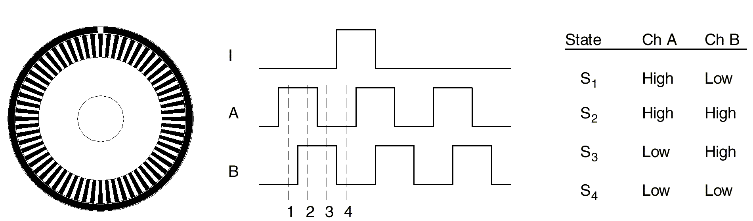
Wheel / Motor Encoders (1)
4.1.3
measure position or speed of the wheels or steering
wheel movements can be integrated to get an estimate of the robots position -> odometry
optical encoders are proprioceptive sensors
  position estimation in relation to a fixed reference frame is only valuable for short movements.
typical resolutions: 2000 increments per revolution.
  for high resolution: interpolation

Slide 32
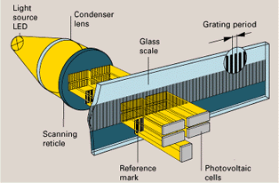
Wheel / Motor Encoders (2)
4.1.3
scanning reticle fields
scale slits
Notice what happen when the direction changes:

Slide 33
Heading Sensors
4.1.4
Heading sensors can be proprioceptive (gyroscope, inclinometer) or exteroceptive (compass).
Used to determine the robots orientation and inclination.
Allow, together with an appropriate velocity information, to integrate the movement to an position estimate.
  This procedure is called dead reckoning (ship navigation)

Slide 34
Compass
4.1.4
Since over 2000 B.C.
  when Chinese suspended a piece of naturally magnetite from a silk thread and used it to guide a chariot over land.
Magnetic field on earth
  absolute measure for orientation.
Large variety of solutions to measure the earth magnetic field
  mechanical magnetic compass
  direct measure of the magnetic field (Hall-effect, magnetoresistive sensors)
Major drawback
  weakness of the earth field
  easily disturbed by magnetic objects or other sources
  not feasible for indoor environments

Slide 35
Gyroscope
4.1.4
Heading sensors, that keep the orientation to a fixed frame
  absolute measure for the heading of a mobile system.
Two categories, the mechanical and the optical gyroscopes
  Mechanical Gyroscopes
    Standard gyro
    Rated gyro
  Optical Gyroscopes
    Rated gyro

Slide 36
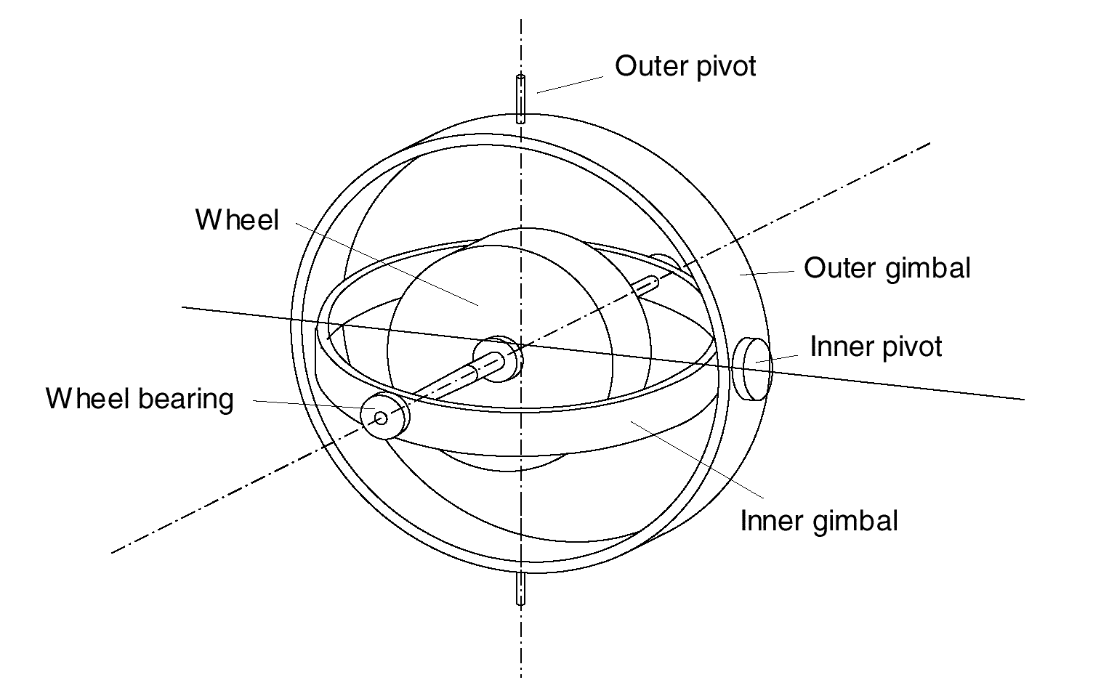
Mechanical Gyroscopes
4.1.4
Concept: inertial properties of a fast spinning rotor
  gyroscopic precession
Angular momentum associated with a spinning wheel keeps the axis of the gyroscope inertially stable.
Reactive torque tao (tracking stability) is proportional to the spinning speed w, the precession speed W and the wheels inertia I.
No torque can be transmitted from the outer pivot to the wheel axis
  spinning axis will therefore be space-stable
Quality: 0.1° in 6 hours
If the spinning axis is aligned with the
north-south meridian, the earth’s rotation
has no effect on the gyro’s horizontal axis
If it points east-west, the horizontal axis
reads the earth rotation

Slide 37
Rate gyros
4.1.4
Same basic arrangement shown as regular mechanical gyros
But: gimble(s) are restrained by a torsional spring
  enables to measure angular speeds instead of the orientation.
Others, more simple gyroscopes, use Coriolis forces to measure changes in heading.

Slide 38
Optical Gyroscopes
4.1.4
First commercial use started only in the early 1980 when they where first installed in airplanes.
Optical gyroscopes
  angular speed (heading) sensors using two monochromic light (or laser) beams from the same source.
On is traveling in a fiber clockwise, the other counterclockwise around a cylinder
Laser beam traveling in direction of rotation
  slightly shorter path -> shows a higher frequency
  difference in frequency Δf of the two beams is proportional to the angular velocity Ω of the cylinder
New solid-state optical gyroscopes based on the same principle are build using microfabrication technology.
MUCH more accurate than mechanical

Slide 39
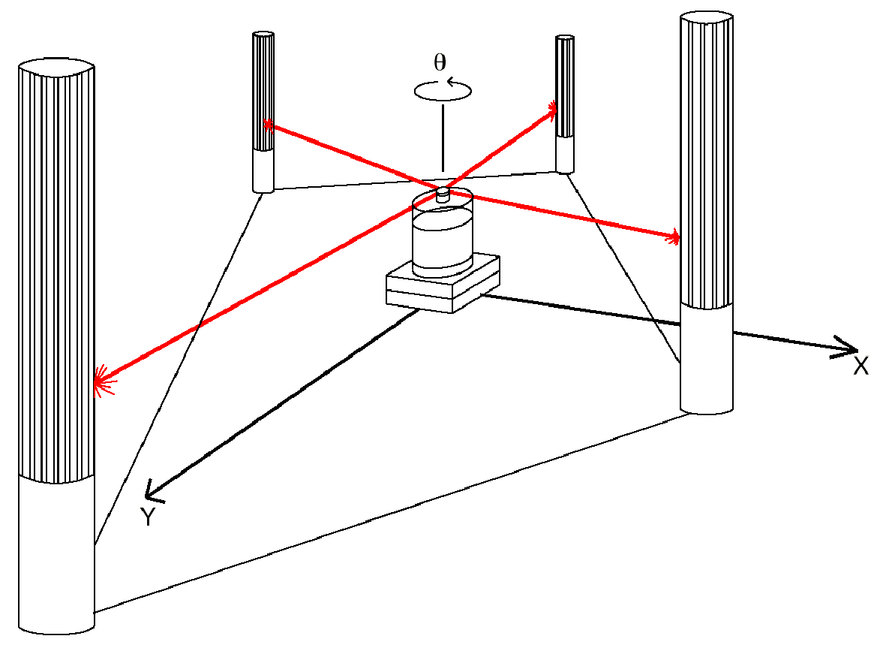
Ground-Based Active and Passive Beacons
4.1.5
Elegant way to solve the localization problem in mobile robotics
Beacons are signaling guiding devices with a precisely known position
Beacon base navigation is used since the humans started to travel
  Natural beacons (landmarks) like stars, mountains or the sun
  Artificial beacons like lighthouses
The recently introduced Global Positioning System (GPS) revolutionized modern navigation technology
  Already one of the key sensors for outdoor mobile robotics
  For indoor robots GPS is not applicable,
Major drawback with the use of beacons in indoor:
  Beacons require changes in the environment
  -> costly.
  Limit flexibility and adaptability to changing
  environments
Key design choice in Robocup
  https://www.youtube.com/watch?v=Kc8ty9mog-I

