Slide 1
2050
RoboCup
  Small Sizehttp://www.youtube.com/watch?v=hZE1YQCghLk
  Legged League http://www.youtube.com/watch?v=skVxn7ab6BM
  Medium Sizehttp://www.youtube.com/watch?v=glPLKo_7Cek

Slide 2
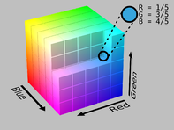
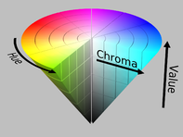
Lab 2
How’s it going?
Blocked?

Slide 3
Classification of Sensors
4.1.1
Proprioceptive sensors
  measure values internally to the system (robot),
  e.g. motor speed, wheel load, heading of the robot, battery status
Exteroceptive sensors
  information from the robots environment
  distances to objects, intensity of the ambient light, unique features.
Passive sensors
  energy coming for the environment
Active sensors
  emit their proper energy and measure the reaction
  better performance, but some influence on envrionment

Slide 4
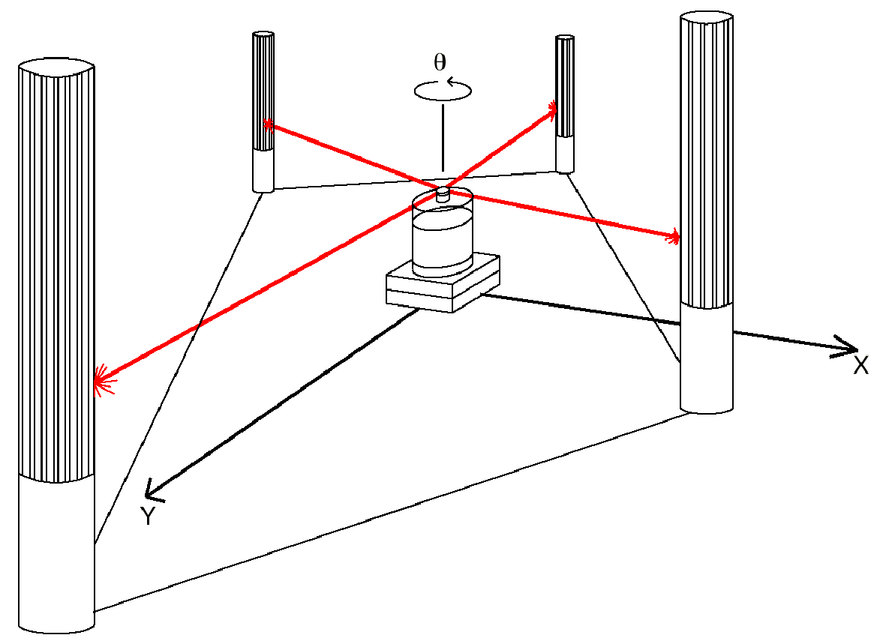
Ground-Based Active and Passive Beacons
4.1.5
Elegant way to solve the localization problem in mobile robotics
Beacons are signaling guiding devices with a precisely known position
Beacon base navigation is used since the humans started to travel
  Natural beacons (landmarks) like stars, mountains or the sun
  Artificial beacons like lighthouses
The recently introduced Global Positioning System (GPS) revolutionized modern navigation technology
  Already one of the key sensors for outdoor mobile robotics
  For indoor robots GPS is not applicable,
Major drawback with the use of beacons in indoor:
  Beacons require changes in the environment
  -> costly.
  Limit flexibility and adaptability to changing
  environments
Key design choice in Robocup
  https://www.youtube.com/watch?v=Kc8ty9mog-I

Slide 5
Global Positioning System (GPS) (1)
4.1.5
  Developed for military use
  Recently it became accessible for commercial applications
  24 satellites (including three spares) orbiting the earth every 12 hours at a height of 20.190 km.
  Four satellites are located in each of six planes inclined 55 degrees with respect to the plane of the earth’s equators
  Location of any GPS receiver is determined through a time of flight measurement
Technical challenges:
  Time synchronization between the individual satellites and the GPS receiver
  Real time update of the exact location of the satellites
  Precise measurement of the time of flight
  Interferences with other signals

Slide 6
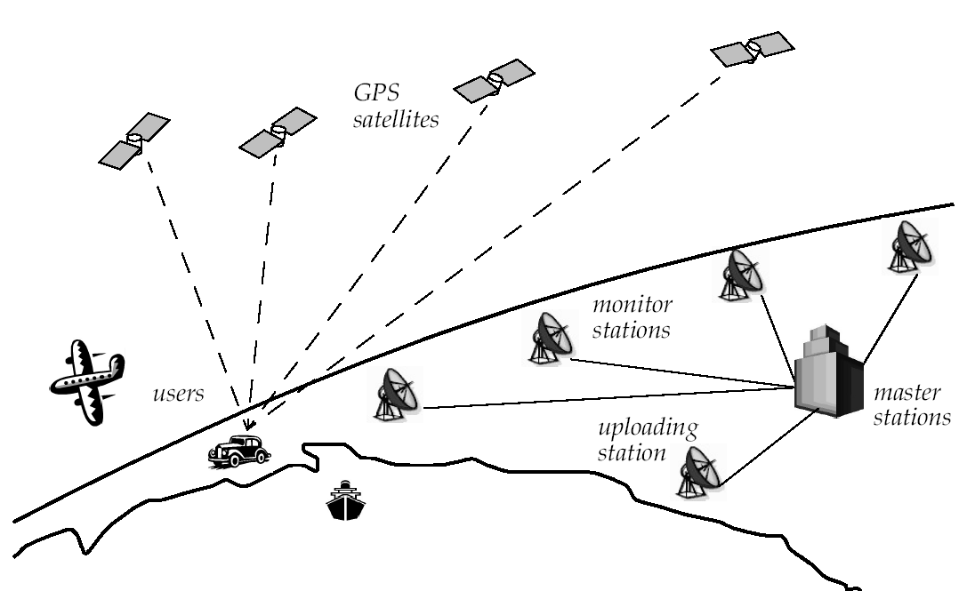
Global Positioning System (GPS) (2)
4.1.5
How many satellites do you need to see?

Slide 7
Global Positioning System (GPS) (3)
4.1.5
Time synchronization:
  atomic clocks on each satellite
  monitoring them from different ground stations.
Ultra-precision time synchronization is extremely important
  electromagnetic radiation propagates at light speed,
Roughly 0.3 m per nanosecond.
  position accuracy proportional to precision of time measurement.
Real time update of the exact location of the satellites:
  monitoring the satellites from a number of widely distributed ground stations
  master station analyses all the measurements and transmits the actual position to each of the satellites
Exact measurement of the time of flight
  the receiver correlates a pseudocode with the same code coming from the satellite
  The delay time for best correlation represents the time of flight.
  quartz clock on the GPS receivers are not very precise
  the range measurement with four satellite
  allows to identify the three values (x, y, z) for the position and the clock correction ΔT
Recent commercial GPS receiver devices allows position accuracies down to a couple meters.

Slide 8
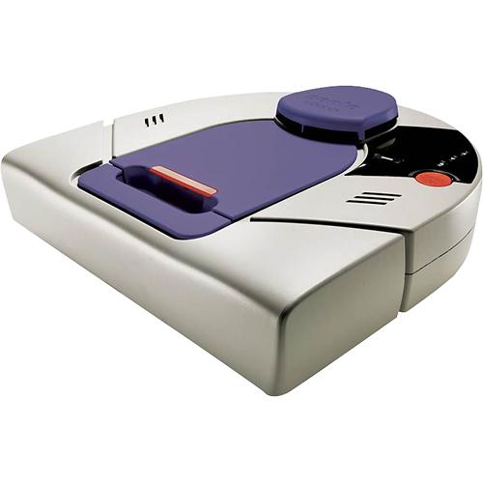
Neato
On-board Room Positioning System (RPS) technology
Maps with only one projector!

Slide 9
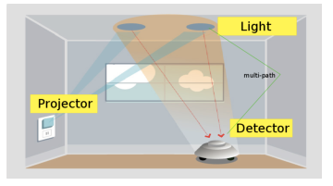
Neato
https://www.researchgate.net/publication/221070323_Vector_field_SLAM

Slide 10
Range Sensors (time of flight) (1)
4.1.6
Large range distance measurement -> called range sensors
Range information:
  key element for localization and environment modeling
Ultrasonic sensors as well as laser range sensors make use of propagation speed of sound or electromagnetic waves respectively. The traveled distance of a sound or electromagnetic wave is given by
  d = c t
Where
  d = distance traveled (usually round-trip)
  c = speed of wave propagation
  t = time of flight.

Slide 11
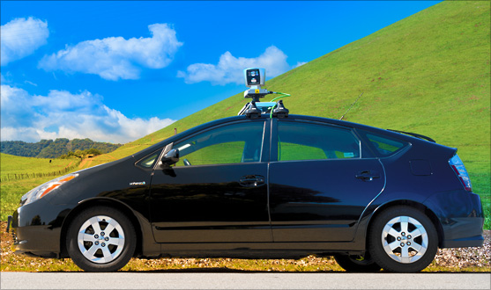
Range Sensors (time of flight) (2)
4.1.6
It is important to point out
  Propagation speed v of sound: 0.3 m/ms
  Propagation speed v of of electromagnetic signals: 0.3 m/ns,
    one million times faster.
  3 meters
    is 10 ms ultrasonic system
    only 10 ns for a laser range sensor
    time of flight t with electromagnetic signals is not an easy task
    laser range sensors expensive and delicate
The quality of time of flight range sensors manly depends on:
  Uncertainties about the exact time of arrival of the reflected signal
  Inaccuracies in the time of fight measure (laser range sensors)
  Opening angle of transmitted beam (ultrasonic range sensors)
  Interaction with the target (surface, specular reflections)
  Variation of propagation speed
  Speed of mobile robot and target (if not at stand still)

Slide 12
Ultrasonic Sensor (time of flight, sound) (1)
4.1.6
transmit a packet of (ultrasonic) pressure waves
distance d of the echoing object can be calculated based on the propagation speed of sound c and the time of flight t.
The speed of sound c (340 m/s) in air is given by
where
: ratio of specific heats
R: gas constant
T: temperature in degree Kelvin

Slide 13
Ultrasonic Sensor (time of flight, sound) (2)
4.1.6
Wave packet
Transmitted sound
Analog echo signal
Threshold
Digital echo signal
Integrated time
Output signal
threshold
integrator
Time of flight (sensor output)
Threshold: high initially (avoid ringing) then decreases over time
Very close objects = trouble!

Slide 14
Ultrasonic Sensor (time of flight, sound) (3)
4.1.6
typically a frequency: 40 - 180 kHz
generation of sound wave: piezo transducer
  transmitter and receiver separated or not separated
sound beam propagates in a cone like manner
  opening angles around 20 to 40 degrees
  regions of constant depth
  segments of an arc (sphere for 3D)
  Typical intensity distribution of a ultrasonic sensor

Slide 15
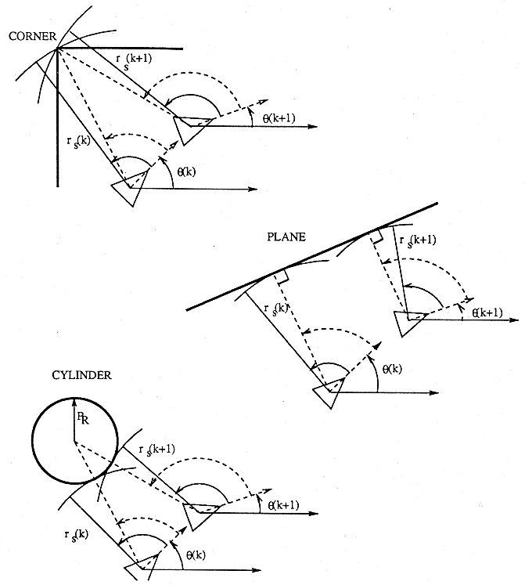
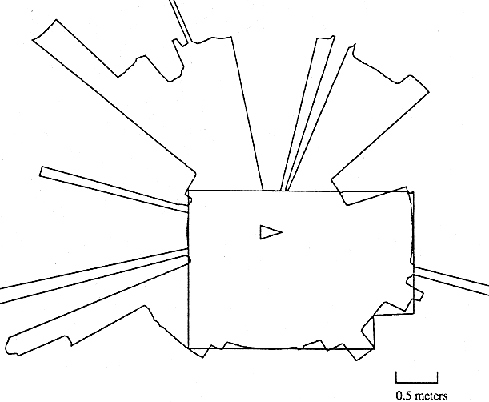
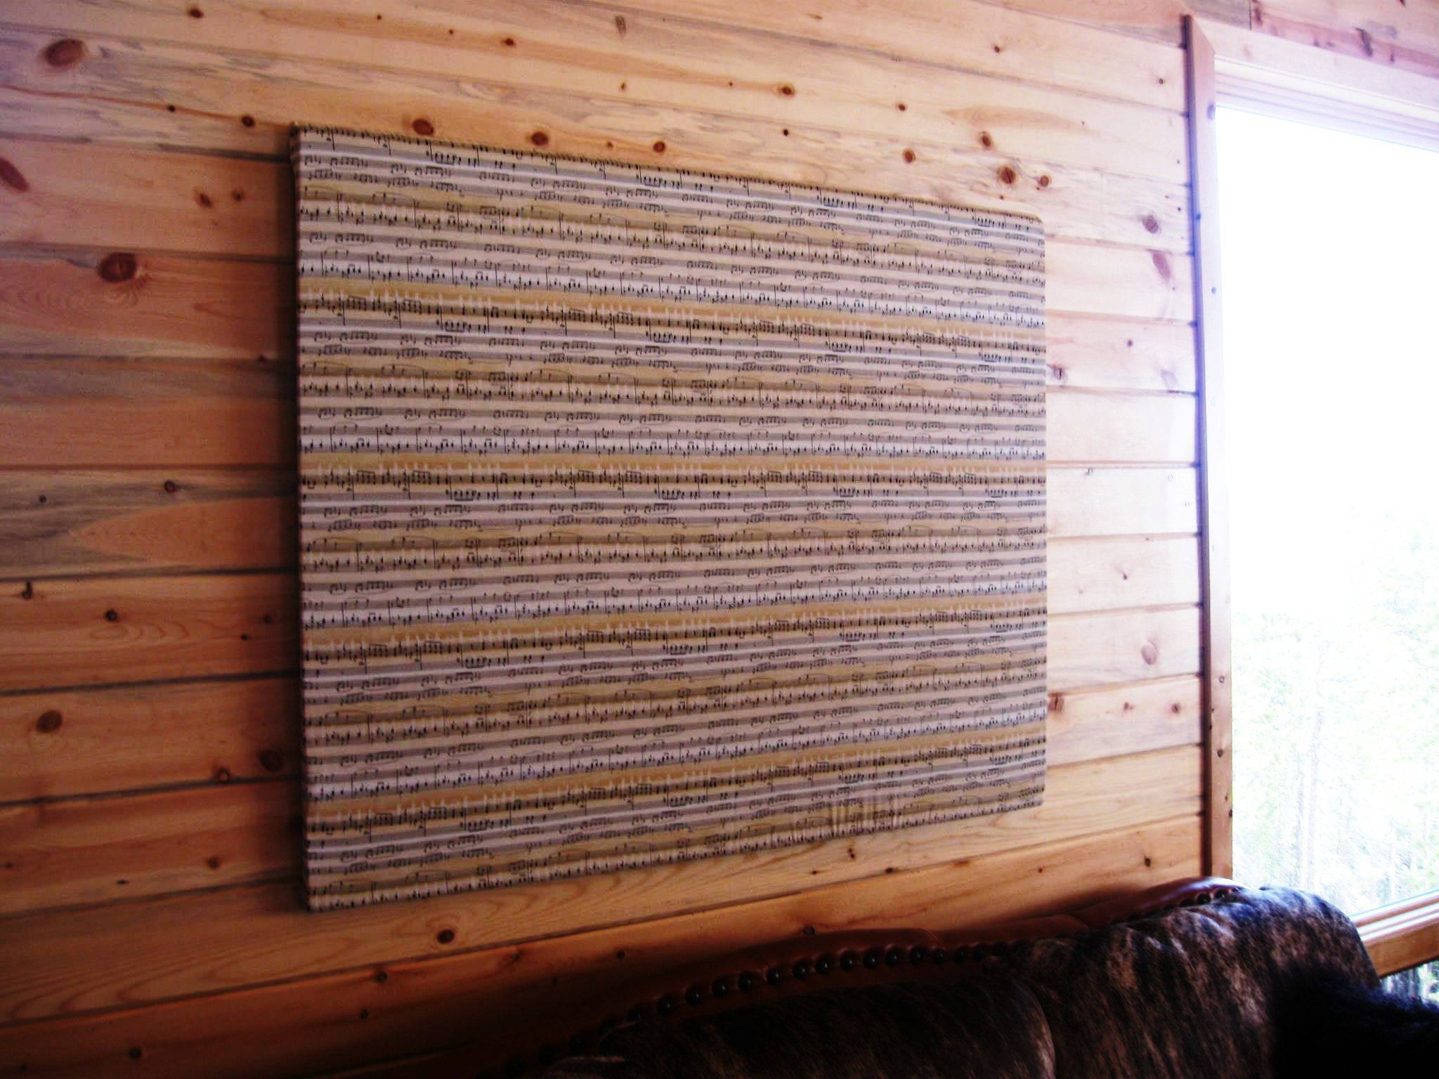
Ultrasonic Sensor (time of flight, sound) (4)
4.1.6
Other problems for ultrasonic sensors
  soft surfaces that absorb most of the
  sound energy
  surfaces that are far from being
  perpendicular to the direction of
  the sound -> specular reflection
a) 360° scan
b) results from different geometric primitives

Slide 16
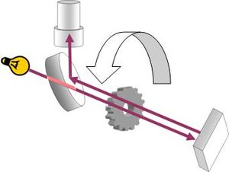
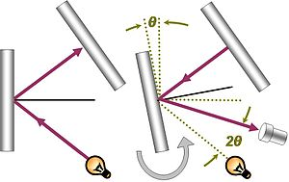
Speed of Light
Fizeau apparatus
Foucault apparatus

Slide 17
Laser Range Sensor (time of flight, electromagnetic) (1)
4.1.6
Transmitted and received beams coaxial
Transmitter illuminates a target with a collimated beam
Received detects the time needed for round-trip
A mechanical mechanism with a mirror sweeps
  2 or 3D measurement

Slide 18
Laser Range Sensor (time of flight, electromagnetic) (2)
4.1.6
Time of flight measurement
Pulsed laser
  measurement of elapsed time directly
  resolving picoseconds
Beat frequency between a frequency modulated continuous wave and its received reflection
Phase shift measurement to produce range estimation
  technically easier than the above two methods.

Slide 19
Laser Range Sensor (time of flight, electromagnetic) (3)
4.1.6
Phase-Shift Measurement
Where
c: is the speed of light; f the modulating frequency; D’ covered by the emitted light is
  for f = 5 Mhz (as in the A.T&T. sensor), λ = 60 meters
λ = c/f

Slide 20
Laser Range Sensor (time of flight, electromagnetic) (4)
4.1.6
Distance D, between the beam splitter and the target
where
  θ: phase difference between the transmitted
Theoretically ambiguous range estimates
  since for example if λ = 60 meters, a target at a range of 5 meters = target at 35 meters
(2.33)

Slide 21
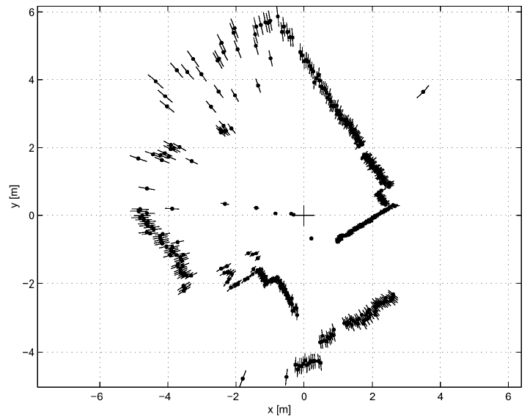
Laser Range Sensor (time of flight, electromagnetic)
4.1.6
Typical range image of a 2D laser range sensor with a rotating mirror. The length of the lines through the measurement points indicate the uncertainties.
http://www.youtube.com/watch?v=NC1F0TwJ_Q8

Slide 22
Triangulation Ranging
4.1.6
geometrical properties of the image to establish a distance measurement
e.g. project a well defined light pattern (e.g. point, line) onto the environment.
  reflected light is than captured by a photo-sensitive line or matrix (camera) sensor device
  simple triangulation allows to establish a distance.
e.g. size of an captured object is precisely known

Slide 23
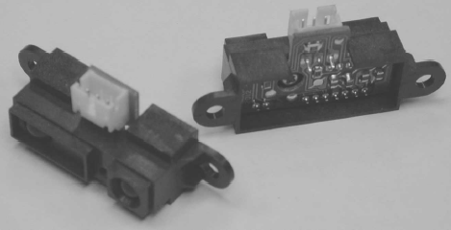
Laser Triangulation (1D)
4.1.6
D
Laser / Collimated beam
P
L
Target
x
Transmitted Beam
Lens
Reflected Beam
Position-Sensitive Device (PSD)
or Linear Camera
  Principle of 1D laser triangulation.
  distance is proportional to the 1/x

Slide 24
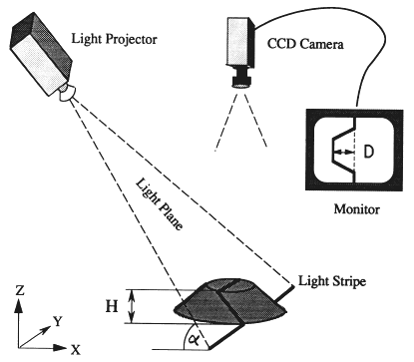
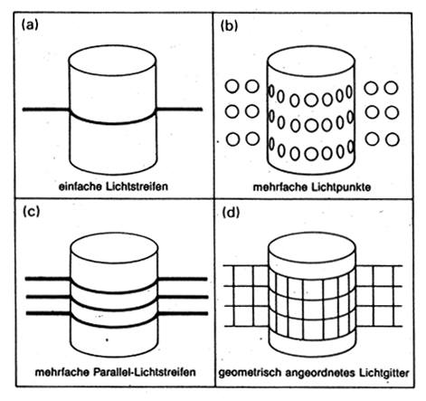
Structured Light (vision, 2 or 3D)
4.1.6
b
a
b
u
Eliminate the correspondence problem by projecting structured light on the scene.
Slits of light or emit collimated light (possibly laser) by means of a rotating mirror.
Light perceived by camera
Range to an illuminated point can then be determined from simple geometry.

Slide 25
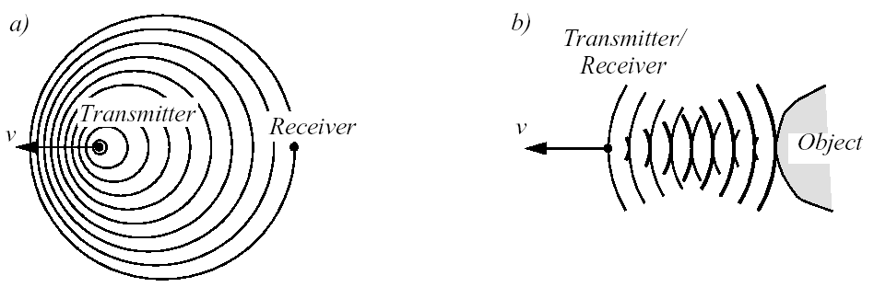




Doppler Effect Based (Radar or Sound)
4.1.7
a) between two moving objects b) between a moving and a stationary object
if transmitter is moving if receiver is moving
Doppler frequency shift relative speed
Sound waves: e.g. industrial process control, security, fish finding, measure of ground speed
Electromagnetic waves: e.g. vibration measurement, radar systems, object tracking

Slide 27
Locomotion: Chapter 1
Enabling robots to move unbounded throughout their environment.
Many bio-inspired methods:
  Walk, jump, run, slide, skate, swim, fly, roll.
  Exception: Powered wheel
    Human invention
    Extremely high efficiency on flat surfaces

Slide 28
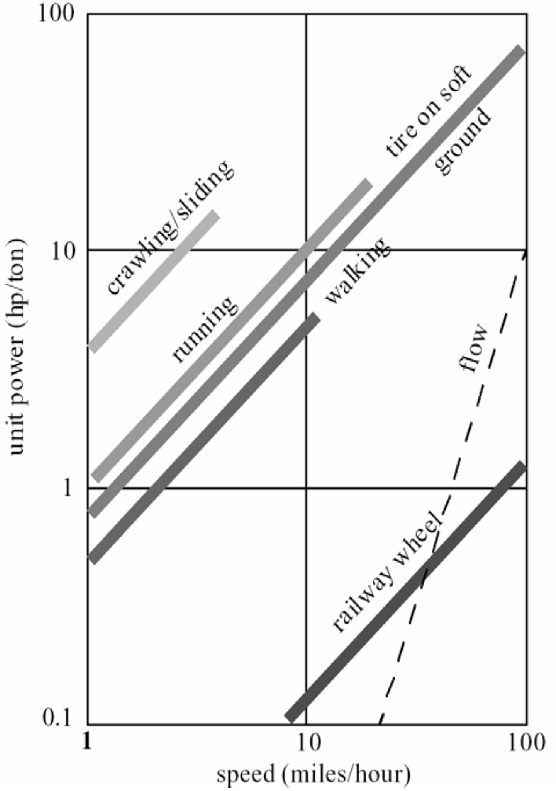
Power vs. Attainable Speed
# of actuators
Structural complexity
Control expense
Efficiency
  Terrain
Motion of the masses
Losses

Slide 29
Key Issues for Locomotion
Stability
  number and geometry of contact points
  center of gravity
  static/dynamic stability
  inclination of terrain

Slide 30
Key Issues for Locomotion
Characteristics of contact
  contact point/path size and shape
  angle of contact
  friction

Slide 31
Key Issues for Locomotion
Type of environment
  structure
  medium
    water
    air
    soft or hard ground

Slide 32
Legged Mobile Robots
Characterized by a series of point contacts between the robot and the ground.
Adaptability and maneuverability in rough terrain.
Power and mechanical complexity.
High degrees of freedom.
Control system complexity.
http://www.youtube.com/watch?v=xlOwk6_xpWo

Slide 33
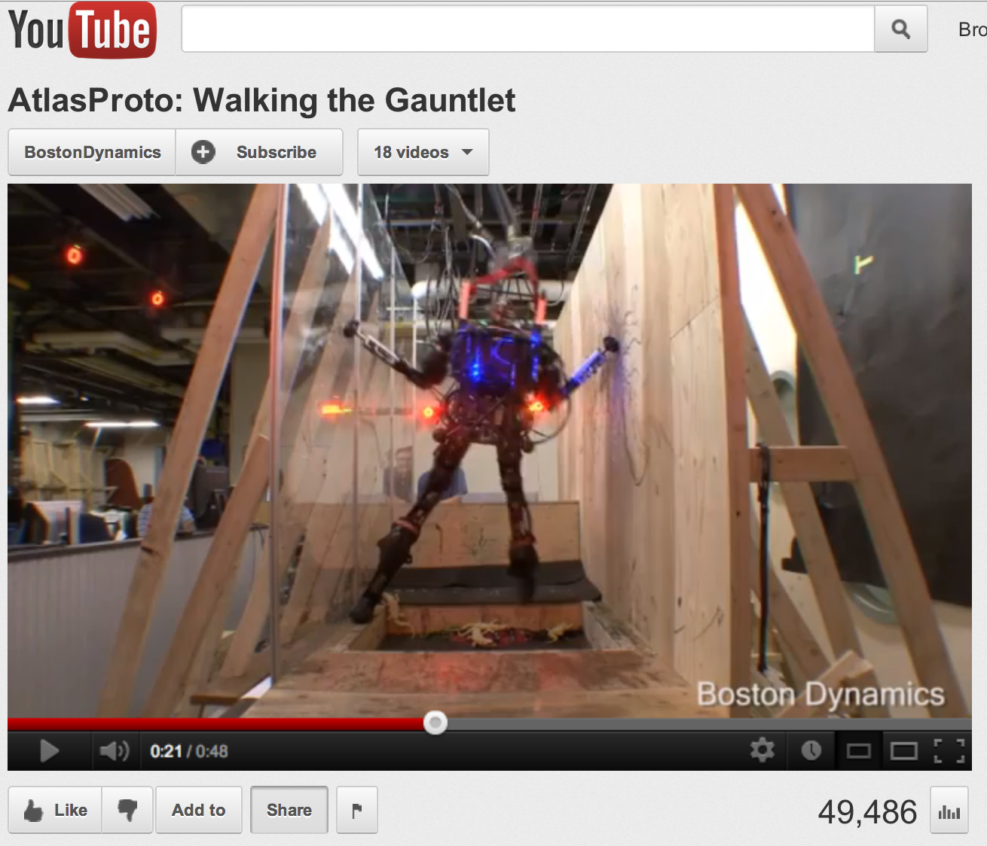
AtlasProto by Boston Dynamics
http://www.youtube.com/watch?v=w40e1u0T1yg
The Atlas robots will participate in the DARPA Robotics Challenge in 2013.

